Slide 1
ASPRS
Yesterday, Today & Tomorrow
Dr. Alvan “Al” Karlin, GISP, CMS
ASPRS Mid-South Regional Conference
Oak Ridge National Laboratory, Oak Ridge, Tennessee

Slide 2
The Early Years

Slide 3
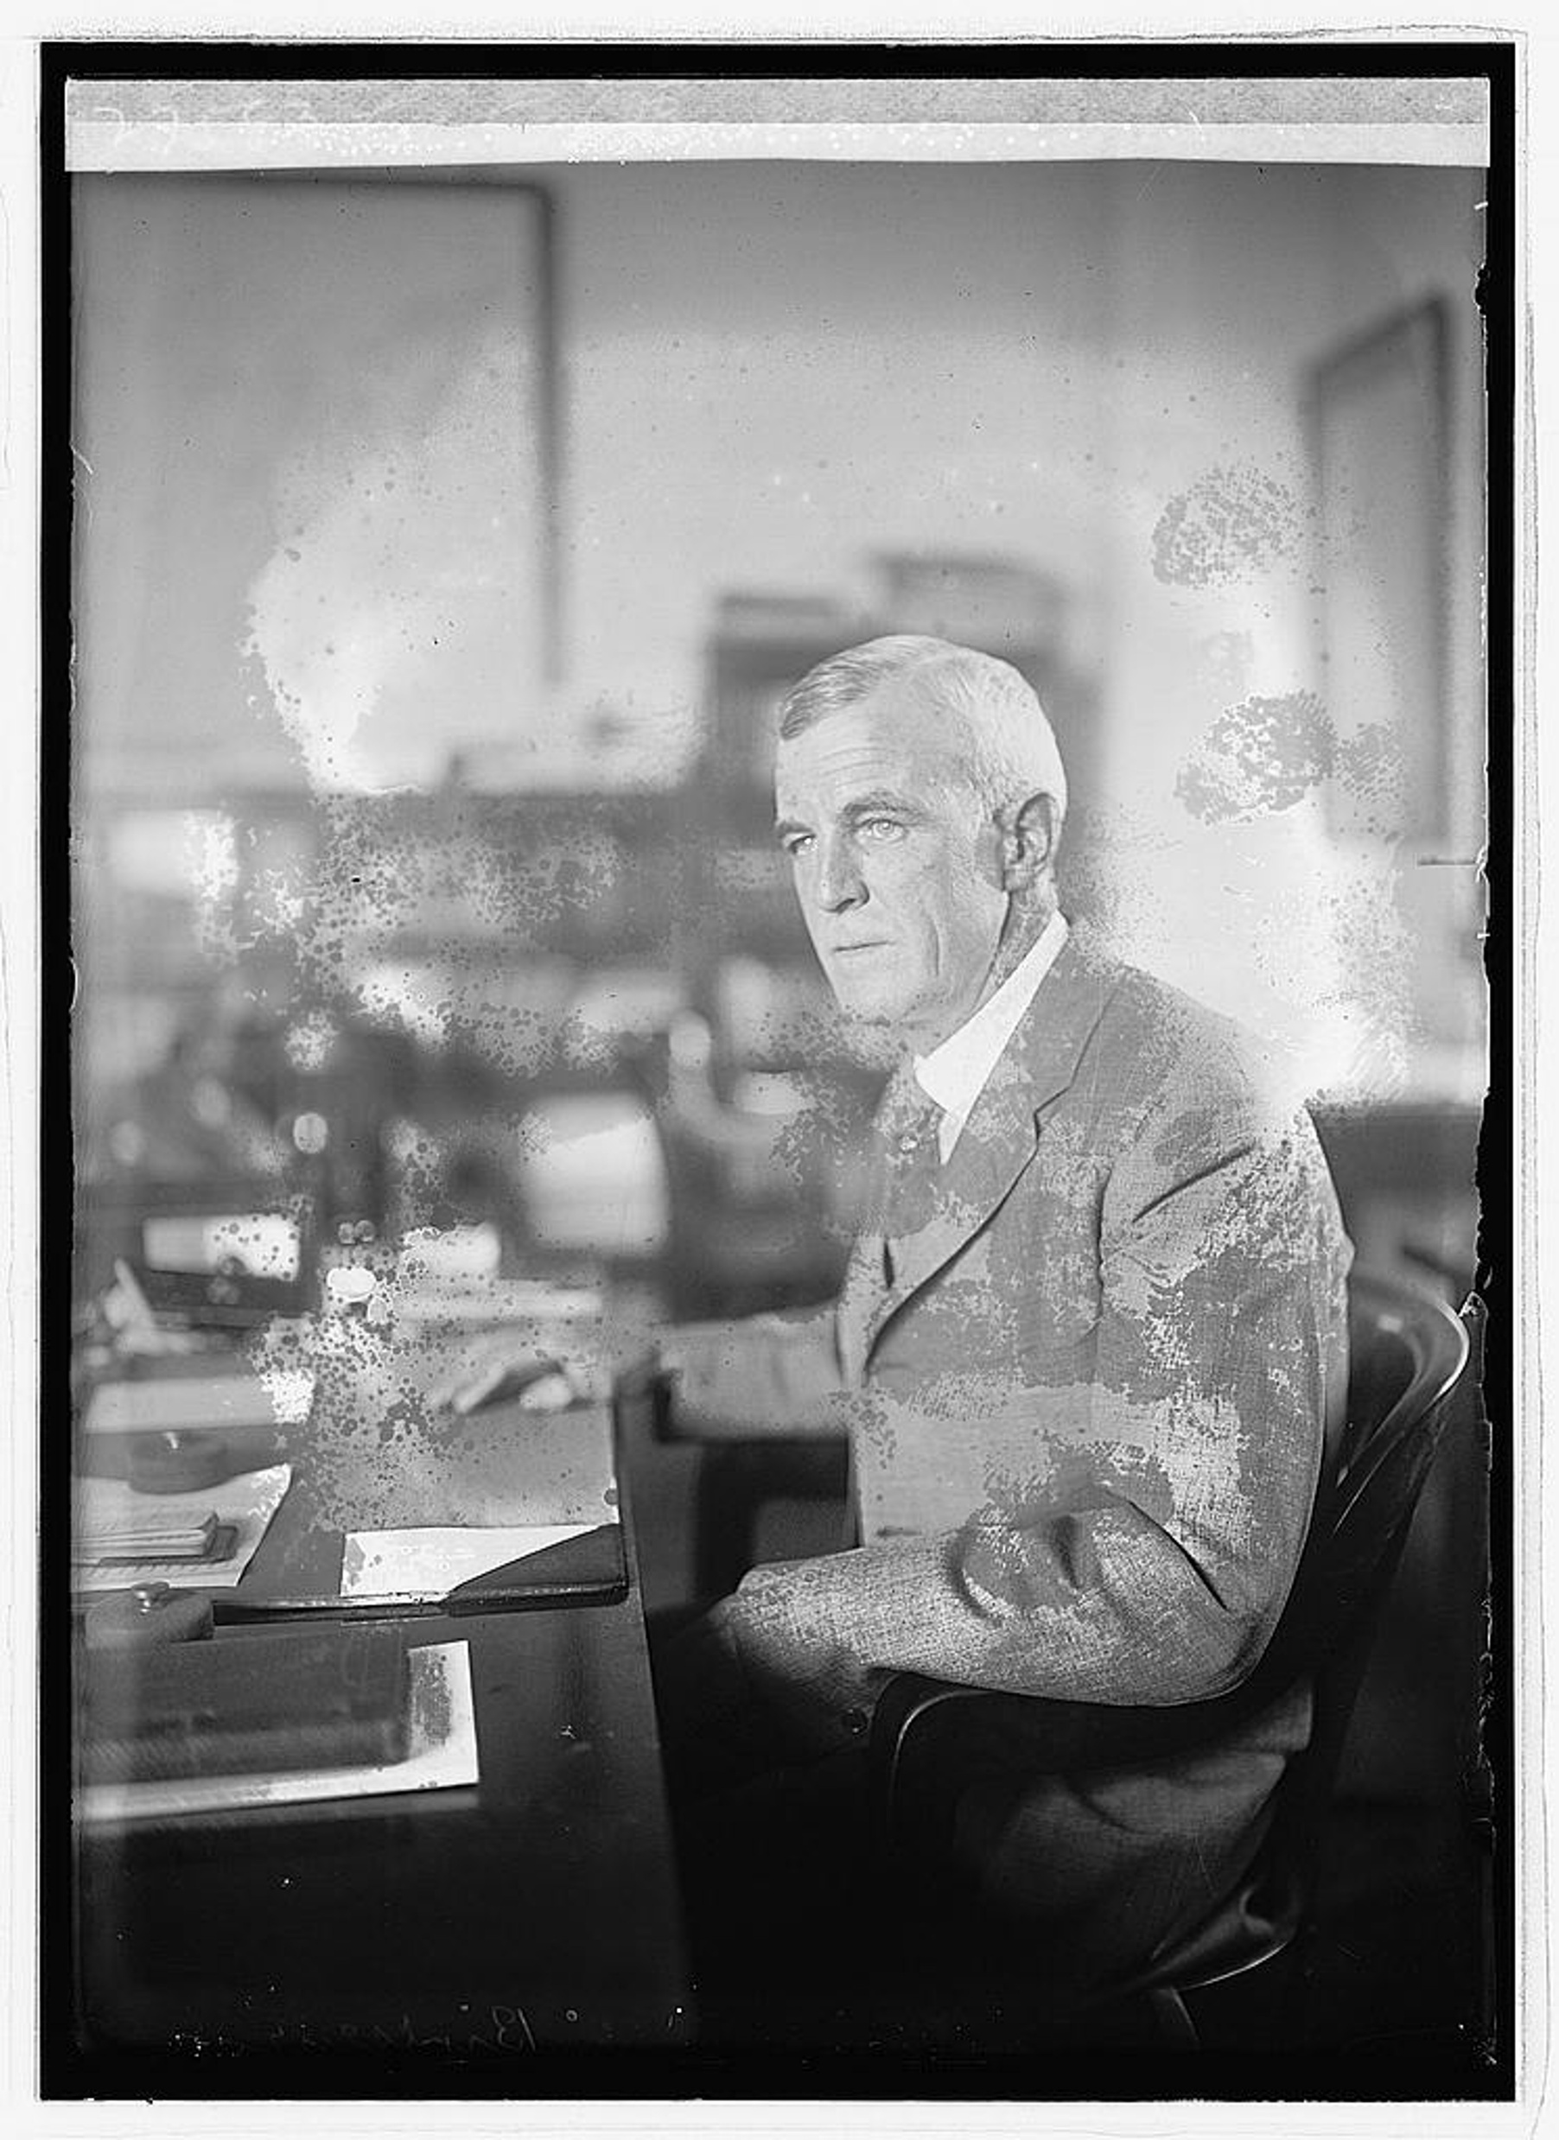
American Society for Photogrammetry: 1934
During the evening of July 29, 1934, a dozen men sat around the author's dining room table in Washington and enthusiastically agreed that there would be an American Society of Photogrammetry. Each individual present had supervision of several to a score or more of men engaged in taking air photographs or mapping from them. It was quickly agreed that there would be at least fifty to a hundred men in the United States who would be glad to pay $3.00 or so a year to be kept informed of the latest technical details of photogrammetric work, both in the United States and abroad, and to have personal contact and discussion at meetings with others 'engaged on similar work. Colonel Birdseye had brought along some copies of the Archives of the International Society of Photogrammetry and he and Mr. Eliel described the extensive activity in photogrammetry abroad. It was agreed that as soon as the American Society was organized, it should join the International Society that had been founded in 1910.
Col. Claude H. Birdseye

Slide 4
ASP becomes ASPRS: 1985
In 1985, ASP was renamed to the
American Society for Photogrammetry and Remote Sensing (ASPRS)
ASPRS MISSION STATEMENT
The mission of the American Society for Photogrammetry and Remote Sensing is to promote the ethical application of active and passive sensors, the disciplines of photogrammetry, remote sensing, geographic information systems, and other supporting geospatial technologies; to advance the understanding of the geospatial and related sciences; to expand public awareness of the profession; and to promote a balanced representation of the interests of government, academia, and private enterprise.

Slide 5
Association Management Transition
2019: ASPRS engaged Postlethwaite & Netterville Association Management (P&N) to assume administrative functions.
2022: ASPRS headquarters relocated from Bethesda, MD to P&N offices in Baton Rouge, LA
2023: P&N acquired by EisnerAmper global business advisors

Slide 6
ASPRS Today

Slide 7
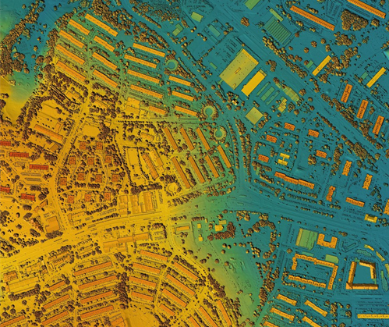
ASPRS Today
ASPRS is a recognized leader in developing standards, best practices, and guidelines for the responsible use of remotely sensed data
Our mission is to ensure accuracy, reliability, and ethical use in every application of remote sensing technology

Slide 8
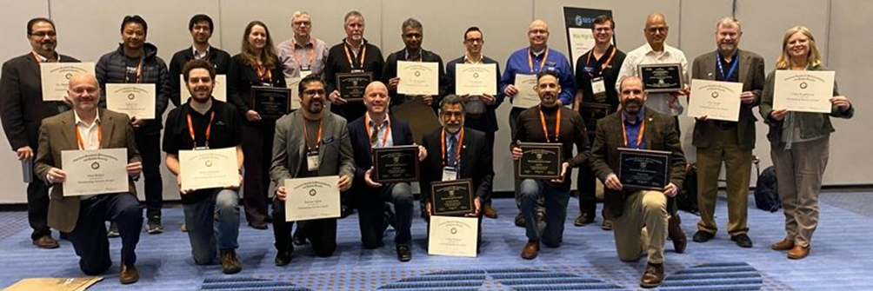
Who are ASPRS Members?
ASPRS members are individuals who work in private industry, government agencies, and academic institutions.
Analysts
Specialists
Educators
Managers
Marketers
Administrators
Researchers
Scientists
Engineers
Technicians
Developers
Manufacturers

Slide 9
ASPRS Member Types
Student Membership
  For associate, bachelor's, or graduate students in any geospatial discipline.
Individual Membership
  For anyone wishing to expand their knowledge of mapping sciences, photogrammetry, remote sensing, and geographic information systems. ASPRS welcomes individuals from around the world to join.
Sustaining Membership
  For companies of any size in the geospatial industry, local, regional, or global. Each SM has a vote on the Sustaining Members Council, which in turn has a seat on the ASPRS Board of Directors.

Slide 10
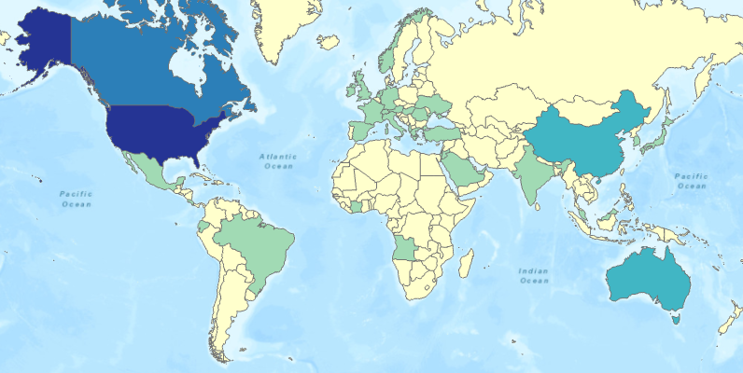
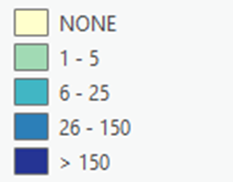
ASPRS Members Worldwide

Slide 11
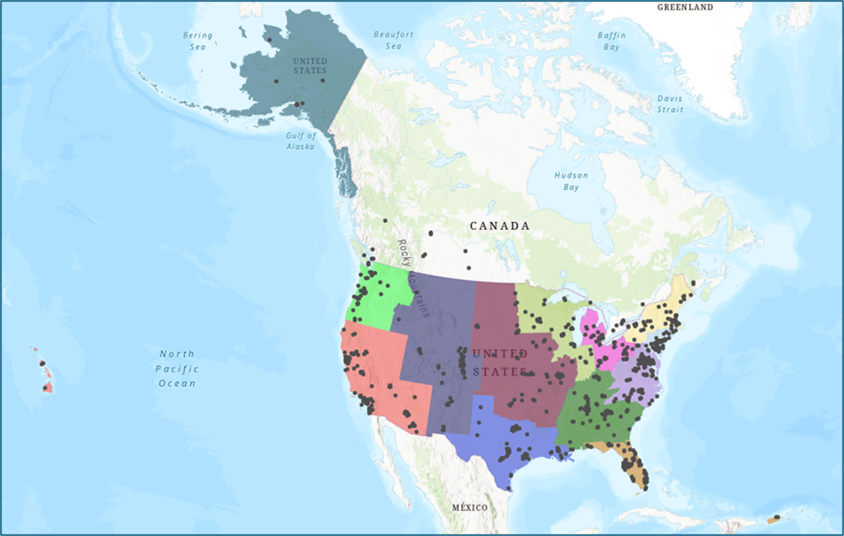
13 Regions
13 Regions cover the United States and adjoining members in Canada
1 At-Large Region represents members outside the US and Canada
Regions offer local programs and networking opportunities for ASPRS members
Regions supervise Geographic and Student Chapters within their respective boundaries

Slide 12
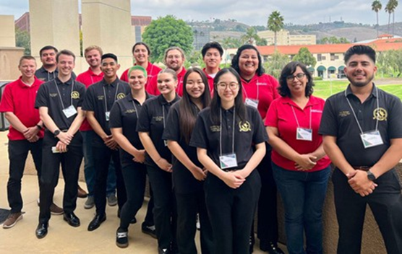
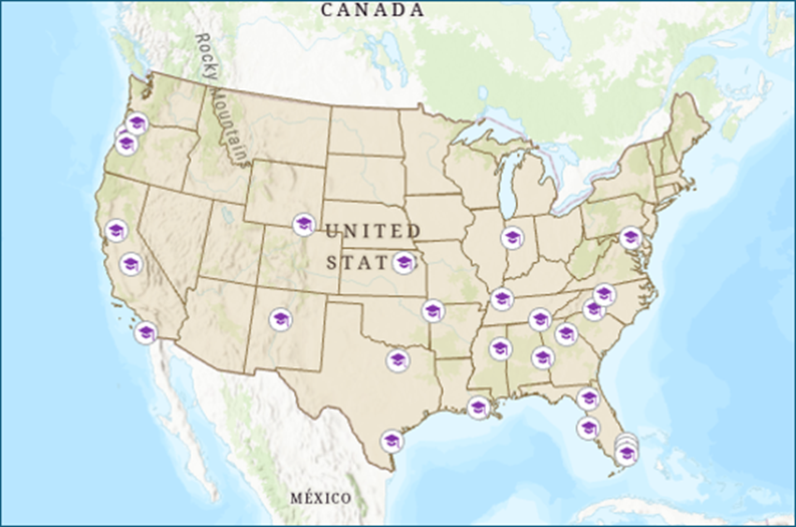
27 Student Chapters
Auburn
CSU Fresno
Dallas College
Florida Atlantic
Florida International
Kansas State
Miami Dade College
Mississippi State
Murray State
Nicholls State
North Carolina A&T
Nova Southeastern
Oregon State
Portland Community College
Purdue
San Diego State
Texas A&M
U of Arkansas
UC Davis
U of Florida
U of Georgia
U of Maryland
U of New Mexico
UNC Charlotte
U of Oregon
U of South Florida
U of Tennessee
U of Wyoming

Slide 13

7 Technical Divisions
Contribute to ASPRS standards and guidelines development
Organize workshops and sessions for conferences
Establishing working groups to study specific research questions or application challenges involving photogrammetry and remote sensing technologies

Slide 14
7 Technical Divisions
GIS Division (GIS)
Lidar Division (LIDAR)
Photogrammetric Applications Division (PAD)
Primary Data Acquisition Division (PDAD)
Professional Practice Division (PPD)
Remote Sensing Applications Division (RSAD)
Unmanned Autonomous Systems Division (UAS)

Slide 15
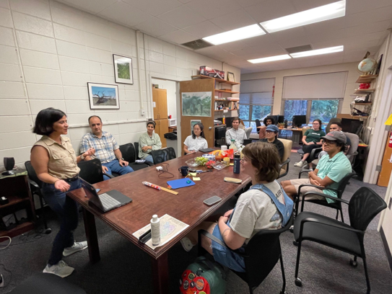
8 Standing Committees
Awards and Scholarships
Data Preservation and Archiving
Diversity, Equity and Inclusion
Education and Professional Development
Evaluation for Certification
Events
Publications
Standards

Slide 16
Who are the ASPRS Leaders?
ASPRS day-to-day operations are handled by EisnerAmper Association Management (EAM) in Baton Rouge, LA
3 paid staff produce PE&RS and provide guidance to EAM
> 150 volunteers occupy ASPRS leadership positions, including
  National Board of Directors
  Region and Chapter Board Members
  Council, Technical Division, Committee, and Working Group Chairs

Slide 17
ASPRS Board of Directors
4 Elected Officers
  President
  President-Elect
  Vice-President
  Immediate Past President
3 Ex-Officio Officers
  Executive Director
  Secretary
  Treasurer
6 Council Chairs
  Technical Division Directors
  Region Officers Council
  Committee Chairs Council
  Student Advisory Council
  Early Career Professionals Council
  Sustaining Members Council

Slide 18




Elected Officers 2024 - 2025
Immediate Past President
Bandana Kar
(US DoE)
President
Amr Abd-Elrahman
(University of Florida)
President-Elect
Al Karlin
(Dewberry)
Vice President
Steve Steinberg
(Los Angeles County)

Slide 19

ASPRS Events
ASPRS Annual Conference at Geo Week
  The premier US-based event highlighting integration between the built environment, advanced airborne/terrestrial geospatial technologies, and commercial 3D technologies.
ASPRS International Technical Symposium
  A multi-day virtual conference held once a year. This conference is a great opportunity for students to present their research.
GeoBytes Webinars
  Online presenters on state-of-the-art geospatial topics

Slide 20
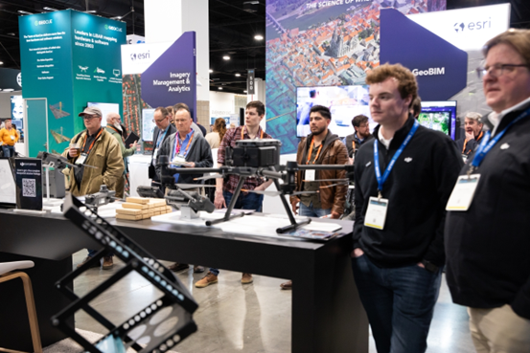
ASPRS at Industry Events
ESRI UC
Commercial UAV Expo
ISPRS Congress
ISPRS Geospatial Week
ISPRS Technical Symposia
MAPPS
Pecora Symposium

Slide 21

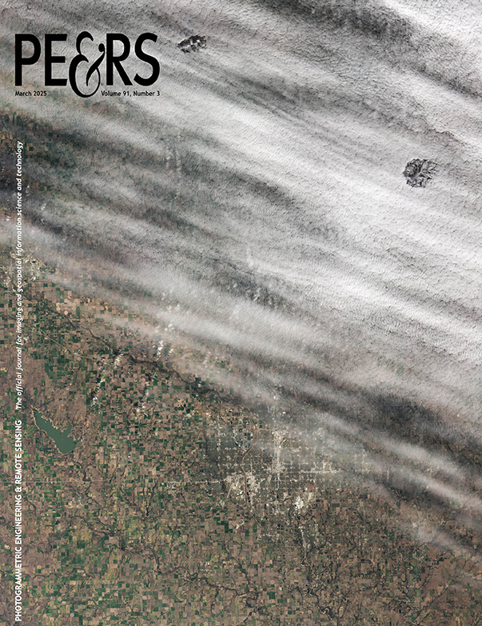

PE&RS Monthly Journal
Industry News
Topical Columns
Book Reviews
Peer-Reviewed Articles
ASPRS members can publish one complimentary open-access peer-reviewed article in PE&RS each membership year. This is a saving over $1,500!

Slide 22
ASPRS Tomorrow
Help make a difference!
Enhance your own knowledge!
Build a strong career profile!

Slide 23
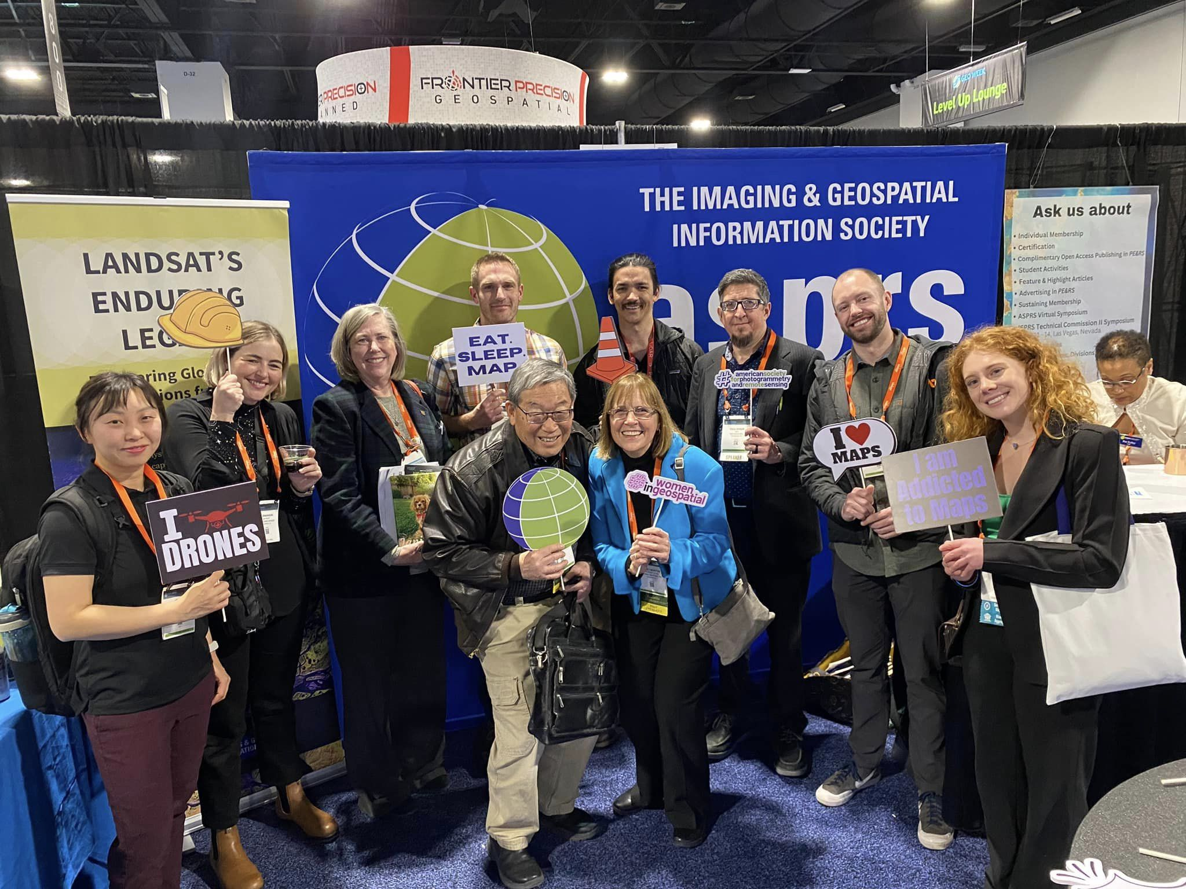
Why become an ASPRS Member?
Engagement
Participate in technical working groups
Resources
Stay informed about industry trends
Career Growth
Develop leadership skills
Community
Make connections that last a lifetime
Professional Development
Present your work at conferences and symposia
Education
Access peer-review articles in PE&RS
Networking
Get involved in Region activities
Savings
Receive discounts on certification and event fees

Slide 24
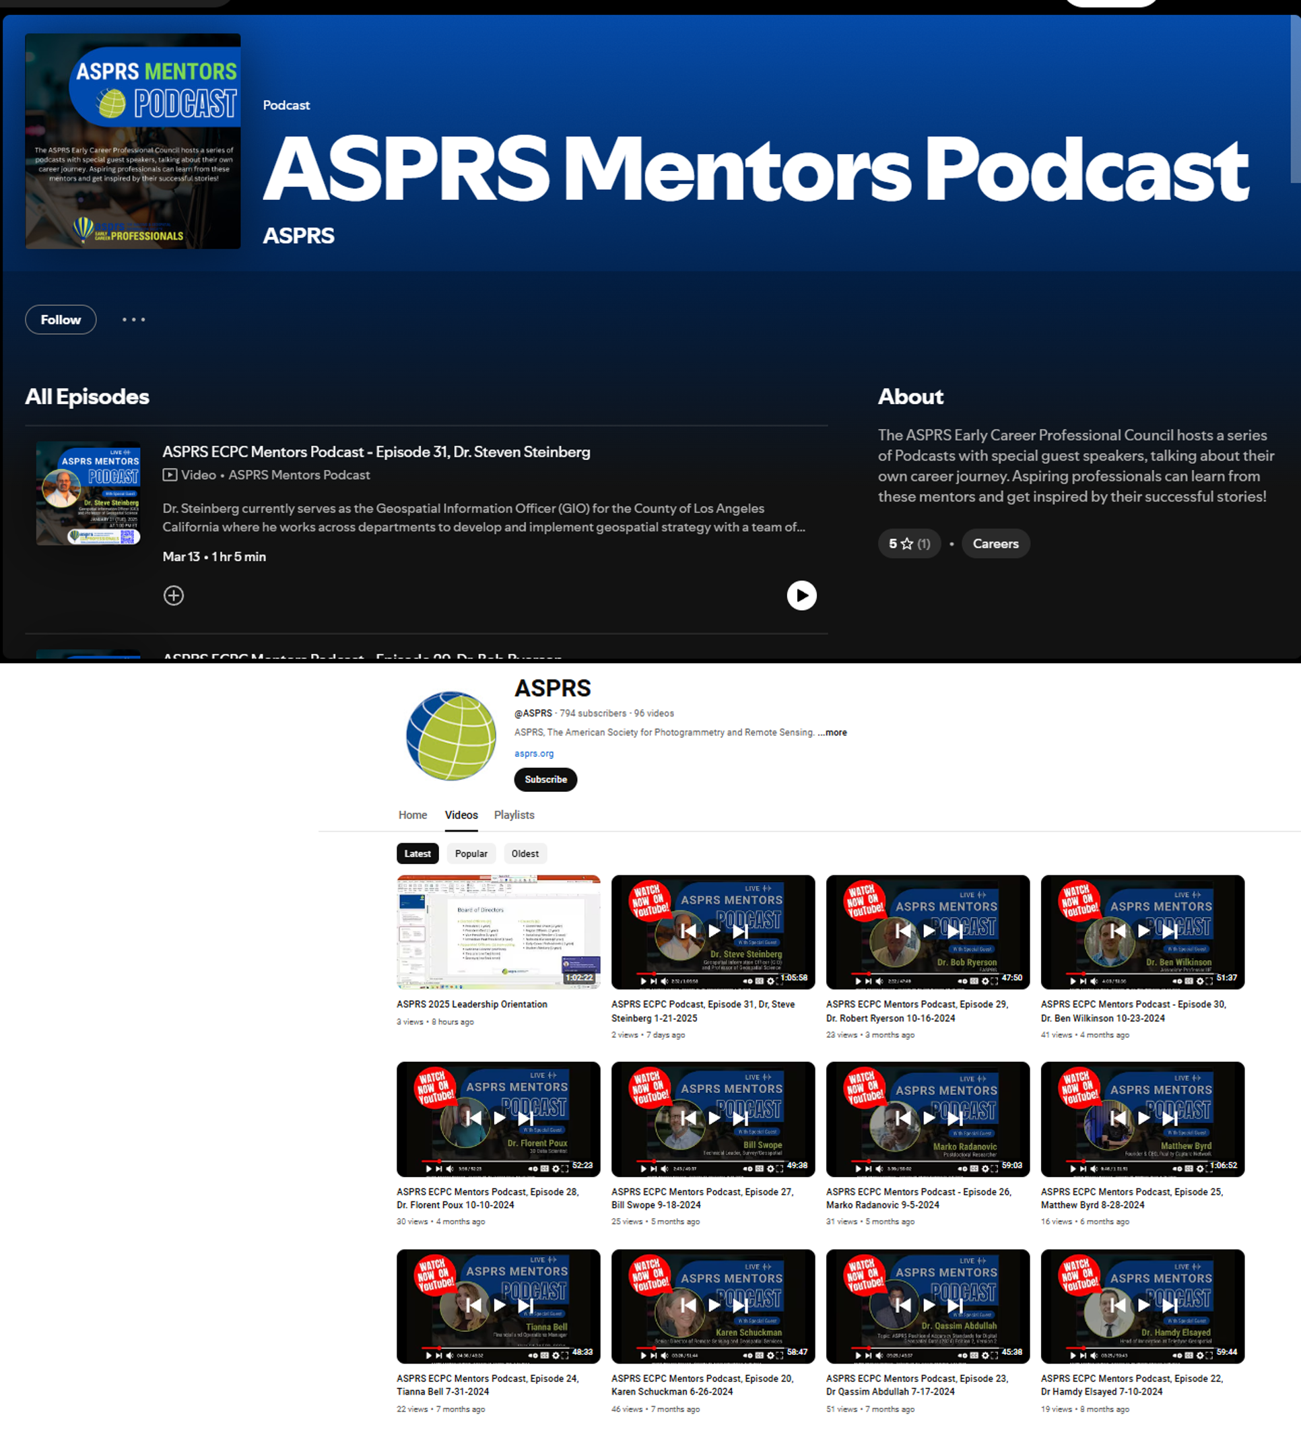
Early Career Professionals Council
ASPRS Mentors Podcast Series
Supports mentoring and networking for ASPRS members who are either recent graduates or new to the field
  “We bring you important information to help you along with your career, from important scholarship information, to highlighting web tutorials, mentorship opportunities, and information on useful geospatial events in your area!”

Slide 25
Student Advisory Council
SAC weaves students into the fabric of ASPRS and our greater geospatial community, providing access to crucial resources and opportunities, such as:
  Highlighting students worldwide in ASPRS Virtual ITS
  Developing technical session tracks for ASPRS program at Geo Week
  Providing volunteer opportunities at ASPRS national and regional events
  Networking through ASPRS hosted social media
  Mentoring student for leadership positions in ASPRS Divisions and Committees
  Eligibility for $40,000 in annual scholarship awards
  Student pricing on ASPRS publications
  Student pricing on Geo Week conference registration

Slide 26

Support the ASPRS Foundation
The ASPRS Foundation is a 501(c)3 tax exempt organization with the primary purpose to advance the understanding and use of spatial data for the betterment of humankind and the effective operation of public and private organizations.
The ASPRS Foundation will establish an extensive and broadly-based program that provides grants, scholarships, loans and other forms of aid to individuals or organizations pursuing knowledge of imaging and geospatial information science and technology, and their applications across the scientific, governmental, and commercial sectors. A key goal of the Foundation is to fully endow all existing ASPRS awards and scholarships in a manner that, at a minimum, keeps up with inflation.

Slide 27


Become ASPRS Certified!
And more!
Advances knowledge
Recognizes experienced practitioners
Upholds a Code of Ethics to guide conduct of certified professionals
Provides a measure of minimum competence or qualifications
Protects health and safety of the public

Slide 28
ASPRS Certification Categories
Certified Photogrammetrist
Certified Mapping Scientist
  Lidar
  Remote Sensing
  UAS
Certified Mapping Technologist
  Photogrammetry
  Lidar
  Remote Sensing
  UAS

Slide 29



!!Thank You!!
Join ASPRS
Follow ASPRS on
LinkedIn
Facebook

