Slide 1
Grading Automatic Image Matches
April 24, 2025 | ORNL Main Campus
Orrin Thomas, PhD
Geomatics Group, ORNL

Slide 2

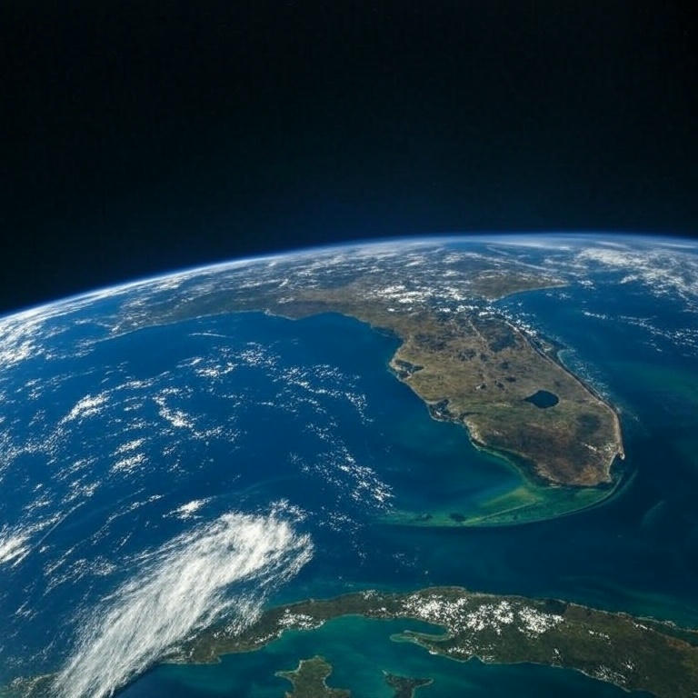
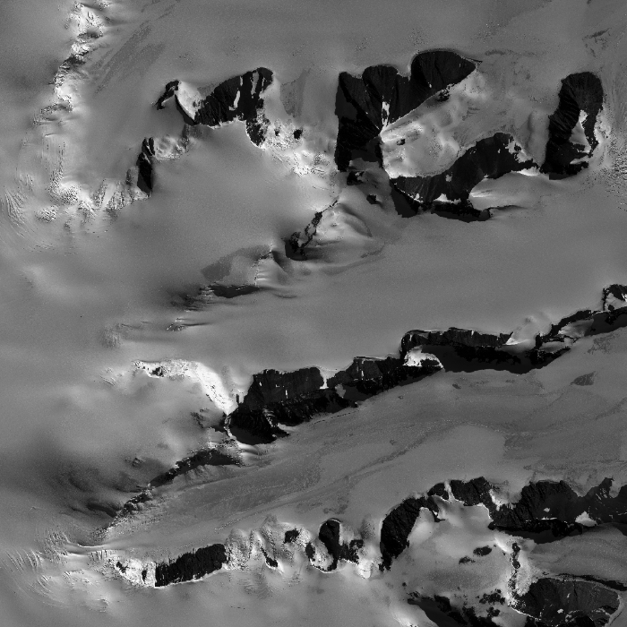





Matching Images Features
Geopositioning
Terrain Extraction
Data Fusion

Slide 3
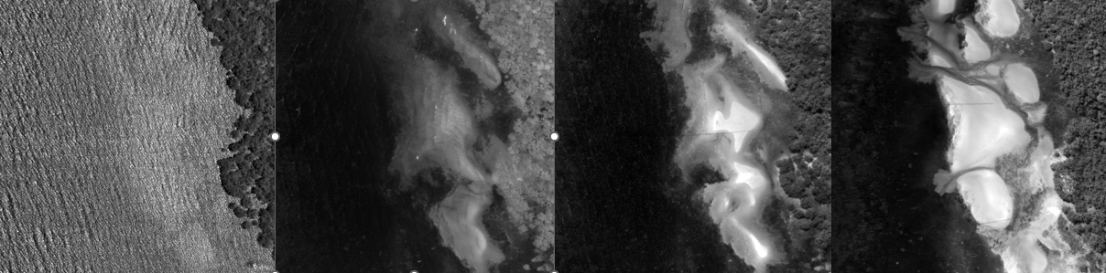
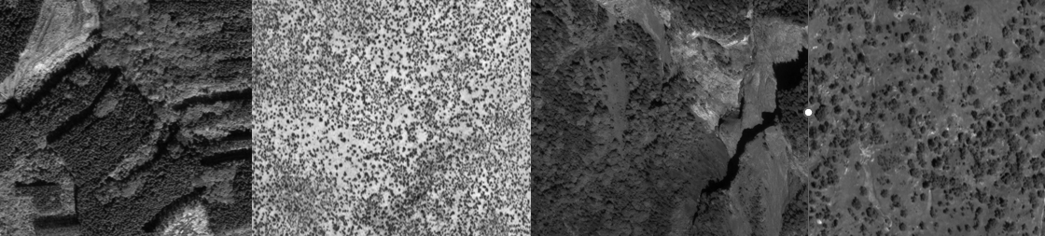
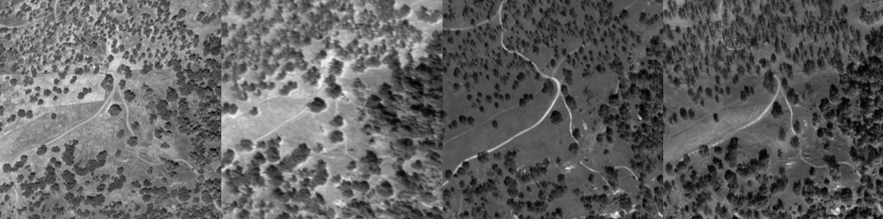
Challenges
Change
Biomes
Biomes
Geometry

Slide 4
There are LOTS of matchers
SuperGlue
LoFTR
asPanformer
LightGlue
RoMa
ORB
Least Squares Matching
Root-SIFT
DSP-SIFT
DKM
D2-Net
SURF
BRIEF
MatchNet
ASLFEAT
NCC
BRISK
MD-Net
SIFT
LIFT
R2D2
1970
1980
1990
2000
2010
2020

Slide 5
Historical Performance Ranking
Reliability of individual matches
Usefulness of the matches
True positives
False positives
False negatives
Pose recovery
Homography recovery
These require truth data and are not scalable.

Slide 6
Historical Performance Ranking
Reliability of individual matches
Usefulness of the matches
True positives
False positives
False negatives
Pose recovery
Homography recovery
This limits our testing to single perspective images.

Slide 7
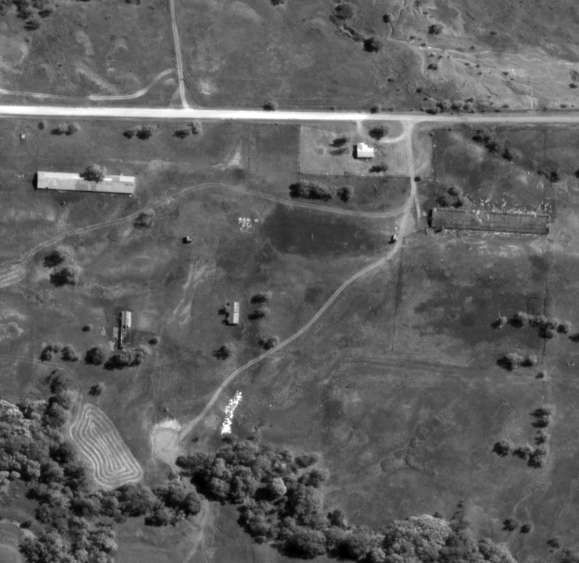
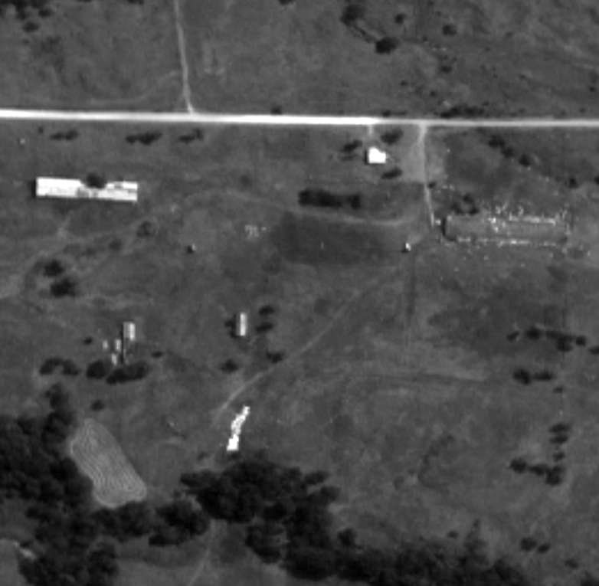

Scalable, no truth data required
Search Area
Epipolar Area
$$P\left(Bad Match looks Good\right)≈ \frac{Epipolar Area}{Search Area}≪0.1$$
Notes:
How can we be confident we have good matches? It’s a probabilistic argument. If we know something about the probability of good bad match masquerading as a good match (geometrically) we can be confident in statistical claims about the inlier matches.

Slide 8
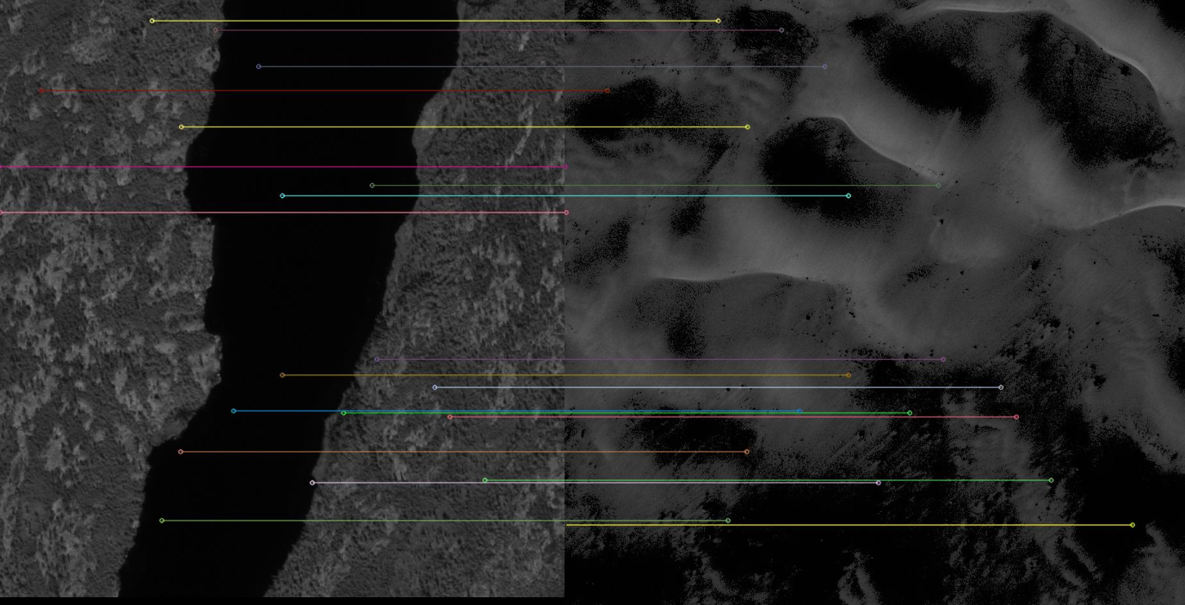
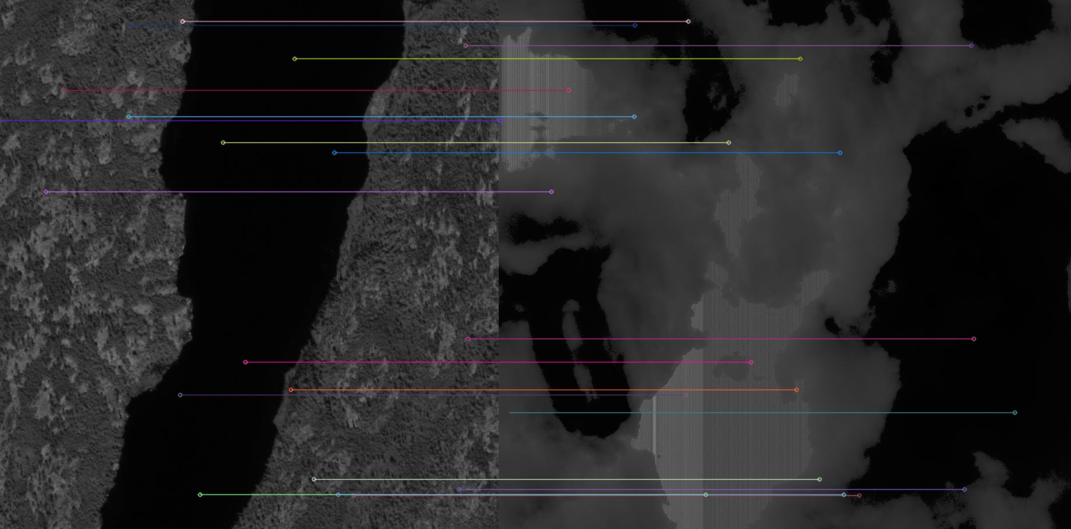
Some Matchers Lie
Notes:
The wrinkle is that some matchers lie. Our system to catch the liars is entrapment. Using the one readily available truth, which images should not match, we temp them to lie to us, and we don’t waste time with the liars.

Slide 9
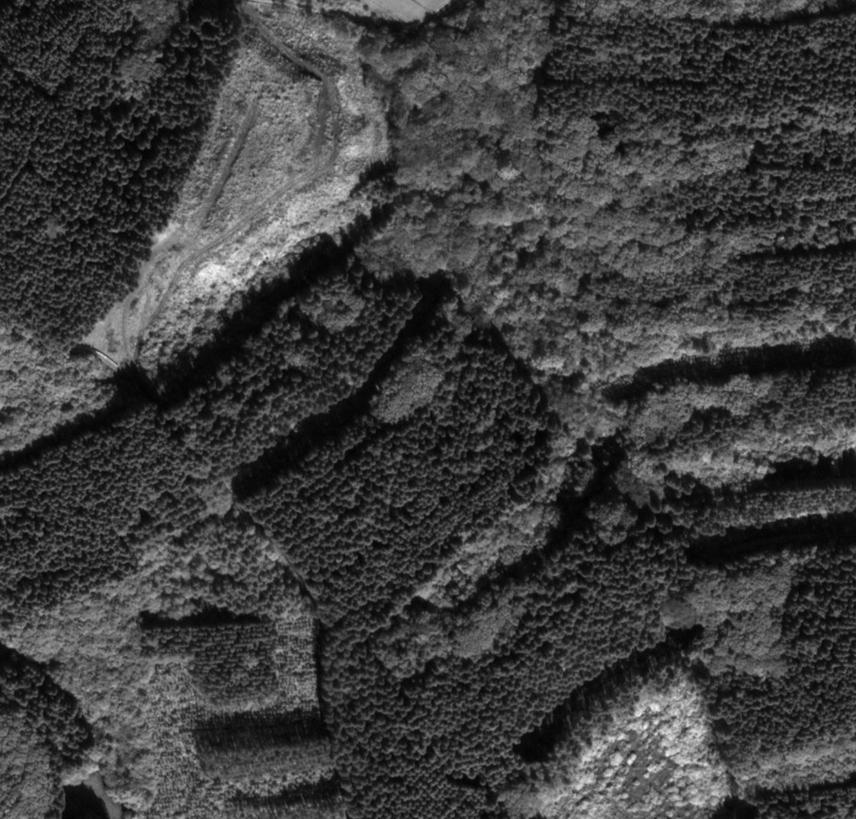
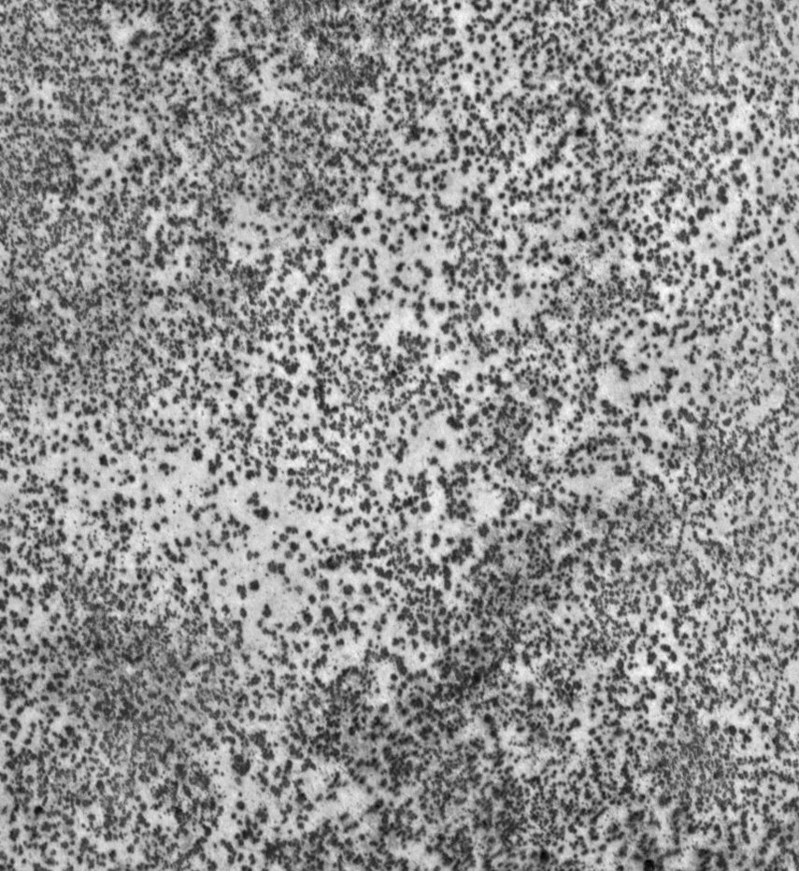
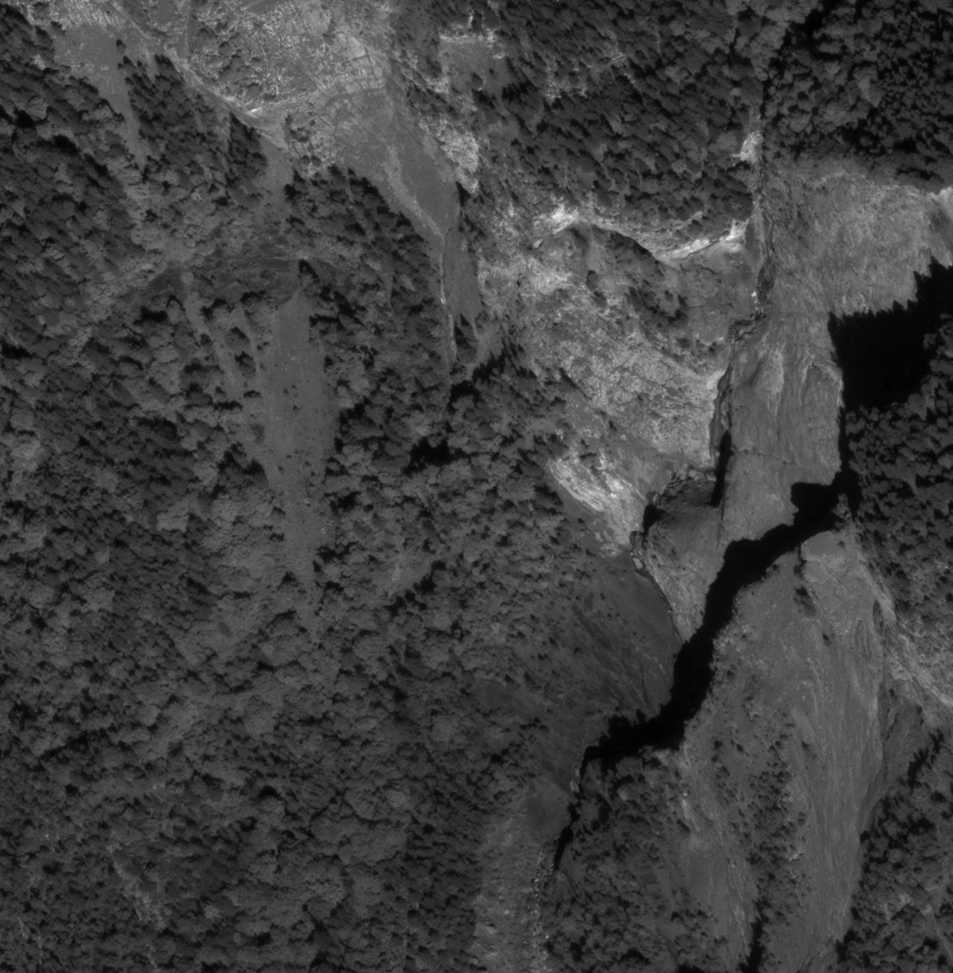
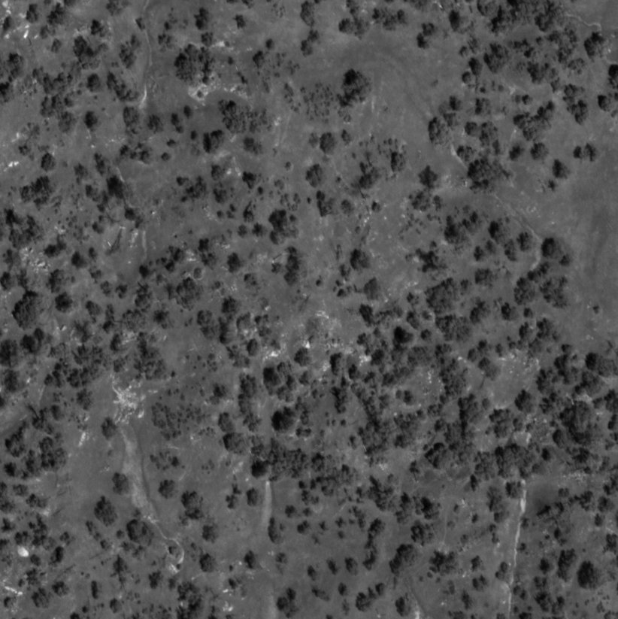
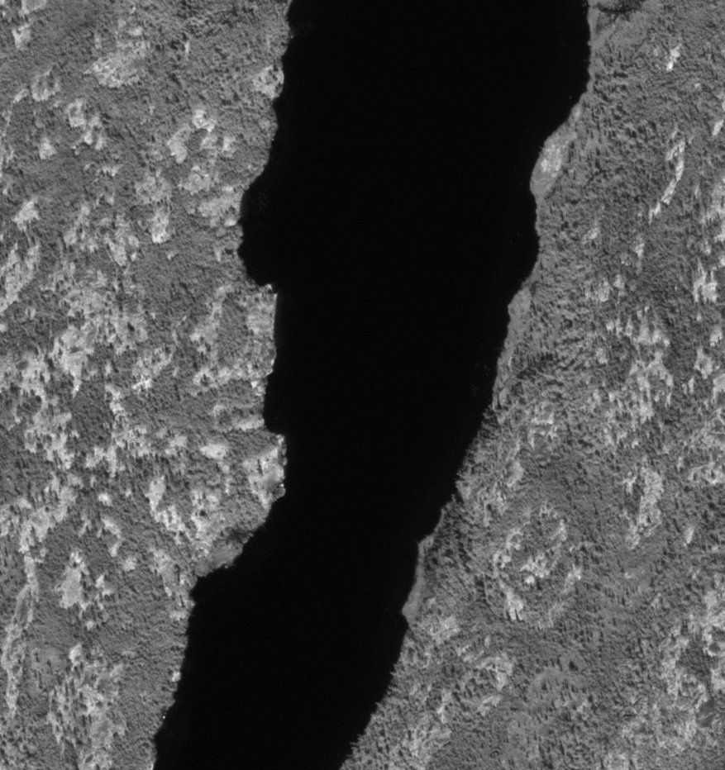
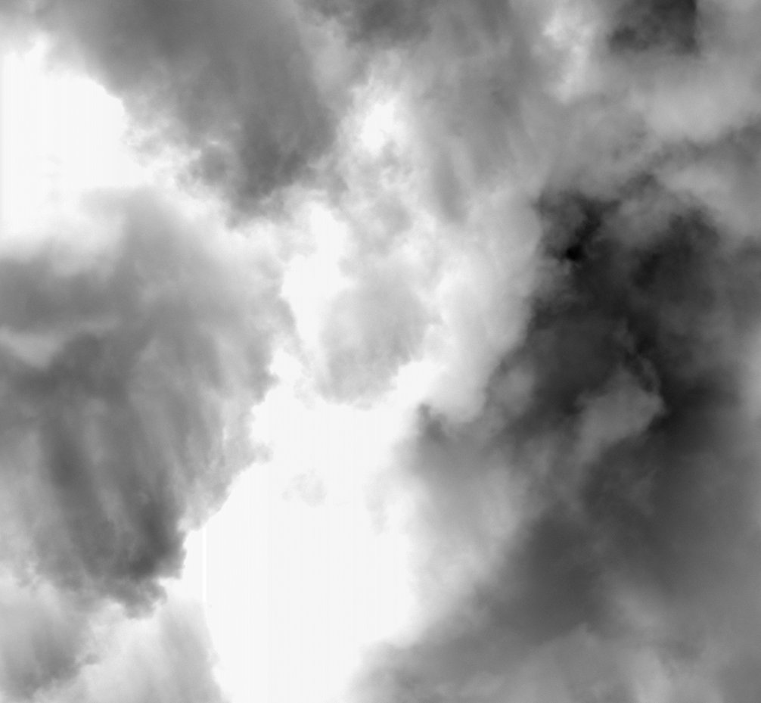
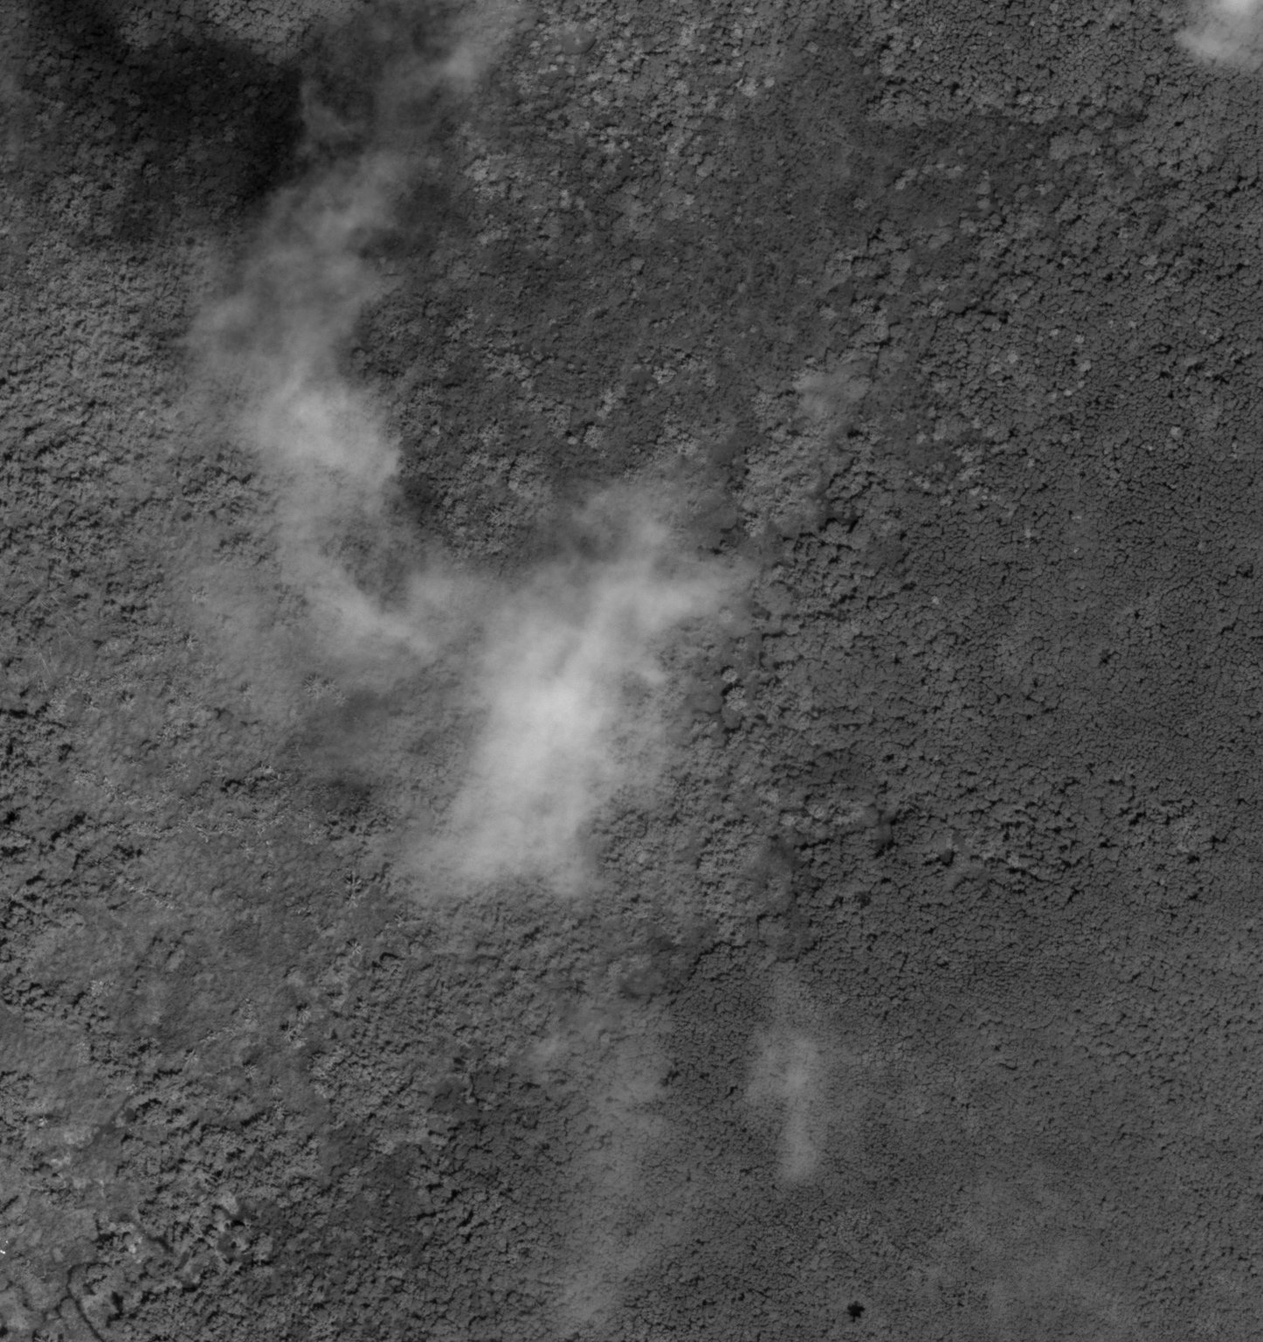
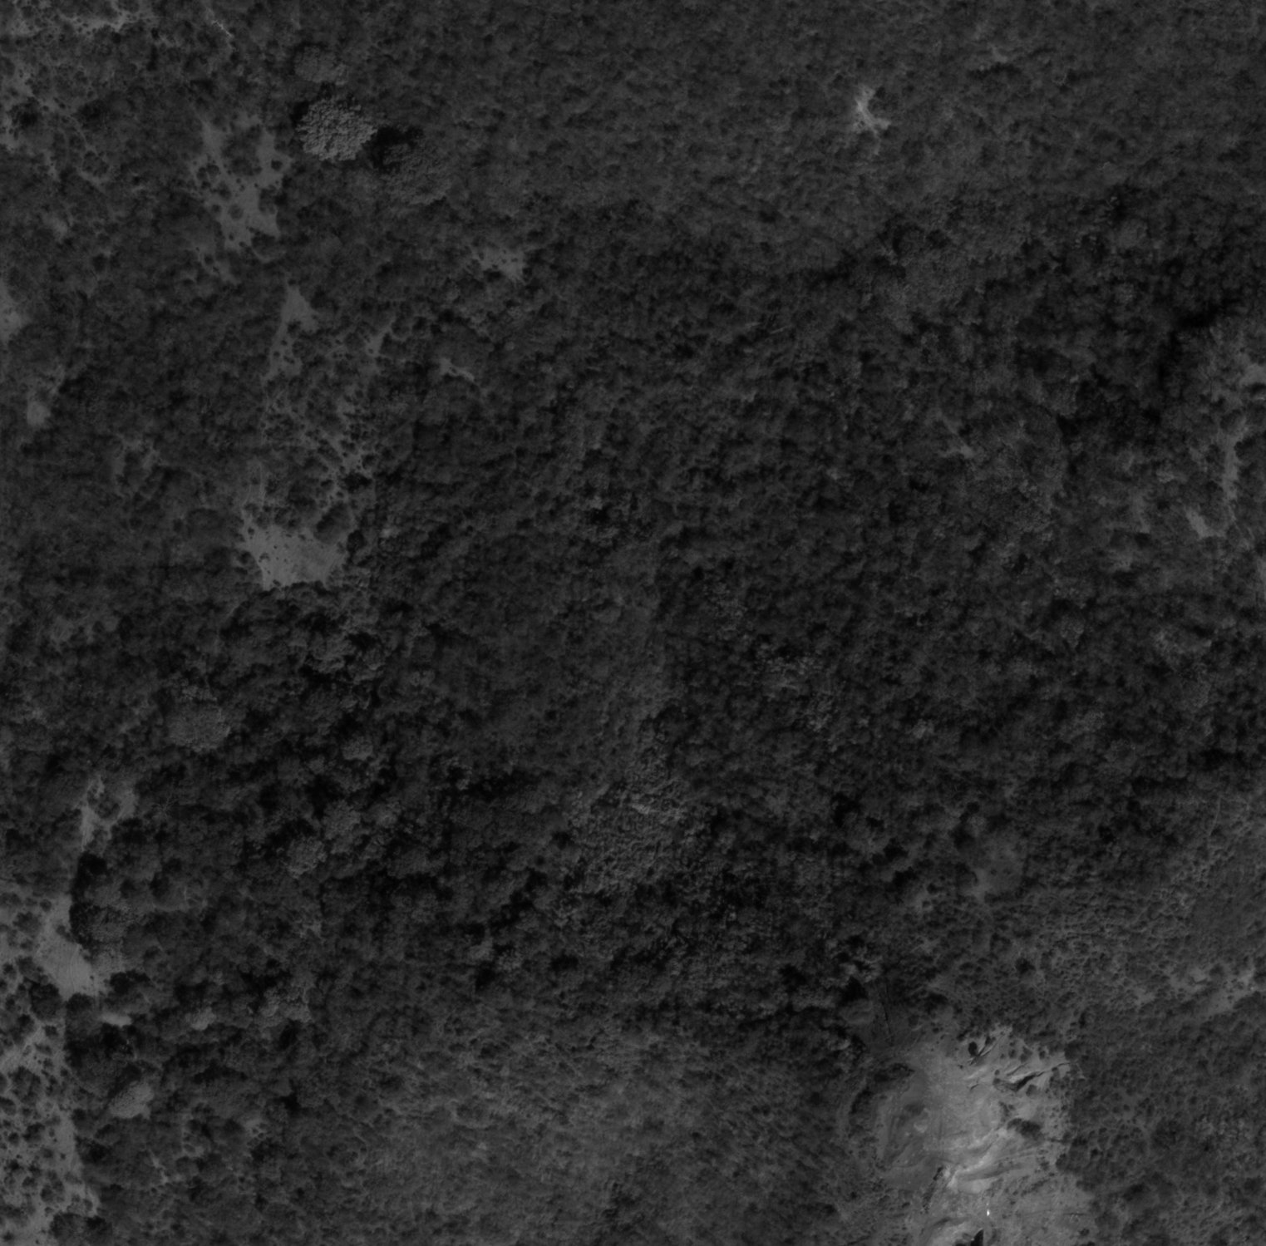
Areas that Shouldn’t Match (Bait)

Slide 10
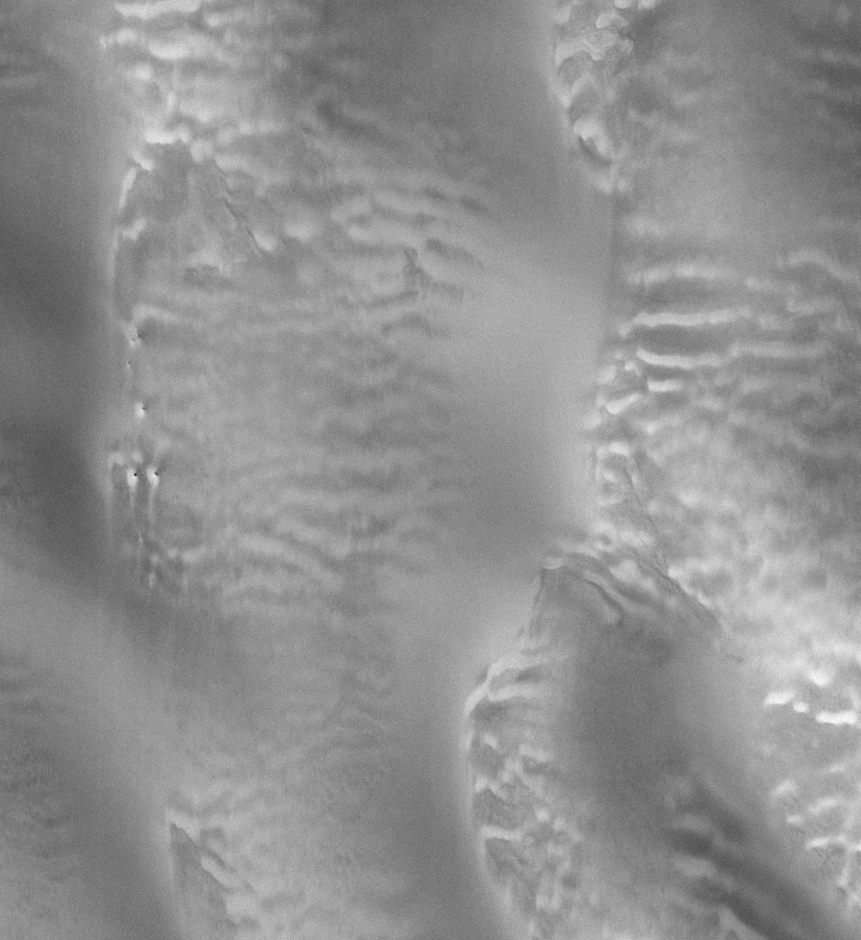
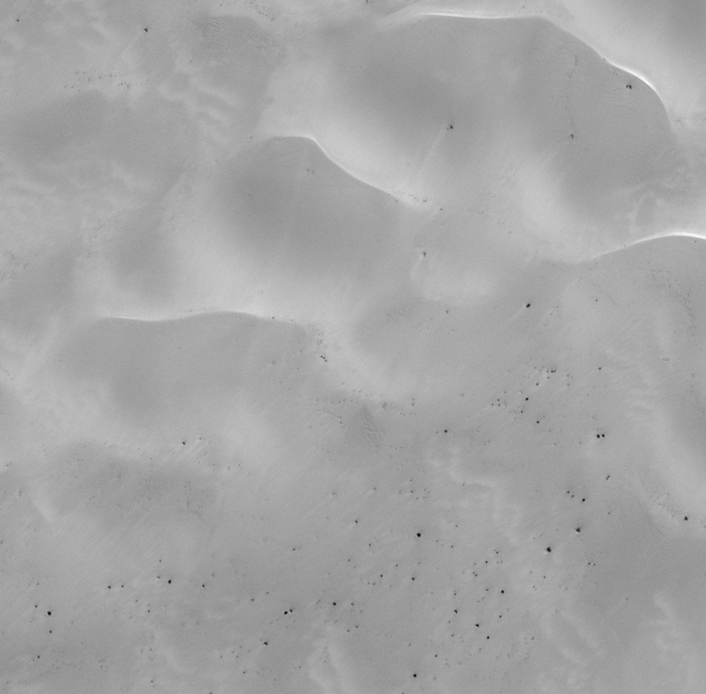
Areas that Shouldn’t Match (Bait)

Slide 11
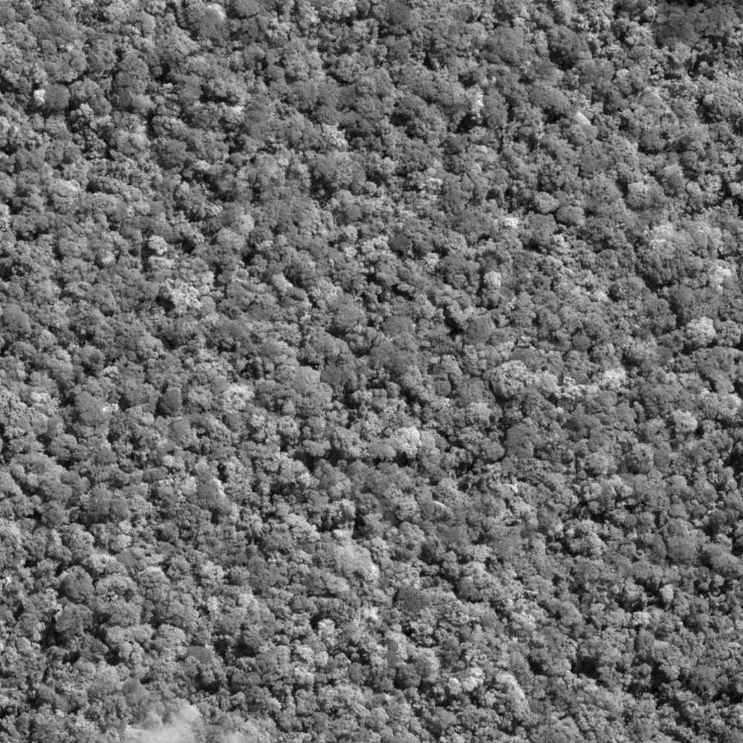
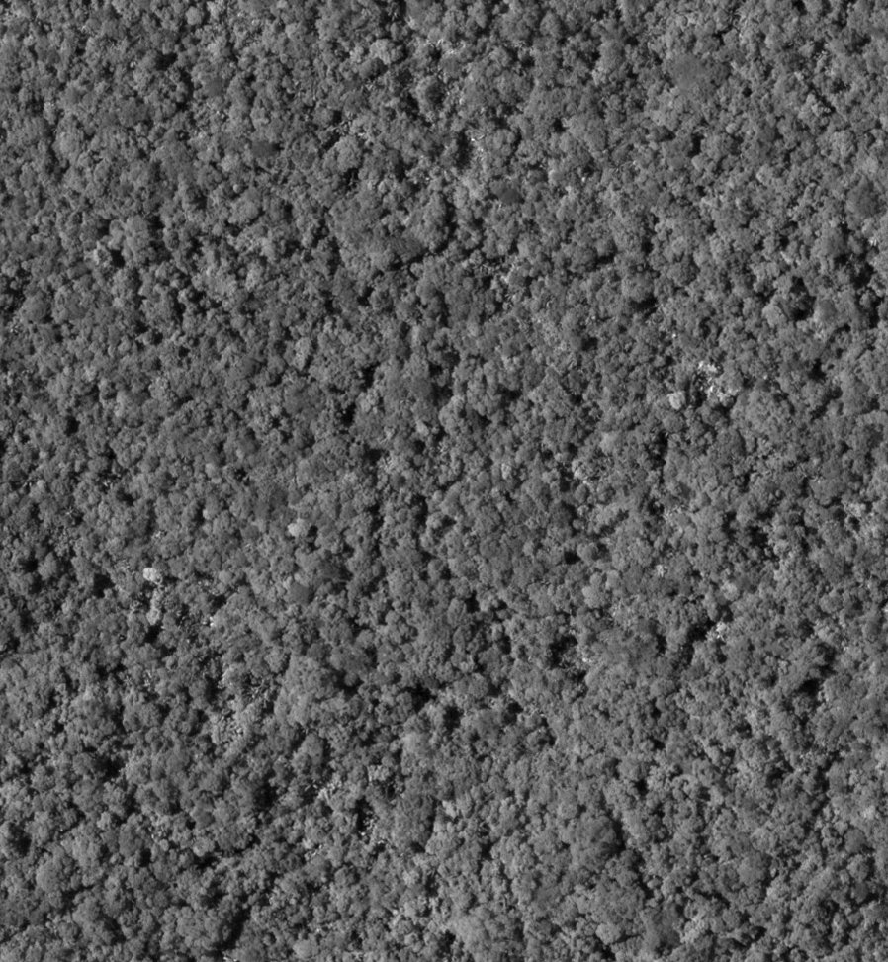
Areas that Shouldn’t Match (Bait)

Slide 12
Increasing Utility
Quality
Quantity
Distribution

Slide 13

SMaUG: Satellite Matching Utility Grade

Slide 14
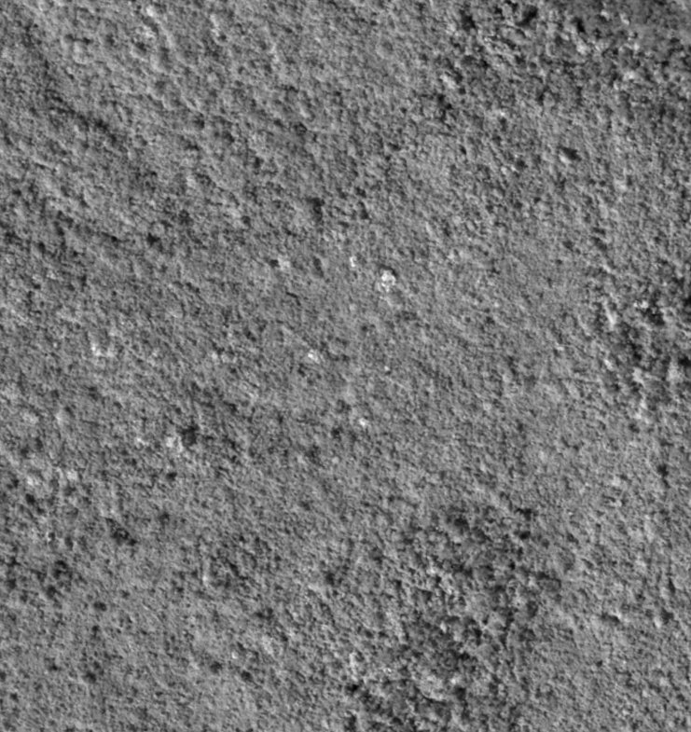
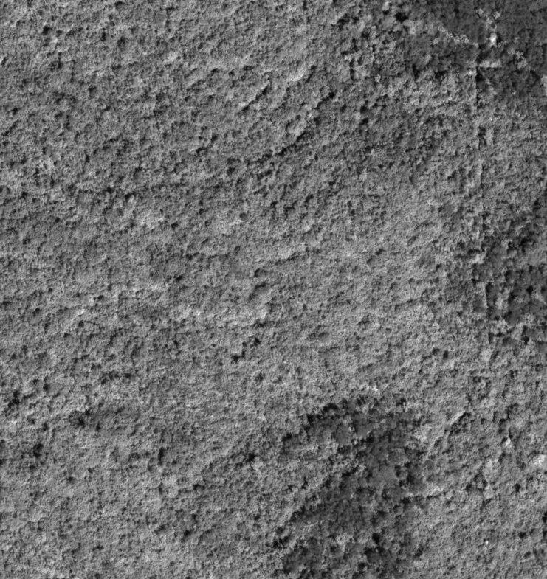
SMaUG: Satellite Matching Utility Grade
Notes:
First, it must segment the inlier from the outliers

Slide 15
SMaUG: Satellite Matching Utility Grade

Slide 16
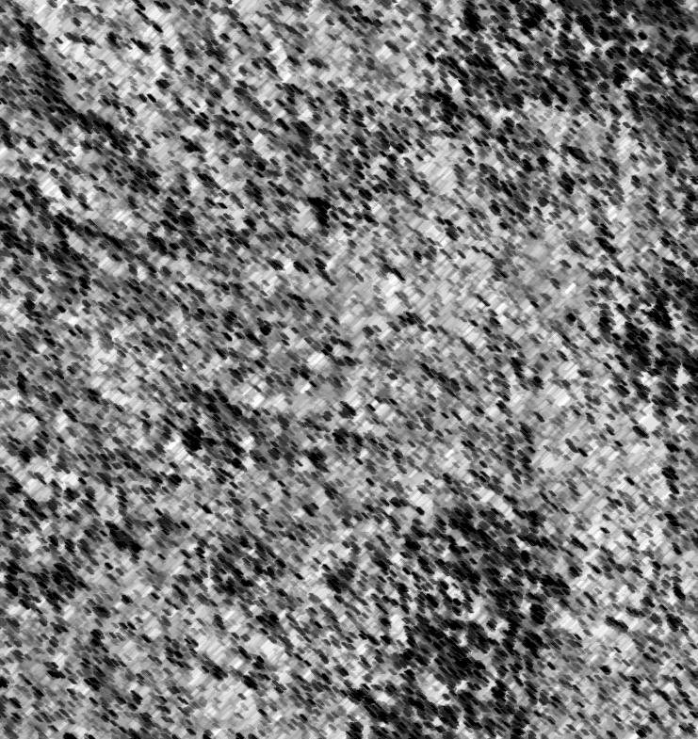
SMaUG: Satellite Matching Utility Grade

Slide 17

SMaUG: Satellite Matching Utility Grade
The proposed metric of matching utility is the maximum 2D uncertainty of the transformed corners: SMaUG$=Max\left(\sqrt{v_{x^{′}}+v_{y^{′}}}\right)$
Should capture quality, quantity, and distribution.
The units are pixels!
Notes:
The segmentation algorithms computes a 2D pixel space transformation. We use to estimate the variances of the transformed corner coordinates, and derive the SMaUG from that.

Slide 18
SMaUG: Math Models
Translation
Projective
Similarity
Affine

Slide 19

SMaUG: Math Models
Translation
Projective
Similarity
Affine

Slide 20
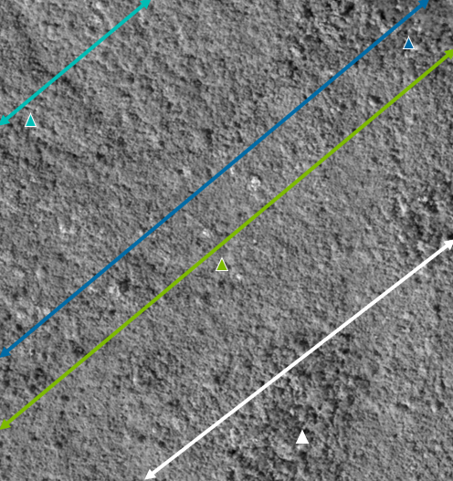
Parallelism of Epipolar Lines
Notes:
Never more than 2.0 pixels on non-parallelism in 4000x4000 tiles, at 8000x8000+ we start to see some outliers, but we’re never working with tiles that large anyway.

Slide 21




SMaUG: Math Models
$$\left[\begin{matrix}1 Translation \\ 1 Rotation \\ 1 Scale\end{matrix}\right]$$
$$\left[\begin{matrix}1 Translation \\ 1 Rotation\end{matrix}\right]$$
More Stability
More Sensitivity
$$\left[\begin{matrix}1 Translation \\ 1 Scale\end{matrix}\right]$$
$$\left[1 Translation\right]$$

Slide 22
Testing Labeling Inliers and Outliers
Notes:
5% mislabels was the 93th percentile
Median was 2.4% mislabeled
In a few cases with low percentages of inliers there was a group of outliers that happen to be geometrically consistent.

Slide 23
Testing Response to Increasing Noise
Notes:
5K simulations in different real sensor geometries
All degraded as expect as the noise scaled
Curves show four specific simulations

Slide 24
Testing Response to Decreasing Area
Notes:
2.2% of the 45K simulation did not increase exactly as expected. The lime green curve is an example. Some noise from the inlier/outlier segmentation and solving.

Slide 25
Testing Response to Increasing Numbers
Notes:
1.7% didn’t move as expected

Slide 26
SMaUG: Satellite Matching Utility Grade
Conclusions
Measures the utility of matches as an uncertainty in pixels (smaller is better).
Does not require truth data, but can be fooled by hallucinating matchers!
Responds as expected to changes in quality, quantity, and distribution of matches.
Correctly labeled 98% of inliers/outliers.
Used only a 2 or 3-parameter pixel space transformation (compared to 6 or 8 for frame images).
Future Work
Reports on the best preforming matchers for remote sensing applications
Open-source python repo with all the matchers we’re testing and SMaUG.
Satellite matching benchmark dataset.

Slide 27
References
Chen, Hongkai, et al. "Aspanformer: Detector-free image matching with adaptive span transformer." European Conference on Computer Vision. Cham: Springer Nature Switzerland, 2022.
Edstedt, Johan, et al. "DKM: Dense kernelized feature matching for geometry estimation." Proceedings of the IEEE/CVF Conference on Computer Vision and Pattern Recognition. 2023.
Lindenberger, Philipp, Paul-Edouard Sarlin, and Marc Pollefeys. "Lightglue: Local feature matching at light speed." Proceedings of the IEEE/CVF International Conference on Computer Vision. 2023.
Xia, Haiying, et al. "Md-net: multi-scale dilated convolution network for CT images segmentation." Neural Processing Letters 51 (2020): 2915-2927.
Luo, Zixin, et al. "Aslfeat: Learning local features of accurate shape and localization." Proceedings of the IEEE/CVF conference on computer vision and pattern recognition. 2020.
Chen, Hongkai, et al. "Aspanformer: Detector-free image matching with adaptive span transformer." European Conference on Computer Vision. Cham: Springer Nature Switzerland, 2022.
Lindenberger, Philipp, Paul-Edouard Sarlin, and Marc Pollefeys. "Lightglue: Local feature matching at light speed." Proceedings of the IEEE/CVF International Conference on Computer Vision. 2023.
Sun, Jiaming, et al. "LoFTR: Detector-free local feature matching with transformers." Proceedings of the IEEE/CVF conference on computer vision and pattern recognition. 2021.
Dusmanu, Mihai, et al. "D2-net: A trainable cnn for joint description and detection of local features." Proceedings of the ieee/cvf conference on computer vision and pattern recognition. 2019.
Revaud, Jerome, et al. "R2d2: Reliable and repeatable detector and descriptor." Advances in neural information processing systems 32 (2019).
Sarlin, Paul-Edouard, et al. "Superglue: Learning feature matching with graph neural networks." Proceedings of the IEEE/CVF conference on computer vision and pattern recognition. 2020.
Han, Xufeng, et al. "Matchnet: Unifying feature and metric learning for patch-based matching." Proceedings of the IEEE conference on computer vision and pattern recognition. 2015.
Yi, Kwang Moo, et al. "Lift: Learned invariant feature transform." Computer Vision–ECCV 2016: 14th European Conference, Amsterdam, The Netherlands, October 11-14, 2016, Proceedings, Part VI 14. Springer International Publishing, 2016.
Oyallon, Edouard, and Julien Rabin. "An analysis of the SURF method." Image Processing On Line 5 (2015): 176-218.
Leutenegger, Stefan, Margarita Chli, and Roland Y. Siegwart. "BRISK: Binary robust invariant scalable keypoints." 2011 International conference on computer vision. Ieee, 2011.
Calonder, Michael, et al. "BRIEF: Computing a local binary descriptor very fast." IEEE transactions on pattern analysis and machine intelligence 34.7 (2011): 1281-1298.
Rublee, Ethan, et al. "ORB: An efficient alternative to SIFT or SURF." 2011 International conference on computer vision. Ieee, 2011.
Dong, Jingming, and Stefano Soatto. "Domain-size pooling in local descriptors: DSP-SIFT." Proceedings of the IEEE conference on computer vision and pattern recognition. 2015.
Arandjelović, Relja, and Andrew Zisserman. "Three things everyone should know to improve object retrieval." 2012 IEEE conference on computer vision and pattern recognition. IEEE, 2012.
Gruen, Armin. "Adaptive least squares correlation: a powerful image matching technique." South African Journal of Photogrammetry, Remote Sensing and Cartography 14.3 (1985): 175-187.
Barnea, Daniel I., and Harvey F. Silverman. "A class of algorithms for fast digital image registration." IEEE transactions on Computers 100.2 (1972): 179-186.

