Slide 1
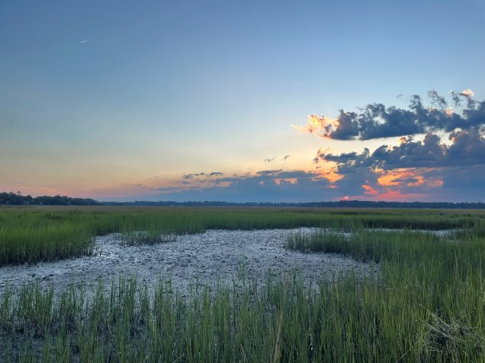
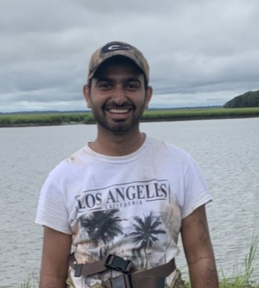
Low-Cost Soil Sensing System for Estimating SOC Stocks in Coastal Wetlands
Towards Accurate, Scalable, Frequent Coastal Wetland Monitoring Systems
Presenter: Rajneesh Sharma
PhD Candidate
Department of Geography
University of Georgia, Athens
Author List:
R. Sharma^{1,2}, J. Hao³, M.B. Fleming⁴, Kyle Reunion⁵, Asa Julien¹, I.K. Kim⁶, S. Kim⁷, L. Ramaswamy⁶, and L.A. Sutter⁴, Matthew R. Levi⁸, D.R. Mishra^{1,2}
¹Center of Geospatial Research, Department of Geography, University of Georgia
²Institute for Artificial Intelligence, University of Georgia
³Governors State University, University Park, Illinois
⁴Biology and Marine Biology, University of North Carolina Wilmington
⁵Department of Marine Science, University of Texas at Austin
⁶School of Computing, University of Georgia
⁷College of Engineering, University of Georgia
⁸Crop and Soil Sciences, University of Georgia

Slide 2
Why Soil Organic Carbon in Wetlands Matters
Coastal Wetlands
Carbon Sequestration
Store 20-25% of Soil Organic Carbon with 4-6% of land area
(Yu et al., 2012)​
Carbon sequestration rates are around 35 times higher than
those of terrestrial ecosystems (Mao et al., 2023; McLeod et al., 2011)
Transient zones between terrestrial and marine
ecosystems
Spartina alterniflora is a keystone species
Soil Organic Carbon
Threats & Protection
Largest share of carbon stock, greater than vegetation
and atmosphere combined
Soil's potential to store carbon and support vegetation
communities in salt marshes
Loss estimated to be 53% in the contiguous US, 16% in
Canada, and 62% in Mexico (Shrestha et al., 2018; Kolka et al., 2018)
Coastal Development & Invasive Species

Slide 3
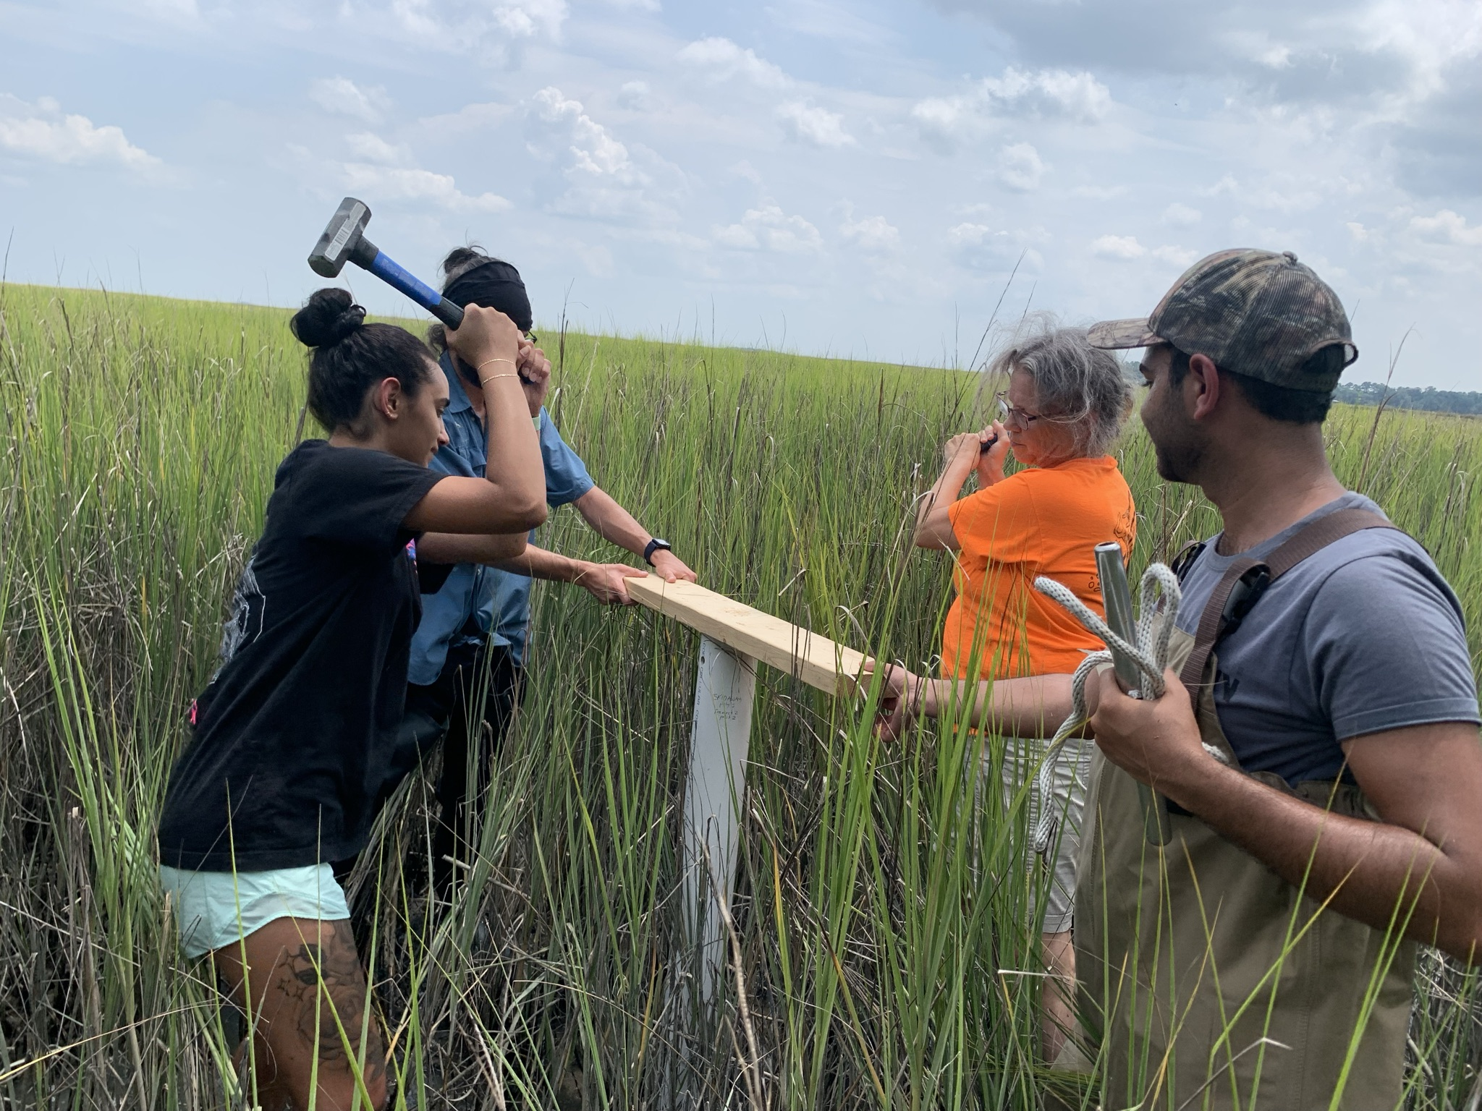
Challenges in Mapping SOC Stock
Traditional soil sampling methods are costly, labor-intensive, and time-consuming
Require pre-processing of soil samples (air-drying, sieving, and pulverizing, which takes even longer for wetland soils)
Lack of space and time scalability for soil properties
Remote sensing offers a more convenient and cost-efficient alternative
But weak signal, non-exposed soil, and surface water
IoT–Based Soil Sensors

Slide 4
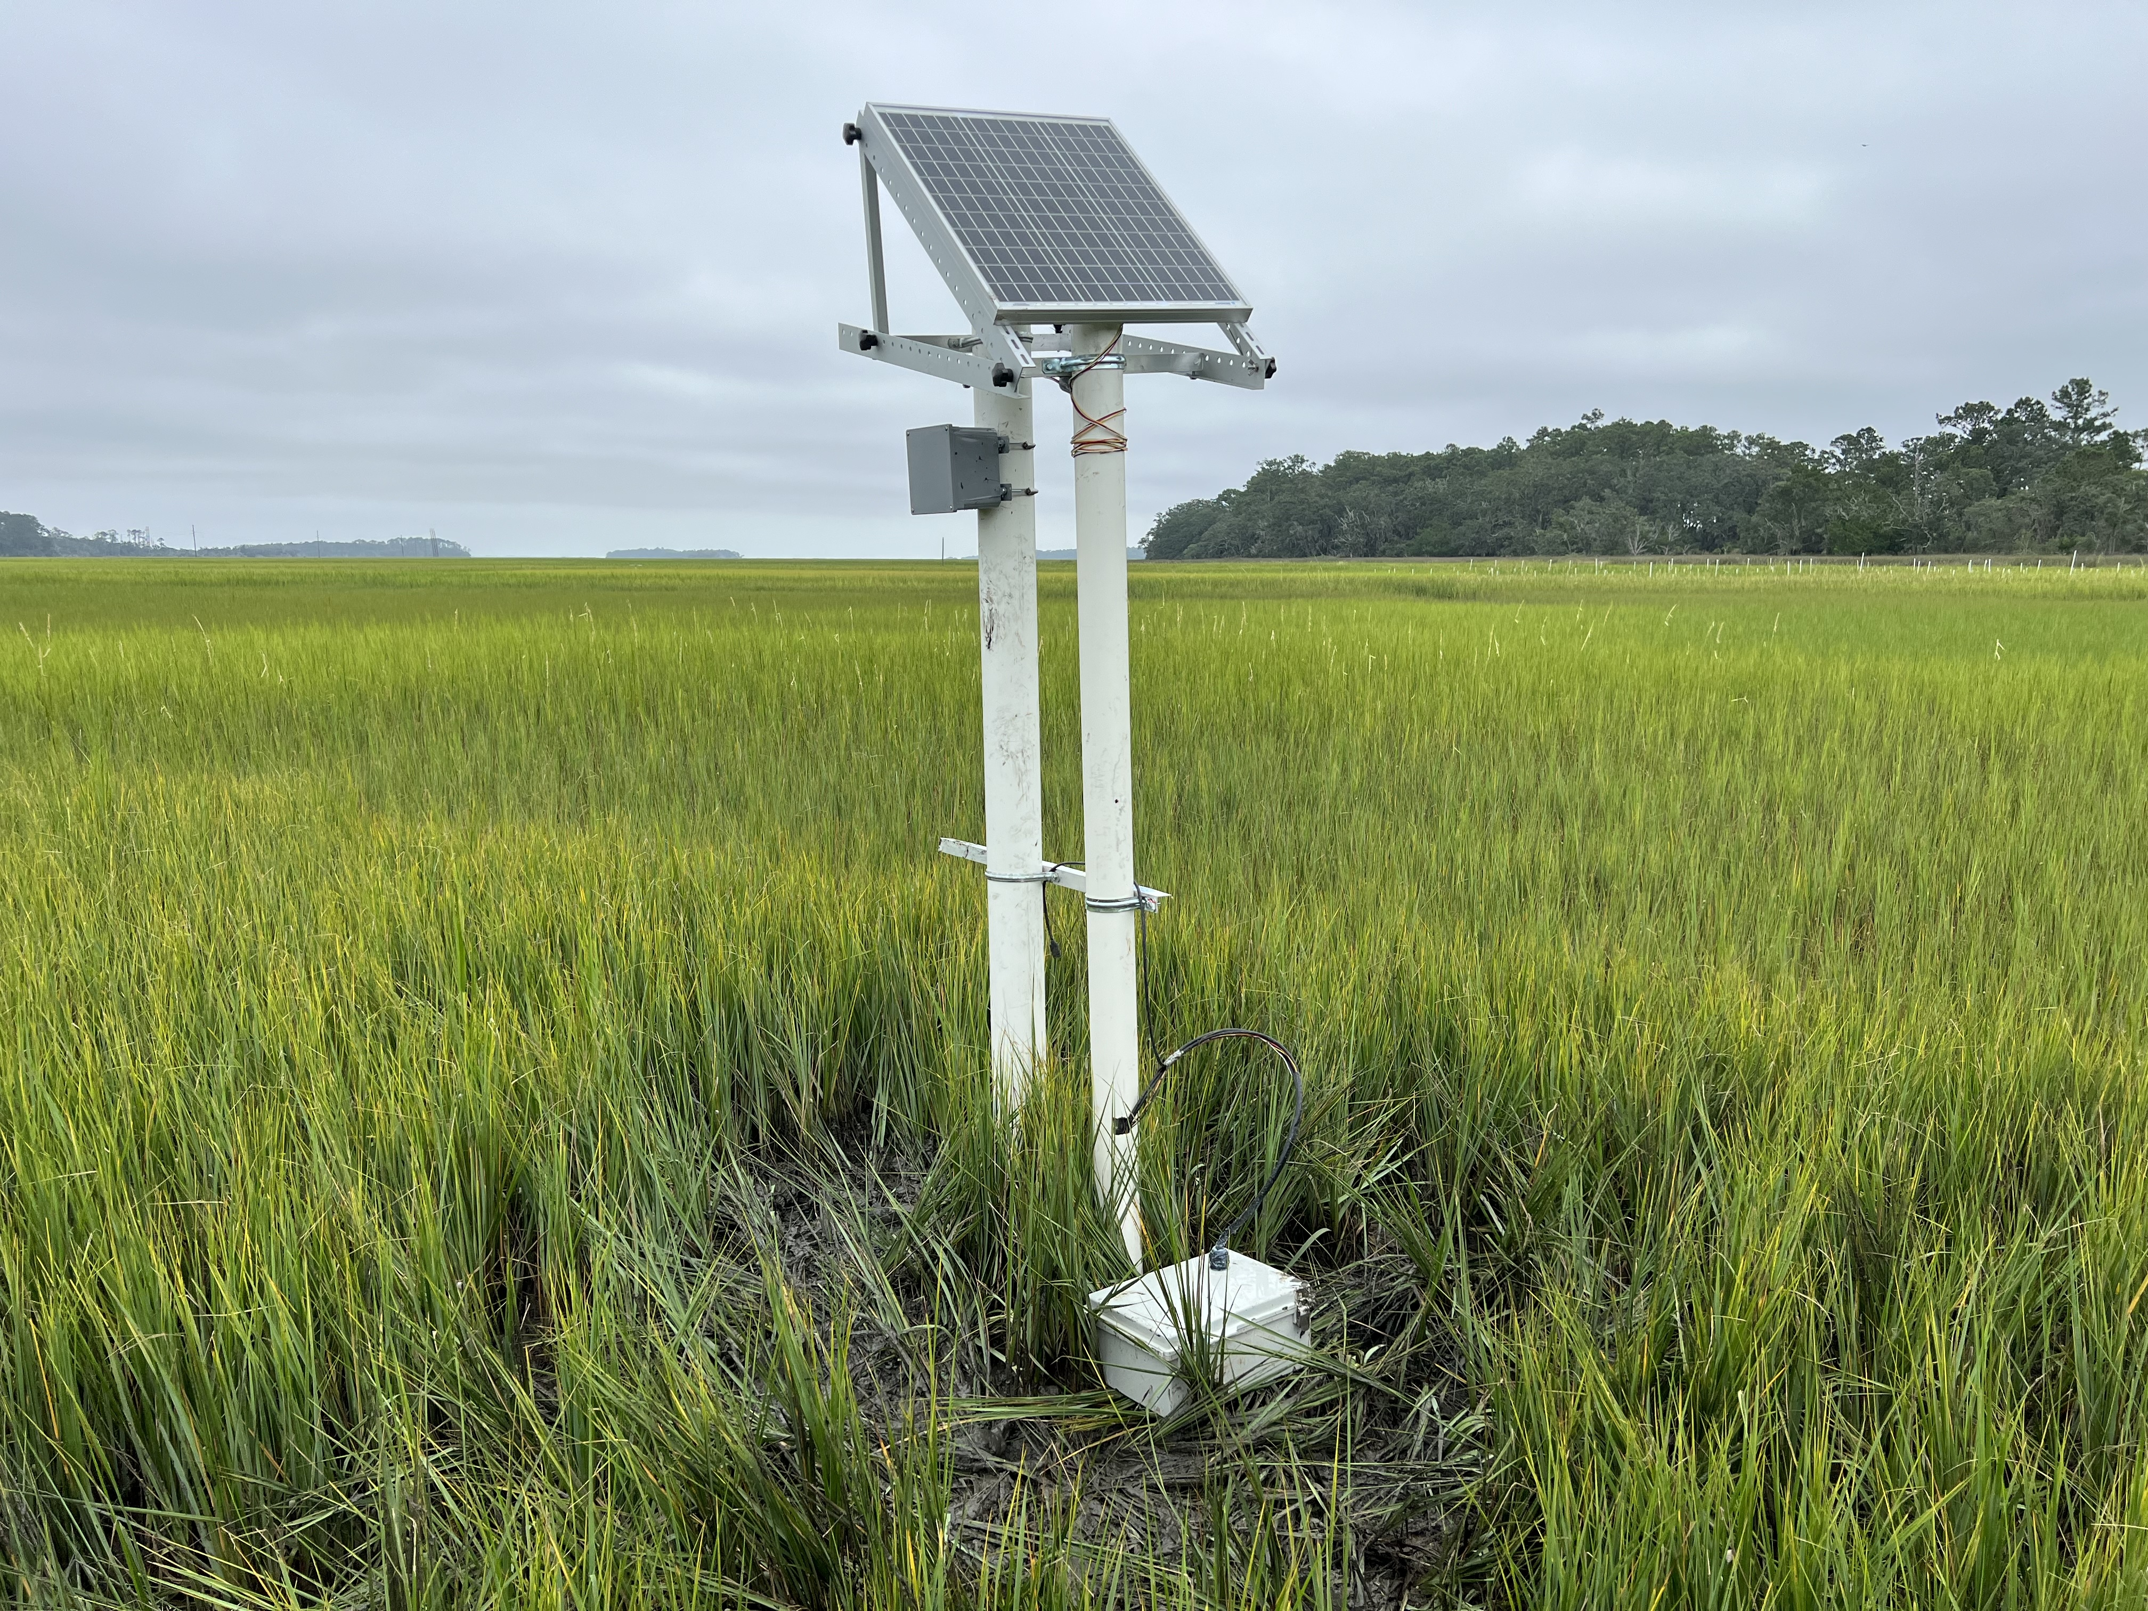
AweSOMSense- A Wetland Soil Organic Matter Sensor

Slide 5
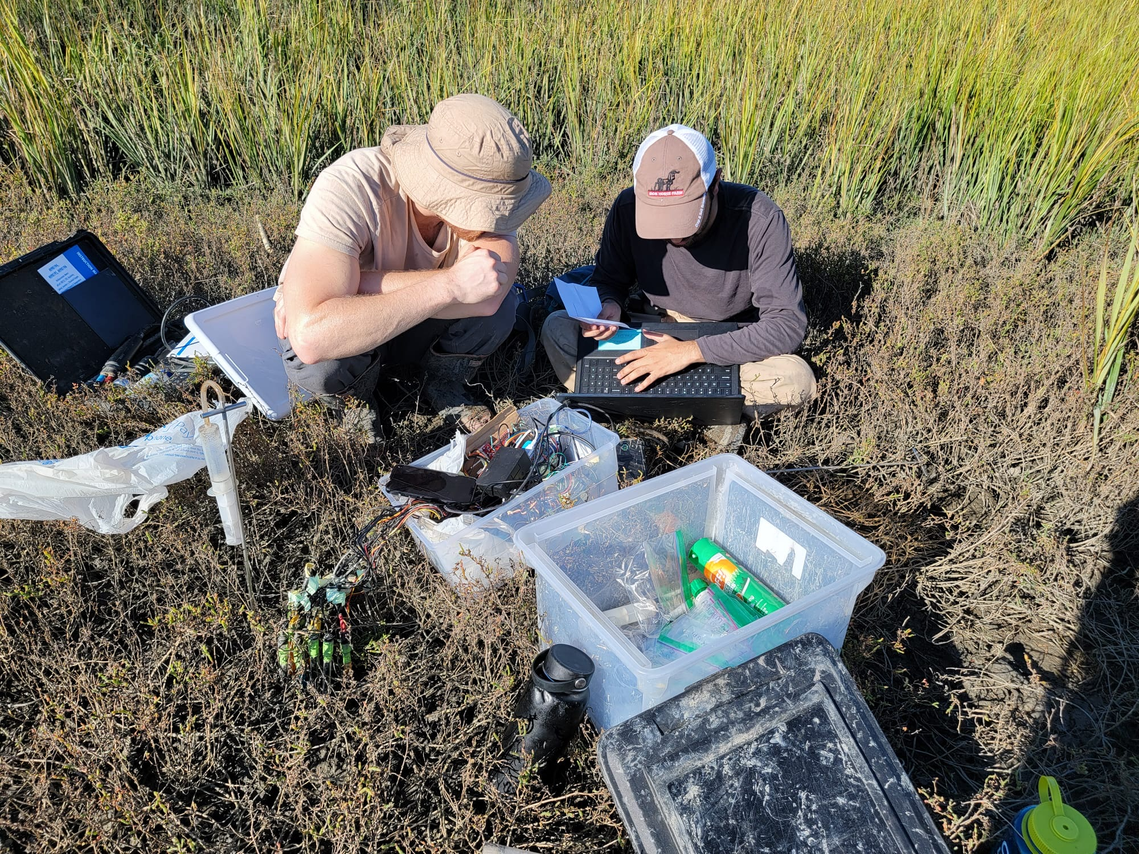
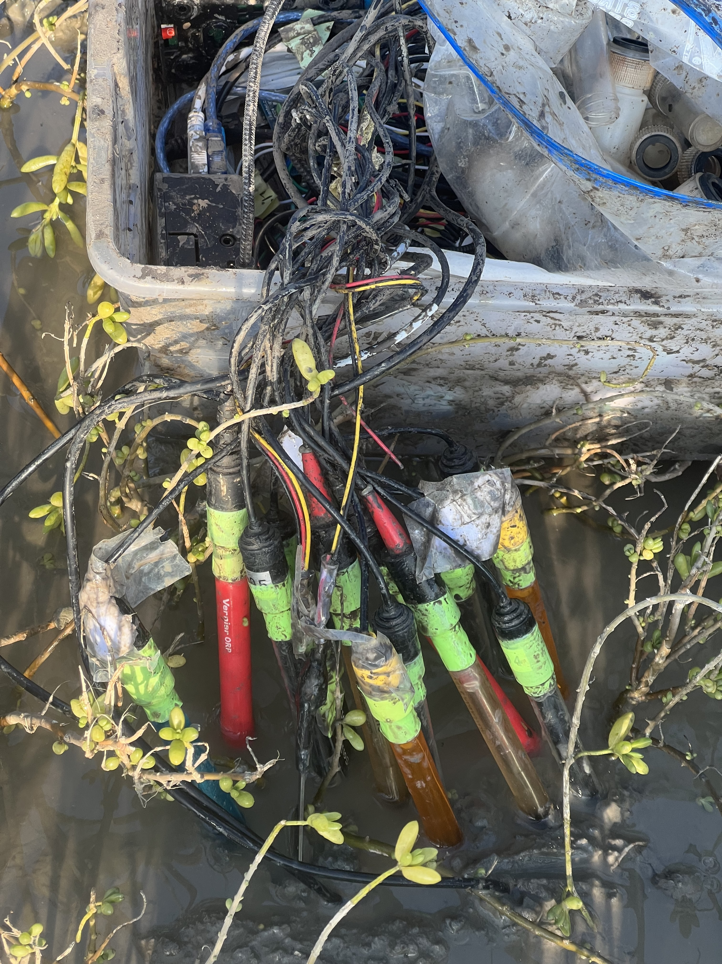
Objectives and Aims
Studying SOC vs Site Characteristic
Comparing SOC with other variables
Feature Engineering: Selecting SOC Predictors
Comparing Accuracy for Soil vs Spectra vs Env Models

Slide 6
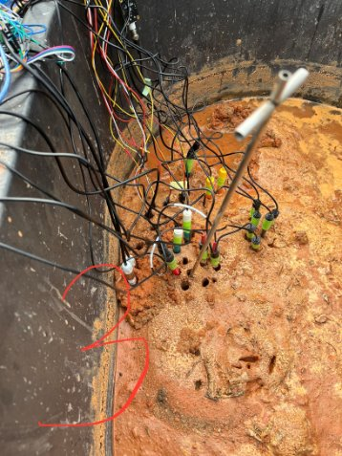
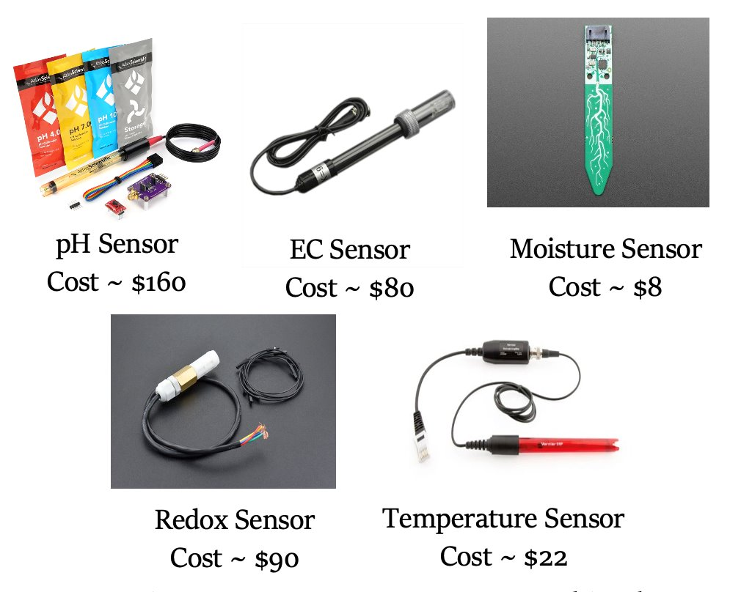
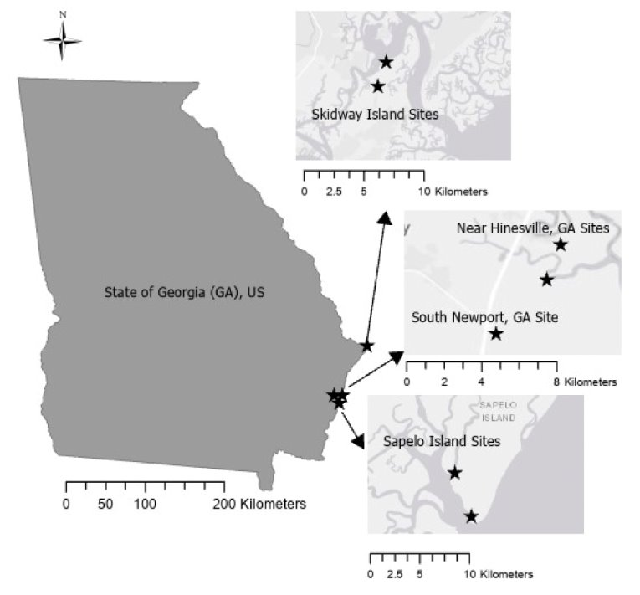
Field Data Collection
Data Collected from 7 wetland sites
Five field expeditions
  March 2022
  Oct 2022
  Nov 2022
  Dec 2022
  May 2023
A total of around ~250 Surface (0-5cm) SOC points
Tested 2 pH sensors, 3 EC Sensors, 2 Redox Sensors, 1 Soil Moisture
Hanna Multi-meter Sensor for comparison
From Hao and Sharma et al., 2023
(J. Hao et al., "Toward Low-Cost and Sustainable IoT Systems for Soil Monitoring in Coastal Wetlands," 2023 IEEE 9th International Conference on Collaboration and Internet Computing (CIC), Atlanta, GA, USA, 2023, pp. 52-61, doi: 10.1109/CIC58953.2023.00017)
Notes:
Data description: We colleted almost 250 point data during March 2022 to Mau 2023.​ These field campaigns were to test performace of soil sensors and their SOC predictive potential, before their long term (3-4 months) field deployment.

Slide 7
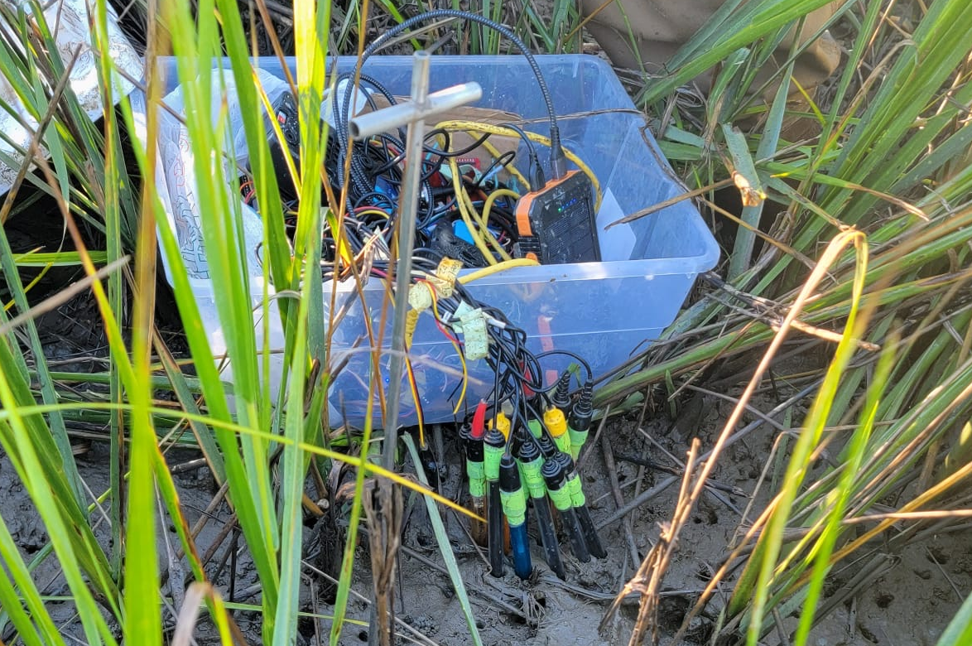
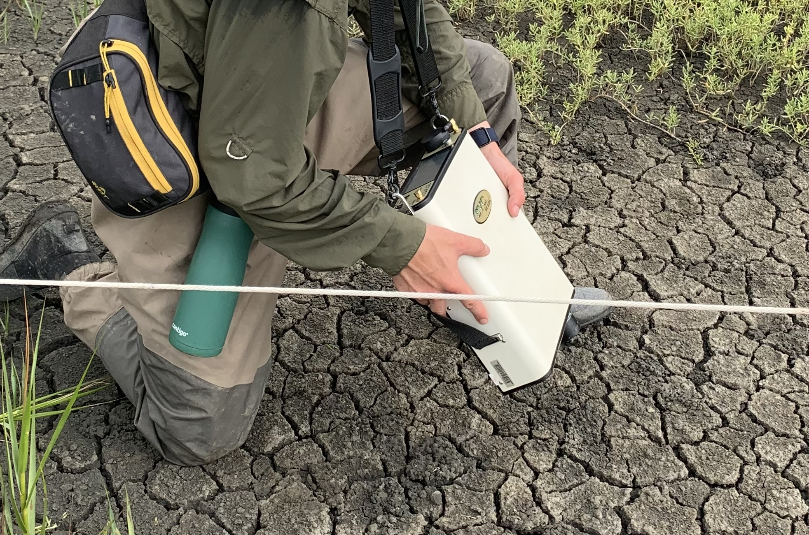
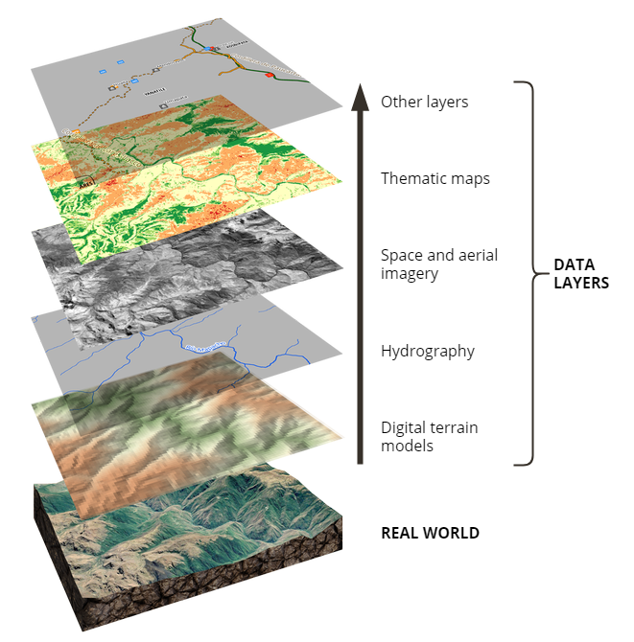
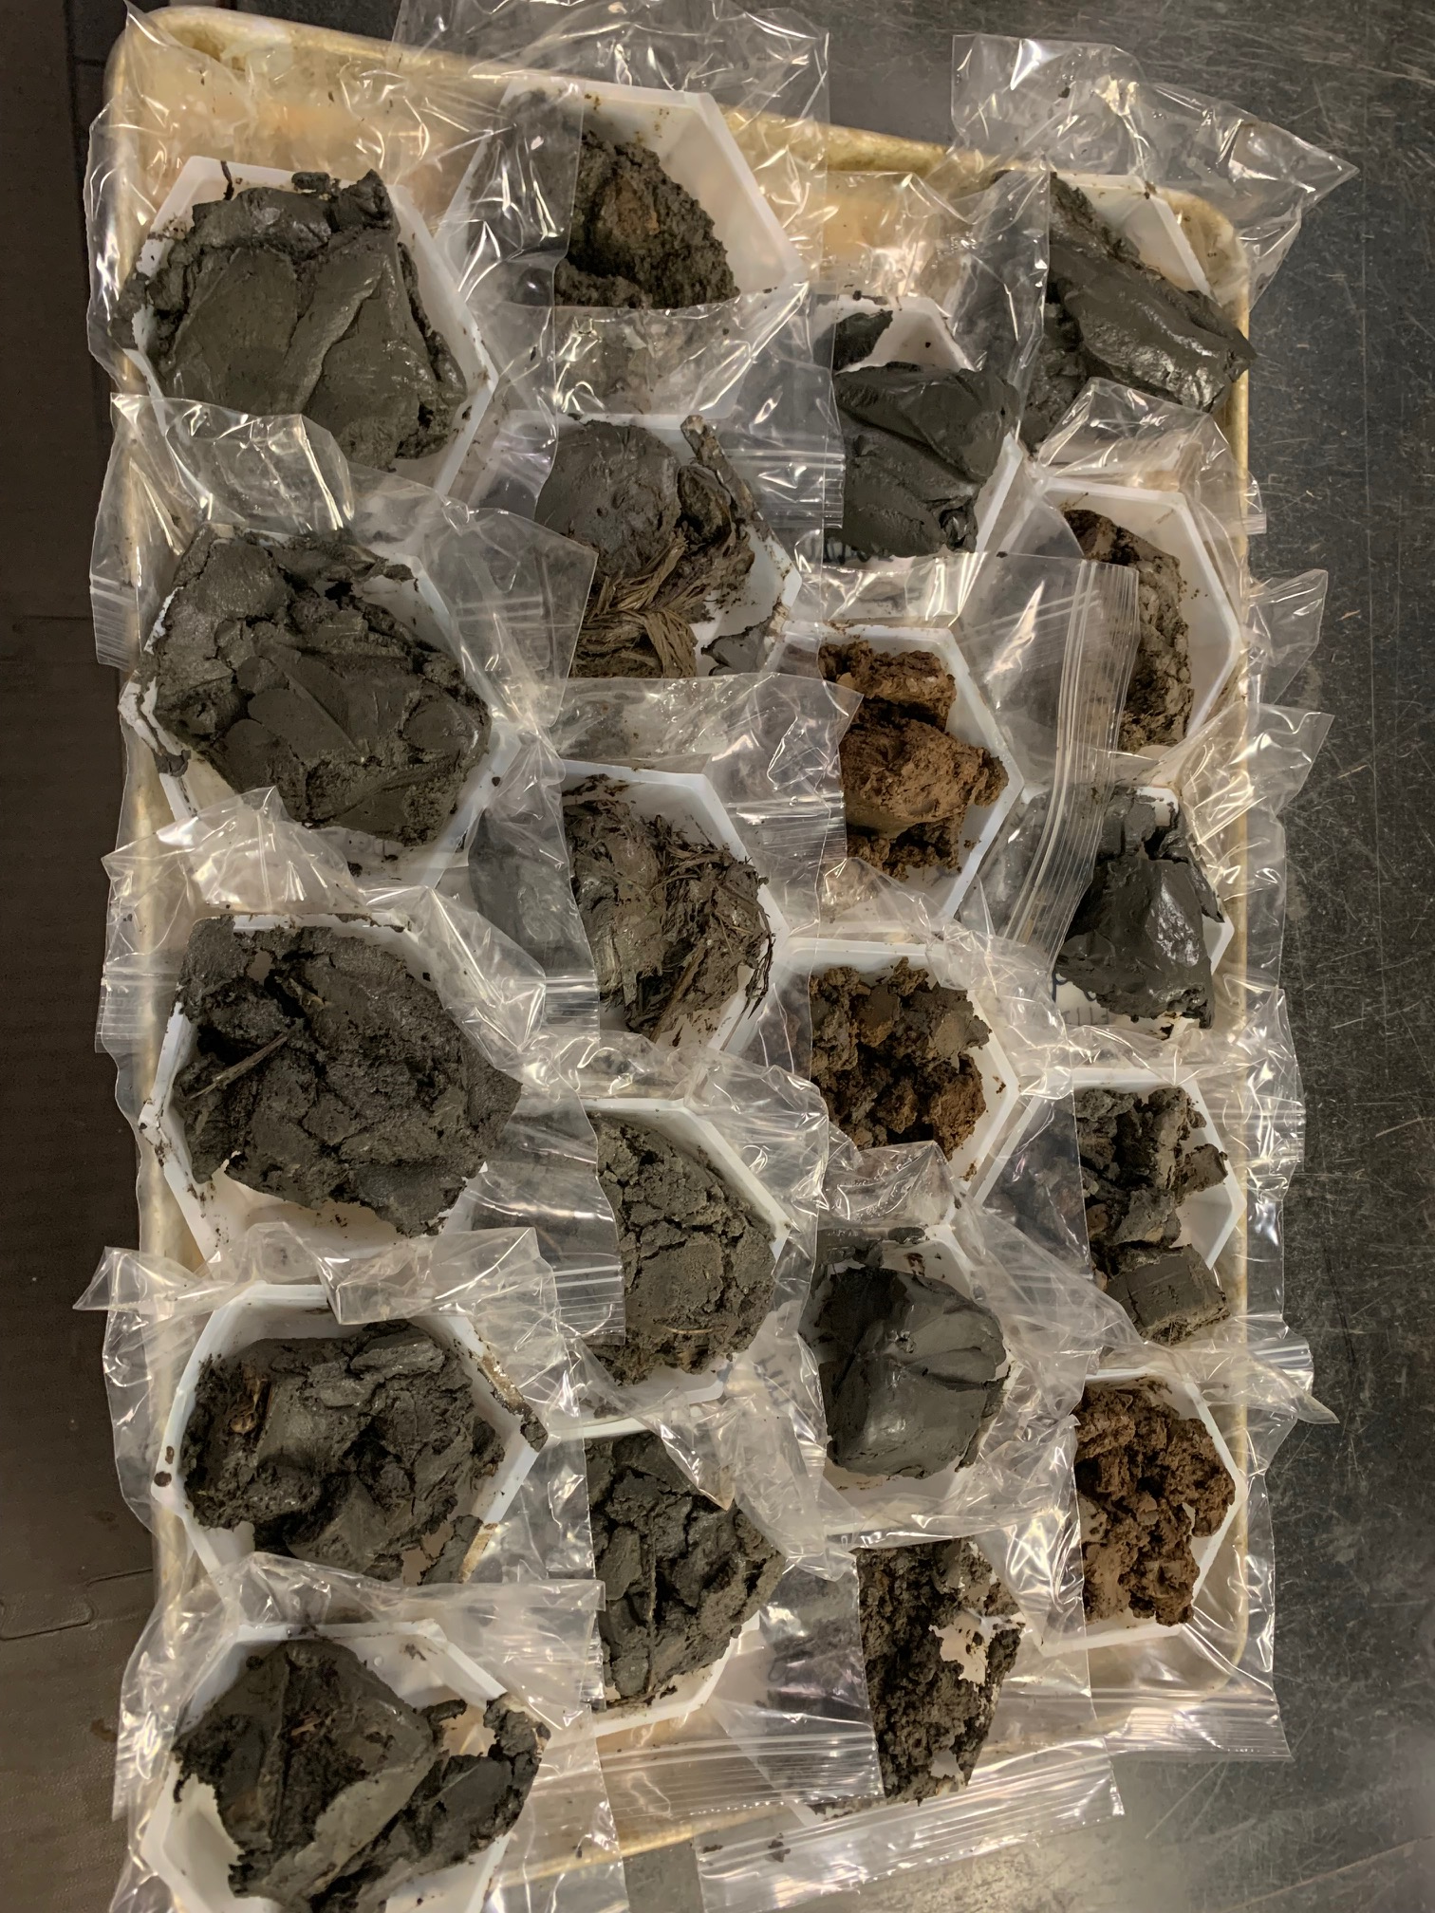
1: Predictors
Training and Testing Data
Low-Cost Soil Sensors
Handheld Spectroradiometer
DEM & Daymet Data
Lab Measured Percent SOC and Soil Bulk Density (0-5 cm)
2: Pre-processing
Low-cost sensor comparison with Hanna Sensor
Sentinel Response Function
Topography and Climate Covariables
Lucas Carvalho Gomes, Raiza Moniz Faria, Eliana de Souza, Gustavo Vieira Veloso, Carlos Ernesto G.R. Schaefer, Elpídio Inácio Fernandes Filho, Modelling and mapping soil organic carbon stocks in Brazil, Geoderma, Volume 340, 2019, Pages 337-350, ISSN 0016-7061, https://doi.org/10.1016/j.geoderma.2019.01.007.
Z-Score Normalization
SHAP Feature Importance
SOC Stock Calculations
(0-5 cm)
Soil Properties based Predictors
Spectra based Predictors
Environment based predictors
80: 20 Training, Testing data Split
100 repetitions due to training-testing data bias
3: ML Models
Soil Model
Soil + Spectra model
Soil + Spectra + Env model
Training SOC Stock Data
Model Testing and Evaluation (Rsq, Adj. Rsq, RMSE, NRMSE, MAPE)
Testing SOC Stock Data

Slide 8
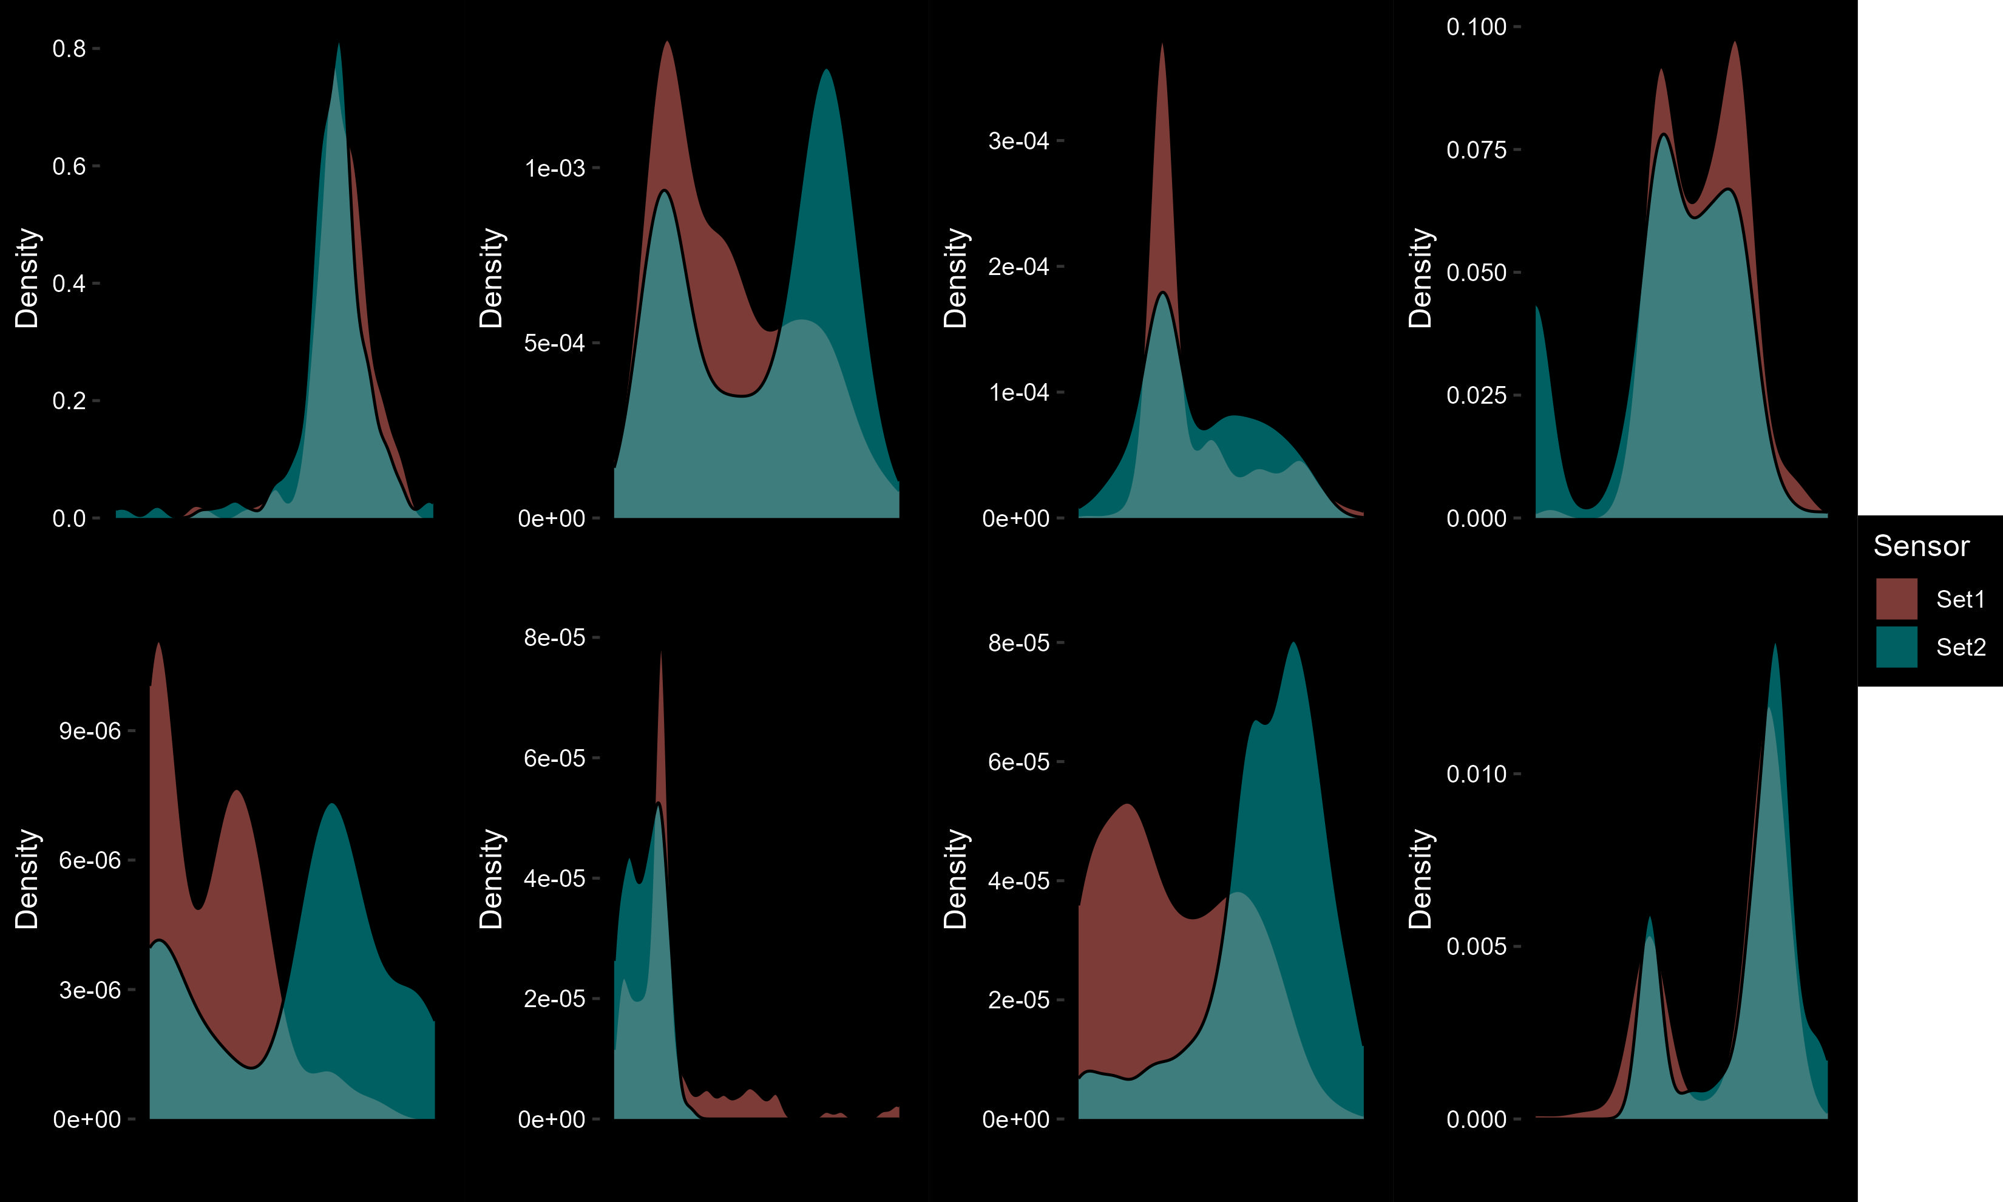
Sensor Selection
Highest Correlation with Hanna Sensor
If same sensors is collected from both replicas (Take Average)
If not choose highest correlation sensor
pH_1
ORP_1
ORP_2
Temp
EC_1
EC_2
EC_3
Moisture

Slide 9
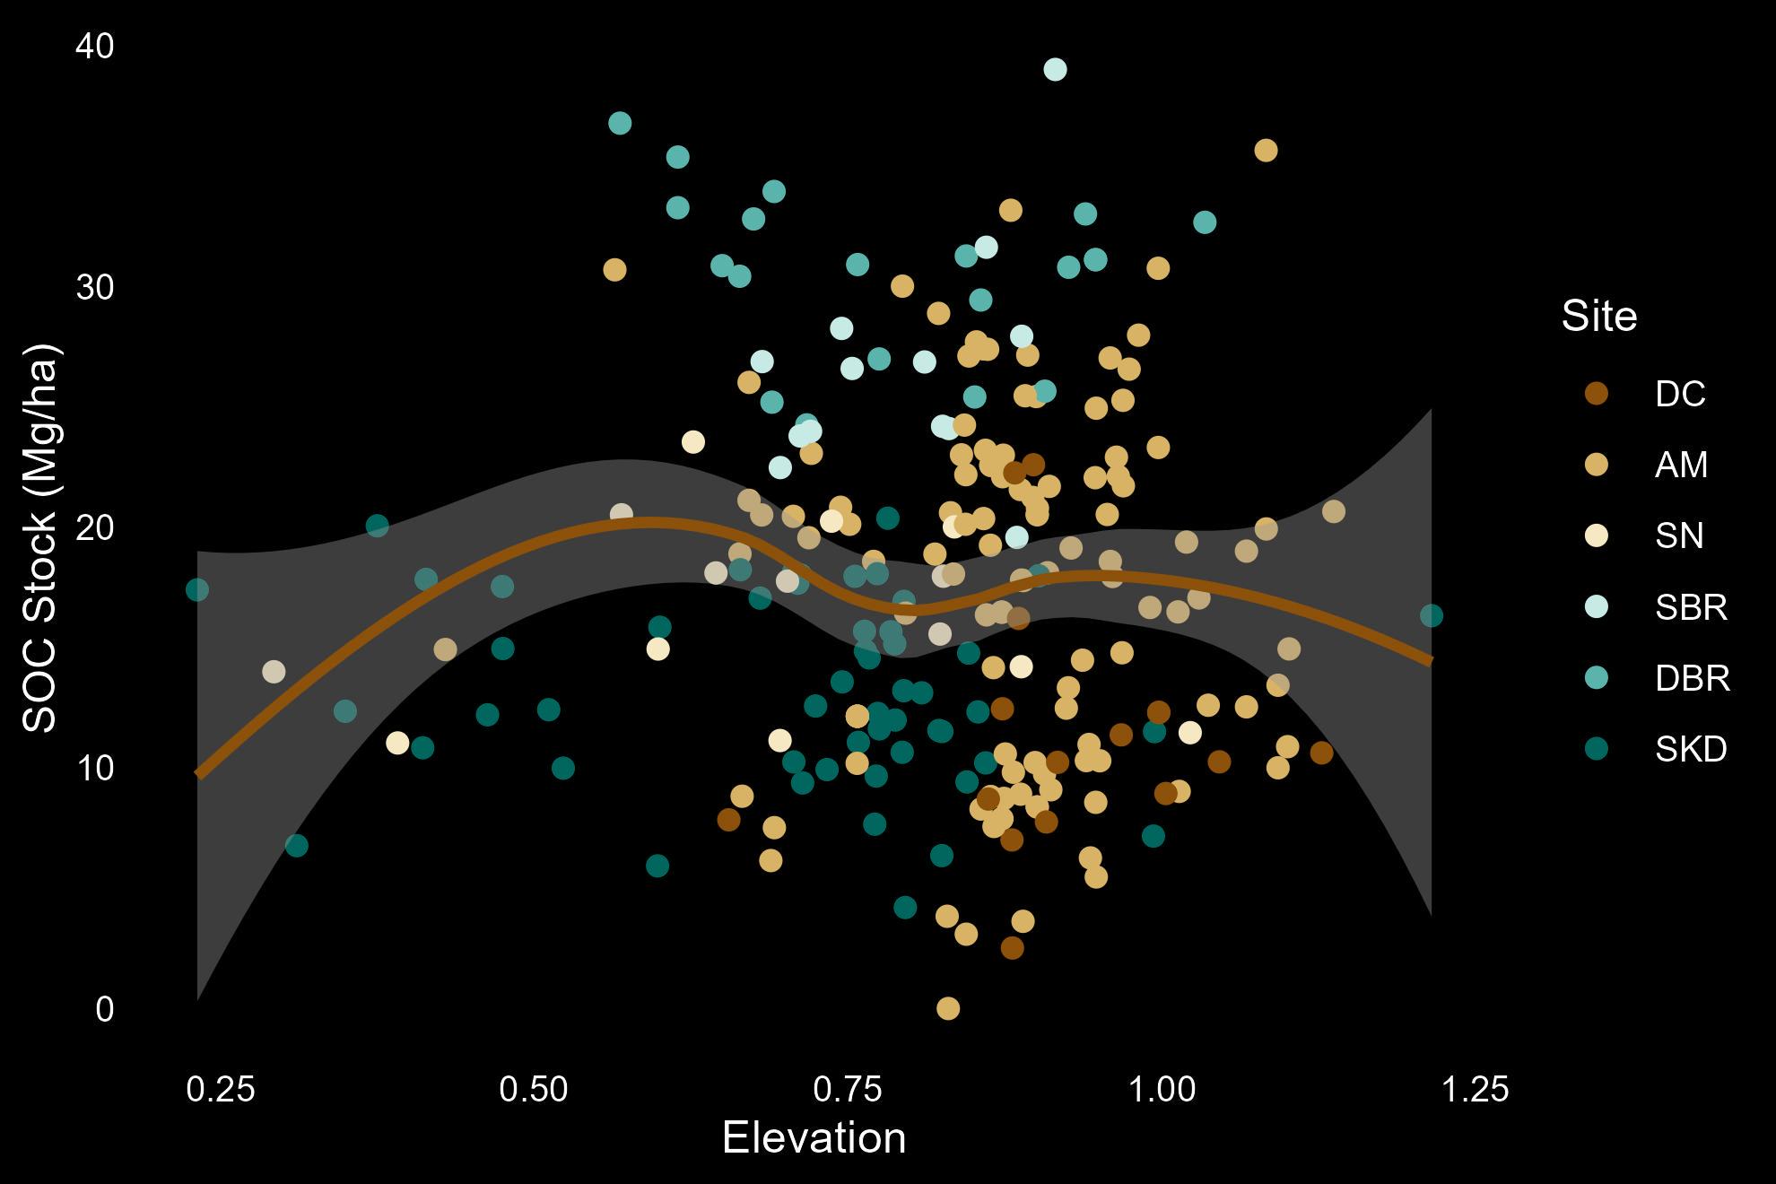
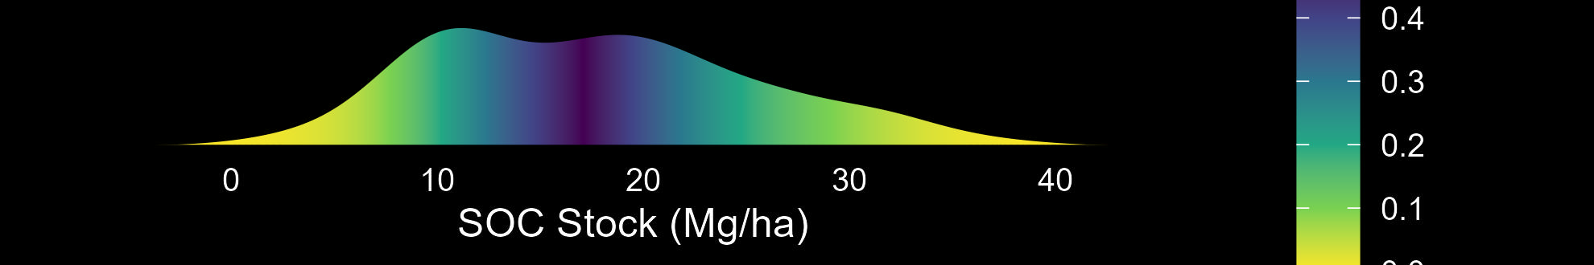
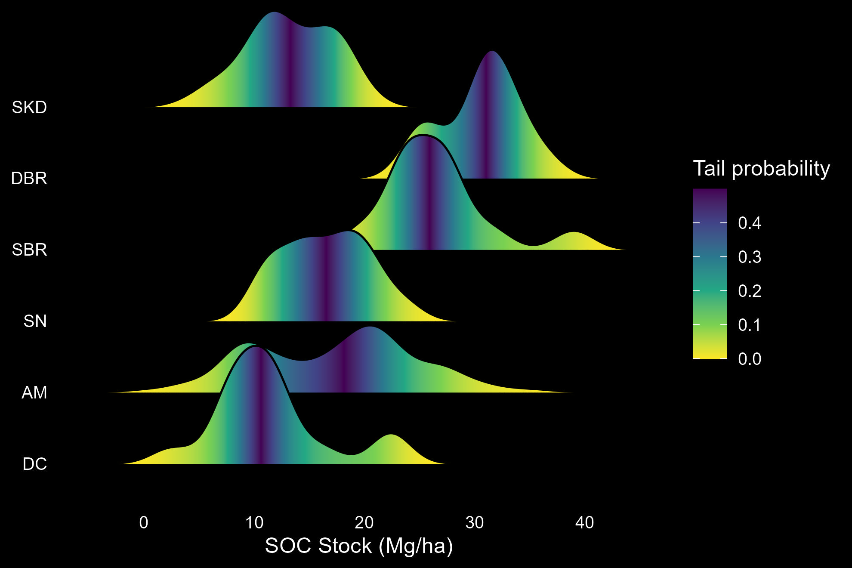
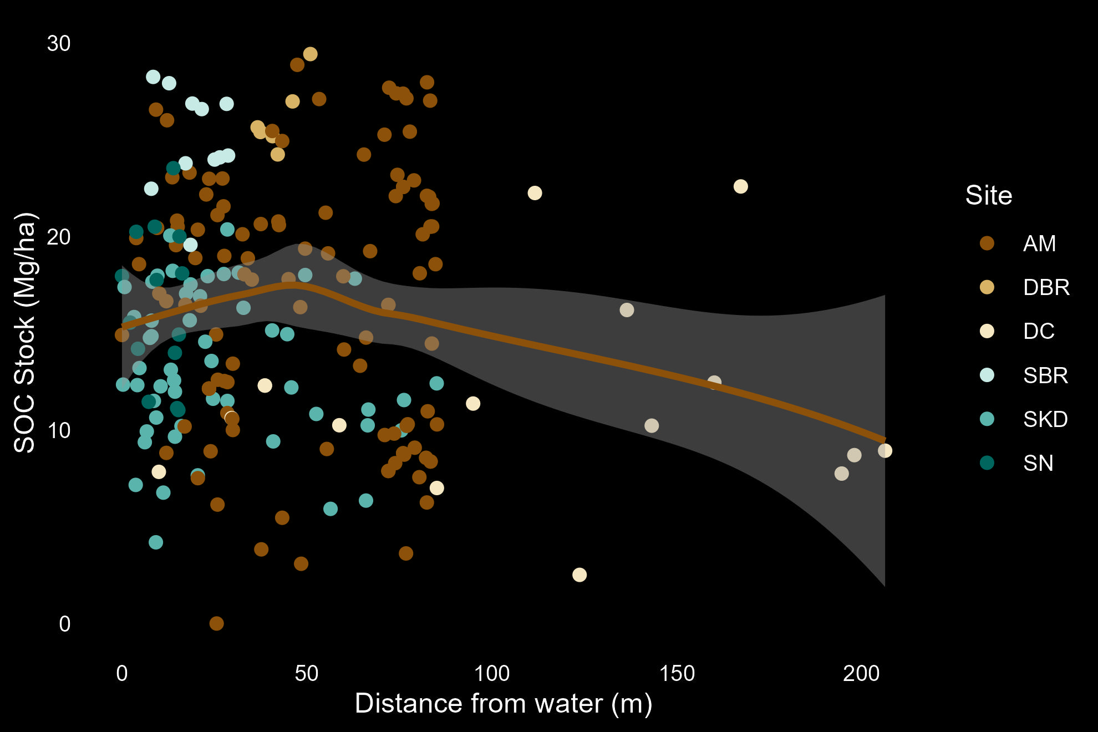
Results and Discussions
All Sites

Slide 10
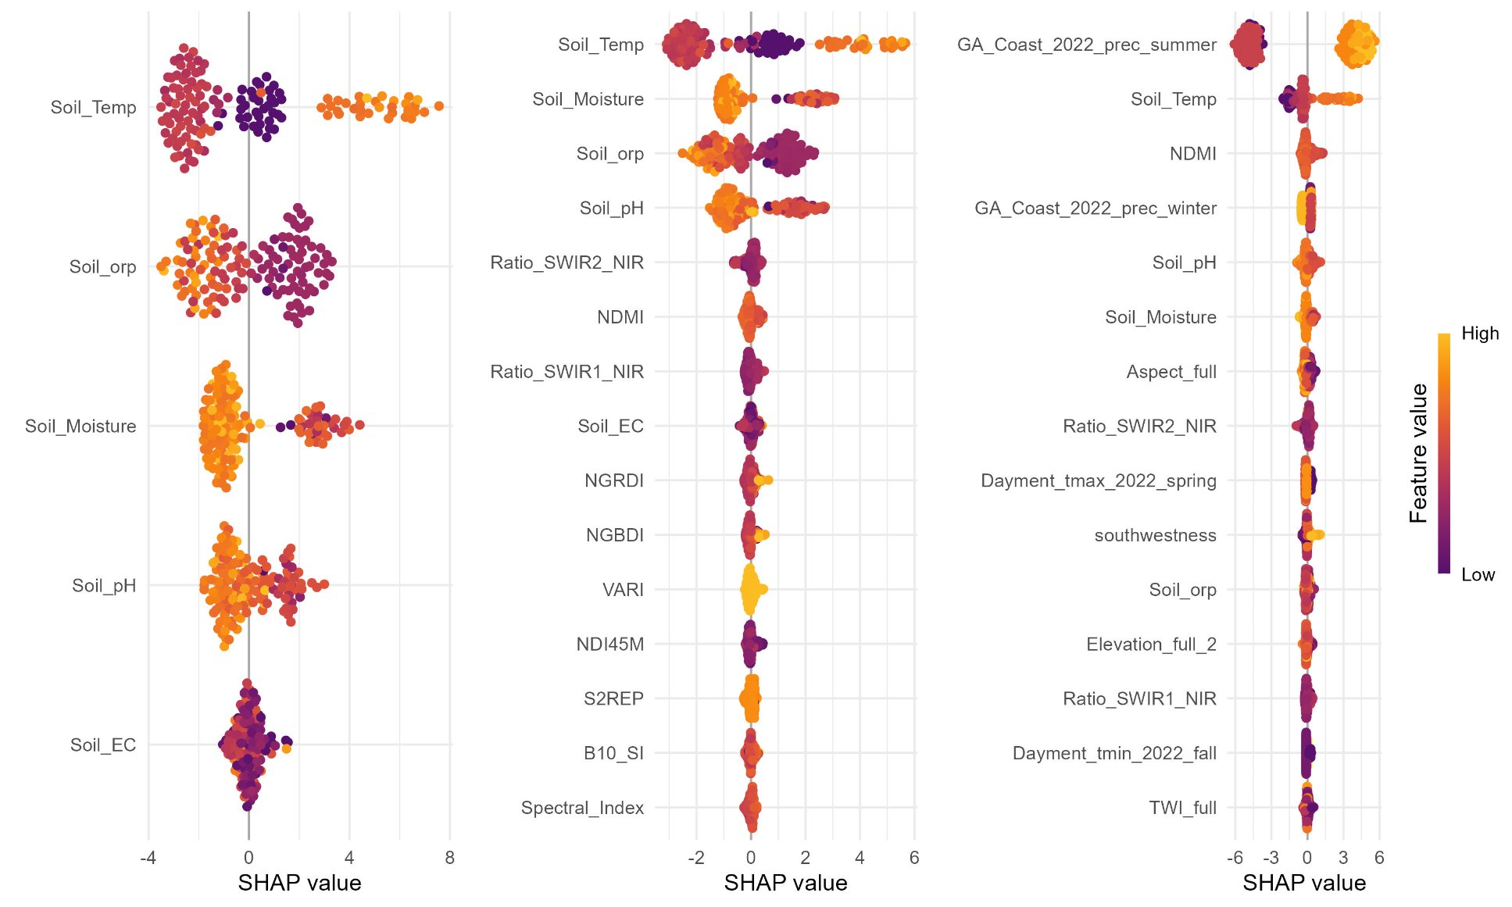
Results and Discussions

Slide 11
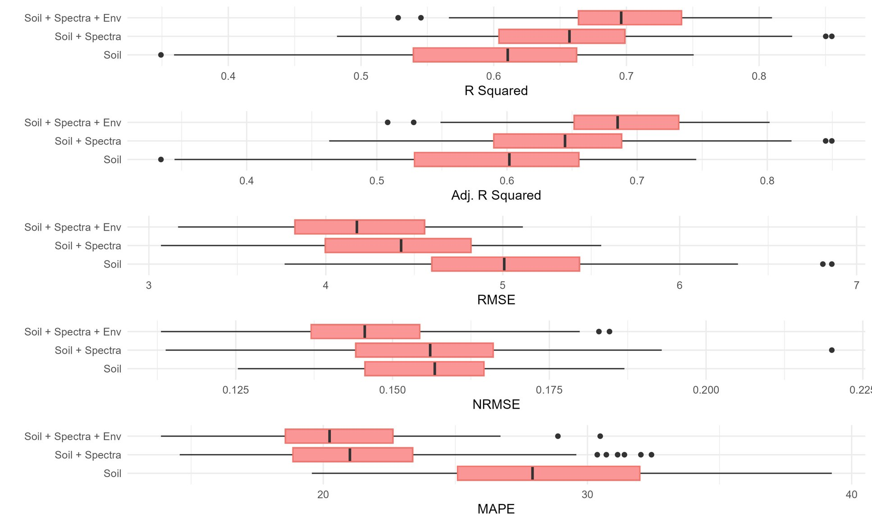
Results and Discussions

Slide 12
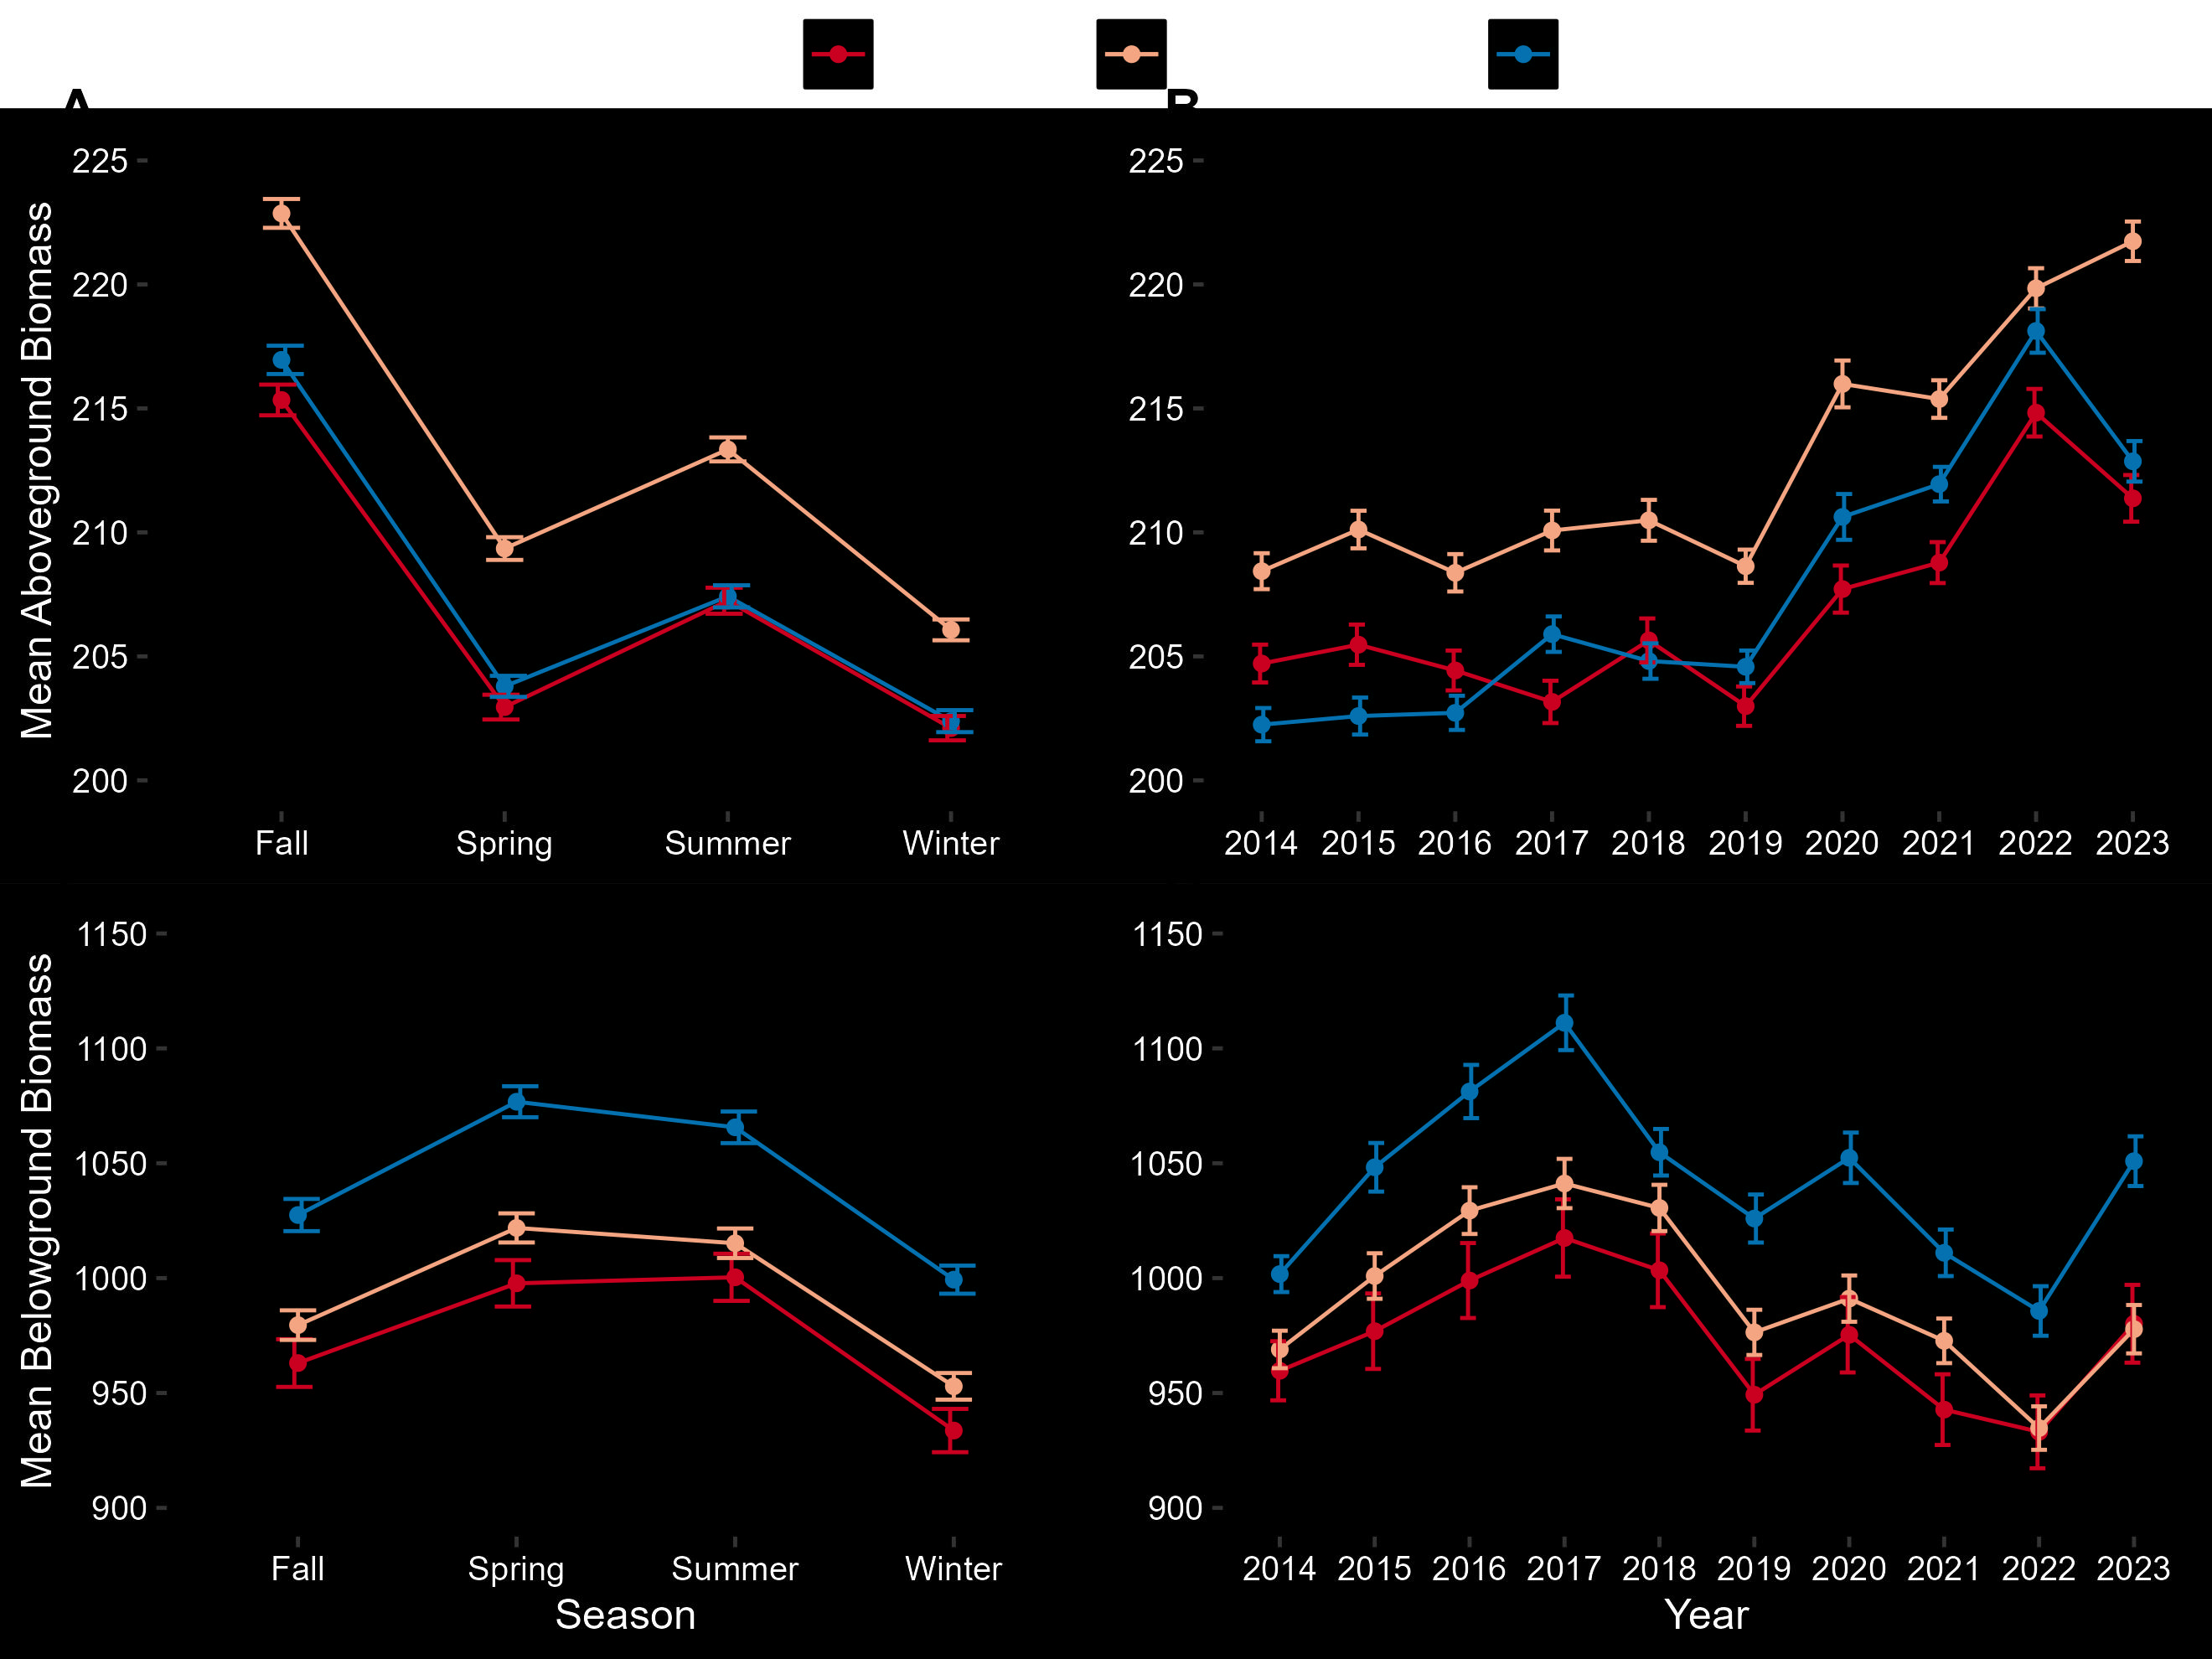
Results and Discussions
Belowground Ecosystem Resiliency Model
(O’Connell et al., 2021; Runion et al., 2024)​
Low SOC (<33%)
Mid SOC (33-66%)
High SOC (>66%)

Slide 13
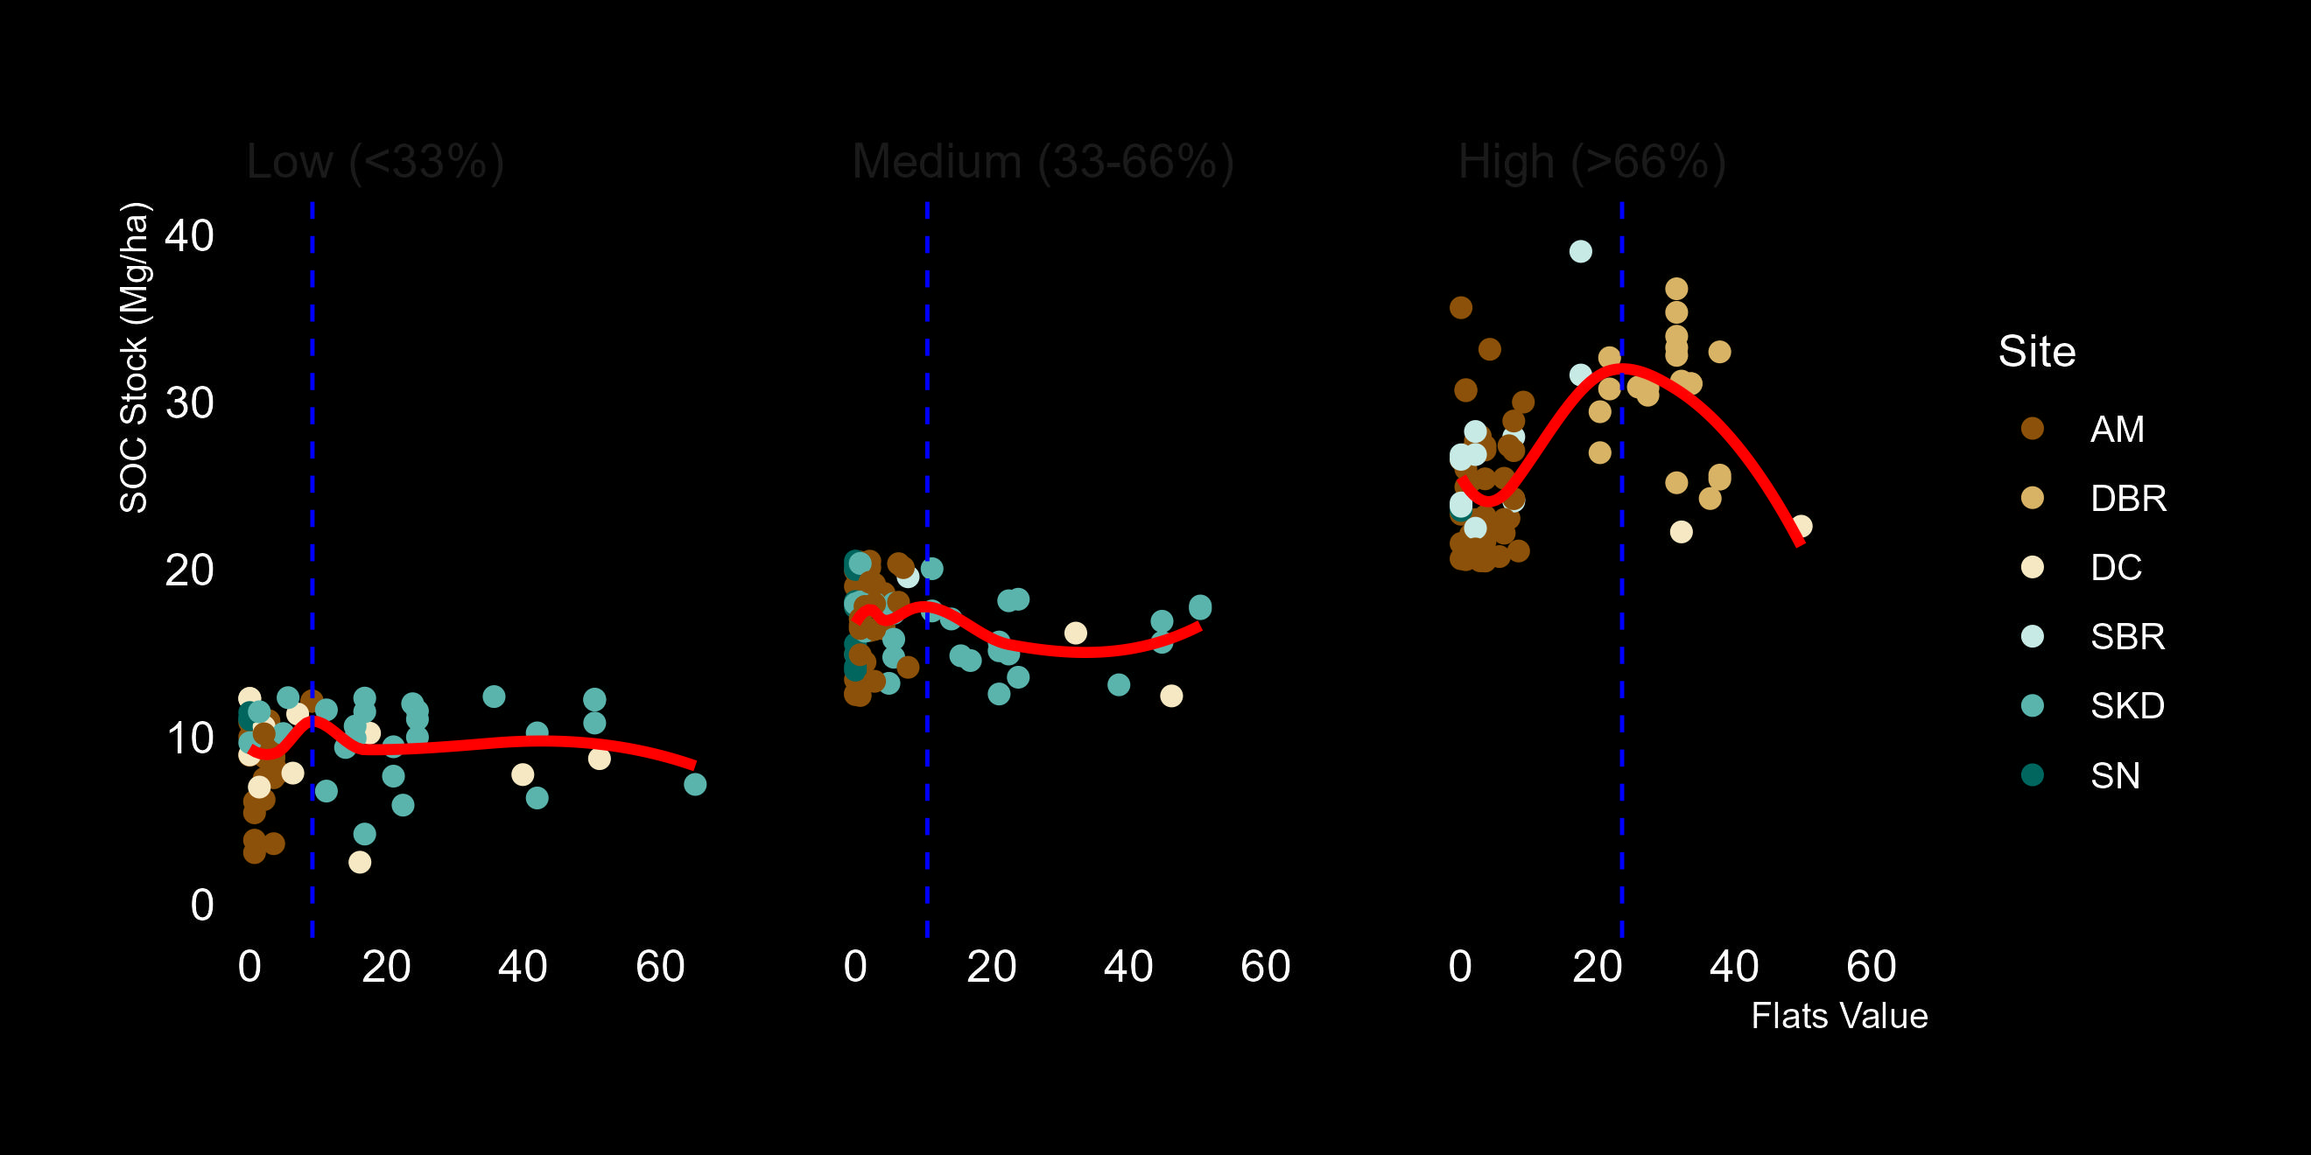
Results and Discussions
Flooding in Landsat Across Tidal Systems (FLATS) model
​(Julien et al., 2025; Narron et al., 2022)​
Low SOC (<33%)
Mid SOC (33-66%)
High SOC (>66%)
23.5
9.15
10.5

Slide 14
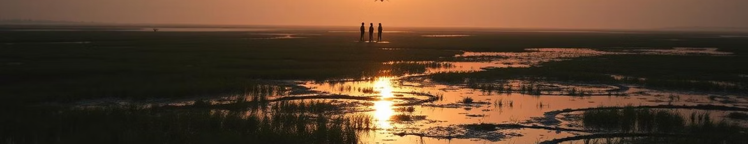
Major Takeaways
Low-Cost Soil Sensors can be used for SOC Monitoring
Spectral and Env Data improves accuracy
SOC indicates Marsh Health
and Resilience
Soil Sensors such as pH, Temp, Moisture, ORP, and Redox can explain SOC Stocks
Soil + Spectra + Env model with around 70% accuracy and 15% error
Trends between SOC, belowground biomass, and flooding frequency

Slide 15

Thanks, and Questions
Rajneesh Sharma
X: @rajneesh1597
rajneesh.sharma@uga.edu
LinkedIn
References:
​Yu, J., Wang, Y., Li, Y., Dong, H., Zhou, D., Han, G., Wu, H., Wang, G., Mao, P., Gao, Y., 2012. Soil organic carbon storage changes in coastal wetlands of the modern Yellow River Delta from 2000 to 2009. Biogeosciences Discussions 9, 1759–1779. https://doi.org/10.5194/bgd-9-1759-2012
​Mao, L., Mishra, D.R., Hawman, P.A., Narron, C.R., O’Connell, J.L., Cotten, D.L., 2023. Photosynthetic Performance of Tidally Flooded Spartina Alterniflora Salt Marshes. J Geophys Res Biogeosci 128. https://doi.org/10.1029/2022JG007161
​McLeod, E., Chmura, G.L., Bouillon, S., Salm, R., Björk, M., Duarte, C.M., Lovelock, C.E., Schlesinger, W.H., Silliman, B.R., 2011. A blueprint for blue carbon: Toward an improved understanding of the role of vegetated coastal habitats in sequestering CO2. Front Ecol Environ 9, 552–560. https://doi.org/10.1890/110004
Shrestha, G.; Cavallaro, N.; Lorenzoni, L.; Seadler, A.; Zhu, Z.; Gurwick, N.P.; Larson, E.; Birdsey, R.; Mayes, M.A.; Najjar, R.G.; et al. Highlights. In Second State of the Carbon Cycle Report (SOCCR2): A Sustained Assessment Report; Cavallaro, N., Shrestha, G., Birdsey, R., Mayes, M.A., Najjar, R.G., Reed, S.C., Romero-Lankao, P., Zhu, Z., Eds.; U.S. Global Change Research Program: Washington, DC, USA, 2018; pp. 1–4
Kolka, R.; Trettin, C.; Tang, W.; Krauss, K.; Bansal, S.; Drexler, J.; Wickland, K.; Chimner, R.; Hogan, D.; Pindilli, E.J.; et al. Chapter 13: Terrestrial wetlands. In Second State of the Carbon Cycle Report (SOCCR2): A Sustained Assessment Report; Cavallaro, N., Shrestha, G., Birdsey, R., Mayes, M.A., Najjar, R.G., Reed, S.C., Romero-Lankao, P., Zhu, Z., Eds.; U.S. Global Change Research Program: Washington, DC, USA, 2018; pp. 507–567
Lucas Carvalho Gomes, Raiza Moniz Faria, Eliana de Souza, Gustavo Vieira Veloso, Carlos Ernesto G.R. Schaefer, Elpídio Inácio Fernandes Filho, Modelling and mapping soil organic carbon stocks in Brazil, Geoderma, Volume 340, 2019, Pages 337-350, ISSN 0016-7061, https://doi.org/10.1016/j.geoderma.2019.01.007
Runion, K.D., Mishra, D.R., Alber, M., Lever, M.A., O’Connell, J.L., 2024. Capturing spatiotemporal variation in salt marsh belowground biomass, a key resilience metric, through geoinformatics. Ecosphere 15. https://doi.org/10.1002/ECS2.70110
​Julien, A.R., Narron, C.R., Mishra, D.R., 2025. Expanding the flooding in Landsat across tidal systems model to Landsat 5–9 imagery for long-term marsh inundation analysis. Science of The Total Environment 965, 178602. https://doi.org/10.1016/J.SCITOTENV.2025.178602

