Slide 1
SAR Approaches for Flood Extent and Depth Mapping
Amanda O’Connor

Slide 2
Outline
Intros
SAR Overview
Case Study
Alternative Products
Recommendations
Discussion

Slide 3
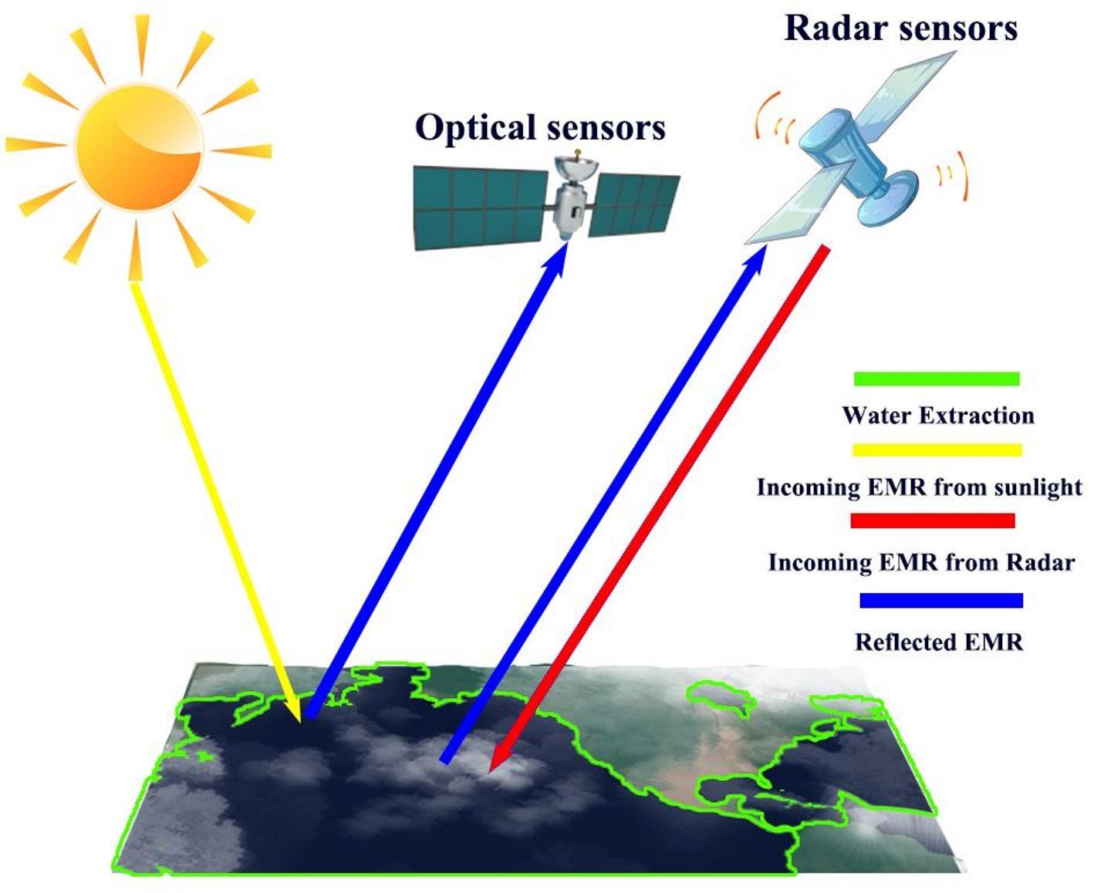
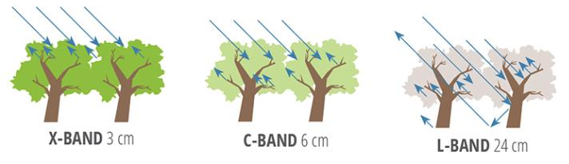
SAR in 60 Seconds

Slide 4
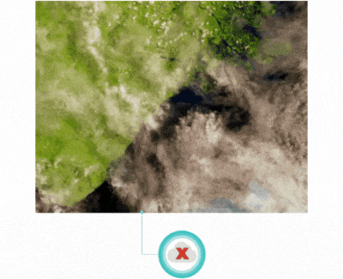
Big Advantage to SAR----Sees through clouds

Slide 5
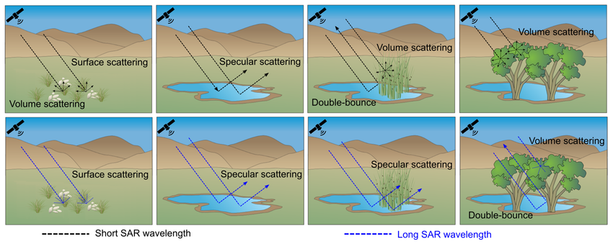
Why is SAR so good for water?
Backscatter Characteristics: Water surfaces generally have a very low backscatter return compared to land surfaces
This distinct difference allows SAR to easily differentiate between water and non-water areas.
Wohlfart, Christian & Winkler, Karina & Wendleder, Anna & Roth, Achim. (2018). TerraSAR-X and wetlands: A review. Remote Sensing. 10. 10.3390/rs10060916.

Slide 6
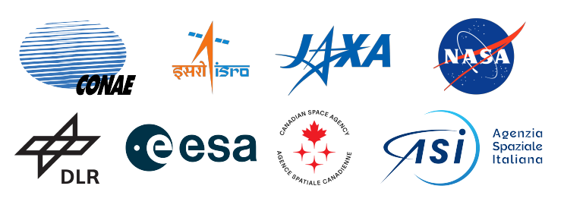



SAR Sensors

Slide 7
SAR Bands
Band | Wavelength | Frequency | Penetration Depth | Benefits for Flood Analysis
X-band | 2.4 - 3.8 cm | 8 - 12 GHz | Shallow | High resolution, effective for detailed urban flood mapping
C-band | 3.8 - 7.5 cm | 4 - 8 GHz | Moderate | Good balance between resolution and penetration, effective for detecting water surfaces and changes in water extent
S-band | 7.5 - 15 cm | 2 - 4 GHz | Moderate | Penetration through vegetation, sensitive to surface wetness
L-band | 15 - 30 cm | 1 - 2 GHz | Deep | Deep penetration through vegetation and soil, effective for detecting flooded areas under dense forest canopies

Slide 8
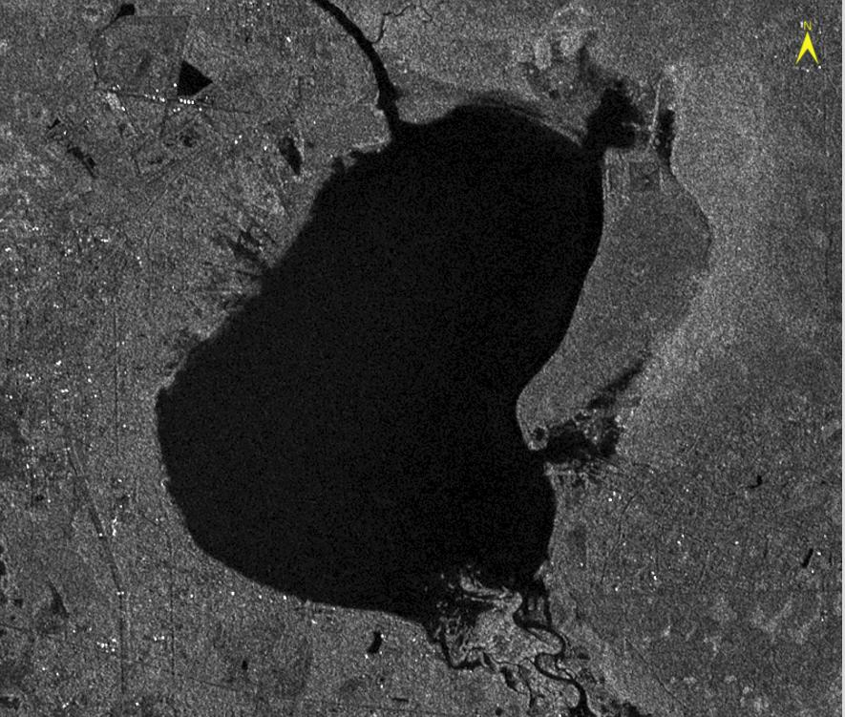
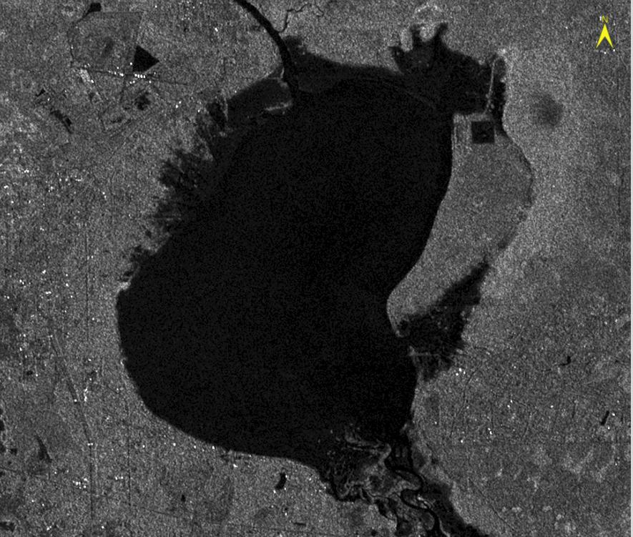
SAR Case Study Hurricane Milton
Sentinel-1 data: Before and After Hurricane Milton, Lake Harney, FL
C-Band, 5m obtained freely from Alaska Satellite Facility
2024/10/03
2024/10/15

Slide 9
Getting the Sentinel-1 Data Ready to Compare
SAR Processing – Get the data into a state where it can be used for analysis. The ENVI SARScape tools to do this, in order, are:
Import Sentinel-1 – Imports the data from the file into the SARScape data format
Multilooking – Reduces speckling and adjusts the pixel sizes to be roughly square
Coregistration – Spatially registers the two images with one another
De Grandi Spatio-Temporal Filter – Performs multi-temporal speckle filtering on the two images enabling change to be detection
Geocoding and Radiometric Calibration –Geometrically and radiometrically calibrates the backscatter values of the two images
Notes:
Radiometric calibration in Synthetic Aperture Radar (SAR) is a process that converts the raw backscatter intensity received by the sensor into a standardized measure known as the normalized radar cross section (Sigma0)
1
2
. This calibration accounts for factors such as the incidence angle of the radar signal and specific characteristics of the sensor 1
.The main goal is to ensure that SAR images from different dates, sensors, or imaging geometries are comparable
1
. This is crucial for applications like environmental monitoring, where consistent and accurate data over time is necessary 2
.

Slide 10
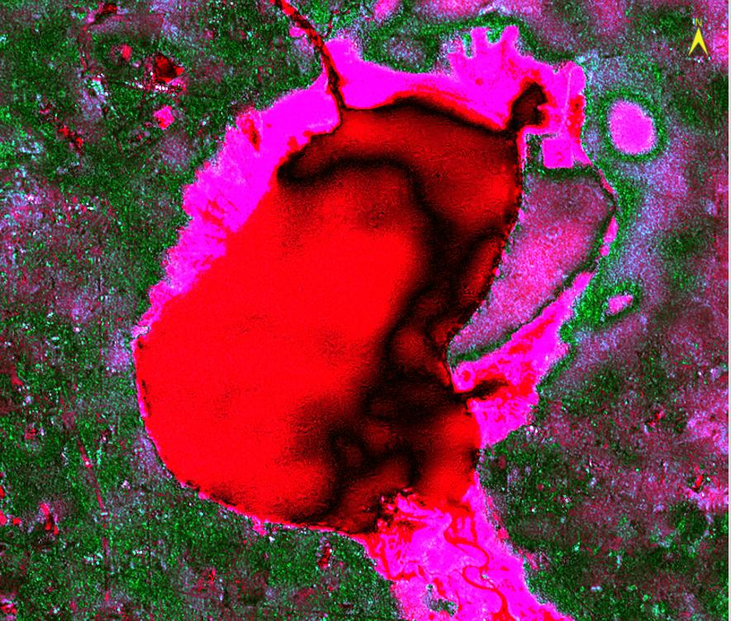
SAR Products Showing Extent and Flood Depth
SAR multi-temporal processing
Magenta is flooded area, red is original lake area
Note Magenta area beyond lake
Useful visualization

Slide 11
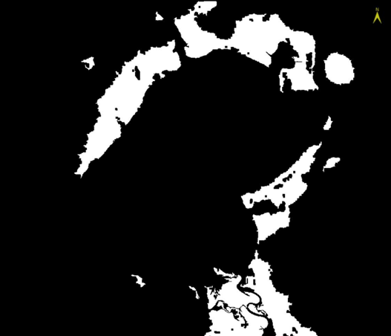
Flood Mask
Comparison of two images
Show Flood extent
But not areas that were already water
Use to create flood vector

Slide 12
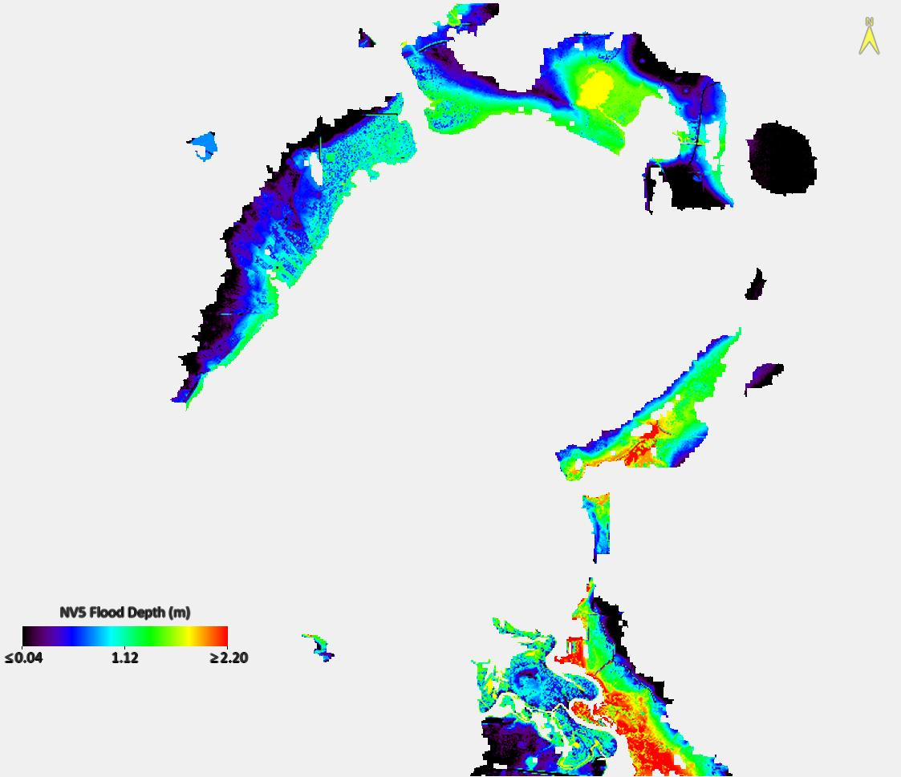
Flood Extent and Depth Product
Flood Depth, subtract all flood extent pixels from 3DEP DEM
Grid the 3DEP 0.87 M data to Sentinel-1
Processing time 18 minutes,
Includes data discovery, preprocessing, grid clipping of DEM product creation, documentation
Develop software once, use over and over
Works in Fluvial, Pluvial, and coastal and under dense vegetation and under clouds
SAR height of 2.9m at the stream gage, approximate, depends on exact time

Slide 13
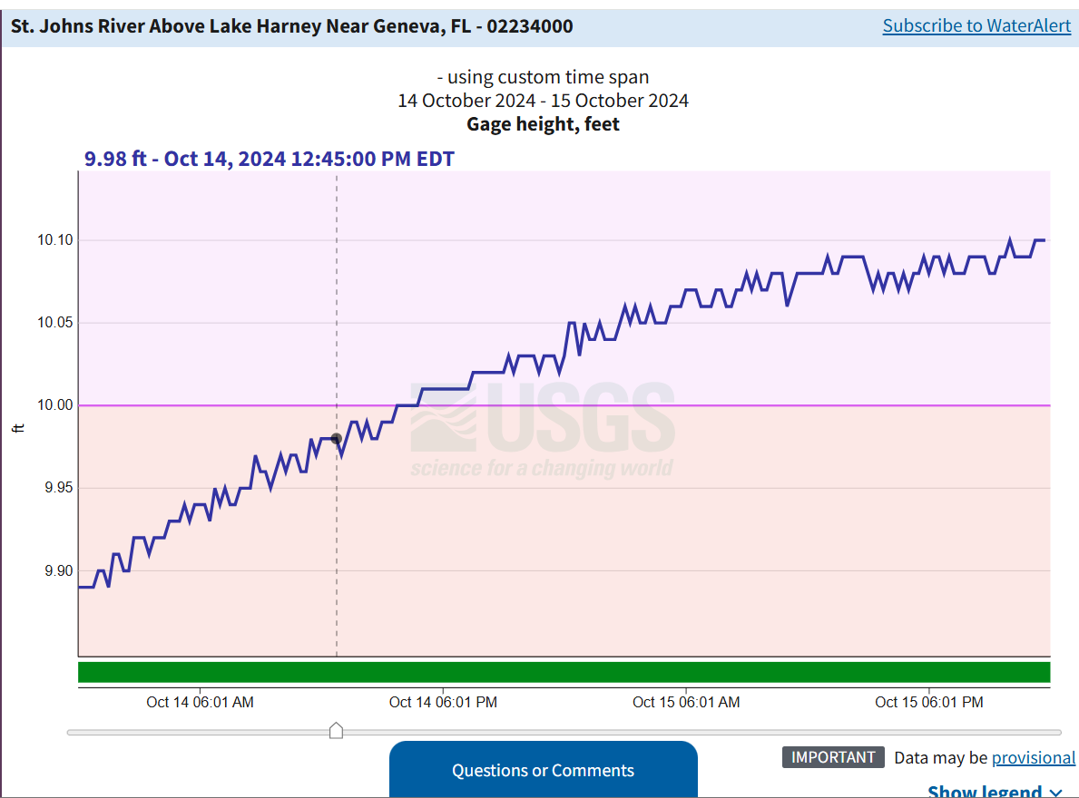
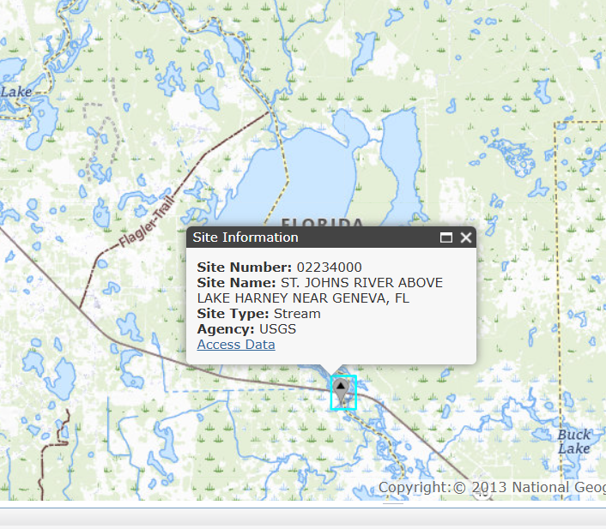
Comparison to real world

Slide 14
Conclusions
SAR Data effective for flood mapping
Combining with high resolution DEMs produces height above ground
All steps can be automated
Questions?
Amanda.Oconnor@nv5.com

