Slide 1

Automated Satellite-Derived Coastal Bathymetry
Dr. Matt McCarthy, Oak Ridge National Laboratory (mccarthymj@ornl.gov)
Dr. Dariusz Stramski, Scripps Institution of Oceanography (UCSD)
Dr. David Hughes, ORNL
Dr. Rick A. Reynolds, Scripps
Dr. Ishan D. Joshi, Scripps
Heidi Tubbs, ORNL
ASPRS Mid-South Regional Conference 2025
Project funded by NGA Research
GPOC: Monique Walker

Slide 2
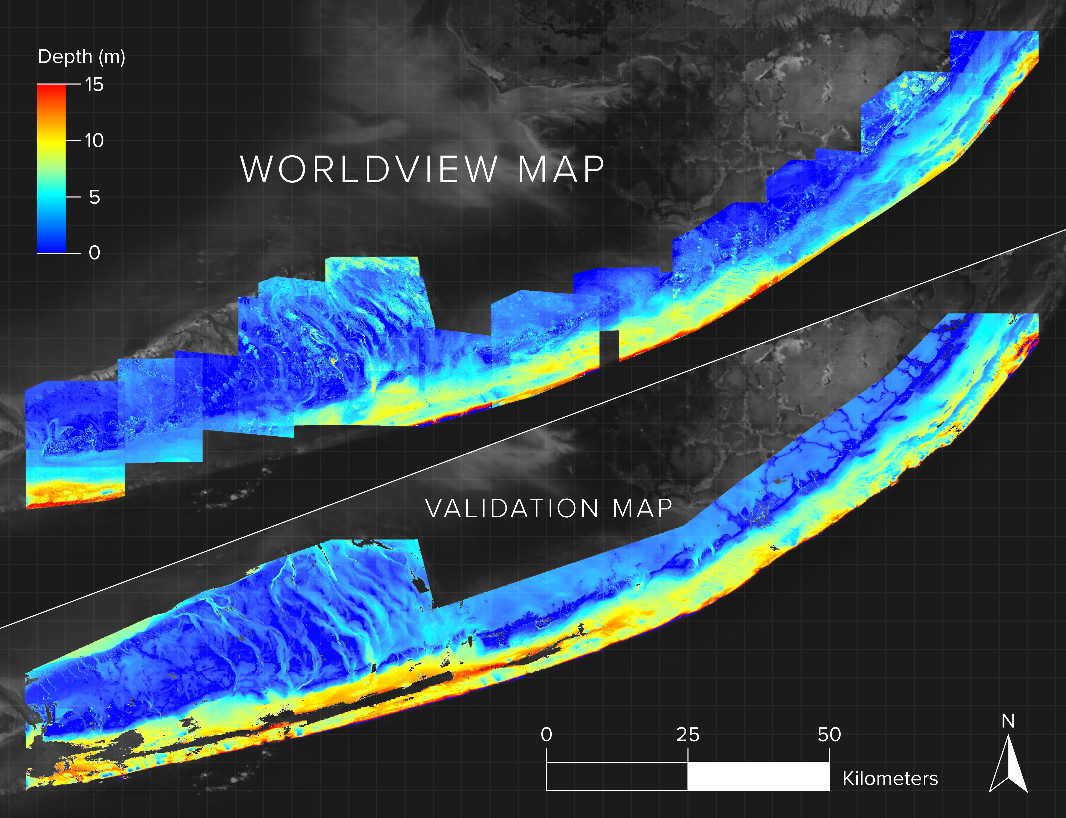
Purpose
Overall Project Goal
Develop physics-based algorithm for mapping coastal bottom depth (0-15m)
Satellite Data
- WorldView-2 and WorldView-3
- 2-meter spatial resolution
- 8 spectral bands (Visible + Near-Infrared)
RMSE = 1.95 +/- 0.06 m
McCarthy et al. 2022

Slide 3
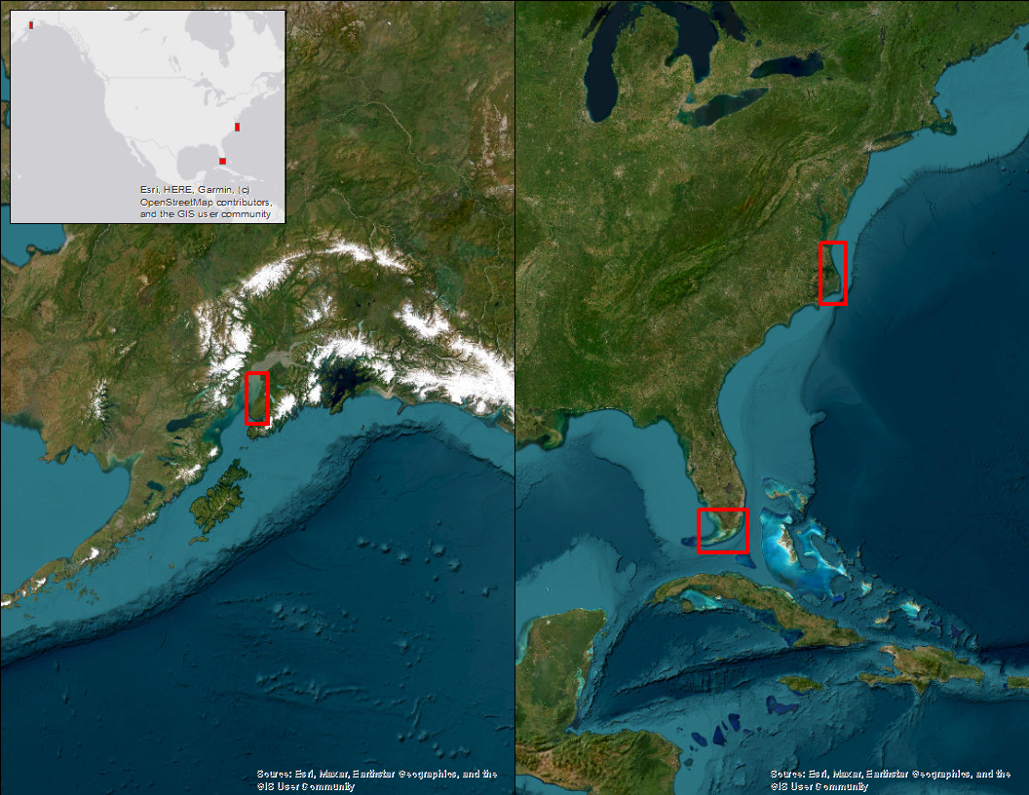
Study Areas
Outer Banks, North Carolina
Cook Inlet, Alaska
Florida Keys

Slide 4
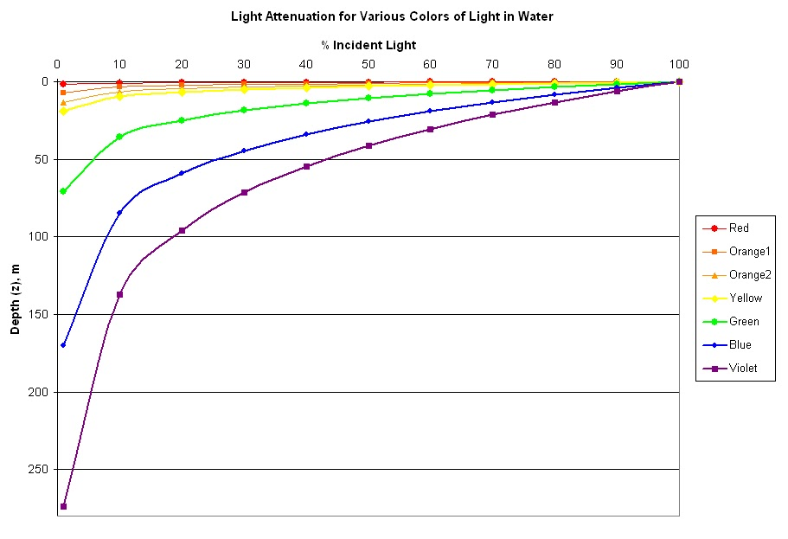
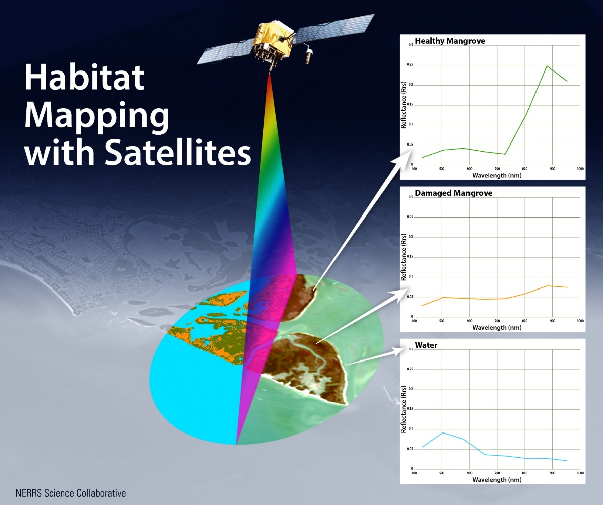
Approach
Notes:
Our approach to create wall-to-wall bathymetry maps is to derive bathymetry based on the attenuation of visible light with depth as observed by satellite sensors. Because water absorbs light at an exponential rate that is predictable with depth and wavelength, we can use the relative difference in observed reflectance in the blue and green wavelengths to estimate depth using a band-ratio approach. The figure on the left reveals the spectral patterns of common surfaces, including water at the bottom. The figure on the right indicates how deep light will penetrate a clear water body based on wavelength. As water depth increases, green light is attenuated more than blue light, such that the relative difference between blue and green bands can be used to estimate depth.

Slide 5
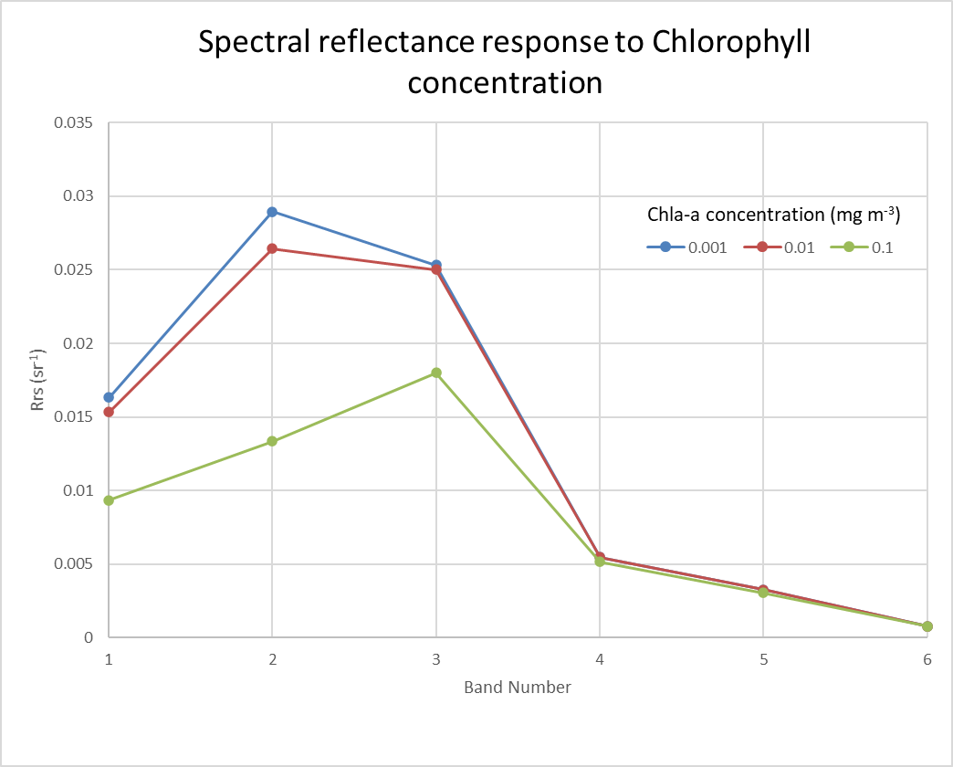
Approach
Notes:
We also account for the fact that water bodies are generally somewhat turbid, with varying concentrations of light-attenuating particles like chlorophyll that modulate light attenuation depending on the concentration. The graph here shows the spectral profiles of water with different chlorophyll concentrations. The discrepancies in blue and green reflectance, highlighted here, indicate the importance of accurately estimating chlorophyll concentration so that it may be corrected for in order to derive an accurate estimate for depth.

Slide 6
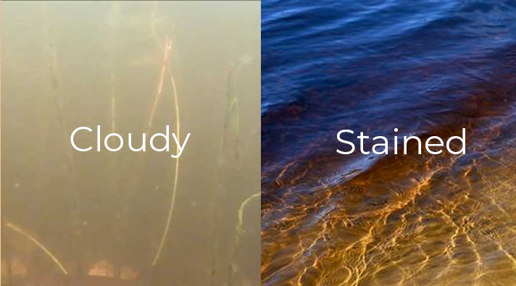
Workflow
Input
R_{rs}(λ)
Model
Data Product
SPM = Suspended Particulate Matter
CDOM = Colored Dissolved Organic Matter
SPM algorithm
Step l
Step 3
CDOM algorithm
SPM
Particulate IOP algorithm
Step 2
SPM
CDOM
a_{g}(λ)
a_{p}(λ)
b_{bp}(λ)
a_{w}(λ)
b_{bw}(λ)
a(λ)
b_{b}(λ)
LUT
Look-up-Tables by benthic type:
Bright
Dark
Mixed
Bathymetry algorithm
Step 4
_{Depth}
Schematic flowchart depicting basic steps in the operation of the water column component of the physics- based bathymetry model.

Slide 7
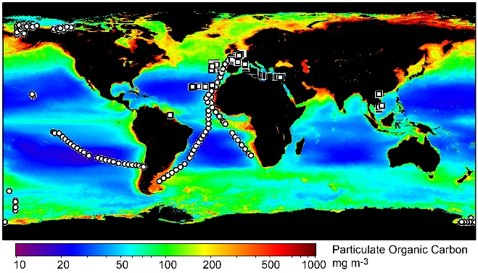
Algorithm Development
Field datasets
Concurrent measurements of R_{rs} with SPM, CDOM (Steps 1,3)
Concurrent measurements of SPM with IOPs (Step 2)
SIO field dataset
~350 stations collected over nearly 3 decades
Globally-distributed
Broad range of optical properties and environments
Inverse Reflectance Model for Bathymetry
Input
R_{rs}(λ)
Model
Data Product
SPM algorithm
Step l
Step 3
CDOM algorithm
SPM
Particulate IOP algorithm
Step 2
a_{g}(λ)
a_{p}(λ)
b_{bp}(λ)
a_{w}(λ)
b_{bw}(λ)
a(λ)
b_{b}(λ)
LUT
Bathymetry algorithm
Step 4
H
Schematic flowchart depicting basic steps in the operation of the water column component of the physics- based bathymetry model.

Slide 8
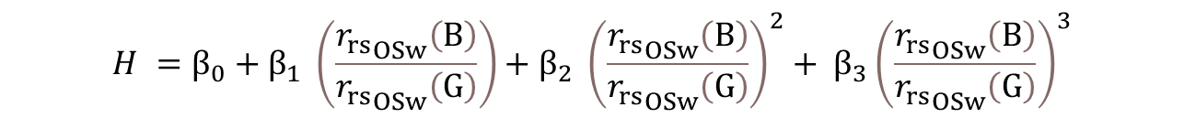
Algorithm Development
Input
R_{rs}(λ)
Model
Data Product
Synthetic datasets
IOP scenarios for simulation modeling of ocean reflectance
NASA PACE synthetic dataset
Collaboration with H. Loisel’s team in France
~3000 unique combinations of seawater IOPs
300-800 nm at 1-nm resolution
Closely match observed oceanic distributions
Used to forward-model reflectances of shallow water given 3,320 combinations of IOPs
LUTs provide coefficients used in bathymetry equation based on matching pixel-by-pixel IOP conditions to optimal model
SPM algorithm
Step l
Step 3
CDOM algorithm
SPM
Particulate IOP algorithm
Step 2
a_{g}(λ)
a_{p}(λ)
b_{bp}(λ)
a_{w}(λ)
b_{bw}(λ)
a(λ)
b_{b}(λ)
LUT
Bathymetry algorithm
Step 4
H
Schematic flowchart depicting basic steps in the operation of the water column component of the physics- based bathymetry model.
$$H ={β_{0}+β}_{1} \left(\frac{{r_{rs}}_{OSw}\left(B\right)}{{r_{rs}}_{OSw}\left(G\right)}\right)+β_{2} {\left(\frac{{r_{rs}}_{OSw}\left(B\right)}{{r_{rs}}_{OSw}\left(G\right)}\right)}^{2}+ β_{3}{\left(\frac{{r_{rs}}_{OSw}\left(B\right)}{{r_{rs}}_{OSw}\left(G\right)}\right)}^{3}$$

Slide 9
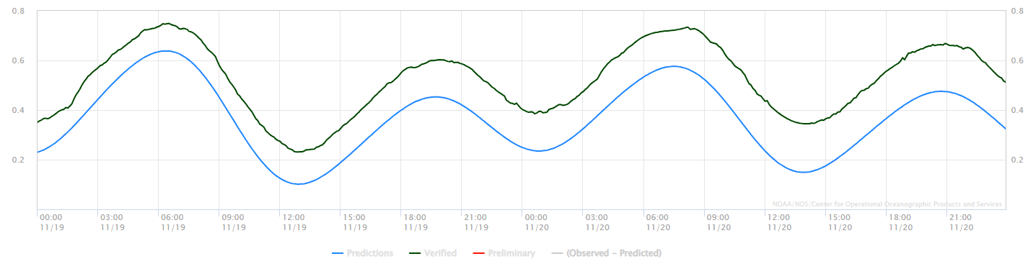
Algorithm Development
Final result selected as shallower of two values:
SPM/CDOM model
Chl model
Tide Correction
Tidal amplitude variability:
- Florida: ~0.39m
- North Carolina: ~0.27m
- Alaska: ~4.8m
Approach:
User defines tide gauge station prior to batch run
Automated search of NOAA API
Verified 6-minute interval water-level observation
Subtract value from all image pixels

Slide 10
Results
Images run: 595 total WorldView-2 & WorldView-3
Florida: 171
North Carolina: 233
Alaska: 191
Processing time: 7 minutes per image
Run on 4-core CPU with 30GB RAM
= ~2000 km2/hour mapping rate
vs 50 km2/hour NOAA LiDAR mapping rate
Bathymetry Validation
Digital topobathymetric maps from NOAA
1-meter spatial resolution
Points randomly extracted, separated by 10-meters
Corrected for tide

Slide 11
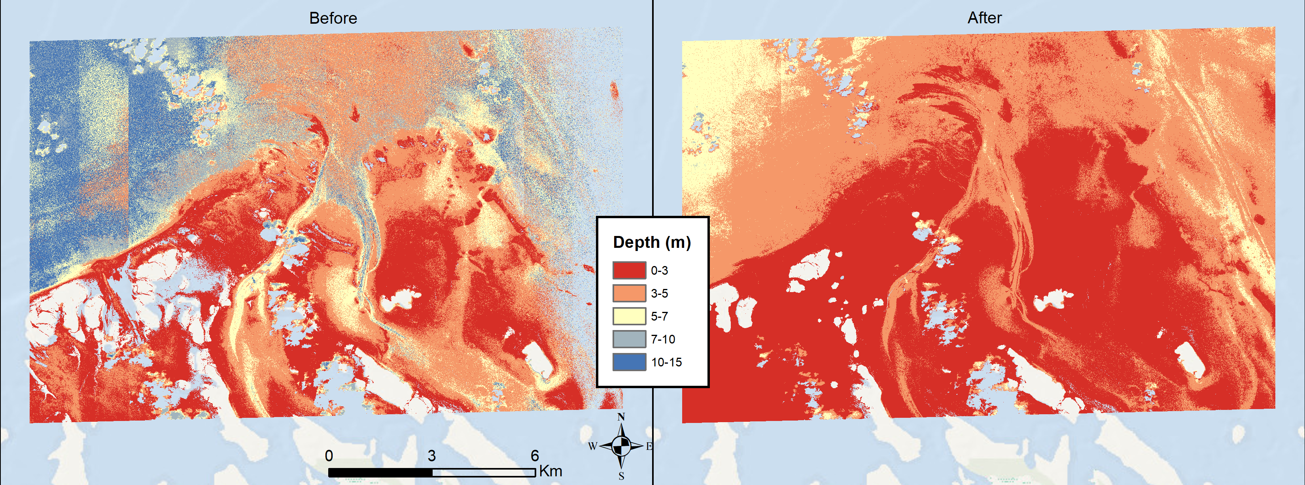
Results
RMSE (m) | Florida (n=38) | North Carolina (n=36) | Alaska (n=3)
Median | 1.58 | 1.12 | 2.08
Mean | 2.15 | 1.37 | 3.06
Min | 0.60 | 0.24 | 2.09
Max | 2.84 | 5.34 | 4.91
Tide Correction Example

Slide 12
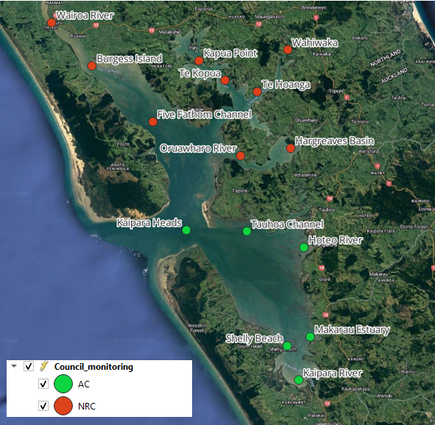
Ongoing Developments: New Zealand

Slide 13
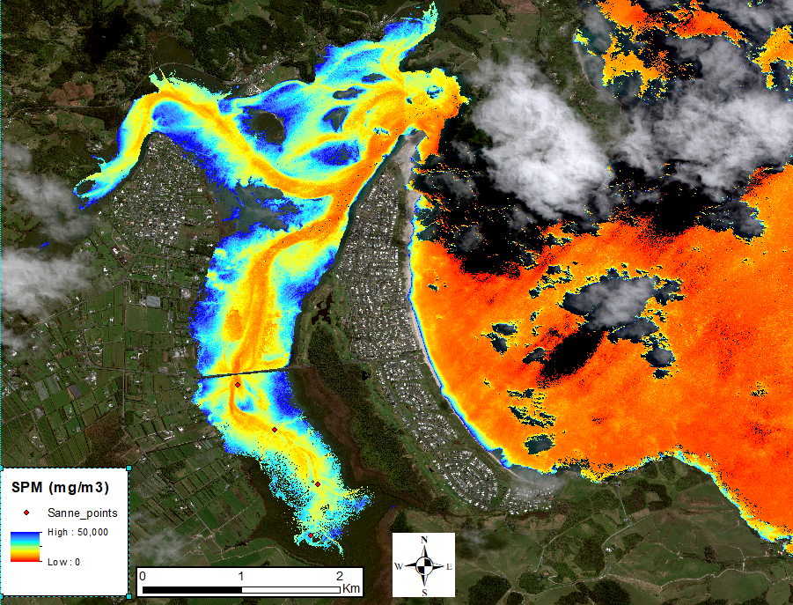
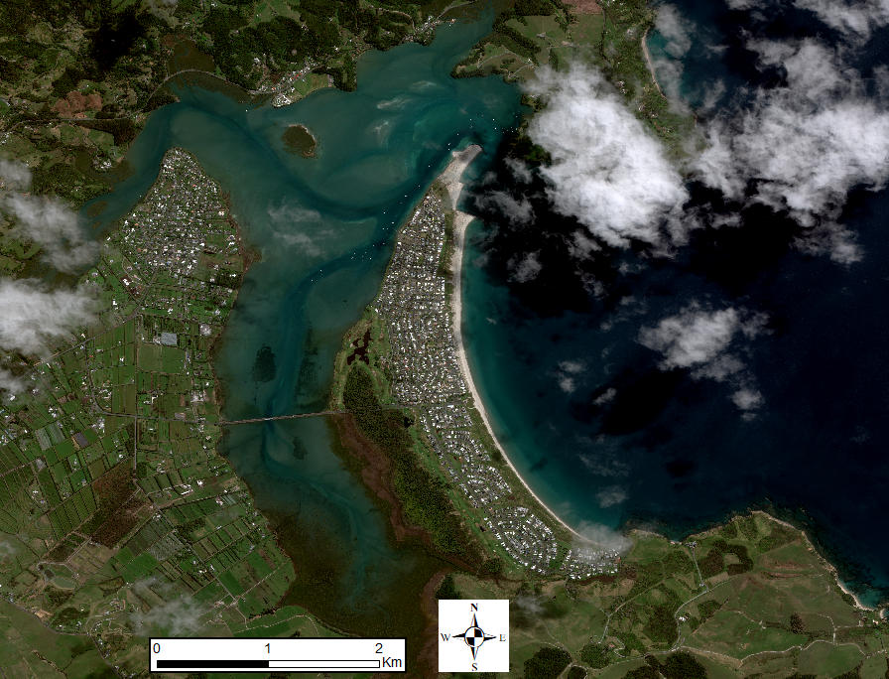
Ongoing Developments: New Zealand

Slide 14
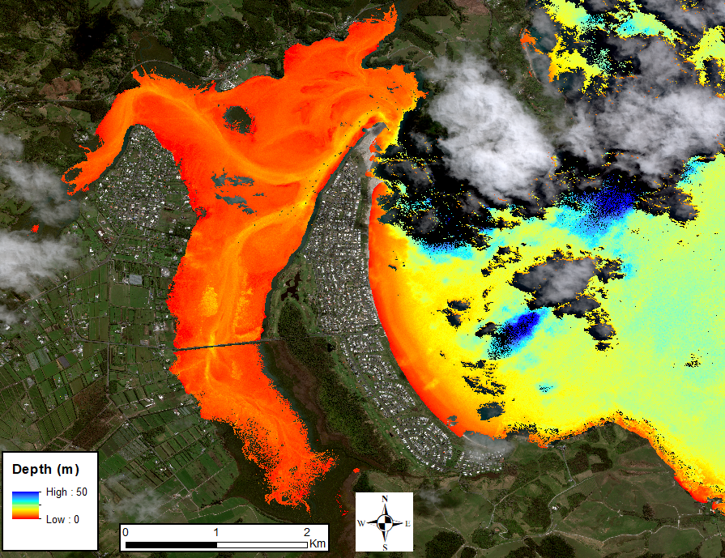
Ongoing Developments: New Zealand

Slide 15
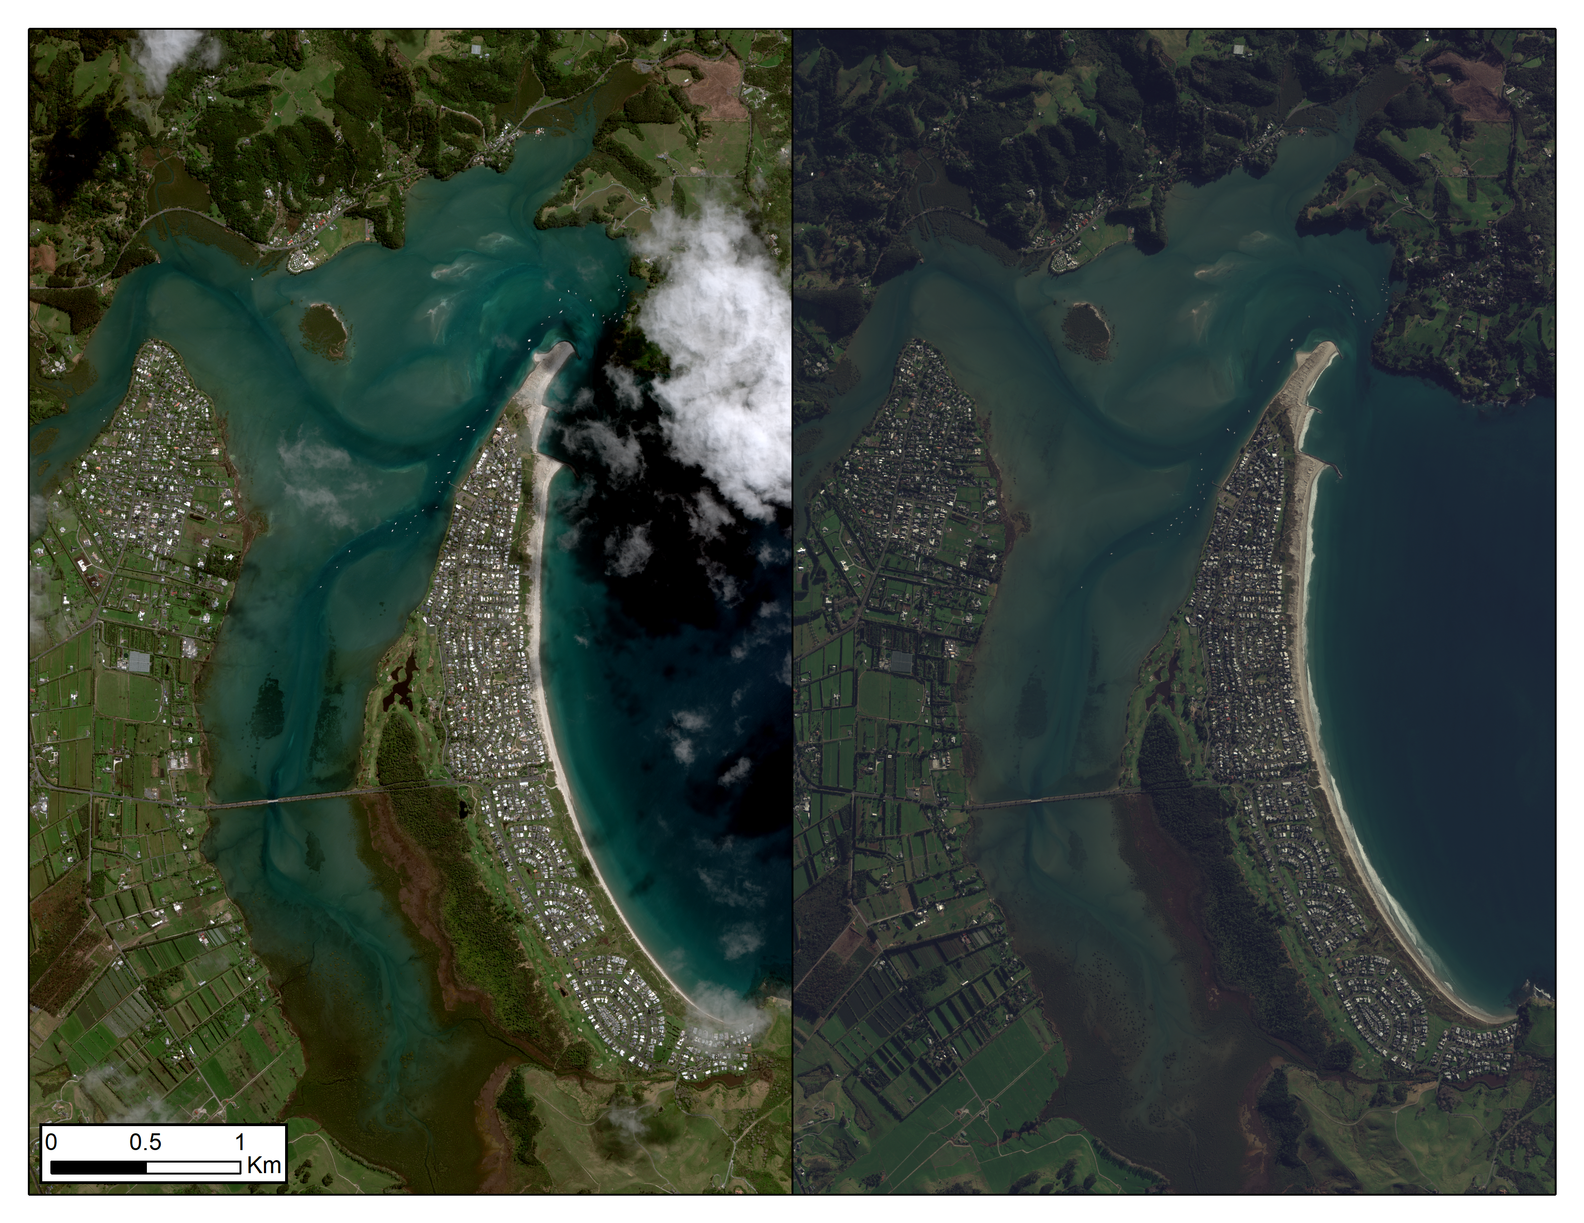
Orthorectified Time Series
2023
2024

Slide 16
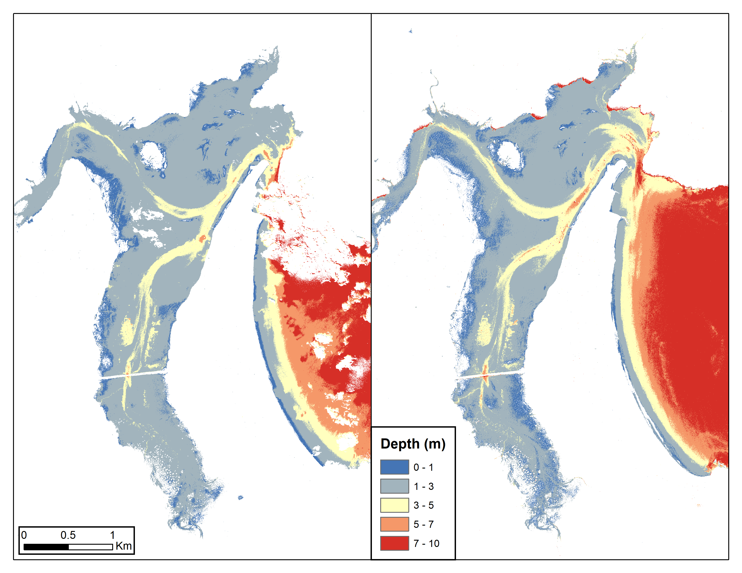
Orthorectified Time Series
2023
2024
Notes:
Ortho: 1.25m 2023, 1.29m 2024
No ortho: 1.34m 2023, 1.53m 2024

Slide 17
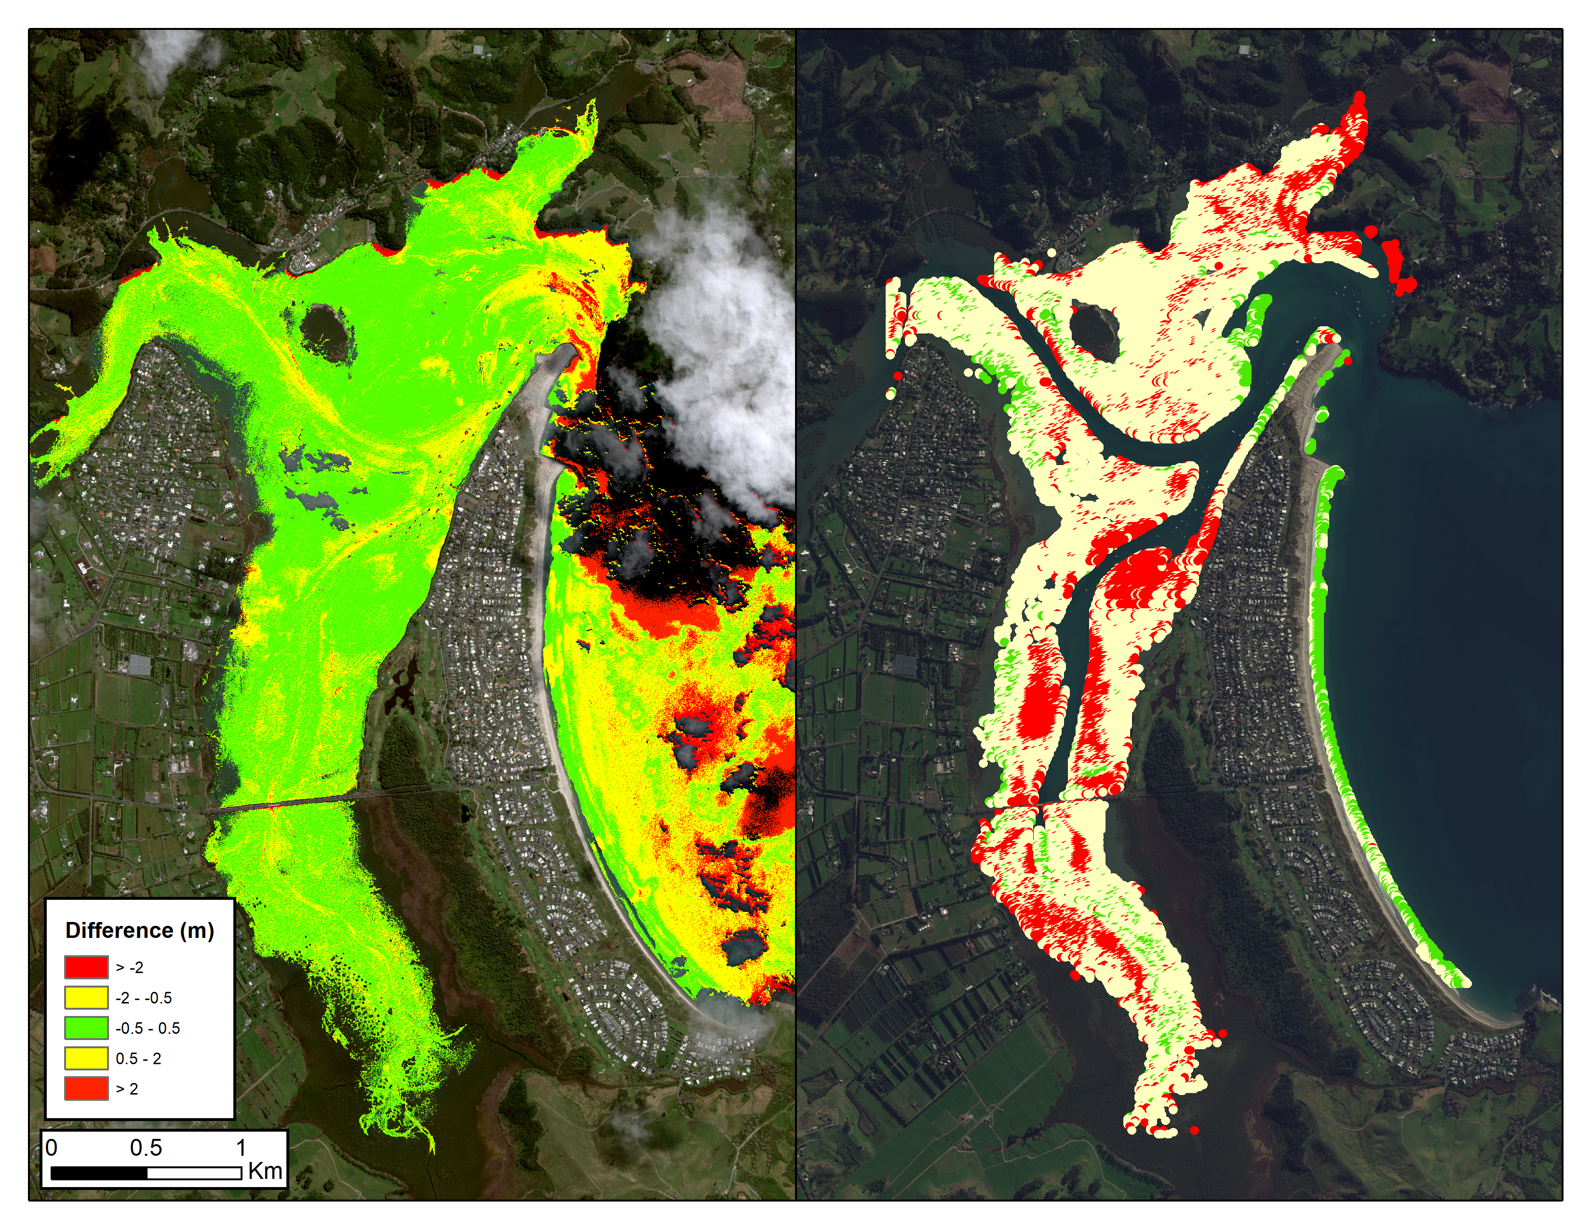
Orthorectified Time Series
Notes:
Map showing how similar the two maps are. Green is within +/- 0.5m.

Slide 18
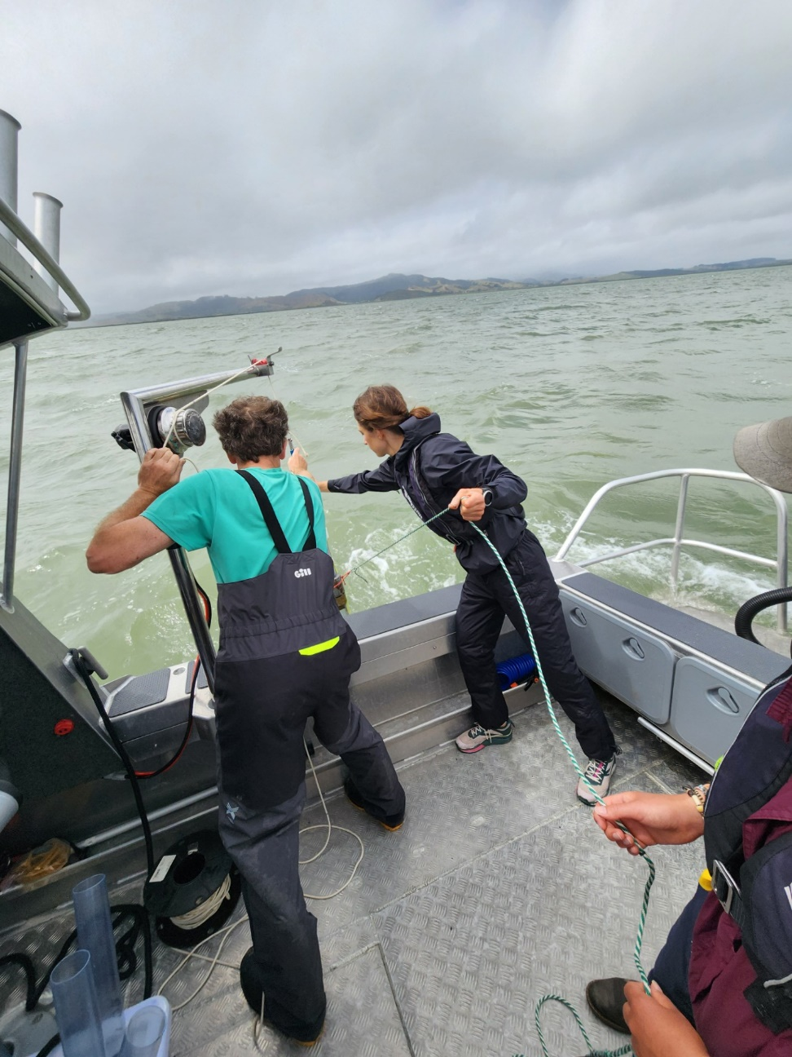
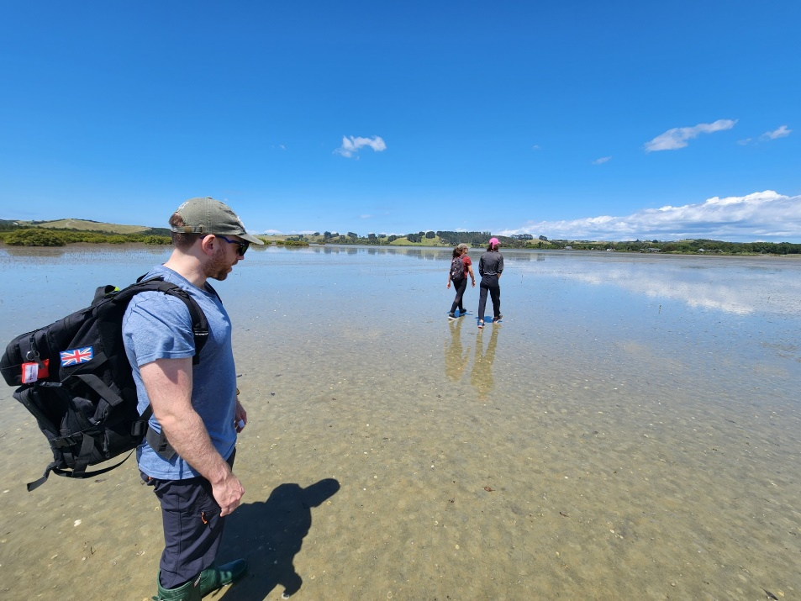
Future Research Opportunities
Expand LUTs for:
Increased solar zenith angle resolution
Automated benthic-type LUT selection
New Zealand
Field deployments for SPM validation/improvement

Slide 19
Questions?
mccarthymj@ornl.gov

