Slide 1
American Physical Society
Shock Compression of Condensed Matter Topical Group (GSCCM)
2022 Annual Business Meeting
Wednesday, 13 July 2022

Slide 2
Agenda
Welcome (Borg)
Election Report (Lane)
Financial Report (Lane)
Summary of SCCM-2022 conference (Jordan/Gleason)
Early Career and Student Symposium Summary (Stekovic/Pacheco)
Invitation to SCCM-2023 in Chicago (Peiris)
Ashcroft Award Review (Lane)
Program Committee Proposal (Jordan)
Topical Group Expansion Focus Groups and Discussion (Task Force) 45-60 minutes

Slide 3
2021 Election Report
145 ballots cast of 489 eligible (29.7% of membership voted)
Election open Oct 25th through Nov 17th, 2021
Vice-Chair, (1 position)
  Minta Akin
  Jerry Lee
Executive Committee, Member-at-large
  Rebecca Lindsey (2 positions)
  Mitch Wood
  Chris Braithwaite
  Matthew Beason
Secretary/Treasurer (1 positions)
  J Matthew Lane
  Sally Tracy
  Romain Perriot

Slide 4
Current GSCCM Executive Committee
Members-at-Large:
Brittany Branch ( 01/21 - 12/22)
Sandia National Laboratories
Nenad Velisavljevic ( 01/21 - 12/22)
Lawrence Livermore National Laboratory
Rebecca Lindsey ( 01/22 - 12/23)
Lawrence Livermore National Laboratory
Mitch Wood ( 01/22 - 12/23)
Sandia National Laboratories
Early Career/Student Member-at-Large:
Belinda Pacheco Johnson ( 01/21 - 12/22)
Los Alamos National Laboratory
Chair: John Borg ( 01/22 - 12/22)
Marquette University
Chair-Elect: Peter Celliers ( 01/22 - 12/22)
Lawrence Livermore National Laboratory
Vice Chair: Minta Akin ( 01/22 - 12/22)
Lawrence Livermore National Laboratory
Sec./Treasurer: J Matthew Lane ( 01/22 - 12/24)
Sandia National Laboratories
Past Chair: Ivan Oleynik ( 01/22 - 12/22)
University of South Florida
Assigned Council Rep: Bill Halperin
Div. Condensed Matter Physics
Thank you to our outgoing officers:
Jennifer Jordan
Chair sequence
01/2018 - 12/2021
Arianna Gleason
Member-at-Large
01/2019 - 12/2021
Marisol Koslowski
Member-at-Large
01/2019 - 12/2021

Slide 5
2021 Year-end Financial Report
End-of-Year Balance (thous.)
  2021: $469.5
  2020: $466.2
  2019: $453.8
  2018: $453.8
  2017: $448.1
  2016: $448.5
  2015: $347.3
  2014: $338.4
  2013: $223.3
  2012: $245.5
  2011: $180.1
  2010: $238.6
2021 income:
Member dues: $2.3k
Investment: $1.0k
2021 expenses:
Misc. $0
Travel $0
Conference $0
2021 Net: $3.3k
Duvall Endowment: $92.5k
Ashcroft Endowment: $150k

Slide 6
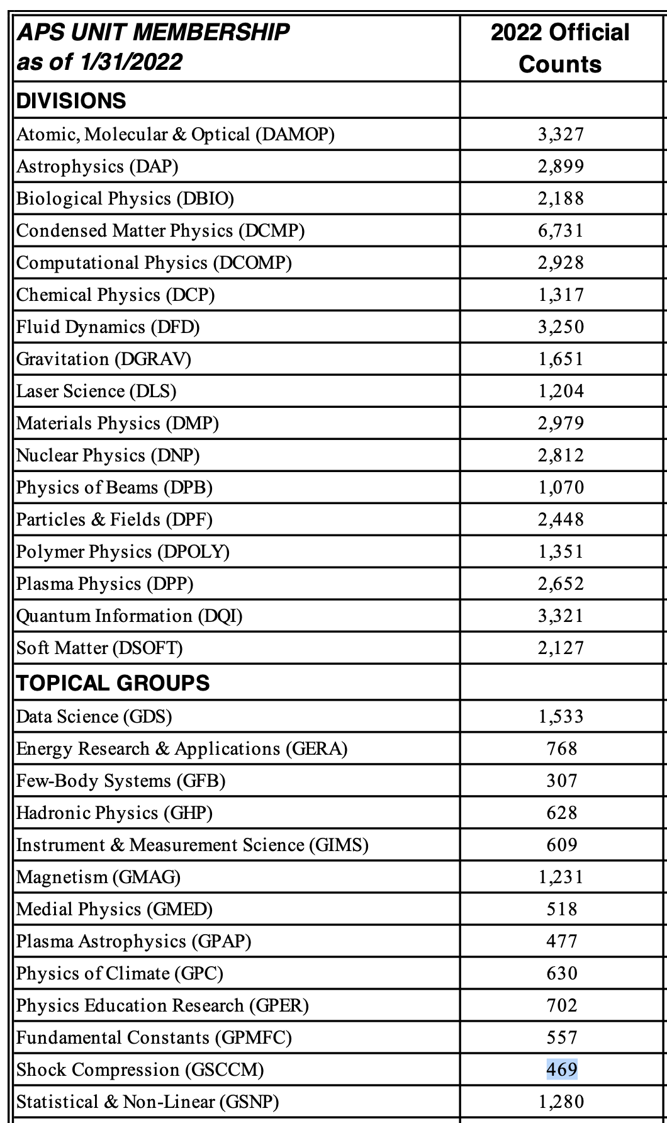
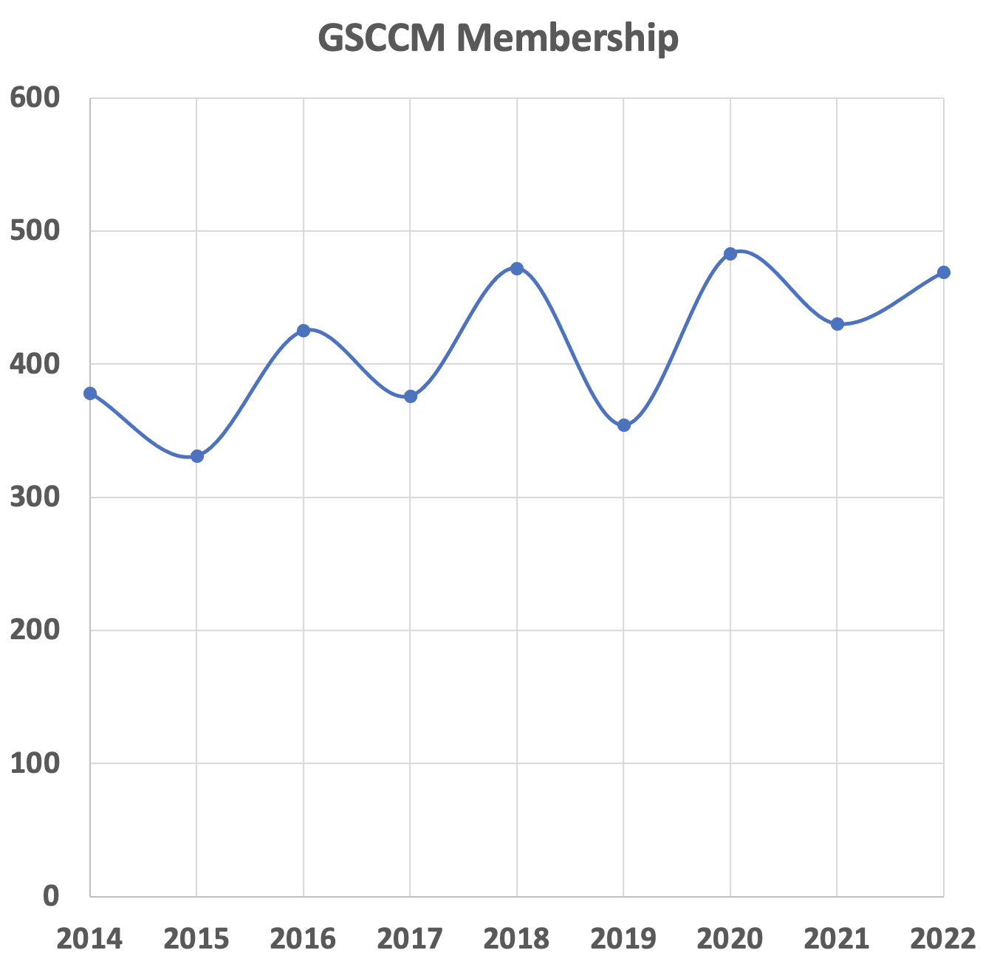
Membership & Fellowship
Dec. 2021: 469
Dec. 2020: 430
Dec. 2019: 483
Dec. 2018: 354
Dec. 2017: 472
Dec. 2016: 376
Dec. 2015: 425
Dec. 2014: 331
Dec. 2013: 378
Approx. 1-2 Fellow Threshold
1502+ unique members and attendees since 2015

Slide 7
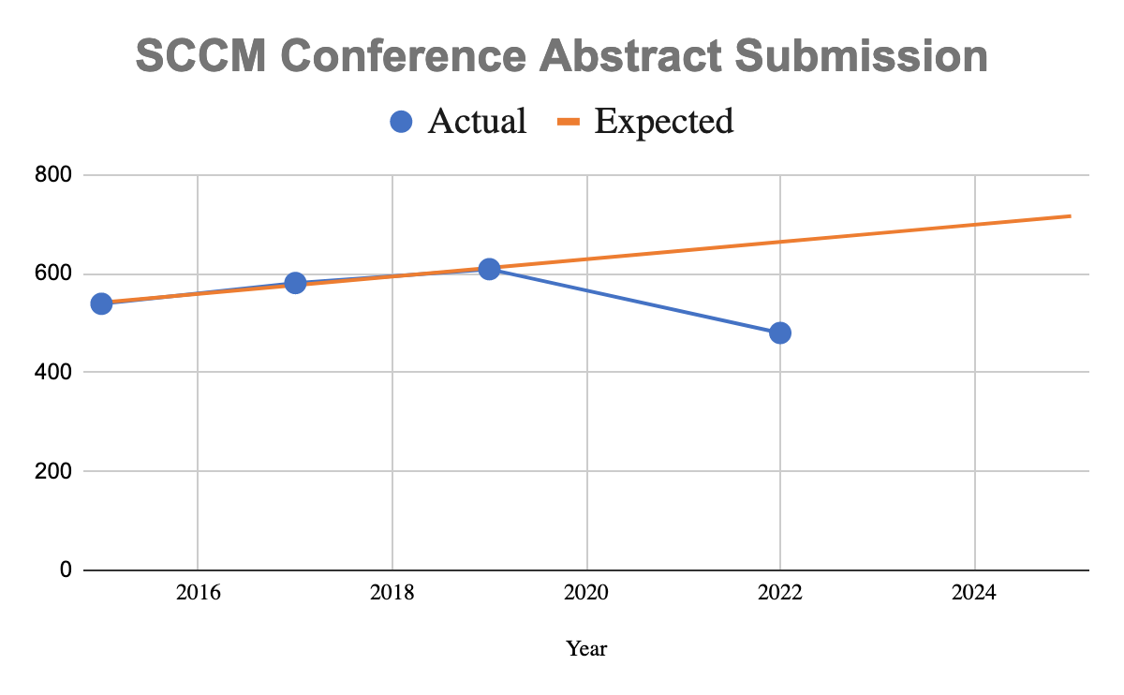
Summary of SCCM 2022 Conference
Conference navigated rescheduling due to COVID, requirements from APS to find a virtual platform, and first virtual abstract sort
Conference planning led by APS Meetings team and technical planning led by conference co-chairs
Conference expected to lose $60-80K:
  Decreased abstract submission → decreased attendance → may not meet guaranteed hotel room minimums
  New requirements: COVID safety protocols and virtual platform
  Several fixed costs, e.g. food and beverage with the hotel, that we must meet regardless of actual attendance

Slide 8
Early Career and Student Symposium
Attendance by Attendee Status
Sunday (July 10, 2022) 7:30 am – 5:00 pm
Lana Stekovic (Northrop Grumman), Chair
Belinda Pacheco Johnson (LANL), Co-Chair
Travel Award Budget: $18,000
Overall attendance: 56
Oral presentations – 15 presenters
Rapid Fire Competition – 7 presenters
Poster Presenters – 9 posters
Awards to the best oral presentations,
best rapid fire, best poster! ($150 each)
Keynote Address by Rick Kraus
Networking and Career Advancement
Workshop by Lana Stekovic
Attendance by Affiliation

Slide 9
Invitation to SCCM 2023 in Chicago
Chaired by
Dayne Fratanduono, Lawrence Livermore National Lab
Suhithi Peiris, Battelle Memorial Institute
Malcolm McMahon, University of Edinburgh, UK
Sheraton Grand Hotel
6 ballrooms for 6 parallel sessions with 140 in each
Separate poster session and lobby space for breaks
Banquet in the ballrooms
Childcare room

Slide 10
Shock Compression of Condensed Matter 2023
Expense | 2019 Costs | Costs inflated to 2023
Audio-Visual | $53,150 | $58,997
Meeting Online Access (?) |  | $40,000
Companion Program | $2,050 | $2,276
Poster Boards, Signage | $34,000 | $37,740
Facility Wireless | $15,000 | $16,650
APS Meeting Org Fee ($30/attendee) | $12,000 | $15,000
Mobile App | $1,200 | $1,332
Breakfast, Breaks, Events | $128,500 | $142,635
Welcome Reception | $80,000 | $88,800
Banquet | $104,836 | $116,368
Printing | $22,560 | $25,042
Registration | $5,000 | $5,550
Shipping | $3,500 | $3,850
Staff Travel | $8,500 | $9,435
Total | $501,796 | $563,675
Budget Estimate
Due to 2021 conference cancellation at this hotel, the contract renegotiations require:
Minimum of 380 Hotel Rooms each day of the week or pay Attrition Fee
And $250K in food expenses + tax and fee ~$350k or pay Attrition Fee
Therefore, registrations fees in 2023, even for ‘early registration’ could be over $1,000
Number of Attendees | Registration Fee
500 | $1,130
600 | $940
700 | $810

Slide 11
Shock Compression of Condensed Matter 2023
Technical Areas (traditional):
Advances in Experimental Techniques and Diagnostics
Detonation and Shock Induced Chemistry
Energetic and Reactive Materials
Equations of State
First-Principles and Molecular Dynamics
Geophysics and Planetary Science
High Energy Density Physics/Warm Dense Matter
Multi-Scale Modeling and Simulations
Particulates, Composites, and Manufactured Materials
Phase Transitions and Kinetics
Soft Matter
Spall Eject and Ballistics
Technical Areas (growth):
Emerging high-pressure user facilities and experimental techniques
Static Compression Research
Data-Driven Modeling and Machine Learning
TBD
Our focus is to increase attendance next year to reduce registration costs. Expansion of scientific areas would be beneficial!
Please nominate suggestions for the Technical Committee.
Send nominations to fratanduono1@llnl.gov by Friday, 07/22/23

Slide 12
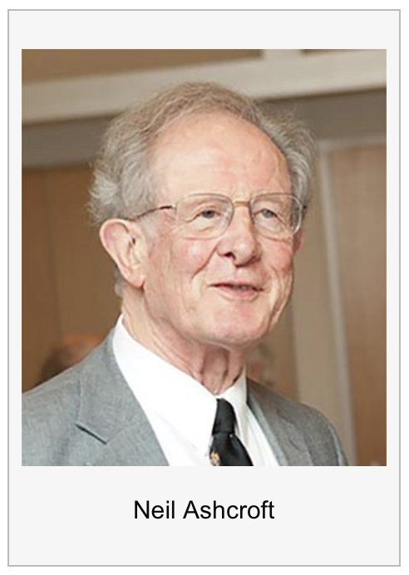
Neil Ashcroft Early Career Award
for Studies of Matter at Extreme High Pressure Conditions
The award recognizes outstanding theoretical or experimental contributions by an early-career scientist (10 years from PhD) to studies of matter at extreme high pressure conditions. This includes static and/or dynamic compressions within the disciplines of Physics, Chemistry, Materials Science, Earth and Planetary Science, Soft Matter and Biology.
The honor is conferred annually and includes of a $5000 stipend
The first Ashcroft Award will be conferred in 2023.
This award was made possible by a generous contribution from Judith Ashcroft and the Ashcroft Family.
Award Creation: Eva Zurek and Shanti Deemyad, Ivan Oleynik, Matt Lane
Selection Committee: Nenad Velisavljevic, Prof. Roald Hoffmann, Shanti Deemyad, Eva Zurek, Cynthia Bolme, Justin Wark, Norimasa Ozaki
12

Slide 13
Program Committee Proposal
Why should GSCCM create a 6-8 member program committee?
Establish leader recruitment/training process so that March meeting and SCCM conference planning is on a schedule
Continuity of service on the committee will provide body of knowledge for March meeting and SCCM conference planning
SCCM conference location planning will be accomplished in advance allowing for better pricing and availability
Proposed by 2022 co-chair Jen Jordan and supported by 2023 co-chairs
  First committee would be “ad hoc” per bylaws
  First committee would propose operating guidelines for the committee
  Early career symposium organizers would be part of committee

Slide 14
Todays meeting
Town Hall Discussion on Group Expansion
GSCCM Executive Committee
John Borg, Marquette Univ. (Chair)
Peter Celliers, LLNL (Chair-Elect)
Minta C Akin, LLNL (Vice Chair)
Ivan Oleynik, Univ of South Florida (Past Chair)
J Matthew D Lane, SNL (Secretary/Treasurer)
William Halperin, Northwestern U. (Assigned Council Rep.)
Brittany Branch, SNL (Member-at-Large)
Nenad Velisavljevic, LLNL (Member-at-Large)
Rebecca K Lindsey, LLNL (Member-at-Large)
Mitchell A Wood, SNL (Member-at-Large)
Belinda Pacheco, LANL (Early Career Member-at-Large)
In June 2022, we invited 55 GSCCM members to join one of four small group conversations about the future of APS-GSCCM

Slide 15
Call for Comments:
The APS SCCM Topical Group has served a critical need of advancing science within the physics community since its founding in 1984.
The field has evolved beyond the confines of shock compression and the historical distinctions between “dynamic” and “static” compression has blurred - e.g., with the advent of shockless techniques, and powerful shared diagnostic facilities, and ability to reach extremely large compressions in dynamic experiments.
The latter has attracted a significant fraction of static compression community to our field.

Slide 16
Scope:
How can GSCCM best serve the community moving forward
  GSCCM Membership
  SCCM Conference
  SCCM Proceedings
Is the time right to expand our topical group to include research in broadly defined area of matter at extreme conditions

Slide 17
Goals and Guidelines:
Our primary goal is to hear your views, not decide the issue
We want to hear from all of you in this open discussion
Comments from the virtual meetings were recorded as a transcript, which will only quote anonymously
Please be respectful, we want to hear opposing viewpoints
If there is anything you want to relate privately, reach out to any of us afterward
(john.borg@mu.edu or jlane@sandia.gov or any committee member)

Slide 18
Timeline: Proposed Path Forward
March 2022 Task force formation
March-May 2022 Executive Committee discussions and formation of Call for Comment
June 2022 Focus Group Meetings
July 2022 GSCCM membership townhall discussion
Nov 2022* APS Council proposal approval (required to bring before the membership)**
Mar 2023* GSCCM Townhall to vote and plan implementation
2022-2025* Focused recruiting and outreach
Sept. 2022 Write & post proposal for community review, comment and modification
* Dates subject to change
** Note: APS may not approve of plans that we might put forth

Slide 19
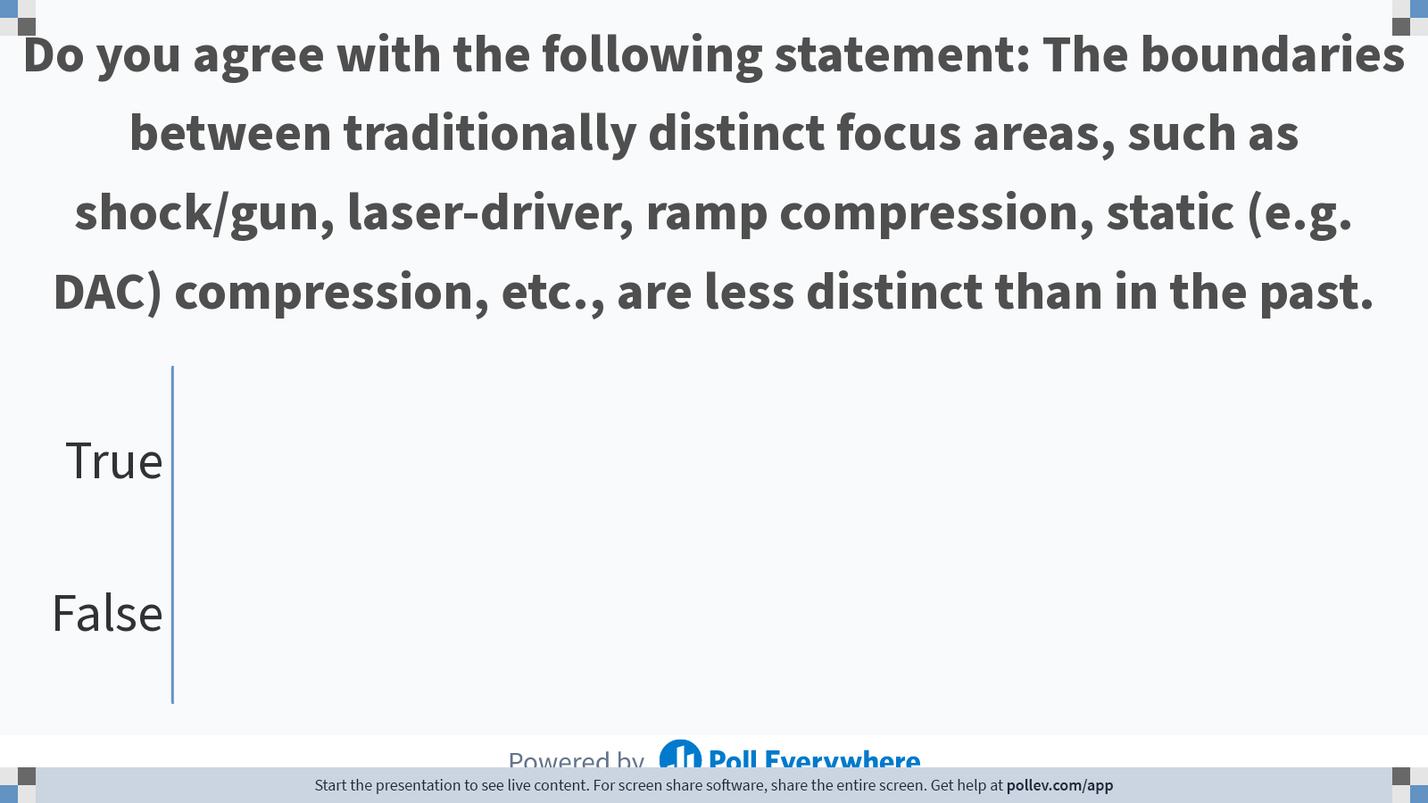
Notes:
Do not modify the notes in this section to avoid tampering with the Poll Everywhere activity.
More info at polleverywhere.com/support
Do you agree with the following statement: The boundaries between traditionally distinct focus areas, such as shock/gun, laser-driver, ramp compression, static (e.g. DAC) compression, etc., are less distinct than in the past.
https://www.polleverywhere.com/multiple_choice_polls/22n6IQoHLMy0bMTzXAbJd

Slide 20
Focus Group Summary
True/False: Do you agree with the following statement: The boundaries between traditionally distinct focus areas, such as shock/gun, laser-driver, ramp compression, static (e.g. DAC) compression, etc., are less distinct than in the past.
True
(21)
False
(2)

Slide 21
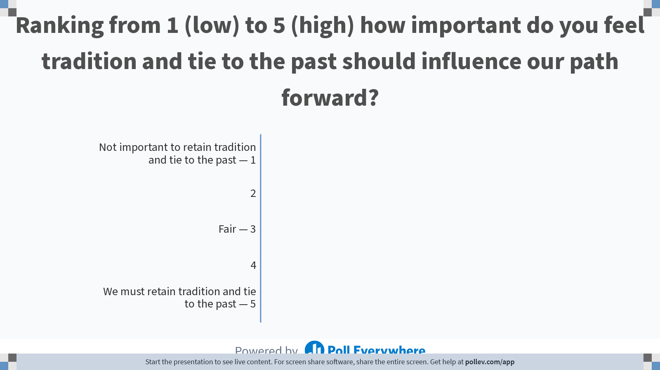
Notes:
Do not modify the notes in this section to avoid tampering with the Poll Everywhere activity.
More info at polleverywhere.com/support
Ranking from 1 (low) to 5 (high) how important do you feel tradition and tie to the past should influence our path forward?
https://www.polleverywhere.com/multiple_choice_polls/6erICaMPtAdVEezeyM9jC

Slide 22
Ranking from 1 (low) to 5 (high) how important do you feel tradition and tie to the past should influence our path forward?
1- Not important to retain tradition and tie to the past
5 – We must retain tradition and tie to the past
Average: 2.82

Slide 23
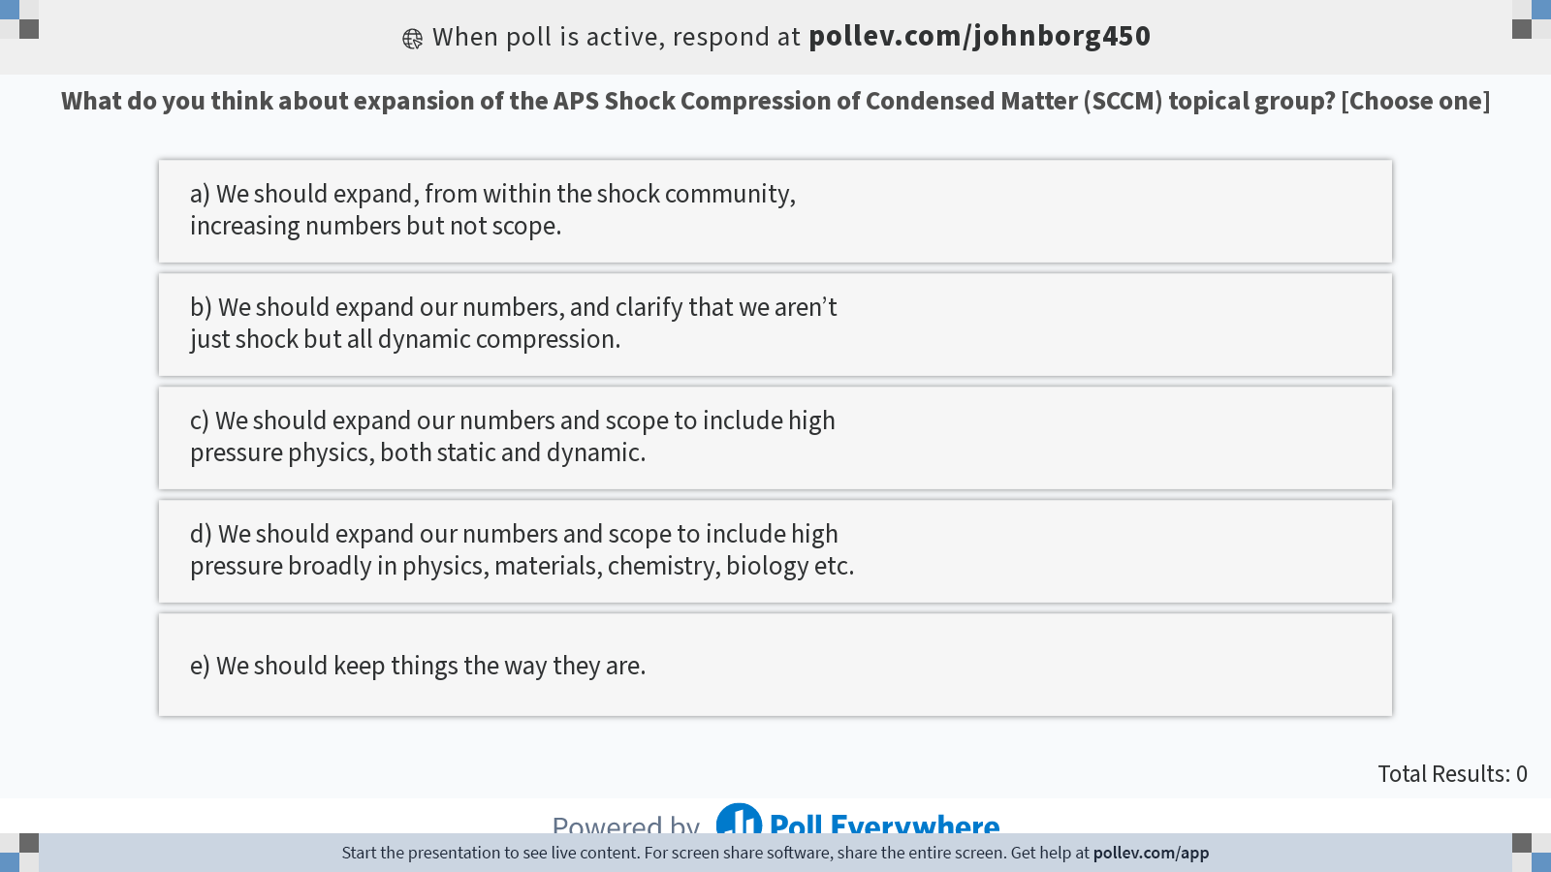
Notes:
Do not modify the notes in this section to avoid tampering with the Poll Everywhere activity.
More info at polleverywhere.com/support
What do you think about expansion of the APS Shock Compression of Condensed Matter (SCCM) topical group? [Choose one]
https://www.polleverywhere.com/multiple_choice_polls/DZ6Sti8iPpV7FNKPZmgUb?display_state=instructions&activity_state=opened&state=opened&flow=Engagement&onscreen=persist

Slide 24
Ranking from 1 (low) to 5 (high) how important do you feel tradition and tie to the past should influence our path forward?
1) We should expand within the shock community, increasing the numbers and not the scope
2) We should expand our numbers, and clarify that we are not just shock but all dynamic compression.
3) We should expand our numbers and scope to include high pressure physics, both static and dynamic.
4) We should expand our numbers and scope to include high pressure broadly in physics, materials, chemistry, biology etc.
Average: 3.35

Slide 25
Assuming we alter our scope in such a way that a name change is required, what would you suggest?
  “I think you need to lose the word "shock" and have something broader.”
  “Exclude SHOCK and Include EXTREME → EXTREME? Need to define”
  “Compression is more general than Shock”
  “Low and High Pressure”
  “Dynamic and Static”
Suggestions:
Compression of Condensed Matter (CCM)
High Pressure Compression Science
Science of Compression of Condensed Matter (SCCM)
Shock and Extreme Conditions in Condensed Matter (SECCM)
Dynamic compression and high pressure science.

Slide 26
List of High-P conferences (dedicated conferences only)
SCCM (Shock Compression of Condensed Matter)
AIRAPT (International Association for the Advancement of High Pressure Science and Technology )
COMPRES (Consortium for Materials Properties Research in Earth Sciences)
GRC Research at High Pressure (Exploring High Pressure Science at the Extremes Through Experiment and Computation)
EHPRG (European High Pressure Research Group)
ACHPR (Asian Conference on High Pressure Research)
DYMAT (European Dynamic Behaviour of Materials Applications)
ARA (Aeroballistic Range Association)
SEM/TMS/...

Slide 27
Town Hall Discussion on Group Expansion
Should GSCCM expand the topical group to include research and broadly defined areas of matters and extreme conditions?
Expansion is supported and has been a priority since origination!
Expansion should focus on common scientific themes rather than diagnostics.
Very important to have traditional ties to the past, but to develop the identity of the topical group through expansion to understand the problems we face, answer new scientific questions, develop interests, and inspire next generation physicists, scientists, engineers, mathematicians, and arts graduates, while being mindful not to significantly overlap with other topical groups.

Slide 28
Focus Group Summary
Outreach to other APS topical groups, societies, academia to increase interest.
Become annual conference to maintain interest and promote participation.
Join other professional societies (both domestic and international) in joint meetings to expand interest.
Target invited talks outside the typical topics (Biology, Materials Science etc.) in order to expand participation into other fields.
Increase visibility of SCCM through outreach and organize symposium for academic participants to recruit from outside national labs.
Change membership requirements to both promote and increase continuity in memberships.
  Nominated Fellows required to have continuous membership, presenters and attendees required to be members.
  Open up fellow nominations beyond shock compression

Slide 29
Focus Group Summary
COMPRES is ending, we should reach out to members looking for continuation
We should have 2 year memberships available
Fellows and leadership should have an longer-term membership requirement
History of early days was presented
We do enough to include by never excluding anyone (debated)
Is this a marketing effort, or a science effort?
Academia often see the labs (and SCCM) and focused and uninviting
Sponsoring pro-risk research vs risk-averse research
Connect with Academia through the Stewardship Academic Alliance
Slight name changes better than big changes
Focus on growth from outside and inside the labs, balance
Build the community by focus on workshops and student development
We need to prevent “dilution” as we seek to attreact new people

Slide 30
List of High-P Awards
Bridgman (via AIRAPT)
  For research in the physics, chemistry, or technology of high pressure science.
Jamison Award (There is one via AIRAPT and via GRC)
  Outstanding achievement in high pressure by a graduate student or postdoctoral researcher.
Van Valkenburg Award (via GRC)
  Young scientist in high pressure, with some preference toward static technologies.
George E. Duvall Shock Compression Science Award (via SCCM)
  Recognize contributions in condensed matter and non-linear physics through shock compression.
Ashcroft Early Career Award (via SCCM) – NEWEST addition starting 2022
  Award for Studies of Matter at Extreme High-Pressure in first 10 yr. post-PhD
Others
  See Dana Medal http://www.minsocam.org/msa/Awards/Dana.html

Slide 31
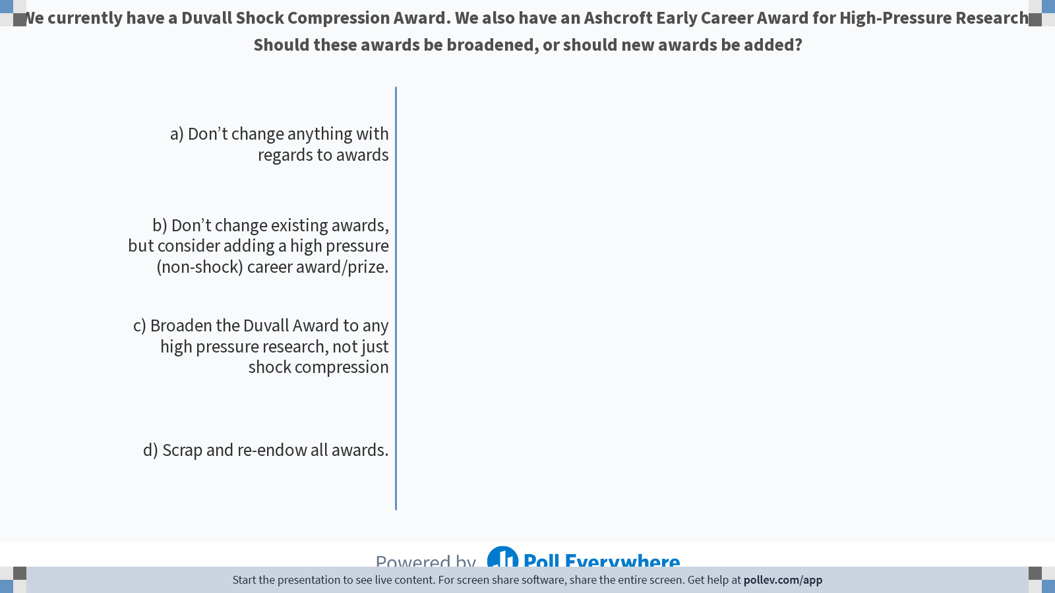
Notes:
Do not modify the notes in this section to avoid tampering with the Poll Everywhere activity.
More info at polleverywhere.com/support
We currently have a Duvall Shock Compression Award. We also have an Ashcroft Early Career Award for High-Pressure Research. Should these awards be broadened, or should new awards be added?
https://www.polleverywhere.com/multiple_choice_polls/pKIzHpkxmpeeV2OQEcdAz

Slide 32
SCCM 2022 Conference - Worked Well
Partnering with APS Meetings
  Relied on APS to handle hotel interactions and changes, COVID protocols
  Developed detailed schedule for conference planning that can be used by future conferences
  Partnered with AIP for exhibitors – much less work for conference organizers
Early Career and Student Symposium
  Inclusion of networking workshop
  Organized by early career for early career
Using virtual tools for planning
  Virtual abstract sort and subsequent programming by APS
  Biweekly WebEx/Zoom meetings and Google Drive (conference co-chairs and APS team)
Conference organizers
  2 conference organizers worked well with APS Meetings support
  More time to focus on technical program
Technical Committee
  Increased focus on diversity and inclusion for technical committee members
  Pre-meeting in December to brainstorm plenary speakers
  Finalizing plenary speakers before abstract sort
  Virtual abstract sort was easy and well coordinated with APS staff. This format could continue in the future to save on cost and travel time

Slide 33
SCCM 2022 Conference – Getting Better
Budgeting now includes virtual platform and COVID protocols; budget will be good basis for 2023 conference
Virtual Component
  Need more communication with attendees about virtual platform up front
  Going forward: standardize expectations conference-to-conference and publicize them starting with abstract submission
  Consider reducing cost for virtual attendance
Conference Communication
  APS has several scheduled conference communications – should review these early with the APS team
  Need to develop plan for conference organizer communications
  Need to add future conferences to GSCCM website (2023 and 2027 are scheduled)
  Invitation of invited speakers and session chairs was a bit messy → need better guidance for technical committee or have session chairs send all invites
  Conference schedule on website early, including planned abstract submission, virtual platform submission, and hotel/ registration dates

Slide 34
SCCM 2022 Conference – Needs Work
$60-80K over budget
  Unplanned COVID/virtual platform costs
  ~2/3 expected number of abstracts submitted
Increased registration cost with decreased benefits
  Decreased number of meals provided, e.g. no breakfast
  No conference bag/mug/etc.
Early Career and Student Symposium
  Involve early career symposium and diversity lunch chairs early in planning process
  Incorporate early career registration into conference registration so there’s no need for a google doc
  Incorporate early career abstract submission/programming/travel grant into March abstract sort/programming
  Include early career symposium into conference announcements and call for abstracts
Author Expectation Communications
  Include in call for abstracts and author acceptance letter that authors are expected to upload recorded presentation, including due date
  Communicate COVID requirements explicitly in all communications, including definition of fully vaccinated and what to do if you get sick and miss the conference

