Slide 1
Women in Physics
in class presentation

Slide 2
Famous physicists
Write down some famous physicists you can think of.
Do a Google search on your phone for famous physicists.
Repeat the search in incognito mode.

Slide 3
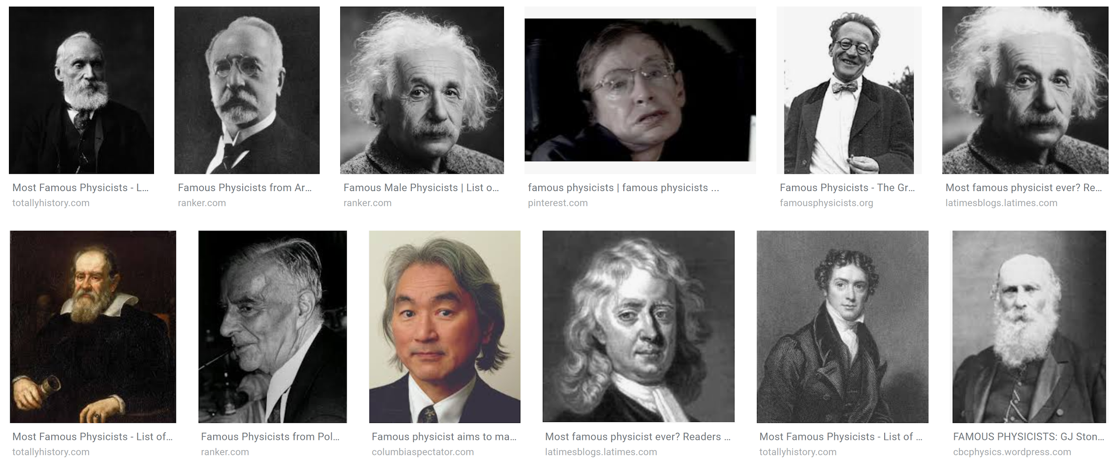
Pre-assignment
What trends do you notice about the physicists you found in your google search?
Notes:
Pre-lesson: Assign students to complete the pre-class assignment prior to class. The assignment requires them to recall famous physicists and conduct a Google search, then answer a few questions about what they find (this primes gender issues given the lack of diversity that results from the search).
It may be important to point out that men have been participating in physics for a long time and that even after Marie Curie, there is a lack of women on the list. (No need to discuss specific biographies; students can bring these examples up in the discussion later).
Teacher says:
What trends do you notice? Is this true of physicists today?
Google customizes its searches. Different people may get different results.

Slide 4
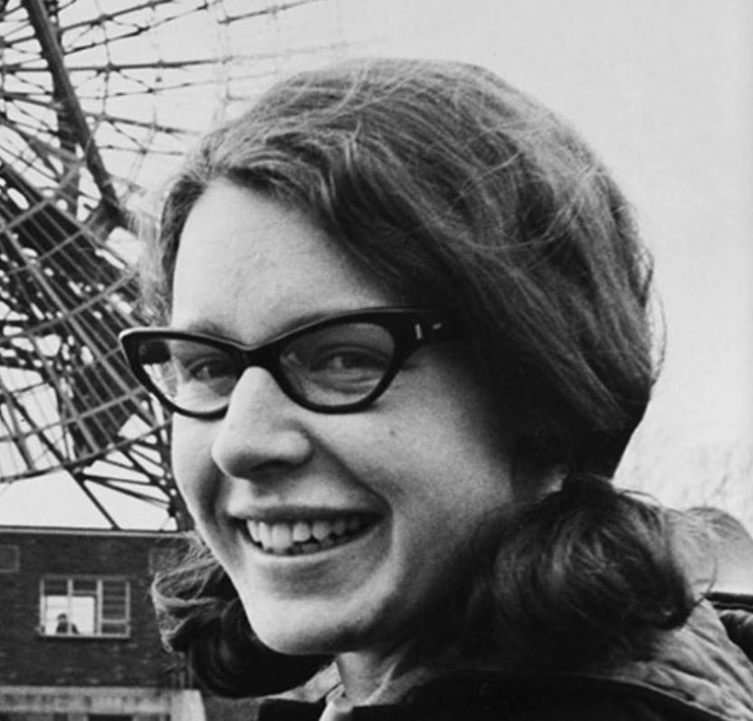
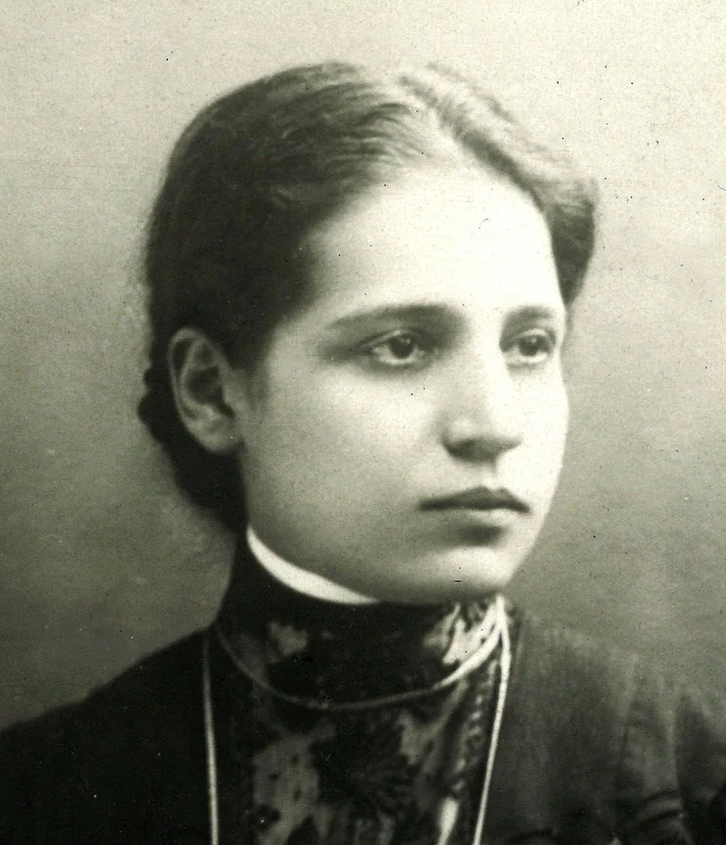
Pre-assignment
Read one of the two articles on these physicists:
Jocelyn Bell Burnell
1943-
discovered pulsars
Lise Meitner 1878-1968
nuclear fission
Notes:
OPTIONAL SLIDE
Pre-lesson: Assign students to complete the pre-class assignment prior to class (Appendix 1). The assignment requires them to read two biographies. One of a historical physicist, choosing between Lise Meitner or Jocelyn Bell Burnell, and one of a modern female physicist from the list provided (this illustrates the difficulties that women have faced and the capability of women to contribute)

Slide 5
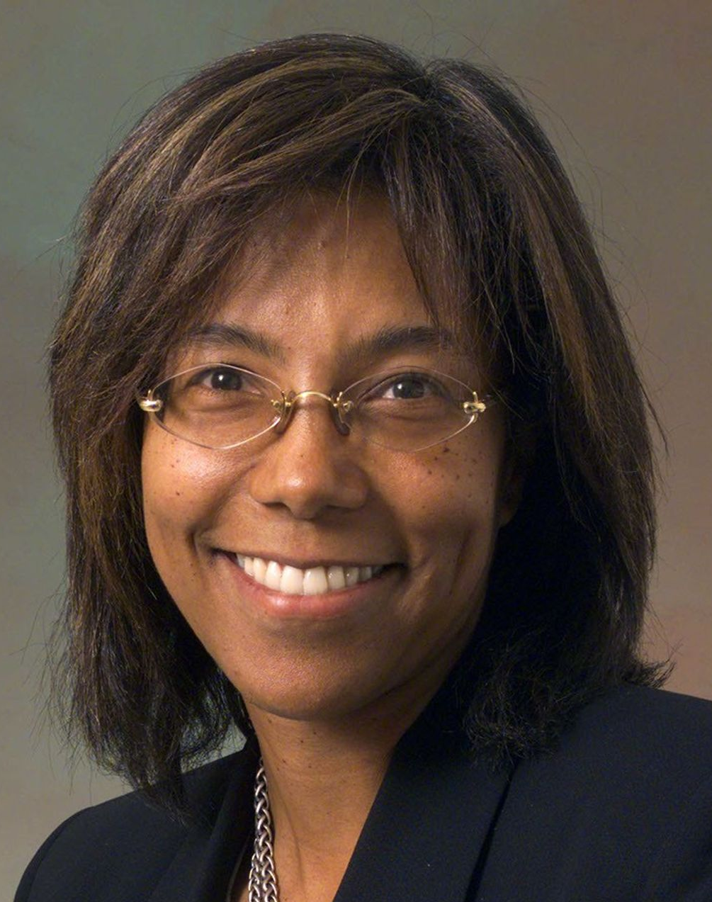

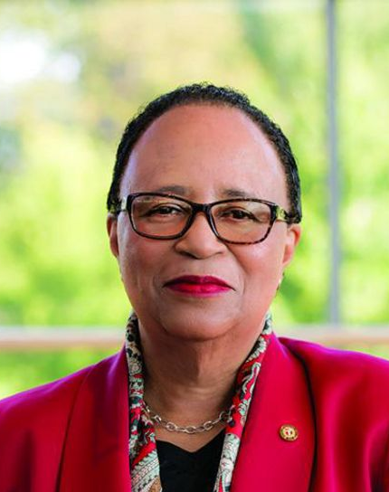
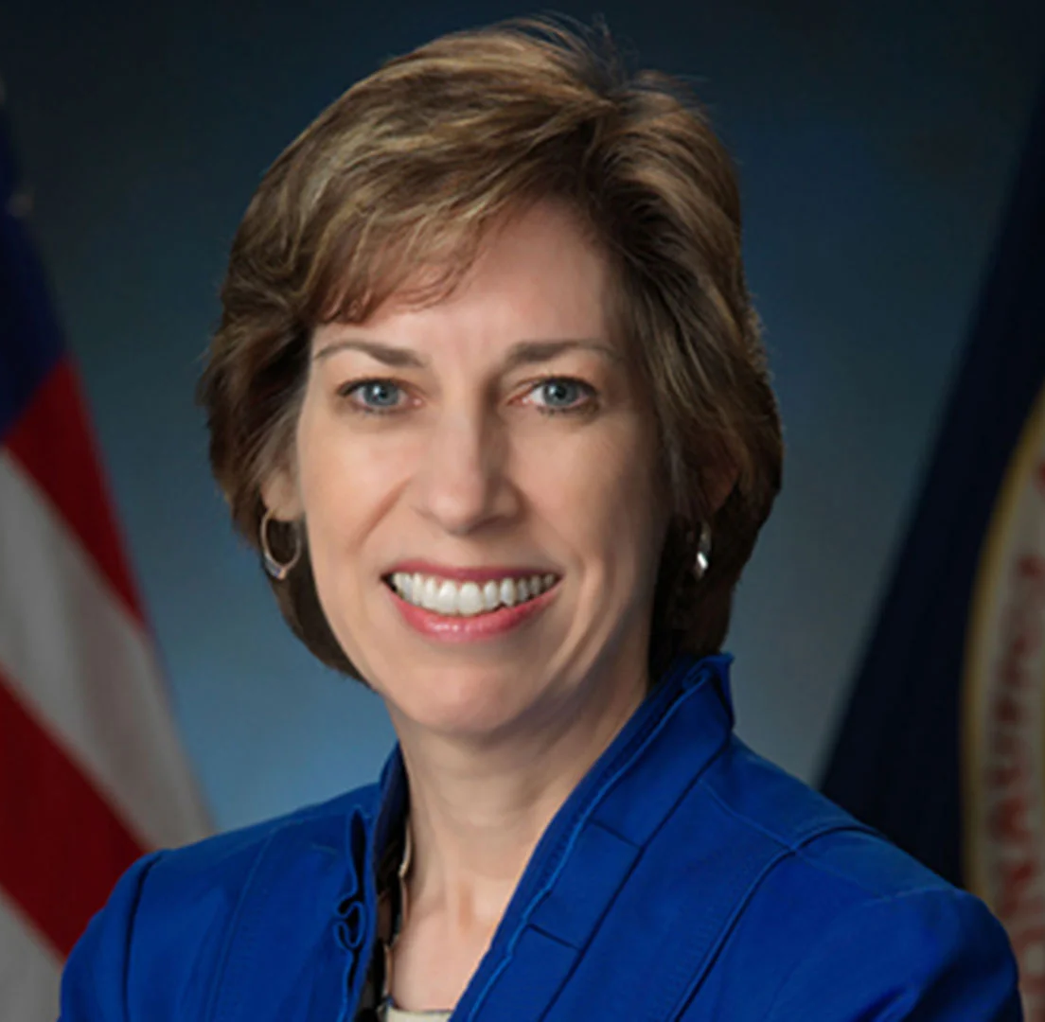
Pre-assignment
Read one of the articles on these physicists:
Deborah Berebichez
Wall Street
Ellen Ochoa
NASA Johnson Space Center
Claudia Alexander
NASA geophysicist
Shirley Ann Jackson
Physicist
Notes:
OPTIONAL SLIDE
Pre-lesson: Assign students to complete the pre-class assignment prior to class (Appendix 1). The assignment requires them to read two biographies. One of a historical physicist, choosing between Lise Meitner or Jocelyn Bell Burnell, and one of a modern female physicist from the list provided (this illustrates the difficulties that women have faced and the capability of women to contribute)

Slide 6
Guidelines for Conduct During Discussion
Share air time equitably
Value differences
Own your impact
Make sure everyone feels safe
Discomfort is okay
Argue using evidence
Notes:
Download poster at STEPUPphysics.org Introduce guidelines (Critical lesson component): Introduce these guidelines to students (or refer to your class conduct rules if you have already established them):
• Share air time equitably. Know yourself, balance your listening and talking.
• Value differences. Remember that your perspective is not the only one.
• Argue using evidence. Back what you have to say with data.
• Make sure everyone feels safe. Safe is not the same as comfortable.
• Discomfort is OK. Identify your learning edge and push it.
• Own your impact. Your intentions may not be the same as your impact.

Slide 7
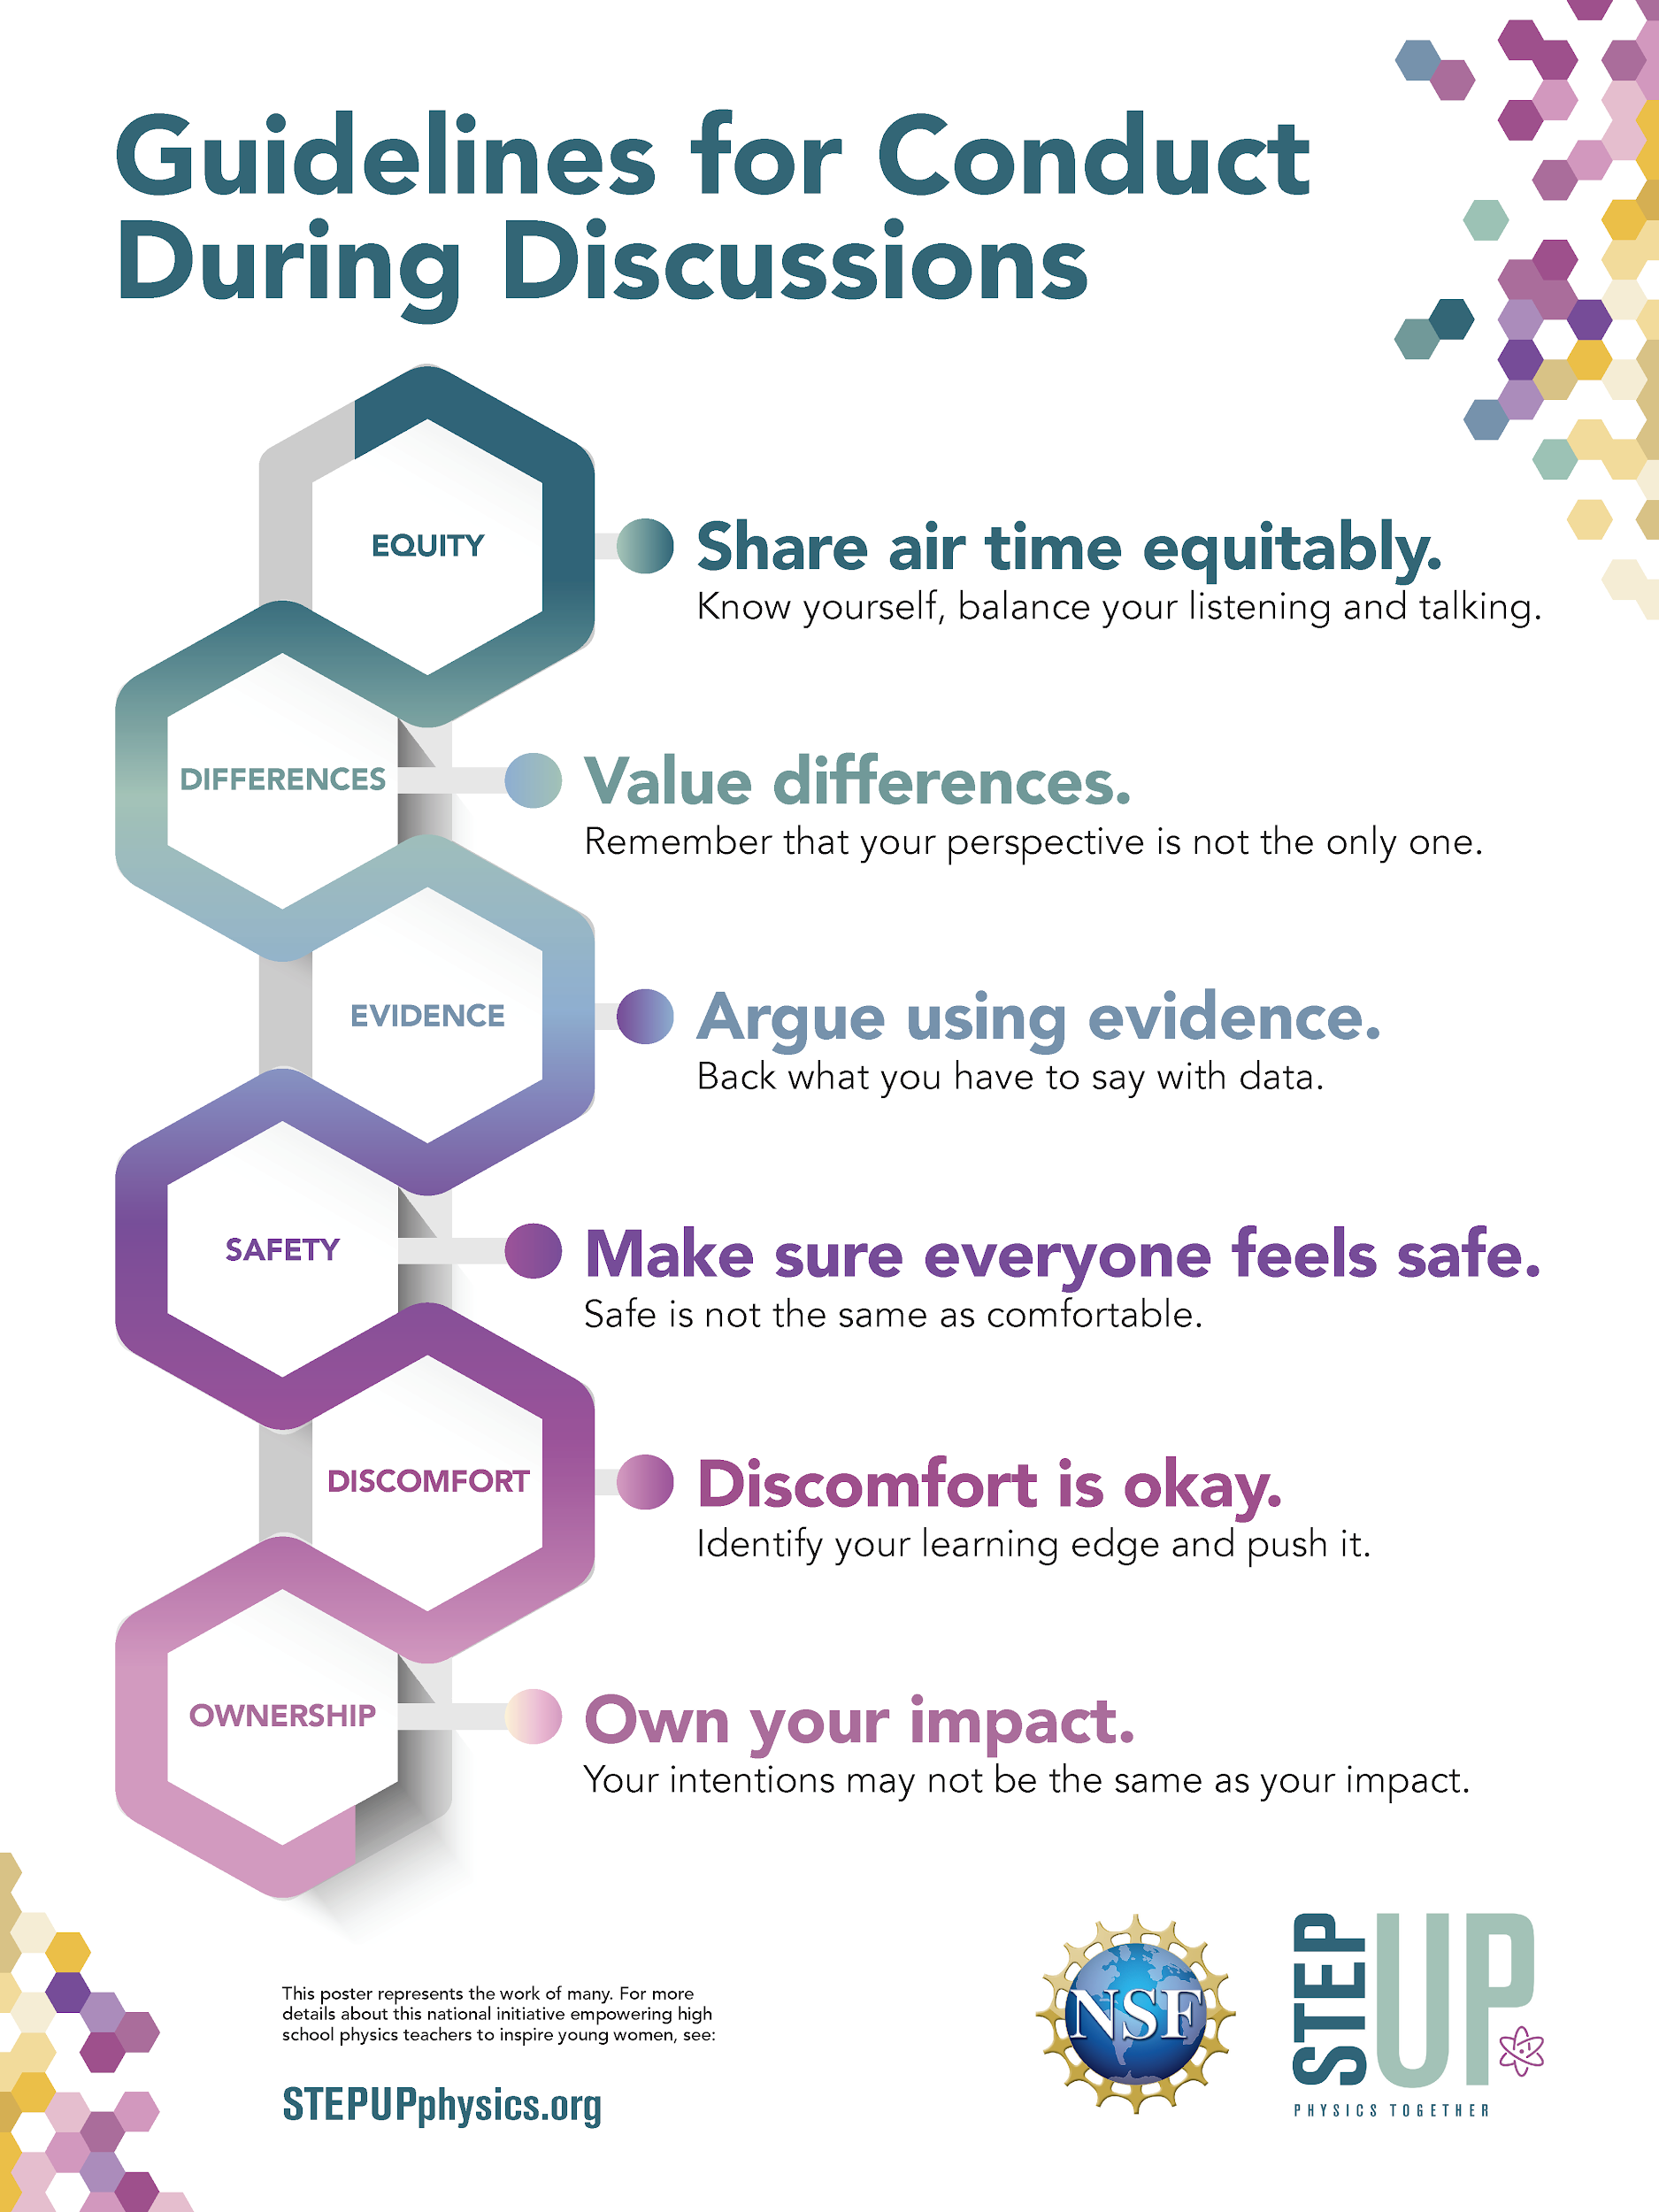
Guidelines for Conduct During Discussion
Notes:
Download poster at STEPUPphysics.org Introduce guidelines (Critical lesson component): Introduce these guidelines to students (or refer to your class conduct rules if you have already established them):
• Share air time equitably. Know yourself, balance your listening and talking.
• Value differences. Remember that your perspective is not the only one.
• Argue using evidence. Back what you have to say with data.
• Make sure everyone feels safe. Safe is not the same as comfortable.
• Discomfort is OK. Identify your learning edge and push it.
• Own your impact. Your intentions may not be the same as your impact.

Slide 8






Discussion Women in Science
Physics Degrees Awarded to Women
Academic Achievement
Unconscious Bias
Gendered Professions
Notes:
This slide outlines the four sections of the discussion that follows.
The three people with two speech bubbles icon indicates a discussion question for the whole class.
The paper and pencil icon indicates a step the students will write about individually.

Slide 9
Percentage of Women in Science
Which science field do you think has the highest percentage of women in it?
A. Math B. Biology C. Chemistry D. Physics E. All about the same
Which field do you think has the lowest percentage of women?
A. Math B. Biology C. Chemistry D. Physics E. All about the same

Slide 10
Additional optional activity:
Within the supplemental slides, there is an additional optional activity about the demographics by race for the United States. This can be done prior to the following activity.
Notes:
Slides #41-43 under the supplemental slide section
The interactive pie chart can be sent directly to students.

Slide 11
For the next activity, there are two activity options:
Slide #11 and 12: Ask students which lines match the trend of STEM majors vs Physics majors
Slide #13-18: This is a slow reveal graph, each slide until #17 reveals one more piece of information. Ask students at each slide what they notice and wonder about the information presented.

Slide 12
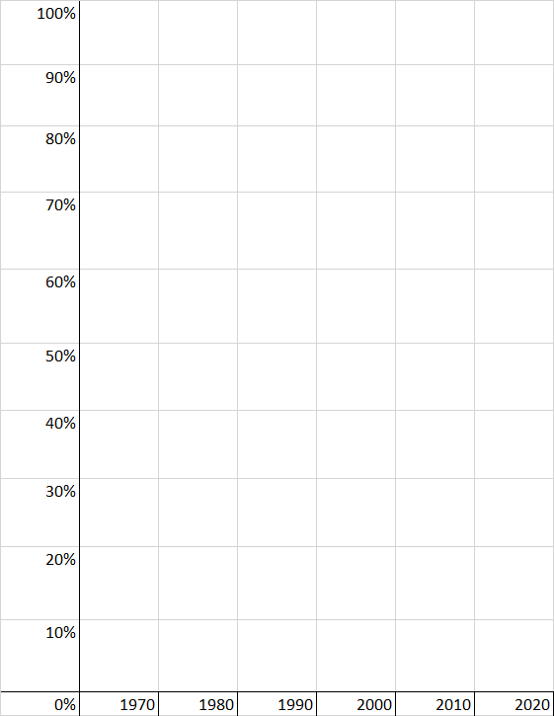
Which trend do you think most closely matches the percentage of STEM-related Bachelor's degrees earned by women in this time period?
Which matches physics only?
% of Bachelor’s degrees awarded to Women
Notes:
Some of these trend line match the trends over the years for some majors but not all.
The red line is roughly the trend of physics, the brown line is roughly the trend of biology; the green line is close to that of math/statistics although a higher percentage

Slide 13
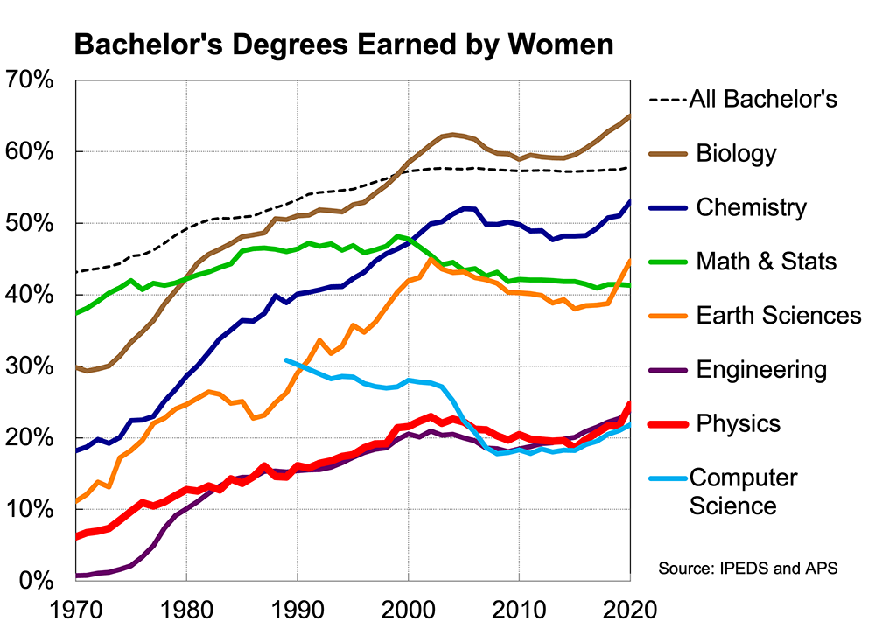
Notes:
https://www.aps.org/learning-center/statistics/diversity
https://www.aps.org/learning-center/statistics/education

Slide 14
Notes:
This is a “slow reveal” version of this graph. You can skip to slide 14 if you would like to show the graph all at once and I analyze it.
https://www.aps.org/learning-center/statistics/diversity

Slide 15
Notes:
This is a “slow reveal” version of this graph. You can skip to slide 14 if you would like to show the graph all at once and I analyze it.
https://www.aps.org/learning-center/statistics/diversity

Slide 16
Notes:
This is a “slow reveal” version of this graph. You can skip to slide 14 if you would like to show the graph all at once and I analyze it.
https://www.aps.org/learning-center/statistics/diversity

Slide 17
Notes:
This is a “slow reveal” version of this graph. You can skip to slide 14 if you would like to show the graph all at once and I analyze it.
https://www.aps.org/learning-center/statistics/diversity

Slide 18
Notes:
This is a “slow reveal” version of this graph. You can skip to slide 14 if you would like to show the graph all at once and I analyze it.
https://www.aps.org/learning-center/statistics/diversity

Slide 19
Notes:
https://www.aps.org/learning-center/statistics/diversity
Biology has the highest percentage of women and physics and engineering have the lowest. The overall trends are that there are more women in STEM now than in the past. However, in recent years, all STEM fields have seen decreases. This data is only for the US.
Note: Within engineering, there is great variation between types of engineering. For example, chemical engineering has a higher percentage of women than electrical engineering.
Encourage a few minutes of discussion on each slide, in particular regarding the role of the individual versus the role of culture and society (e.g. social norms).
In Slide 6, students are asked to suggest reasons why women are better represented in some fields than in others. Make sure to have students come up with ideas, and then the teacher can categorize these responses (for example, can have a “culture/socialization” category and a “biology/inherent traits” category).

Slide 20
Why are women better represented in some fields over others?
For example, in the US, why does physics/engineering have a lower proportion of bachelor's degrees awarded to women than biology/chemistry?
Notes:
Teacher asks students to suggest reasons why women are better represented in some fields than in others. Make sure to have students come up with ideas, and then the teacher can categorize these responses (for example, can have a “culture/socialization” category and a “biology/inherent traits” category).

Slide 21
Why are women better represented in some fields over others?
Which of the following countries has the highest percentage of women in physics? The lowest?
A. Taiwan
B. Argentina
C. Egypt
D. USA
E. Canada
Or are they all about the same?
Notes:
Teacher asks students to suggest reasons why women are better represented in some fields than in others. Make sure to have students come up with ideas, and then the teacher can categorize these responses (for example, can have a “culture/socialization” category and a “biology/inherent traits” category).

Slide 22
Percentage of Undergraduate Physics Degrees Awarded to Women
100%
90%
80%
70%
60%
50%
40%
30%
20%
10%
0% | Taiwan | USA | Argentina | Canda | Egypt
Drag the top of each bar until it represents the percentage of female physics degree holders that you think are in that country.
% of Bachelor’s degrees awarded to Women
Notes:
This activity can be sent to students in a separate presentation for them to complete before continuing to the next slide.

Slide 23
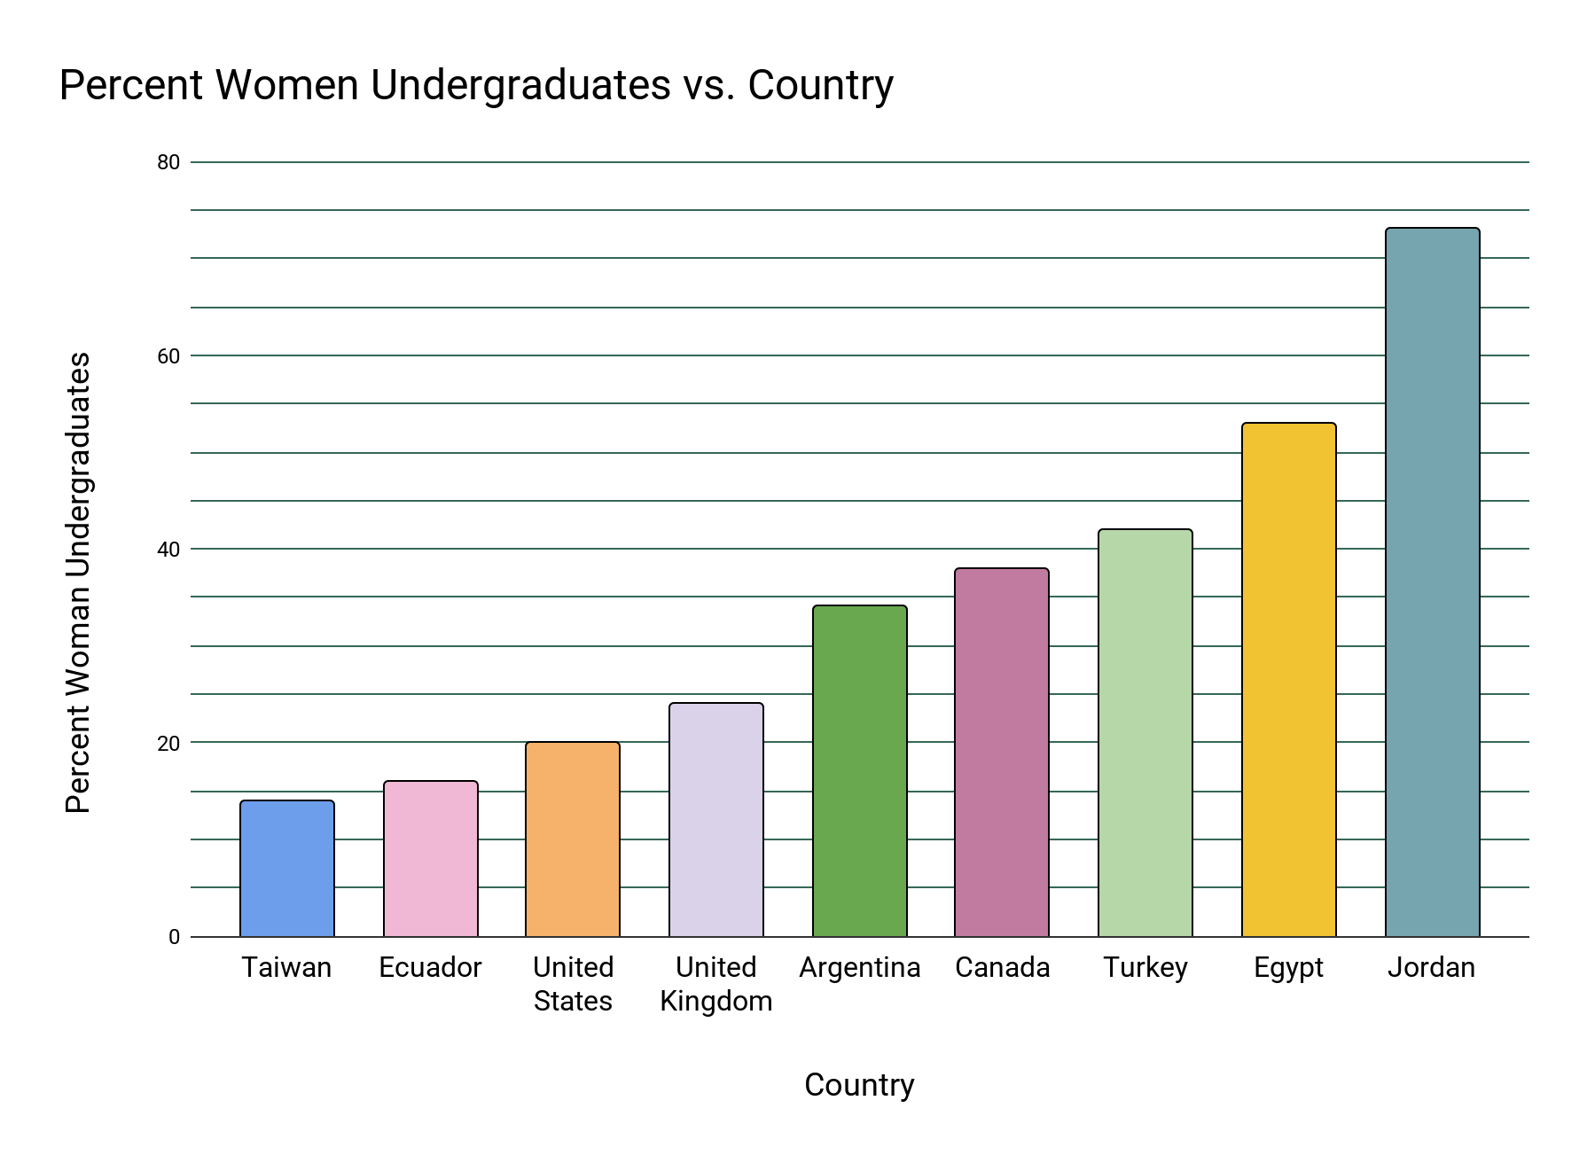
Percentage of Undergraduate Physics Degrees Awarded to Women
Source: IUPAP International Conference on Women in Physics Proceedings (2018-2023)
Notes:
More information about this graph can be found in the document “Women in Physics International Facts” document.
Reports from different countries from different years vary in how they are presented, so numbers are pulled from Conference Proceedings over a range of years rather than only the most recent reports. Note that in Albania, students are assigned majors based on their performance rather than their preference.
Students might conclude that because the percentage of women in physics varies by country, the representation of women in physics is a cultural issue rather than a biological one.
This graph suggests the cause is sociocultural rather than biological. If the cause was biological, all countries would have similar percentages.

Slide 24
Women in Physics Internationally
None of these countries’ aggregate data can tell the story of individuals within the country. In addition, no country is meant to represent all countries in that region.
Each country has their own culture, history and education systems that influence higher education in that country.

Slide 25
Academic Achievement
Do you think there are gender differences in physics grades in high school or college?
If you think there are differences, what are the causes? Exam bias, ability differences, or something else? Why?

Slide 26
Percentage of Undergraduate Physics Degrees Awarded to Women
Source: IUPAP International Conference on Women in Physics Proceedings (2018-2023)
Notes:
Ask students to share what they notice about the graph, what other things they may wonder about.

Slide 27
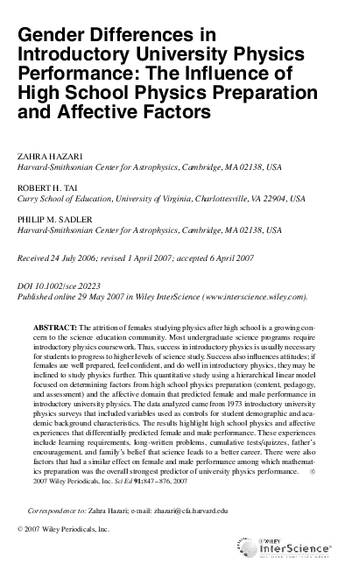
Academic Achievement
Men and women achieve similar grades in high school and university physics
The difference in science and math achievement between boys and girls is very small and varies more with country than between genders
Hazari et al., 2007; Hazari et al., 2008; Hyde and Linn, 2006
Notes:
Men and women perform similarly in math and science. This includes physics. The differences that do appear are often due to bias in the instruments (See next slide). However, confidence varies between genders.

Slide 28
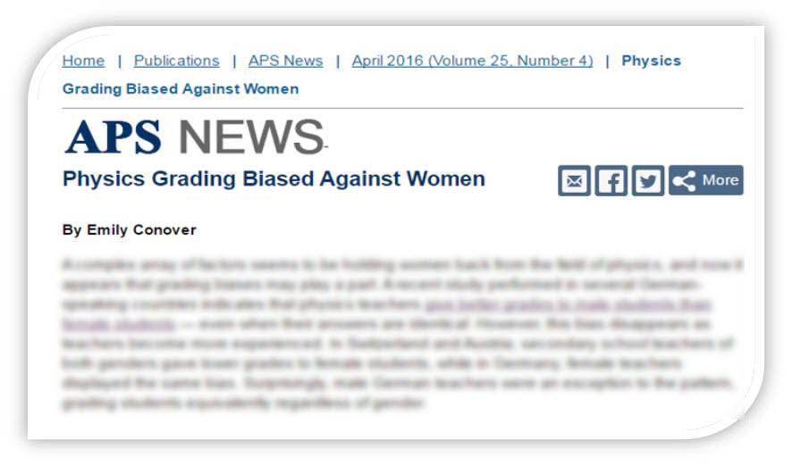
Unconscious Bias
Even small grade differences that do exist may be due to bias. How does this happen?
Notes:
Ref: Conover, 2016

Slide 29
What is unconscious bias?
Unconscious bias refers to the unconscious sorting of people, often based on stereotypes and beliefs, bypassing rational and logical thinking
Sexist behavior can arise even when people are not consciously sexist.
All people have some degree of unconscious bias and many people even hold unconscious bias towards the groups that they belong
Becoming aware of your own unconscious biases is the first step to overcoming them
Notes:
Ref: Fiske, 2002; Moule, 2009
This should help students see that bias can exist even if no one is overtly sexist, but that bias can be overcome with conscious effort and training.

Slide 30
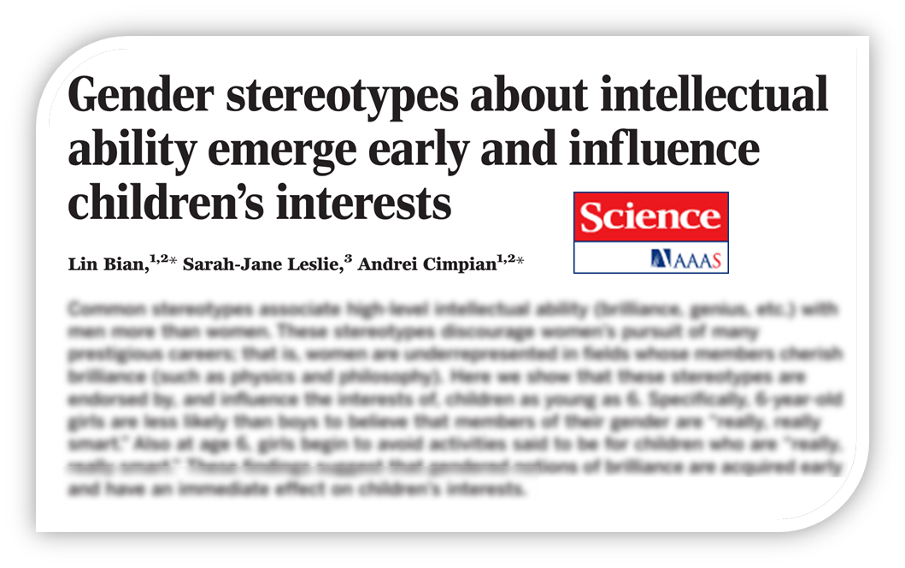
How early can unconscious bias emerge?
In the US, girls age 6 are less likely than boys to believe that members of their gender are ‘really, really smart’,” and avoid activities associated with being “really, really smart”. Why?
Notes:
Ref: Bian et al., 2017

Slide 31
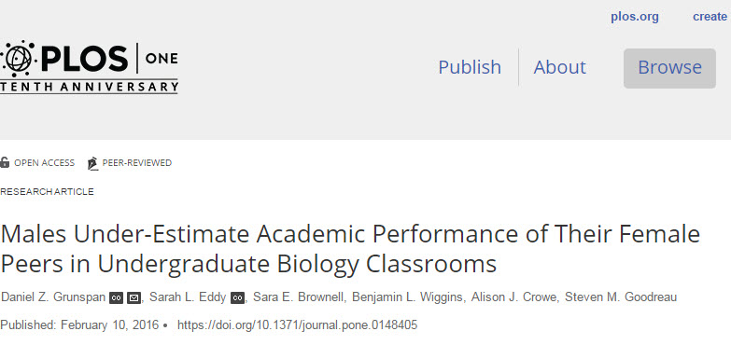
Another example of unconscious bias
Even after accounting for actual class performance and outspokenness, men assumed other men knew the content better than women. Does this happen here?
Notes:
Ref: Grunspan et al., 2016

Slide 32
Gendered Professions
Why do you think women appear in particular science fields more than others?
What gender are your doctors and nurses?
What about people you know in other technical professions (e.g. engineering)?

Slide 33
Gendered Professions
What gender are your teachers in various subjects?
What patterns have you noticed in who pursues different careers?
Why do you think we see these differences?
Describe experiences you or a friend has had related to science and gender issues.
Examples: Who do you feel comfortable working with in class? Do you feel more comfortable in any particular class? Have you felt your abilities being questioned?
Notes:
Possible responses to gendered professions:
A. Stereotypes - Students may notice that many female scientists portrayed in the media are in fields other than physics (e.g. on the Big Bang Theory, forensic shows, medical shows).
B. Students may notice that most engineers are men or that most nurses are women, for example. Terms indicating that a profession has a default gender may be shared, such as “male nurse” since the default gender of nurses is stereotyped to be female.
C. Nature versus Nurture arguments will likely emerge. Some students might say that women “naturally” gravitate to fields other than physics and engineering. Other students may believe this is due to stereotypes and other societal influences.

Slide 34
Discussion Women in Science
Physics Degrees Awarded to Women
Academic Achievement
Unconscious Bias
Gendered Professions
Notes:
This slide reminds students of the four different points of the prior discussion.

Slide 35
Stop and Reflect
Write your answers
Describe experiences you or a friend has had related to science and gender issues.
Notes:
Students write an example and share with a friend, then write a 2nd answer and report out to the class (The 2nd can be written or submitted anonymously and then collected/redistributed or read out by the teacher)
Examples: Who do you feel comfortable working with in class? Do you feel more comfortable in any particular class? Have you felt your abilities being questioned?
Possible responses include students mentioning occasions when:
• someone has said something disparaging
• others have dominated a conversation/activity
• they have been made to feel stupid
• they prefer the environment in certain classes over others
• they prefer working with people of certain genders more than others
• they heard about experiences from friends or family
• “women just aren’t interested in science”
• no experience of gender issues at all

Slide 36
Career Influences
Do you think societal beliefs related to gender have any influence on the career you want to pursue? Or on careers you would not consider?
Notes:
General tips for class discussion
• Encourage students to disagree constructively (e.g. with evidence or argumentation).
• If the students aren’t challenging each other, encourage them to, or jump in yourself (e.g. if students mention women’s disinterest in physics being biological, ask why the same trends are not seen in all countries).
• Always encourage students to think about WHY gender disparities exist. At some point, a ‘nature vs. nurture’ discussion is likely to arise. Students need to become aware of the sociocultural pressures impacting their individual decisions.

Slide 37
What can we do?
What can be done at our school to support diversity in physics?
What could you do as a physics class community to support one another?

Slide 38
Women in Physics Today
The challenges faced by women today are often not as obvious as the challenges faced by women in the past, but they are still very real.
Sociocultural issues influence women’s career decisions.
Sexism today often occurs in the form of unconscious biases. Having these biases does not make anyone a bad person. Becoming aware of our own unconscious biases is necessary in order to overcome them.
Notes:
Ref: Fiske, 2002; Moule, 2009

Slide 39
Collective Commitment
Discuss with your group, what commitments can we make for the good of our class community?

Slide 40
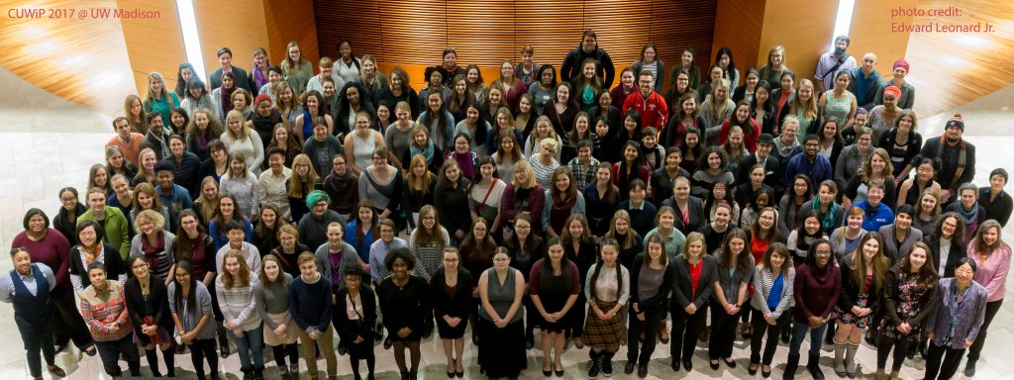
Have you considered physics?
In the US, UK, and Canada, thousands of women physics majors and their allies gather each year in support
Don’t let unconscious bias keep you from considering a physics career!
Source: Conferences for Undergraduate Women in Physics (CUWiP)

Slide 41
References
APS and IPEDS Completion Survey, www.aps.org/programs/education/statistics/womenmajors.cfm
Bian, L., Leslie, S. J., & Cimpian, A. (2017). Gender stereotypes about intellectual ability emerge early and influence children’s interests. Science, 355(6323), 389-391.
Boring, A., Ottoboni, K., & Stark, P. (2016). Student evaluations of teaching (mostly) do not measure teaching effectiveness. ScienceOpen Research.
Caplar, N., Tacchella, S., & Birrer, S. (2017). Quantitative evaluation of gender bias in astronomical publications from citation counts. Nature Astronomy, 1(6), 0141.
Conferences for Undergraduate Women in Physics (CUWiP), http://www.iop.org/activity/groups/subject/wip/history/icwip/page_64677.html
Conover, E. (2016). Physics grading biased against women. APS News, 25(4), https://www.aps.org/publications/apsnews/201604/grading.cfm
Fiske, S. T. (2002). What we know now about bias and intergroup conflict, the problem of the century. Current Directions in Psychological Science, 11(4), 123-128.
Grunspan, D. Z., Eddy, S. L., Brownell, S. E., Wiggins, B. L., Crowe, A. J., & Goodreau, S. M. (2016). Males under-estimate academic performance of their female peers in undergraduate biology classrooms. PloS one, 11(2), e0148405.
Hazari, Z., Sadler, P. M., & Tai, R. H. (2008). Gender differences in the high school and affective experiences of introductory college physics students. The Physics Teacher, 46(7), 423-427.
Hazari, Z., Tai, R. H., & Sadler, P. M. (2007). Gender differences in introductory university physics performance: The influence of high school physics preparation and affective factors. Science Education, 91(6), 847-876.
IUPAP International Conference on Women in Physics Proceedings (2005-2013), www.iop.org/activity/groups/subject/wip/history/icwip/page_64677.html
Leslie, S. J., Cimpian, A., Meyer, M., & Freeland, E. (2015). Expectations of brilliance underlie gender distributions across academic disciplines. Science, 347(6219), 262-265.
Moule, J. (2009). Understanding unconscious bias and unintentional racism. Phi Delta Kappan, 90(5), 320-326.
Potvin, G., & Hazari, Z. (2016). Student evaluations of physics teachers: On the stability and persistence of gender bias. Physical Review Physics Education Research, 12(2), 020107.

Slide 42
Supplemental Slides
The following are supplemental slides you can share with your students to expand the conversation.
6

Slide 43
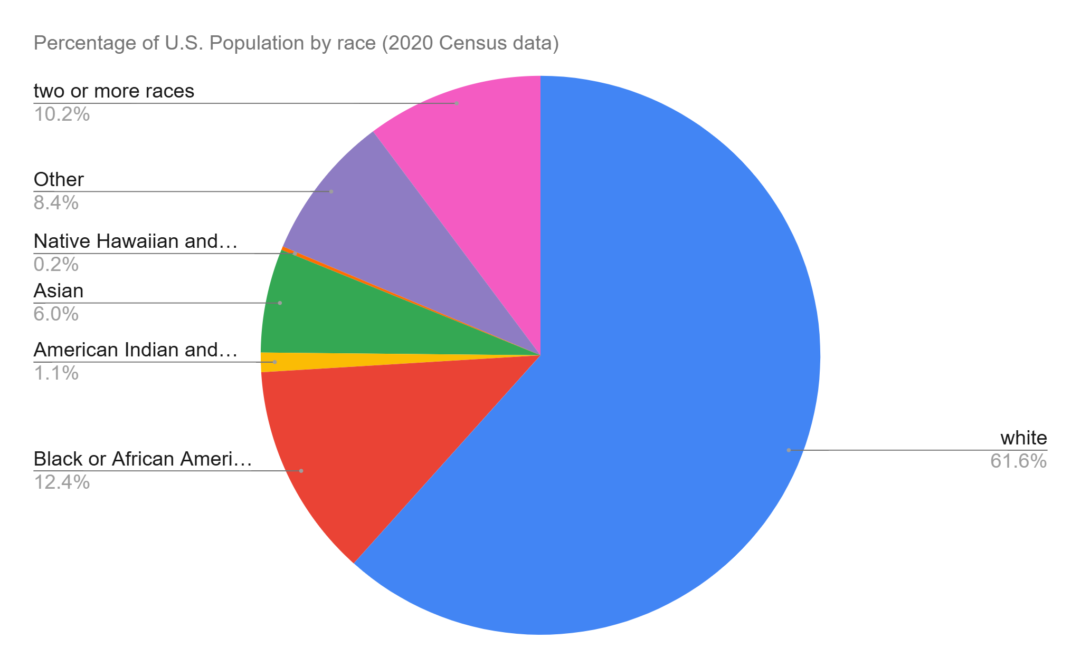
Demographics of the US population

Slide 44
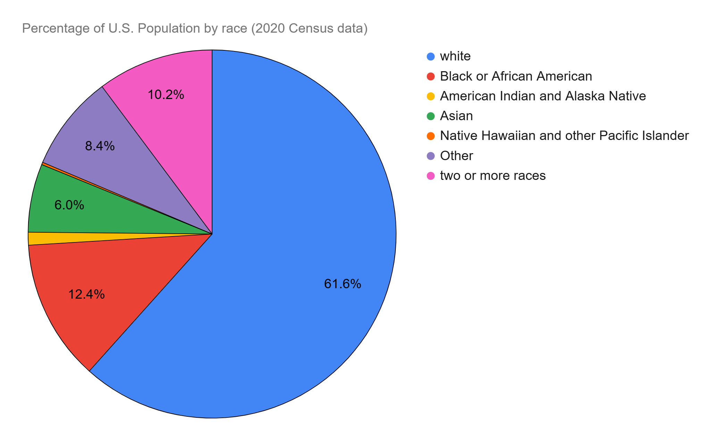
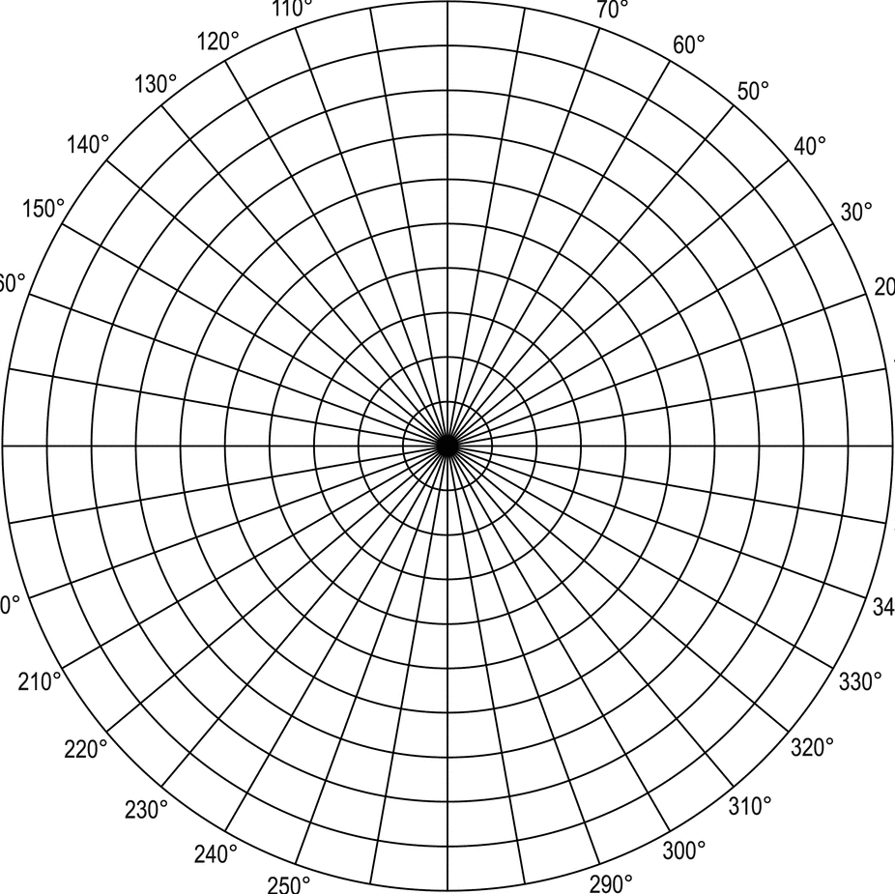
Who does Physics in the US?
⏺Hispanic
To match our available data, Hispanic has been added as a category
Drag the corner of a pie wedge to adjust the percentage you think each demographic represents of the total US population.
Notes:
This activity can be sent to students in a separate presentation for them to complete before continuing to the next slide.

Slide 45
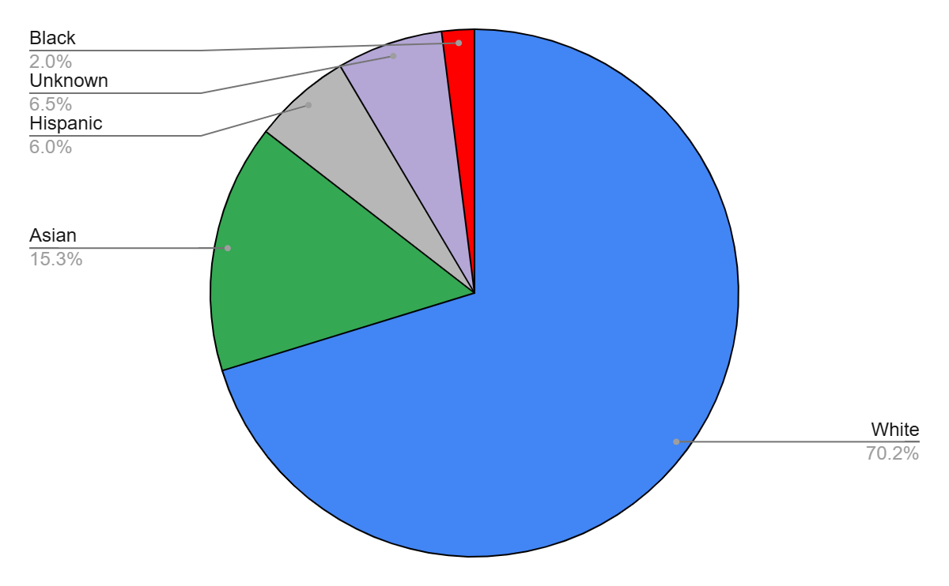
The categories of race in the US Census don’t exactly match the categories of data for physicists in the US.
Notes:
https://www.zippia.com/physicist-jobs/demographics/

Slide 46
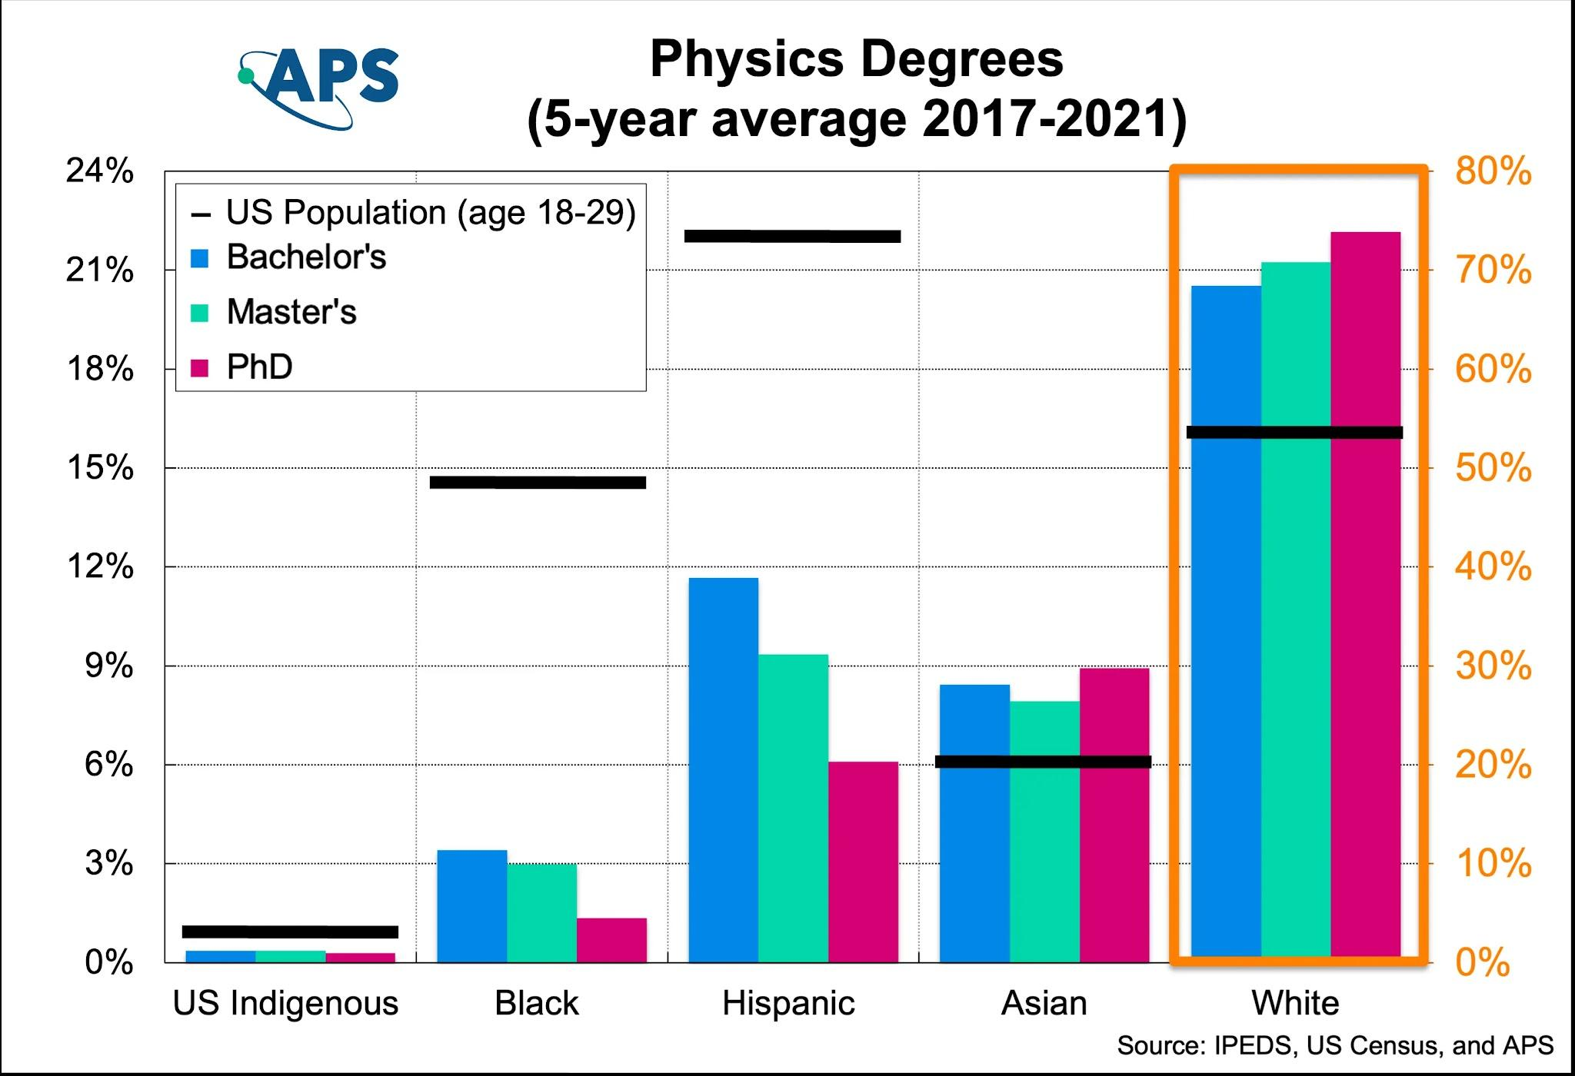
Notes:
https://www.aps.org/images/MarginalizedRaceEthnicity-physics-av-2021_3.webp
Looking at some specific marginalized groups, the black line represents their share of the overall US population in that age level compared to their share of physics degrees. For example, despite making up over 20% of the US population from 2017-2021, less than 12% of Physics bachelors degrees were awarded to students that identified as Hispanic.
Note difference axis for the white group on the far right, a click will scale the other groups to the same scale.

Slide 47
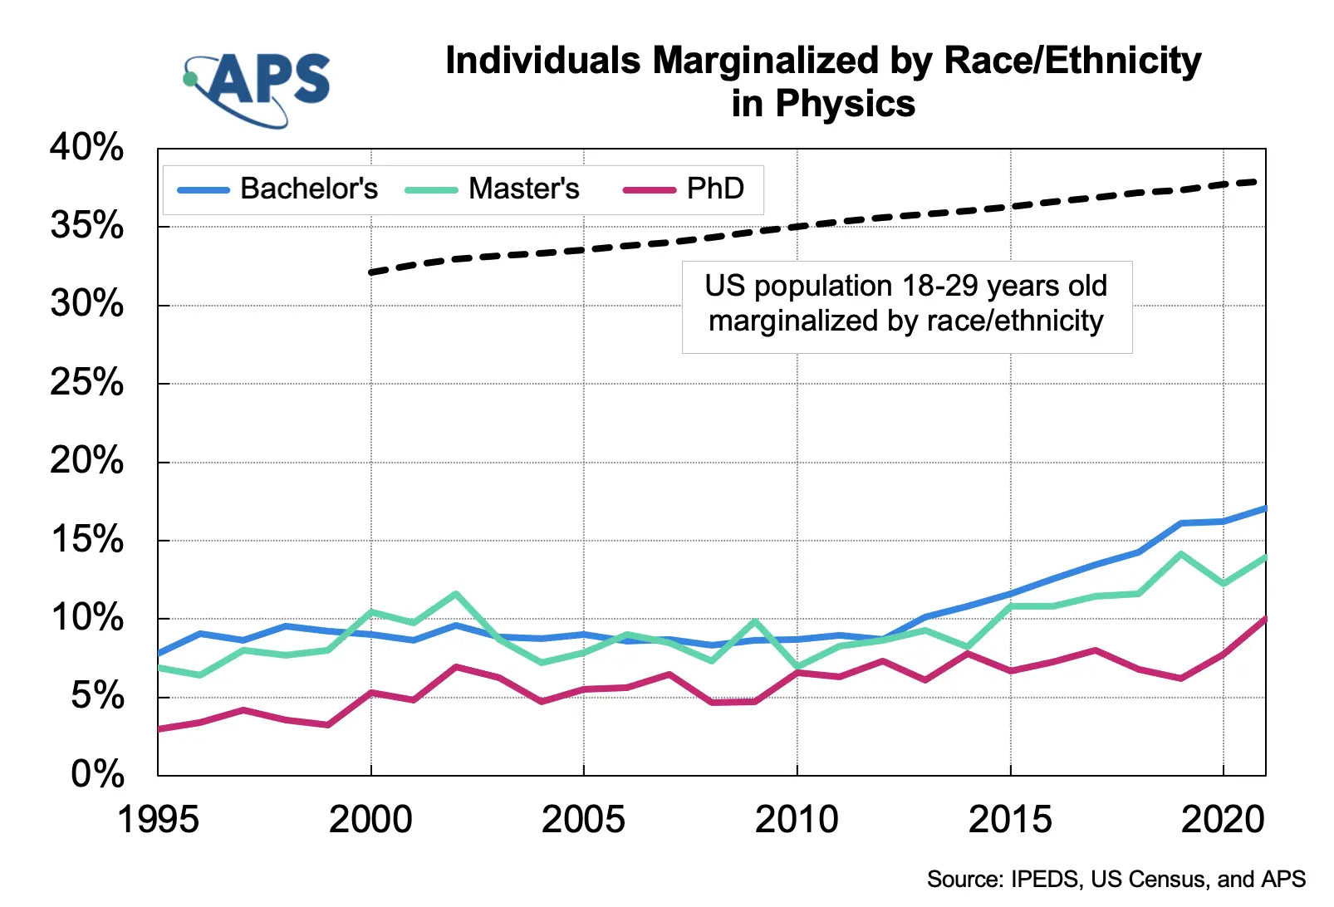
Notes:
https://www.aps.org/images/MarginalizedRaceEthnicity-physics-2021.webp
Looking at the trends of marginalized groups over time, there is an increase in physics degrees awarded but it is a shallower gain than the population gain

Slide 48
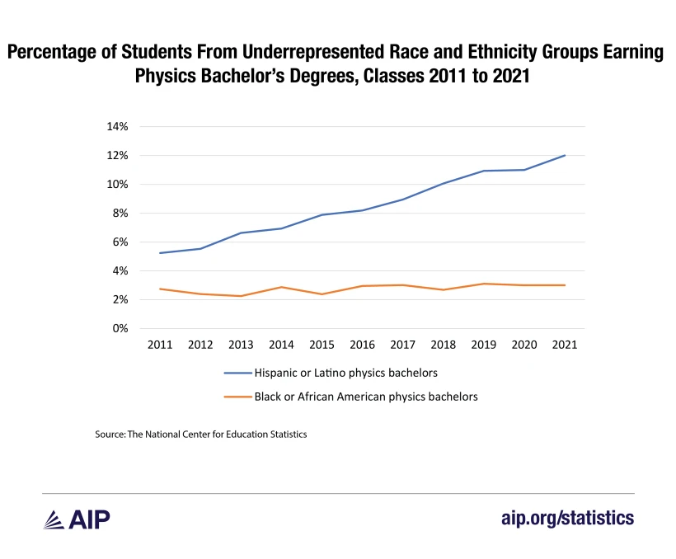
Notes:
https://ww2.aip.org/statistics/attrition-and-persistence-in-undergraduate-physics-programs

Slide 49
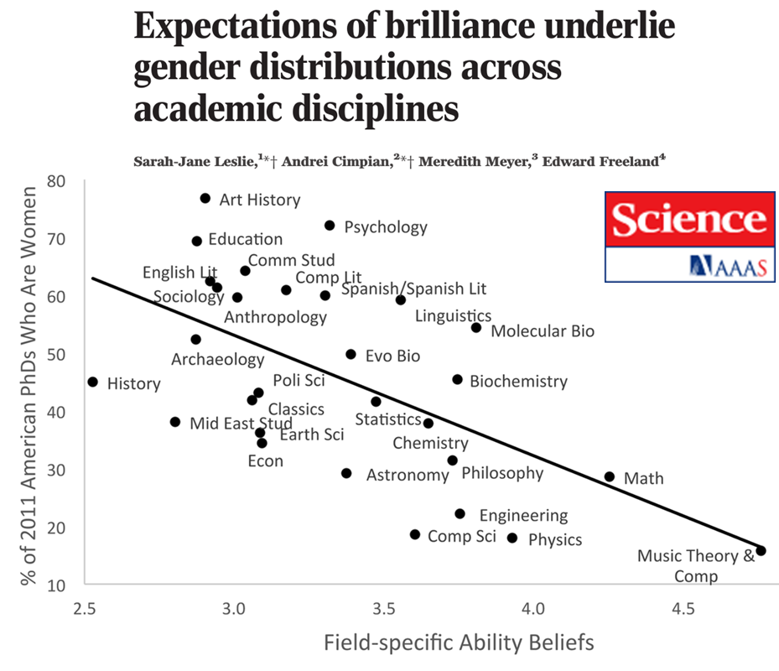
An effect of unconscious bias
The more a field is associated with intellectual ability, the lower the percentage of PhDs in that field who are women.
6
Notes:
Ref: Leslie et al., 2015

Slide 50
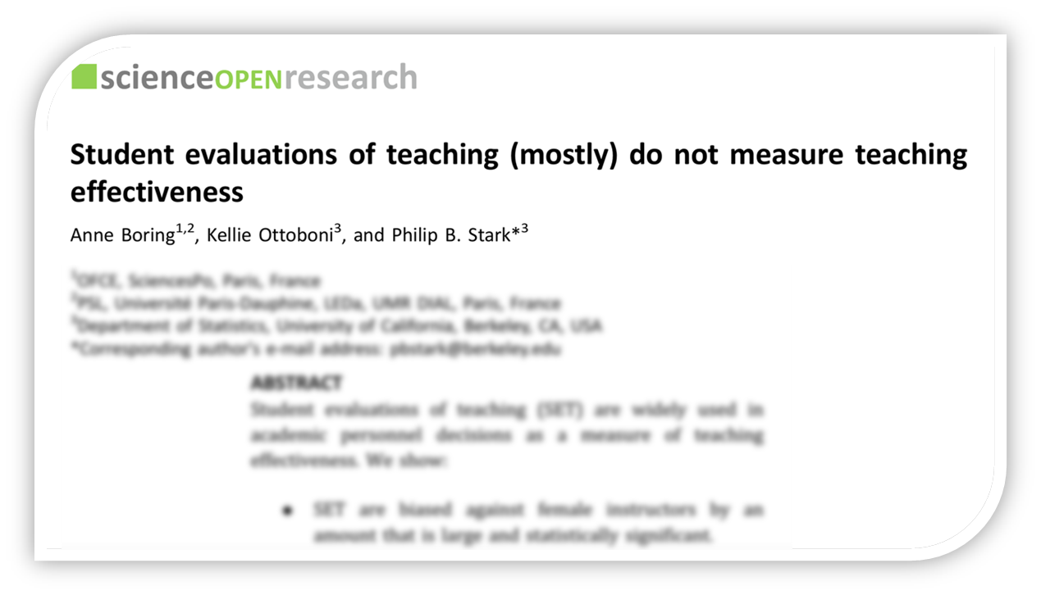
An effect of unconscious bias
In identical online classes, instructors received better evaluations using a man’s name than a woman’s name. Gender bias in evaluations also occurs for physics teachers.
Notes:
Ref: Boring et al., 2016; Potvin & Hazari, 2016

Slide 51
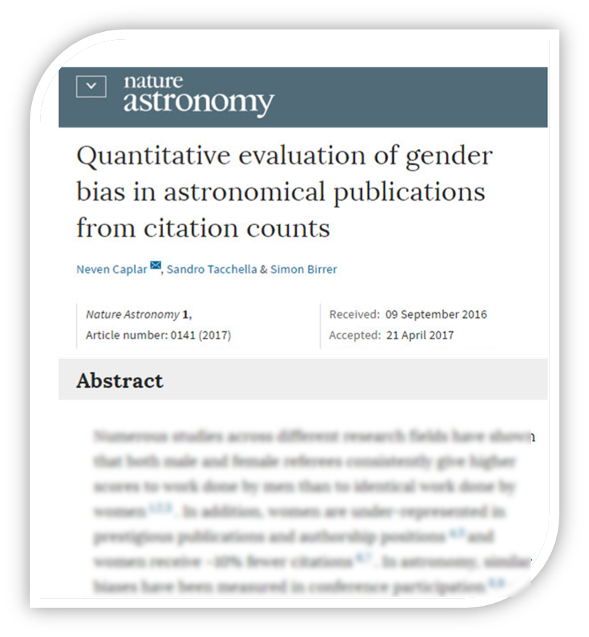
An effect of unconscious bias
Women are treated unfairly in science even today though scientists may not be consciously aware of this.
How can we counteract these effects?
6
Notes:
Ref: Leslie et al., 2015

Slide 52
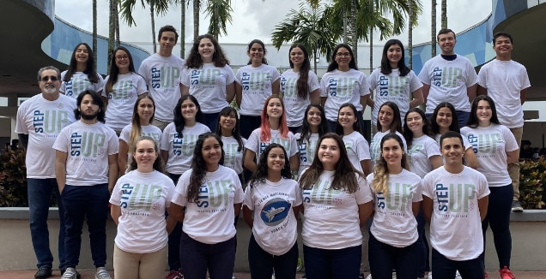
This project is funded by the National Science Foundation, grant # 1720810, 1720869, 1720917, and 1721021 and the Gordon & Betty Moore Foundation. Any opinions, findings, and conclusions or recommendations expressed in these materials are those of the author(s) and do not necessarily reflect the views of the funders.
52
Notes:
Picture: STEP UP Ambassador Andres Torres and his STEP UP club at Ronald Reagan/Doral Senior High School in Florida.

