Slide 1
Bachelors Degrees in Physics
What you didn’t know

Slide 2
Job Stability & Satisfaction
Based on national surveys of students with bachelor’s degrees in physics
High employment rates (95%)
High job satisfaction in terms of
  Feelings of job security
    nearly 90% (depending on sector) felt secure
  Overall satisfaction
    85% (depending on sector) felt a sense of satisfaction
Notes:
https://www.aip.org/statistics/job-satisfaction-of-physics-bachelors-in-private-sector-stem-positions-academic-years-2020-21-and-2021-22
https://www.aip.org/statistics/status-of-physics-bachelors-one-year-after-degree-academic-years-1996-through-2022

Slide 3
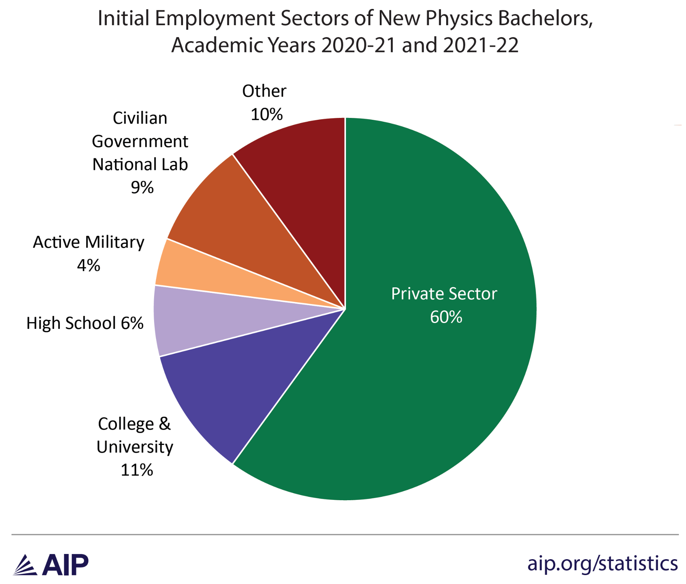
Optional Research
Go to the American Institute of Physics Statistics website and research more about who is hiring physics majors to do what within the government or private sector.
Notes:
The interactive at https://www.aip.org/statistics/whos-hiring-physics-bachelors allows students to click on any state and see who is hiring physics bachelors degrees there.

Slide 4
Job Opportunities
Flexible options and sectors including:
National Labs
Professional Schools (e.g. Medicine, Health)
Environmental/Climate Science and Energy
Space Science
Government/Policy
Public Administration and Business
Communication (e.g. Science Writing, Media)
Education (e.g. High School, College/University)
Engineering and Computing
Arts (e.g. Music, Television)
Not-for-Profit Organizations
Graduate Studies (e.g. multiple STEM disciplines)
Notes:
Reference: IOP, 2017; Mulvey & Pold, 2017; Tesfaye & Mulvey, 2012

Slide 5
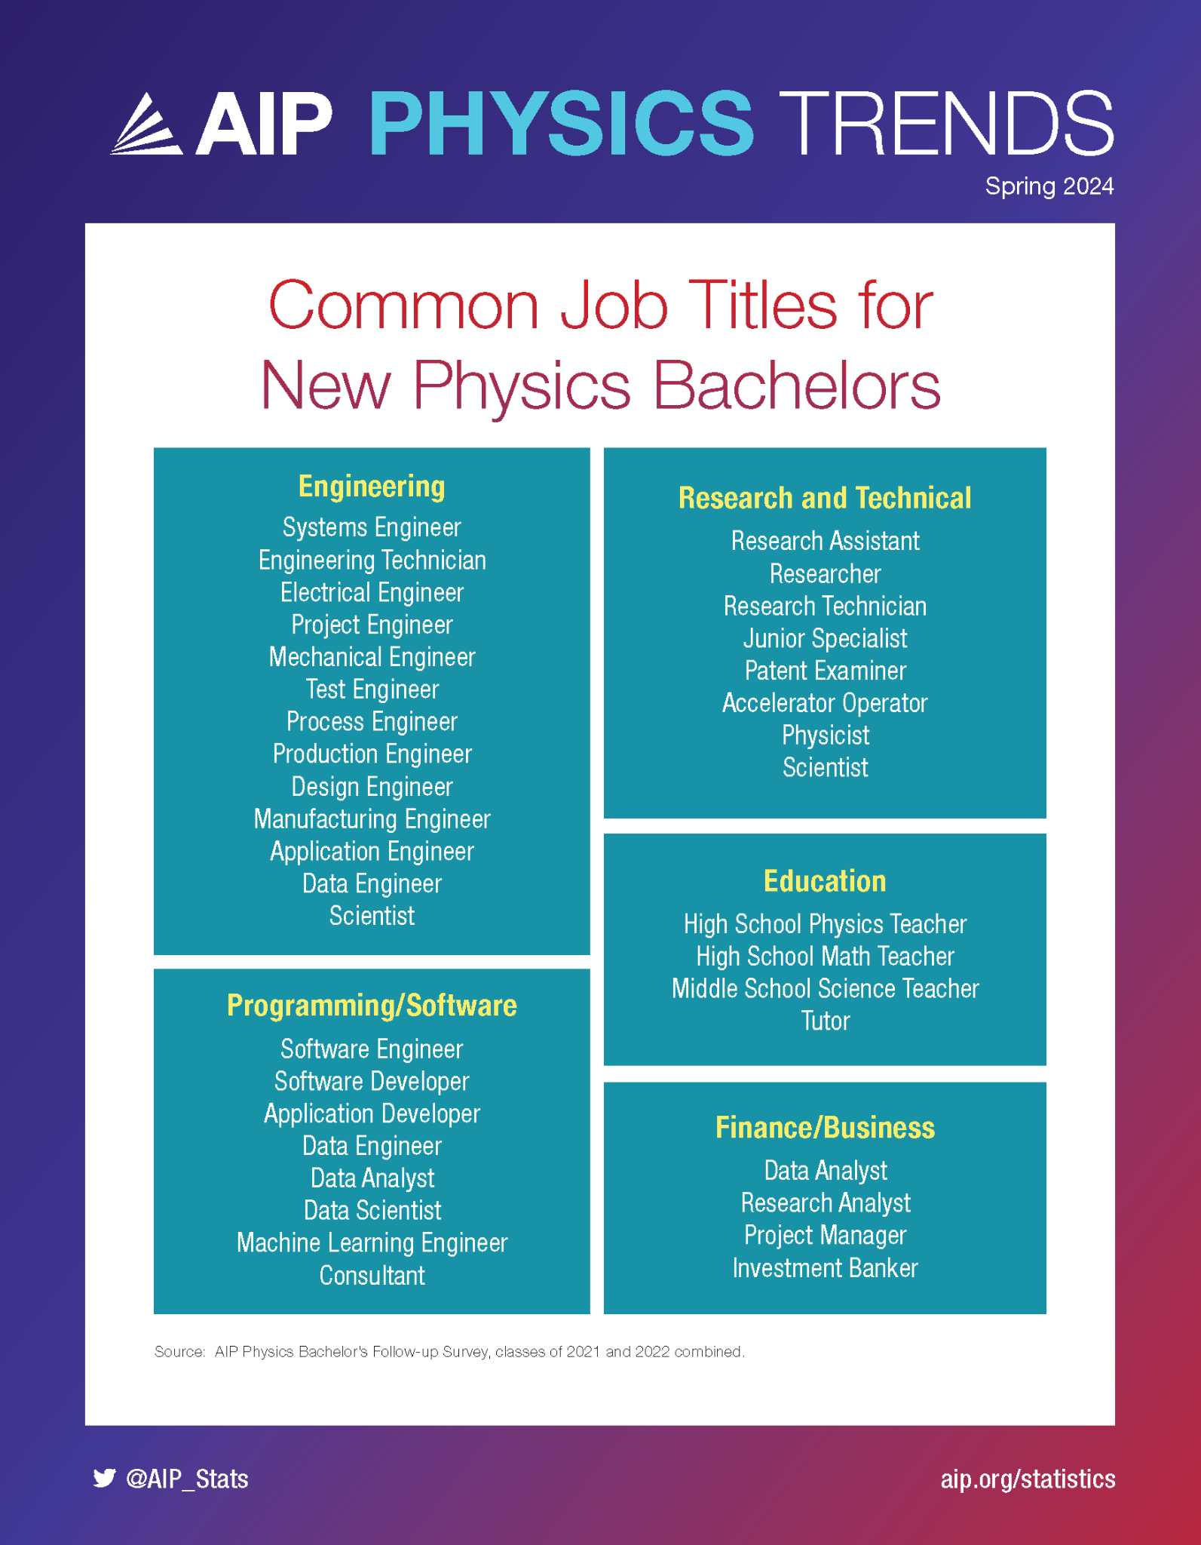
Surprising Facts: Salaries
Lots of job variety with flexible options and multiple sectors
Notes:
https://www.aip.org/statistics/physics-trends-common-job-titles-for-new-physics-bachelors

Slide 6
Job Opportunities
On the MCAT (Medical College Admission Test), which major from amongst the following gets the highest scores? Lowest scores?
A. Biology B. Psychology C. Chemistry D. Physics E. Engineering
On the LSAT (Law School Admission Test), which major from amongst the following gets the highest scores? Lowest scores?
A. Biology B. Psychology C. Chemistry D. Physics E. Engineering
Notes:
Reference: IOP, 2017; Mulvey & Pold, 2017; Tesfaye & Mulvey, 2012

Slide 7
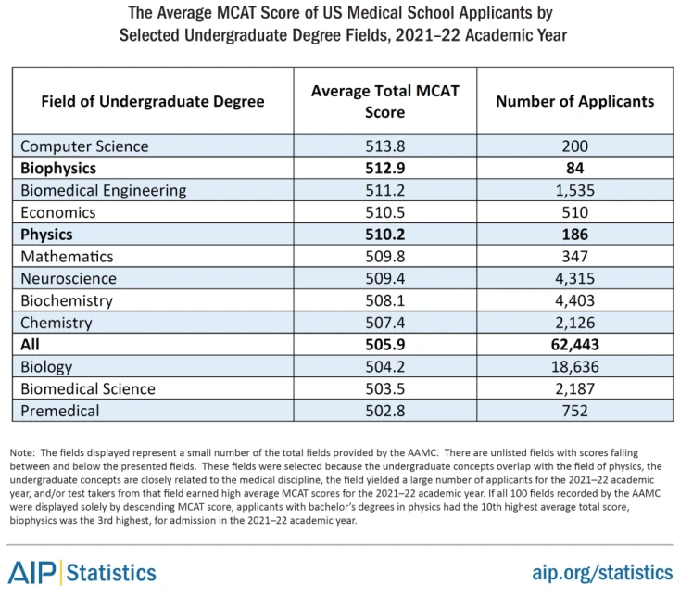
Surprising Facts: Medicine
Physics Majors and Medical School
  Physics majors get very high scores on the MCATs
Notes:
(Tyler & Mulvey, 2022)
https://www.aip.org/statistics/how-well-do-physics-bachelors-degree-recipients-perform-on-the-mcat-and-lsat-exams

Slide 8
Surprising Facts: Law
Law School Admissions Test (LSAT): Top Ten College Majors for "Mean Highest LSAT" Score, 2017-18
Field of Undergraduate Degree | Average total LSAT Score | Number of Applicants
Statistics | 164.14 | 21
Mathematics | 162.8 | 293
Physics, General | 161.58 | 122
Astronomy | 161.33 | 9
Computer Sci, General | 161.24 | 136
Nuclear Engineering | 161.2 | 10
Physics, Specialization | 161 | 11
Biomedical Engineering | 160.45 | 90
Classics | 160.38 | 264
Environmental Engineering | 160.32 | 28
Source: Law School Admission Council, 2018
Physics Majors and Law School
  Physics majors get very high scores on the LSATs
Notes:
Source: Cottle 2019
https://bridgetotomorrow.wordpress.com/2019/10/22/which-college-majors-score-best-on-the-law-school-admissions-test-here-are-the-top-ten-for-2017-18/

Slide 9
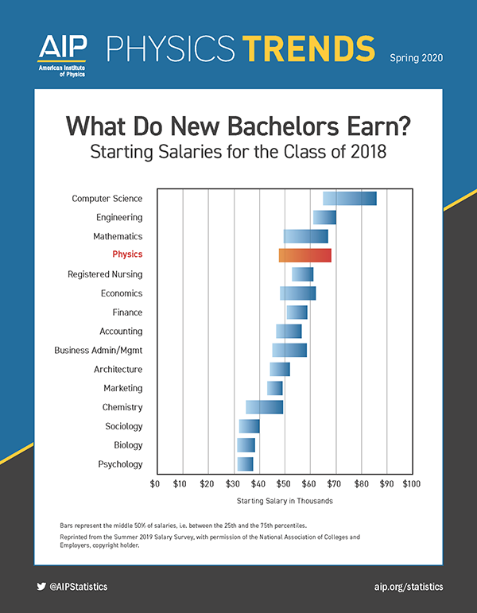
Surprising Facts: Salaries
Physics Majors and Earnings
  Physics bachelors earn comparatively more
Notes:
Reference: AIP, Spring 2020: https://www.aip.org/statistics/physics-trends/what-do-new-bachelors-earn
Reference: AIP, January 2025: https://www.aip.org/statistics/starting-salaries-for-new-physics-bachelors-academic-years-2020-21-and-2021-22

Slide 10
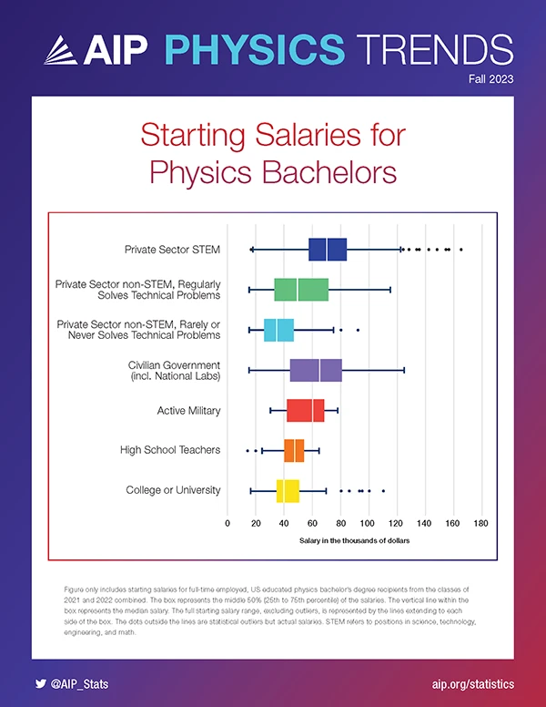
Surprising Facts: Salaries
Physics Majors and Earnings
  Physics bachelors earn comparatively more
Notes:
Old Reference: AIP, Spring 2020: https://www.aip.org/statistics/physics-trends/what-do-new-bachelors-earn
Reference: AIP, January 2025: https://www.aip.org/statistics/starting-salaries-for-new-physics-bachelors-academic-years-2020-21-and-2021-22
https://www.aip.org/statistics/starting-salaries-for-physics-bachelors

Slide 11
Surprising Facts: Helping Society
Physics Majors Help Others
Improving people’s health
  Diagnosis and treatment of illness, for example:
    Cancer treatment using radiation, new nanobot technology to target individual cancer cells
    Body imaging using X-rays, ultrasound, NMR and PET scans
    New methods using infrared light to monitor our blood
Addressing environmental issues
  Energy needs and climate change effects, for example:
    New renewable energy technology
    Climate change effects on humans, animals (e.g. penguin populations), and land (size of the Sahara Desert)
    Environmentally friendly transportation methods
And many more…
Notes:
Reference: AIP, 2016

Slide 12
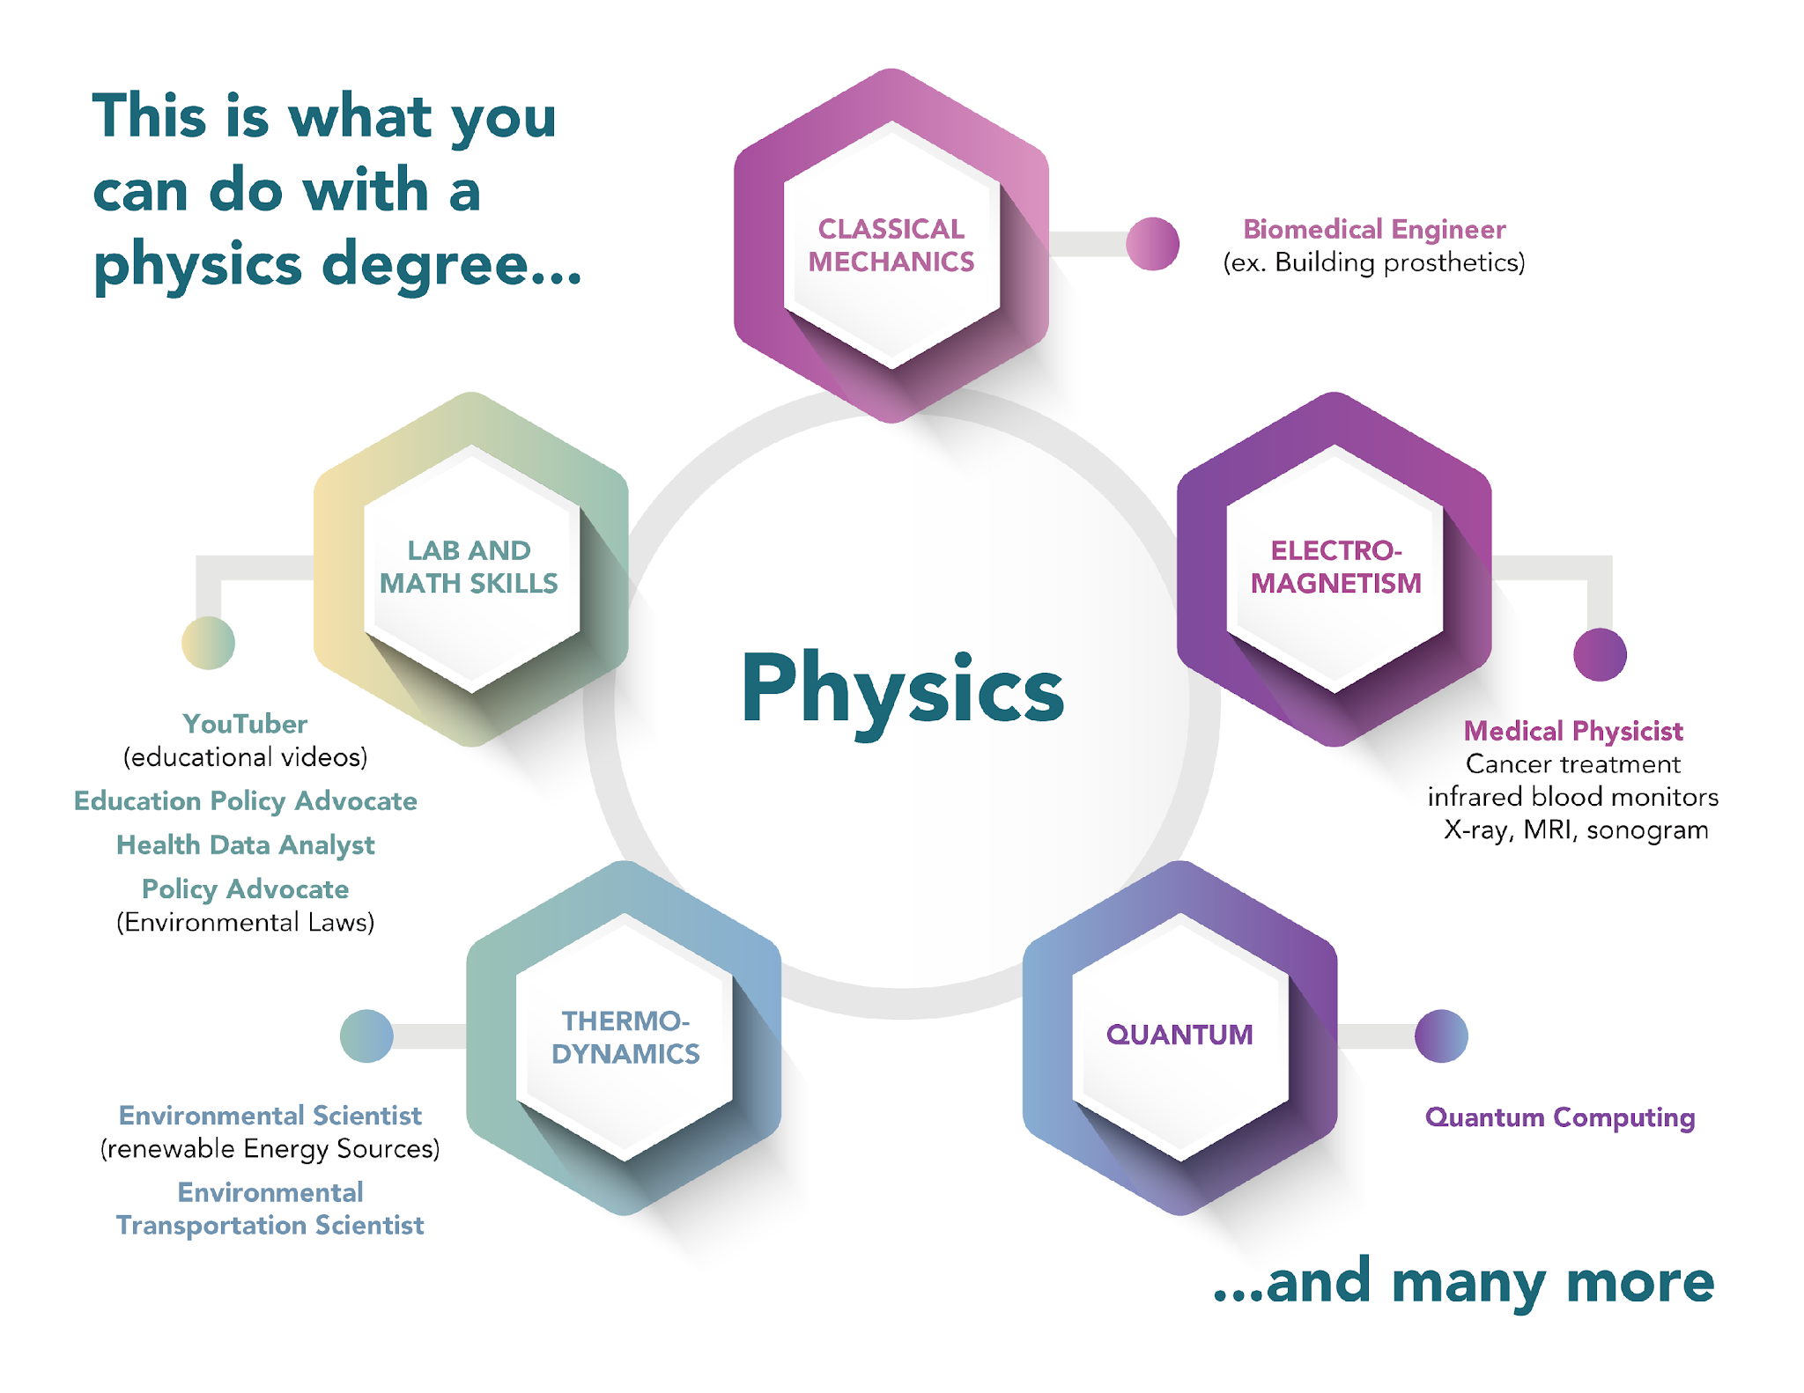
Surprising Facts: Helping Society

Slide 13
Summary
Students who earn a degree in physics:
Have high employment and job satisfaction
Work in many different sectors (STEM/non-STEM)
Gain skills that give them a competitive edge for Medical and Law School
Earn comparatively higher salaries than most other bachelor’s degrees
Have the opportunity to help society in substantial ways

Slide 14
Discussion Questions
What surprised you about the:
Areas in which physicists work?
Skills physicists apply working in such diverse areas?
Benefit physicists can have on the lives of others?

Slide 15
References
AIP Statistics (2016). What’s a Bachelor’s Degree Worth? American Institute of Physics (AIP). Retrieved from: https://www.aip.org/sites/default/files/statistics/physics-trends/fall16-bs-deg-worth.pdf
Cottle, P. (2019, October 22). Which college majors score best on the Law School Admissions Test? Here are the top ten for 2017-18. Bridge to Tomorrow. https://bridgetotomorrow.wordpress.com/2019/10/22/which-college-majors-score-best-on-the-law-school-admissions-test-here-are-the-top-ten-for-2017-18/
IOP (2017). Institute of Physics (IOP) Careers from physics. Retrieved from: http://www.physics.org/careers.asp?contentid=381
Mulvey, P., & Pold, J. (2017). Physics Bachelor: Initial Employment. American Institute of Physics (AIP) Report. Retrieved from: https://www.aip.org/sites/default/files/statistics/employment/bachinitemp-p-14.1.pdf
Pold, J., & Mulvey, P. (2016). Physics Bachelors: One Year after Degree. American Institute of Physics (AIP) Report. Retrieved from: https://www.aip.org/sites/default/files/statistics/employment/bach1yrafterdeg-p-14.1.pdf
Tesfaye, C.L., & Mulvey, P. (2012). Physics Bachelor’s Initial Employment. American Institute of Physics (AIP) Report. Retrieved from: https://www.aip.org/sites/default/files/statistics/employment/bachinitemp-p-10.pdf
Tesfaye, C.L., & Mulvey, P. (2013). MCAT, LSAT and Physics Bachelor's. American Institute of Physics (AIP) Report. Retrieved from: https://www.aip.org/sites/default/files/statistics/undergrad/mcat-lsat1.pdf
Tyler, J., & Mulvey, P. (2022, April 1). How Well Do Physics Bachelor's Degree Recipients Perform on the MCAT and LSAT Exams? American Institute of Physics. https://www.aip.org/statistics/how-well-do-physics-bachelors-degree-recipients-perform-on-the-mcat-and-lsat-exams

Slide 16
Acknowledgement: This work is supported by the National Science Foundation under Grant No. 1720810, 1720869, 1720917, and 1721021 and Moore and Betty Foundation DOI: doi.org/10.37807/GBMF11451

