Slide 1




Dark and Smelly Urine- Now What?
Prepared for APIC SD Chapter 1/11/24
Victoria Walker MD, CMD, FAAFP
Avera LTC Medical Director
Avel eCare Senior Care Medical and Clinical Officer
Form 0003-22 EDUC.SRCR (Rev. 10/22)
Notes:
Hello, I am Dr. Victoria Walker. I am the Medical Director for Avera LTC and Medical and Clinical Officer for Avel eCare Senior Care program.
I am a fellow of the American Academy of Family Physicians, a Certified Medical Director in PALTC, and a Clinical Associate Professor in family medicine at the Sanford School of Medicine.
Our focus today will be current recommendations of the management of urine infections to achieve effective antimicrobial stewardship for geriatric populations.

Slide 2


Objectives
Establish the definition of urinary tract infection
Review the focused assessment of urinary tract in older patients
Discuss management strategies
Notes:
Specifically, at the end of the presentation today, you will:
Understand the limitations of the urine culture and frequency of bacteriuria and harms associated with misdiagnosis
Apply evidence-driven criteria to order urinalysis
Discuss special situations, like when there are communication limitations due to cognitive impairment and the differential diagnoses of nonspecific symptoms
Consider Practice change strategies, such as nurse-driven interventions, re-evaluation strategies and pearls for communicating with staff and families

Slide 3
About half the antibiotics prescribed to older adults are for suspected urinary infections.
Many of these do not meet clinical guidelines for appropriate prescribing
Notes:
The management of suspected urine infections has a huge impact on antimicrobial stewardship. Antibiotics are one of the most frequently prescribed classes of medications 47-79% of LTC residents receive antibiotics in a year; between 25-75% is unnecessary. About half the antibiotics prescribed to older adults are for suspected urinary infections. If this was clearly benefiting them, it would not be a concern. However, as we’ll discuss further in the presentation, these prescriptions are often associated with harm.

Slide 4
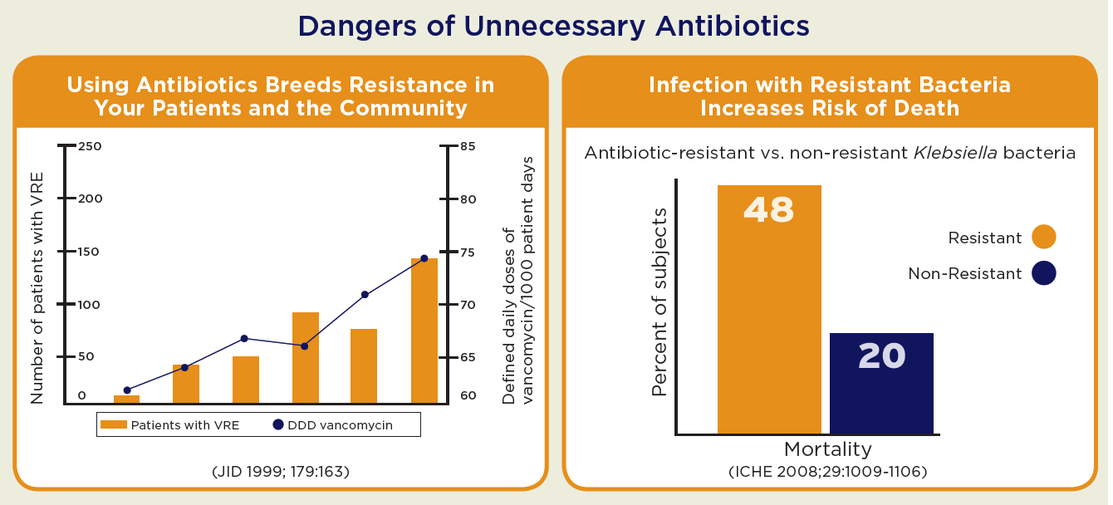
What can it hurt?
Notes:
We've probably all been guilty of saying “let’s be on the safe side” as a justification to start an antibiotic…and even patting ourselves on the back that we “caught that infection early”
if we are actually looking at the evidence, though, if we want to be on the safe side, we will actually refrain from using antibiotics for nonspecific indications.

Slide 5


Case Study:
Bladder Infection or Something Else?
Harriet is a 75 year old female nursing home resident with a history of late stage Alzheimer’s disease and breast cancer. She had an episode of urosepsis with fever, dysuria, urgency, and hypotension 4 years previously. While she can engage in casual conversation, she is unable to recall most recent events. The night nurse requests a urine culture because she believes Harriet has a bladder infection. Her daytime nurse reported no fever, flank pain, or complaints of dysuria, hematuria, suprapubic pain, urgency or frequency. Harriet’s vitals are normal, but she is noted to be less interactive over the past day and is not eating as well.

Slide 6
Follow Up to Case Study:
Bladder Infection or Something Else?
Because Harriet did not have urinary signs or symptoms, she was evaluated by her primary care physician who noted that she had a new left facial droop and was slurring her words.
The nurse reported she had been having trouble understanding Harriet’s speech but hadn’t recognized the facial droop.
If the physician had ordered the urine culture and risked treating ASB, he would have missed the fact she had a stroke. Harriet was treated conservatively. No urine culture was ordered. Her speech deficit improved and she remains alive, happy and symptom free three years later.
Notes:
In this case, Harriet’s doctor asked to see her because of her new symptoms. A new facial droop and slurring of speech were recognized, and she was diagnosed with a stroke. With conservative treatment, she improved and against the odds, she is alive and doing well 3 years later.

Slide 7
Long Stay Quality Measure N024
Urinary Tract Infection
Reflects the percent of long-term residents who had an infection in their urinary tract anytime during the 30 days before their most recent assessment.
If a physician or provider documents a UTI, it will be included – even if it did not meet the diagnostic criteria.
This contributes to the 5-star Quality Measures score.

Slide 8

What can we do about it?

Slide 9
Multiple Approaches
Knowledge
PCP, nurses, consultants
New hire orientation
Policy and Practice
Discontinue dipsticks
Use nurse-driven interventions
Empower staff and families
Education on Admission
Discuss at resident/family meetings
Antibiotics time outs
Coach nursing to discuss evidence-based protocol with providers

Slide 10
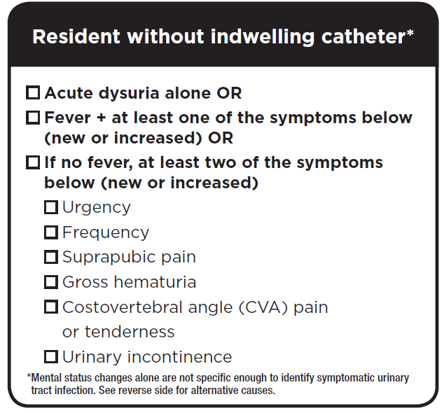
Definition of UTI
Diagnosis is based on CLINICAL signs and symptoms NOT culture results alone
Notes:
One of the key points to remember is that the definition of a urinary tract infection requires that clinical signs and symptoms are present. These are defined on the right – Dysuria alone or Fever along with a localizing symptom – or if no fever is present, 2 localizing symptoms – urgency/frequency/incontinence/suprapubic or CVA pain. It is important to note that mental status changes are certainly concerning, they occur with many different triggers, so this is not considered a localizing symptom.

Slide 11
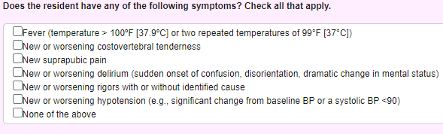
Definition of UTI
Diagnosis is based on CLINICAL signs and symptoms NOT culture results alone
Residents With an Indwelling Catheter
Notes:
When a catheter is present, the chance of infection is much higher and the presence of any of these symptoms meets the minimum criteria to initiate antibiotics

Slide 12
Preventing Catheter-associated urinary tract infections
Avoid placing if possible
Use sterile technique when placing
Remove ASAP
Traps to Avoid
Believing that cloudy/smelly/dark urine means infection
Ordering routine/follow up urine cultures and UA
Treating incidentally discovered asymptomatic bacteriuria
Using antibiotic prophylaxis
Ordering routine changing of a functioning catheter
Notes:
Most of our time today is going to be spent on the biggest area that we have for impacting change, which is to improve diagnostic accuracy for urinary tract infections in people without catheters.

Slide 13
Asymptomatic Bacteriuria (ASB) – aka Colonization
The presence of bacteria (>100,000 CFU/ml) in a urine culture without the presence of urinary symptoms
ASB is found in 50% or more of nursing home residents.
Treatment of ASB does not prevent symptomatic bladder infections, and in fact antibiotic treatment appears to increase the risk of future bladder infections.
Notes:
If localizing symptoms are not present, then the presence of bacteria in urine does not mean that the patient has an infection. This is extremely common in nursing home residents, where studies have shown that at any given time, half of residents do have bacteria present in urine culture … and attempts at eradicating colonization are ineffective and do not carry any benefit to residents.

Slide 14
IDSA, AGS, AMDA and CDC concur…
Numerous studies have consistently shown no benefits to treatment – no reductions in falls, hospitalizations, or mortality
Notes:
It’s worth repeating – the Infectious Disease Society of America, American Geriatrics Society, Society for Post-Acute and Long Term Care medicine, Centers for Disease control and other experts all concur. There is high quality evidence that treating asymptomatic bacteriuria does not benefit patients – there is no reduction in falls, hospitalization, or death.

Slide 15
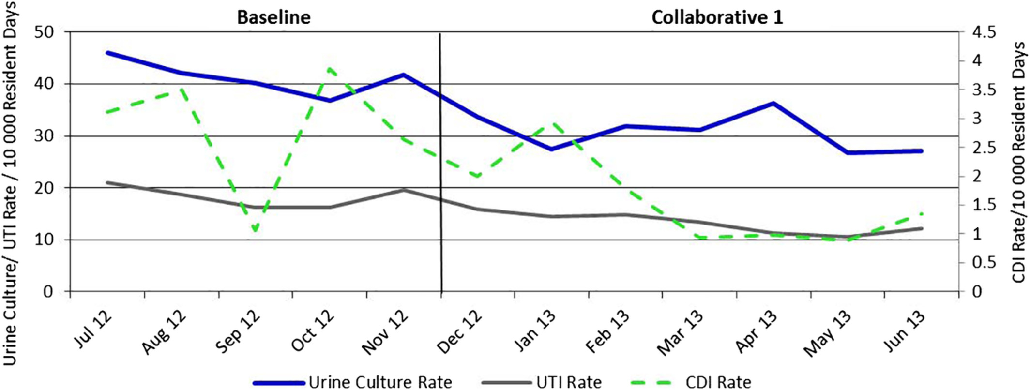
CHANGE IS ACHIEVABLE!
A Statewide Program to Improve Management of Suspected Urinary Tract Infection in Long‐Term Care
J American Geriatrics Society, Volume: 68, Issue: 1, Pages: 62-69, First published: 28 November 2019, DOI: (10.1111/jgs.16261)
Notes:
Rates of urine cultures performed, urinary tract infections (UTIs) diagnosed, and Clostridioides difficile infection (CDI) over time, all per 10 000 resident days in facilities participating in the first collaborative (n = 17). [Color figure can be viewed at wileyonlinelibrary.com]

Slide 16


This toolkit is designed to help PALTC facilities implement an antibiotic stewardship program centered on improving the management of urinary tract infections or UTI. In particular, the toolkit focuses on a specific type of UTI—uncomplicated bladder infections or cystitis.
Notes:
The IOU Study Toolkit is a very helpful resource if you are working to reduce the over-diagnosis of urinary tract infections. In particular, this study was specifically done with a nursing home population, and has very practical approaches outlined for the most common situations that arise. We will walk through some of these actual cases together.

Slide 17

Case Study:
“This is how mom always gets with a UTI”
Mildred is a 94 year old nursing home resident with a history of late stage Alzheimer’s disease, depression, and severe knee arthritis. She was admitted to the nursing home because of her dementia, arthritis and inability to ambulate. The family reports a history of recurrent “urinary tract infections”.
One month after admission, the nurses report Mildred has had a change in condition. She has become irritable and quite nasty towards the staff. She insults the nurses and physically pushes the aides away when they attempt to provide care. She has no fever, no urinary symptoms and her vitals are stable. The daughter requests a urine test because this is “how her mother presents when she has a UTI”.
Notes:
Clinicians are often concerned that because a patient is a poor historian, that it is justified to test and treat without localizing symptoms. It is especially tempting to do this when a family member is insisting that their loved one “always does this” when they have a UTI.
Urinary tract infections are the most common source of bacteremia – catheters, BPH, atrophic vaginitis, neurogenic bladder and dehydration are all risk factors.
Typical incident rate is 9/1000 resident days with catheter, 2.8/1000 resident days without.

Slide 18
Outcome:
Mildred had no urinary symptoms. Because she presented with aggressive behaviors, had significant knee arthritis, and declined to get out of bed, her physician considered pain as a cause following examination.
Pain commonly presents as irritability or physical aggression in residents with dementia.
Scheduled acetaminophen was begun and by the next day, she had improved without antibiotics.
This scenario repeated itself over the next year, but the physician was finally able to convince the daughter that her behavioral changes were not related to UTI.
Notes:
A careful history shed light on a pattern of irritability that raised the likelihood that arthritic pain was triggering her symptoms. Treatment of her pain successfully minimized her irritability and aggression. .

Slide 19
Alternatives to the Knee Jerk Urine Culture Order
If the resident is stable (no urinary symptoms and no systemic signs of infection such as fever or hypotension are present)
Close monitoring of vital signs, intake and behavior is appropriate +/- labs
If the resident doesn’t improve and there are no urinary or infectious symptoms, the resident should be evaluated by a practitioner
Notes:
Nursing home residents presenting without urinary symptoms are no more likely to have bladder infections than any other acute change in condition. Taking a knee jerk approach to ordering a UA may harm the resident by ignoring the true cause for a change in condition and greatly increasing the risk of adverse drug events, drug interactions, Clostridium difficile infections, and resistant bacteria. Unnecessary treatment increases costs to the patient and may contribute to avoidable hospitalizations.

Slide 20
Non-Specific Signs and Symptoms
Urinary Incontinence
Foul smelling or dark urine
New fatigue
New confusion or delirium
Change in behavior
Less interactive
SHOULD be further evaluated…but they are not an indication to check a urine.
These DO NOT support the Diagnosis of UTI in ABSENCE of Key Symptoms
Notes:
As a reminder, these are all NONSPECIFIC symptoms – when they are present, they should be further evaluated – but they are not an indication to check a urine.

Slide 21
Consider alternative diagnoses
“Poor historian” doesn’t mean they have nothing to tell you – it means you may need to listen more carefully.
• Speak to the resident directly and in a quiet setting.
• Minimize distractions by turning off the TV, loud music, and closing the door.
• Establish a calm, relaxed rapport with the resident.
• Use yes / no type questions and use visual clues.
• Give the resident time to respond to questions.
• When asking specific questions about urinary symptom, rephrase the questions using a variety of alternative descriptors. For example, when investigating whether a resident has dysuria, ask not just about burning on urination, but also ask about discomfort, pain, “hurting when you pee”.
• Weave repeated questions into your conversation.
• Suprapubic, flank, and scrotal pain are both symptoms and an exam findings. Always perform an abdominal exam when assessing for suprapubic pain.
Notes:
It is so important to remember that dementia residents often have a lot to tell us, even when their verbal and cognitive skills have been diminished by their disease. It can be reassuring to family members when you take the time to explain to them that because their loved one has dementia, you are taking extra precautions to make sure you don’t miss anything. Some tips for listening to what they have to say include slowing down, minimizing distractions, using simple and repeat questions.

Slide 22
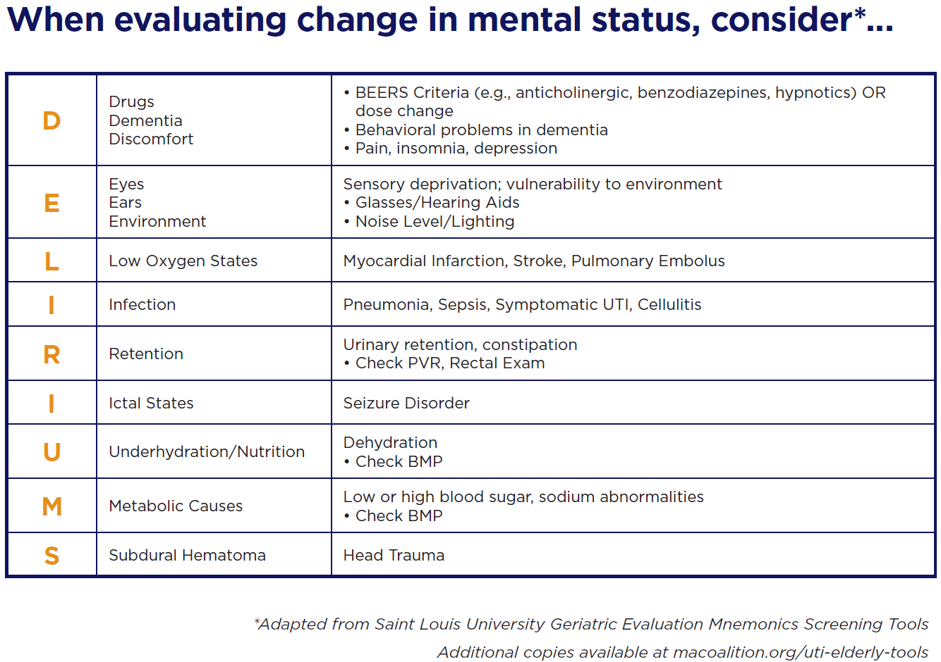
When evaluating change in mental status, consider*…
Notes:
We all benefit from hitting the pause button, and carefully exploring “what else” might be going on. DELIRIUMS is a mneumonic that can help you keep a broad differential in mind, considering everything frommedication side effects to urine retention, sepsis, hyponatremia, dehydration and head trauma.

Slide 23
If key symptoms are not present, do not order a UA
Active Monitoring Orders:
Encourage __ oz of liquid intake __ times daily
Record fluid intake, notify physician if less that ___ cc daily
Vital signs, including temp, every shift (____ hours) for ___ days
Notify physician/NP/PA if symptoms worsen or are unresolved in ____ hours
Obtain the following bloodwork ____
Consult pharmacist to review medication regimen
Institute Active Monitoring and Evaluate for other causes
Notes:
It is important that staff and family member’s concerns are taken seriously – when they notice a change in condition, it should be addressed. Instituting active monitoring orders and evaluating for causes of the changes are recommended. These sample active monitoring orders can readily be adopted for your facility.

Slide 24
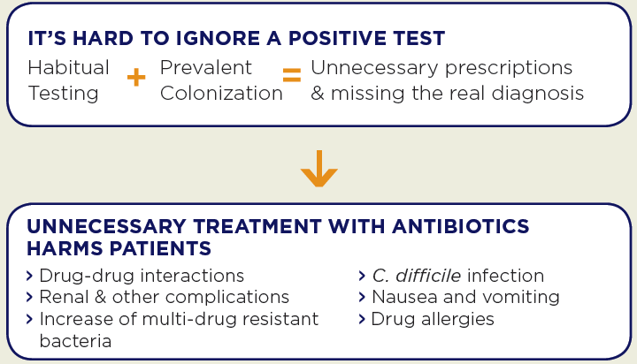
Don't Order a Urine Culture
In residents without urinary symptoms or signs of systemic infection (fever, chills, leukocytosis)
In residents with non-specific symptoms alone in the absence of urinary or systemic infectious signs
As part of a routine yearly physical
Based on standing orders in residents without symptoms
To verify eradication after antibiotic treatment
To evaluate foul smelling urine in the absence of urinary symptoms
To evaluate urine that is cloudy or dark in color
Notes:
Best practice guidelines also recommend that urine cultures are not recommended as part of yearly physicals, based on standing orders, or to do test of cures.

Slide 25

Effective Communication Strategies
Actively Listen to the Concern behind the Request
Validate the Concerns, Explain Action Plan
Active Monitoring Orders:
Encourage __ oz of liquid intake __ times daily
Record fluid intake, notify physician if less that ___ cc daily
Vital signs, including temp, every shift (____ hours) for ___ days
Notify physician/NP/PA if symptoms worsen or are unresolved in ____ hours
Obtain the following bloodwork ____
Consult pharmacist to review medication regimen

Slide 26
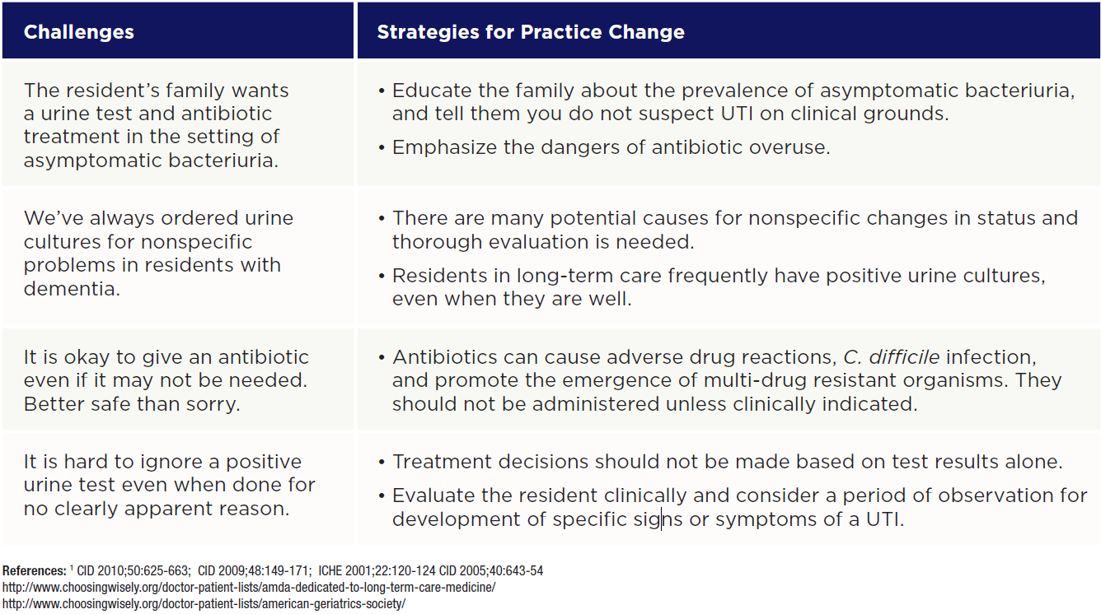

Slide 27
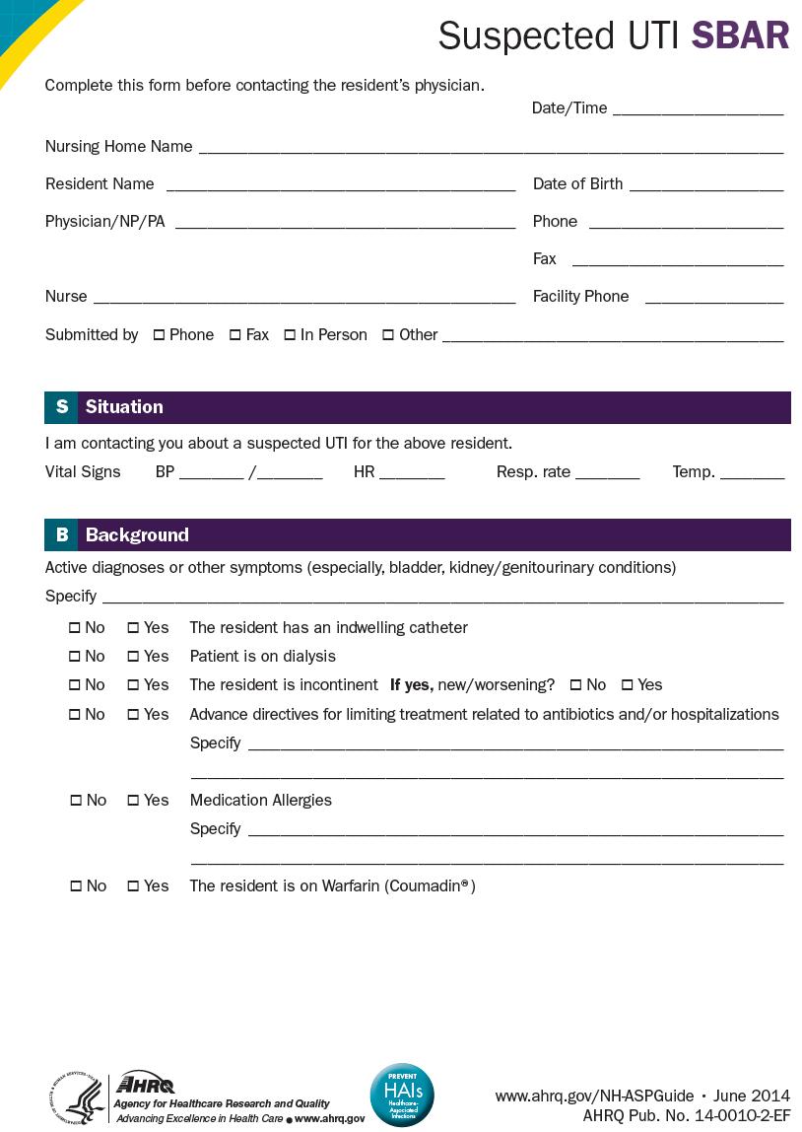
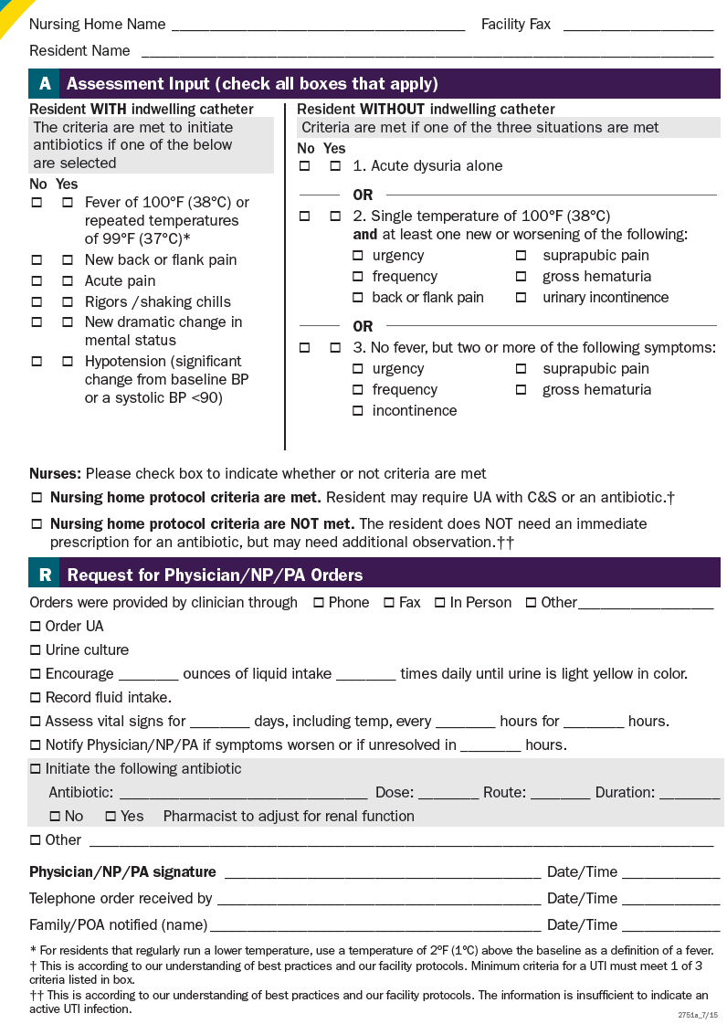
Agency for Healthcare Research and Quality (AHRQ)
Notes:
There are many excellent resources available to help you implement the best practices that we covered today. This is one example from the Agency for Healthcare Research and Quality. Others are included in the final slide of this presentation. I thank you for your participation today, and your dedication to caring for older patients.

Slide 28
References
Agency for Healthcare Research and Quality (2016). Toolkit 1. Suspected UTI SBAR Toolkit . ahrq.gov/nhguide/toolkits/determine-whether-to-treat/toolkit1-suspected-uti-sbar.html
Massachusetts Coalition for the Prevention of Medical Errors. Healthcare Associated Infections. http://macoalition.org/evaluation-and-treatment-uti-in-elderly.shtml
Mody, L., Crnich, C. (2015) . Effects of Excessive Antibiotic Use in Nursing Homes. Journal of American Medical Association Internal Medicine 175 (8), 1339-1341. doi: 10.1001/jamainternmed.2015.2774..
Nicolle, L.E., Gupta, K., Bradley, S. F., Colgan, R., DeMuri, G. P. , Drekonja, D., Eckert, L.O., Geerlings, S.E., et. Al. (2019). Clinical Practice Guideline for the Management of Asymptomatic Bacteriuria. Clinical Infectious Diseases 68 (10), e83-e110, https://doi.org/10.1093/cid/ciy1121
Quality Measures Resource Manual (2004). CHAPTER 6 – SECTION N Percent of Residents With a Urinary Tract Infection (cms.gov)
Salem-Schatz, S., Griswold, P., Kandel, R., Benjamin-Bothwell, S., DeMaria Je., A., EcElroy, No., Bolstorff, B., et. Al. (2020) . A Statewide Program to Improve Management of Suspected Urinary Tract Infection in Long-Term Care. Journal of American Geriatric Society 68 (1) 62-69
Society for Post-Acute and Long-term Care Medicine (AMDA) Improving Outcomes of UTI. iou Toolkit | AMDA | The Society for Post-Acute and Long-Term Care Medicine (paltc.org).
Society for Post-Acute and Long-term Care Medicine (AMDA ). Choosing Wisely Campaign Choosing Wisely | AMDA | The Society for Post-Acute and Long-Term Care Medicine (paltc.org)

