Slide 1


Slide 2

Under Chat, please tell us who you are, where you work, & how long you have worked in Infection Prevention.
If you have any questions for the SD APIC Board of Directors, please write them in the chat & we will monitor that throughout the discussion.

Slide 3
Current Board Members
President: Bunny Christie (2024-2027)
President-Elect: Leah Bomesberger (2025-2027)
Secretary: Sheila Pitts (2024-2025)
Treasurer: Lisa Hamm (2024-2026)
Education Coordinator: Elizabeth Healy (2024-2026)
Nomination Committee Chair: Michelle Jury (2024-2026)
Chapter Webmaster: Shelly Heckenlaible (2024-2027)
Chapter Conference Committee: Jess Danko (2024-2026) & Rebecca Sime (2024-2027)
Chapter Chair- Shannon Britt (2024-2026)
*Open position*– Legislative Chair
Notes:
Allow Leah to make her announcement when her title is read.

Slide 4
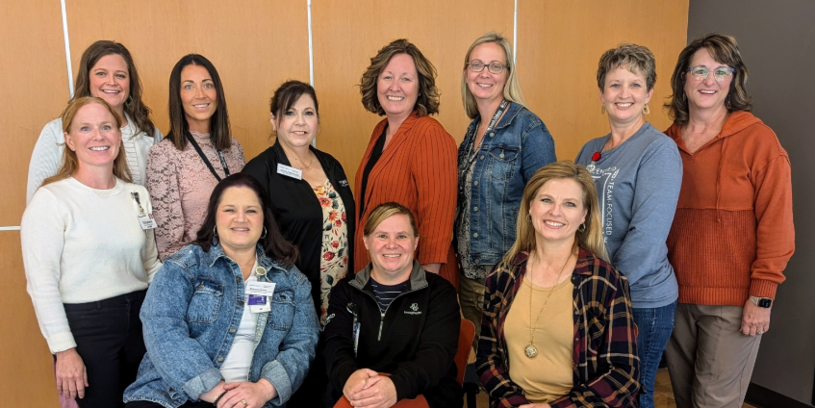

Slide 5
Notes:
We shared this slide and timeline at one of our first meetings. It has taken a lot of work to get a chapter started.

Slide 6
Notes:
2024- Dr. Victoria Walker, Elizabeth Gonzalez (EBP), Jacob Parson (SDAHO Legislation Update). We had great attendance for our first conference with both an in person and virtual option.

Slide 7
Notes:
2025– We want to continue to partner with agencies such as Immunize South Dakota and Voices for Vaccines in addition to other agencies in South Dakota. Talk about new newsletter coming out soon.

Slide 8
Notes:
We will need new board members next year to continue our work and advocacy. Many members means light work.

Slide 9





Access to APIC Chapter Website (Chapter 136)
  $25 annual membership fee that will expire when your national membership expires
  Contact Information for Board Members
  Slides & Presentations available
  Upcoming Events
  Networking & contacts
Facebook Page– APIC South Dakota
Gmail account- apicsouthdakota@gmail.com

Slide 10
Benefits of a Chapter Member
Provide ongoing member support at the local level
Foster communication and networking opportunities
Offer educational opportunities through chapter events and/or conferences
Develop strong leaders through mentorship and local volunteer opportunities
Advocate for infection prevention issues
Notes:
Talk about Discussion page on SD APIC website to get feedback, help with policies and procedures, etc.

Slide 11

APIC South Dakota Tour
APIC South Dakota Chapter Website
Notes:
Liz will review this data

Slide 12
Measles Case Study
3-day is seen on 3/1/25 for 3 day history of low-grade fever with right sided ear pain.
  Family had been traveling and swam in a pool they thought was somewhat dirty
  Diagnosed with an ear infection and prescribed antibiotic.
Patient returned on 3/6/25 with maculopapular rash that developed earlier in the day
  Rash began on the torso and has spread to the extremities
  New infrequent cough, no congestion or conjunctivitis
  When questioned about vaccination status, mother is unsure if they received MMRs. There is no vaccination history in EMR or state website.
What is your next step??
Notes:
Important to note specific dates– Symptom onset date, date of fever onset, date of rash onset. Any other symptoms? Anyone else sick at home? Any sick contacts while traveling? Where did they travel to?

Slide 13
Measles Case Study
Immediate Priorities
  Airborne Isolation
  Quarantine Contacts
    Susceptible vs. Non-Susceptible
  Obtain nasopharyngeal swab from patient and send to laboratory
  Contact Department of Health
Next Steps:
  Thorough medical history including vaccination history
  Get detailed symptom history including travel dates, where they stayed, etc
  Determine isolation period– Rash onset is day 0
  Begin to determine contacts (school, family, sports, etc)
Notes:
What does susceptible mean? Not vaccinated with 2 MMRs, immunocompromised

Slide 14
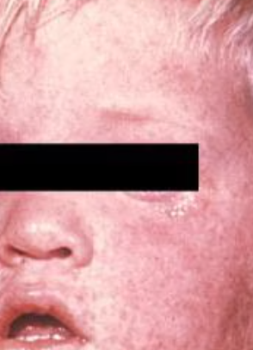
Measles Case Study
Measles is characterized by:
  Fever (as high as 105º F, malaise, AND
  Cough, Coryza (inflammation of mucuous membranes inside the nose), and conjunctivitis (three Cs)
  A pathognomonic enanthema (Koplik spots)
  Followed by a maculopapular rash

Slide 15
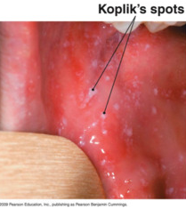
The rash usually appears 14 days after a person is exposed.
The rash spreads from the head to the trunk to the extremities
Patients are considered contagious from 4 days before to 4 days after the rash appears.
Sometimes immunocompromised patients do not develop the rash.

Slide 16
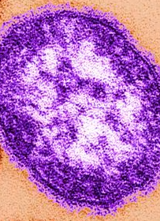
Measles Case Study
Measles is caused by a single-stranded, enveloped RNA virus with 1 serotype. Humans are the only natural hosts of measles virus.
Measles is one of the most contagious of all infectious diseases.
  Up to 9 out of 10 susceptible people with close contact to a measles patient will develop measles.
The virus is transmitted by direct contact with infectious droplets when an infected person breaths, coughs or sneezes.
  Measles can remain infectious is the air for up to 2 hours after an infected person leaves an area.
Complications include acute encephalitis (results in brain damage), respiratory & neurologic complications, subacute sclerosing panencephalitis.

Slide 17
Measle Case Study- Prepare your facility!
Do your staff know the main symptoms of measles?
Are your staff aware of Measles outbreaks in the US and high traveled destinations?
Are staff asking pts about recent travel?
Do your staff know what to do if they had a suspected measles case?
Isolation
Laboratory tests—Is your lab ready?
Do staff know how to check vaccination status on patients?
Are boosters needed?
Employee Health
Notes:
Contact your lab to see if they can run a measles test in house or would they send out? Would it be sent to the state lab versus a commercial lab? If sent to the commercial lab, who is contacting the DOH? During outbreaks, works with DOH if boosters are recommended. Employee health should have documentation of employee vaccination status if there are exposures. What is your policy on visitation—especially with children? Any travel advisories for visitors?

Slide 18
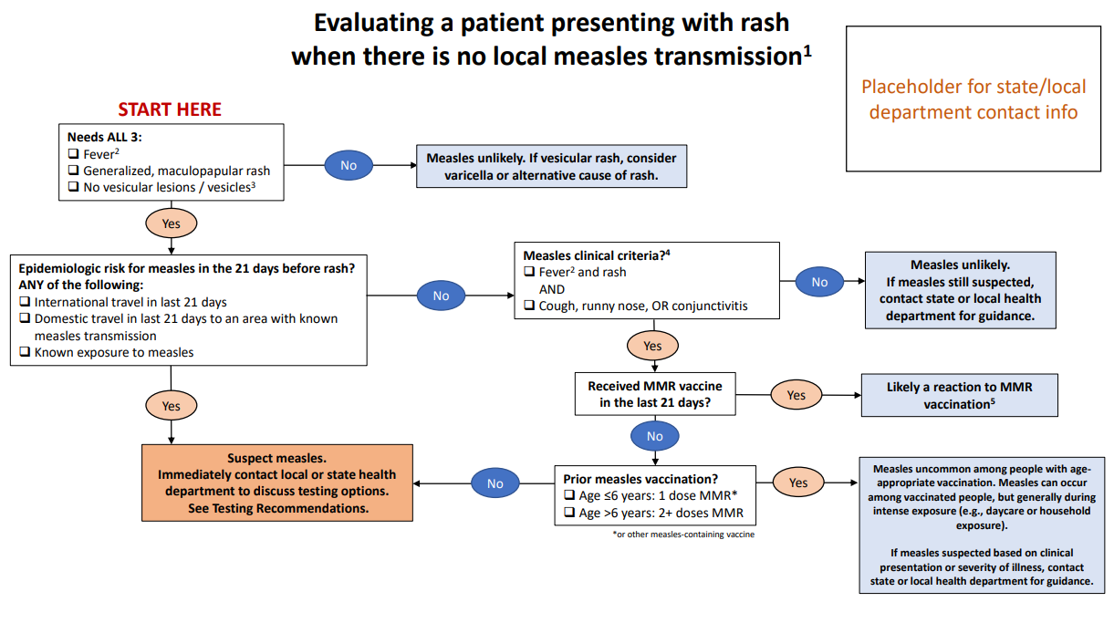
Notes:
SD providers can call the SD DOH for help if they have a suspected measles case. NP swab is preferred along with serum or urine.

Slide 19


Notes:
Introduce the polling through Zoom.

