Slide 1
Sterile Processing’s role in Regulatory Compliance and Surgical Instruments
Don Williams, CRCST, CIS, CHL, CFER, CSSGB

Slide 2
Objectives
Identify
Identify outbreaks associated with lapse in cleaning and disinfection practices
Evaluate
Evaluate the necessary training needed to maintain competency in SPD
Describe
Describe decontamination and where it begins
Review
Review the implications of Immediate Use Steam Sterilization
Understand
Understand transportation of surgical instrumentation
Understand
Understand the loaner process and how it affects daily operations

Slide 3

Assessment of disease transmission
Failures to follow recommendations for reprocessing of surgical instruments may place patients at risk for exposure to pathogenic microorganisms. When such failures occur, medical facilities often face considerable uncertainty and challenges in assessing the actual risks of disease transmission.

Slide 4
High Risk
The following recommendations apply to devices and equipment contaminated with high-risk tissues (defined as brain [including dura mater], spinal cord, and eye tissue) from high-risk patients (i.e., those known or suspected to have CJD):
1) Devices that are constructed so that cleaning procedures result in effective tissue removal (e.g., surgical instruments) can be cleaned with a chemistry shown to safely reduce prion infectivity and then steam sterilized at 134°C (273°F) for greater than or equal to 18 minutes in a dynamic-air-removal sterilizer or at 121°C to 132°C (250°F to 270°F) for 1 hour in a gravity-displacement sterilizer.
2) Devices that are impossible or difficult to clean should be discarded. In some cases, the contaminated device may be placed in a container filled with a liquid (e.g., saline, water, or a cleaning solution known to safely reduce the risks of prion contamination) to prevent drying, then initially decontaminated by steam sterilizing it at 134°C (273°F) for 18 minutes in a dynamic-air-removal sterilizer (liquids must be removed before the device is sterilized) or at 121°C to 132°C (250°F to 270°F) for 1 hour in a gravity-displacement sterilizer or by soaking it in 1N NaOH for 1 hour. The device is then cleaned, wrapped, and terminally sterilized as described in 1).

Slide 5
Low risk
The following recommendations apply to devices and equipment contaminated with low-risk tissues (e.g., defined as cerebrospinal fluid and kidney, liver, spleen, lung, and lymph node tissue) from high-risk patients.
Devices can be cleaned and disinfected or sterilized using conventional protocols of high-level disinfection, thermal sterilization, or chemical sterilization. It is recommended that devices are cleaned with a chemistry shown to safely reduce prion infectivity. Steam sterilization or hydrogen peroxide gas sterilization processes shown to have safely reduced prion infectivity are preferred.
Environmental surfaces contaminated with low-risk tissues require only standard disinfection using disinfectants recommended by OSHA for decontaminating blood-contaminated surfaces (preferably with 500 to 5,000 ppm sodium hypochlorite).

Slide 6
Necessary Training needed to maintain competency
a) an initial orientation covering all tasks performed in the sterile processing area, including orientation in policies and procedures regarding infection prevention and control, safety, attire, personal hygiene, and compliance with state and federal regulations;
1
b) continuing education at regular intervals to review and update knowledge and skills and to maintain competency and certification; and
2
c) in-service training on all new instrumentation, devices, and equipment.
3

Slide 7
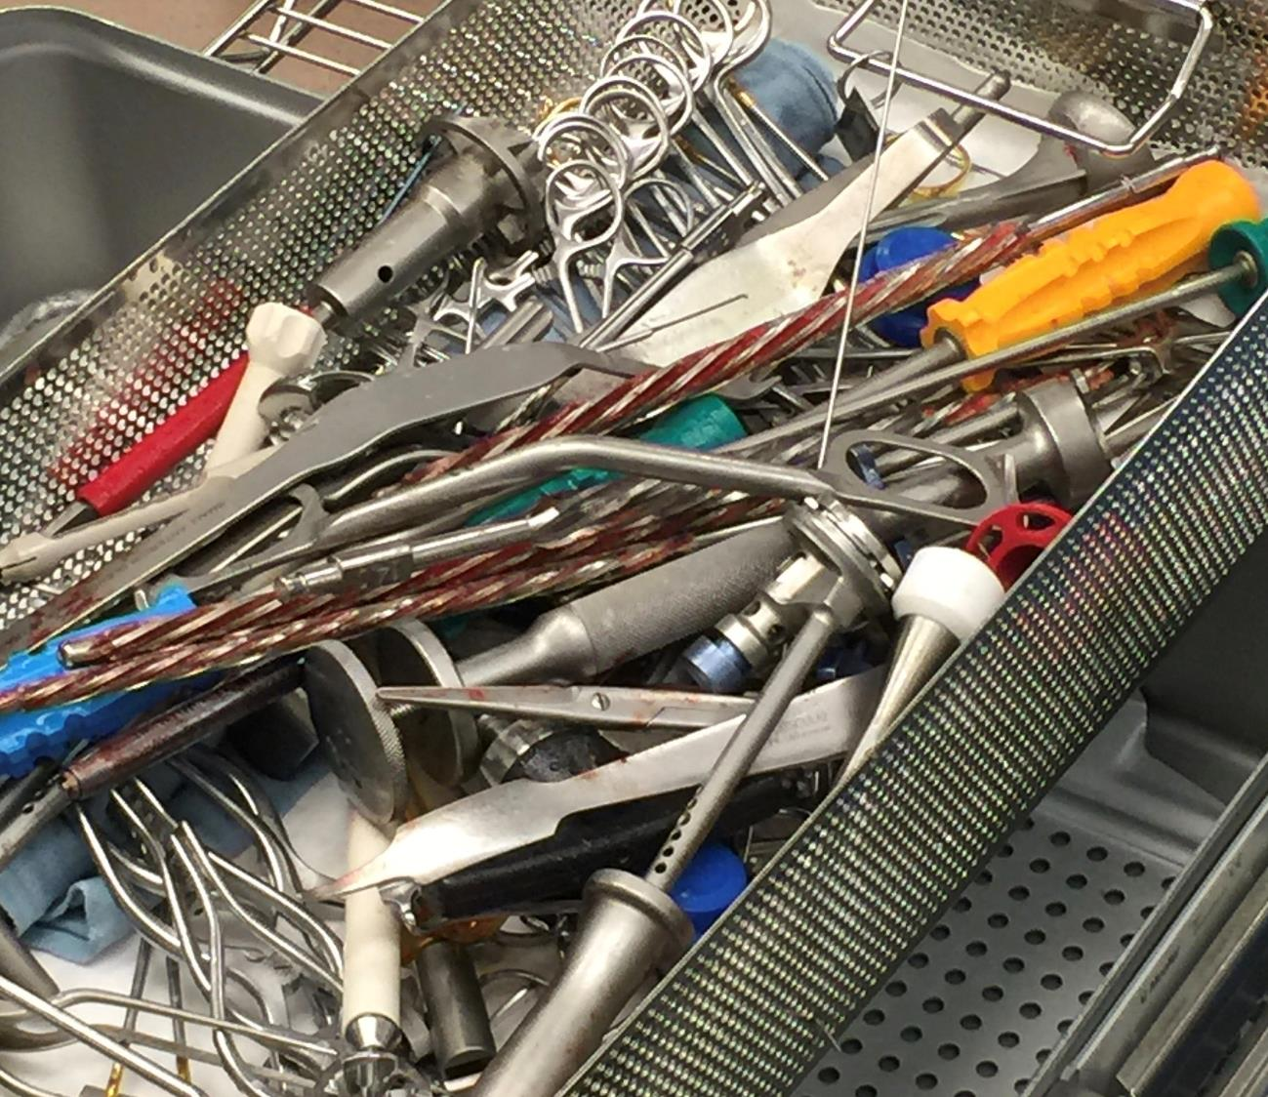
The Importance of Cleaning

Slide 8
Importance of Cleaning
During transport of instruments from the point of use to the decontamination area, appropriate precautions (e.g., use of a closed transport container) should be taken to avoid personnel exposure to blood-borne pathogens, contamination of the work environment, and further contamination of the instruments. The time between using instruments and cleaning them should be kept to a minimum.
Decontamination design considerations should include containment systems that must meet OSHA standards for contaminated items at the point of use.
The first steps in a proper reprocessing cycle are taken in the operation theatre. Coarse contamination, residues from hemostatics, skin disinfectants and slip agents, as well as caustic drugs should, wherever possible, be removed before the instruments are set down.

Slide 9
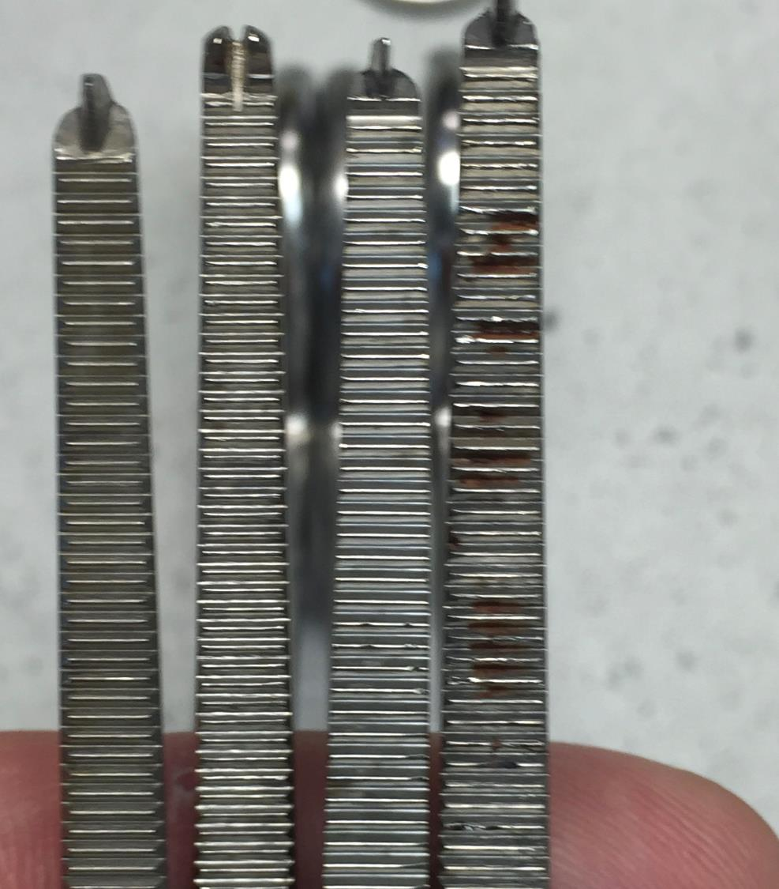
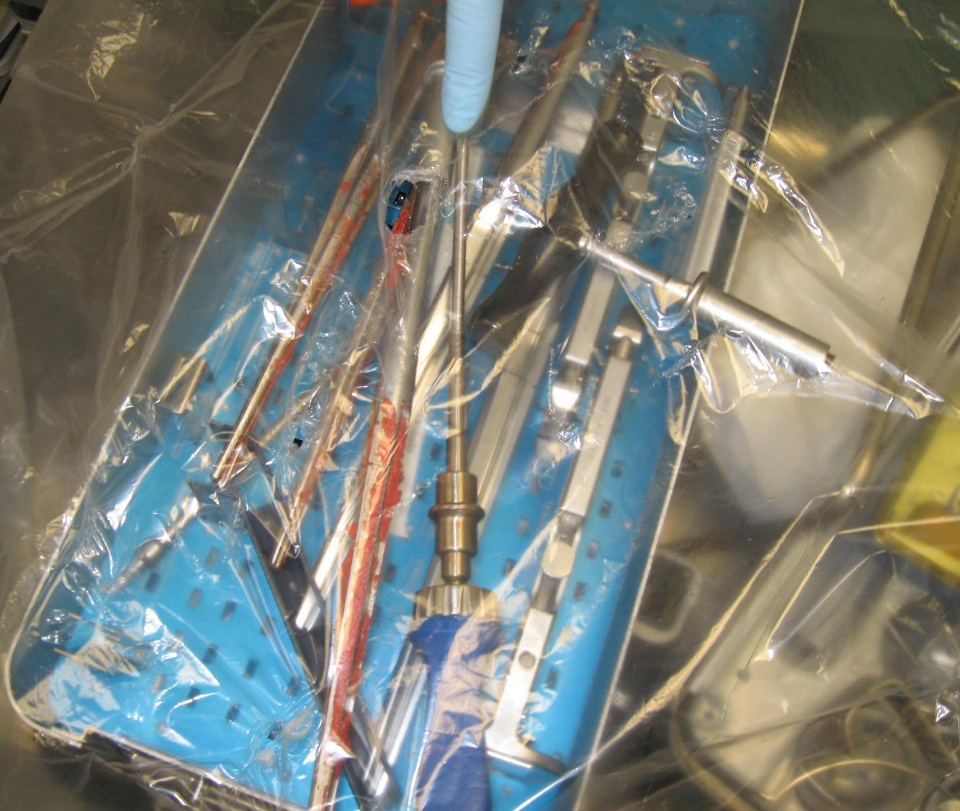
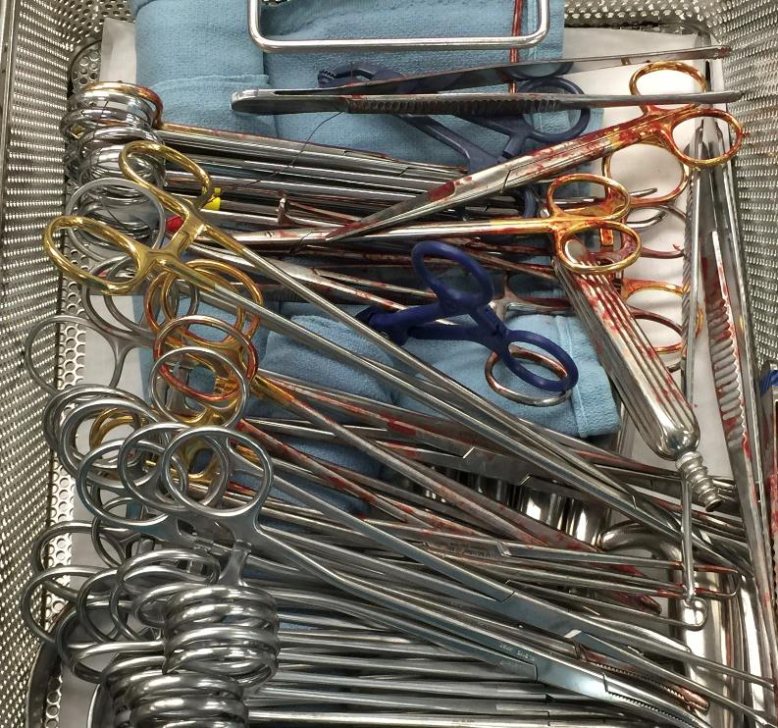

Slide 10
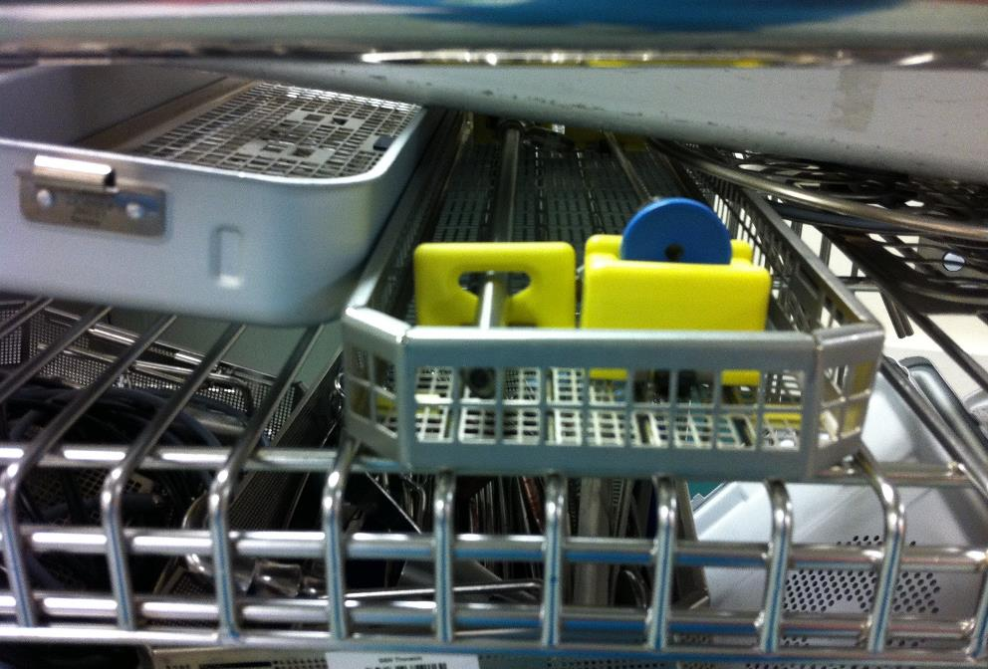
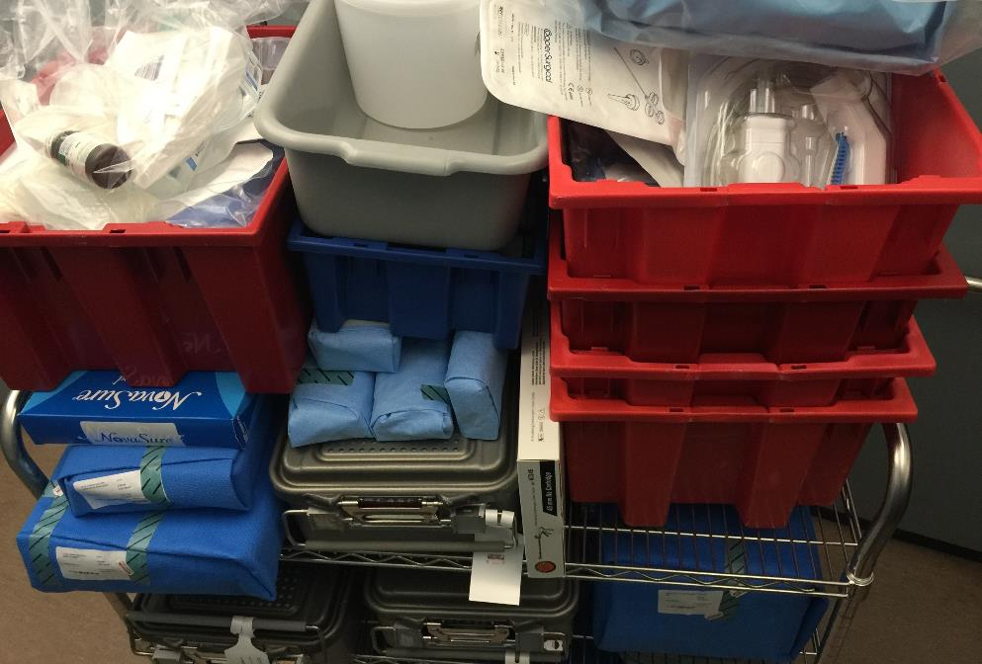
Transportation

Slide 11
Instrument Transportation
Procedures must be developed, with support from the infection prevention and control and hazardous materials personnel, to protect personnel, patients, and the environment from contamination and to comply with OSHA regulations limiting occupational exposure to blood-borne pathogens (29 CFR Part 1910.1030)
Transported to decontamination area as soon as possible after the completion of the procedure.
The amount of time between use and decontamination should be minimized because the soil on items provides an ideal medium for microbial reproduction and increases the risk of corrosion. Biofilm can begin to form within minutes and is difficult to remove. In addition, soil can dry on the instrument if left standing, making it difficult to remove. Health care personnel should schedule the pickup and transport of soiled items from each area so that the items are transported and cleaned as soon as possible after becoming soiled.
The procedures for packaging and transporting contaminated items off-site for processing must comply with applicable Department of Transportation (DOT) and state regulations.

Slide 12
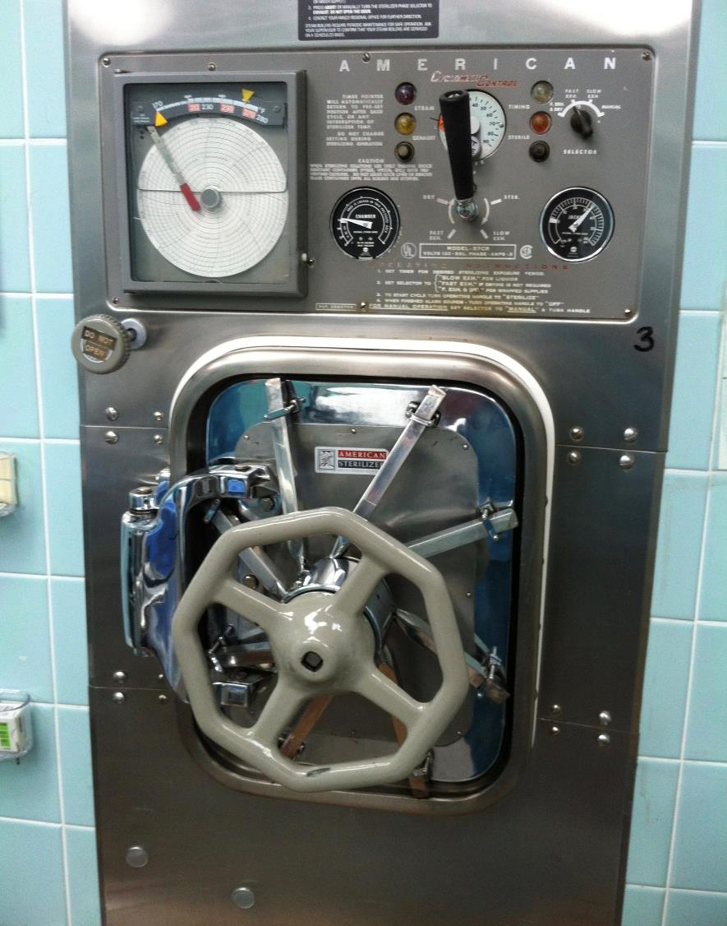
Immediate Use Steam Sterilization
Immediate Use Steam Sterilization (IUSS) may increase the risk of infection to patients. Time constraints may result in pressure on personnel to eliminate or modify one or more steps in the cleaning and sterilization process.
Immediate use steam sterilization should be used only when there is insufficient time to process by the preferred wrapped or container method intended for terminal sterilization.
Implants are foreign bodies and they increase the risk of SSI.
If IUSS is unavoidable due to a documented emergency, a rapid-action biological monitoring device should be used along with a type 5 CI. The implant should be quarantined on the back table until the rapid-action indicator provides a negative result.

Slide 13
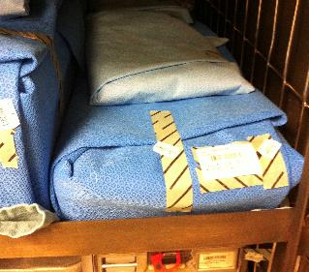
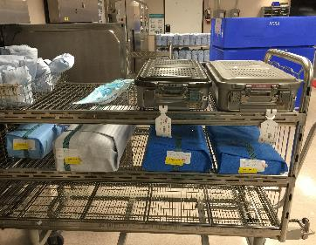
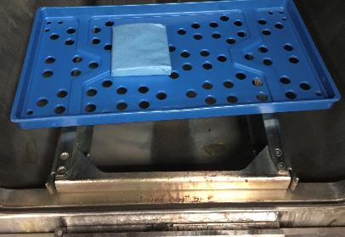
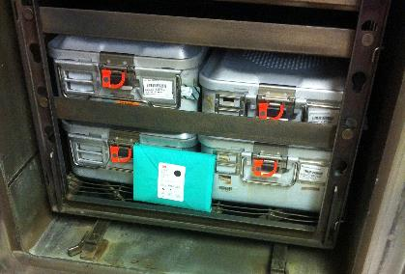
Sterilization
Load configurations should ensure adequate air removal, penetration of steam into each package, and steam evacuation. Loading the sterilizer in this fashion allows adequate air elimination and drainage of condensate, which are needed to attain product sterility. Nonlinting, absorbent cart shelf liners can be helpful in drying a load. Nonlinting materials are recommended because lint can be introduced into a patient’s wound and cause a foreign-body reaction. Placing metal items below textile items enables condensate to drain out without dripping onto items below.

Slide 14
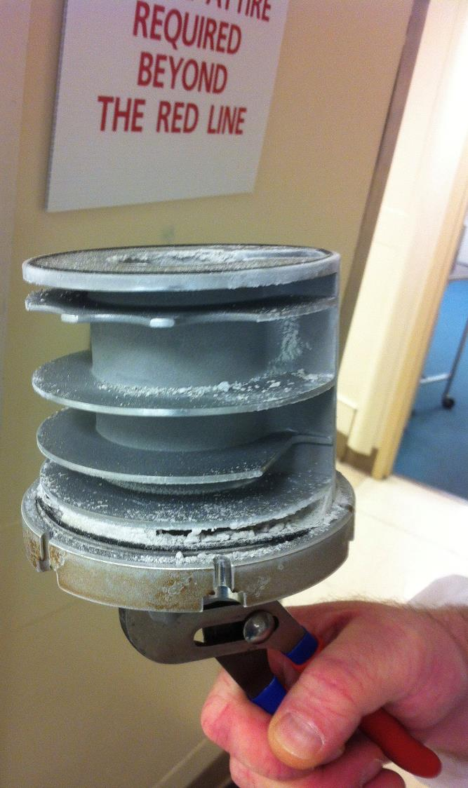
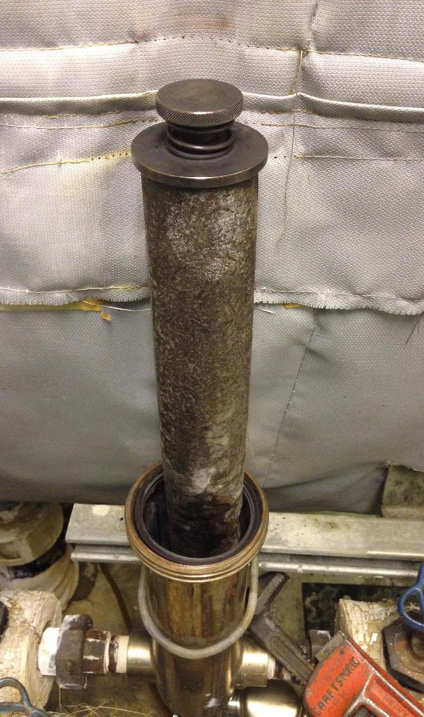
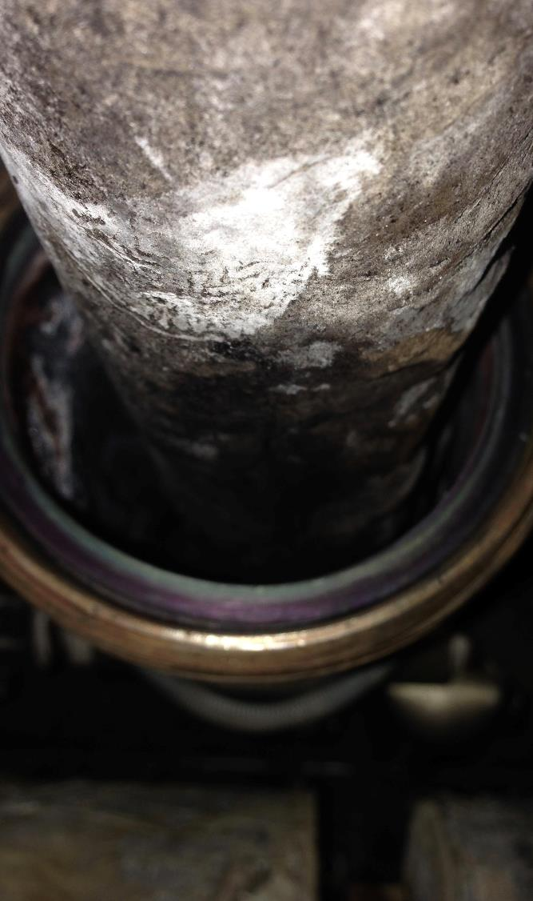

Slide 15
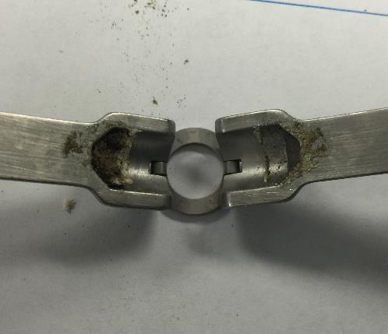
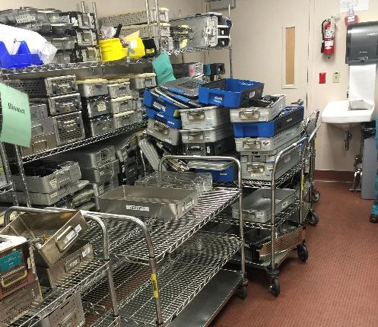
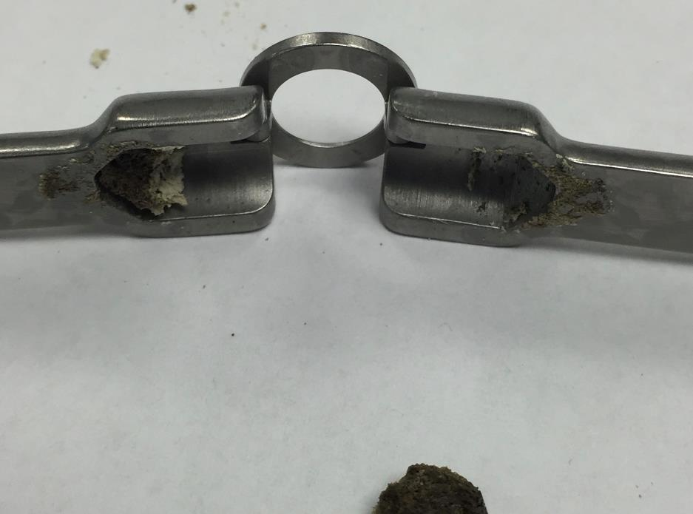
Loaner Instruments

Slide 16
Factors that affect Sterilization
WATER QUALITY
Water quality supplied to each piece of equipment should meet the manufacturers' requirements. Water quality is key to prolonging the life of medical instrumentals, and more importantly, minimize the risk of patient infection resulting from contaminated medical devices.
Water quality is a factor in all disinfection and sterilization processes. If the quality of the water used for steam generation for steam sterilization or hot-water disinfection is inappropriate, residues that condense out of the steam onto the device can lead to staining or corrosion of medical devices. Furthermore, the quality of water can affect the efficacy of LCSs or HLDs that are diluted to achieve the correct use-dilution.
It should be noted that many sterilization methods do not completely inactivate endotoxins on a device. Therefore, Critical Water should be used to rinse critical devices before sterilization to help reduce the amount of endotoxins on the sterilized device and to lessen the chance of a pyrogenic or other adverse patient reaction.

Slide 17
Loaner Instruments Cont.
Implementation of tracking and quality controls and procedures is necessary to manage instrumentation and implants that are brought in from outside organizations and companies.
Loaner instrumentation checklist
  CSSD notified of loaners prior to receiving them
  Received in facility (decontamination) at least two working days (48 hours) for existing loaner sets and three working days (72 hours) for new sets before scheduled case
  Inventory list provided/available
  FDA-cleared manufacturer written instructions for cleaning, packaging, and sterilization available
  Inventory and quality checks completed
  Multiple trays numbered and labeled (patient name, surgeon)
  Trays do not exceed 25 pounds □ All instruments in good condition, with no rusting or pitting
  Container in good condition, with no rusting, tape, residue, etc.

Slide 18
Loaner Instruments Cont…
Common issues with loaner instrumentation include an inability to follow manufacturers’ recommendation for cleaning and sterilization due to a lack of training, lack of sets and lack of time, which in turn increases immediate use sterilization. The high-level methodology for healthcare systems to avoid these issues is by adhering to the three Cs:
Communication. There’s no such thing as too much communication concerning loaner trays. A smart CSD leader will constantly talk to all parties involved with these instruments, including OR leadership, physicians, vendors, CSD staff and infection preventionists. Especially important is ensuring that CS technicians have easy access to IFUs, in advance of needing to sterilize instruments. Furthermore, facilities should require that vendors provide detailed in-servicing, education and training on instruments before bringing them into service.
Collaboration. CS leaders should work with all parties to ensure that every patient has access to the right instrumentation that has been properly decontaminated and placed through terminal sterilization. This ensures the same standard of care for every patient.
Control. CS departments can exercise control through the diligent use of a well organized set of policies and procedure. This is arguably the single most important aspect of dealing appropriately with these trays, because it should hold all parties accountable.

Slide 19
Quality Control
Monitoring and verifying the cleaning process
Sterilization process monitoring
  monitoring of every package and sterilization load
  routine monitoring of sterilizer efficacy
  qualification testing of the sterilizer after installation, relocation, sterilizer malfunction, major repairs, and sterilization process failures
  periodic product quality assurance testing

Slide 20
Summary
Infection Preventionist collaboration with the Sterile Processing Department (SPD) is key
Include SPD in your Joint Commission tracer and rounding activities
Ensure that all policies and procedures are evidence-based and up to date
Quality does not automatically translate into patient safety
Monitoring of the sterilization process is necessity for maintaining patient safety
Conduct regular risk assessments of the various processes and potential problems using tools such as FMEA, Situational Analysis, and RCA when issues arise that impact patient safety
Be aware of the concerns in the SPD

Slide 21


Questions?

Slide 22
References
ANSI/AAMI ST79: 2017 Comprehensive guide to steam sterilization and sterility assurance in health care facilities
AORN Guidelines for Perioperative Practice 2018
Instrument Reprocessing: Reprocessing of instruments to Retain Value 11th edition – 2017 (www.a-k-i.org)
OSHA 1910.1030 - Bloodborne pathogens
IAHCSMM Position Paper on the Management of Loaner Instrumentation 2012 (https://www.iahcsmm.org/images/Resources/Loaner_Instrument/Position-Paper.pdf)
ANSI/AAMI TIR34:2014
https://www.aesculapusa.com/services/resource-center/service-articles/loaner-instruments-how-to-be-prepared-for-complex-surgical-assets

