Slide 1

Advanced Infection Prevention and Control (IPC) Training
Prevention of surgical site infection (SSI)
2018
WHO Global IPC Unit 2018

Slide 2
Module outline
Session 1. SSI prevention in the context of infection prevention and control
Session 2. The importance of SSI: epidemiology and burden on a global scale
Session 3. SSI prevention measures: the 2016 WHO global guidelines for the prevention of SSI and other associated recommendations
Session 4. Understanding the application of implementation strategies to ensure SSI prevention including real life examples
Session 5. Applying a multimodal improvement strategy for SSI prevention

Slide 3
The symbols explained
You are encouraged to participate in
Interactive question
discussion questions, where you can use your own experience and prior knowledge
Some suggested answers to activities/group work
Answers
Group work
You are encouraged to participate in group activities to drill into key topics
In-depth case study applying learning to practice
Case study
Key resource
Essential content (not to be missed!)
Video material to supplement learning
Video
Reference/ reading
Key reference for consolidating learning
Required reading or reflection outside the classroom
Homework

Slide 4
Competencies
At the end of this module, the IPC focal point should be able to:
analyse and communicate data and evidence relating to the importance of SSI and its prevention, including through networking, influence and proactivity;
lead the development of knowledge and skills of the IPC team and surgical teams in SSI prevention and its practice, including creating and implementing learning opportunities and solutions;
motivate and work with others (mainly senior managers and IPC and surgical teams) to develop, implement, evaluate and embed SSI prevention strategies with linkages to the wider facility’s quality and safety strategies/goals;
demonstrate improvement of quality and safety through the design, planning, application and monitoring of improvement strategies to prevent SSI.

Slide 5
Overall learning objectives (1)
On completion of this module, the student should be able to:
describe the interconnection between SSI prevention and overall IPC efforts and how preventing SSI should be a critical part of a strong and effective IPC programme;
describe and explain the burden and epidemiological factors that influence SSI, understand the importance of reviewing existing and emerging data to aid SSI reduction within the local context;
explain the content of the WHO SSI prevention recommendations and understand the evidence supporting them;

Slide 6
Overall learning objectives (2)
describe adaptive and technical improvement approaches and the role of process and outcome indicators, which form part of an improvement project applied to SSI prevention;
explain how evidence-based recommendations on SSI can be implemented effectively in the local context and in real life situations;
describe and explain the WHO multimodal improvement strategy designed to implement SSI prevention recommendations.

Slide 7

Common abbreviations
FourEs – engage, educate, execute, evaluate
ABHR – alcohol-based handrub AMR – antimicrobial resistance
CDC – [United States] Centers for Disease Control and Prevention
CHG – chlorhexidine gluconate
CUSP – comprehensive unit-based safety programme
HAI – health care-associated infection IPC – infection prevention and control
LMICs – low- and middle-income countries
MBP – mechanical bowel preparation
MRSA – methicillin-resistant
Staphylococcus aureus
NNIS – national nosocomial infection surveillance
PPE – personal protective equipment SAP – surgical antibiotic prophylaxis SSI – surgical site infection
SUSP– surgical unit-based safety programme
VAP – ventilator-associated pneumonia
WHO – World Health Organization

Slide 8
Group work 1. Acknowledging the current status of your SSI prevention
Take a few minutes to talk to the person next to you. Take it in turns to describe your top three challenges with SSI prevention.
Then take it in turns to tell each other one thing that is currently working really well in your SSI prevention work – it can be anything, small or big
– concerning a technical piece of work or building relationships.

Slide 9
Session 1
SSI prevention in the context of IPC
9

Slide 10
Learning objective – session 1
Describe the interconnection between SSI prevention and overall IPC efforts and how preventing SSI should be a critical part of a strong and effective IPC programme

Slide 11

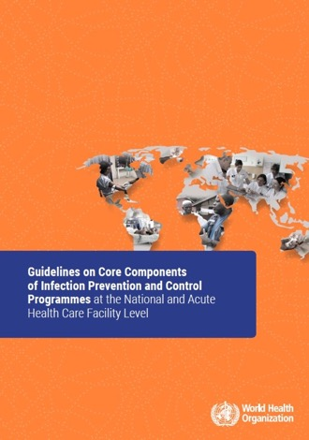

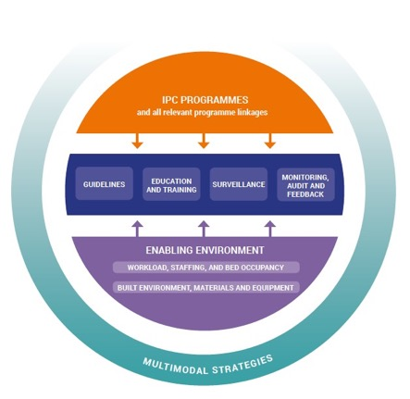

Effective IPC programmes –
the core components and SSI prevention
Source: Guidelines on core components of infection prevention and control programmes at the national and acute health care facility level. Geneva: World Health Organization; 2016
(http://www.who.int/infection-prevention/publications/ipc-core-components/en/).

Slide 12
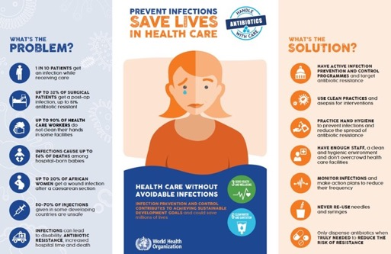


Use of the core component resources to promote and support SSI and IPC work
Source: https://www.youtube.com/watch?v=LZapz2L6J1Q&feature=yout u.be
Source: http://www.who.int/gpsc/HAI-Infographic.pdf?ua=1

Slide 13
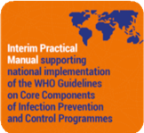
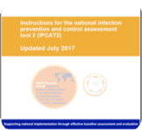
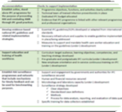


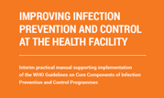
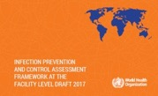

IPC implementation resources
Practical manuals to support implementing the core components
Assessment tools to support baseline and follow-up assessment
Academic publications to convince senior managers and leaders
Videos explaining the core components and leadership in IPC
Advocacy video on IPC, health care-associated infection (HAI) and antimicrobial resistance (AMR)
Sources: Storr J, Twyman A, Zingg W, Damani N, Kilpatrick C, Reilly J et al. Core components for effective infection prevention and control programmes: new WHO evidence-based recommendations. Antimicrob Resist Infect Control. 2017; 6:6. (https://aricjournal.biomedcentral.com/articles/10.1186/s13756-016-0149-9);
Price L, MacDonald J, Melone L, Howe T, Flowers P, Currie K, Curran E et al. Effectiveness of national and subnational infection prevention and control interventions in high-income and upper-middle-income countries: a systematic review. Lancet Infect Dis. 2018;18(5):e159-e171 (http://www.thelancet.com/journals/laninf/article/PIIS1473- 3099(17)30479-6/fulltext)
Source: http://www.who.int/infection- prevention/tools/core-components/en/

Slide 14
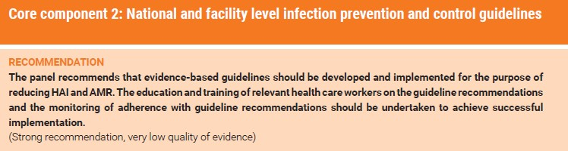
WHO core components – a focus on IPC guidelines
Among the core components to prevent HAI, WHO recommends the development and implementation of evidence-based guidelines. SSI prevention guidelines are among those recommended as a priority.
Source: Guidelines on core components of infection prevention and control programmes at the national and acute health care facility level. Geneva: World Health Organization; 2016 (http://www.who.int/infection-prevention/publications/ipc-components-guidelines/en/).

Slide 15
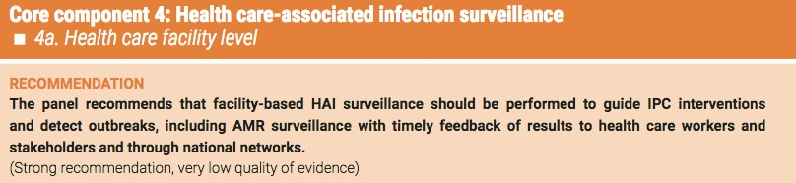
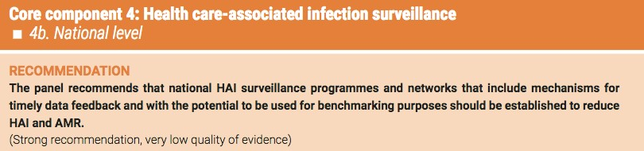
WHO core components – a focus on surveillance
The WHO recommendations on HAI surveillance were supported by studies into SSI surveillance and reduction.
Source: Guidelines on core components of infection prevention and control programmes at the national and acute health care facility level. Geneva: World Health Organization; 2016 (http://www.who.int/infection-prevention/publications/ipc-core-components/en/).

Slide 16
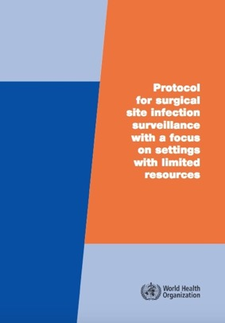
WHO protocol for SSI surveillance in settings with limited resources
Surveillance: “the ongoing, systematic collection, analysis, interpretation and evaluation of health data closely integrated with the timely dissemination of these data to those who need it”
Conducting high-quality SSI surveillance is crucial to detect the magnitude of the problem and to assess the impact of any prevention/improvement intervention.
Source: Protocol for surgical site infection surveillance with a focus on settings with limited resources. Geneva: World Health Organization; 2018 (http://www.who.int/infection-prevention/tools/surgical/evaluation_feedback/en/).

Slide 17
The WHO approach to SSI
surveillance in settings with limited resources
WHO has created an adapted approach that has been used in settings with limited resources to conduct surveillance in the context of interventions to reduce SSI.
The protocol is based on the widely accepted Centers for Disease Control and Prevention – National Healthcare Safety Network (CDC- NHSN) definitions for SSI, but definitions based on clinical signs and symptoms should be prioritized, given the lack of high-quality microbiology laboratory support.
For feasibility reasons, this protocol is based on post-discharge surveillance up to 30 days only.
Patient follow-up after discharge includes phone calls and involvement of the patient in recognizing signs and symptoms of SSI.

Slide 18
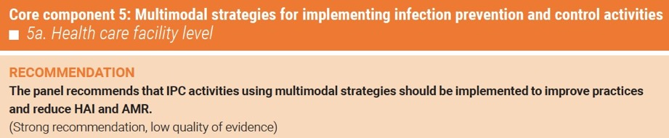
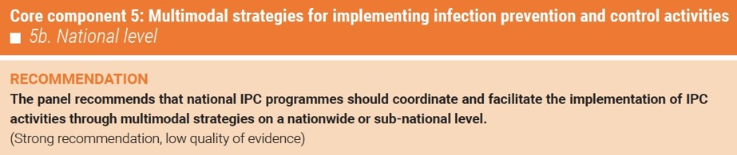
WHO core components – a focus on prevention and implementation
The WHO recommendations on best IPC implementation strategies were supported by studies into approaches for SSI reduction.
Source: Guidelines on core components of infection prevention and control programmes at the national and acute health care facility level. Geneva: World Health Organization; 2016 (http://www.who.int/infection-prevention/publications/ipc-core-components/en/).

Slide 19
Session 2
The importance of SSI: epidemiology and burden on a global scale

Slide 20
Learning objective – session 2
Describe and explain the burden and epidemiological factors that influence SSI, understand the importance of reviewing existing and emerging data to aid SSI reduction within the local context

Slide 21

SSI burden in the local context
Do you think SSI is a problem in your setting?
If so, how big is the problem?
Do you have any idea how many surgical patients get an SSI per 100 operated patients in your facility?

Slide 22

CDC classification of SSI – the problem for the patient
Purulent drainage from superficial incision
Pain, swelling, erythema or heat at incision site and surgeon deliberately opens incision
Skin
Superficial Incisional SSI
Subcutaneous Tissue
Abscess involving deep incision found during radiological exam, direct exam or re-operation
Purulent drainage found during deep incision but not from organ/space component
Deep Soft Tissue (fascia
and muscle)
Deep Incisional SSI
Mediastinitis
Endocarditis
Osteomyelitis
Meningitis
Ventriculitis
Intra-abdominal
Organ / Space
Organ/Space SSI
Source: Mangram AJ, Horan TC, Pearson ML, Silver LC, Jarvis WR. Guideline for prevention of surgical site infection, 1999: Centers for Disease Control and Prevention (CDC) Hospital Infection Control Practices Advisory Committee. Am J Infect Control. 1999; 27(2):97–134.

Slide 23
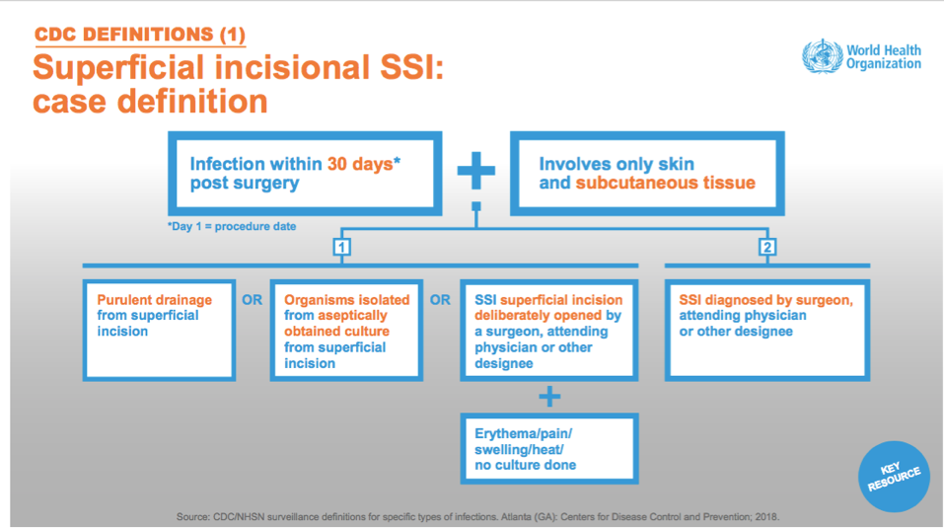

Slide 24
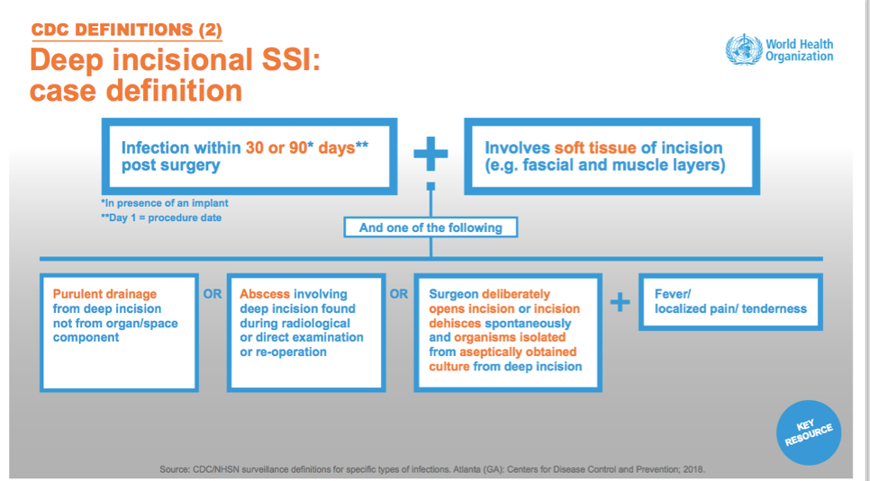

Slide 25
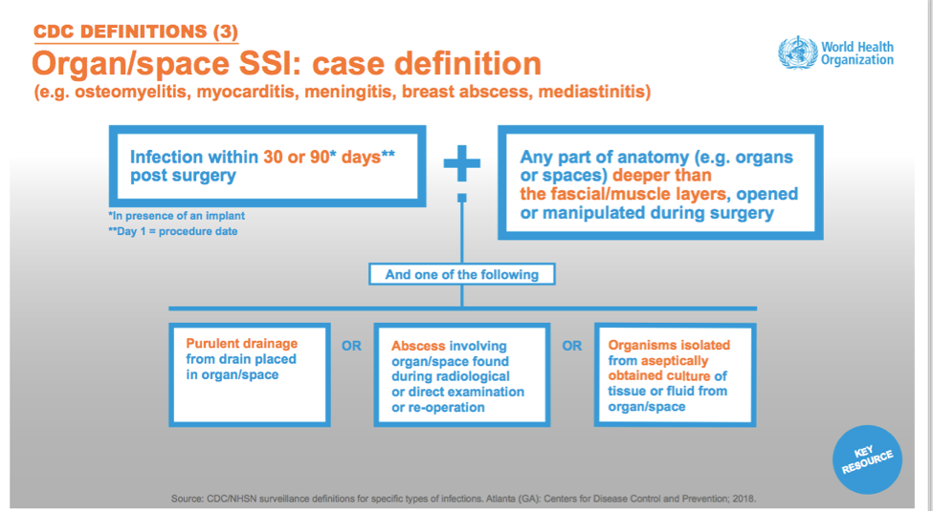

Slide 26
Wound classification (1)
Clean: an uninfected operative wound in which no inflammation is encountered and the respiratory, alimentary, genital, or uninfected urinary tracts are not entered. In addition, clean wounds are primarily closed and, if necessary, drained with closed drainage. Operative incisional wounds that follow nonpenetrating (blunt) trauma should be included in this category if they meet the criteria.
Clean-contaminated: operative wounds in which the respiratory, alimentary, genital, or urinary tracts are entered under controlled conditions and without unusual contamination. Specifically, operations involving the biliary tract, appendix, vagina and oropharynx are included in this category, provided no evidence of infection or major break in technique is encountered.
Source: Mangram AJ, Horan TC, Pearson ML, Silver LC, Jarvis WR. Guideline for prevention of surgical site infection, 1999: Centers for Disease Control and Prevention (CDC) Hospital Infection Control Practices Advisory Committee. Am J Infect Control. 1999; 27(2):97–134.

Slide 27
Wound classification (2)
Contaminated: open, fresh, accidental wounds. In addition, operations with major breaks in sterile technique (e.g. open cardiac massage) or gross spillage from the gastrointestinal tract, and incisions in which acute, nonpurulent inflammation is encountered including necrotic tissue without evidence of purulent drainage (e.g. dry gangrene) are included in this category.
Dirty or infected: includes old traumatic wounds with retained devitalized tissue and those that involve existing clinical infection or perforated viscera. This definition suggests that the organisms causing postoperative infection were present in the operative field before the operation.

Slide 28
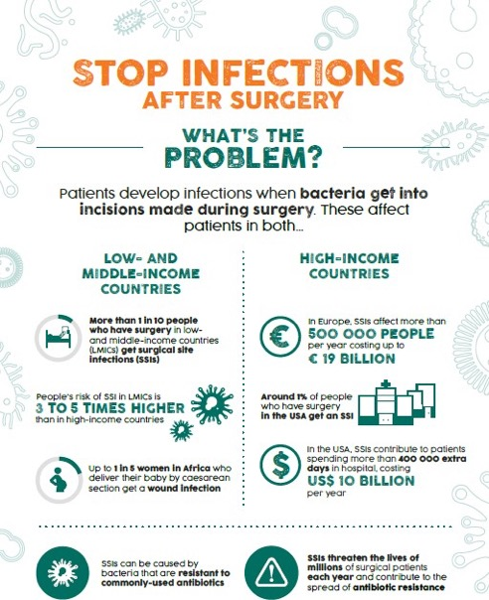
Source: http://www.who.int/gpsc/ssi-infographic.pdf?ua=1

Slide 29
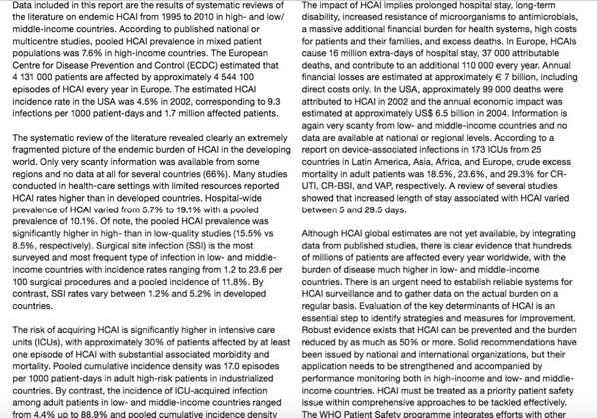
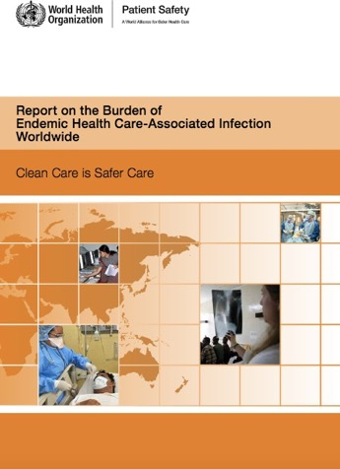
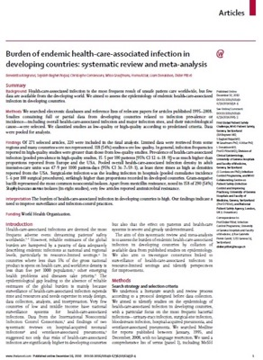
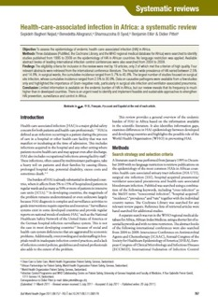
“Surgical site infection (SSI) is the most surveyed and most frequent type of infection in low- and middle-income countries with incidence rates ranging from 1.2 to 23.6 per 100 surgical
procedures and a pooled incidence of 11.8%. By contrast, SSI rates vary between 1.2% and 5.2% in developed countries.”
Sources:
Report on the Burden of endemic health care- associated infection worldwide. Geneva: World Health Organization; 2011 (http://www.who.int/infection- prevention/publications/burden_hcai/en/);
Allegranzi B, Bagheri Nejad S, Combescure C, Graafmans W, Attar H, Donaldson L et al. Burden of endemic health-care-associated infection in developing countries: systematic review and meta- analysis. Lancet. 2011; 377:228–41;
Bagheri Nejad S, Allegranzi B, Syed SB, Ellis B, Pittet
D. Health care-associated infection in Africa: a systematic review. Bull World Health Organ. 2011; 89:757–65.

Slide 30
SSI burden – an overview (1)
Second most frequent type of HAI in Europe and the USA
Most frequent type of HAI on admission (67% in the USA, 33% in Europe)
  SSI incidence (per 100 procedures)
– USA 2014: 1.9%
– Europe 2013–14: 0.6–9.5%
o Incidence varies according to type of procedure (very low in clean procedures, such as arthroplasty; higher in contaminated/dirty procedures, such as colon surgery)
  Most frequent pathogens: Gram-positive cocci (such as Staphylococcus aureus (S. aureus) at 17–30%), followed by Gram- negative bacilli
  AMR: 39–51% of SSI pathogens are resistant to standard prophylactic antibiotics in the USA
Sources:
Mu Y, Edwards JR, Horan TC, Berrios-Torres SI, Fridkin SK. Improving risk-adjusted measures of surgical site infection for the national healthcare safety network. Infect Control Hosp Epidemiol. 2011;32(10):970-86.
National and state healthcare-associated infections progress report. Atlanta (GA): National Center for Emerging and Zoonotic Infectious Diseases, Centers for Disease Control and Prevention; 2016 (http://www.cdc.gov/HAI/pdfs/progressreport/ hai-progress-report.pdf, accessed 10 August 2016).
ECDC. Annual epidemiological report 2016 – surgical site infections. Stockholm: European Centre for Disease Prevention and Control; 2016 (https://ecdc.europa.eu/en/publications-data/surgical-site-infections-annual- epidemiological-report-2016-2014-data).
Sievert DM, Ricks P, Edwards JR, Schneider A, Patel J, Srinivasan A et al. Antimicrobial-resistant pathogens associated with healthcare-associated infections: summary of data
reported to the National Healthcare Safety Network at the Centers for Disease Control and Prevention, 2009–2010. Infect Control Hosp Epidemiol. 2013;34:1–14.

Slide 31
SSI burden – an overview (2)
Most frequent type of HAI in LMICs
Infection is the most frequent complication of surgery in Africa
Pooled SSI incidence in LMICs (WHO unpublished data, 2017)
  5.9 per 100 procedures
  11.2 per 100 surgical patients
A few studies from LMICs report SSI rates by surgical procedure and data on microbiological causes of SSI
Most frequent pathogens are S. aureus (20.3%) and Escherichia coli (E. coli) (20.3%)
Average methicillin resistance among S. aureus isolates (MRSA): 54.5%
SSI pooled incidence in South-east Asia: 7.7%
Surgical sepsis = 30% of all patients with sepsis
Sources:
Allegranzi B, Bagheri Nejad S, Combescure C, Graafmans W, Attar H, Donaldson L et al. Burden of endemic health-care-associated infection in developing countries: systematic review and meta-analysis. Lancet. 2011; 377:228–41.
Ling ML, Apisarnthanarak A, Madriaga G. The burden of healthcare-associated infections in Southeast Asia: a systematic literature review and meta-analysis. Clin Infect Dis. 2015;60(11):1690–9.
Bruce M Biccard, Thandinkosi E Madiba, Hyla-Louise Kluyts, Dolly M Munlemvo, Farai D Madzimbamuto, Apollo Basenero, et al. Lancet published online January 3, 2018 http://dx.doi.org/10.1016/S0140-6736(18)30001-1.

Slide 32
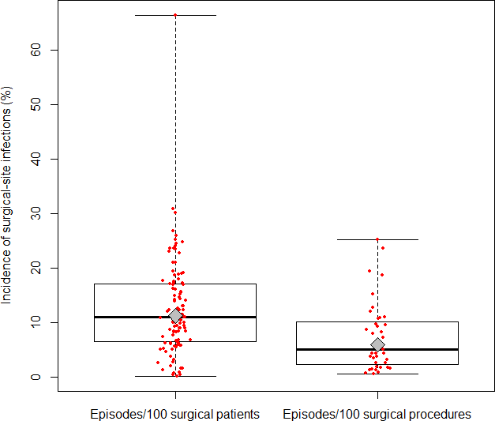
SSI incidence in LMICs (1995–2015, 107 studies)
SSI pooled incidence in LMICs in:
caesarean sections: 11.7%* (95% CI: 9.1–14.8)
prosthetic orthopaedic surgery: 9.7%** (95% CI: 5.3–15.3)
* in Europe: 2.7%
** in Europe: 0.7% (knee prosthesis) to
1.0% (hip prosthesis)
Pooled cumulative incidence:
11.2% per 100 surgical patients (95% CI: 9.7–12.8)
5.9 per 100 surgical procedures (95% CI: 4.8–7.1)
I² = 99.8%
Source: updated systematic review – WHO unpublished data, 2017.

Slide 33
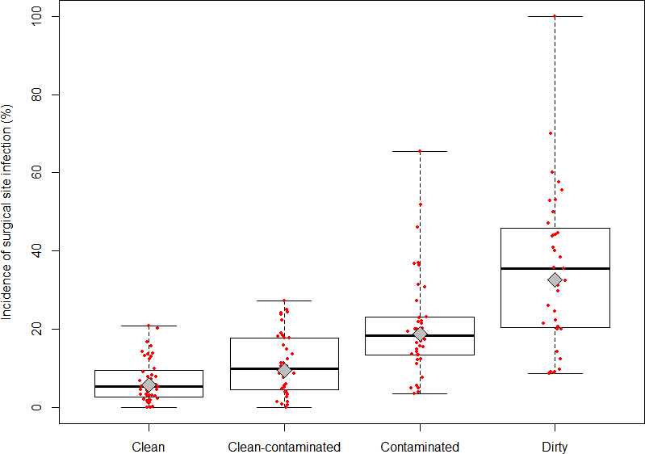
SSI risk in LMICs according to wound classification (1995–2015, 231 studies)
SSI pooled means:
5.8, 9.5, 18.9, 32.7
episodes per 100 surgical procedures (from clean to dirty wound)
Categories of surgical procedures
Source: updated systematic review – WHO unpublished data, 2017.

Slide 34
Examples of studies reporting SSI burden* in LMICs
Author, year, country | Population | LOS*, days | Mortality | Costs
Ameh, 2009, Nigeria | Paediatrics | 26.1 (8–127) with SSI vs 18.0 (1–99) without | 10.5% vs 4.1% | NA
Bhatia, 2003, India | Coronary artery bypass graft (CABG) | LOS significantly higher (mild 15, moderate 20, severe 25) | No SSI related deaths | Increase by 3.8%, 14.7% and 29.4% in mild, moderate, severe infections
Raka, 2007, Kosovo (in accordance with Security Council resolution 1244 (1999) | Abdominal surgery | 9 with SSI vs 4 without | NA | NA
Kasatpibal, 2005, Thailand | Mixed surgery | Mean excess LOS: 21.3 |  | Mean excess cost: US$1355
Kaya, 2006, Turkey | General surgery | Mean excess LOS: 8 | NA | Mean excess cost: US$600
Le, 2006, Vietnam | Orthopaedics and neurosurgery | Median excess LOS: 18 | No mortality difference | NA
*Mortality, length of stay (LOS), costs.
Source: Report on the Burden of endemic health care-associated infection worldwide. Geneva: World Health Organization; 2011 (http://www.who.int/infection-prevention/publications/burden_hcai/en/);

Slide 35
SSI burden data in the local context – summary
Surveillance is important in understanding and explaining your own incidence and prevalence.
It is important to use country and regional data to explain what the common problems are likely to be and to persuade others to commit to improvement.
Based on your/available data, you are then able to consider prioritizing an improvement likely to have the greatest impact.
Choose improvement actions that are measurable and where progress can be clearly reported over time, against prevalence or incidence studies.
Use the WHO Protocol for surgical site infection surveillance with focus on settings with limited resources Geneva: World Health Organization; 2018 (http://www.who.int/infection-prevention/tools/surgical/SSI-surveillance-protocol.pdf?ua=1) to understand more about conducting surveillance.

Slide 36

What leads to SSI?
Lack of understanding of the problem (frequency and burden)
Lack of adherence to safe processes
Lack of a safety culture
Lack of awareness of what the safe processes are (effective SSI preventive measures)

Slide 37
WHAT ARE THE KNOWN RISK FACTORS FOR SSI?

Slide 38
Overall risk factors for SSI
Patient-related
increasing age
diabetes
obesity
smoking
immunosuppressive drugs (corticosteroids)
Staphylococcus aureus carriage (nasal or other)
distant infection focus
malnutrition
Preoperative
preoperative length of stay
antibiotic prophylaxis
hair removal technique
Operative
wound classification
operative technique, degree of tissue trauma
prolonged duration of surgery
traffic intensity in the operating room
presence of foreign body
need for blood transfusion
Source: Global guidelines for the prevention of surgical site infection. Geneva: World Health Organization; 2016 (http://www.who.int/infection-prevention/publications/ssi-prevention- guidelines/en/).

Slide 39

Assessment of SSI risk
Infection risk lower
Intact skin
Intact mucous membrane
Broken skin or mucous membrane
Foreign body implant (fully enclosed)
Foreign body from outside to inside body
Infection risk increases

Slide 40
Session 3
SSI prevention measures: the 2016 WHO global guidelines for the prevention of SSI and other associated recommendations

Slide 41
Learning objective – session 3
Explain the content of the WHO SSI prevention recommendations and understand the evidence supporting them

Slide 42
How do SSIs occur?

Slide 43

Summary: how an SSI can occur
Source of pathogens:
  endogenous flora on the patient’s skin, mucous membranes and hollow viscera
  exogenous organisms (air in the operating room, surgical equipment, implants, gloves/hands, medications administered during operative procedure) – including various pathogens
Routes of entry:
  hands, equipment, intravenous, air, ways of controlling the whole surgical patient environment/experience (skin preparation, including hair removal, intraoperative temperature)
We can protect surgical patients from endogenous and exogenous organisms.
Source: Global guidelines for the prevention of surgical site infection. Geneva: World Health Organization; 2016 (http://www.who.int/infection-prevention/publications/ssi-prevention-guidelines/en/).

Slide 44



Sources of SSI in the operating room environment specifically
1. ENDOGENOUS INFECTIONS
Patient’s own microflora
2. STAFF IN THE OPERATING ROOM Staphylococci from nasal carriage, skin of hand and forearm via contact through punctured gloves
or wet gown
3. ENVIRONMENTAL SOURCE
Contaminated air and dust due to inadequate ventilation and cleaning

Slide 45
What are the most important measures to prevent SSI?

Slide 46
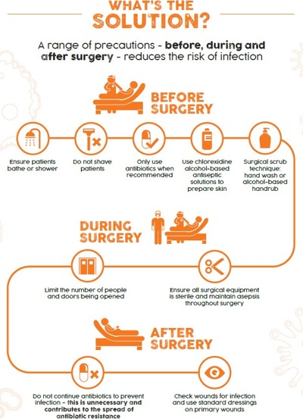
One visual poster highlighting the most important measures for
SSI prevention throughout the patient journey
Source: http://www.who.int/gpsc/ssi-infographic.pdf?ua=1

Slide 47
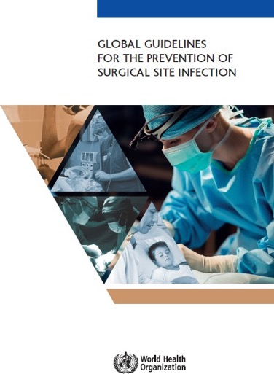
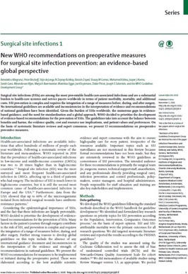
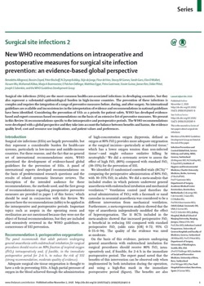
WHO guidelines, 2016
Source: Global guidelines for the prevention of surgical site infection. Geneva: World Health Organization; 2016 (http://www.who.int/infection-prevention/publications/ssi-prevention-guidelines/en/).

Slide 48
Methods for recommendation development (1)
Development of recommendations
Recommendations were developed according to the Grading of Recommendations Assessment, Development and Evaluation (GRADE) approach, based on scientific evidence and expert consensus/country experience.
The decision-making process involved expert discussion about the evidence of effectiveness of the preventive measure, any harms it may cause, resource implications of implementation and views of patients and professionals.
Source: Global guidelines for the prevention of surgical site infection. Geneva: World Health Organization; 2016 (http://www.who.int/infection-prevention/publications/ssi-prevention-guidelines/en/).

Slide 49
Methods for recommendation development (2)
Strength of recommendations – two types
“Strong” – the expert panel was confident that benefits outweighed risks, that the measure was considered to be adaptable for implementation in most (if not all) situations and that patients should receive the intervention as standard.
“Conditional” – the expert panel considered that the benefits of intervention probably outweighed the risks or that a more structured decision-making process should be undertaken, based on stakeholder consultation and involvement of patients and health care professionals.

Slide 50
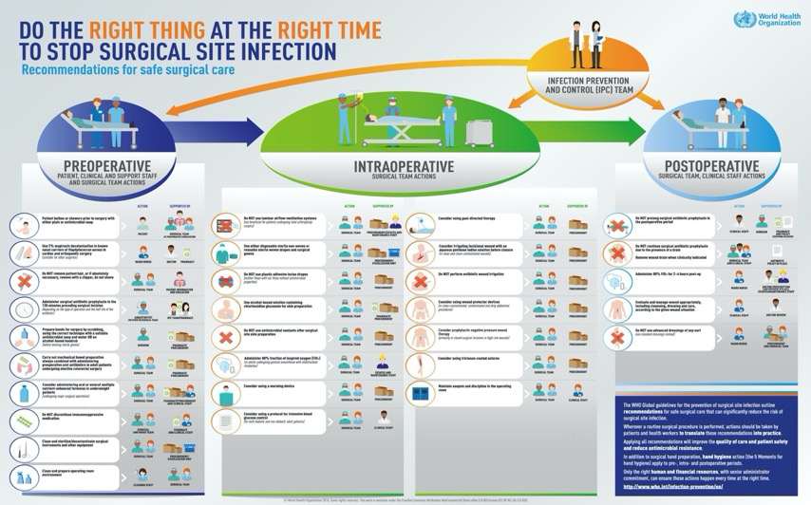
WHO recommendations for SSI prevention (1)
Source: http://www.who.int/infection-prevention/tools/surgical/reminders-advocacy/en/

Slide 51
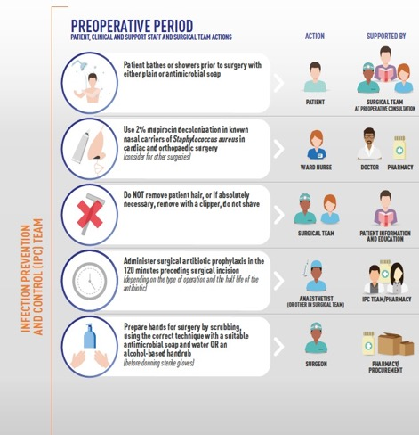
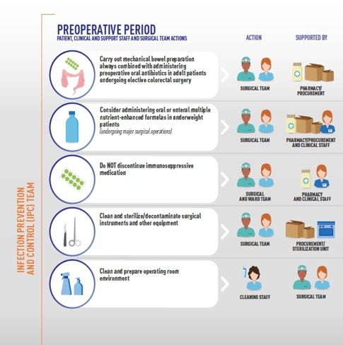
WHO recommendations for SSI prevention (2)

Slide 52
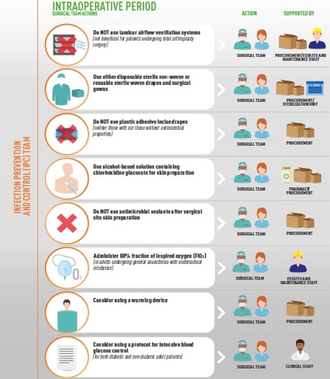
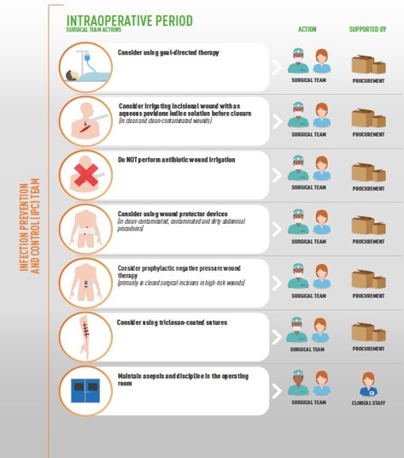
WHO recommendations for SSI prevention (3)

Slide 53
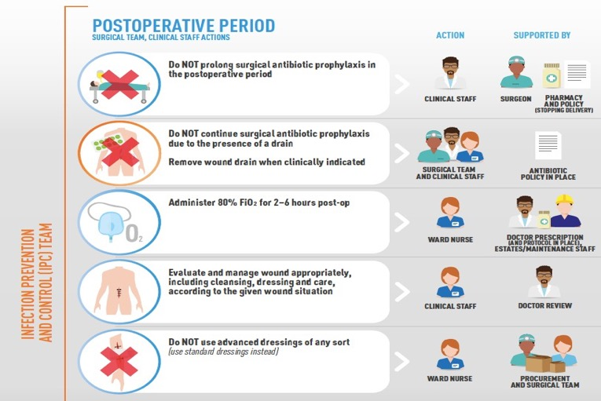
WHO recommendations for SSI prevention (4)

Slide 54

Strong recommendation – preoperative measures: treatment of S. aureus nasal carriers (1)
Patients undergoing cardiothoracic and orthopaedic surgery with known nasal carriage of S. aureus should receive perioperative intranasal applications of mupirocin 2% ointment with or without a combination of chlorhexidine gluconate (CHG) body wash.
Consider treating patients with known nasal carriage of S. aureus undergoing other types of surgery with perioperative intranasal applications of mupirocin 2% ointment with or without a combination of CHG body wash (associated conditional recommendation).

Slide 55
Strong recommendation – preoperative measures: treatment of S. aureus nasal carriers (2)
Why
S. aureus is a leading HAI pathogen worldwide.
S. aureus infections impose a high burden on the patient and the health system and are a known cause of postoperative wound infections.
Nasal carriage of S. aureus is a risk factor for subsequent infection in a patient. It has been shown repeatedly that a large proportion of HAIs due to S. aureus originate from patients' own flora.

Slide 56
Strong recommendation – preoperative measures: treatment of S. aureus nasal carriers (3)
Notes
Screening of patients for S. aureus varies between and within countries and is dependent on several factors including cost–effectiveness and local epidemiology.
This recommendation only applies to facilities where screening (nasal swabs sent to a laboratory) for S. aureus is feasible, and may not apply to settings with high prevalence of mupirocin resistance.

Slide 57
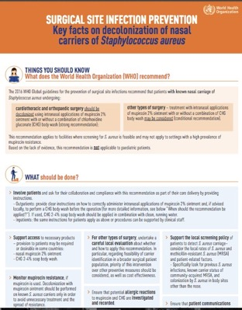

Practical points
This recommendation can be applicable to pre- and perioperative periods (depending on local conditions for treatment).
The application of mupirocin is usually twice a day for 5–7 days before surgery or from the day of hospital admission to the day of surgery.
Ensure that potential allergic reactions to mupirocin are investigated and recorded and patient communications and record keeping regarding this treatment occur.
Source: http://www.who.int/infection- prevention/tools/surgical/training_educatio n/en/

Slide 58

Strong recommendation – preoperative measures: mechanical bowel
preparation (MBP) and preoperative
oral antibiotics
MBP alone (without administration of oral antibiotics) should not be used in adult patients undergoing elective colorectal surgery (strong recommendation).
Preoperative oral antibiotics combined with MBP should be used to reduce the risk of SSI in adult patients undergoing elective colorectal surgery (conditional recommendation).
Why?
Evidence (moderate quality) showed that preoperative MBP alone has neither benefit nor harm in reducing SSI rate when compared to performing no MBP.
Further evidence (moderate quality) showed that preoperative MBP combined with oral antibiotics reduced SSI when compared to MBP alone.

Slide 59
Practical points
This recommendation applies only to the preoperative period and should not be referred to as “selective digestive decontamination”.
Local considerations may determine variations in decisions about the type of MBP regimen and oral antibiotics, and the drug of choice for intravenous antibiotic prophylaxis (availability, resistance data and volume of surgical activity).
The combination of drugs used should guarantee activity against both facultative gram-negative and anaerobic bacteria. In most studies, oral aminoglycosides were combined with metronidazole or erythromycin.

Slide 60

Strong recommendations – preoperative measures: hair removal
In patients undergoing any surgical procedure, hair should either not be removed or, if absolutely necessary, should only be removed with clippers. Shaving is strongly discouraged at all times, whether preoperatively or in the operating room.
Why?
Removal of hair by any method has no benefit on the incidence of postoperative infection compared to no hair removal.
The incidence of SSI is higher when hair removal is performed by razor than by clippers because shaving causes small abrasions to the skin.
Most studies support that hair removal, if any, should be done immediately before operation.
Note: the evidence showed that use of depilatory creams has no benefit (no lower SSI risk) compared with shaving; in addition, these sometimes produce hypersensitivity reactions. WHO does not recommend their use.

Slide 61
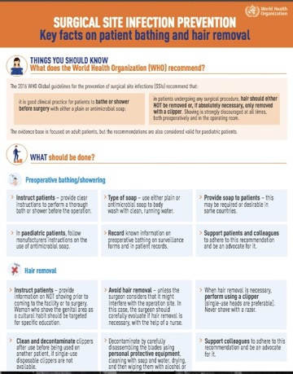
Practical points
It has been noted that, when hair absolutely must be removed (when presence of hair will interfere with the operation), a single-use head should be used for electric clippers.
Women may prefer shaving the genital area before surgery and may even come to the hospital already shaved because of cultural norms – this is something that should be avoided and should be addressed in training and education targeted at patients.
Source: http://www.who.int/infection- prevention/tools/surgical/training_educatio n/en/

Slide 62

Strong recommendations – preoperative measures: Surgical antibiotic prophylaxis (SAP) timing (1)
SAP should be administered before the surgical incision, when indicated.
SAP should be administered within 120 minutes before incision, while considering the half-life of the antibiotic.
Why?
Correct preoperative administration timing to achieve adequate concentration of drug at the site of incision at the beginning of the operation (highest risk of surgical site contamination) is critical. Incorrect (before 120 minutes or after incision) timing can lead to an increased risk of SSI.
Correct antibiotic type according to the procedure and patient history aims to destroy the bacteria most frequently found at the operation site and to be safe for the patient.

Slide 63
Strong recommendations – preoperative measures: SAP timing (2)
Notes
Correct dosage is important to have the right antibiotic concentration at the operation site throughout the entire operation.
Correct use of SAP is important not only to prevent SSI but also to avoid emergence of antimicrobial-resistant pathogens that can cause more serious disease to the patient.

Slide 64
Practical points
Half-life of antibiotics may affect serum and tissue concentrations – half-life of
administered antibiotics should be taken into account in order to establish the exact time of administration within the 120-minute recommendation.
Antibiotics with a short half-life (e.g. cefazolin, cefoxitin and penicillins in general) should be administered closer to the incision time (<60 minutes).
Underlying factors in patients may also affect drug disposition (e.g. malnourishment, obesity, cachexia or renal disease with protein loss may result in suboptimal antibiotic exposure through increased antibiotic clearance in the presence of normal or augmented renal function).
An example of surgery not requiring SAP is clean orthopaedic surgery not involving implantation of foreign materials.
There are recommendations about redosing if a procedure exceeds two half-lives of the drug or if there is excessive blood loss, but not enough evidence is available to make this confirmed protocols.

Slide 65

Strong recommendations – preoperative measures: surgical hand preparation
Surgical hand preparation should be performed by either scrubbing with a suitable antimicrobial soap and water or using a suitable alcohol-based handrub (ABHR) before donning sterile gloves.
Why?
It is vitally important to maintain the lowest possible contamination of the surgical field (even when sterile gloves are worn – glove punctures can occur). Hand preparation should reduce the release of skin bacteria from the hands to the open wound.
Surgical hand preparation should eliminate transient flora and reduce resident flora.
Moderate-quality evidence shows the equivalence of ABHR and use of antimicrobial soap and water.
Note: the hands of the surgical team should be clean upon entering the operating room.

Slide 66
Practical points
Once in the operating area, repeating handrubbing or scrubbing without an
additional prior handwash is recommended before switching to the next procedure.
Surgical handscrub and surgical handrub with an alcohol-based product should not be combined sequentially.
Alcohol-based handrubs can be produced locally (more on this later).
The use of alcohol on patients or health workers who for religious reasons may object has been addressed in the WHO guidelines on hand hygiene in health care, with cultural and religious leaders providing supporting statements to overcome barriers.
Skin irritation can happen and health facilities should be alert to deal with such situations.
There is more on practical support for implementation of this recommendation later in this module.
Source: WHO guidelines on hand hygiene in health care. Geneva: World Health Organization; 2009 (http://www.who.int/infection-prevention/tools/core-components/en/).

Slide 67

Strong recommendations – preoperative measures: surgical site skin preparation
Alcohol-based antiseptic solutions based on CHG for surgical site skin preparation should be used in patients undergoing surgical procedures.
Why?
This measure reduces the microbial load on the patient’s skin as much as possible before incision.
Alcohol-based CHG is more effective in reducing SSI rates compared to alcohol-based povidone-iodine.
Notes: intact skin prep should be done prior to incision in the operating room. This recommendation is not proven for paediatric patients.

Slide 68
Practical points
Alcohol-based solutions should not be in contact with mucosa or eyes and should not be used on newborns.
Ensure operating and ward staff are aware that CHG can cause skin irritation.
The use of alcohol on patients or health workers who for religious reasons may object has been addressed in the WHO guidelines on hand hygiene in health care, with cultural and religious leaders providing supporting statements to overcome barriers.
Alcohol/CHG-based skin preparation solutions can be produced locally if needed (more on this later).
In the operating room:
ensure correct placement of patient (to avoid movement after skin prep but considering areas of skin that might be prone to breaking down due to the pressure of being in one position for too long) and skin examine;
protect health workers against splashing – gloves should be worn but changed once the skin prep is complete;
ensure skin preparation is not removed/washed off before draping.

Slide 69
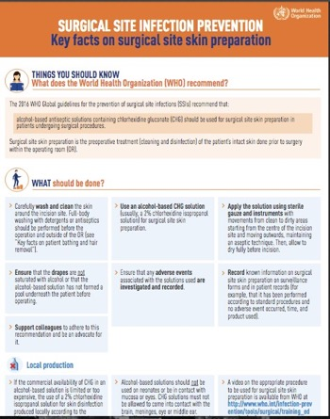
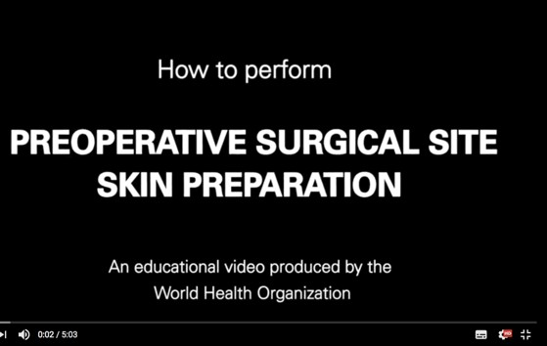
Surgical skin preparation in practice: key resources
Key resource
Video
Source: http://www.who.int/infection-prevention/tools/surgical/training_education/en/

Slide 70

Strong recommendations – intra- and postoperative measures:
SAP prolongation
SAP administration should not be prolonged after completion of the operation.
Why?
Moderate-quality evidence shows that prolonged SAP postoperatively has no benefit in reducing SSI after surgery compared to a single (preoperative) dose.
Discontinuation of SAP after surgery avoids unnecessary extra costs, potential side-effects and emergence of AMR.

Slide 71
Practical points
This recommendation is applicable to the peri- and postoperative periods.
A relevant harm linked to SAP prolongation is the intestinal spread of Clostridium difficile, with higher risk of clinical manifestation of infection.
It can be challenging to ensure SAP is not continued or confused with the need for antibiotics due to an infection.

Slide 72
WHO conditional recommendations for SSI prevention
Conditional recommendations are also important recommendations for which the expert panel considered that the benefits of intervention probably outweighs the risks; however, when considering them for adoption, a more structured decision-making process should be undertaken, based on stakeholder consultation and involvement of patients and health care professionals.
This involves considering local priorities for improvement, feasibility, resource (both human and financial) implications and local culture.

Slide 73
WHO conditional recommendations for SSI prevention –
preoperative period (1)
Topic | Research question | Recommendation | Strength Quality
Perioperative discontinuation of immunosuppressive agents | Should immunosuppressive agents be discontinued perioperatively and does this affect the incidence of SSI? | Immunosuppressive medication should not be discontinued prior to surgery for the purpose of preventing SSI. | Conditional recommendation ------------------------ Very low quality of evidence
Enhanced nutritional support | In surgical patients, should enhanced nutritional support be used for the prevention of SSI? | Consider the administration of oral or enteral multiple nutrient-enhanced nutritional formulas for the purpose of preventing SSI in underweight patients who undergo major surgical operations. | Conditional recommendation ---------------------------- Very low quality of evidence
Preoperative bathing | 1. Is preoperative bathing using an antiseptic soap more effective in reducing the incidence of SSI in | It is good clinical practice for patients to bathe or shower before surgery. | Conditional recommendation ----------------------------
 | surgical patients when compared to bathing with plain soap? 2. Is preoperative bathing with CHG-impregnated cloths more effective in reducing the | Either a plain soap or an antiseptic soap could be used for this purpose. Due to very low quality evidence, the panel decided not to formulate a | Moderate quality of evidence
 | incidence of SSI in surgical patients when compared to bathing with antiseptic soap? | recommendation the use of CHG- impregnated cloths for the purpose of reducing SSI.
Source: Global guidelines for the prevention of surgical site infection. Geneva: World Health Organization; 2016 (http://www.who.int/infection-prevention/publications/ssi-prevention-guidelines/en/).

Slide 74
WHO conditional recommendations for SSI prevention –
preoperative period (2)
Topic | Research question | Recommendation | Strength Quality
Decolonisation with mupirocin ointment with or without CHG body wash for the prevention of S. aureus infection in nasal carriers undergoing surgery | Is mupirocin nasal ointment in combination with or without a CHG body wash effective in reducing the number of S. aureus infections in nasal carriers undergoing surgery? | Patients undergoing cardiothoracic and orthopaedic surgery with known nasal carriage of S. aureus should receive perioperative intranasal applications of mupirocin 2% ointment with or without a combination of CHG body wash. Consider also treating patients with known nasal carriage of S. aureus undergoing other types of surgery with perioperative intranasal applications of mupirocin 2% ointment with or without a combination of CHG body wash. | Strong recommendation ---------------------------- Moderate quality of evidence Conditional recommendation ---------------------------- Moderate quality of evidence
MBP and the use of oral antibiotics | Is MBP combined with or without oral antibiotics effective for the prevention of SSI in colorectal surgery? | Preoperative oral antibiotics combined with MBP should be used to reduce the risk of SSI in adult patients undergoing elective colorectal surgery. | Conditional recommendation ------------------------- Moderate quality of evidence
 |  | MBP alone (without the administration of oral antibiotics) should not be used | Strong recommendation
 |  | for the purpose of reducing SSI in adult patients undergoing elective colorectal surgery. | ------------------------- Moderate quality of evidence

Slide 75
WHO conditional recommendations for SSI prevention –
preoperative period (3)
Topic | Research question | Recommendation | Strength Quality
Antimicrobial skin sealants | In surgical patients, should antimicrobial sealants (in addition to standard surgical site skin preparation) versus standard surgical site skin preparation be used for the prevention of SSI? | Antimicrobial sealants should not be used after surgical site skin preparation for the purpose of reducing SSI. | Conditional recommendation -------------------------- Very low quality of evidence
Perioperative oxygenation | How safe and effective is the perioperative use of an increased fraction of inspired oxygen in reducing the risk of SSI? | The panel recommends that adult patients undergoing general anaesthesia with endotracheal intubation for surgical procedures should receive an 80% fraction of inspired oxygen intraoperatively and, if feasible, in the immediate postoperative period for 2-6 hours to reduce the risk of SSI. | Conditional recommendation ----------------------- Moderate quality of evidence

Slide 76

WHO conditional recommendations for SSI prevention –
intraoperative period (1)
Topic | Research question | Recommendation | Strength Quality
Maintaining normal body temperature (normothermia) | In surgical patients, should systemic body warming versus no warming be used for the prevention of SSI? | Warming devices should be used in the operating room and during the surgical procedure for patient body warming with the purpose of reducing SSI. | Conditional recommendation -------------------------- Moderate quality of evidence
Use of protocols for intensive perioperative blood glucose control | Do protocols aiming to maintain optimal perioperative blood glucose levels reduce the risk of SSI? What are the optimal perioperative glucose target levels in diabetic and non- diabetic patients? | Protocols for intensive perioperative blood glucose control should be used for both diabetic and non-diabetic adult patients undergoing surgical procedures. | Conditional recommendation -------------------------- Low quality of evidence
Maintenance of adequate circulating volume control/ normovolaemia | Does the use of specific fluid management strategies during surgery affect the incidence of SSI? | Goal-directed fluid therapy should be used intraoperatively for the purpose of the reduction of SSI. | Conditional recommendation ------------------------ Low quality of evidence

Slide 77
WHO conditional recommendations for SSI prevention –
intraoperative period (2)
Topic | Research question | Recommendation | Strength Quality
Drapes and gowns | Is there a difference in SSI rates depending on the use of disposable non-woven drapes and gowns vs. reusable, woven drapes and gowns? Does changing drapes during operations affect the risk of SSI? Does the use of disposable adhesive incise drapes reduce the risk of SSI? | Either sterile disposable non-woven or sterile reusable woven drapes and surgical gowns can be used during surgical operations for the purpose of preventing SSI. Plastic adhesive incise drapes with or without antimicrobial properties should not be used for the purpose of preventing SSI. | Conditional recommendation ------------------------- Moderate to very low quality of evidence Conditional recommendation -------------------------- Low to very low quality of evidence
Wound protector devices | Does the use of wound protector devices reduce the rate of SSI in open abdominal surgery? | Consider the use of wound protector devices in clean-contaminated, contaminated and dirty abdominal surgical procedures for the purpose of reducing the rate of SSI. | Conditional recommendation ---------------------------- Very low quality of evidence

Slide 78

WHO conditional recommendations
for SSI prevention – intraoperative period (3)
Topic | Research question | Recommendation | Strength Quality
Incisional wound irrigation | Does intraoperative wound irrigation reduce the risk of SSI? | There is insufficient evidence to recommend for or against saline irrigation of incisional wounds for the | Conditional recommendation ------------------------ Low quality of evidence Conditional recommendation ---------------------------- Low quality of evidence Conditional recommendation ---------------------------- Low quality of evidence
 |  | purpose of preventing SSI.
 |  | Consider the use of irrigation of the incisional wound with an aqueous
 |  | povidone iodine solution before closure for the purpose of preventing SSI, particularly in clean and clean- contaminated wounds.
 |  | Antibiotic incisional wound irrigation before closure should not be used for the purpose of preventing SSI.
Prophylactic negative pressure wound therapy | Does prophylactic negative pressure wound therapy reduce the rate of SSI compared to the use of conventional dressings? | Prophylactic negative pressure wound therapy may be used on primarily closed surgical incisions in high-risk wounds and, taking resources into account, for the purpose of preventing SSI. | Conditional recommendation ------------------------- Low quality of evidence

Slide 79
WHO conditional recommendations for SSI prevention –
intraoperative period (4)
Topic | Research question | Recommendation | Strength Quality
Antimicrobial- coated sutures | Are antimicrobial-coated sutures effective to prevent SSI? If yes, when and how should they be used? | Triclosan-coated sutures may be used for the purpose of reducing the risk of SSI, independent of the type of surgery. | Conditional recommendation ------------------------ Moderate quality of evidence
Laminar flow ventilation systems in the context of operating room ventilation | Is the use of laminar air flow in the operating room associated with the reduction of overall or deep SSI? Does the use of fans or cooling devices increase SSIs? Is natural ventilation an acceptable alternative to mechanical ventilation? | Laminar airflow ventilation systems should not be used to reduce the risk of SSI for patients undergoing total arthroplasty surgery. | Conditional recommendation ------------------------- Low to very low quality of evidence

Slide 80
WHO conditional recommendations for SSI prevention –
postoperative period
Topic | Research Question | Recommendation | Strength Quality
Antimicrobial prophylaxis in the presence of a | 1. In the presence of drains, does prolonged antibiotic prophylaxis prevent SSI? | Perioperative surgical antibiotic prophylaxis should not be continued due to the presence of a wound drain for the | Conditional recommendation ---------------------------- Low quality of evidence Conditional recommendation ---------------------------- Very low quality of evidence
drain and optimal timing for wound drain removal | 2. When using drains, how long should they be kept in place to minimise SSI as a complication? | purpose of preventing SSI.
 |  | The wound drain should be removed when clinically indicated. No evidence
 |  | was found to allow making a recommendation on the optimal timing of wound drain removal for the purpose of the prevention of SSI.
Advanced dressings | In surgical patients, should advanced dressings vs. standard sterile wound dressings be used for the prevention of SSI? | Advanced dressing of any type should not be used over a standard dressing on primarily closed surgical wounds for the purpose of preventing SSI. | Conditional recommendation ---------------------------- Low quality of evidence

Slide 81




Four recommendations specifically focus on improving antibiotic use in surgery and contribute to reducing AMR
Optimal timing for SAP
  Intravenous SAP should be administered prior to the surgical incision when indicated (depending on the type of operation).
  The administration of SAP should be within 120 minutes of the incision, while considering the half-life of the antibiotic (microbiology and pharmacy advice will support this decision).
Recommendations are against:
Antibiotic wound irrigation
Antibiotic prophylaxis in presence of a drain
SAP prolongation in the postoperative period
This is important in relation to the WHO global action plan on AMR.
Source: Global action plan on antimicrobial resistance. Geneva: World Health Organization; 2015 (http://www.who.int/antimicrobial-resistance/publications/global-action-plan/en/).

Slide 82
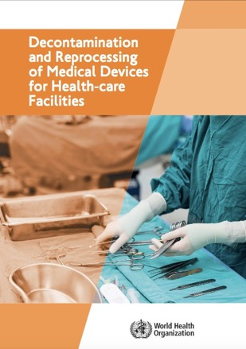
Sterilization and decontamination recommendations as part of SSI prevention
Aspects of sterilization
Risk management
The sterile services department
Cleaning of medical devices
Preparation and packaging for reprocessing
Chemical disinfectants
Decontamination of endoscopes
Sterilization of reusable medical devices
Reuse of single use medical devices
Transporting of medical devices
Dental practice
Source: Decontamination and reprocessing of medical devices in health-care facilities. Geneva: World Health Organization; 2016 (http://www.who.int/infection-prevention/publications/decontamination/en/).

Slide 83
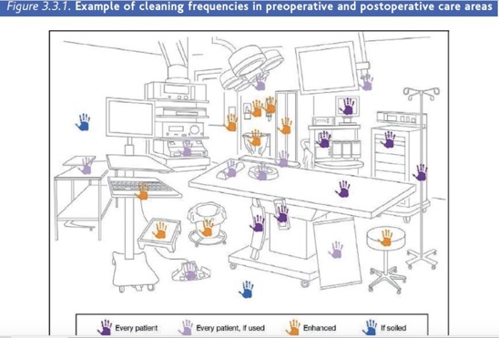

Environmental cleaning in operating rooms
General principles for environmental cleaning and cleaning requirements for various surface types in operating rooms
Source: Global guidelines for the prevention of surgical site infection. Geneva: World Health Organization; 2016 (http://www.who.int/infection-prevention/publications/ssi-prevention-guidelines/en/).

Slide 84

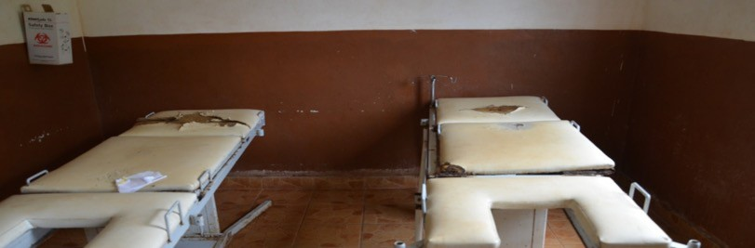
Basic principles of environmental cleaning
Provide training to cleaning staff.
Appropriate personal protective equipment (PPE) must be worn.
Special emphasis should be placed on hand touch surfaces.
Always start with:
the cleanest areas first
the top first
the dirtiest last; the bottom last.
Discard items that cannot be decontaminated effectively.
Note:
if an item is torn, it will not be possible to decontaminate it effectively, so discard it or find a way to resolve the problem (e.g. cover the bed with a plastic sheet until a replacement is found).

Slide 85
Cleaning, decontamination and disinfection requirements for surfaces
in clinical (including surgical) areas
SURFACE TYPE | DEFINITION | CLEANING REQUIREMENT
High hand touch surface | Any surface with frequent contact with hands | Requires special attention and more frequent cleaning After thorough cleaning with detergent, use of appropriate disinfectants to decontaminate these surfaces
Minimal touch surface (floors, walls, ceilings, window sills, etc.) | Any surface with minimal contact with hands Not in close contact with the patient or his/her immediate surroundings | Requires cleaning on a regular basis with detergent only, or when soiling or spills occur

Slide 86


Surfaces contaminated with blood and body fluids
Wear appropriate personal protective equipment.
Contain spills using absorbent material (cloth, paper etc.) and remove as soon as possible.
Clean with detergent and then disinfect the surface.
Dispose of materials into dedicated medical waste containers.

Slide 87
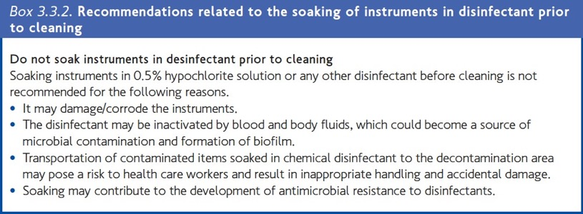

Decontamination and sterilization of operating room equipment principles
The decontamination facility should have standard operating procedures including on decontamination of surgical instruments
  The role of the surgical team in decontamination and sterilization should also be outlined
For more information on this topic, please refer to the “Decontamination and sterilization” training module.
Source: Decontamination and reprocessing of medical devices in health-care facilities. Geneva: World Health Organization; 2016 (http://www.who.int/infection-prevention/publications/decontamination/en/).

Slide 88

Group work 2. Resource considerations
Lack of availability or cost of, for example, mupirocin, antimicrobial soap, ABHR, CHG, SAP and oxygen may create procurement issues and a financial burden, including on patients.
Technical laboratory capacity and other facility infrastructure (such as water or sterilization services) may not be available.
Workload and organizational commitment are required – for example, related to MBP and oxygenation and the required written procedures/instructions.
Staff training and specific expertise (e.g. on increased oxygenation, glucose control) are needed.
Importantly, some recommendations have no added cost or burden – for example, avoiding hair removal.
Local production of many resources is possible and often a low-cost option.
Note: some costs of SSI prevention will still be lower than not undertaking the recommended interventions and dealing with the subsequent consequences, including SSI.
Source: Global guidelines for the prevention of surgical site infection. Geneva: World Health Organization; 2016 (http://www.who.int/infection-prevention/publications/ssi-prevention-guidelines/en/).

Slide 89
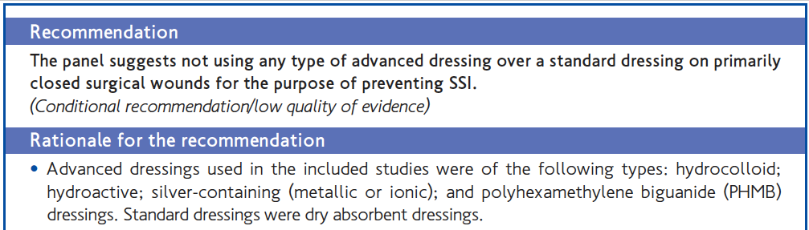
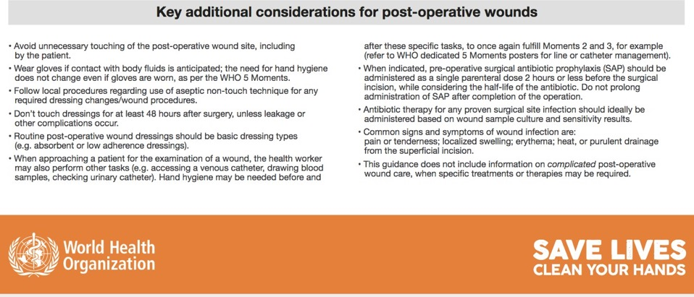
WHO advice for wound management
Sources: Global guidelines for the prevention of surgical site infection. Geneva: World Health Organization; 2016 (http://www.who.int/infection- prevention/publications/ssi-prevention-guidelines/en/); http://www.who.int/gpsc/5may/5moments-EducationalPoster.pdf?ua=1

Slide 90

Why do we need to understand postoperative wound care?
Wounds should heal by primary intention,
but may not always heal “normally” (owing to many risk factors, as described earlier in this module).
If a wound does not heal normally:
  it must be managed to ensure the best outcome;
  the process of wound assessment, cleansing and care must suit the patient’s needs and must limit additional infection risk;
  there is a risk of introducing infection to a postoperative wound.
There are different phases of wound healing: an understanding may be required if a wound is not healing.
Communication with community health workers may be critical if wound healing is problematic after discharge.

Slide 91
Wound evaluation/dressing (1)
Following closure of the surgical incision site, the following actions should be taken.
A standard wound dressing should be applied.
The wound should be checked after about 48 hours. Dressing removal should be assessed; if the wound is dry and healing with no signs of infection, no additional dressing is required (the patient can shower as normal).
If any signs of discharge/infection are seen, a doctor/wound specialist should be consulted (to undertake further wound assessment and decisions, such as specimen sample, further dressings).

Slide 92
Wound evaluation/dressing (2)
Before removing the dressing, patient preparation should take place (comfort, pain relief) – the patient should be actively involved in wound healing goals (considering that nutrition and similar are part of maintaining healthy skin and tissue). Check the patient's care notes for an update on any changes in the patient's condition and to make sure the dressing is due to be removed.
A decision should be made if the dressing will be changed using a nontouch or a full aseptic technique (which will determine what type of gloves to be used). For closed surgical wounds with no signs of complication, a nontouch technique using nonsterile gloves to remove the surgical wound dressing should be acceptable.

Slide 93
Wound evaluation/dressing (3)
Premade packs are available in some countries, containing all items needed for wound dressing removal/wound cleaning if required – otherwise, all clean/sterile items should be gathered before starting the wound evaluation/dressing procedure.
A wound assessment should be completed – some health facilities have wound assessment forms containing prompts, e.g. on a visual check, comparing and evaluating any smell, amount of blood or ooze (excretions), their colour and the size of the wound if it is not healing.

Slide 94
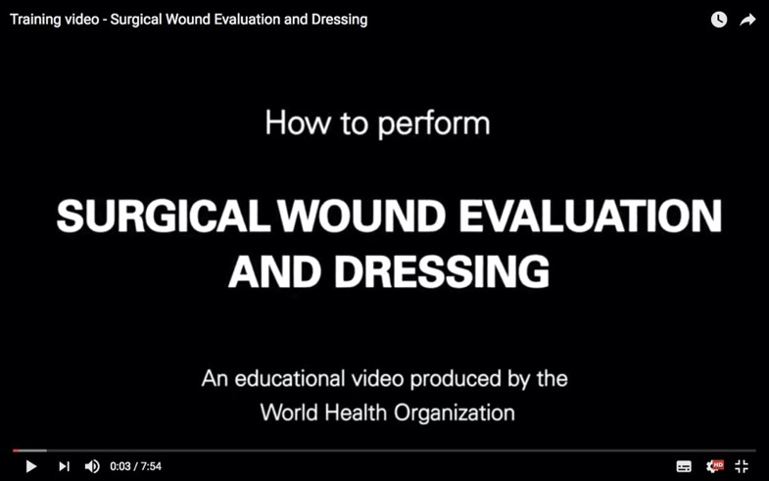

Wound dressing video
Source: http://www.who.int/infection-prevention/tools/surgical/training_education/en/

Slide 95
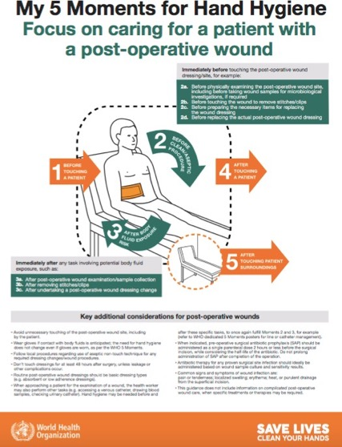
Group work 3. Hand hygiene workflow
Post-training exercise (to be done at your facility)
Group work
Source: Hand hygiene technical reference manual. Geneva: World Health Organization; 2009 (http://www.who.int/gpsc/5may/tools/evalua tion_feedback/en/).
Key resource

Slide 96
Group work 4. Using SSI guidelines in your setting
Do you have SSI prevention guidelines in your institution? If not, can you explain why not?
If you have your own guidelines, how do they compare to the WHO recommendations? If you do not have your own guidelines, how would you present the WHO recommendations in your institution?
Have you identified from the WHO recommendations which are the most challenging to include in your guidelines or to implement?

Slide 97
Session 4
Understanding the application of implementation strategies to ensure SSI prevention including real life examples
99

Slide 98
Learning objectives – session 4
Describe adaptive and technical improvement approaches and the role of process and outcome indicators, which form part of an improvement project applied to SSI prevention
Explain how evidence-based recommendations on SSI can be implemented effectively in the local context and in real-life situations

Slide 99
HOW DO WE START TO IMPROVE ADHERENCE TO SSI RECOMMENDATIONS?

Slide 100

An approach for improving SSI outcomes
Technical work
Evidence-based interventions
Adaptive work
Safety culture

Slide 101
Explaining technical and adaptive work
TECHNICAL WORK | ADAPTIVE WORK
Work that we know we should do: implementation of evidence-based recommendations (e.g. appropriate antibiotic dosing and skin preparation) | The intangible components of work, like ensuring that team members speak up with concerns and hold each other accountable
Work that lends itself to standardization (e.g. checklists and protocols) | Work that shapes the attitudes, beliefs and values of clinicians, so that they consistently perform tasks the way they know they should
Evidence-based interventions | Safety culture, including improved communications and teamwork
Principles of safe design: CUSP integrates adaptive and technical work. Baltimore, ML: Johns Hopkins Medicine;2014 (https://www.hopkinsmedicine.org/armstrong_institute/training_services/workshops/cusp_implementation_training/cusp_guidance.html).

Slide 102

A patient safety culture approach – “adaptive”
Comprehensive unit-based safety programme (CUSP)
Educate staff on science of safety
Identify defects
Assign an executive to the unit
Learn from one defect per quarter
Implement teamwork tools
Armstrong Institute for Patient Safety and Quality [website]. Baltimore, ML: Johns Hopkins Medicine; 2014 (https://www.hopkinsmedicine.org/armstrong_institute/training_services/workshops/cusp_implementation_training/c usp_guidance.html).

Slide 103

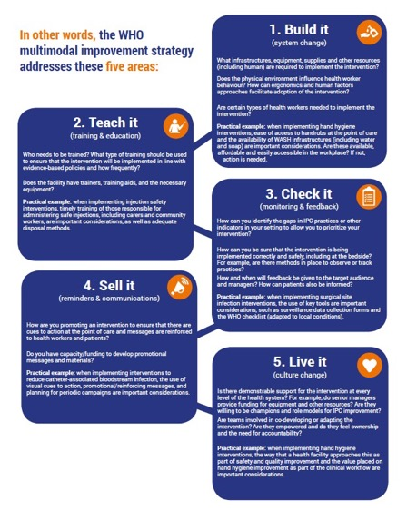
A key lesson – summary of a multimodal improvement strategy
IPC focal points must embody these five areas and apply them to infection prevention activities as necessary.
Source: Interim practical manual supporting national implementation of the WHO guidelines on core components of infection prevention and control programmes. Geneva: World Health Organization; 2017 (http://www.who.int/infection- prevention/tools/core-components/en/).

Slide 104
The surgical unit-based safety programme (SUSP) – combining technical and adaptive work
This is one example of a proven approach to reducing SSI by improving (perioperative) safety including through documenting the culture of safety within a health care facility.
It provides tools and resources to improve safety culture and reduce SSIs.
It aids tracking of valid performance measures.
It engages front-line clinicians and hospital leaders to implement evidence-based interventions and improve patient care.
It supports infrastructure development to improve teamwork and learn from mistakes.
It is an approach that has now been tested in the USA and four African countries.
Source: The surgical unit-based safety programme in African hospitals. In: World Health Organization [website]. Geneva: World Health Organization; 2018 (http://www.who.int/infection-prevention/countries/surgical/en/).

Slide 105
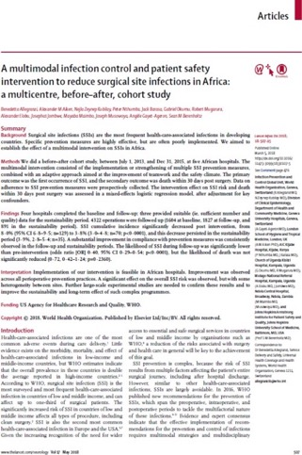
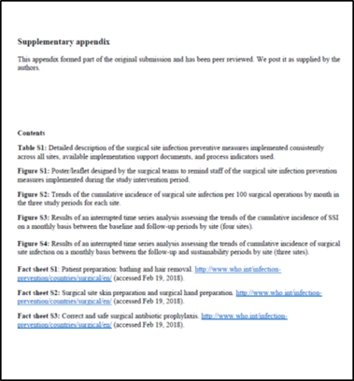

Group work 5. Case study
Source: Allegranzi B, Aiken AM, Zeynep Kubilay N, Nthumba P, Barasa J, Okumu G et al. A multimodal infection control and patient safety intervention to reduce surgical site infections in Africa: a multicentre, before–after, cohort study. Lancet Infect Dis. 2018; 18(5):507–515.

Slide 106
The SUSP approach
Patient safety culture improvement (CUSP approach):
science of safety education
staff safety assessment
leadership
learning from defects
team work and communication
Infection prevention best practices
evidence-based and identified according to local staff assessment
+
Improvement of the patient safety climate
Reduction of:
SSIs
surgical complications

Slide 107
Group work 6. Understand your current situation
How did you or will you start your SSI prevention journey – what approach are you using?
What tools did you or will you use to understand the local priorities for improvement?
Discuss the following questions from the SUSP Perioperative Staff Safety Assessment Tool:
  Briefly describe the most frequent ways (list a maximum of three) in which patients may get an SSI in your surgical services/facilities.
  Describe what you think can be done to prevent this SSI.
Source: Supplemental Tools [website]. Rockville, MD: Agency for Healthcare Research and Quality; 2018 (https://www.ahrq.gov/professionals/quality-patient-safety/hais/tools/surgery/guide-appcusp.html).

Slide 108

Gap areas leading to SSI identified in African SUSP hospitals
Lack of infection prevention and control = inadequate/inappropriate:
  SAP
  patient bathing
  hair removal
  surgical hand preparation
  surgical skin site preparation
  discipline in the operating room
  equipment: sterile gloves, sterilization, clippers, drapes, gowns
Lack of staff training & education, patient education
Source: Allegranzi B, Aiken AM, Zeynep Kubilay N, Nthumba P, Barasa J, Okumu G et al. A multimodal infection control and patient safety intervention to reduce surgical site infections in Africa: a multicentre, before–after, cohort study. Lancet Infect Dis. 2018; 18(5):507–515.

Slide 109
The best approach for starting a SUSP project –
adaptive and technical focus
Assemble a multidisciplinary team to include pre-anaesthesia, surgery and post-anaesthesia units.
Engage a senior-level executive as part of your team.
Implement the project with the intention of improving perioperative teamwork, communication and safety culture.
Meet regularly as a team to implement interventions and monitor performance.
Collect a minimal set of standardized surgical outcome data monthly.

Slide 110
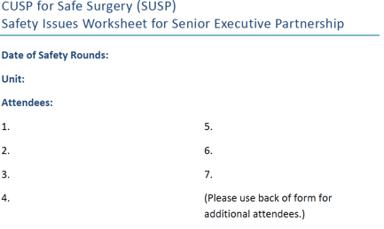

Tools to address the culture
Core CUSP toolkit
Created for clinicians by clinicians, the CUSP toolkit is modular and modifiable to meet individual unit needs. Each module includes teaching tools and resources to support change at the unit level, presented through facilitator notes that take you step-by-step through the module, presentation slides, tools, videos.
Sources: Core CUSP Toolkit [website]. Rockville, MD: Agency for Healthcare Research and Quality; 2018 (https://www.ahrq.gov/professionals/education/curriculum-tools/cusptoolkit/modules/index.html); Supplemental Tools [website]. Rockville, MD: Agency for Healthcare Research and Quality; 2018 (https://www.ahrq.gov/professionals/quality-patient- safety/hais/tools/surgery/guide-appcusp.html).

Slide 111





Understanding and influencing the local culture: tools created by SUSP teams in African hospitals
Source: The surgical unit-based safety programme in African hospitals. In: World Health Organization [website]. Geneva: World Health Organization; 2018 (http://www.who.int/infection-prevention/countries/surgical/en/).

Slide 112



WHO protocol and forms for SSI surveillance based on SUSP testing in African hospitals
Source: Protocol for surgical site infection surveillance with a focus on settings with limited resources. Geneva: World Health Organization; 2018 (http://www.who.int/infection-prevention/tools/surgical/evaluation_feedback/en/).

Slide 113





Reproduced with permissions

Slide 114


Improving surgical hand preparation
Local production of modified WHO formulation for ABHR
Surgical hand preparation
  Antimicrobial soap + water = 2–5 minutes
  Alcohol-based = 1.5–3 minutes
  The right technique is crucial
  Nailbrushes are not recommended.

Slide 115


Modified WHO formulations for surgical hand preparation
Formulation I
Final concentrations: ethanol 80% wt/wt, glycerol 0.725% vol/vol, hydrogen peroxide 0.125% vol/vol.
Ingredients:
1. ethanol (absolute), 800 g
2. H₂O₂ (3%), 4.17 ml
3. glycerol (98%), 7.25 ml (or 7.25
x 1.26 = 9.135 g)
4. top up to 1000 g with distilled or boiled water
Formulation II
Final concentrations: isopropanol 75% wt/wt, glycerol 0.725% vol/vol, hydrogen peroxide 0.125% vol/vol.
Ingredients:
1. isopropanol (absolute), 750 g
2. H₂O₂ (3%), 4.17 ml
3. glycerol (98%), 7.25 ml (or 7.25 x
1.26 = 9.135 g)
4. top up to 1000 g with distilled water
Quality assurance and efficacy must be assured
Sources:
Suchomel M KM, Kundi M, Pittet D, Rotter ML. Modified World Health Organization hand rub formulations comply with European efficacy requirements for preoperative surgical hand preparations. Infect Control Hosp Epidemiol. 2013; 34(3):245–250.
Allegranzi B, Aiken AM, Zeynep Kubilay N, Nthumba P, Barasa J, Okumu G et al. A multimodal infection control and patient safety intervention to reduce surgical site infections in Africa: a multicentre, before–after, cohort study. Lancet Infect Dis. 2018; 18(5):507– 515.

Slide 116


System change – surgical skin preparation
Local preparation of 2% chlorhexidine isopropanol solution
Isopropanol: 62.7 % g/g
chlorhexidine 12.1% g/g taken from a 18.8% g/g chlorhexidine digluconate water solution
Top up with distilled water up to 100%
Source: Allegranzi B, Aiken AM, Zeynep Kubilay N, Nthumba P, Barasa J, Okumu G et al. A multimodal infection control and patient safety intervention to reduce surgical site infections in Africa: a multicentre, before–after, cohort study. Lancet Infect Dis. 2018; 18(5):507–515.

Slide 117


Impact on preventive measures
Source: Allegranzi B, Aiken AM, Zeynep Kubilay N, Nthumba P, Barasa J, Okumu G et al. A multimodal infection control and patient safety intervention to reduce surgical site infections in Africa: a multicentre, before–after, cohort study. Lancet Infect Dis. 2018; 18(5):507–515.

Slide 118

Impact on SSI
Source: Allegranzi B, Aiken AM, Zeynep Kubilay N, Nthumba P, Barasa J, Okumu G et al. A multimodal infection control and patient safety intervention to reduce surgical site infections in Africa: a multicentre, before–after, cohort study. Lancet Infect Dis. 2018; 18(5):507–515.

Slide 119
Summary of success factors
Use of multimodal strategies (this does not mean checklists and bundles)
Having a step-wise action plan
Mapping recommendations according to the surgical patient journey
Empowering teams and involving front-line staff
Engaging leadership
Letting teams take the lead on adaptation
Catalysing collective and individual ownership
Using data to create awareness
Awarding teams and work demonstrating a safety culture spirit

Slide 120
Session 5
Applying a multimodal improvement strategy for SSI prevention

Slide 121
Learning objectives – session 5
To describe and explain the WHO multimodal improvement strategy designed to implement SSI prevention recommendations

Slide 122


Use this document is to learn about a range of tested approaches to achieve successful SSI prevention implementation at the facility level, including in the context of a broader surgical safety climate.
http://www.who.int/infection-prevention/tools/surgical/en/
Ariyo P, et al. ICHE 2019, in press

Slide 123



A WHO implementation framework
Stepwise approach
Sources: http://www.who.int/infection-prevention/tools/core-components/en
Preventing surgical site infections: implementation approaches for evidence-based recommendations. Geneva: World Health Organization; 2018 (http://www.who.int/infection- prevention/tools/surgical/en/).

Slide 124
WHO core component 5 for effective IPC Strong recommendation: multimodal strategies
National level: national IPC programmes should coordinate and facilitate the implementation of IPC activities through multimodal strategies on a nationwide or subnational level.
Facility level: IPC activities using multimodal strategies should be implemented to improve practices and reduce HAI and AMR.
  A multimodal strategy comprises several elements or components (three or more; usually five) implemented in an integrated way with the aim of improving an outcome and changing behaviour. It includes tools, such as bundles and checklists, developed by multidisciplinary teams that take into account local conditions.
  The five most common components are: (i) system change (availability of the appropriate infrastructure and supplies to enable IPC recommendations implementation); (ii) education and training of health care workers and key players; (iii) monitoring infrastructures, practices, processes, outcomes and providing data feedback; (iv) reminders in the workplace/communications; and (v) culture change within the establishment or the strengthening of a safety climate.
Source: Guidelines on core components of infection prevention and control programmes at the national and acute health care facility level. Geneva: World Health Organization; 2016 (http://www.who.int/infection-prevention/publications/ipc-core-components/en/).

Slide 125

Operational manual for the WHO SSI prevention recommendations.
This implementation manual is designed to help you understand the WHO multimodal improvement strategy applied to SSI prevention
http://www.who.int/infection-prevention/tools/surgical/en/

Slide 126
IPC multimodal improvement strategy
IPC focal points must embody these five areas and apply them to infection prevention activities as necessary.
Source: Interim practical manual supporting national implementation of the WHO guidelines on core components of infection prevention and control programmes. Geneva: World Health Organization; 2017 (http://www.who.int/infection- prevention/tools/core-components/en/).

Slide 127

Understanding the multimodal strategy for SSI prevention (1)
System change
“Build it”
Ensuring that the health care facility has the necessary infrastructure and resources in place to allow for steps to be taken to prevent SSI based on the known modifiable risk factors
The right infrastructure and available resources can streamline interventions for consistent delivery of care and make execution easier and safer.
Source: Preventing surgical site infections: implementation approaches for evidence-based recommendations. Geneva: World Health Organization; 2018 (http://www.who.int/infection-prevention/tools/surgical/en/).

Slide 128
System change - “Build it” (cont’) Necessary infrastructure and resources
Allocated budget
Standard operating procedures, protocols, local policies and tools/mechanisms for training
An IT system (or paper) for monitoring and feedback on infrastructure and resources and other improvement steps
Laboratory services
Surgical services/human resources including a dedicated, competent team for ensuring SSI prevention activities working to an action plan
Supplies for surgical hand preparation*
- ABHR, antimicrobial soap
* Procurement vs local production
Sterile drapes and gowns
The correct antibiotics for SAP (and if need to be given with MBP) - easily accessible
Clippers (if hair removal essential)
Chlorhexidine- alcohol-based (skin prep) solution*
Mupirocin 2% ointment
Oxygen
Standard postoperative wound dressings
Antimicrobial-coated sutures
Negative pressure wound therapy devices
Nutritional formulas
Warming devices
Fluid therapy
Aqueous povidone iodine solution (irrigation)
To consider:

Slide 129

Understanding the multimodal strategy for SSI prevention (2)
Training and education – “Teach it”
Practical training and education methods aligned with the recommendations for SSI prevention
Onsite hospital courses
Bolus (single relatively large) sessions
Simulation sessions for skills training
Use of locally made or online videos
Online e.learning courses and webinars
Focus groups and workshops
Bedside training
In-person sessions, e.g. during ward or grand rounds, town hall meetings, coaching visits
Pre and post knowledge and perception tests
Training support materials (handouts, e-learning, etc.)

Slide 130

Understanding the multimodal strategy for SSI prevention (3)
Evaluation and feedback
“Check it”
Regular monitoring and timely
feedback of:
risk factors for SSI;
compliance with recommended procedures and practices;
infrastructures and available resources and supplies;
It should not be seen as a component separate from implementation or only to be used for scientific purposes. Targeted tools and use of observations are inherent.
This is an essential step in:
identifying areas deserving major efforts and feeding crucial information into development of local local action plan;
measuring the changes induced by improvement efforts and ascertaining whether interventions have been effective;
engaging staff in deciding upon different formats for providing feedback (real time and personalised feedback have proven beneficial).
knowledge and perception of the problem;
SSI rates.

Slide 131

Understanding the multimodal strategy for SSI prevention (4)
Reminders and communications
“Sell it”
Posters
Leaflets
Banners
Stickers
Flowcharts
Infographics
Letter templates
Advocacy messages suitable to the local setting, e.g. memos
Manuals
Electronic reminders (built in to hospital IT system)
Telephone call (including for patient reminders)
Reminding and prompting health care workers about the importance of practices to prevent SSI when they are working at the point of care
Informing patients and their visitors of the standard of care that they should expect to receive
Communications to inform senior leaders and decision-makers regarding the standards that they should assure

Slide 132

Understanding the multimodal strategy for SSI prevention (5)
Institutional safety climate and culture
“Live it”
Creating an environment and the perceptions that facilitate awareness-raising about SSI prevention at all levels:
a climate that understands and prioritizes surgical safety issues;
team spirit and cohesion;
awareness of self-capacity to make a change, ownership of the intervention.
Motivated, multidisciplinary well functioning teams
Champions
Role models
Visible leadership including on ward/grand rounds, through photographs and signatures
Morbidity and mortality meetings including senior hospital staff – to learn from defects and facilitate sharing for improvement
Advocacy messages from leaders (delivered in a timely manner)

Slide 133
Group work 8. Preparing a multimodal strategy for SSI - example

Slide 134


Integration of hand hygiene in the flow of patient care
Source: http://www.who.int/infection- prevention/tools/surgical/reminders-advocacy/en/

Slide 135

System change: modified WHO formulations for surgical hand preparation
Formulation I
Final concentrations: ethanol 80% wt/wt, glycerol 0.725% vol/vol, hydrogen peroxide 0.125% vol/vol.
Ingredients:
1. ethanol (absolute), 800 g
2. H₂O₂ (3%), 4.17 ml
3. glycerol (98%), 7.25 ml (or 7.25
x 1.26 = 9.135 g)
4. top up to 1000 g with distilled or boiled water
Formulation II
Final concentrations: isopropanol 75% wt/wt, glycerol 0.725% vol/vol, hydrogen peroxide 0.125% vol/vol.
Ingredients:
1. isopropanol (absolute), 750 g
2. H₂O₂ (3%), 4.17 ml
3. glycerol (98%), 7.25 ml (or 7.25 x
1.26 = 9.135 g)
4. top up to 1000 g with distilled water
Sources:
Suchomel M KM, Kundi M, Pittet D, Rotter ML. Modified World Health Organization hand rub formulations comply with European efficacy requirements for preoperative surgical hand preparations. Infect Control Hosp Epidemiol. 2013; 34(3):245–250.
Allegranzi B, Aiken AM, Zeynep Kubilay N, Nthumba P, Barasa J, Okumu G et al. A multimodal infection control and patient safety intervention to reduce surgical site infections in Africa: a multicentre, before–after, cohort study. Lancet Infect Dis. 2018; 18(5):507–515.

Slide 136


Education and training example: improving surgical hand preparation
Local production of modified WHO formulation for ABHR
Surgical hand preparation
  Antimicrobial soap + water = 2–5 minutes
  Alcohol-based = 1.5–3 minutes
  The right technique is crucial
  Nailbrushes are not recommended.

Slide 137



Education and training example
Video
https://www.youtube.com/watch?v=h16JPBcOIGs
WHO Collaborating Centre on Patient Safety
Infection Control & Improving Practices
University of Geneva Hospitals
and Faculty of Medicine, Geneva, Switzerland

Slide 138




Monitoring example – observation tools
Sources:
http://www.who.int/infection-prevention/tools/hand- hygiene/evaluation_feedback/en/
Protocol for surgical site infection surveillance with a focus on settings with limited resources. Geneva: World Health Organization; 2018 (http://www.who.int/infection-prevention/tools/surgical/evaluation_feedback/en/).

Slide 139


Reminders
Source: http://www.who.int/infection- prevention/tools/surgical/reminders-advocacy/en/

Slide 140

Reminders and communications: campaigning poster
Source: http://www.who.int/gpsc/5may/A4_hh-poster- visual-EN.pdf?ua=1

Slide 141

Reminders: embedding hand hygiene in the surgical patient’s journey
Source: http://www.who.int/infection- prevention/tools/surgical/reminders-advocacy/en/

Slide 142
Tools to address the culture
Core CUSP toolkit
Created for clinicians by clinicians, the CUSP toolkit is modular and modifiable to meet individual unit needs. Each module includes teaching tools and resources to support change at the unit level, presented through facilitator notes that take you step-by-step through the module, presentation slides, tools, videos.
Sources: Core CUSP Toolkit [website]. Rockville, MD: Agency for Healthcare Research and Quality; 2018 (https://www.ahrq.gov/professionals/education/curriculum-tools/cusptoolkit/modules/index.html); Supplemental Tools [website]. Rockville, MD: Agency for Healthcare Research and Quality; 2018 (https://www.ahrq.gov/professionals/quality-patient- safety/hais/tools/surgery/guide-appcusp.html).

Slide 143

SSI prevention throughout the patient journey – IPC in action
Source: http://www.who.int/gpsc/ssi-infographic.pdf

Slide 144







WHO SSI Prevention Implementation Package
WHO Adaptive Tools to Support
SSI Prevention Implementation
http://www.who.int/infection-prevention/tools/surgical/evaluation_feedback/en/
Fact sheets on
SSI recommendations
http://www.who.int/infection-prevention/tools/surgical/en/

Slide 145
Acknowledgements
Benedetta Allegranzi (Department of Service Delivery and Safety, WHO) coordinated the development of this module and contributed to its writing.
Claire Kilpatrick (Department of Service Delivery and Safety, WHO) led the writing of the module.
Anthony Twyman and Nizam Dimani (Department of Service Delivery and Safety, WHO) contributed to the writing of the module.

Slide 146


WHO Infection Prevention and Control Global Unit

