Slide 1
Cleaning in the OR and Procedure Rooms
Module 3

Slide 2
Outcomes
Upon completion of this module, participants will be able to
  describe the different traffic areas: unrestricted, semi-restricted, and restricted zones;
  describe end of procedure cleaning and terminal cleaning;
  list high-touch objects in the operative and procedural environment, and;
  describe how often cleaning should occur.

Slide 3
Definitions
Clean
  the absence of visible dust, soil, debris, or blood
Disinfection
  a process that kills pathogenic and other microorganisms by physical or chemical means
Terminal cleaning
  thorough environmental cleaning that is performed at the end of each day the room or area is used
End of procedure cleaning
  cleaning and disinfecting the operating or procedural room between patients throughout the day while used

Slide 4
Traffic in the Surgical Area
The surgical area is composed of unrestricted, semi-restricted, and restricted zones
  traffic patterns show how the patient and team members move into, through, and out of the areas
  signage helps clarify the requirements for what team members must wear in each zone
  defined by the activities performed in each area
Notes:
Increasing environmental controls and surgical attire occurs as team members progressively move from unrestricted to restricted areas. This decreases the potential for cross-contamination and the potential for infection in the OR area.

Slide 5
Traffic in the Surgical Areas
OR and procedure rooms are in a controlled traffic area
Monitoring of the flow of patients, team members, equipment, and supplies occurs at certain points in the space
  control desk
  double closed doors to hallways
Notes:
How do these steps protect the patient? Patient safety includes shielding the patient from harm in many ways. We never want to expose the patient to germs that could cause harm (infections).

Slide 6
Traffic Patterns
The surgical area is composed of three zones
unrestricted
semi-restricted
restricted
Notes:
Discuss the “chain of infection” concepts here. By limiting the amount of germs on our clothes, we decrease the number of microorganisms brought into the environment. We cover all types of hair to decrease the chances of shedding loose hair into the surgical environment. Masks should be worn if team members are around open sterile supplies to keep from contaminating these supplies and equipment.

Slide 7
Unrestricted Zone
Central control point (front desk)
  monitor the entrance of patients, personnel, and materials
Street clothes are permitted in this area
Traffic is not limited
The entrance to the surgical suite should be restricted to authorized personnel based on organizational policies
Notes:
In the unrestricted areas, street clothes are permitted.

Slide 8
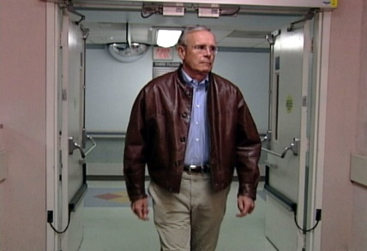
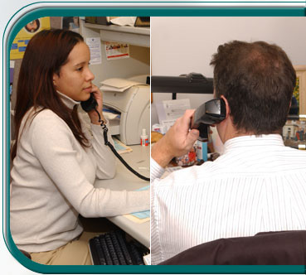
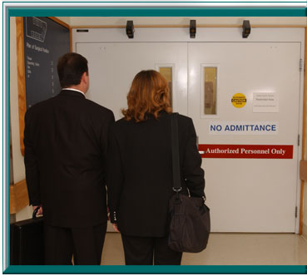
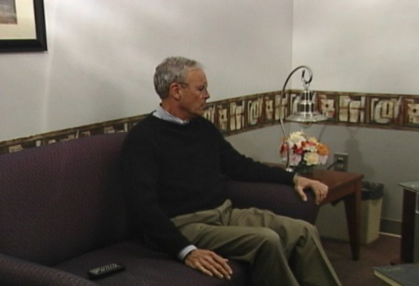
The Unrestricted Zone

Slide 9
The Semi-restricted Zone
Includes
  scrub sink areas
  storage areas for clean and sterile supplies
  work areas for processing surgical instruments
  corridors leading to the surgical suite
Traffic is only allowed for authorized team members and patients
Team members wear
  hospital laundered scrub attire
  head and facial hair is covered
  masks are not required in this area
Notes:
This area includes the peripheral support areas of the surgical suite, but surgery does not happen in this space. Talk about surgical attire here. Talk about why it would still be important to protect the patient from harm here (importance of decreasing germs in the area, controlling traffic, etc.).

Slide 10
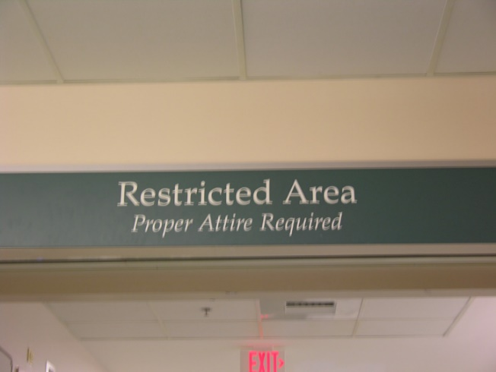
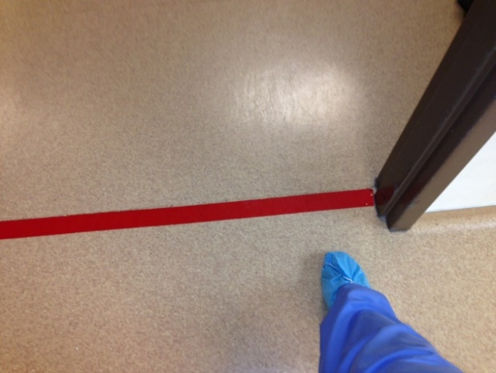
Indicate Semi-restricted and Restricted

Slide 11
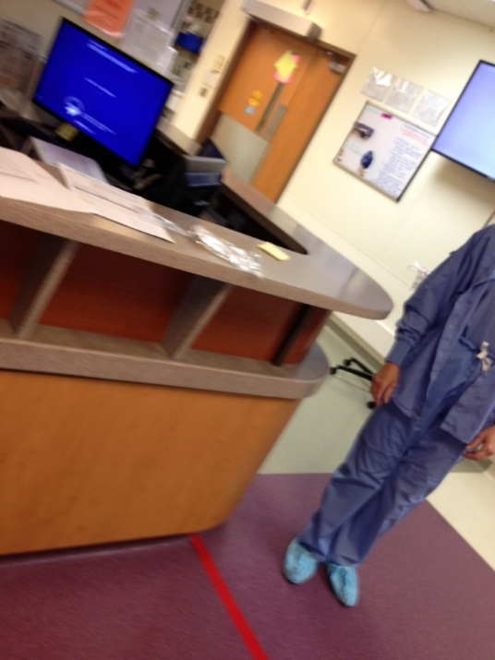
From Unrestricted to Semi-restricted
Unrestricted
Semirestricted

Slide 12
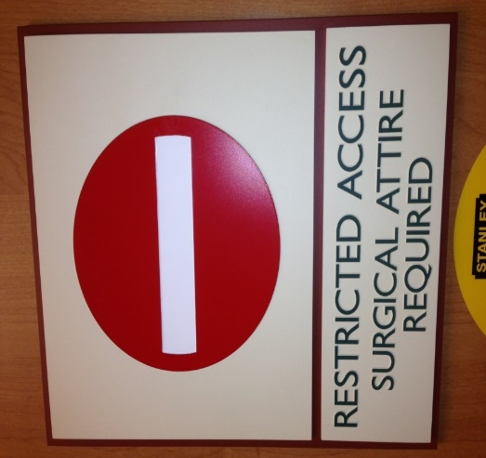
Signage

Slide 13
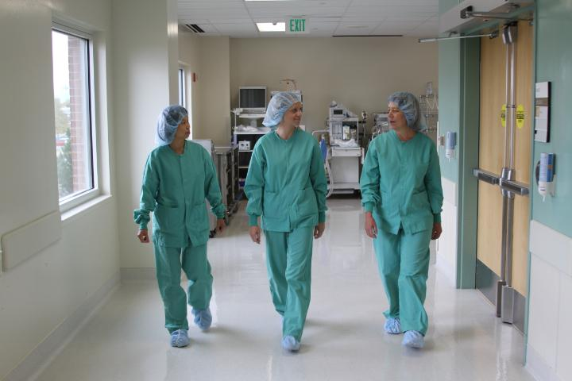
The Semi-restricted Zone
Notes:
Discuss why it is important to protect this area from outside germs.

Slide 14
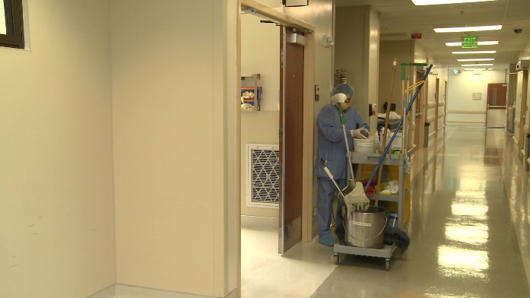
Semi-restricted - OR Corridors

Slide 15
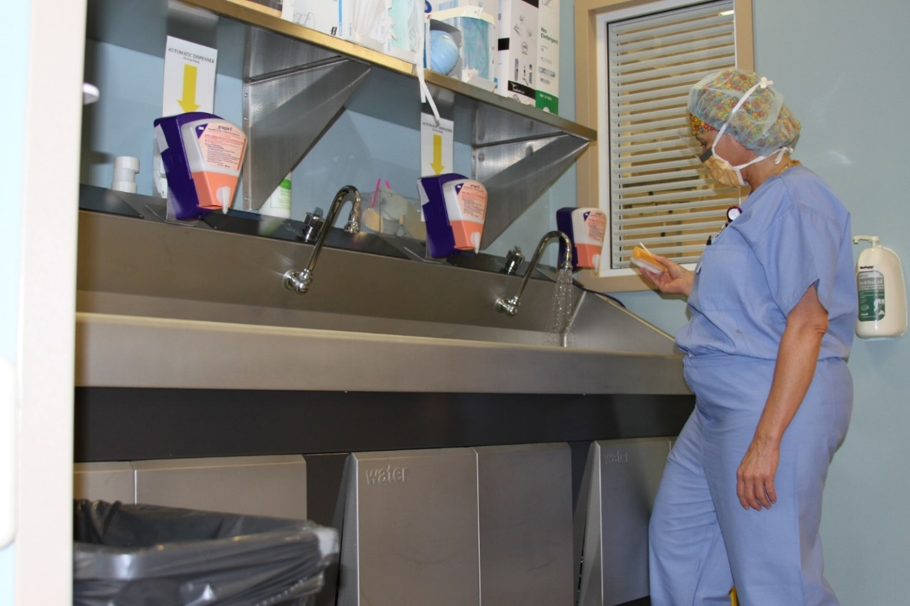
Semi-restricted - Scrub Sinks

Slide 16
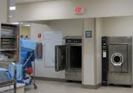
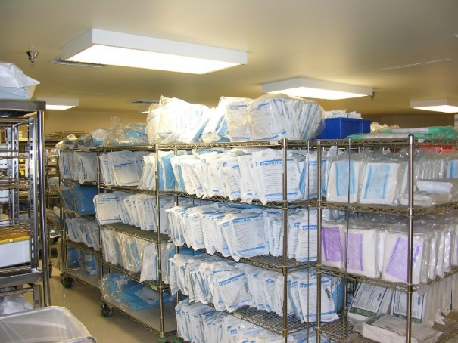
Semi-restricted - Sterile Processing Areas

Slide 17
Restricted Zone
Includes
  OR
  procedure rooms
  clean core area

Slide 18
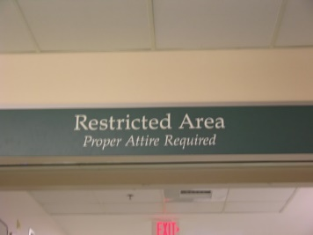
Restricted Zone
Restricted zone
  traffic is only allowed for authorized team members and patients
  team members wear hospital laundered scrub attire, no outside clothes
  head and facial hair is covered
  masks are worn if open sterile supplies and equipment are being used
Notes:
Discuss why it would be important to protect this area from outside germs. Discuss the chain of infection concepts here. By limiting the amount of germs on our clothes, we decrease the number of microorganisms brought into the environment. We cover all types of hair to decrease the chances of shedding loose hair into the surgical environment. Masks should be worn if team members are around open sterile supplies to keep from contaminating these supplies and equipment.

Slide 19
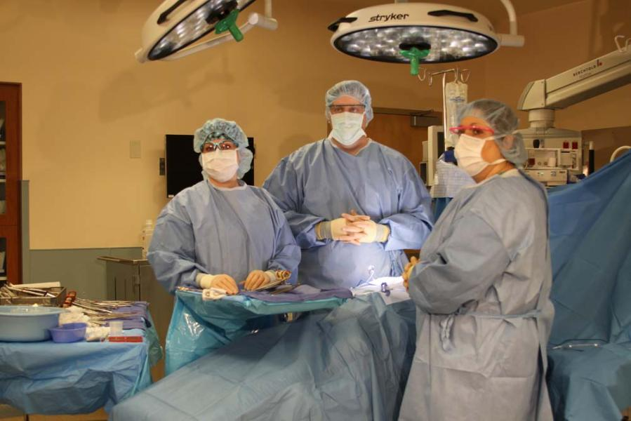
Restricted – The Operating Room
Notes:
Discuss why it would be important to protect this area from outside germs.

Slide 20
Surgical Attire for People coming into the Semi-restricted and Restricted Zones for Brief Periods of Time for a Specific Purpose
Examples include
  law enforcement officers
  parents
  biomedical engineers
Cover all head and facial hair
Put on surgical scrubs or a single-use coverall suit
  all outside clothing must be covered

Slide 21
A Transition Area
Team members can enter into an unrestricted area in street clothing and exit into the semi-restricted in surgical attire
  locker rooms
May also be used as a security point to monitor traffic

Slide 22
Types of Cleaning in the OR
Damp dusting
  first thing in the morning before surgical supplies are brought into the OR
  before surgical supplies are opened
End of procedure cleaning and disinfecting
  cleaning and disinfecting between every patient during the day
Terminal cleaning and disinfecting
  cleaning and disinfecting done at the end of the day
Notes:
Now, let’s discuss these terms. It is important to describe the different types of cleaning and when the cleaning occurs. Each of these terms will be discussed in depth in the following slides.

Slide 23
Use Dedicated Cleaning Equipment
Cleaning equipment for semi-restricted and restricted areas
  Should be dedicated equipment
    Wheels on carts and other equipment can transfer soil from outside areas
  Using dedicated equipment for the semi-restricted and restricted areas may decrease the risk of cross-contamination from other areas in the hospital

Slide 24
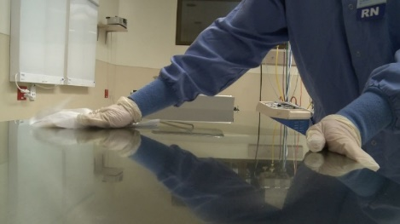
Damp Dusting
Use a clean, low-linting cloth moistened with disinfectant
Damp dust first thing in the morning
  before additional items or equipment are brought into the room
Damp dust from top to bottom
Why damp dust?
  removes dust from horizontal surfaces
Notes:
Nursing personnel normally performs damp dusting prior to bringing in equipment and supplies. Every team member should know what this term means. Highlight that this occurs first thing in the morning, so team members understand the importance of removing anything that might have “settled” in the room overnight.

Slide 25
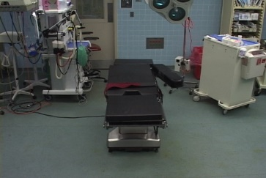
End of Procedure Cleaning
Cleaning and disinfecting the OR or procedural room between patients throughout the day
Also called room turnover cleaning
This step is very important!
  stopping the spread of germs from one patient to the next
  decreasing the amount of germs in the environment
Notes:
Remind personnel about the chain of infection discussed in Module One of this series. Every patient deserves care in a clean, safe environment. Having a clean, disinfected room for care to be delivered in is a foundation of patient safety.

Slide 26
Equipment and Supplies
Gather the correct equipment and supplies needed to clean and disinfect the room
  detergents and disinfectants
  low-linting cloths
  mop
  single-use disposable wipes
Check the expiration dates on detergents and disinfectants
  if expired, discard the old product and replace it with new supply
Notes:
Discuss checking the safety data sheets (SDS) for instructions on how to properly discard the old, expired product. If possible, show team members the SDS sheets for the products they will use to clean at this time and talk through the process according to the manufacturer's guidelines.

Slide 27
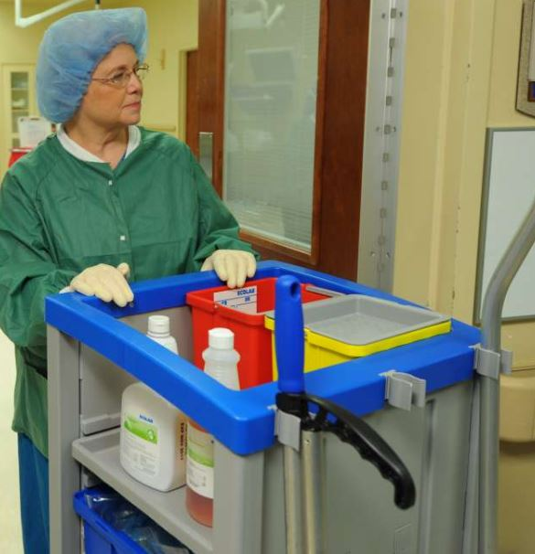
“Courtesy of Ecolab® Inc.”

Slide 28
Detergent or Disinfectant?
Use a detergent before using a disinfectant to make sure all soil and dirt are removed if equipment is visibly dirty
Products are
  one step: combined detergent and disinfectant
  or
  two step: two separate products for detergent and disinfectant
Notes:
Talk about the products used in your facility. Point out to personnel if the product is a one or two step product. Team members need to be able to verbalize the difference between the two types of products.

Slide 29
Cleaning Before Disinfecting
Cleaning of visible soil or dirt from objects is very important
  soil and dirt can be a barrier stopping the disinfectant from working to kill germs on the surface
Notes:
Explain why blood, bodily fluids, or dirt can create a barrier to disinfecting environmental surfaces. If the disinfectant has to cut through additional barriers, it will not have the appropriate amount of time to be on the surface of the item and decreasing the amount of germs on that item.

Slide 30
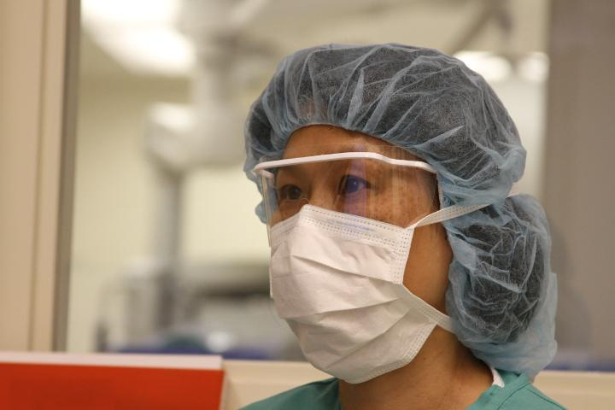
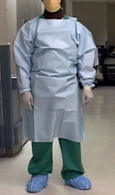
End of Procedure Cleaning
Do not begin cleaning until the patient has left the area
Put on appropriate PPE upon entering room
  standard precautions
Notes:
Always wear appropriate PPE per OSHA bloodborne pathogen standards. Further discussion of standard precautions, if needed, should happen at this point in the lecture.

Slide 31
What should be cleaned first?
Clean from
  top to bottom
  clean to dirty areas
Clockwise or counter-clockwise cleaning may be performed when used along with clean-to-dirty and top-to-bottom cleaning methods
Notes:
Dust, debris, and contaminated cleaning solutions may contaminate items below if cleaning is not performed from top-to-bottom. The reason to clean from clean-to-dirty is to avoid potentially spreading germs from dirty areas into cleaner areas. Depending on the space, a clockwise or counter-clockwise may be used, but it should never replace the foundational methods of top-to-bottom or clean-to-dirty.

Slide 32
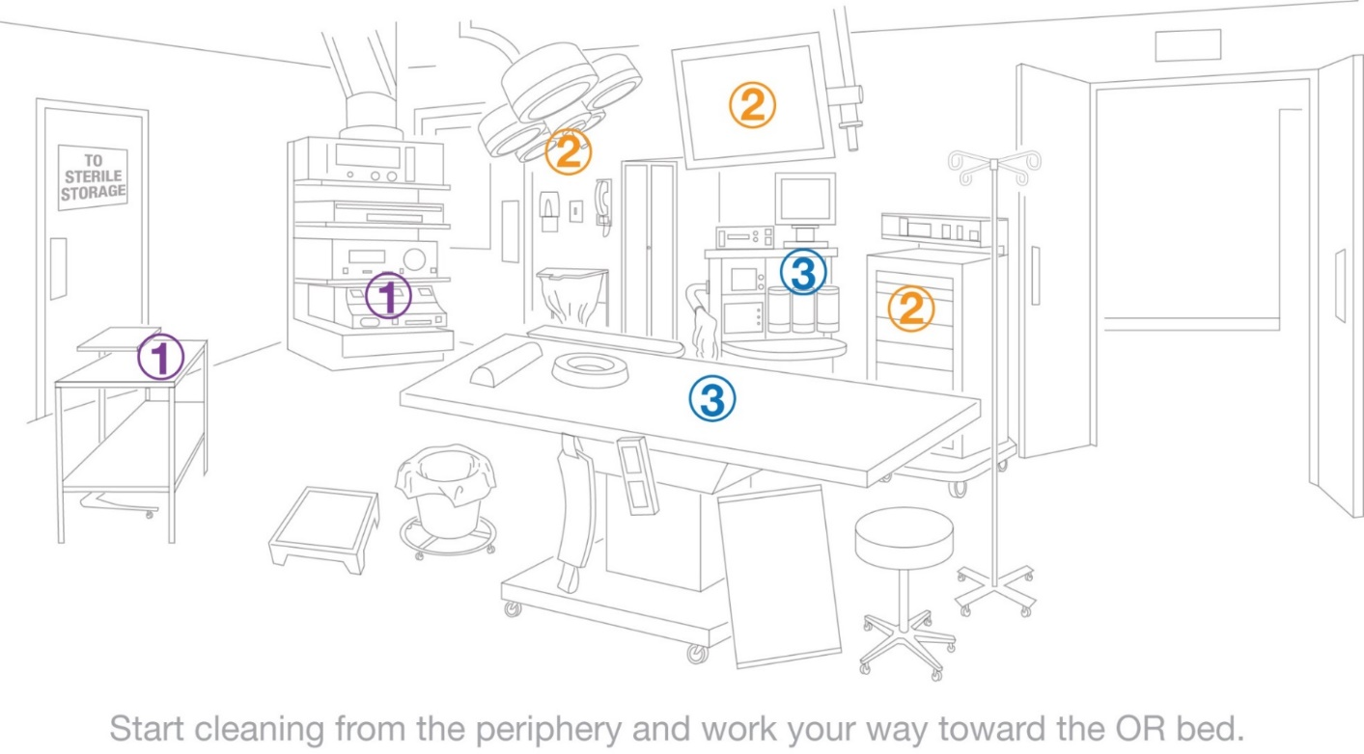
Cleaning the OR
Notes:
Discuss this slide with personnel. Have them explain what this means. Make this interactive so personnel can really understand the purpose behind the recommended cleaning practices.

Slide 33
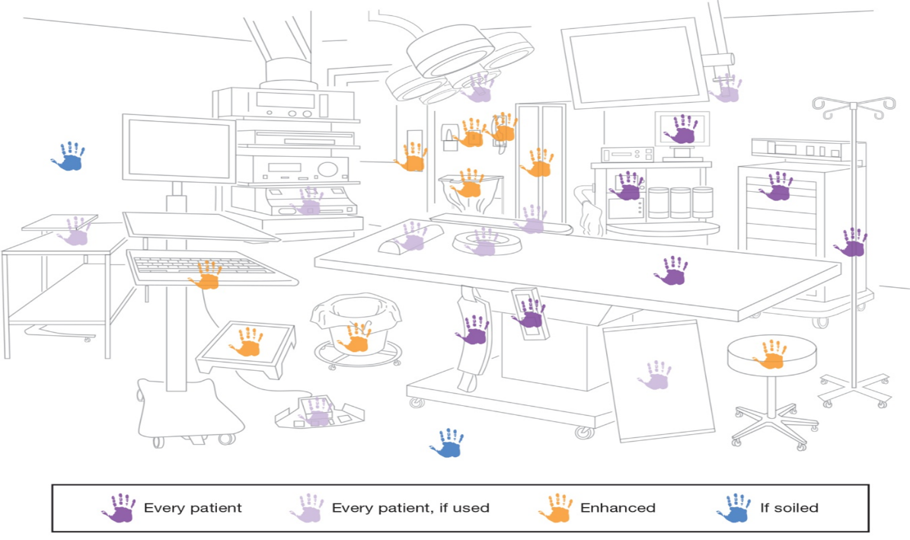
End of Procedure Cleaning in the OR or Procedural Room
Adapted with permission from Perioperative Standards and Recommended Practices.
Copyright © 2014, AORN, Inc, 2170 S. Parker Road, Suite 400, Denver, CO 80231. All rights reserved.
Notes:
Discuss this slide with personnel. Have them point out objects in the picture and identify the frequency of cleaning. Make this interactive so personnel can really understand the purpose behind the recommended cleaning practices.

Slide 34
What must be cleaned?
In the OR or procedural room
  anesthesia machine and carts
  equipment booms
  IV poles and pumps
  patient monitors
Notes:
Talk about the items shown here and explain why cleaning and disinfecting of each piece of equipment is important for stopping the spread of infections.

Slide 35
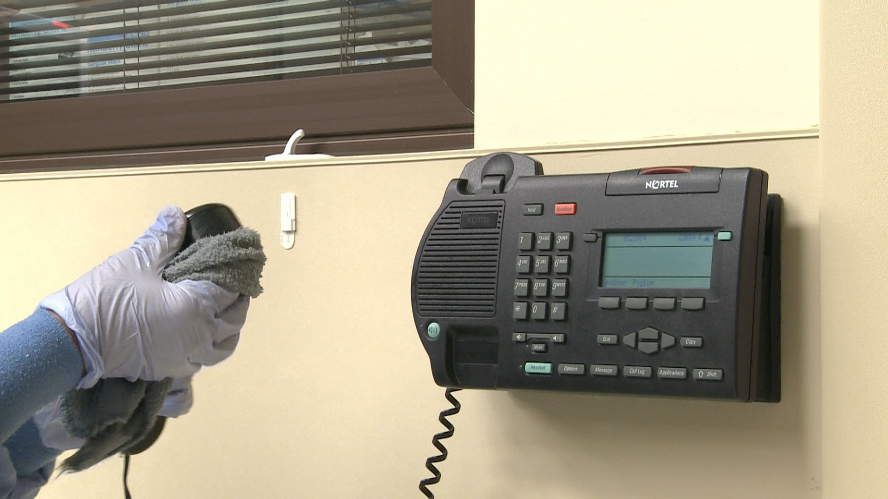
Telephones

Slide 36
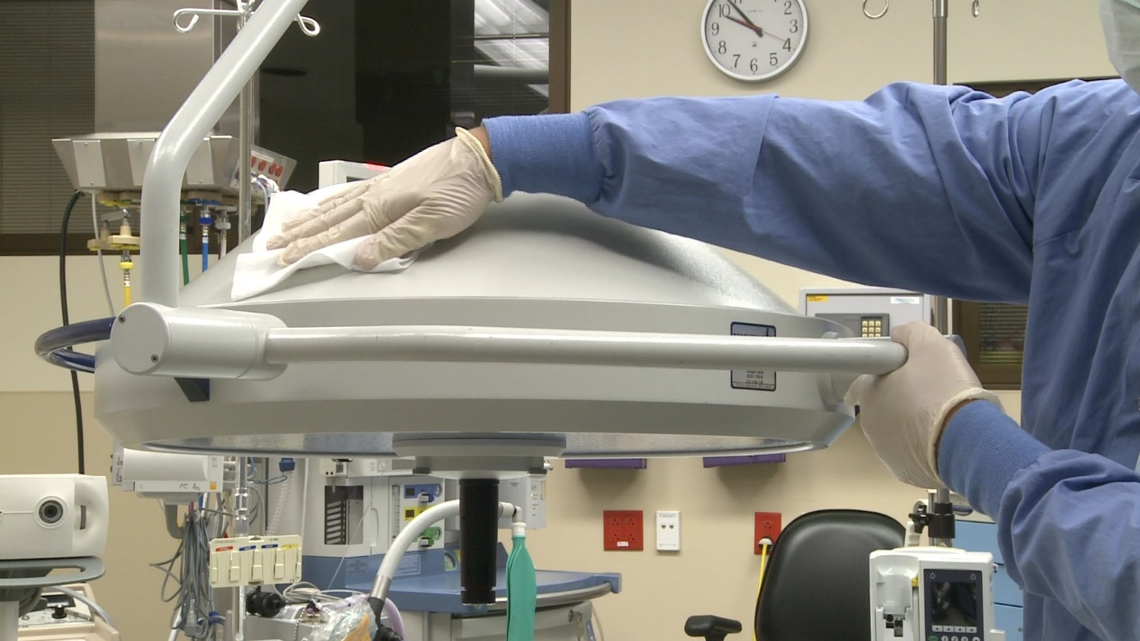
OR Lights

Slide 37
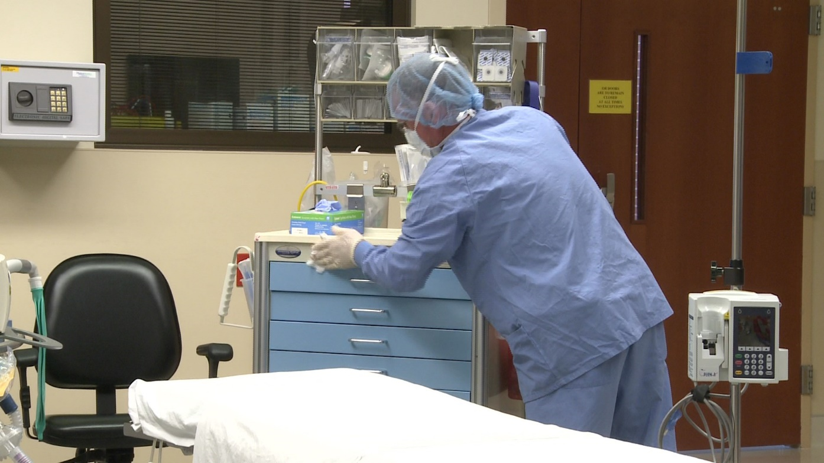
Anesthesia Cart

Slide 38
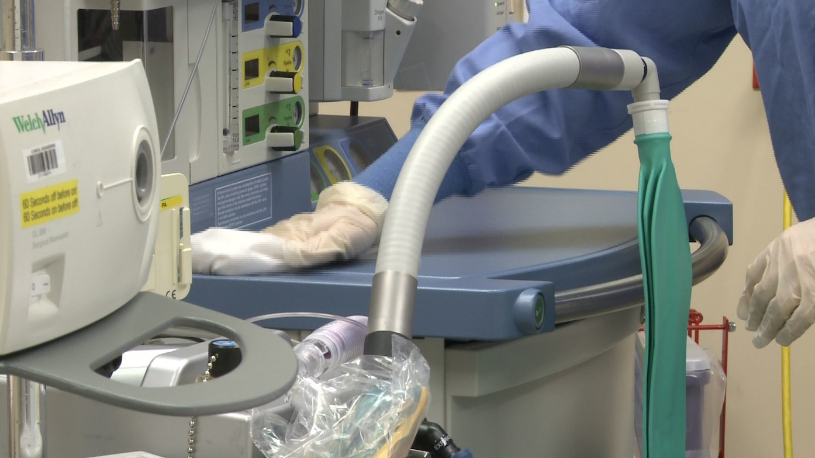
Anesthesia Machine

Slide 39
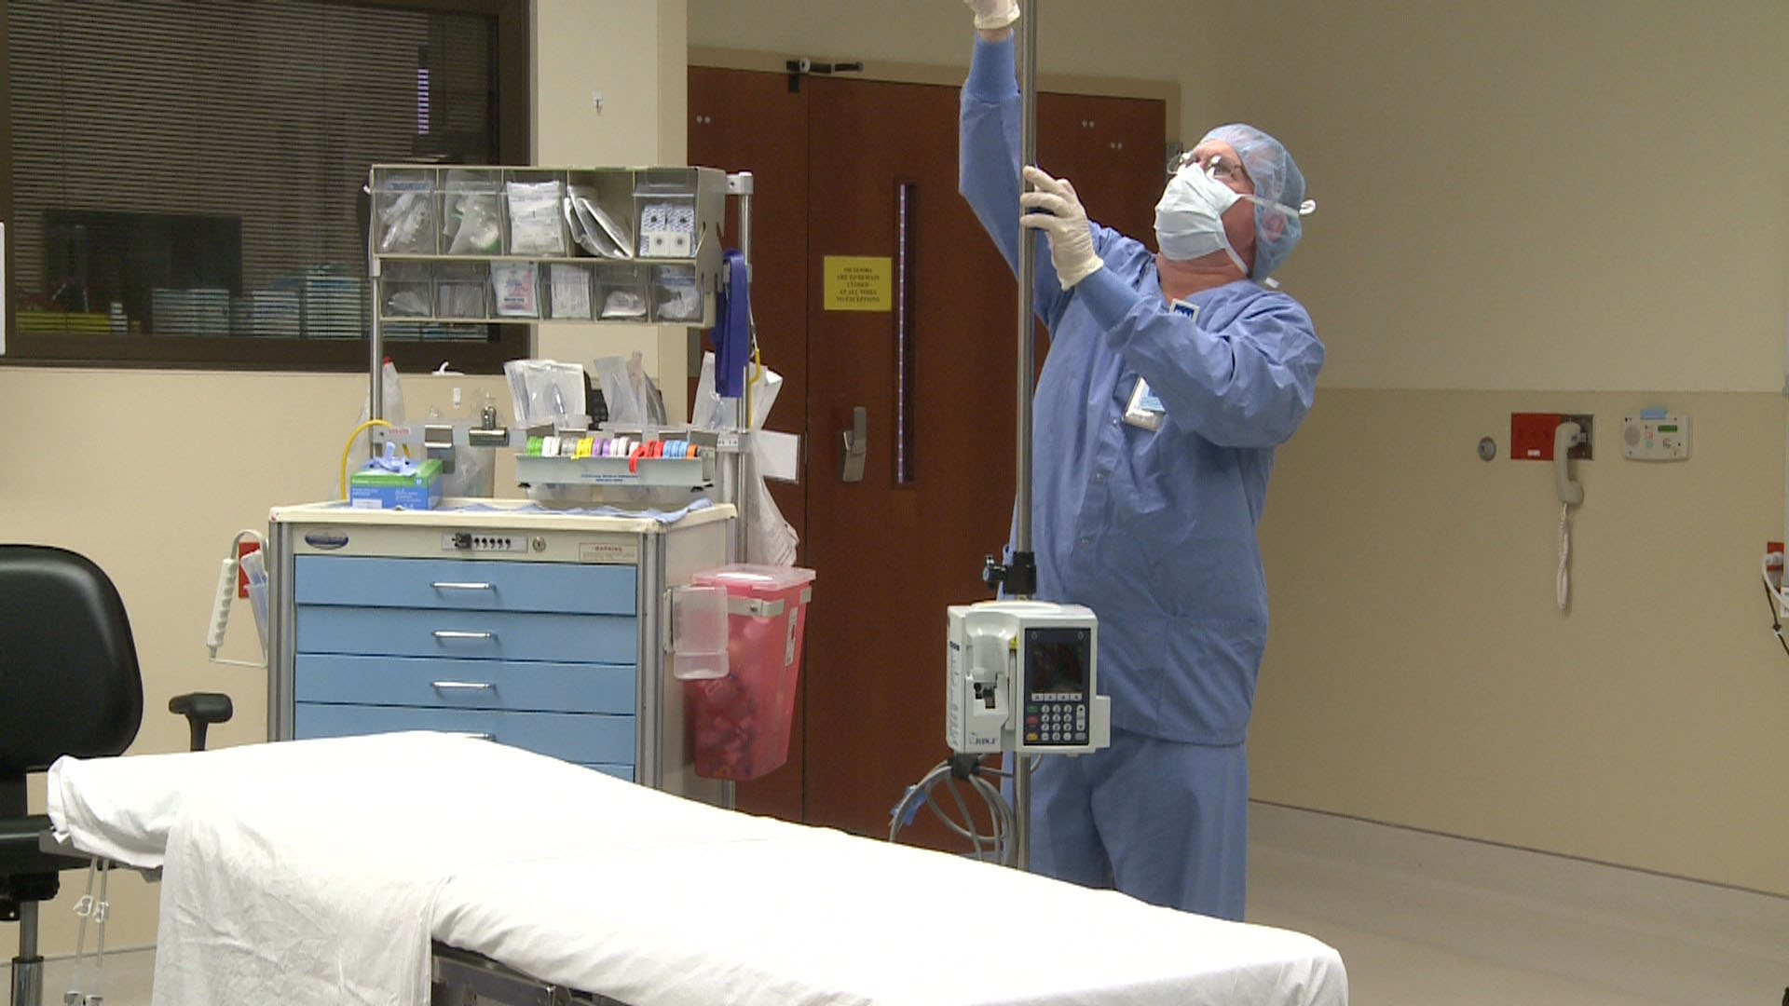
IV Poles

Slide 40
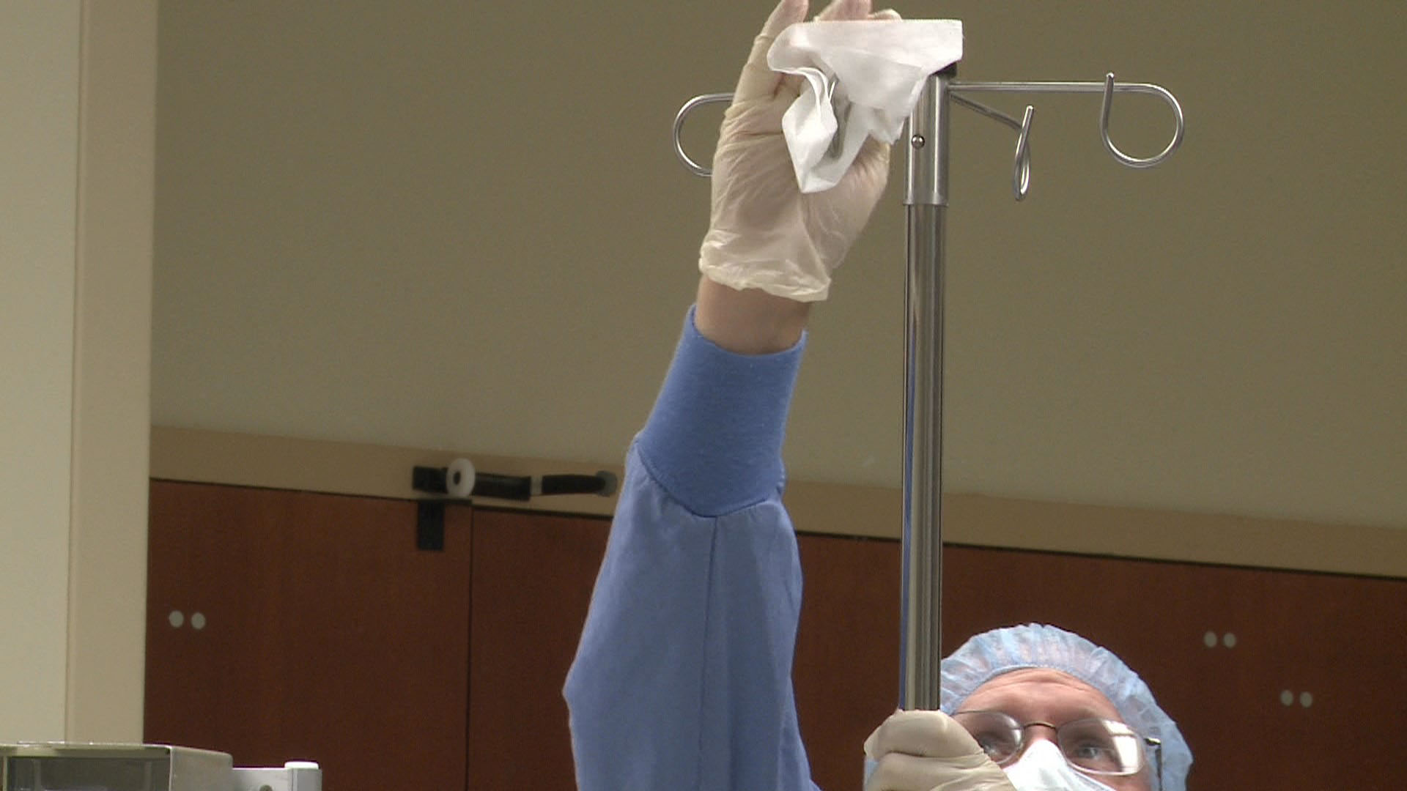
IV Poles

Slide 41
What must be cleaned?
Chairs, stools, and step stools
Linen receptacles
Tables and Mayo stands
Trash receptacles
Notes:
Talk about the items shown here and explain why cleaning and disinfecting of each piece of equipment is important for stopping the spread of infections

Slide 42
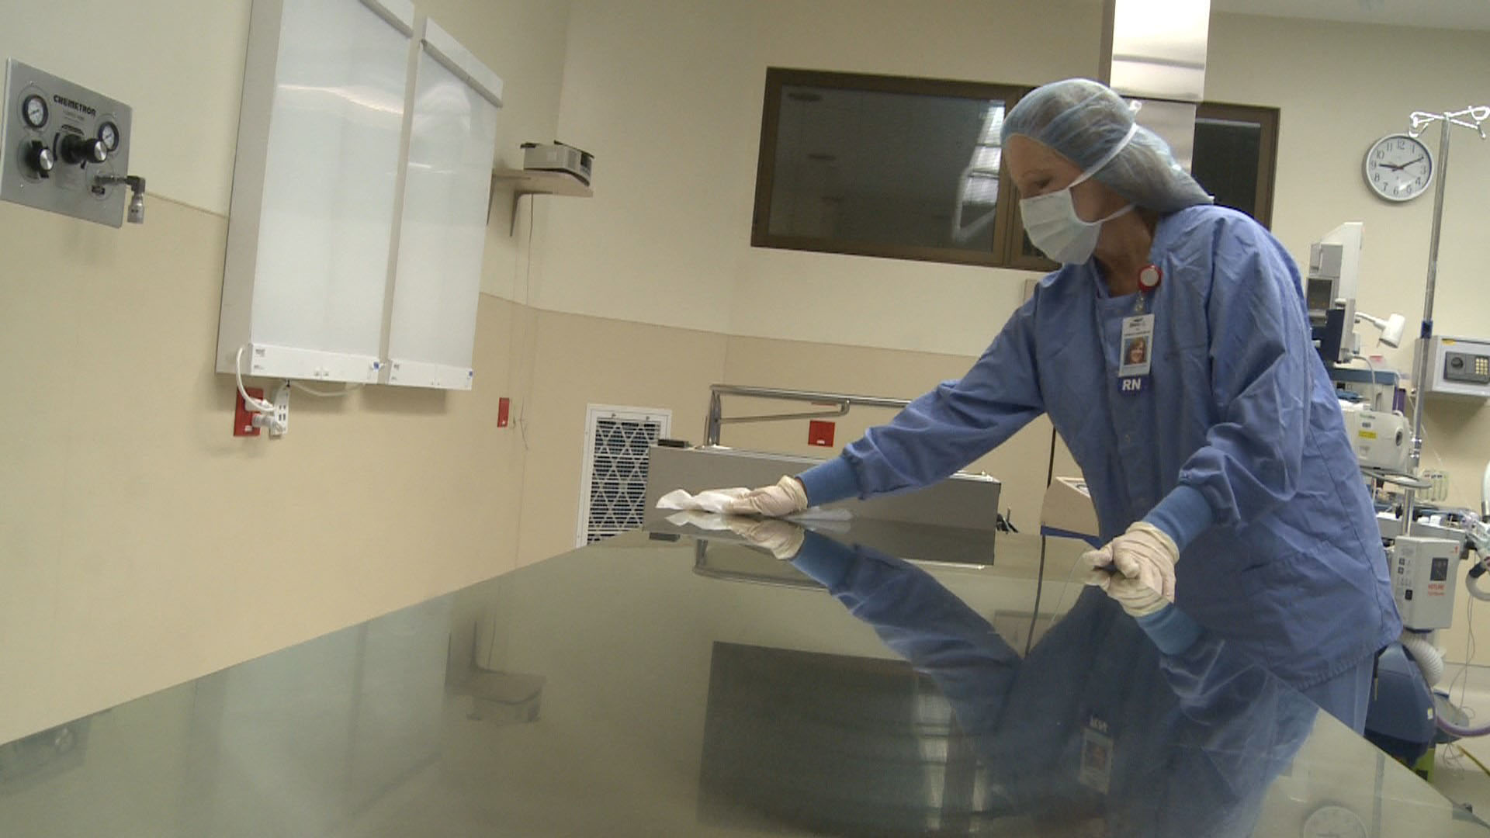
Tables

Slide 43
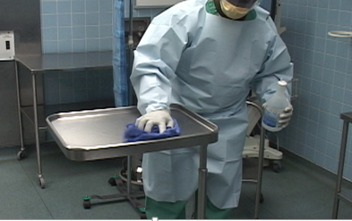
Mayo Stand

Slide 44
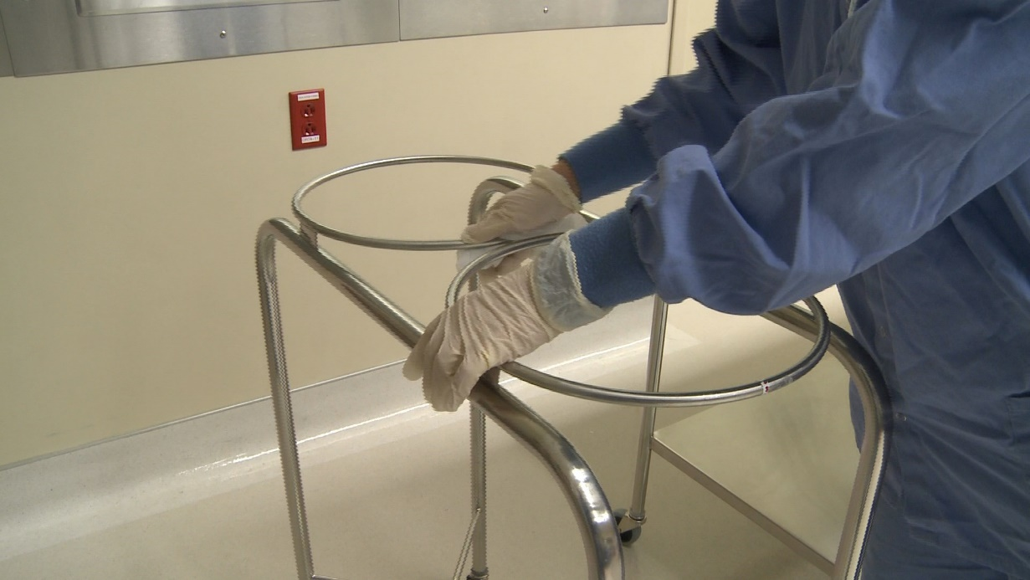
Ring Stand

Slide 45
What must be cleaned?
Overhead procedure lights
Mobile and fixed equipment
  electrosurgical units
  lasers
  medical gas gauges
  microscopes
  radiology equipment
  robots
  suction regulators
  viewing monitors
Notes:
Talk about the items shown here and explain why cleaning and disinfecting of each piece of equipment is important for stopping the spread of infections.

Slide 46
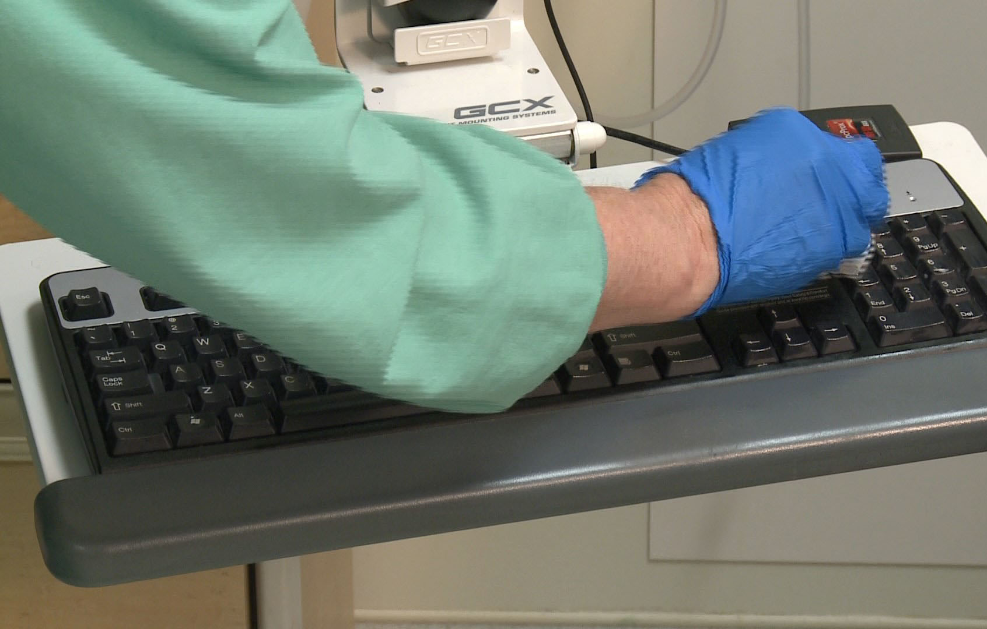
Keyboards

Slide 47
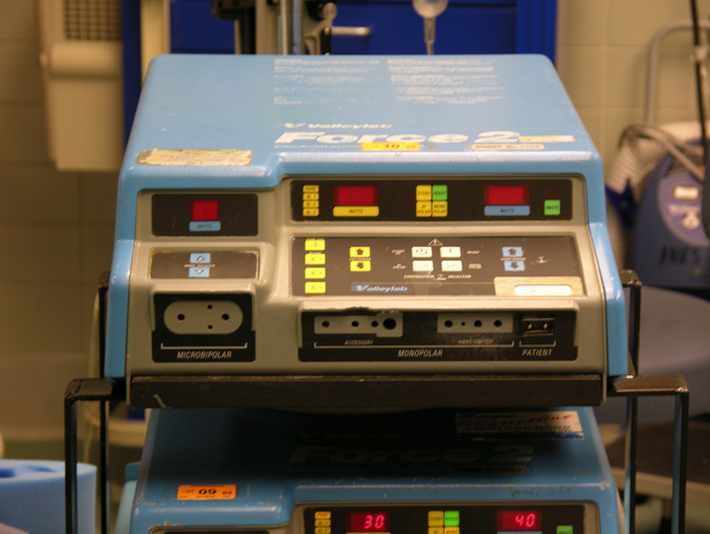
Electrosurgical Units

Slide 48
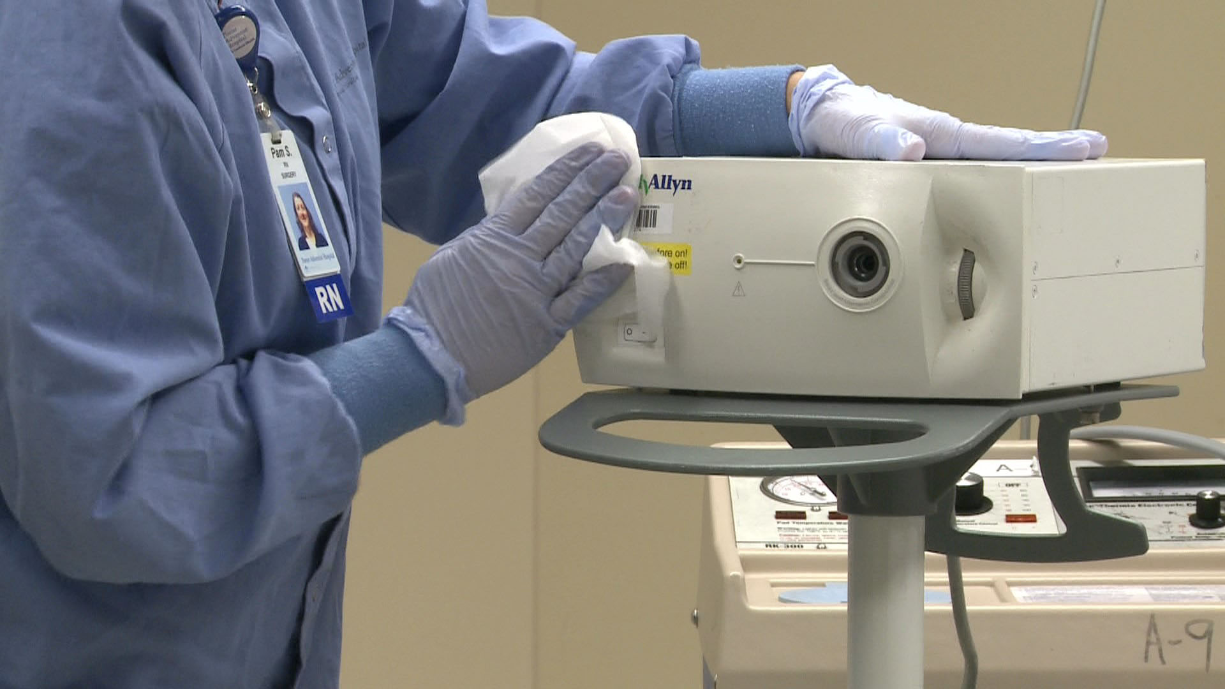
Light Source

Slide 49
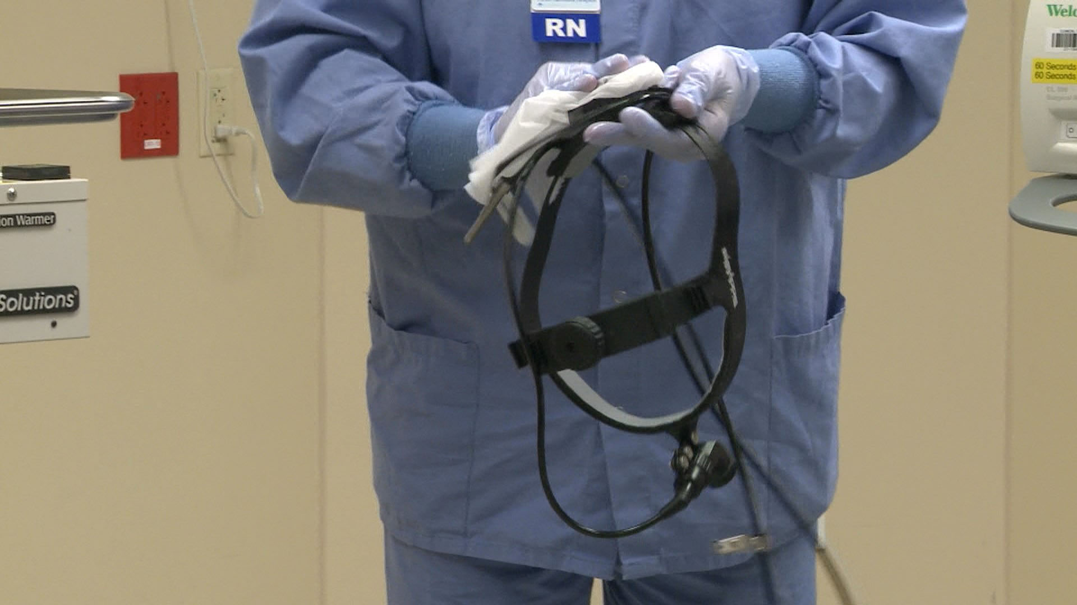
Headlights

Slide 50
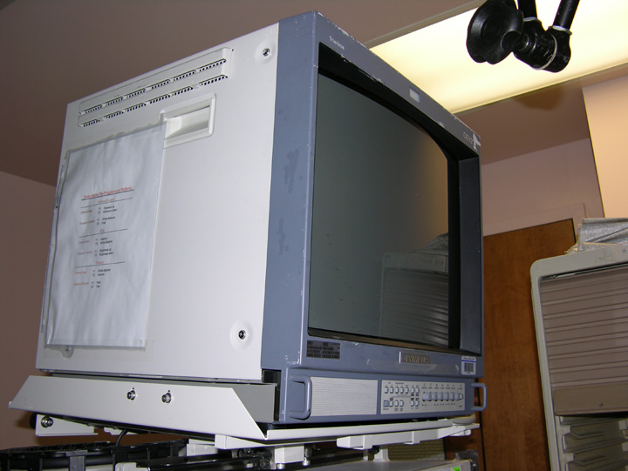
Monitors
Notes:
It’s important to follow the manufacturer's instructions for use when cleaning. Using an incompatible cleaning product may damage the equipment and void the warranty.

Slide 51
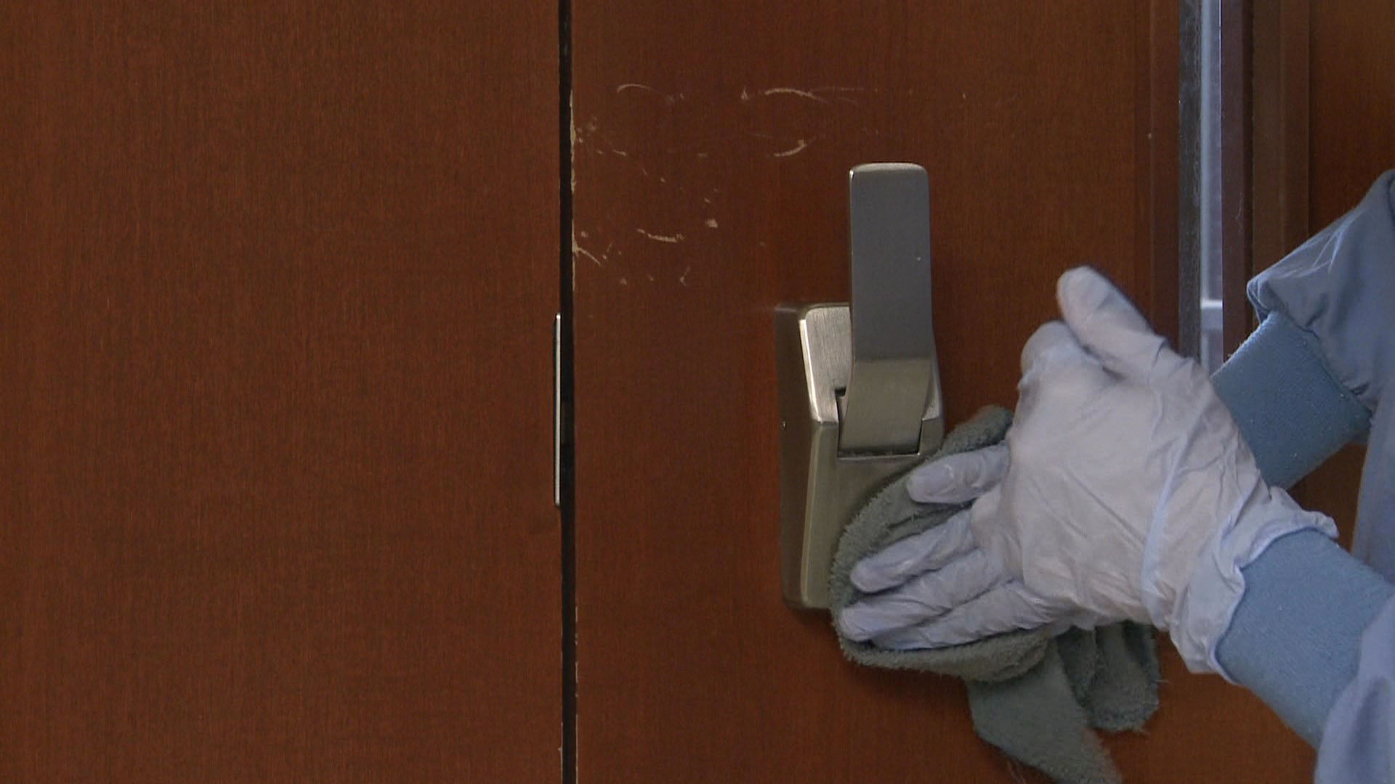
Door Handles

Slide 52
What must be cleaned?
OR beds and attachments
Positioning devices
Patient transfer devices
Reusable patient safety straps

Slide 53
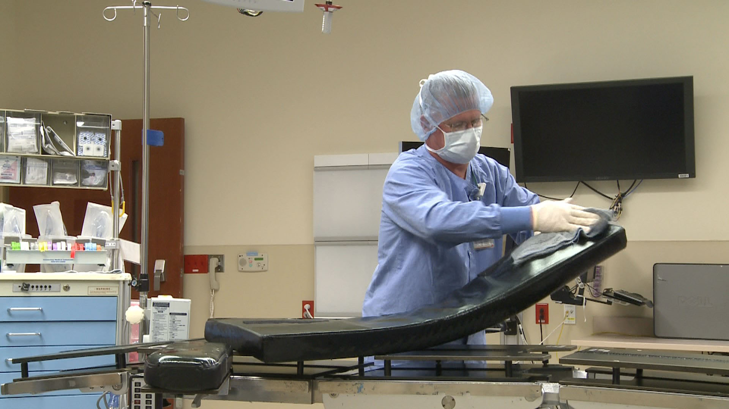
OR Bed

Slide 54
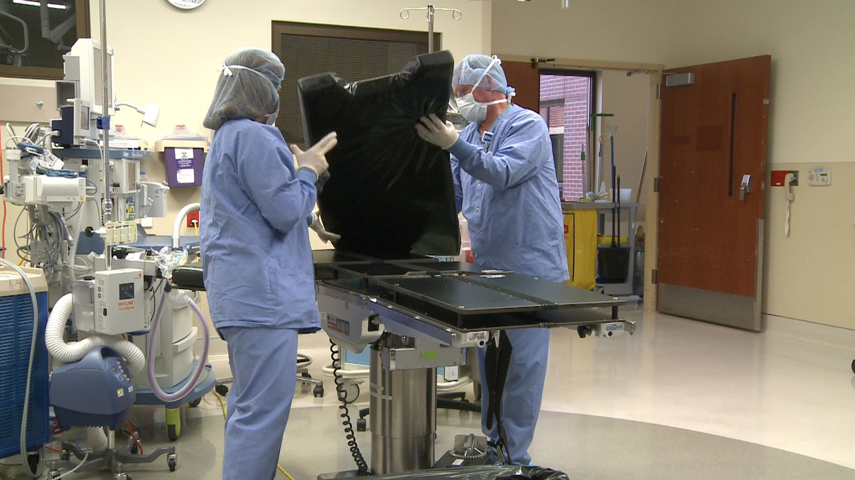
OR Bed

Slide 55
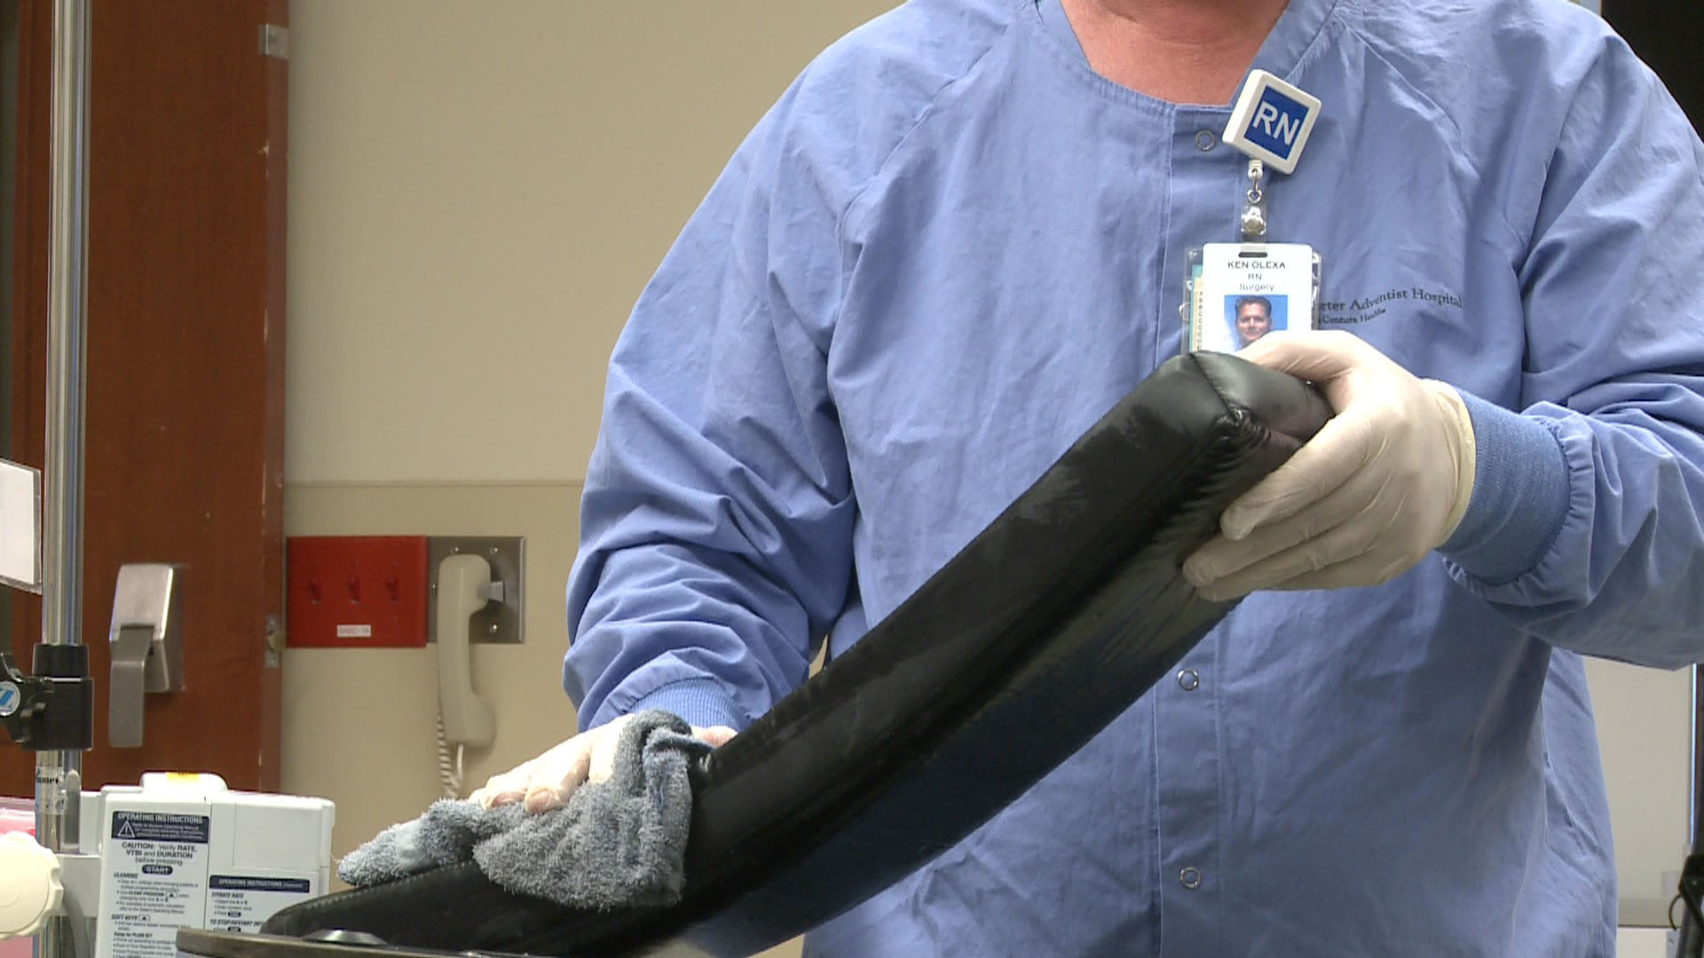
OR Bed Arm Boards

Slide 56
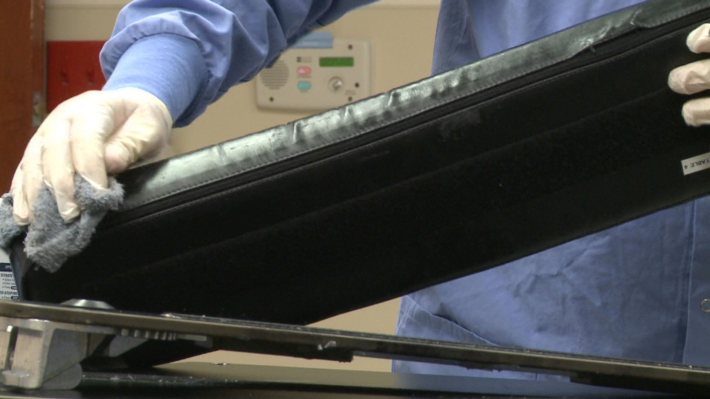
OR Bed Arm Boards

Slide 57
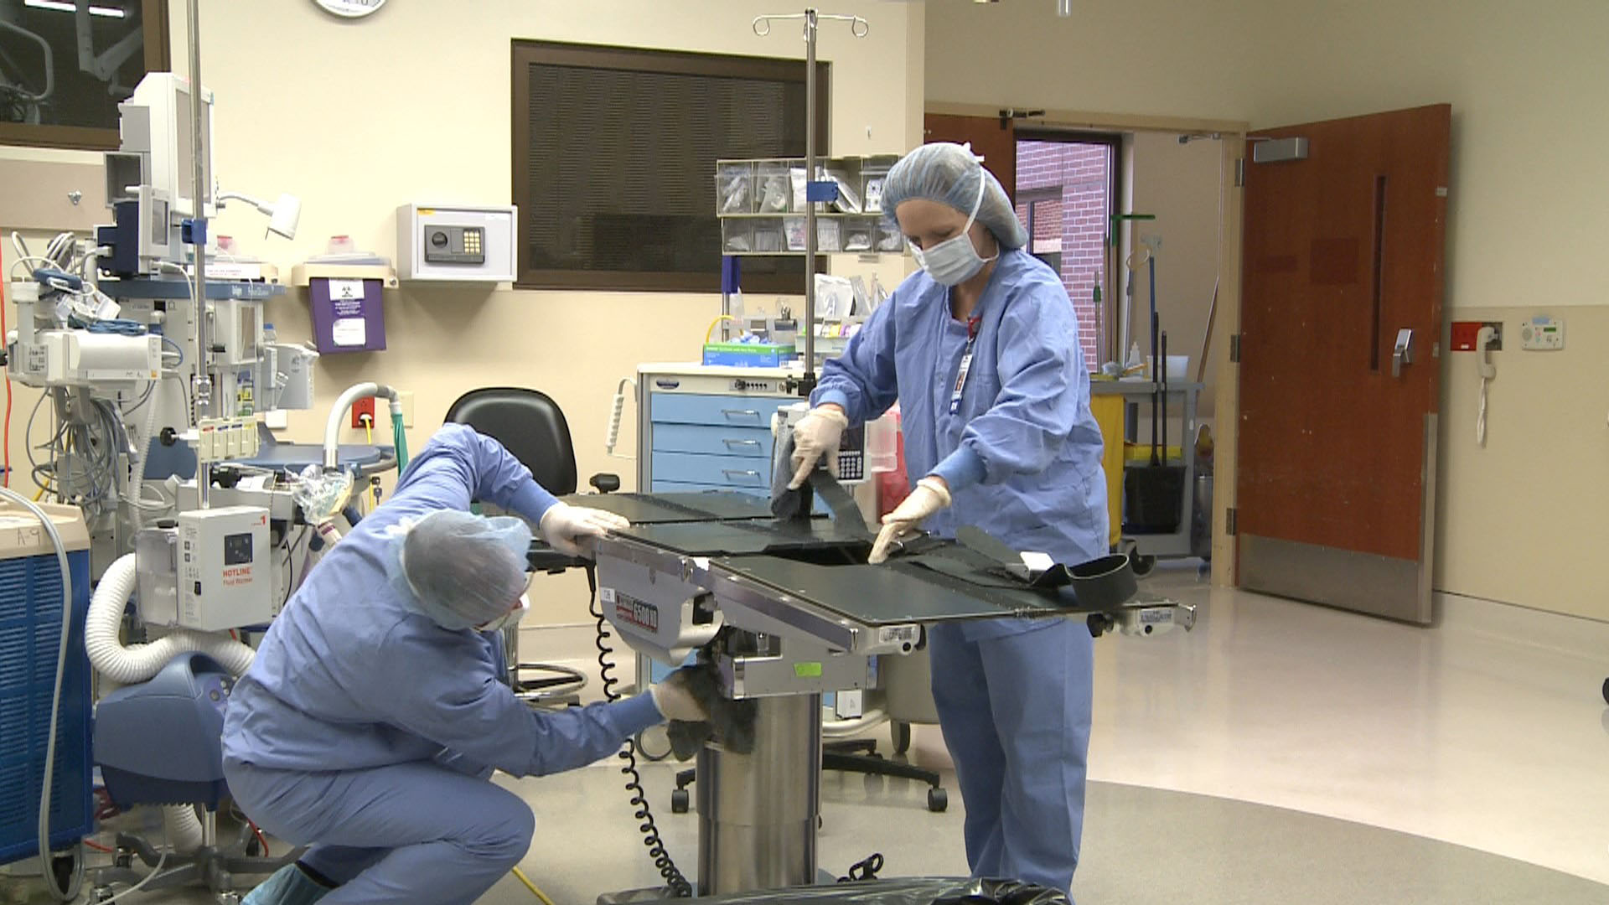
OR Bed

Slide 58
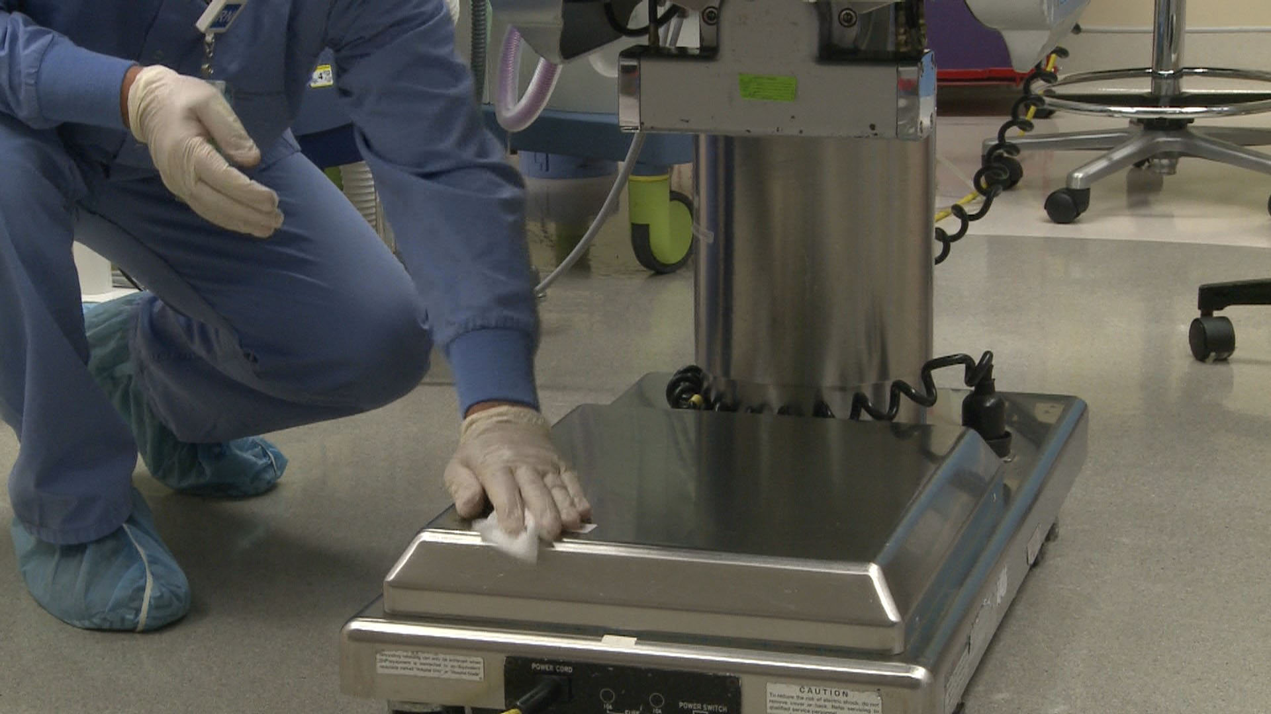
OR Bed

Slide 59
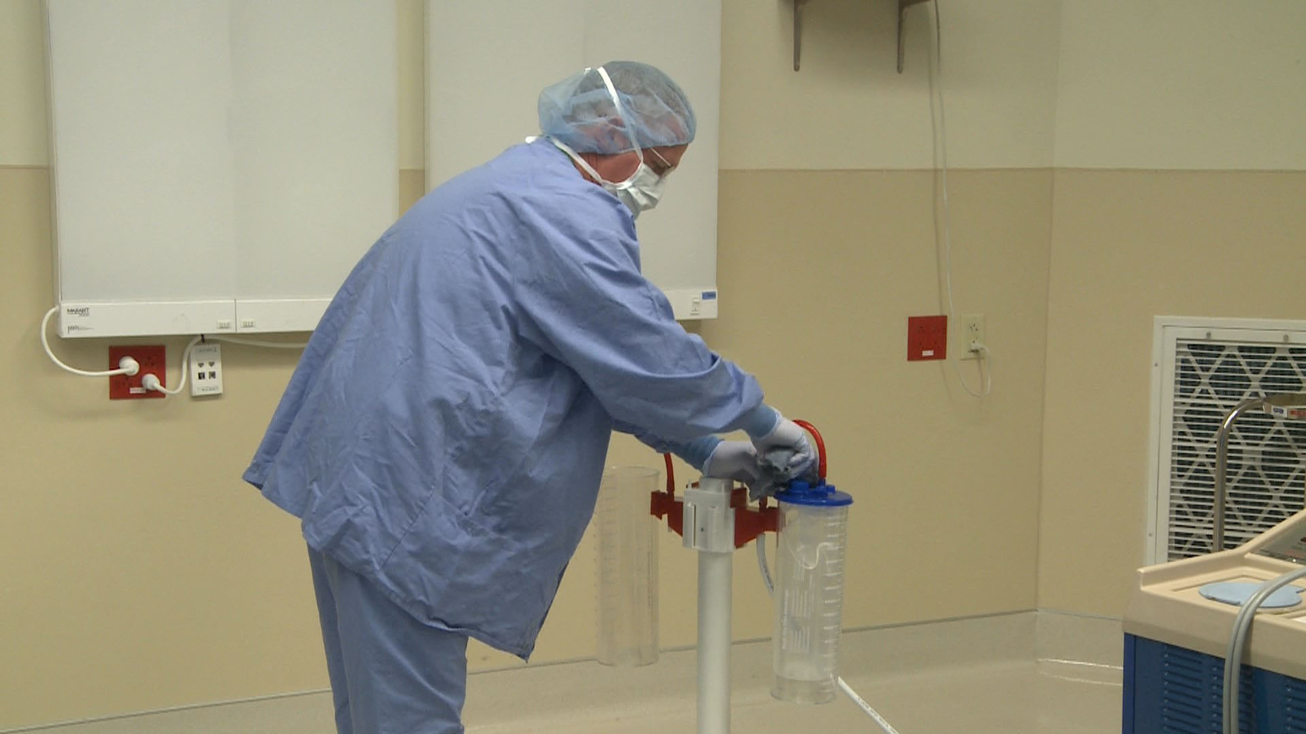
Suction Devices

Slide 60
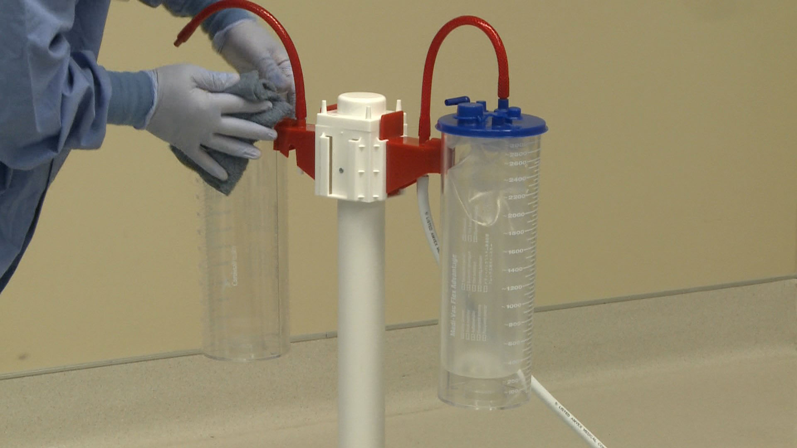
Suction Devices

Slide 61
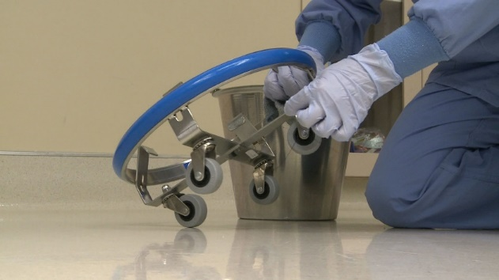
Kick Bucket and Holder

Slide 62
Floor Cleaning
Clean and disinfect the floor surfaces
  at the edge of the room first
  moving toward the center of the room
The center of the room is where most patient care happens
  the center is likely to be dirtier
Notes:
Have personnel explain why this is important using the clean-to-dirty cleaning method.

Slide 63
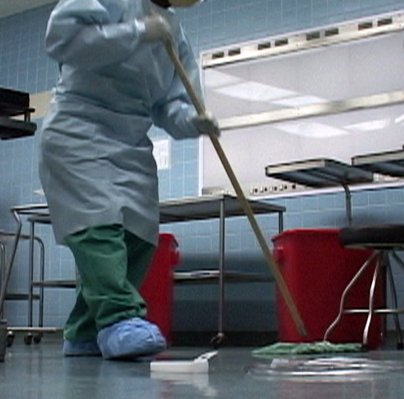

Slide 64
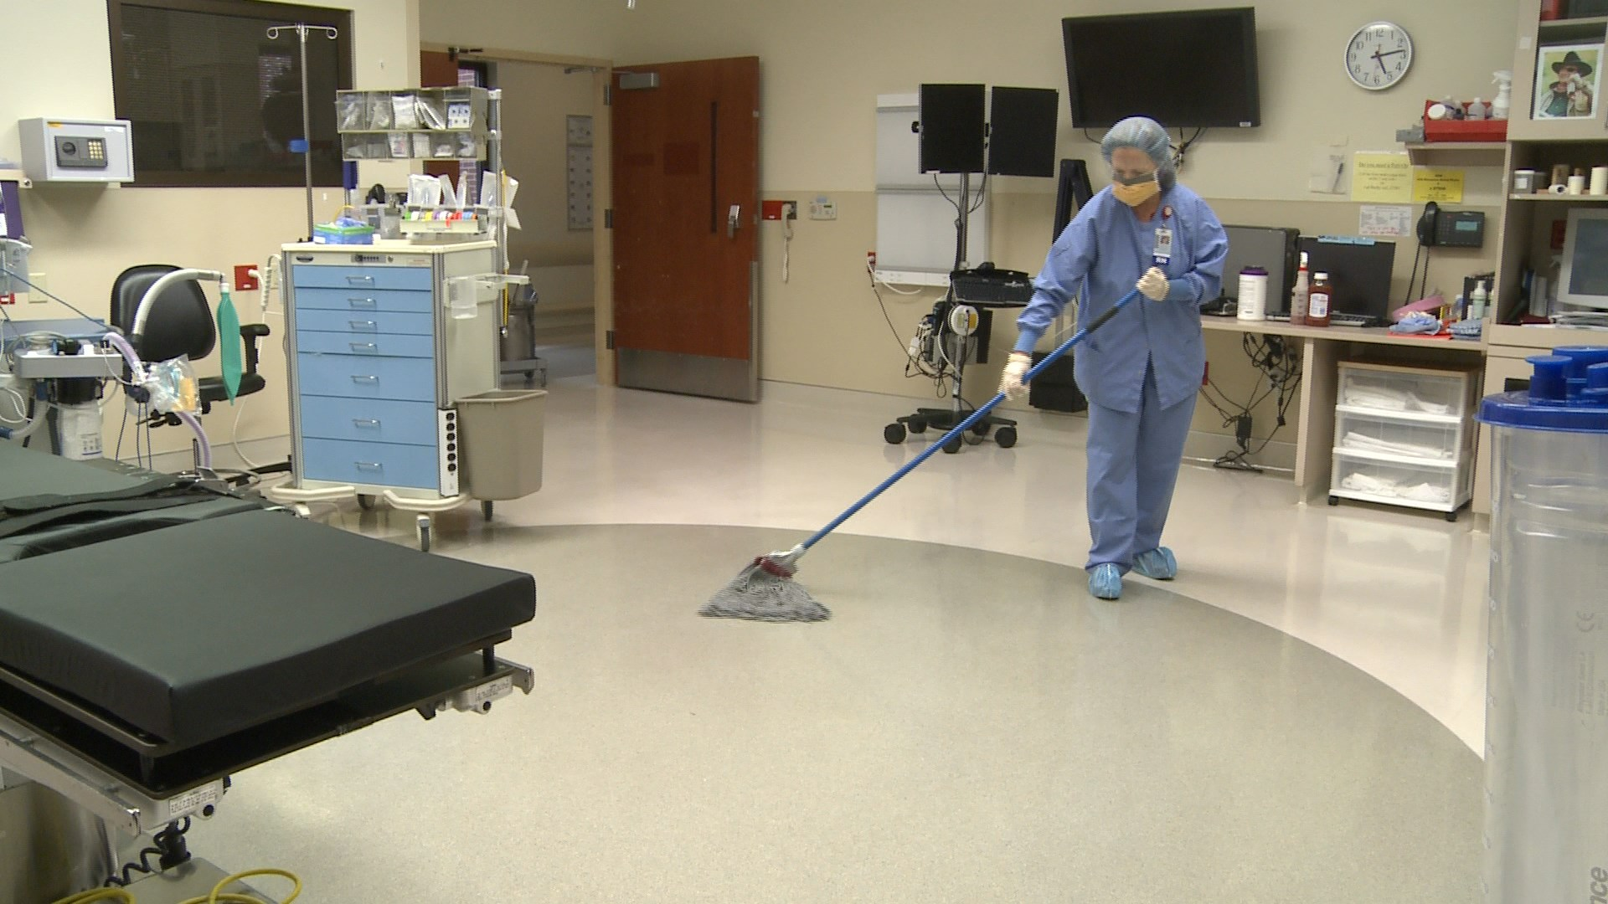

Slide 65
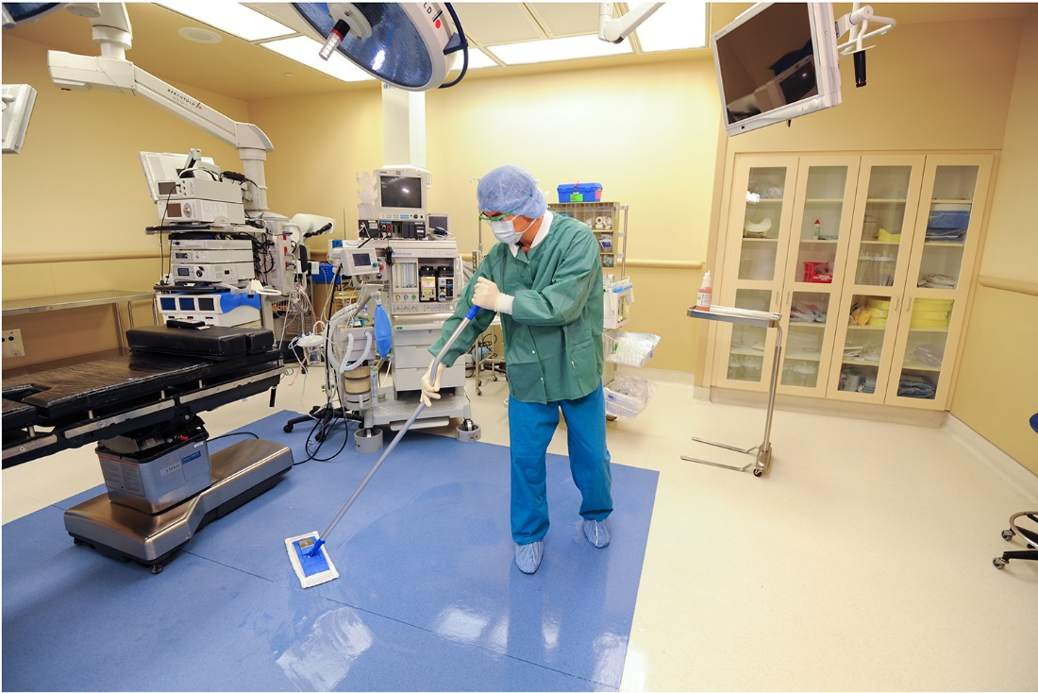
“Courtesy of Ecolab® Inc.”

Slide 66
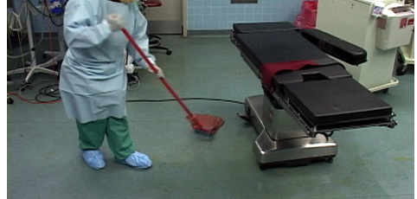

Slide 67

“Courtesy of Ecolab® Inc.”

Slide 68
End of Procedure Cleaning
Remove all cleaning equipment brought into the room
Place all disposable cleaning supplies and equipment in the trash
Remove trash and linen bags from the room
  use the corridor doors only
  do not bring trash or any contaminated items through the clean/sterile core area
Notes:
Removing the trash and linen bags at the end of the cleaning process ensures any cloths that were used in the cleaning process leave the room once team members are done cleaning. Every patient in the room, whether the first or the last, will have a clean environment for care to be delivered.
Never bring trash or any potentially contaminated item through the clean/sterile core area in order to maintain the cleanliness of the environment.

Slide 69
Terminal Cleaning
Terminal cleaning and disinfection of the OR and procedural areas should be performed at the end of the day every day the room or area is used

Slide 70
Terminal Cleaning
Clean and disinfect all exposed surfaces
  including wheels and casters
  all equipment in the room
Move the equipment around the room to clean the floor underneath
Notes:
It is very important to move equipment and clean underneath. Dust can collect under equipment. Blood and bodily fluid may have been splattered underneath equipment that was not noticed during the day. Soil, dirt, and debris must be removed to provide a clean, safe environment for the patient.
Team members can choose to leave moved equipment in a slightly different location after cleaning has been performed. This is sometimes used to give a visual cue to the OR team that the room has been terminally cleaned.

Slide 71

Scheduled Cleaning
Not all areas in the OR and procedural areas are cleaned daily
Each facility will decide how frequently these areas should be cleaned
  weekly or monthly

Slide 72

Scheduled Cleaning
These areas include
  clean and soiled storage areas
  corridors
  elevators
  environmental service closets
  shelves and storage bins
  stairwells
  sterile storage area
Notes:
Talk about these areas with personnel and identify how often they are cleaned at this point in the presentation. If your facility uses a cleaning schedule or another tool for documentation of cleaning, share this with personnel as well. Ask personnel why they think it would be important to clean these spaces and discuss how cleaning these areas can stop the spread of infection.

Slide 73
Scheduled Cleaning
  Scrub sinks
  Walls and ceilings
  Privacy curtains
  Pneumatic tubes and carriers
  Lounges
  Workstation desks
Notes:
Ask personnel why they think it would be important to clean these spaces and discuss how cleaning these areas can stop the spread of infection.

Slide 74

Notes:
Cleaning air return grilles is part of scheduled cleaning.

Slide 75


Slide 76
Coordinated Cleaning
Cleaning of the following equipment will need to be done along with facility maintenance
  eyewash stations
  ice machines
  refrigerators
  sterilizers
  ventilation ducts
Routine maintenance of these items is necessary
Equipment must be cleaned before bringing patients in for care
Notes:
Check with your facility’s maintenance department and validate how often these items are serviced for preventative maintenance. Eyewash stations may be checked by maintenance or nursing based on your facility policy, so discuss with team members who is responsible for this task and how frequently it is done. If your facility uses a cleaning schedule or another tool for documentation of cleaning, share this with personnel as well. If there are additional documentation requirements, such as with an eyewash station, show team members what documentation is required.
Ask personnel why they think it would be important to clean these spaces and discuss how cleaning these areas can stop the spread of infection.

Slide 77
The End
Notes:
Please use the above resources for additional guidance, if needed.

