Slide 1

Max Holder, MSN, RN, CRNI, NE-BC

Slide 2
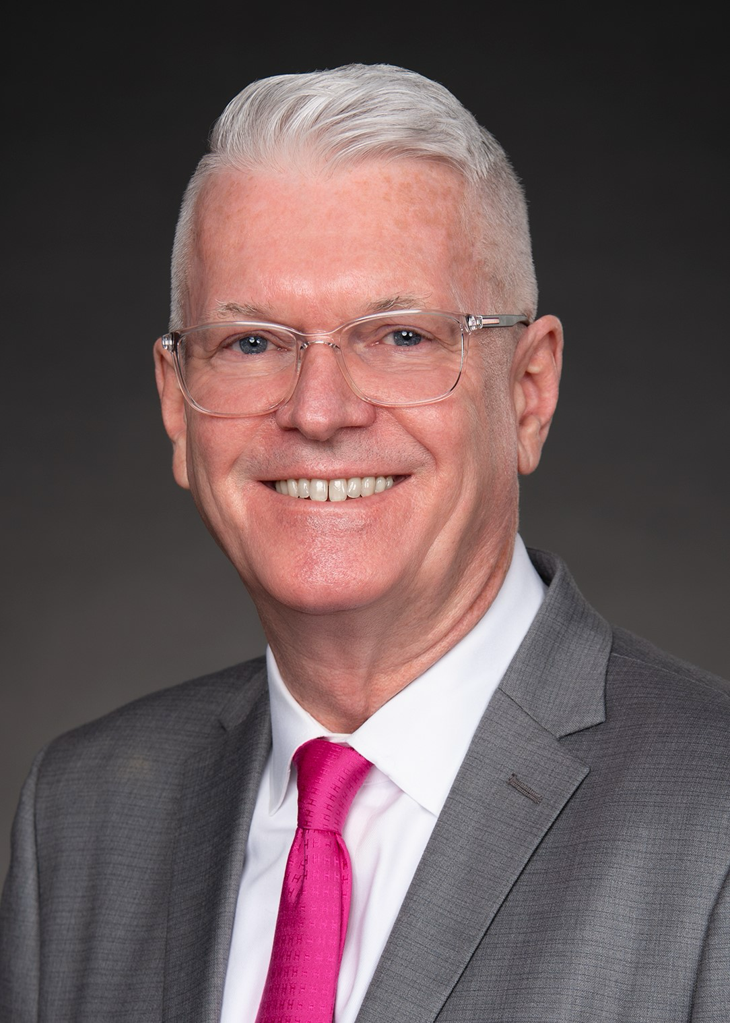

Slide 3
BIO
Max Holder has 31 years of nursing experience in Emergency Nursing, Corporate Compliance, and Infusion Therapy/Vascular Access. He is the nurse manager of the Vascular Access Team and Acute Care Hemodialysis Unit at Baylor Scott and White Health (BSWH) University Medical Center in Dallas Texas; a 900- bed quaternary teaching hospital. Max chairs the BSWH Vascular Access Committee with responsibility for risk reduction associated with vascular access and infusion therapy.

Slide 4
BIO
He received the Baylor University Medical Center Clinical Nurse Excellence award in 2019, was named a Dalla/Ft. Worth Great 100 Nurse in 2020, and was recognized by D Magazine with their Nursing Excellence Leadership award in 2024. He works as an expert witness in cases related to infusion therapy and vascular access and has published and presented nationally and internationally on Vascular access and infusion therapy topics. He served 7 years on the Infusion Nurses Society Board of Directors and now serves on the North Texas Organization for Nursing Leadership and the Association of Vascular Access Foundation board of directors.

