Slide 1
Changing Terminology in Infection Control
Darlene Morse MSN RN, M.Ed., CIC
December 1, 2023
APIC New England

Slide 2
Objectives
Discuss the presentations at the 2023 APIC meeting
Discuss when it is appropriate to use Enhanced Barrier Precautions (EBP)
Explain how the latest practice changes impact infection prevention and control

Slide 3

Activities at the 2023 APIC Conference
Personal Brand Bar-Photo taken, learned to organize emails and to update our Linkedin page.
So many presentations to attend:
  How State and Local Health Departments can Partner with APIC for IP Workforce Needs
  IP’s in the know, The latest Practice changes in Infection Prevention and Control
  Carbapenem-resistant Acinetobacter Baumannii Outbreak in a Burn unit
  Promoting Chapter Excellence with the APIC Research toolkit
  Investigation and Response to a Case of Paralytic Polio in New York
  Success Stories of MDRO/C. Auris containment and Prevention
  Peer-reviewed publication: Why not me?
  And many more….

Slide 4
Enhanced Barrier Precautions
Presented by:
  Bola Ogundimu, DrPH, RN, CIC, CPHQ
  Heather Jones, DNP, FNP-C

Slide 5
Historical Terminology
Universal Precautions-Recommendations published by the CDC initially in 1985. There were several areas in that document which covered the do’s and don’ts of universal precautions and was meant to offer protection from HIV.
The term Standard precautions was introduced in 1996. At the same time the guidelines around three transmission based precautions were introduced: airborne, droplet and contact. These transmission based precautions were to be used along with standard precautions.
In 2019 CDC introduced Enhanced barrier precautions to HICPAC for input related to the care of Nursing home residents with considerations regarding implementation or scope

Slide 6
Review of the Data
Pineles et al. AJIC 2017 and Bianco et al. ICHE 2018. Spreading of Germs During High-Contact Resident Care Activities (Spread of two different organisms to gowns and gloves)
Roghmann et al., 2015. MRSA Spread to Gowns of Healthcare Wrokers during Care of MRSA-Colonized* Residents by Type of Care Provided and Presence of Chronic Skin Breakdown (*germ found on the body but no symptoms)
Lydecker et al., 2021. Targeted Gown and Glove Use to Prevent Staphylococcus aureus in Community-Based Nursing Homes: A Pilot Study
Mody et al., 2015. A Targeted Infection Prevention Intervention in Nursing Home Residents with Indwelling Devises

Slide 7
What they Found
Clearly organisms were spread on gloves and gowns during high contact resident care
Spread was higher for all activities in the presence of areas of chronic skin breakdown
This could be a novel evidence based process to prevent the spread of germs within a facility
Prevention interventions within a facility showed reduced colonization and infection for patients with indwelling devices

Slide 8
Enhanced Barrier Precautions (EBP)
Targeted gown and glove use in high-risk individuals to reduce the spread of MDRO’s
Gowns and gloves used during high-contact resident care activities
Used with Standard Precautions and good infection prevention and control practices
Expands personal protective equipment use (PPE) beyond situations where blood or body fluid exposure is anticipated

Slide 9
MDRO’s Targeted by the CDC but not limited to the following:
Pan-resistant organisms
Carbapenemase-producing carbapenem-resistant Enterobacterales
Carbapenemase-producing carbapenem-resistant Pseudomonas spp.
Carbapenemase-producing carbapenem-resistant Acinetobacter baumannii
Candida auris
Methicillin-resistant Staphylococcus aureus (MRSA)
ESBL-producing Enterobacterales
Vancomycin-resistant Enterococci (VRE)
Multidrug-resistant Pseudomonas aeruginosa
Drug-resistant Streptococcus pneumoniae
https://www.cdc.gov/hai/containment/PPE-Nursing-Homes.html

Slide 10
When are EBP’s indicated?
When Contact Precautions do not apply
For Nursing home residents who have a wound (such as a chronic wound) or an indwelling medical device, regardless of MDRO colonization status
Infection or Colonization with an MDRO
EBP’s should be continued for the duration of the stay

Slide 11
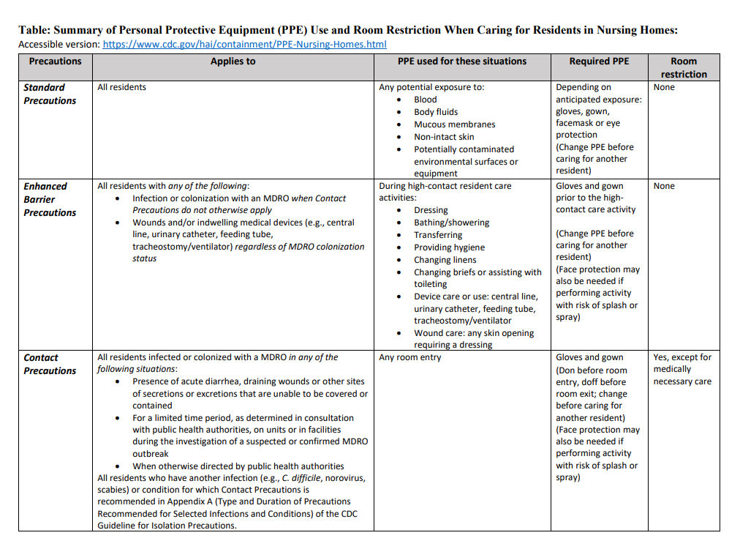

Slide 12
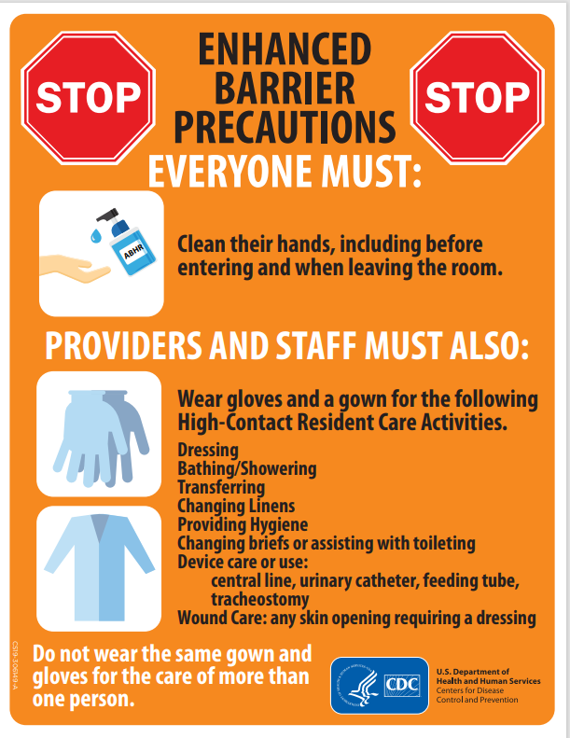

Slide 13
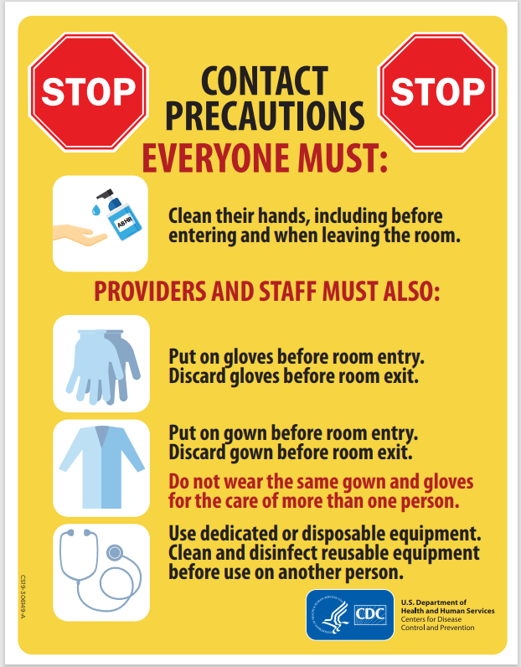

Slide 14
References
Aliyu, S., McGowan, K., Hussain, D., Kanawati, L., Ruiz, M. &Yohannes, S. (2022). Prevalence and Outcomes of Multi-Drug Resistant Blood Stream Infections Among Nursing Home Residents Admitted to an Acute Care Hospital. Journal of Intensive Care Medicine, 37(4), 565-571. doi:10.1177/08850666211014450
Blanco, N., Johnson, J.K., Sorkin, J.D., Lydecker, A.D., Levy, L., Mody, L. & Roghmann, M-C. (2018). Transmission of resistant gram-negative bacteria to healthcare personnel gowns and gloves during care of residents in community-based nursing facilities. Infection Control & Hospital Epidemiology, 39(12), 1425-1430. doi: 10.1017/ice.2018.247
Cassone, M. & Mody, L. (2015). Colonization with multi-drug resistant organisms in nursing homes: Scope, importance, and management. Current Geriatrics Reports, 4(1), 87-95. https://doi.org/10.1007/s13670-0150120-2
Lydecker, A.D., Osei, P.A., Pineles, L., Johnson, J.K., Meisel, J., Stine, O.C., Magder, L., Gurses, A.P., Hebden, J., Oruc, C., Mody, L., Jacobs, Slifka, K., Stone, N.D. & Roghmann, M-C. Targeted gown and glove use to prevent Staphylococcus aureus acquisition in community-based nursing homes: A pilot study. Infection Control & Hospital Epidemiology, 42(4), 448-454. doi: 10.1017/ice.2020.1219

Slide 15
References (Con’t)
Mody, L., Maheshwari, S., Galecki, A., Kauffman, C.A. & Bradley, S.F. (2007). Indwelling device use and antibiotic resistance in nursing homes: Identifying a high-risk group. Journal of the American Geriatrics Society, 55(12), 1921-1926. https://doi.org/10.1111/j.1532-5415.2007.01468.x
Mody, L., Krein, S.L., Saint, S., Min, L.C., Montoya, A., Lansing, B., McNamara, S., Symons, K.,Fisch, J., Koo, E., Rye, R.A., Galecki, A., Kabeto, M. U., Fitzgerald, J.T., Olmstead, R.N., Kauffman, C.A. & Bradley, S.F. (2015). A targeted infection prevention intervention in nursing home residents with indwelling devices: a randomized clinical trial. JAMA Internal Medicine, 175(5), 714-723. doi: 10.1001/jamainternmed.2015.132
Pineles, L., Morgan, D.J., Lydecker, A., Johnson, K., Sorkin, J.D., Langenberg, P., Blanco, N., Lesse, A., Sellick, J., Gupta, K., Leykum, L., Cadena, J., Lepcha, N. & Roghmann, M-C. (2017). Transmission of methicillin-resistant Staphylococcus aureus to health care worker gowns and gloves during care of residents in Veterans Affairs nursing homes. American Journal of Infection Control, 45(9), 947-953. doi.org/10.1016/j.ajic.2017.03.004
Roghmann, M-C., Johnson, J.K., Sorkin, J.D., Langenberg, P., Lydecker, A., Sorace, B., Levy, L. & Mody, L. (2015). Transmission of methicillin-resistant Staphylococcus aureus (MRSA) to healthcare worker gowns and gloves during care of nursing home residents. Infection Control Hospital Epidemiology, 36(9), 1050-1057. doi:10.1017/ice.2015.119
All references listed here, are from the presentation given at APIC 2023, included here for greater reference. Many of the same references here are listed on the CDC document: Implementation of Personal Protective Equipment (PPE) Use in Nursing Homes to Prevent Spread of Multidrug-resistant Organisms (MDRO’s). Located at: https://www.cdc.gov/hai/containment/PPE-Nursing-Homes.html

Slide 16
APIC Research Toolkit
Log on to APIC.org
Sign in with your APIC credentials
Click on ‘Resources’ (top header)
Scroll down and click on ‘APIC Toolkits’
Scroll down to ‘APIC Chapter Research Toolkit’
Click on ‘Learn More and Download’
There is an option to download the toolkit
Resources for Research:
APIC research committee research@apic.org
APIC research consultant: Shanina Knighton sknighton@apic.org
Katreena Merrill: Katreena.Merrill@byu.edu

Slide 17


