Slide 1
APIC Annual Conference 2024
San Antonio

Slide 2
APIC Practice Guidance Committee & the Latest Changes in Infection Prevention and Control

Slide 3
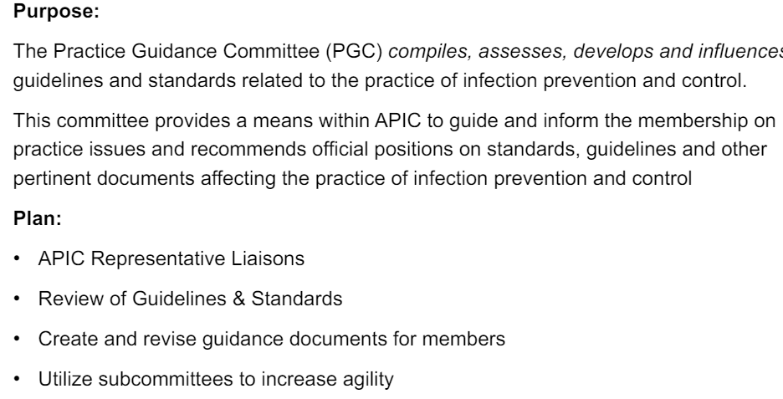
PGC Overview

Slide 4
Recently Published/ In Development:
Recently Published:
10 key points the IP needs to know about USP <797>
August 2023
10 key points the IP needs to know about AAMI
December 2023
APIC toolkit for patient hand hygiene
January 2024
Heightening awareness for the IP in the behavioral health setting
January 2024
In Development:
Creating guidance specific to long term care setting
Revision to APIC’s position paper: Safe injection, Infusion, and Medication Vial Practices in Health care (2016)

Slide 5
Implementation Guides Subcommittee
New subcommittee for 2024
Completed review of SHEA compendiums vs. APIC Implementation guides 2023
Based on 2023 review, PGC proposed a strategy for updating current implementation guides
Goal is to create concise updated documents that primarily contain implementation information only

Slide 6
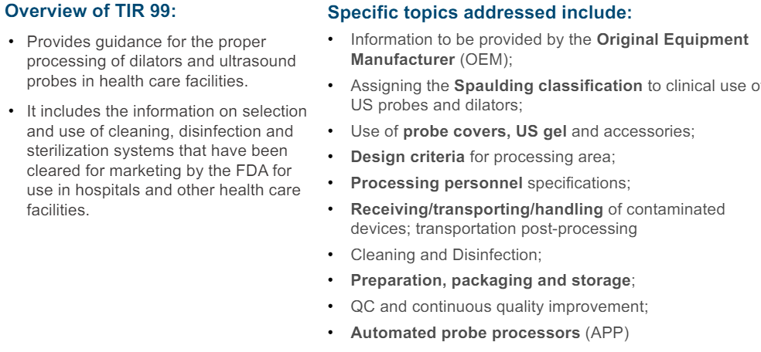
AAMI Standards Updates
TIR 99: Processing of dilators, transesophageal & ultrasound probes

Slide 7
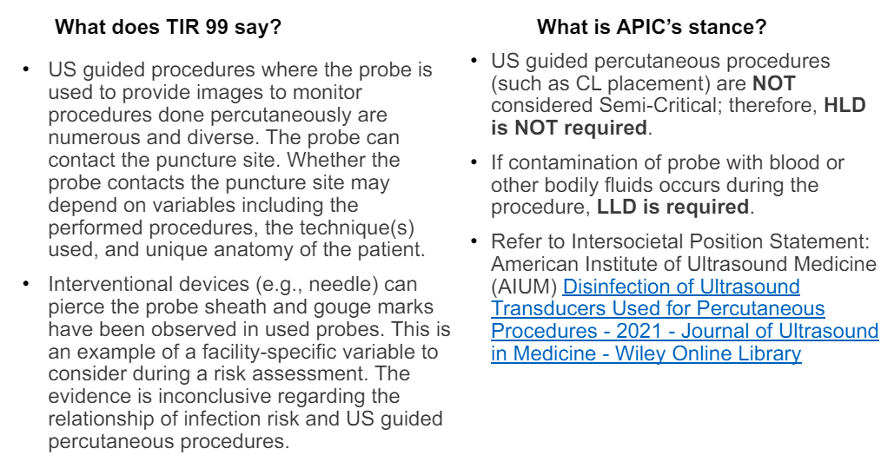
Percutaneous Procedures

Slide 8
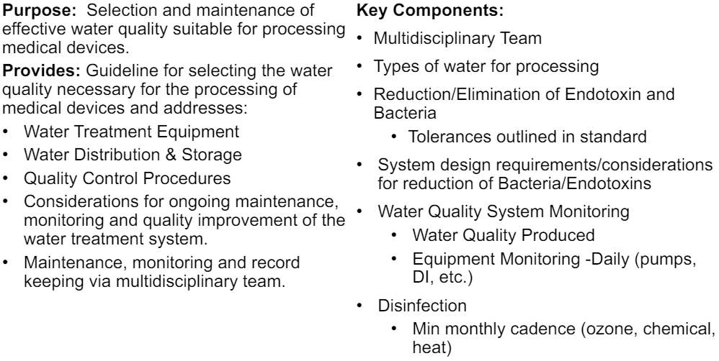
ANSI/AAMI ST 108:2023 Water for the processing of medical devices

Slide 9
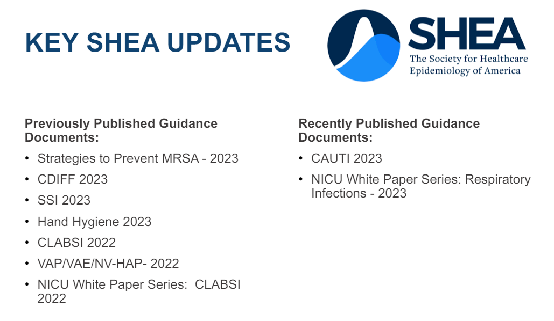
SHEA Updates

Slide 10
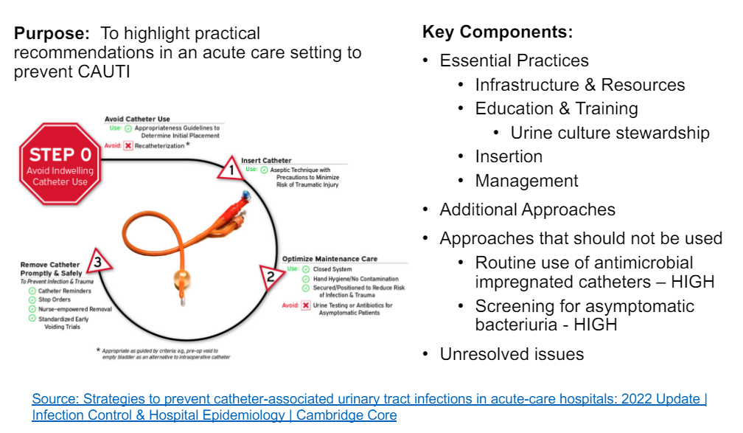
CAUTI Prevention- 2023

Slide 11
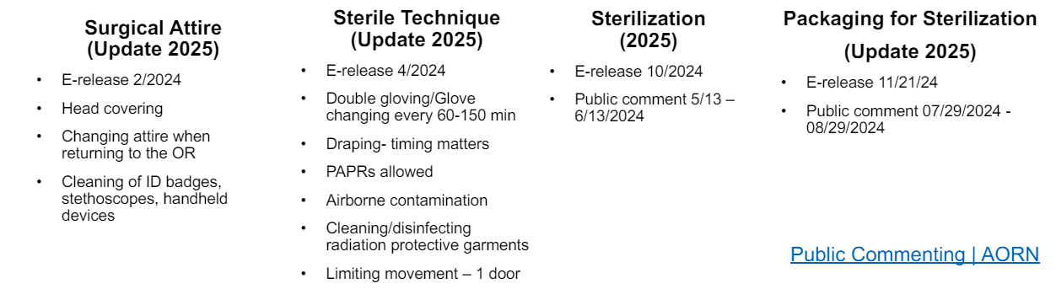
AORN Updates

Slide 12
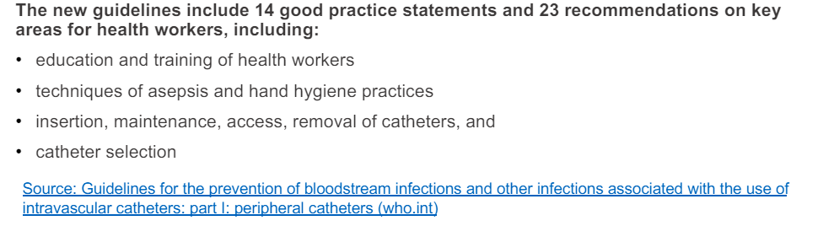
WHO Guidelines for prevention of BSI

Slide 13
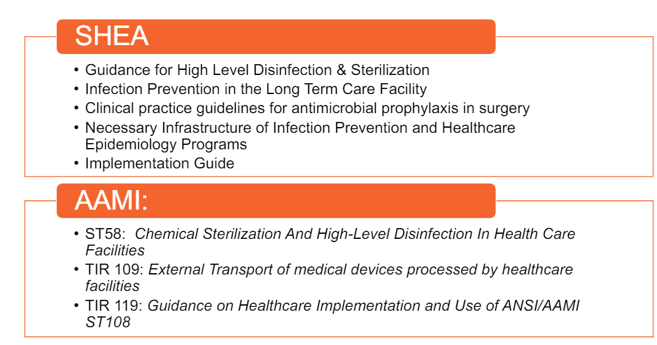
Coming Soon…

Slide 14
Advanced Leadership Certification in Infection Prevention
What is the AL-CIP?
The Advanced Leadership Certification in Infection Prevention & Control (AL-CIP) is an assessment of knowledge, skills, and abilities expected of individuals who demonstrate professional expertise, leadership and impact in the field of infection prevention and control.
It is a portfolio-based assessment (no testing)
Development was guided by the APIC Competency Model
Demonstrates leadership within infection prevention and control that has a measurable impact

Slide 15
Eligibility Guidelines
Demonstrate positive impact on the profession: Active engagement and advanced infection prevention and control practice, leadership, education, research, policy and/ or advocacy for a minimum of 5-10 years
Certification and/ or Fellow Designation: Current relevant certifications (e.g., CBIC, NAHQ, or ABMS) or fellow designation (e.g., APIC, SHEA, IDSA)

Slide 16
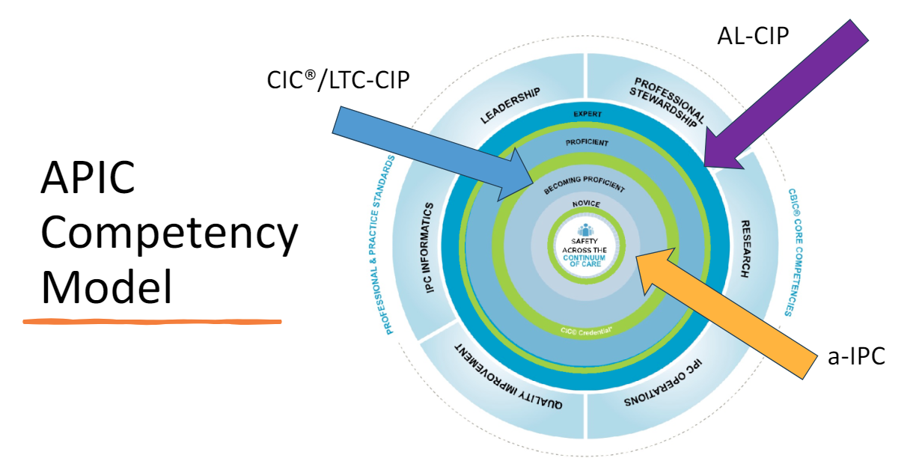
APIC Competency Model

Slide 17
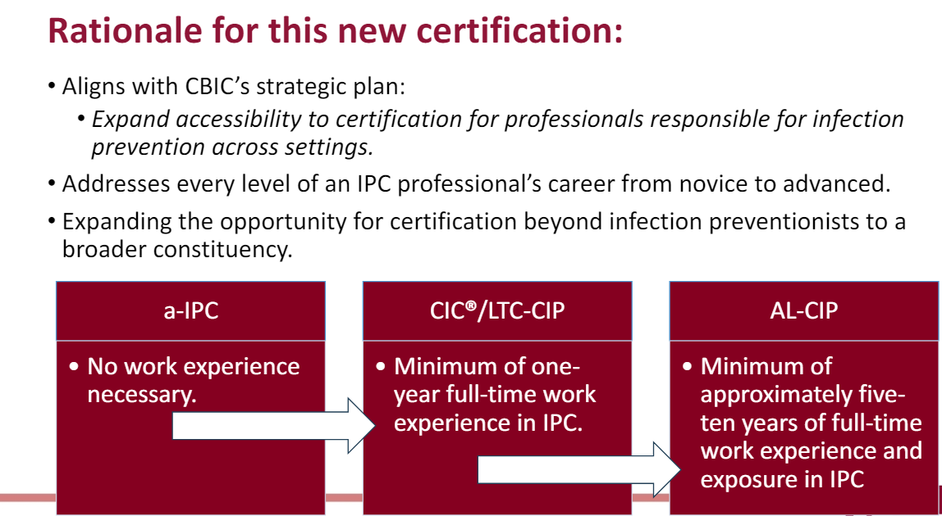
WHY….

Slide 18
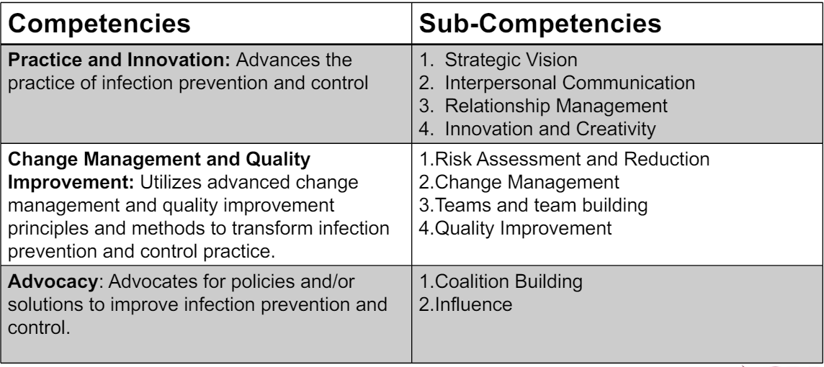
Domain 1: Leadership

Slide 19
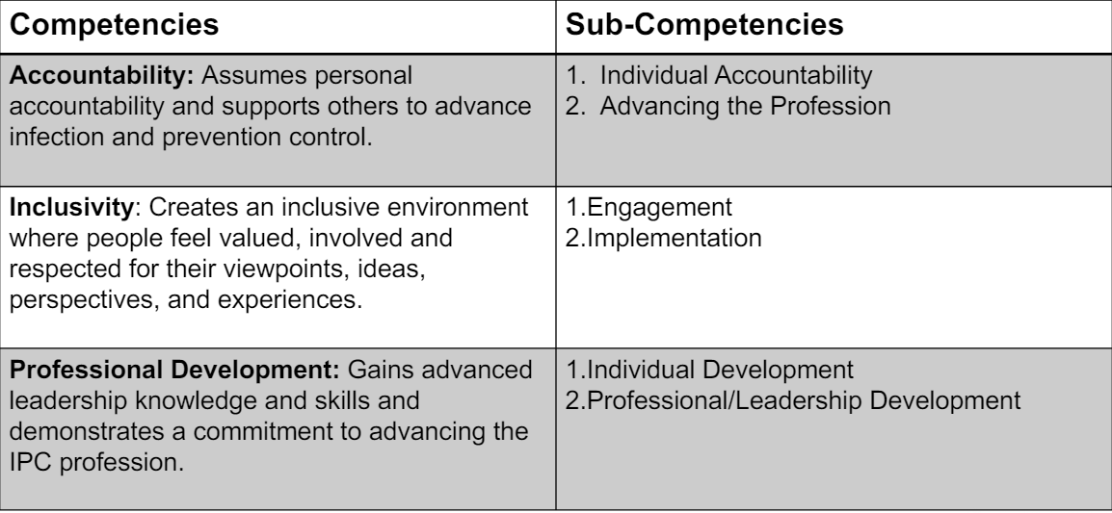
Domain 2: Professionalism

Slide 20
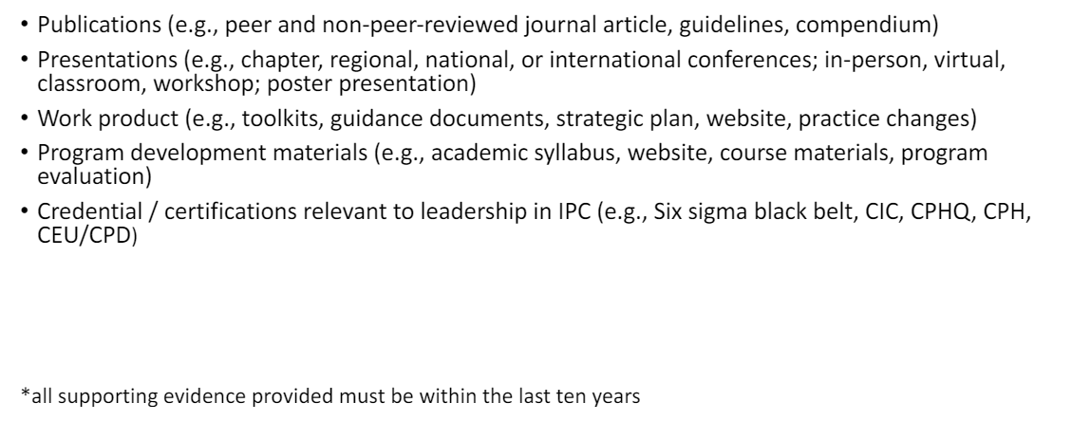
Examples of Evidence:

Slide 21
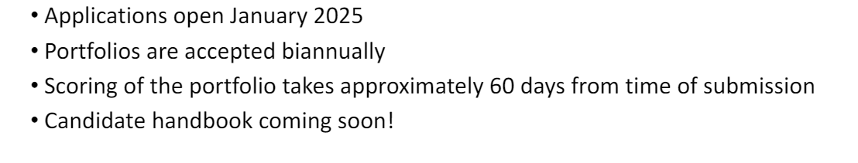
Application Process

Slide 22
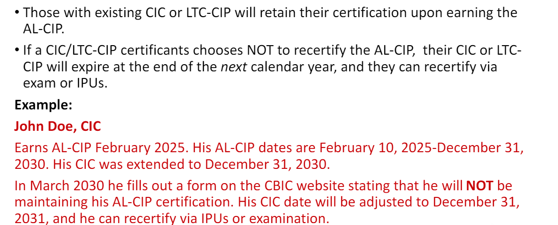
Already CBIC certified?

