Slide 1
Updates in urinary tract infections
Jessica Zering, PharmD, BCIDP, BCPS, CAPM
Jessica.zering@doh.wa.gov
Inland NW APIC Chapter – March 13, 2026

Slide 2
What’s new in antibiotics

Slide 3
Pivmecillinam

Slide 4
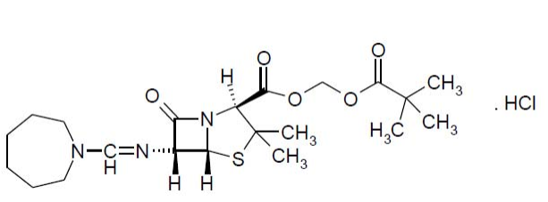
Pivmecillinam^{1,2}
FDA-approved for the treatment of adult female patients with uncomplicated UTI
Used in Europe for over 40 years to treat UTI
Spectrum¹:
Gram-negatives: E.coli, P. mirabilis, ESBLs
Gram-positives: S. saprophyticus
1. FDA Approves New Treatment for Uncomplicated Urinary Tract Infections | FDA
2. Pivya. Package insert. Utility Therapeutics; 2024. Accessed April 24, 2024

Slide 5
Pivmecillinam¹
Mechanism of Action
Amidinopenicillin, pro-drug of mecillinam, as effective as cephalexin in approval data
Binds to parts of the cell wall of susceptible bacteria
Dose
185mg PO tablet TID x 3 – 7 days
This is the only approved US dosing regimen
Cost:
Unknown
Pivya. Package insert. Utility Therapeutics; 2024. Accessed April 24, 2024

Slide 6
Pivmecillinam¹
Contraindications
Contraindications:
Adverse Drug Reactions
Nausea
Carnitine deficiency
Avoid use with valproic acid or valproate
Hypersensitivity to beta-lactams
History of Steven-Johnson syndrome
Methotrexate use
Diarrhea, including C. difficile
Vulvovaginal candidiasis
Genital pruritis
Headache
Porphyria
1. Pivya. Package insert. Utility Therapeutics; 2024. Accessed April 24, 2024

Slide 7
Activity Against ESBLs
Caution! Data from a European study show less efficacy against ESBLs at the approved US dose.¹
Package insert states that the antibiotic “has demonstrated activity” against select ESBLs²
Bollestad, M et al. J Antimicrob Chemother. 2018 Sep 1;73(9):2503-2509
Pivmecillinam. Package insert. Utility Therapeutics; 2024. Accessed April 24, 2024

Slide 8
Potential Future Roles in Therapy
High resistance (≥ 20%) or confirmed allergy to sulfamethoxazole/trimethoprim and nitrofurantoin
ESBL E. coli only if no other option (monitor response)
Once generic: 1st line for UTI as per IDSA guidelines¹
Note: not as effective as other options
1. Gupta K et al. Clin Infect Dis. 2011 Mar 1;52(5):e103-20

Slide 9
Gepotidacin

Slide 10
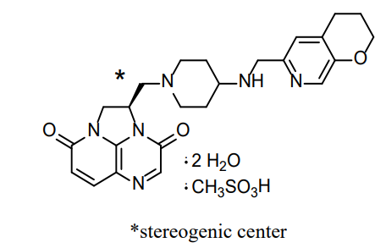
Gepotidacin¹
Approved for female adult and pediatric patients aged 12 years and older and weighing at least 40 kg with uncomplicated urinary tract infections (uUTIs)
Spectrum:
Gram negatives: Escherichia coli, Klebsiella pneumoniae, ESBLs, and Citrobacter freundii complex
Gram positives: Staphylococcus saprophyticus (S. saprophyticus), and Enterococcus faecalis
1. Blujepa. Package Insert. GlaxoSmithKline:2025. Accessed October 6, 2025

Slide 11
Gepotidacin
Mechanism of Action¹
First-in-class tirazaacenaphthylene bacterial type II topoisomerase inhibitor, works as well as nitrofurantoin in approval data
Dose¹
1500mg (2 x 750mg tablets) PO BID x 5 days taken after a meal
Cost
Approx. $1,000 per GoodRX
Works like fluroquinolones, but on different bacterial sites
Gepotidacin. Package Insert. GlaxoSmithKline:2025. Accessed October 6, 2025
Flamm RK et al. Antimicrob Agents Chemother. 2017 Jun 27;61(7):e00468-17

Slide 12
Warnings/Precautions¹
Multiple Drug Interactions
Acetylcholinesterase Inhibition
Drugs that inhibit or induce CYP3A4 may increase/decrease exposure
Gepotidacin = reversible acetylcholinesterase inhibitor
May increase effect of acetylcholinesterase inhibitors (e.g. donepezil), succinylcholine-type medications
May decrease the effect of anticholinergics (e.g,oxybutynin)
Monitor digoxin levels
Run a drug interaction check before prescribing!
Gepotidacin. Package Insert. GlaxoSmithKline:2025. Accessed October 6, 2025

Slide 13
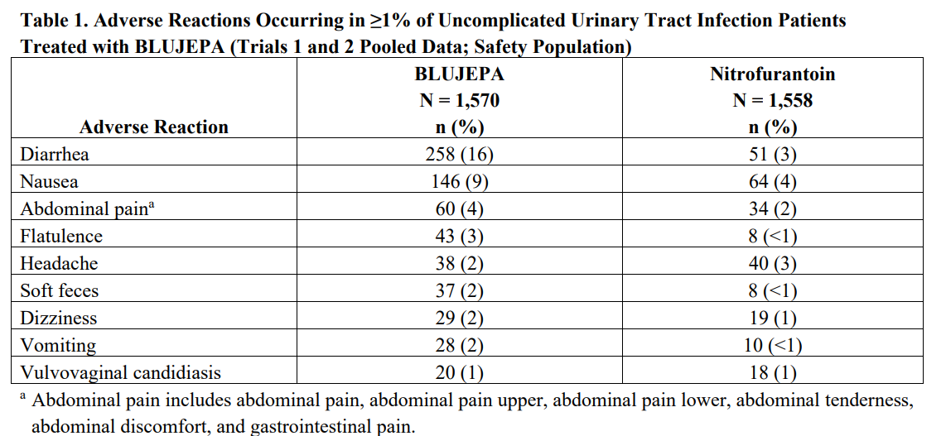
Adverse Reactions
Image Credit: Gepotidacin. Package Insert. GlaxoSmithKline:2025. Accessed October 6, 2025

Slide 14
Potential Future Roles in Therapy
High resistance (≥ 20%) or confirmed allergy to sulfamethoxazole/trimethoprim and nitrofurantoin
ESBL E.coli and K. pneumoniae that is not sensitive to the above antibiotics
Fluoroquinolone-resistant pathogens

Slide 15
Sulopenem etzadroxil and probenecid

Slide 16
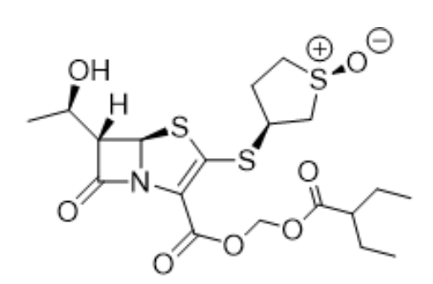
Sulopenem etzadroxil + probenecid
FDA-approved for the treatment of adult female patients with uncomplicated UTI with limited or no other treatment options caused by E.coli, K. pneumoniae, and P. mirabilis
Cannot be used for complicated UTI or complicated intraabdominal infections – not even as a stepdown therapy
Spectrum - Gram-negatives: E.coli, K. pneumoniae, P. mirabilis, ESBLs
1. Sulopenem etzadroxil and probenecid. Package Insert. Iterum Therapeutics:2025. Accessed Feb 11th, 2026.

Slide 17
Sulopenem etzadroxil + probenecid
Mechanism of Action¹
Pro-drug of sulopenem, inhibition of cell wall synthesis through to cell wall
Dose¹
500mg/500mg (1 tablet) PO BID X 5 days
Cost:
Approx. $2,952 per GoodRX
1. Sulopenem etzadroxil and probenecid. Package Insert. Iterum Therapeutics:2025. Accessed Feb 11th, 2026.

Slide 18
Warnings/Precautions¹
Hypersensitivity
Side Effects¹
Diarrhea
Nausea
Known uric acid kidney stones
Caution if patient has gout – package insert recommends increased fluid intake and alkalization of urine
May exacerbate gout
Blood dyscrasias
Probenecid component has multiple interactions
Contraindicated when used with ketorolac
Vulvovaginal candidiasis
Headache
Vomiting
Abdominal pain
C. difficile (rarely)
1. Sulopenem etzadroxil and probenecid. Package Insert. Iterum Therapeutics:2025. Accessed Feb 11th, 2026.

Slide 19
Activity Against ESBLs
Caution! Overuse of this drug will likely promote cross resistance to carbapenems in some E. coli isolates¹
Preferred treatment options for uncomplicated UTI due to ESBLs are nitrofurantoin and trimethoprim-sulfamethoxazole²
Second-line agents include ciprofloxacin, levofloxacin, and carbapenems²
Gandra S et al. Int J Antimicrob Agents. 2020 Mar;55(3):105902
Tamma P, Heil E et al. IDSA 2024 Guidance on the Treatment of Antimicrobial-Resistant Gram-Negative Infections. Clin Infect Dis. 2024 Aug 7:ciae403

Slide 20
Potential Future Roles in Therapy
Confirmed high resistance (≥ 20%) or confirmed allergy to sulfamethoxazole/trimethoprim and nitrofurantoin
ESBL E.coli and K. pneumoniae that is not sensitive to the above antibiotics

Slide 21
Barriers
Cost
Newer therapies often subjected to prior authorization, which can lead to treatment delay
Discount Cards
Medicare/Medicaid patients often not eligible for drug discount cards
Branded drug = higher cost
Susceptibilities
Pivmecillinam only (mecillinam)¹
Use these only when needed to ensure accessible patient care!
1. CLSI M100 -ED36: 2026 Performance Standards for Antimicrobial Susceptibility Testing

Slide 22
What’s new in Diagnostics

Slide 23
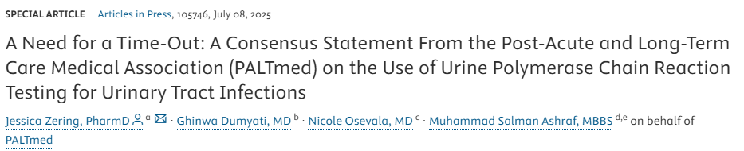
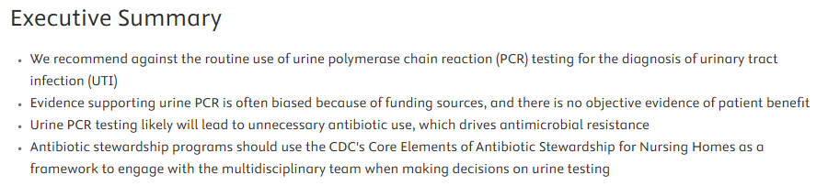

Slide 24
Factors Impacting Decision-Making Between Using Urine Culture and Urine PCR | Urine Culture | Urine PCR
Sensitivity and Specificity for UTI Diagnosis | 90% and 89% | Unknown
Scope | Live organisms only | Live and dead organisms
Organisms Detected | Clinically significant organisms, with the option to order specialized testing | Detects up to 42 different organism types regardless of clinical significance
Turn Around Time for Final Result | Up to 72 hours | 24 hours
Detects Antibiotic Resistance Genes | No | Yes
Phenotypic Susceptibilities | Yes | No, but can be performed separately
Standardized Organism Thresholds (e.g. CFU/ml) for UTI Diagnosis | Yes | No
Median Cost² | $8 | $585
1. Table Adapted from: Zering et al. J Am Med Dir Assoc. 2025 Jul 8:105746
2. Hatfield et al. JAMA Netw Open. 2024 Nov 4;7(11):e2446842

Slide 25
Confusing Results¹
PCR detects both live AND dead genetic information (cells/mL or copies/µL instead of colony-forming units/mL)
Overly broad scope of detection
The advertised high sensitivity is due to increased detection of organisms that represent contaminants
Genotype detected, not phenotype (separate test)
1. Zering et al. J Am Med Dir Assoc. 2025 Jul 8:105746

Slide 26
Potential for Contamination¹
Manufacturers advertising the option of “swabbing the briefs”
  Studies of urine samples taken from briefs failed to account for impacts of fecal and skin contamination on quality
  One recommended further research before widespread clinical use of brief urine samples
  No data to support “swabs”
1. Zering et al. J Am Med Dir Assoc. 2025 Jul 8:105746

Slide 27
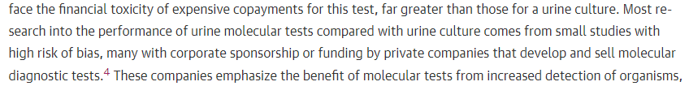
High Bias Risk – JAMA Commentary
Image Credit: Fitzpatrick et al. JAMA Netw Open. 2024;7(11):e2446711

Slide 28
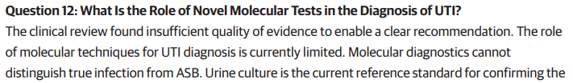
Role is Unknown - WikiGuidelines
Image Credit: Nelson et al. JAMA Netw Open. 2024;7(11):e2444495

Slide 29

Urine PCR Literature
Xu et al.
Cybulski et al.
Image Credit: Xu et al. Diagnostics 2021, 11(3), 479
Image Credit: Cybulski et al. Radiol Oncol. 2013 Jul 30;47(3):296–303

Slide 30
Takeaways
The 3 new UTI antibiotics will likely not be routinely useful until they drop in price or go generic
Reserve sulopenem etzadroxil + probenecid for situations with limited or no PO options
Urine PCR should not be routinely used

