Slide 1
APIC Inland Northwest Chapter
02/09/2024
Member Meeting

Slide 2
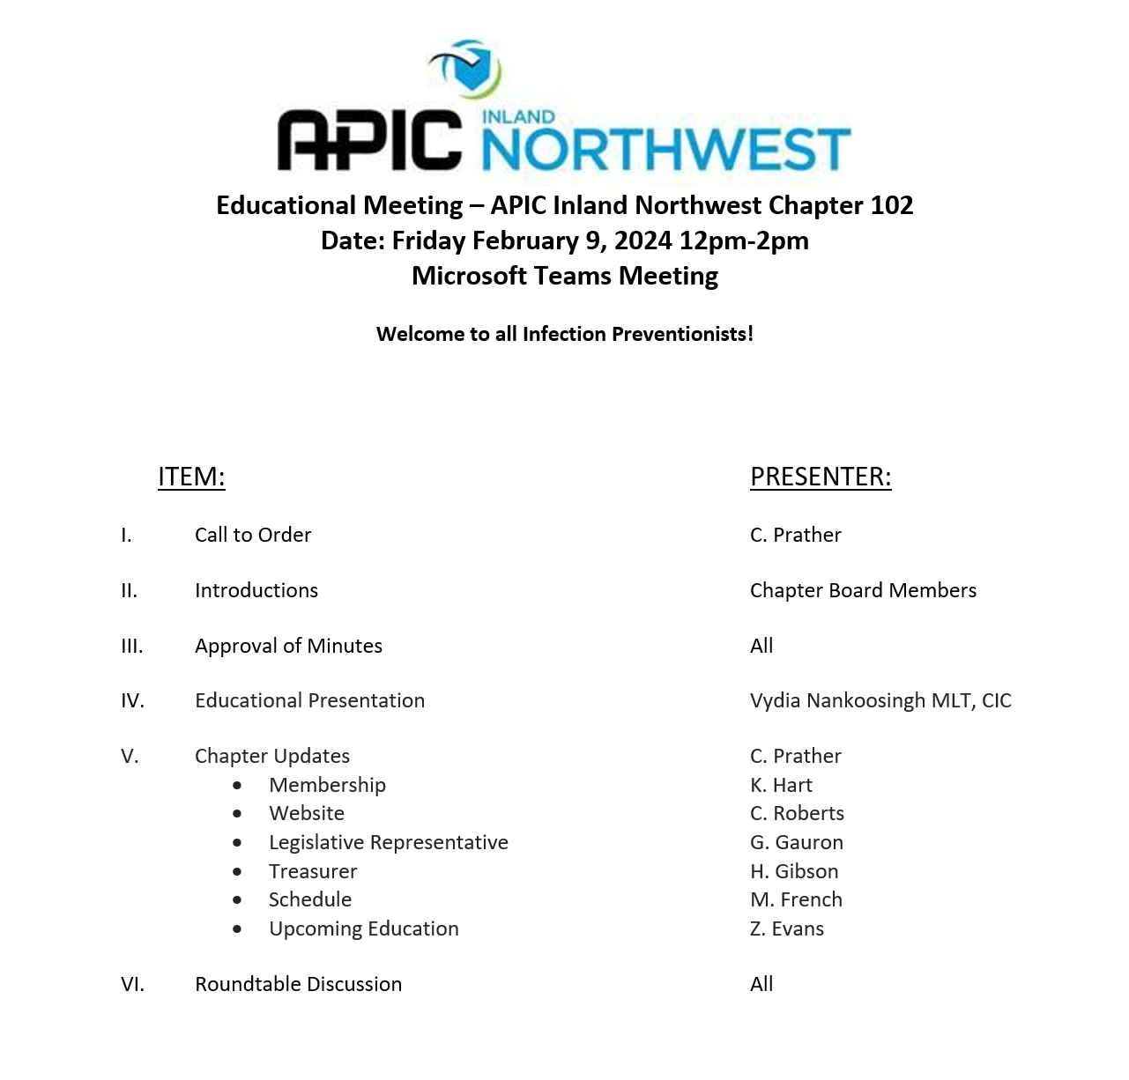
APIC INW
Member Meeting Agenda
~WELCOME~
We are happy you are here with us today. Thank you for taking the time to be a member of our chapter.

Slide 3

APIC INW
Educational Presentation
Speaker: Vydia Nankoosingh
Company: Diversey
Topic: Environmental Cleaning
and Disinfection in Rehab
and Dialysis Settings

Slide 4
2024 Inland Northwest Chapter Board Members
APIC INW
Meet our Board
President: Cassie Prather
  Leads board meetings, reports on general chapter updates, open positions, meeting cadence and topics, etc.
President Elect: Amy Moon Ullock
  Assist president in duties, become familiar with system structure, bylaws, policies, and committees
Treasurer: Heather Gibson
  Monthly financial updates, reporting, reports: balance and income statements.
Secretary: Laura Gutierrez
  Responsible for accurate recording and transcribing of the minutes of all BOD meetings, membership notices, custodian of chapter records

Slide 5
2024 Inland Northwest Chapter Board Members
APIC INW
Meet Our Board Continued..
Board of Directors: Lori Benton
  Support the business of the chapter, voting member of chapter leadership
Membership Chair: Kris Hart
  Chapter growth, new member programs and engagement, create membership brochures/ content to keep members informed
IT Support Coordinator: Christina Roberts
  Web page master, board membership list, digital updates on events and meetings, create members only page, establish social media presence

Slide 6
2024 Inland Northwest Chapter Board Members
APIC INW
Meet Our Board Continued..
Education Chair: Zach Evans
  Promote the educational activities, schedule guest speakers, assess educational needs of the chapter
Legislative Representative: Georgia Gauron
  Promote legislative and regulatory issues affecting the practice of infection prevention and control
Chapter Bylaws Chair: Sharyl Bergerud
  Review chapter bylaws, process proposed changes to bylaws for chapter approval and adoption
Communications Chair: Marena French
  Communicate to the board on important events, meetings, educational sessions, etc.

Slide 7

APIC INW
Chapter Updates
Chapter Updates
    Membership
    Website
    Treasurer
    Schedule / Communication
    Upcoming Education

Slide 8

APIC INW
Roundtable Discussion
We would like to hear from you!

Slide 9
ADJOURN!
Next Member Meeting:
Friday, April 12th, 2024

