Slide 1
Inland NW APIC
March 13th

Slide 2
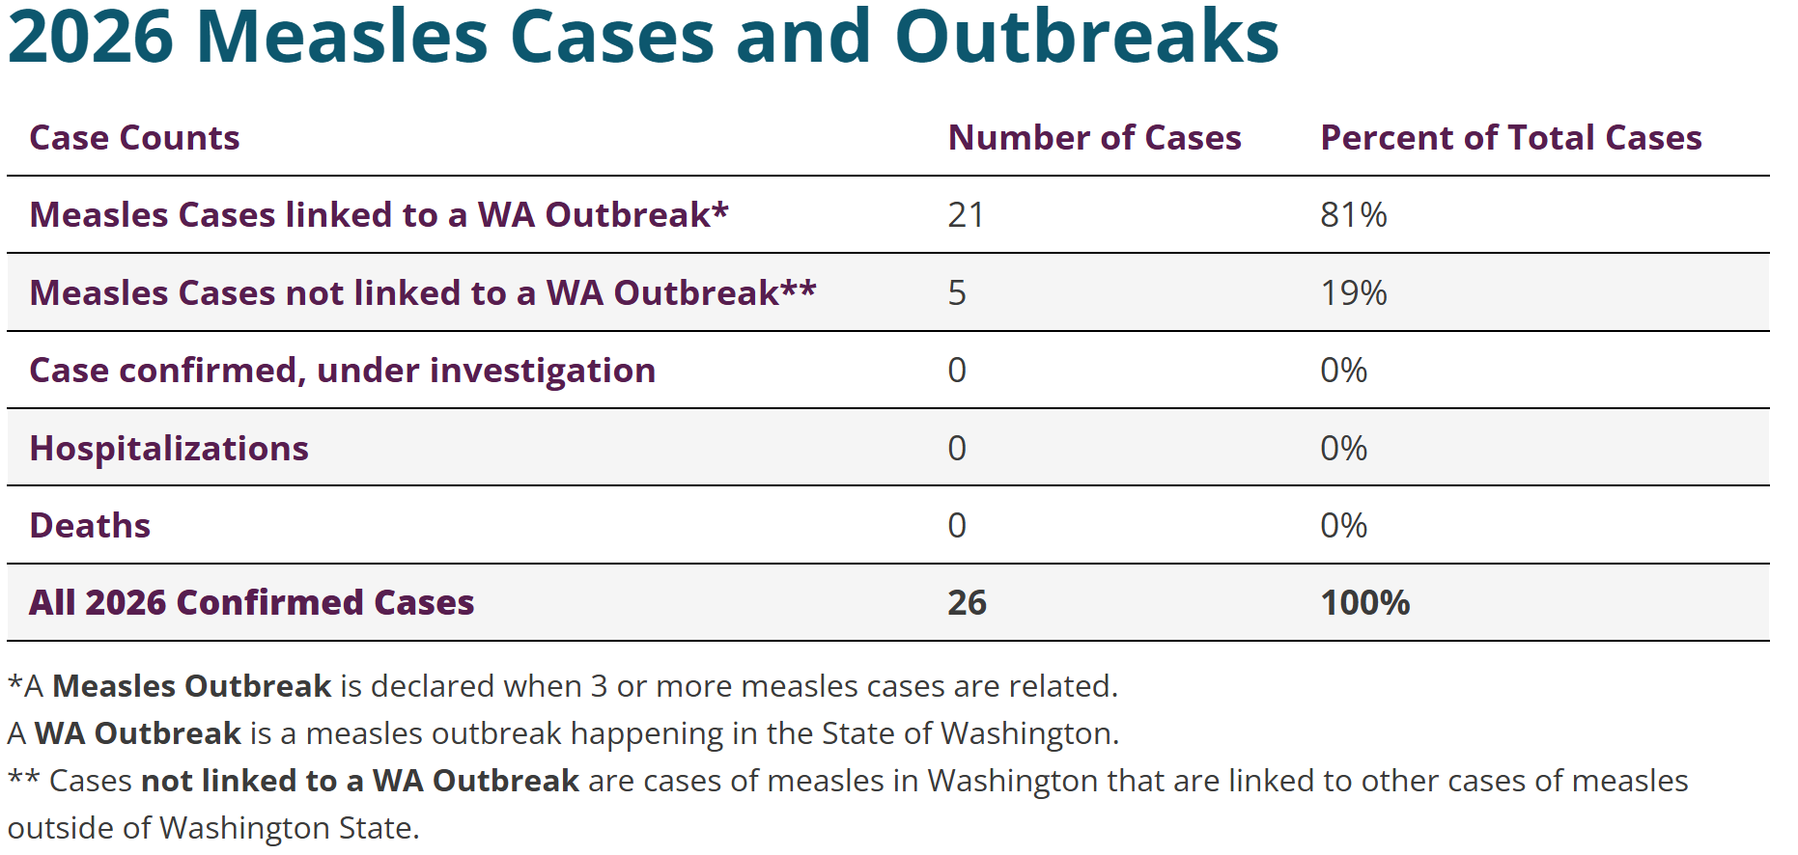
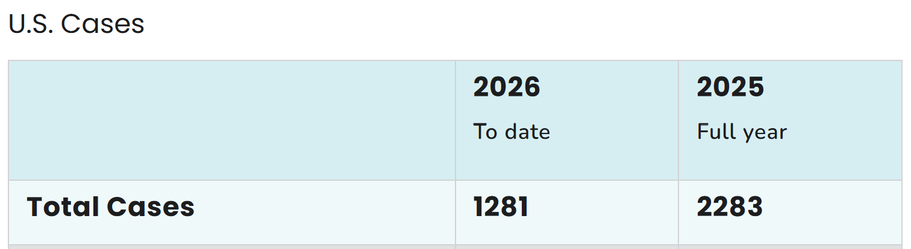
Measles
Measles Cases and Outbreaks | Measles (Rubeola) | CDC
Measles Cases in Washington State | Washington State Department of Health

Slide 3
Measles Review
Signs & Symptoms
Acute, infective, respiratory viral disease
Inhaled virus → infects respiratory tract → spreads to lymphoid tissue → disseminates throughout bloodstream (viremia) → infects distant organs
In an infected person, the virus transfers from the dendritic cells and lymphocytes to the epithelial cells of respiratory tract, which are shed and expelled, causing further transmission
What is measles
Prodromal symptoms (average 2-4 days, range 1-7 days)
Rash illness (5-6 days)
coryza
Conjunctivitis
Cough
Maculopapular rash occurs after dissemination due to perivascular and lymphocytic infiltrates
Infectious 4 days before through 4 days after rash onset
Begins at hairline, then progresses downward and outward
Fever (increases in stepwise fashion and often as high as 103°F to 105°F) coincides with development of viremia.
Koplik spots (present on mucous membrane and are unique to measles, occurring 2-3 days after symptoms begin and 1-2 days before rash. Appear as punctate blue-white spots on the bright red background of the buccal mucosa)
Average incubation period 11-12 days, range 7-21 days after exposure

Slide 4
Infection Prevention
Considerations
Plan for screening and managing access
Triage nurses
Signage before entry
Masks available
Pre-messaging to patients
Plan for rooming suspect cases or people in quarantine
Airborne isolation precautions and standard precautions
Harm reduction!
Last patient of the day (only immune staff present)
Telehealth or evaluate outside
Patient should wear source control (mask or blanket over head of baby who can’t mask)
Private room, door closed
PPE – if not fit tested, then immune HCP and best mask available
Bundle care to keep door closed
Source control for any transport through building
Manage who is close to the patient
ensure that people at higher risk of measles complications are as far away as possible
Guidance
DOH’s guidance for Preventing Measles in Health Care Settings
Interim Infection Prevention and Control Recommendations for Measles in Healthcare Settings | Infection Control | CDC
Measles Preparedness and Response in Healthcare Settings | Infection Control | CDC

Slide 5
Suspect Measles
SRHD approves testing at Wa State Public Health Lab.
Specimen Collection & Shipping Guide: View File - MediaLab.
Urine and respiratory sample (NP preferred) collection: View File - MediaLab
IgM: View File - MediaLab
IgG: View File - MediaLab
Patient should isolate!
Ensure a good hand-off to EMS and receiving facility
The first step is to call SRHD and follow this assessment tool: Measles Assessment Quicksheet for Providers

Slide 6
Vaccine
Assess MMR coverage rates of your patients
Identify who is due now based on age. Make sure adult patients are up-to-date.
Identify whose are at the minimum age and can get them scheduled sooner.
Reminder/Recall strategy (reach out and schedule an appointment) for anyone who is over-due, due soon, or not up-to-date.
If your office doesn’t have the ability to run coverage rate reports or set-up a reminder/recall strategy, here are videos and reference guides to help you utilize those functions in the WA IIS.
Reminder/Recall DOH Training video: Updated Reminder Recall
Reminder/Recall DOH Quick Reference Guide: 348-573-ReminderRecallGuidePub.pdf
Coverage Rate Report DOH Training video: (131) Assess Vaccination Rates with the Coverage Report in the WA IIS - YouTube
Coverage Rate Report Quick Reference Guide: 348-647-CoverageRateReportGuide.pdf
What can clinics do to prepare?

Slide 7
What’s happening in your setting?
PPE practices
Airborne and standard, but what does that look like?
Vaccine status of staff
If HR, can you influence that process?
Prepared to furlough staff
No record, then day 5-21 day furlough
Preparedness efforts

