Slide 1

MEMBER MEETING
7/12/2024

Slide 2

Meeting Agenda
12:00-12:15 | Chapter updates
12:15-12:30 | Lori Benton
12:30-12:45 | Drew Pratt
12:45-1:00 | Amy Moon-Ullock
1:00-1:15 | Questions for APIC presenters
1:15-1:45 | Christa Arguinchona – Joint Commission HCID standards
1:45-2:00 | Closing/Questions

Slide 4
Chapter Updates
Christina Roberts: IT Support Coordinator
Cassie Prather: President
Heather Gibson: Treasurer
Zach Evans: Education Chair

Slide 5


Cassie
Chapter News
Elections for board positions for 2025 will be coming in the November member meeting – reach out with questions
Inland Northwest chapter will be holding a conference in Spring of 2025, we need volunteers for a planning committee
In-person meeting(s)
Q2 Treasurer Report – Heather Gibson
APIC Highlights
Policy Pro – APIC PolicyPro – APIC
APIC Emerging Infectious Disease Updates - Emerging Infectious Diseases - APIC

Slide 6


Zach
APIC Attendee Presentations
Lori Benton, RN, CIC – Director of Infection Prevention and EVS TriState Health
Drew Pratt - Epidemiologist, Disease Prevention and Response Spokane Regional Health District
Amy Moon-Ullock, LPN – Infection Preventionist Royal Park Health ND Rehabilitation

Slide 7
APIC Annual Conference 2024
San Antonio

Slide 8
APIC Practice Guidance Committee & the Latest Changes in Infection Prevention and Control

Slide 9
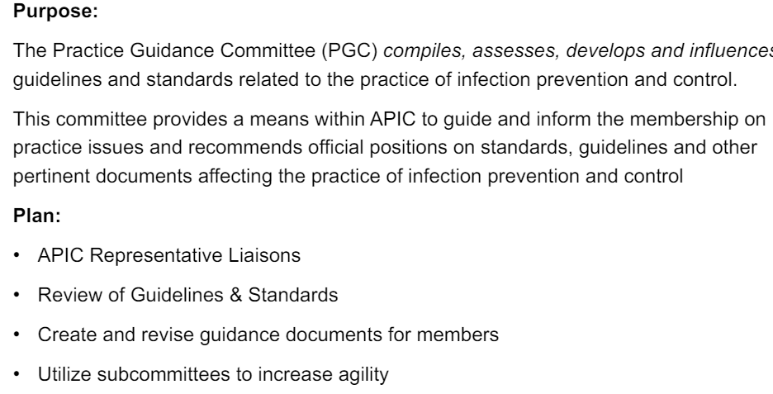
PGC Overview

Slide 10
Recently Published/ In Development:
Recently Published:
10 key points the IP needs to know about USP <797>
August 2023
10 key points the IP needs to know about AAMI
December 2023
APIC toolkit for patient hand hygiene
January 2024
Heightening awareness for the IP in the behavioral health setting
January 2024
In Development:
Creating guidance specific to long term care setting
Revision to APIC’s position paper: Safe injection, Infusion, and Medication Vial Practices in Health care (2016)

Slide 11
Implementation Guides Subcommittee
New subcommittee for 2024
Completed review of SHEA compendiums vs. APIC Implementation guides 2023
Based on 2023 review, PGC proposed a strategy for updating current implementation guides
Goal is to create concise updated documents that primarily contain implementation information only

Slide 12
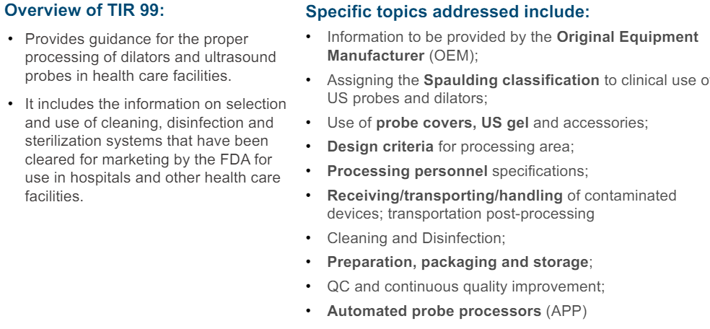
AAMI Standards Updates
TIR 99: Processing of dilators, transesophageal & ultrasound probes

Slide 13
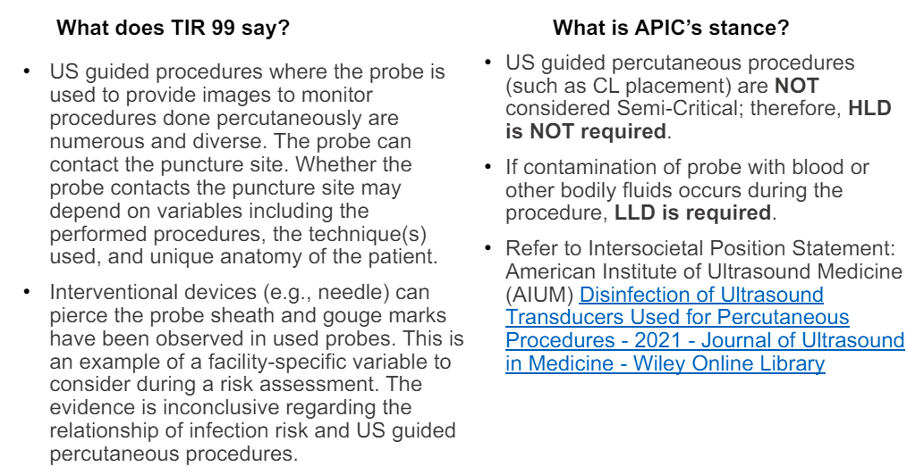
Percutaneous Procedures

Slide 14
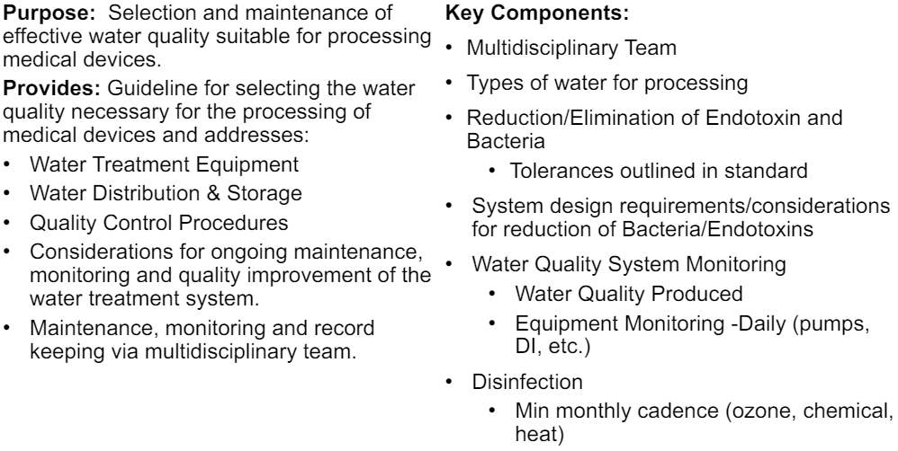
ANSI/AAMI ST 108:2023 Water for the processing of medical devices

Slide 15
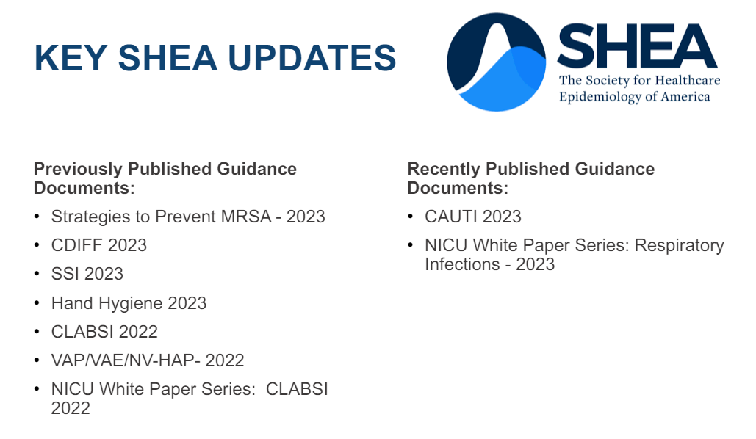
SHEA Updates

Slide 16
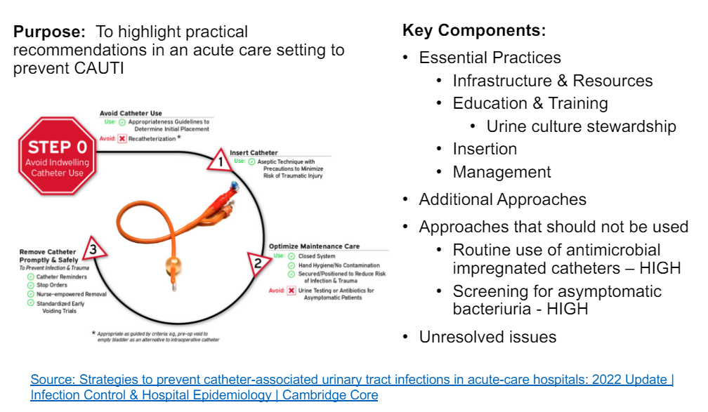
CAUTI Prevention- 2023

Slide 17
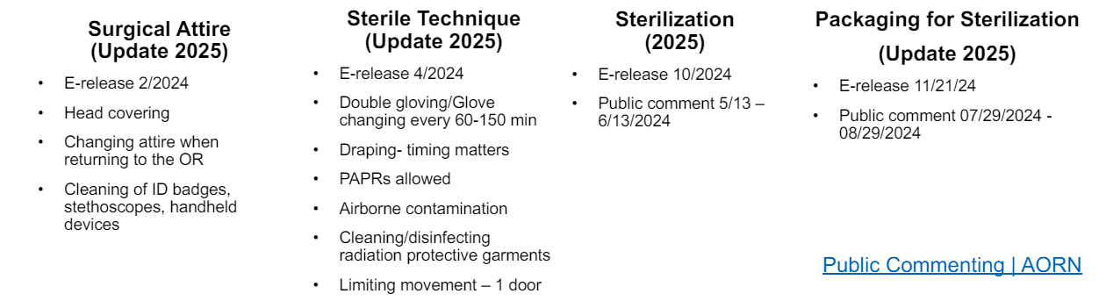
AORN Updates

Slide 18
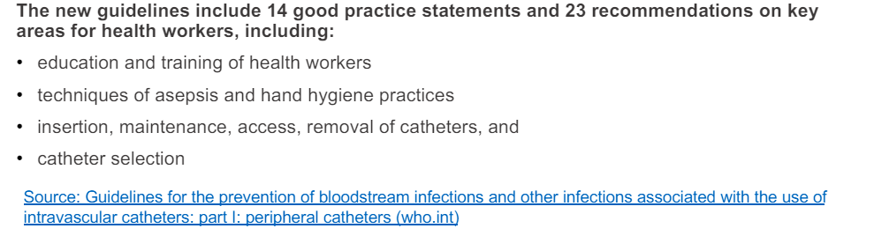
WHO Guidelines for prevention of BSI

Slide 19
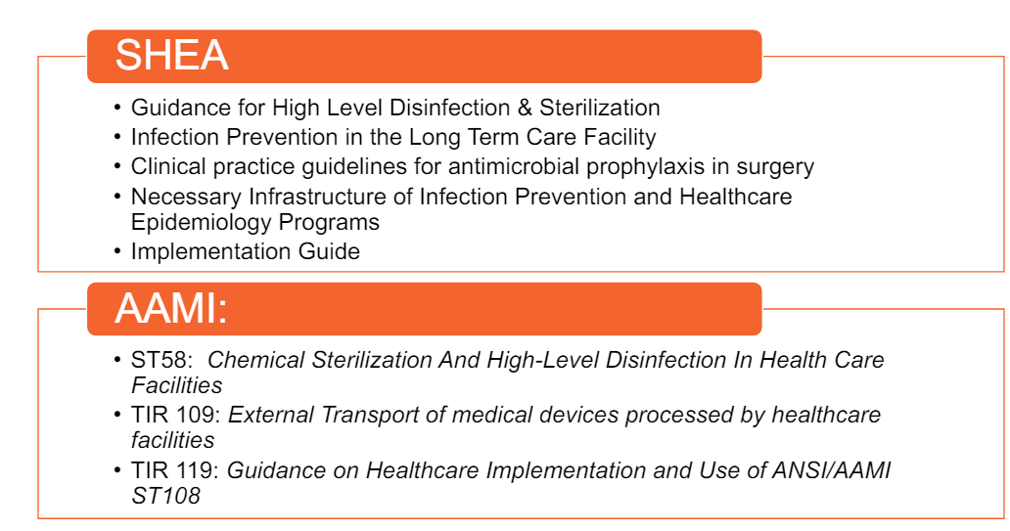
Coming Soon…

Slide 20
Advanced Leadership Certification in Infection Prevention
What is the AL-CIP?
The Advanced Leadership Certification in Infection Prevention & Control (AL-CIP) is an assessment of knowledge, skills, and abilities expected of individuals who demonstrate professional expertise, leadership and impact in the field of infection prevention and control.
It is a portfolio-based assessment (no testing)
Development was guided by the APIC Competency Model
Demonstrates leadership within infection prevention and control that has a measurable impact

Slide 21
Eligibility Guidelines
Demonstrate positive impact on the profession: Active engagement and advanced infection prevention and control practice, leadership, education, research, policy and/ or advocacy for a minimum of 5-10 years
Certification and/ or Fellow Designation: Current relevant certifications (e.g., CBIC, NAHQ, or ABMS) or fellow designation (e.g., APIC, SHEA, IDSA)

Slide 22
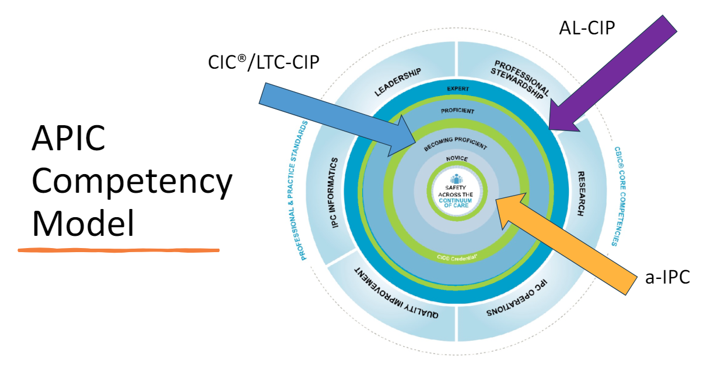
APIC Competency Model

Slide 23
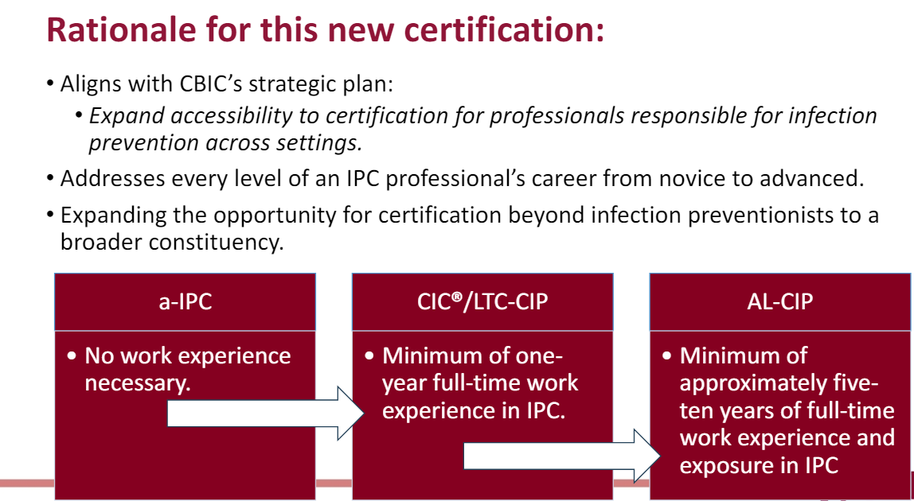
WHY….

Slide 24
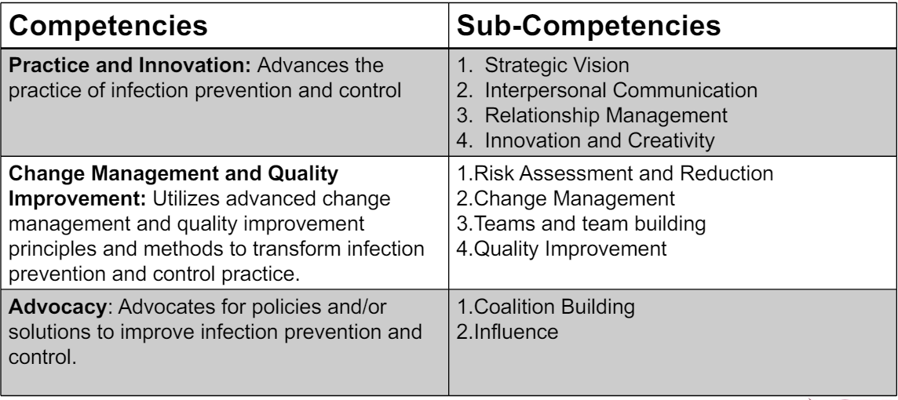
Domain 1: Leadership

Slide 25
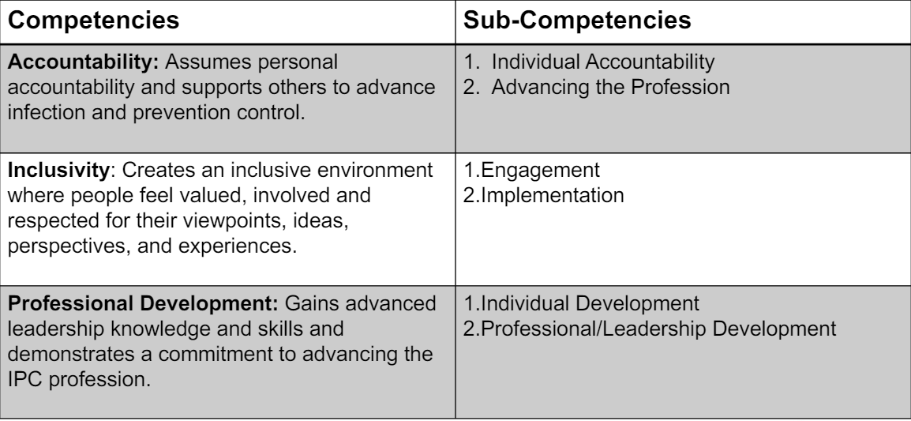
Domain 2: Professionalism

Slide 26
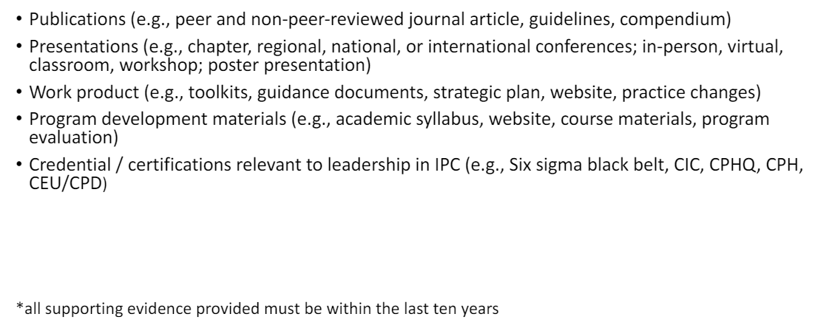
Examples of Evidence:

Slide 27
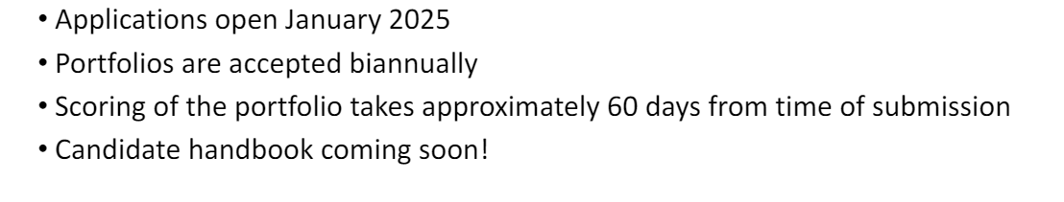
Application Process

Slide 28
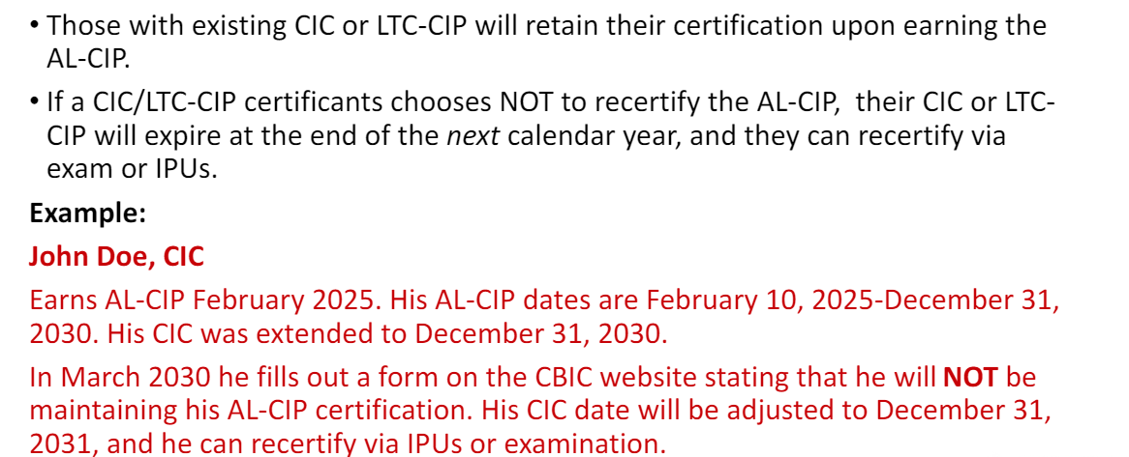
Already CBIC certified?

Slide 29

APIC 2024
Amy Moon Ullock. LPN

Slide 30
What's in your laundry facility? Its time to find out!
As a lone IP in a nursing home, I am always looking for educational offerings on subjects that I don’t have the best grasp on
I wanted to get a better understanding of what to look for when I round in the laundry facility

Slide 31
Healthcare textiles
I learned that all linen we use is called healthcare textiles, or HCT
These are used in a variety of healthcare locations including:
Hospitals
Long Term Care
Critical Access Hospitals
Outpatient locations

Slide 32

What to expect
When we grab our HCT from the clean area, what do we expect?
Clean
Free of any visible stains
Free of any odors
Free of any harmful pathogens
They also mentioned at this point that the term most often associated with healthcare linens is “hygienically clean”
This means that the linen is “free of pathogens in sufficient numbers to cause human illness”

Slide 33

Can linen pose a risk?
According to the presentation, it is rare to have an HAI or infectious disease related to HCT but,
The soft surfaces of linens can provide a substrate for organisms to live on
MRSA can live on improperly cleaned HCT for up to 5 days
A study in the UK showed that c. diff spores could remain on HCT if the water temperature, disinfection process, and time weren’t properly implemented
There have been 13 outbreaks in 56 years were case clusters of mucormycosis

Slide 34
Quick facts
Its estimated that 10 billion pounds

Slide 35
QUESTIONS?
Thank you to our APIC attendees for your presentations!

Slide 36




Zach
Christa Arguinchona, MSN, RN, CCRN
Region 10 Emerging Special Pathogens Treatment Center Manager at Providence Sacred Heart Medical Center
Education Overview:
Understanding the Joint Commission updates around high consequence infectious diseases or special pathogens

Slide 37

THANK YOU!
Next Member Meeting | September 13th, 2024
Sister Loretta Room – 2nd Floor Providence Medical Park
16528 E. Desmet Ct. Spokane Valley, WA 99216
LUNCH IS PROVIDED!

