Slide 1
APIC Inland Northwest Chapter Meeting
11/08/2024
Member Meeting

Slide 2

APIC INW Chapter
AGENDA
12:00: Welcome
12:05-12:10: Zach Evans
12:10-1:00: Educational Presentation
1:00-1:10: Chapter Updates
1:10-1:30: Chapter Board Positions/ Policy & Bylaw changes
1:30-1:40: Voting
1:40-2:00: Closing remarks

Slide 3

APIC INW Chapter
Education Session
Addressing CAUTI Prevention and Alternative Urinary Devices
Presentation lead by:
Haylee Corvi, RN, BSN a BD Clinical Manager, based in Portland, where she supports the North-West Region for Urology and Critical care. She is an active member of the BD Acute Academy team and holds a seat on the BD Clinical Innovation Council. Outside of work, Haylee loves to spend time out on the water paddle boarding with family and friends.

Slide 4

APIC INW Chapter
Chapter 102 Updates
APIC Inland Northwest Conference 2025
  Interested in joining? Email APIC.inlandnw@gmail.com
Board positions nomination/election
Bylaws
APIC Annual conference scholarship

Slide 5
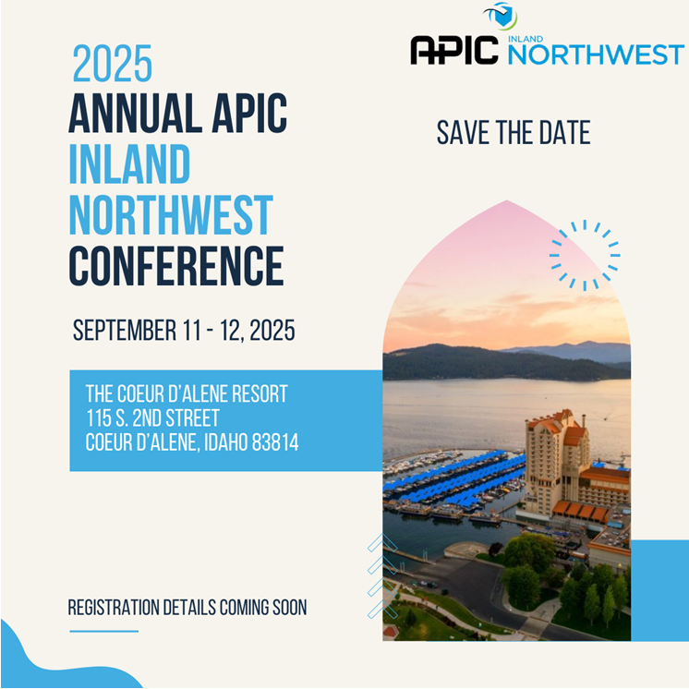
Save the Date!
Questions? Contact Erin Wilder, conference committee chair.
Erin.Wilder@KH.org

Slide 6

APIC INW Chapter
Open Positions 2025
President Elect:
  Prepares to assume the office of president, gaining the necessary experience and knowledge for the transition
  1 year term commitment, with 2 consecutive years into president, and immediate past president
  They support the president in key initiatives and fill the office of president if it becomes vacant
  Also assumes the duties of the secretary in the event of a vacancy, ensuring continuity in chapter operations
General Board Member:
  Supports the chapter in any extra duties to accomplish goals
  Voting member of chapter leadership
  Steps in to support the business of the chapter
  Assists in vacancies throughout the year if necessary

Slide 7
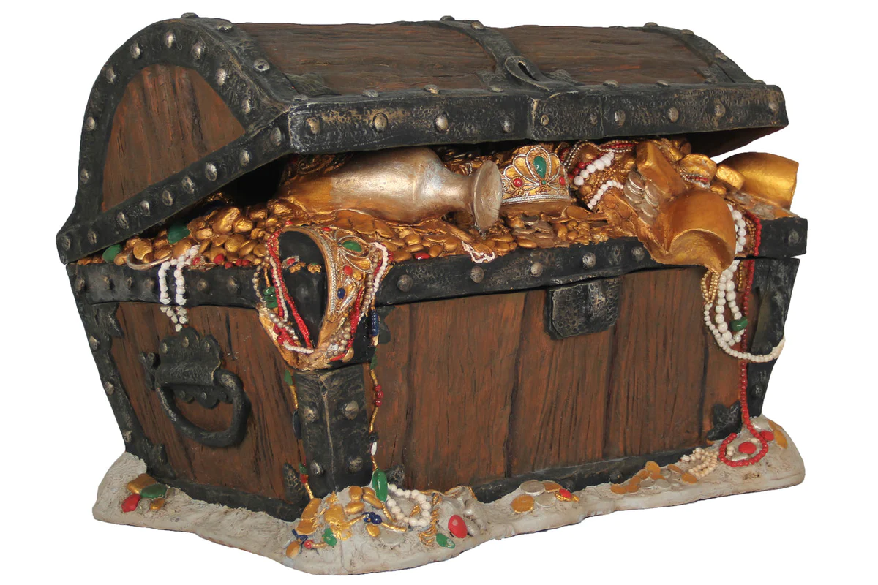
Treasurer:
APIC INW Chapter
Open Positions 2025
This is a 2 year commitment with 1 year support to your predecessor. This means that you will have help.
As Treasures you will keep the tax ID number and file the exempt status forms to the IRS.
Submit next years budget plan to National APIC at the end of the year.
Submit the annual dues to National APIC .
Report chapters current finances to the local chapter and board.
The financial information is already organized into an excel sheet so you just need to maintain the spreadsheet.
National APIC has leadership support and is very responsive.
Our Board is very supportive and helpful.
This position will meet the requirements if you are interested in becoming an APIC Fellow

Slide 8

APIC INW Chapter
Nominations 2025 Positions
Current Position Nominations
President Elect:
  Heather Morasch
Treasurer:
  Heather Gibson
General Board Member 1:
  none
General Board Member 2:
  none
- Will assume position in office February 2025 -

Slide 9
APIC INW Chapter
Policy & Bylaws Proposed Changes 2025
Policy Changes
Addition of scholarship drawing for general membership to APIC National Conference
Bylaws Revisions
Board positions are changed from a 3-year term to a 2-year term
Committee chair positions be included as Board Members, and serve a 2-year term

Slide 10

PLEASE VOTE!
APIC INW Chapter

Slide 11

QUESTIONS?
Be on the lookout for the 2025 Chapter Member Meeting Schedule!
Visit our website for more: Home - APIC 102 - Inland Northwest

