Slide 1
A Quick Welcome to the Sterile Processing Department
Notes:
SCRIPT NOTES:
Welcome to STERIS University’s program A Quick Welcome to the Sterile Processing Department.

Slide 2
Disclosures
Notes:
SCRIPT NOTES:
Before we start, let’s review the disclosures. STERIS is offering the continuing education credits for this program. Participants must complete the entire program and submit an evaluation to receive their certificate. No partial credit will be given.
The presenter is an employee of STERIS. All fees and costs associated with development of this program was provided by STERIS.
Any product seen or referred to in this program does not constitute commercial support by STERIS or the speaker.
Additional information
None

Slide 3
STERIS Corporation is an approved provider of continuing nursing education by CBRN – provider # CEP 11681 and an approved Administrator Education Unit (AEU) and Infection Prevention Control (IPCH) provider by BASC – provider # 1417.
This program is approved for:
0 hour(s) of GI Specific content credit by ABCGN (American Board of Certification for Gastroenterology Nurses),
1 AEU(s) & 1 IPCH(s) by BASC (Board of Ambulatory Surgery Certification), and
1 contact hour(s) of continuing education credit
CBRN (California Board of Registered Nursing);
CBSPD (Certified Board for Sterile Processing and Distribution); and
HSPA (Healthcare Sterile Processing Association).
Notes:
SCRIPT NOTES:
This program has been credentialed for (read the value, abbreviated credited hour and abbreviation of the credentialing agent. For example:. 1 hour of GI specific content by ABCGN)
Additional information
None

Slide 4
Notes:
SCRIPT NOTES:
Through our partnership with CCI, CE earned through CBRN may be used towards your CNOR and CSSM recertification requirements.
Additional information
None

Slide 5
Describe the various activities performed by healthcare professionals working in sterile processing departments.
Identify specific activities necessary for the development of policies and procedures.

Slide 6

Importance of Sterile Processing
Central hub of healthcare facility
Efforts effect virtually every patient in facility
Notes:
Let’s first look at the importance of sterile processing in healthcare facilities and their unique challenges. Understaffed, under equipped and underfunded. Activities from simple to complex.
Read bullets.

Slide 7

Sterile Processing Personnel Challenges
Low priority and misunderstood
Time demands
Intimidation
No formal sterile processing education
Notes:
Sterile processing can also be a very intimidating area, especially if you don’t know what goes on in the department or what to look for. After all, how many of you have ever received formal sterile processing education? Sterile processing is not normally a part of formal education. Therefore, it is up to you to pursue sterile processing education and certification.

Slide 8
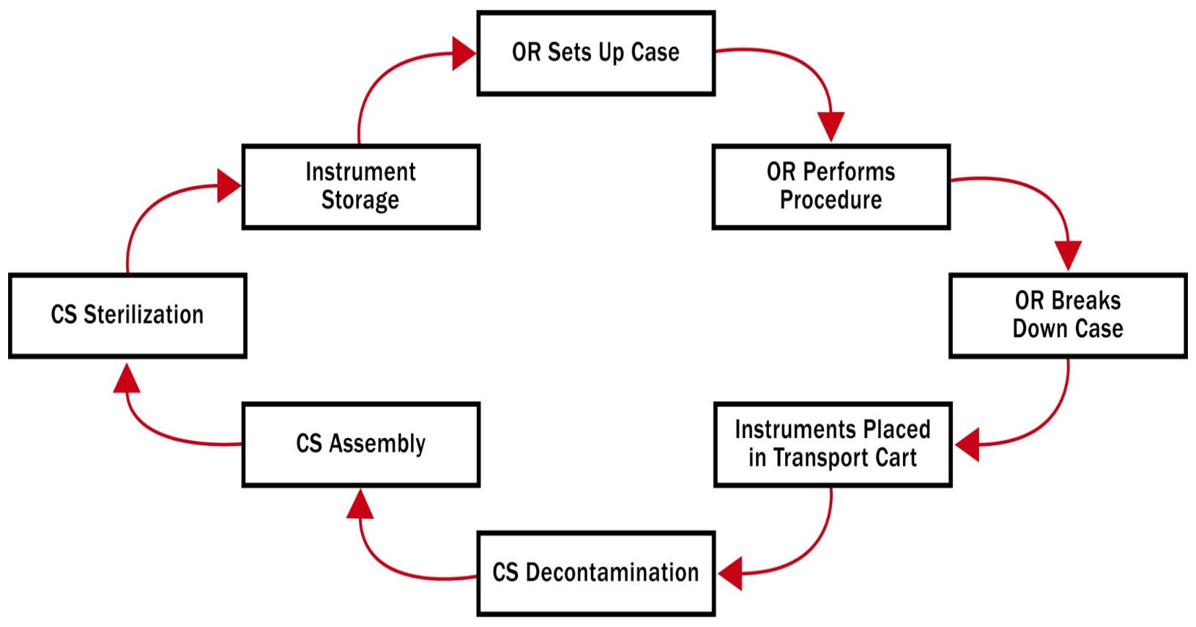
Understand the Flow
Notes:
It is also important to understand the flow of instruments, which typically begins at the point of use, or where the procedure is performed. Following the procedure in the OR, the OR staff breaks down the case, instruments are pretreated, which begins the decontamination process at the point of use, they are then placed in a transport cart and transported to the CS decontamination area. From there, instruments are assembled, packaged and sterilized. Following sterilization, they are placed in a sterile storage area until needed for case set up for the next patient procedure.

Slide 9
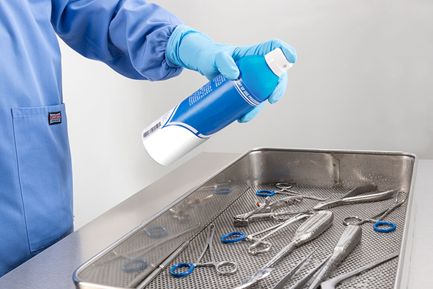
Point of Use
OR, L&D and Clinics
At the point of use:
Separate disposable from reusable, including sharps
Keep instruments moist
Pretreat per ST79
Prepare for transport
Notes:
The point of use in a health care facility can be in a variety of areas.
OR, L&D, ICU, ER, the Cardiac Cath Lab, Radiology, and in-house clinics that perform minor procedures.
At the point of use, disposable items must be separated from reusable devices.
All items must be contained in a manner that prevents personnel contact with contaminated items during transfer.
OSHA requires that
a) all containers, devices, or carts used for containing contaminated items be marked with a biohazard label, a
red bag, or other means of identifying contaminated contents; and
b) puncture-resistant, leak-proof on the sides and bottom, closable, and labeled containers must be used for
devices with edges or points capable of penetrating container or skin.
Contaminated items should be kept moist in the transport container by adding a towel moistened with water (not
saline) or a pretreatment product specifically intended for this use, or by placing items inside a package that can
maintain moist conditions.
Containers used for holding contaminated items should be
made of material that can be effectively decontaminated; or
b) designated for single use and made of material that can be incinerated or otherwise disposed of following
use.
Resource:
ST79:2017, 6.4, pp 35-36.

Slide 10
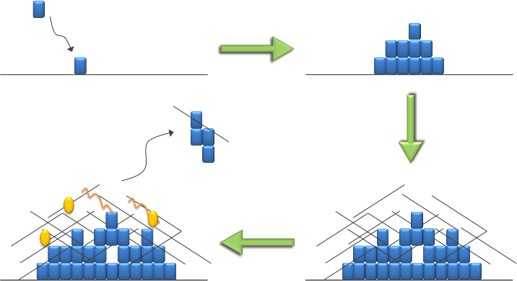
Decontamination Delay
Delays in transport:
Dried debris difficult to clean
Development of biofilm
Damage to passivation layer of surgical instruments
Biofilm Development
Notes:
Beware of areas within the facility where procedures are performed after hours and instruments are not properly processed.
There may also be areas where there are huge delays between the time instruments are used and when they can be processed. These delays can result in debris drying on the surface of instruments making them difficult to clean, promoting the development of biofilm, and resulting in damage to the passivated layer of stainless steel surgical instruments.
If delays in processing are a concern at your facility brainstorming with key stakeholders may lead to solutions. Every effort should be made to eliminate any and all delays in reusable device processing.

Slide 11
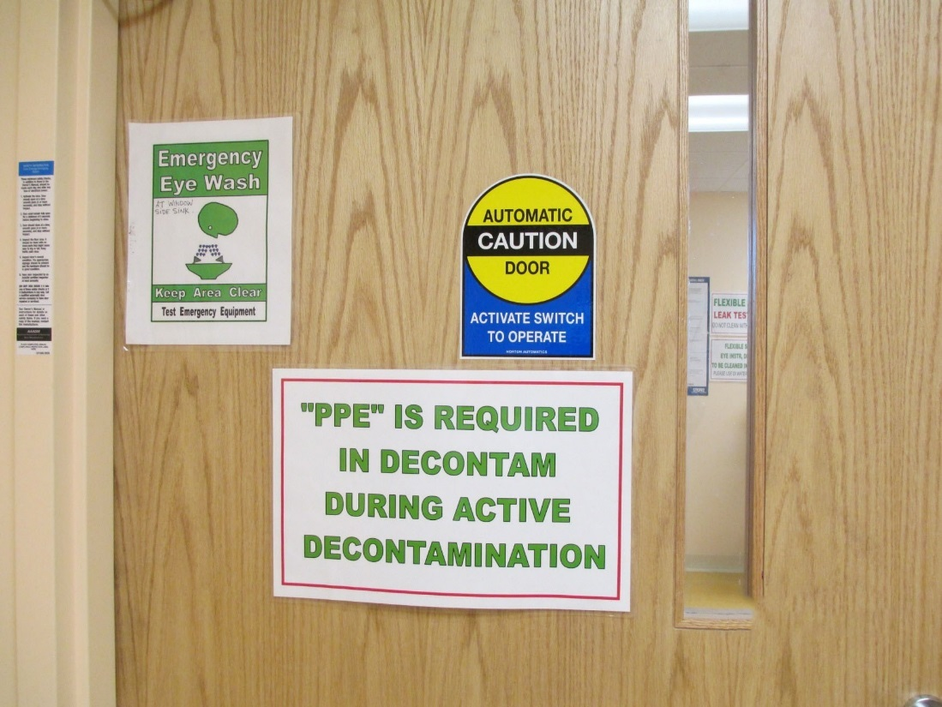
Physical Environment
Traffic Patterns
Notes:
Decontamination areas should be off limits to anyone other than authorized personnel. Anyone entering the area must wear appropriate personal protective attire (PPE) and following department decontamination policies and procedures.
ANSI/AAMI ST79:2017 section 3.2.3 discusses Traffic Control in restricted and unrestricted areas of the SPD.
Resource:
Resource: ST79:2017, 3.2.3., p.15

Slide 12
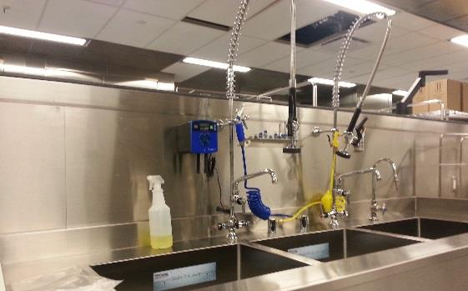
Lighting
Notes:
Good lighting is essential in decontamination areas. Besides excellent general lighting consider lighting over the sink for better identification of soil and cleaning.
Here are three helpful tips about lighting work surfaces:
As people age they need a high amount of illuminance i.e., we need bright light! ☺
When speed is of the essence, more light is needed.
Lighter colors reflect light; darker colors absorb light therefore, the greater the reflectance, the less illuminance is required. That is why we wear light colored clothing in the summer.
Resource:
Table 1-IES-recommended illuminance levels for work environments is on p. 20 of ST79:2017

Slide 13
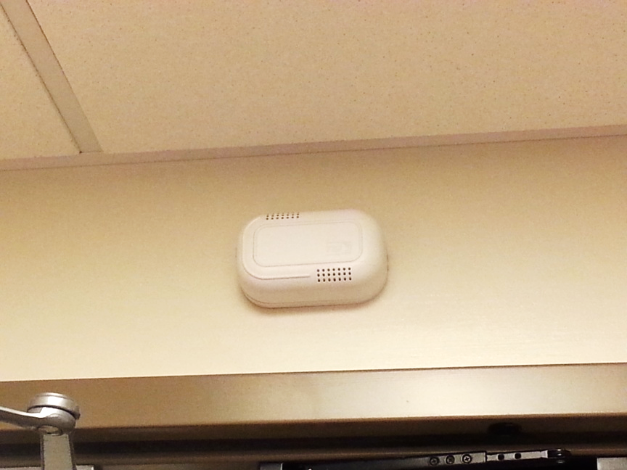
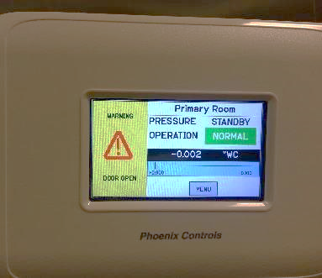
Ventilation
Notes:
ANSI/AAMI ST79:2017, 3.3.5.5 Heating, ventilation, and air conditioning (HVAC) operating parameters
The health care organization should identify which version of ANSI/ASHRAE/ASHE 170 will be used based on when the HVAC system was initially installed or last upgraded. The health care facility should establish and implement systematic processes for monitoring HVAC performance parameters and a mechanism for identifying and resolving variances within the rooms throughout the facility where sterile processing occurs.
Facility engineering personnel or designated responsible personnel should establish policies and procedures for monitoring and maintaining HVAC parameters within the sterile processing areas. Procedures should include maintaining records of monitoring results that are retrievable either from a central system or a local log.
If a variance in the HVAC parameters occurs, sterile processing personnel in combination with a multidisciplinary team (e.g., facility engineer, infection preventionist, risk manager, sterile processing manager or other designated personnel) should conduct a risk assessment. The sterile processing department is defined by ANSI/ASHRAE/ASHE 170 as a critical area.
Note to speaker: See also Annex Q.
Rationale: The effect of the HVAC system parameters falling out of range is variable. A small variance for a short period of time might not be of clinical concern, whereas a large variance for a longer period could have clinical significance. A risk assessment provides necessary information to guide appropriate response measures
Resource: ST79:2017, 3.3.5.5, p. 19

Slide 14
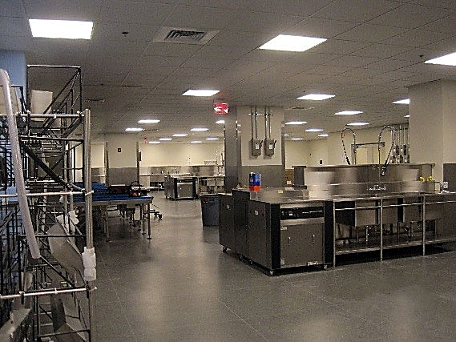
Smooth Surfaces
Floors, walls, ceilings
Work surfaces
Compatible with cleaning chemicals
Notes:
All floors, walls, and the ceiling in sterile processing areas should have smooth surfaces that are capable of frequent cleaning. They must also be compatible with cleaning chemicals typically found in sterile processing areas.

Slide 15
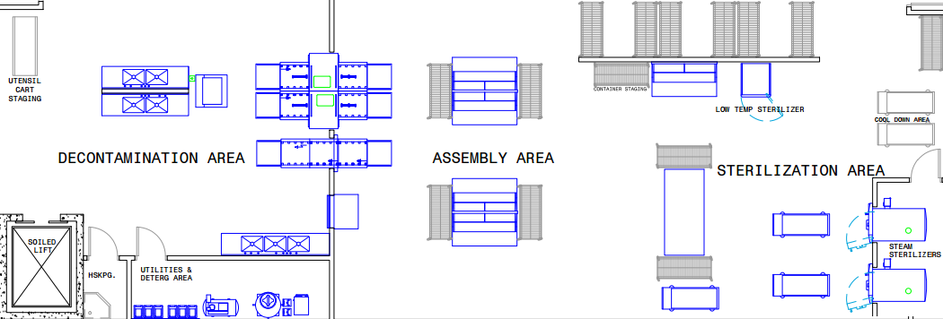
Work Flow
The decontamination area should be physically separated from all other areas of processing department…” (AAMI ST79, 2021)
Notes:
Ideally, the decontamination area should be physically separated from all other areas of the processing department and accessible from a service corridor. In small health care facilities, clinics, and dental/medical offices, it might not be possible to physically separate the decontamination area. In such cases, procedural barrier separation, while not generally desirable, could be adequate, provided that work practices prevent splashing, the production of aerosols, and contamination of clean items and work surfaces, and provided that work practices promote the changing of PPE when personnel leave the decontamination area and enter clean areas. In surgical facilities, the decontamination area should be physically separated from other areas by means of doors, service windows, and/or pass-through equipment.

Slide 16
Employee Safety
PPE
Hand Hygiene
Emergency Eyewash Equipment
Notes:
Note to speaker: The following notes are from slides 19-21 from the full version ppt slide deck (2hour CE)
Slide 19: PPE: Since contaminated instruments are sources of disease producing microorganisms that can invade personnel through skin nicks, cuts or abrasions or through mucus membranes of the eyes, nose, or mouth, all personnel must wear appropriate attire when working in the decontamination area. This employee is properly attired for the decontamination area. All personnel working in the decontamination area should wear clean, facility-provided uniforms that are donned at the facility. Attire should be changed daily, or immediately if it becomes wet, grossly soiled, or visibly contaminated by blood or body fluids. All head and facial hair (except for eyebrows and eyelashes) should be completely covered with a surgical-type hair covering or hood. Neither jewelry nor wristwatches should be worn.
The face mask should protect the employees’ face, including eyes, from splashes, vapors, etc. There are a number of different masks available, which include mask with faceshield, full-length face shield, half-length face shield with facemask, facemask with goggles, etc.
In addition to the attire recommended above, general-purpose utility gloves, a liquid-resistant covering with sleeves (for example, a backless gown, jumpsuit, or surgical gown), a surgical face mask, and eye protection should be worn at all times in the decontamination area.
Slide 20: Hand washing stations must be readily accessible in the decontamination area to encourage good hand washing practices. These stations should be separate from decontamination sinks that are used for cleaning or rinsing instruments and devices being reprocessed. Typically this is located near the door way. Hands-free activated controls are preferred for sinks, paper towels and soap dispensers to minimize cross contamination after the hands have been rinsed. The use of alcohol-based, waterless agents is an effective means of hand decontamination when hands are not visibly soiled.
Slide 21: Chemicals, solutions, body fluids that are splashed into the eye(s) should be considered an emergency.
OSHA regulations state that emergency eyewash/shower equipment should be:
Accessible within 10 seconds and 30 meters or 100 feet from the potential chemical exposure site.
Equipment should be hands free (not a water bottle) with the hot water disabled. When caustic chemicals or strong acids are used in work areas, eye wash stations must be located immediately adjacent to the hazard, tested regularly to ensure it is functioning correctly, and employees should be trained on its use. Maintain routine testing logs.
Procedure: Flushing of the eye(s) should be done for 15 continuous minutes.

Slide 17
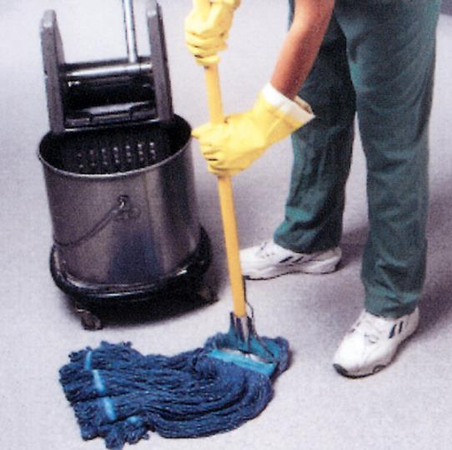
Environmental Service
Daily cleaning/disinfection of floors and horizontal surfaces
Sequence cleaning from clean → dirty
Keep separate cleaning supplies
Notes:
Sterile processing departments must be kept clean to reduce the risk of disease and cross contamination. There should be a daily schedule of cleaning and disinfection of floors and horizontal work surfaces. The sequence of cleaning should be from clean to dirty areas. Ideally, there should be separate cleaning supplies for both decontamination and prep & pack areas.
Any cleaning that takes place in the CS department should start in the clean area and then progress to the dirty area/room.
Hopefully, you will have 2 separate cleaning storage areas, one for the decontamination room and one for the prep and pack and sterile storage area. The cleaning supplies should be kept separate.
EVS should follow the same procedures as those to clean OR and DR
External surfaces of decontamination equipment cleaned at least daily
Floors and work surfaces cleaned daily
Walls, shelves, air ducts cleaned on regular basis
Light fixtures every six months
Keep clean to reduce risk of disease

Slide 18
Decontamination
Cleaning
Disinfection
Sterilization
Multi-step process
1
2
3
Notes:
The term “decontamination” is often used incorrectly and is sometimes confused with cleaning. Decontamination is a multi-step process. It begins with cleaning and then followed by a microbicidal process which can either be a disinfection or sterilization step.
Note to speaker: The following notes are from slide 24 from the full version ppt slide deck:
Cleaning is the first and most important step in the decontamination process. Thorough cleaning can remove much of the bioburden and is an essential contributor to the sterilization process.

Slide 19

Microbicidal Processes
Designed to provide a particular level of lethality (kill)
Depending on the level of decontamination disinfection or sterilization may be used
Notes:
The Microbicidal process is used to provide a particular level of microbial kill. This part of the decontamination process does not refer to the final microbicidal process so that a device can be used on a patient. This microbial process refers to what is done to the instruments after the cleaning process so that employees can handle the instruments without fear of transmission of microbes.

Slide 20
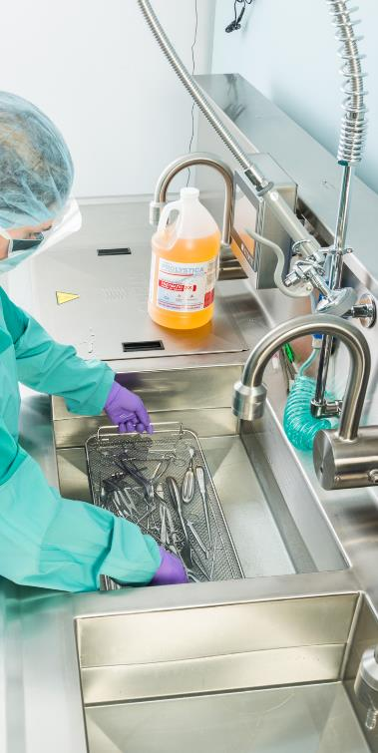
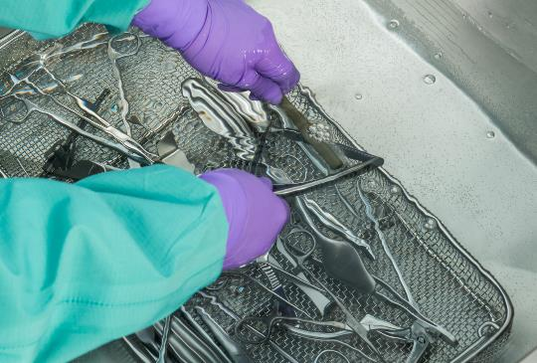
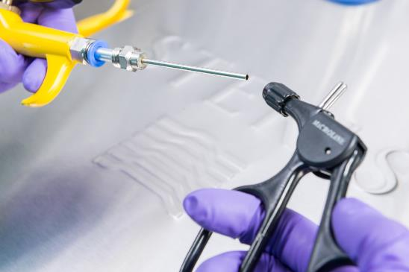
Manual vs. Automated Cleaning
Manual Cleaning
First: soak
Second: wash
Third: rinse/treated water
Notes:
Decontamination areas are too important to contain insufficient or inadequate equipment. Decontamination area sinks should be large enough to contain large utensils and instruments, and there should be enough sinks to accommodate concurrent soaking, washing, and rinsing. Treated water (deionized, distilled or reverse osmosis) should be available for final rinsing.
Note to speaker: The following notes are from slides 27- 35:
27: Decontamination areas are too important to contain insufficient or inadequate equipment. Decontamination area sinks should be large enough to contain large utensils and instruments, and there should be enough sinks to accommodate concurrent soaking, washing, and rinsing. Treated water (deionized, distilled or reverse osmosis) should be available for final rinsing.
28: There are many medical devices that require manual cleaning, such as heat and moisture sensitive devices. Because of this, they do not benefit from thermal disinfection that takes place in automated washer/disinfector equipment. Manual cleaning is not a disinfection process because disinfection requires either a thermal disinfection process, or disinfection products, correct dilution and specified wet surface contact time to achieve disinfection. If disinfection cannot be achieved following cleaning, then staff members must wear gloves in the prep and pack area while handling these items for further processing.
Because manual cleaning does not provide disinfection gloves should be worn when prepping and packing the manual cleaned items for sterilization.
29: Cleaning brushes are an essential tool for successful instrument cleaning and should be available and plentiful. They need to be the correct size and in good working order to prevent damage to the instrument. The device manufacturer should provide recommendations for the cleaning method most appropriate depending on the device’s size, fragility, immersibility, complexity, working parts, sensitivity to the cleaning agents, and other properties. Wire brushes should never be used unless they are specifically designed for cleaning surgical instruments.
30: Mechanical washers are prevalent in decontamination areas and if trays are prepared correctly and the racks loaded properly, they can provide an almost hands-free means to achieve instrument decontamination. It is important to understand how each piece of equipment functions in the decontamination area and what level of cleaning and disinfection are available in each type of equipment. Mechanical cleaning is accomplished with an automated cleaning and rinsing system. An automated washer will cycle through a number of processes, typically beginning with:
A cold water pre-wash cycle (60ºF for approximately 2 minutes);
Followed by an enzyme pre-soak diluted with hot tap water for approximately 4 minutes (enzymes added to this cycle will enhance the cleaning process by helping to loosen and remove soils for the instruments) and a brief rinse;
The primary wash cycle responsible for the majority of the cleaning (a cleaning detergent is used and the temperature ranges between 150-165º F for approximately 2 minutes, but may be extended to meet facility needs);
A second rinse phase (hot tap water for approximately 15 seconds);
A thermal rinse (180ºF for one minute);
And a drying phase (240ºF for approx. 6 min).
An optional final deionized rinse may be available as well as an instrument lubrication cycle.
By using automated washer/disinfectors, staff members benefit from the thermal disinfection during the thermal rinse that renders instruments safe to handle for further processing.
31:Instruments must remain open and/or disassembled during the decontamination process. If instrument trays are too full or if hinged instruments are closed, water and cleaning chemicals will not contact all areas and the cleaning process will be hindered.
32: The racks on the left are properly loaded, while the rack on the right is poorly loaded and organized for processing through an automated washer. The multi-layered set cannot possibly come into contact with water and detergents if the layers are stacked on top of each other. The other tray is overloaded, the hinged instruments are not opened, and the basin on top of the instruments could potentially damage the instruments below it, as well as deflect water and detergents from coming into contact with the tray contents.
33: An effective cleaning process will improve the appearance, function, and life of surgical instruments. In tight budgets, it is critical that the health care facility get as much use out of their instruments as possible. Quality cleaning and disinfecting products will help extend the life of these instruments by removing both organic and inorganic substances without damaging the finish of the instruments. Ensure that only appropriate cleaning chemicals are present in decontamination areas and that each product has an SDS on file in the facility. Products must also be used following manufacturer's instructions for proper use and dilution.
34: Ultrasonic cleaners are great “helper” cleaners in decontamination areas and operate in a similar fashion as a giant jewelry cleaner. They are available in small table top units to large console units. Ultrasonic cleaners work through a process known as cavitation. As sonic energy increases in intensity inside the chamber, tiny bubbles form on the surface of the instruments. These bubbles expand until they become unstable and then collapse or implode. The resulting implosion produces very localized vacuum areas responsible for dislodging soil from surfaces.
Operate with lid closed
Low sudsing detergents only
Instruments open and apart
Thorough rinsing
Change solution when visibly dirty
35:Lubricating surgical instruments during processing is a common practice that may be accomplished as part of an automated process within a washer/disinfector cycle, or it may be accomplished manually by spraying instruments or soaking them in a bath of instrument lubricant, also called “instrument milk” because of it’s milky appearance. Manual lubrication should only take place in the clean processing area to prevent contamination of the lubrication product from aerosolized organisms prevalent in the decontamination area. Lubrication products used should only be water soluble lubricants that contain no oil. Oil-based lubricants can coat bacteria and interfere with sterilant contact and should never be used. Follow manufacturers instructions.

Slide 21
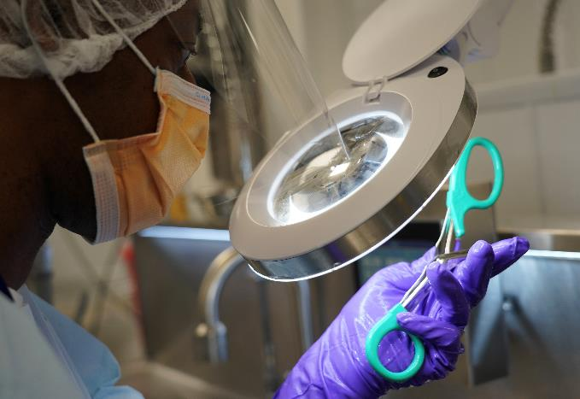

Assembly Area
Instrument Inspection
Clean
Working order
Notes:
The preparation/assembly area is the area of sterile processing where instruments and reusable supply items are inspected for cleanliness and proper working order, and then assembled for packaging. Finding dirty or malfunctioning instruments during a surgical procedure can be disastrous and can pose a serious health risk for the patient, so ensuring that instruments are thoroughly inspected and tested during the assembly process is paramount. Lighted magnifying glasses at work stations are essential for detailed inspection, especially for micro surgical instruments.
Note to speaker: The following notes are from slide 37 of the full version ppt slide deck (2hour CE):
When assembling instrument trays, count sheets or inventory lists should be used to ensure that all set/tray components are accounted for. Count sheets are also used in the OR for pre-OP and post-OP instrument counts; therefore they must be included with the instrument tray, however, there is much controversy over placing the count sheet inside trays due to the potential harmful effect of toxic ink from the print on the count sheets. Since no scientific evidence is available to support whether placing a count sheet in a tray is harmful or not, each facility must set their own policy on how to address this issue. AORN 2016 Guidelines for Perioperative Practice, Recommendation IV. D., p. 390
Tray liners, whether reusable or disposable can be very helpful in wicking moisture during the sterilization process and will aid drying. Tray liners should be absorbent, and should be lint-free. Disposable tray liners should be designed for this purpose and used following manufacturer’s instructions. Before using tray liners inside rigid containers, consult the container manufacturer for tray liner use guidance.
Accessories such as silicone mats and tip protectors can be useful in providing protection to delicate instruments during sterilization. Tip protectors must be manufactured for use as tip protectors and not fashioned from tubing or other materials available in the department. The use of paper/plastic peel pouches inside instrument sets should be eliminated due to the challenge for sterilant penetration and because they can contribute to wet pack occurrences.
All set contents should be evenly distributed and weight limits should be closely monitored to limit the maximum weight to between 16-17 pounds per tray, and not to exceed 25 pounds. Be cautious of disposable single-use devices and supply items that may be routinely reprocessed for patient use. This poses a liability issue for the facility.

Slide 22

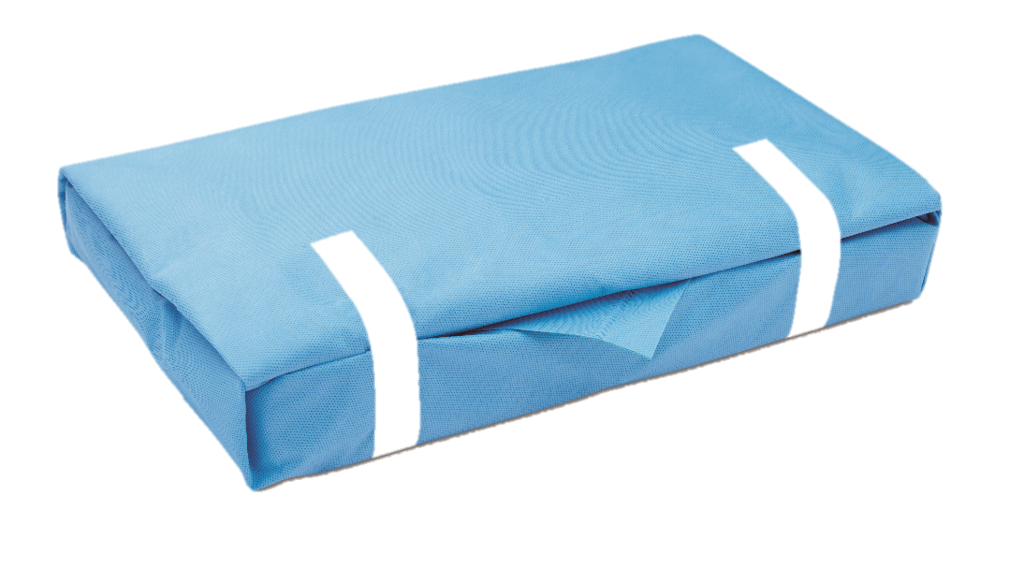
Packaging
Peel pouches
Sterilization wrap
Rigid sterilization containers
Notes:
Packaging for any item that is being sterilized must serve a number of purposes. Packaging must protect items and ensure maintenance of sterility during sterilization and subsequent handling.
There are three types of packaging commonly used for items to be sterilized. Peel pouches, sterilization wrap (muslin, non-woven disposable, and other woven wrap materials), and rigid sterilization containers. The type of packaging to be used is dependent on the individual item/set being packaged.
Note to speaker the following notes are from slides 39-43 from the full version of the ppt slide deck (2 hour CE):
39: Peel pouches are designed for packaging single instrument or a small number of instruments. The contents of a peel pouch should be light weight to prevent package damage and subsequent compromise in sterility maintenance. Peel pouches allow visibility of package contents and are available in a variety of sizes. Peel pouches are also available in a variety of materials appropriate for the type of sterilization being used. Paper/plastic peel pouches are appropriate for both steam sterilization and ethylene oxide sterilization, while tyvek/plastic is appropriate for hydrogen peroxide gas plasma and ethylene oxide sterilization. For ozone sterilization, a mylar/plastic pouch is appropriate.
40: Peel pouches may be self-seal adhesive type pouches, may require heat sealing, or may be sealed with sterilization tape, although the latter would not be the preferred method of sealing a peel pouch. All seals must be smooth and absent of wrinkles that can allow microbial migration into the pouch through the wrinkles.
Double pouching may be necessary for instruments that are a little heavier than others or when multiple instruments are packaged together. When double pouching is necessary, the inner pouch must be smaller than the outer pouch and the inner pouch should not be folded over onto itself.
When labeling peel pouches, written labels must be on the plastic side of the pouch and not the paper or Tyvek side to prevent a pathway for microorganisms through the ink.
41: The use of sterilization wrap for packaging instrument sets and other medical devices is a common packaging method that has been used for many, many years. Sterilization wrap can be either woven muslin or other types of reusable fabric wrap, or non-woven disposable sterilization wrap. Non-woven wrap may consist of single layer wrap that requires two layers of wrap sequentially wrapped, or a two-layer bonded wrap that provides a one-step simultaneous wrap method. Remember when labeling, write on instrument tape or label, never on packaging material.
42: Rigid sterilization containers have been available in the U.S. market since the late 1970s, providing a durable packaging alternative to peel pouches and sterilization wrap. Containers are constructed of a variety of materials such as anodized aluminum and plastic composite materials. It is important that the container manufacturer’s instructions for care and use be followed to prevent damaging the container surfaces. Cleaning chemicals used to clean containers should be carefully scrutinized to ensure that they are compatible with the container materials.
Rigid sterilization containers also function in a variety of ways. Some container systems have reusable and/or disposable filters, some are filter less and contain valve mechanisms, but all have gaskets that assist in maintaining a secure fit between the container bottom and lid.
43: Rigid sterilization containers are not without their challenges and may crack or dent with improper handling. Filter and valve mechanisms may also become damaged if not maintained properly, and each must be cleaned after each use.
All container systems have weight restrictions based on the container size. Manufacturer’s instructions for the maximum weight for each container size should be followed, along with guidance on stacking containers during sterilization, and post-sterilization shelf life.

Slide 23
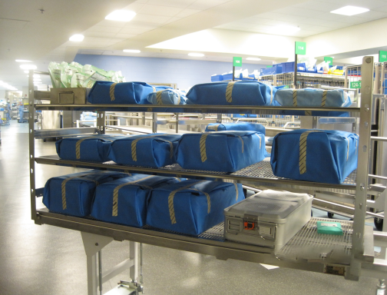
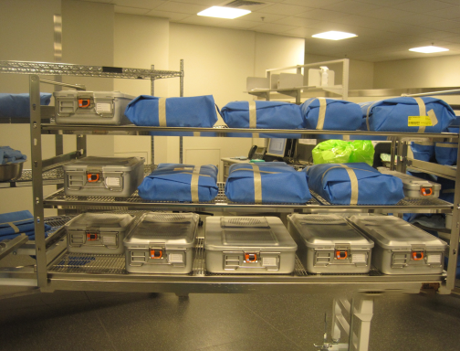
Loading the Sterilizer Cart
Do not overload
Basins positioned for drainage
Packages should never contact sterilizer chamber walls
Notes:
Sterilization shelves should never be overloaded. Overloading can prevent steam penetration and air circulation, and may result in unsuccessful sterilization or wet packs. Basins should be positioned on sterilization carts in a manner that promotes drainage. The upper picture demonstrates good loading technique for basin sets. You will notice that the sterilization tape is being used as a landmark for proper cart placement. The diagram on the bottom demonstrates how moisture can be retained in an improperly positioned basin set like the one on the left, and the basin set on the right shows how the basin set components will easily allow excess moisture to drain due to proper placement.

Slide 24
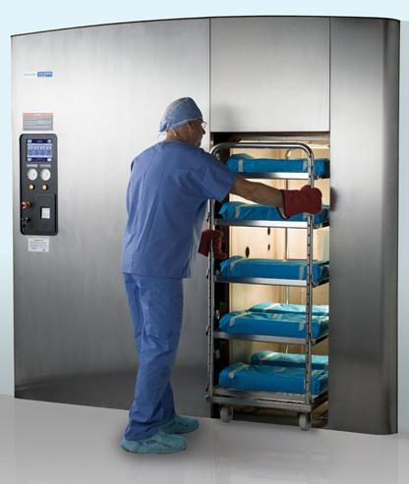
Sterilization
Testing requirements
Monitoring practices
Record keeping practices
Failure investigation
Extended cycles
Notes:
Sterilization is undoubtedly the most intimidating area; however, it is a critical area and if a suspected sterilization failure occurs in your facility, you must be intimately aware of the work practices in your facility in order to assist in the investigation process.
Become familiar with the routine testing requirements for sterilizers and the sterilization monitoring practices that take place in the sterile processing area. Ensure that you understand how records are kept and where they are located. It’s also a good idea to set up routine, unscheduled surveys of the area to review sterilization records. This is not only a good exercise for you, but it keeps sterile processing personnel on their toes.
It is also important to note that two of the most frustrating issues for sterile processing departments at this time are the variety of sterilization cycles required for specialty medical devices and complex trays of surgical instruments, especially orthopedic loaner instruments used in total joint replacement procedures. Many times these cycles are longer than traditional sterilization cycles of four minutes and are also referred to as extended cycles. Currently, there are no FDA cleared sterilization monitoring devices for these types of cycle and some existing monitoring products may be adversely affected by these longer cycles.
Due to the length of this presentation, only steam sterilization will be discussed in this section.

Slide 25
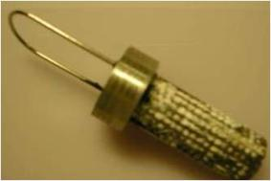
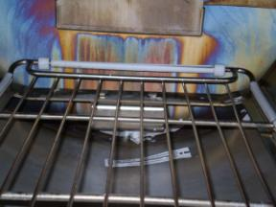
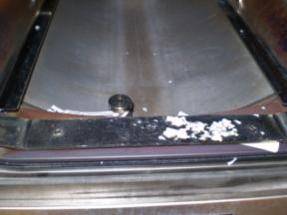
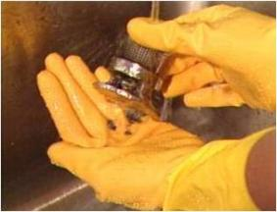
Equipment Monitoring
Routine maintenance
Preventative/breakdown maintenance
Maintenance records
Notes:
It’s important to have a clear understanding of how steam sterilization equipment is being cared for in sterile processing. Is preventive maintenance carried out following the equipment manufacturer’s guidance or is breakdown maintenance the only maintenance being performed? Where are service records kept and who are the service providers? Are they the original equipment manufacturer, another manufacturer, a third party service provider, or are they maintained in-house through the biomedical engineering department?
Are sterile processing personnel conducting routine maintenance of sterilization equipment such as cleaning the chamber? Is the drain strainer checked on a daily basis for debris? Is the door gasket inspected for tears and general wear? Are external surfaces of sterilizers free of dust?
These pictures demonstrate what can happen if a sterilizer drain strainer is not routinely cleaned. The picture above is completely clogged with paper chemical indicators that caused the sterilizer to malfunction. A simple daily inspection and cleaning as needed can prevent malfunctions of this type.

Slide 26
Routine Monitoring
Bowie-Dick air removal test
Prevacuum cycles
Biological testing
Other testing
Following installation, relocation or major repairs
Notes:
Routine monitoring using a Bowie Dick or Dynamic Air Removal Test should be performed every day before the first cycle of the day on ALL the prevacuum cycles on all the sterilizers in the hospital – CS and OR. Since there are so many commercially prepared Bowie Dick tests on the market today, most hospitals prefer using them. The routine monitoring of the sterilization equipment should also include biological testing. The microbial testing or BI test should be performed at least weekly but daily testing is preferred. Again, each sterilization cycle type must be routinely tested and each sterilization temperature used in each cycle type must also be routinely tested.
Give example: 250 degrees F in gravity and 270 degrees F in gravity must be tested separately.
Every day that a BI is processed, a control, from the same lot as the test BIs needs to be incubated according to the manufacturer’s instructions. This control BI should show a color change, which verifies that the test spores were alive and well and ready to be killed, that the media is still good and will promote growth of the spores, and it also verifies that the proper incubation temperature was used. Each sterilization cycle type that is used whether in CPD or the OR must by tested and the test cycle must be negative for spore growth.
In sterile processing the routine biological testing is performed in a loaded chamber using a BI test pack. A commercially available BI product is preferred; however, if an in-house test pack is used, it must be constructed following AAMI recommended practice guidelines. Test pack placement in the load should be in the most difficult area of a sterilizer that presents the greatest challenge, which is usually on the lowest shelf of the sterilizer rack, and directly over the drain; however, the sterilizer manufacturer must be consulted to determine this location. A chemical indicator or integrator should be included in the BI Challenge Pack.
Testing using both Bowie-Dick tests and BI tests are necessary following installation, sterilizer relocation, or after a major repair. In these circumstances three consecutive BI tests would need to be performed, followed by three consecutive Bowie-Dick tests.

Slide 27
Chemical Indicators
Six types
Three categories
Exposure
Special applications
Internal
FDA recognizes only Types 1, 2 and 6
Each Type has different performance specifications
Notes:
There are currently six Types of chemical indicators recognized by ISO and AAMI; however only Types 1, 2 and 6 are recognized by the FDA. A manufacturer can submit test data to the FDA that demonstrates performance of a Class 3, 4, or 5 and achieve clearance as an indicator, but it will not be recognized by the FDA as a Class 3, 4, or 5.

Slide 28
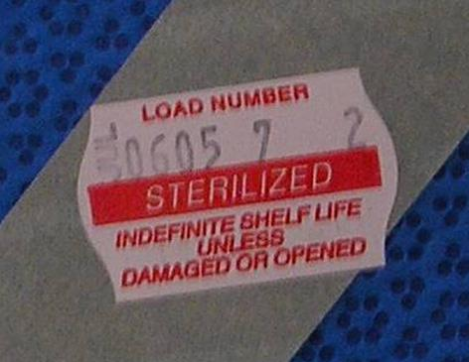
Process Control
Lot control label
Notes:
Process control is another important step in the sterilization loop. Process control labels allow us to place a lot-type tracker on all processed items. Process control labels contain the sterilizer identification number, sterilization date, sterilizer cycle number, and expiration date if applicable.
Note to speaker: The following notes are from slide 68 from the full version of the ppt slide deck (2 hour CE):
Documentation for each sterilization cycle should include: lot number, load contents, the duration and temperature of the exposure phase of the cycle, initials of sterilizer operator, the date and time of the cycle, the results of the chemical indicator/integrator, and results of the BI if applicable.
Daily Bowie-Dick test results must also be maintained. Sterilization records should also reflect any reports of inconclusive or nonresponsive chemical indicators found in the load. It is extremely important to maintain full traceability of sterilized items to each patient.

Slide 29
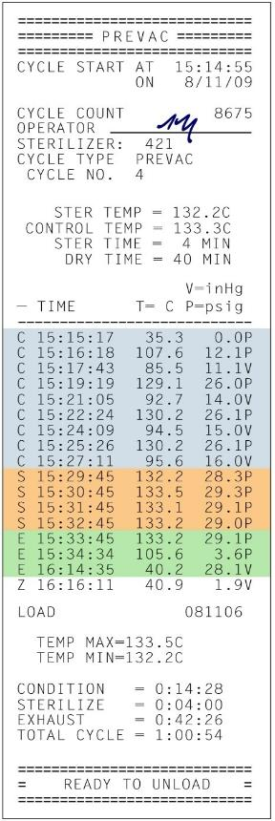
Load Release (Non-Implant Loads)
At the end of the cycle:
Review cycle print out tape
Review external chemical indicator
Notes:
It is important to understand what should take place following each sterilization cycle because there are a series of steps that contribute to the quality control process. For loads that do not contain implants, at the end of each sterilization cycle:
The sterilizer cycle print out tape must be reviewed for cycle selection, cycle completion, and the absence of cautions or warnings. The print out tape should also be initialed by the tape reviewer.
All external chemical indicators should be reviewed for proper color change. This may include sterilization tape or indicators on data cards, etc.
Any internal chemical indicators that can be viewed inside peel pouches should also be reviewed for proper color change.
The results from any other sterility assurance monitors used should also be reviewed and interpreted.
Note to speaker: The following notes are from slide 66 from the full version of the ppt slide deck (2 hour CE): For loads that do contain implants, at the end of each sterilization cycle:
The sterilizer cycle print out tape must be reviewed for cycle selection, cycle completion, and the absence of cautions or warnings. The print out tape should also be initialed by the tape reviewer.
All external chemical indicators should be reviewed for proper color change. This may include sterilization tape or indicators on data cards, etc.
Any internal chemical indicators that can be viewed inside peel pouches should also be reviewed for proper color change.
The results of enzyme-based early readout BI products and the results from any other sterility assurance monitors used should be reviewed and interpreted.

Slide 30
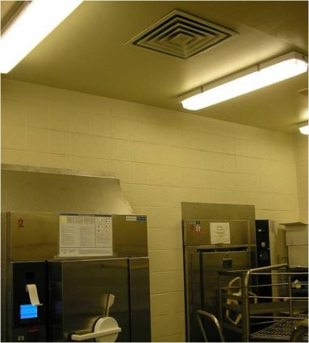
Post Sterilization
Place loading carts
Low traffic areas
Handle when completely cool
Inspect package integrity
Notes:
Following steam sterilization cycles, loads should be removed from the sterilizer and placed in a low traffic area away from air conditioning vents. Load contents should not be handled until items are completely cooled and prior to distributing, all packages should be inspected for package integrity.

Slide 31
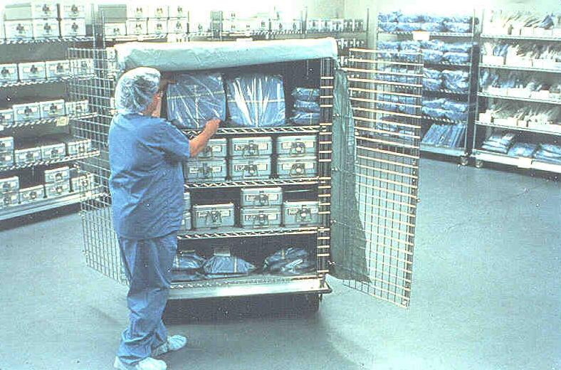
Handling and Distribution
Transport sterile/clean in controlled environments
Notes:
Handling and distribution activities can also expose sterile supplies to the potential for contamination; therefore, they should be transported in controlled environments in carts with solid bottom shelves, in carts with covers, or in totes with lids. Carts and cart covers should be decontaminated between uses. Items should also be positioned to prevent package damage during handling. All unused packages should be inspected for package integrity prior to returning to inventory.
Note to speaker: The following notes are from slide 70 from the full version of the ppt slide deck (2 hour CE):
Sterile storage areas also should not be taken lightly, especially since supplies are stored in many areas throughout the facility.
Sterile items should always be stored in a secure manner.
Temperature and humidity levels should always be controlled in sterile storage areas. The maximum temperature should not exceed 75ºF, and the humidity should not exceed 70%.
Traffic must be controlled to sterile storage areas.
Storage structures may include closed cabinets, or open shelving as long as the bottom shelf is solid or contains a shelf liner.
Sterile supplies should not be stored in a manner that caused items to be crushed or compressed. Compressing or crushing packages can compromise sterility.
The picture of the left represents poor work practices and may have compromised the sterility of the packages in the picture.
Pack placement of storage shelves:
8 to 10 inches from the floor
18 inches from the ceiling

Slide 32

Product Recalls
In the event of a recall:
Recall all items from affected loads
Reprocess all items
Clear, written policies and procedures
Notes:
Unfortunately, real or suspected sterilization failures do happen due to equipment failure or human error. Because of this a product recall may be necessary. To ensure that product recalls are handled properly, clear, written policies and procedures must be in place to address this type of issue because in the case of a real or suspected sterilization failure, a quick, thorough response in a timely manner is essential. Policies and procedures should:
Ensure a smooth process for item retrieval
Address the process for Physician notification and patient surveillance
Provide a clear understanding of follow up actions
A process to insure that the failure is thoroughly investigated
And a follow up or summary report must be completed for each incident

Slide 33
Action Items
Survey sterile processing departments routinely
Standards compliance
Industry recommended practice compliance
Approach systematically
Collaboration between departments
Notes:
There is certainly a lot involved in sterile processing in health care facilities and these activities must be carefully watched over.
Make a concerted effort to routinely survey sterile processing departments and all sterile processing activities facility-wide for standards compliance and industry recommend practice compliance.
Surveys should never be a burden and won’t be if approached in a systematic manner.
Partner with sterile processing so that your relationship with CS is as smooth as a dance. View yourself as an advocate of their efforts in promoting safe work practices and contributing to positive patient outcomes.

Slide 34
References
American National Standard Institute/Association for the Advancement of Medical Instrumentation (2018). ANSI/AAMI ST77:2013/(R)2018 Containment devices for reusable medical device sterilization. Arlington, VA: Author.
American National Standard Institute/Association for the Advancement of Medical Instrumentation (2021). ANSI/AAMI ST79:2017 & 2020 Amendments A1, A2, A3, A4 (Consolidated Text) Comprehensive guide to steam sterilization and sterility assurance in health care facilities. Arlington, VA: Author.
American National Standards Institute/International Safety Equipment Association (2014). ANSI/ISEA Z358.1-2014: American national standard for emergency eyewash & shower equipment. Arlington, VA: International Safety Equipment Association.
American National Standard Institute/Association for the Advancement of Medical Instrumentation (2014). ANSI/AAMI/ISO 11140-1:2014: Sterilization of health care products – chemical indicators – part 1 general requirements. Arlington, VA: Author

Slide 35
References
Center for Disease Control and Prevention (2019). Guideline for disinfection and sterilization in healthcare facilities. Retrieved from https://www.cdc.gov/infectioncontrol/pdf/guidelines/disinfection-guidelines-H.pdf
International Association of Healthcare Central Service Materiel Management (2016). Central Service Technical Manual (8th ed.). Chicago, IL: Author.
Ninomura, P., Rousseau, C., & Bartley, J. (2006). Updated guidelines for design and construction of hospital and health care facilities. ASHRAE, 48, pp. 33-37. Retrieved from: http://www.ashrae.org/File%20Library/docLib/Public/20091215_ashraed2830220060711.pdf
Occupational Safety and Health Administration. (n. d.). Medical services and first aid. Retrieved from: https://www.osha.gov/pls/oshaweb/owadisp.show_document?p_table=STANDARDS&p_id=9806

Slide 36
References
Occupational Safety and Health Administration. (n. d.). Blood born pathogens. Retrieved from: https://www.osha.gov/pls/oshaweb/owadisp.show_document?p_table=STANDARDS&p_id=10051
Perkins, John J. (1983) Principles and Methods of Sterilization in Health Sciences, Second Edition, eighth printing, p. 246-248.
STERIS Corporation. (2007). Preparing instruments, utensils, and textiles for sterilization and wet pack problem solving guide. Retrieved from: http://rwjms.rutgers.edu/research/core_facilities/ses/documents/WetPackPromlems.pdf

Slide 39

Obtain Your Certificate
Thank you for attending this CE activity
Scan the QR code with your smartphone’s camera
Enter the Course Code 7579
Complete the acknowledgement, provide feedback, and download your certificate
Notes:
DESIGNER NOTE:
This slide is only required for Instructor led programs.

Slide 40
Revision History
Date | Revisions | Revised By: | Notes
2/12/2018 | Speaker notes updated to reflect changes in ST79:2017: s7, and 10. Slide 12 “Controlled Environment” deleted. Slide 11: Speaker notes updated to reflect ST79:2017 recommendation for HVAC operating parameters. ST79 Reference updated to 2017 edition, Slide 32. | S. Beauclair
06/07/18 | Updated the CE slide and added Disclaimer slide | S. Beuaclair
11/11/19 | Added new accreditations for BASC Removed page numbers | H. Ames
11/28/2022 | Updated format to current template. Confirmed references to latest additions. | H. Ames | None

