Slide 1

Highly Pathogenic Avian Influenza: Influenza A (H5N1)
2024 Annual APIC-WV
September 19-20, 2024

Slide 2
About Highly Pathogenic Avian Influenza
Background
Endemic in wild waterfowl and may infect domestic poultry or other birds.
“Highly pathogenic” refers to the virus’ ability to cause high morbidity and mortality in infected poultry.
How is it transmitted?
Infected birds shed the virus in their saliva, mucous and feces.
Other animals become infected through direct contact with infected birds or virus contaminated environments.
Human infections may occur if virus gets into a person’s eyes, nose, mouth or is inhaled during:
- direct contact with infected birds or virus contaminated environments or
- contact with an infected intermediate host.
Notes:
Avian influenza is caused by influenza Type A virus (influenza A). Avian-origin influenza viruses are broadly categorized based on a combination of two groups of proteins on the surface of the influenza A virus: hemagglutinin or “H” proteins, of which there are 16 (H1–H16), and neuraminidase or “N” proteins, of which there are 9 (N1–N9). Many different combinations of “H” and “N” proteins are possible. Each combination is considered a different subtype, and related viruses within a subtype may be referred to as a lineage. Avian influenza viruses are classified as either “low pathogenic” or “highly pathogenic” based on their genetic features and the severity of the disease they cause in poultry. Most viruses are of low pathogenicity, meaning they cause no signs or only minor clinical signs of infection in poultry.

Slide 3
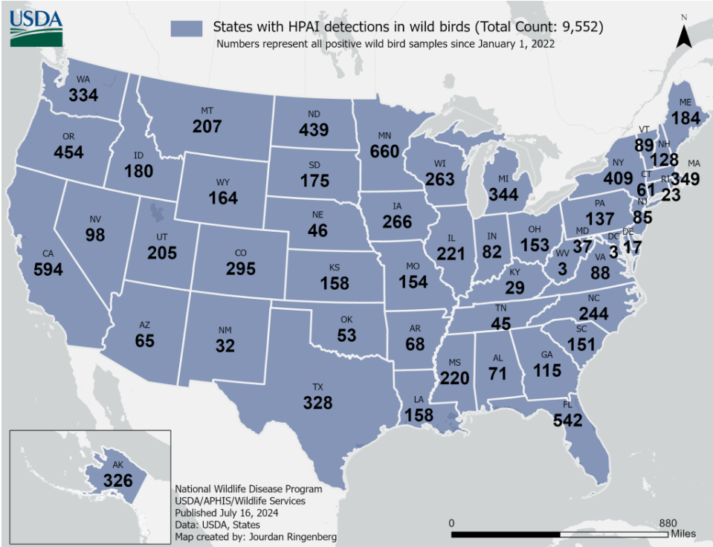
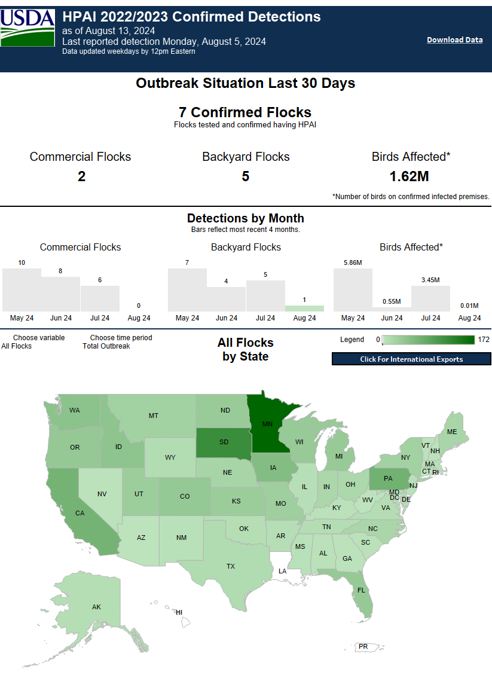
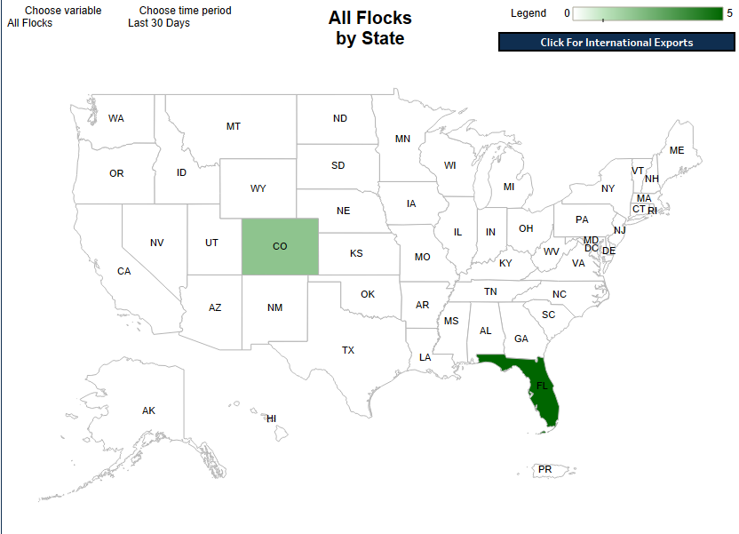
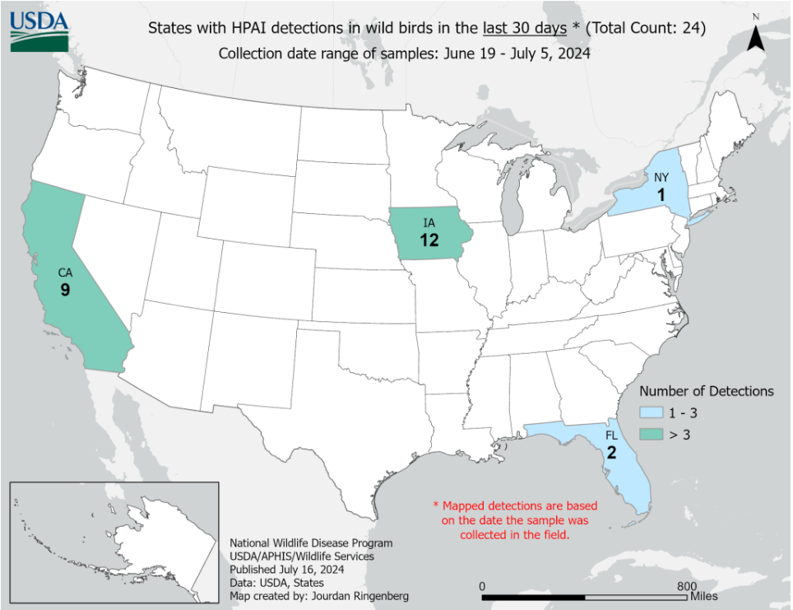
Impacts on Wild Birds and Poultry
Notes:
APHIS confirmed highly pathogenic avian influenza (HPAI) in a commercial flock in the United States on February 8, 2022. HPAI has led to the death and mass slaughter of over 557 million poultry worldwide between 2005 and 2023, with an unprecedented peak of 141 million in 2022. During this peak in 2022, more than 85 countries and territories in the world were affected with HPAI.

Slide 4
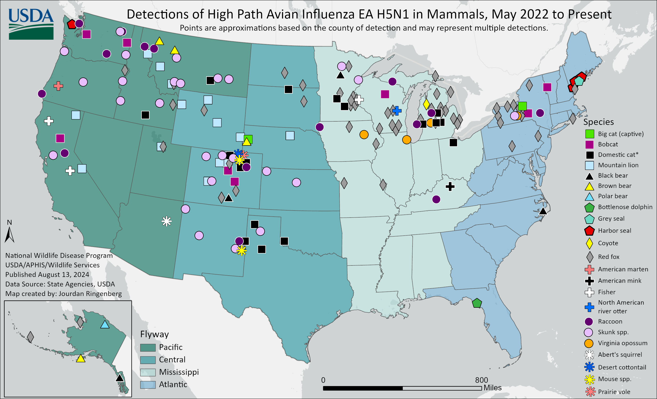
Influenza A(H5N1) in Mammals
While uncommon, HPAI A(H5N1) can infect mammals through eating infected birds or exposure to virus-contaminated environments.
The USDA has identified more than 200 mammals confirmed to be infected with HPAI A(H5N1) since 2022.
Most recently, HPAI A(H5N1) has been found in goats and cattle.

Slide 5
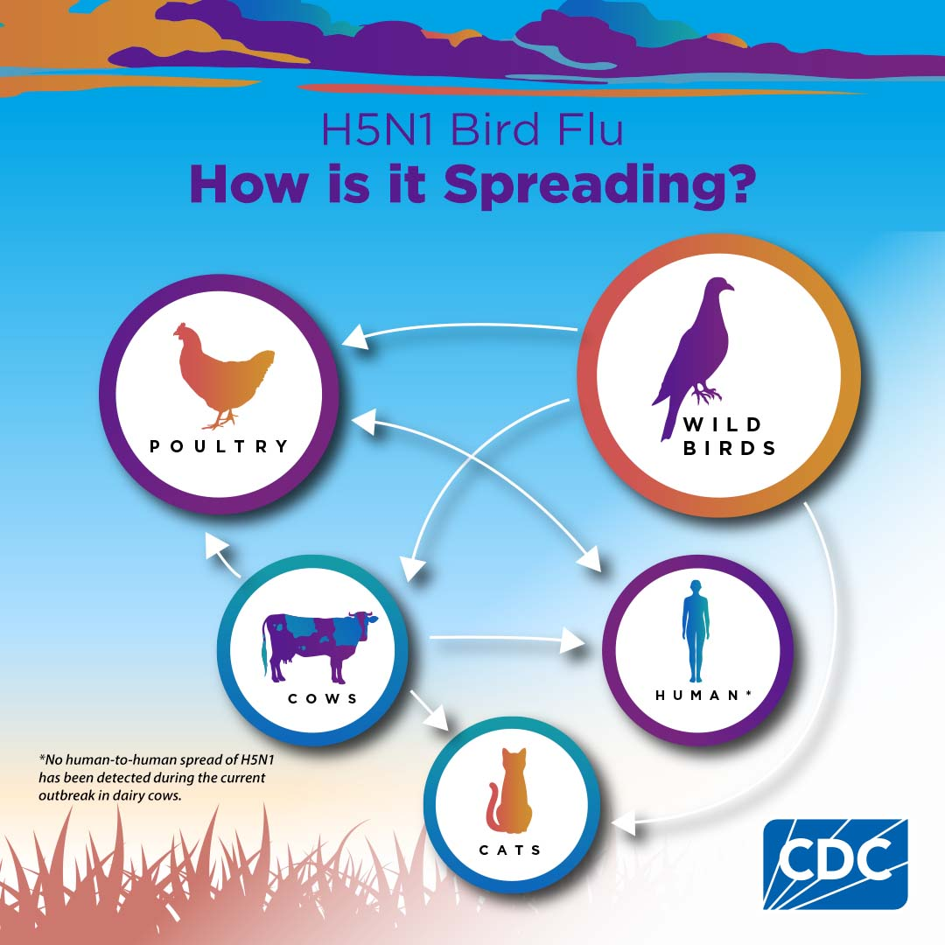
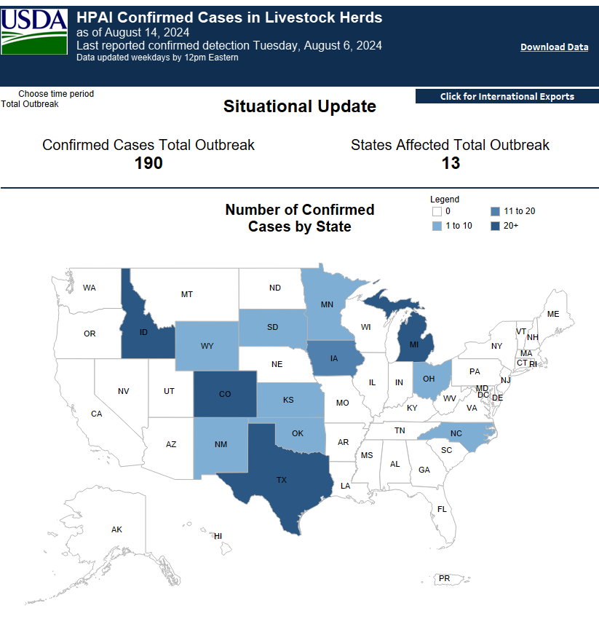
Influenza A(H5N1) in Dairy Cattle
A multi-state outbreak in dairy cows identified on March 25, 2024.
Four dairy farm workers infected.
Cats infected after consuming raw milk.
Notes:
SIUTATION SUMMARY
A multistate outbreak of influenza A(H5N1) in dairy cows was first reported on March 25, 2024. This is the first time that these bird flu viruses had been found in cows. As of June 4th 79 affected dairy cattle herds across nine states have been detected. On April 1, CDC confirmed one human HPAI A(H5N1) infection in a person with exposure to dairy cows in Texas that were presumed to be infected with the virus. This is thought to be the first instance of likely mammal to human spread of HPAI A(H5N1) virus. In May 2024, CDC began reporting additional, sporadic human cases in people who had exposure to infected dairy cows. Findings in Texas suggest that H5N1 was introduced by wild birds and then spread between cows in the same herd, between herds, from herds to neighboring poultry premises and from infected cows to people. Still genetic analysis has not found changes that would make the virus from dairy cattle more transmissible to people. State and local health departments monitor people exposed to infected cattle for 10 days after their last exposure. Between March 2024 and now, there have been 390 people monitored, 44 people tested for novel influenza A, and Three cases of avian influenza A(H5N1) identified. In 2024, three human cases of influenza A(H5N1) virus infection have been reported by two states (Texas, Michigan) following exposure to dairy cattle. This is thought to be the first instance of likely mammal to human spread of HPAI A(H5N1) virus. A total of four human cases have been reported in the United States ever, with the first case occurring in 2022, following exposure to presumably infected poultry. The patients reported eye redness and discomfort, consistent with conjunctivitis, as their only symptoms and have recovered. Only one case reported respiratory symptoms having a cough without fever.
The first human case of A(H5N1) bird flu linked to an outbreak in dairy cows in the United States was reported on April 1, 2024, in Texas. It was also likely the first human infection with A(H5N1) from a cow globally. A second human case associated with the dairy cow outbreak was identified in Michigan on May 22, 2024. A third human case associated with the dairy cow outbreak was identified in Michigan on May 30, 2024. None of these three cases are associated with the others. These cases were actually the second, third, and fourth human cases of A(H5N1) ever reported in the United States. The first human case of A(H5N1) bird flu in the United States was reported on April 28, 2022 in a person in Colorado who had direct exposure to poultry and who was involved in depopulating poultry with presumptive A(H5N1) bird flu. The 2022 human case was not related to dairy cattle. The person only reported fatigue without any other symptoms and recovered.
https://www.cdc.gov/mmwr/volumes/73/wr/mm7321e1.htm
Tests indicate that the virus detected in dairy cows is H5N1, Eurasian lineage goose/ Guangdong clade 2.3.4.4b and has not found changes that would make the virus more transmissible to humans.

Slide 6
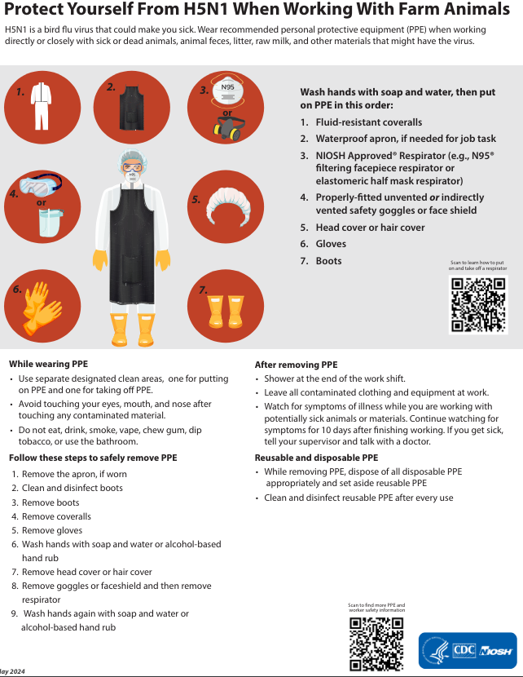
Personal Protective Equipment (PPE)
Workers should be able to demonstrate an understanding of PPE.
Workers who have direct or close contact with animals or materials, including raw milk that are potentially infected should wear appropriate PPE
Employers should take action to conduct a risk assessment of the farm and select engineering and administrative controls to address hazards on the property.
Notes:
Workers on the farm should be able to demonstrate an understanding when to use PPE, what PPE is necessary, what it looks like when PPE is properly fitted, how to properly disinfect resusable PPE, and how to dispose of damaged or single use PPE.
Workers who have direct or close contact with animals or materials, including raw milk, that are infected or contaminated or potentially infected or contaminated with HPAI A(H5N1) virus, should wear appropriate PPE.
Employers should conduct a site-specific risk assessment and select the engineering and administrative controls and personal protective equipment (PPE) that best address the hazards present.

Slide 7
The Food Supply is Safe!
Pasteurization inactivates the influenza A(H5N1) virus.
Analysis of retail beef samples did not find influenza A(H5N1) viral particles.
Cooking ground beef to FSIS recommended temperatures inactivates the influenza A(H5N1) virus.
Retail sampling studies has confirmed that dairy products tested were negative for viable for influenza A(H5N1) virus.
These studies provide strong assurances that pasteurized retail dairy products are safe.
Notes:
FOOD SUPPLY
The United States food supply is considered to be safe. Studies by FDA and USDA’s Food Safety and Inspection Service (FSIS), have shown that pasteurization is effective at inactivating H5N1 and beef muscle sampling of cull dairy cows condemned to slaughter showed no viral particles were detected in 108 out of 109 muscle samples. Additionally, the ground beef cooking study showed FSIS recommended cooking temperatures are effective in inactivating H5N1 virus. Even cooking burgers to 120 (rare) degrees, which is well below the recommended temperature, substantially inactivated the virus. Samples collected from retail outlets in states where dairy cattle herds had tested positive for H5N1 influenza virus were analyzed and found no virus particles to be present.
https://www.aphis.usda.gov/livestock-poultry-disease/avian/avian-influenza/hpai-detections/livestock/h5n1-beef-safety-studies

Slide 8
Timeline
HPAI A(H5N1) ancestors emerge
China
1997
First human case
Spain
Sept 2022
Multi-state outbreak in dairy cows
United States
Mar 25, 2024
First commercial poultry outbreak
Indiana, US
Feb 9, 2022
First human case
Ecuador
Jan 2023
Poultry outbreaks
United States
Dec 11, 2014
First human case
United Kingdom
Jan 2022
First human case
Vietnam
Oct 2022
May 2024
United States
3rd and 4th case
Mammal mortality
Polar regions
Dec 2023
Reassortment
2020
Mammals
United States
May 2022
Feb 2022
Peru
Sea Lions
2021
Netherlands & Estonia
wild foxes
Oct 2022
Spain
Mink Farm
Outbreak
Feb 2023
Cambodia
First and Second human case
Apr 1, 2024
United States
2nd case
2003
Reassortment &
Reemergence
Apr 28, 2022
Colorado, US
First human case
July 2024
United States
10 cases
Nov 2022
China
First human case (mortality)
Jan 13, 2022
United States
wild birds
Notes:
Avian influenza viruses are endemic in wild birds and it is not uncommon to detect these viruses in wild waterfowl, as the viruses circulate freely without causing illness. During 2020, highly pathogenic avian influenza (HPAI) A(H5N1) clade 2.3.4.4b viruses arose from previously circulating influenza A(H5Nx) viruses and spread predominantly via migratory birds to many parts of Africa, Asia and Europe. The epizootic has led to unprecedented numbers of deaths in wild birds and caused outbreaks in domestic poultry. In late 2021, these viruses were introduced to North America.
Since 1997, over 900 sporadic human cases of HPAI A(H5N1) have been reported in 23 countries, with more than half of these cases resulting in death. However, human cases have decreased substantially since 2015, and only a small number of sporadic human cases have been reported worldwide since 2022. It’s important to note that the contemporary H5N1 virus detected in the United States since 2022 are different from these earlier A(H5N1) viruses that emerged in 1997.
GLOBAL
While rare, mammals can be infected with highly pathogenic avian influenza (HPAI) A(H5N1) (“H5N1 bird flu”) viruses. Reports of these sporadic infections in mammals have occurred globally amid widespread outbreaks of bird flu infections in wild birds and poultry. Mammals can be infected with H5N1 bird flu viruses when they eat infected birds, poultry, or other animals and/or if they are exposed to environments contaminated with virus.
Additionally, globally, there have been increased detections of A(H5N1) viruses in non-avian species including wild and domestic (including companion and farmed) terrestrial and marine mammals and, more recently in goats and dairy cattle in the United States of America. Of the avian influenza viruses genetically characterized since 2020, a majority of A(H5N1) belong to the 2.3.4.4b clade. Since the beginning of 2021, 30 detections of A(H5N1) in humans have been reported to WHO, including three cases who had exposure to dairy cattle presumed to be infected with A(H5N1) virus. Of these human cases, where the haemagglutinin (HA) H5 clade is known, 13 have been caused by clade 2.3.4.4b viruses.
Sporadic influenza A(H5N1) virus infections in mammals have been reported across the continents of Asia, North America, South America, and Europe. Specifically, recent HPAI A(H5N1) infections in mammals have been detected in sea lions in Peru and Chile, sea elephants in Argentina, and foxes in Canada, France, and other countries. In the United States, since 2022, USDA APHIS has reported HPAI A(H5N1) virus detections in more than 200 mammals.
Since 2003, 23 countries have reported rare, sporadic human infection.
UNITED STATES
In the United States, ongoing outbreaks of H5N1 bird flu in wild birds and poultry and now cattle have been caused by clade 2.3.4.4b A(H5N1) bird flu viruses.
During 2020, reassortment (gene-swapping) between poultry and wild bird viruses led to the emergence of HPAI H5N1 with the NA viruses with an N1 NA from wild birds.
In January 2022, an HPAI H5N1 clade 2.3.4.4b virus infection was reported in an asymptomatic 80-year-old man who raised ducks that became sick in England in late December 2021.
LINKS
https://www.cdc.gov/flu/avianflu/chart-epi-curve-ah5n1.html
https://www.cdc.gov/flu/avianflu/avian-flu-summary.htm

Slide 9
Influenza A(H5N1) and People
What is an exposure?
What are the signs and symptoms?
What is the risk to human populations?
How does this impact healthcare providers?
What is public health doing about it?
Notes:
Right now, Avian Influenza A(H5N1) remains predominantly an animal health concern.
RISK OF HUMAN INFECTION
Avian influenza viruses do not normally infect people. However, risk is based on exposure and due to outbreaks in domestic commercial and backyard poultry flocks, and infections in wild birds and some mammals, some groups of people with job-related or recreational exposures to H5 virus-infected birds or dairy cows, are at greater risk of infection. People with job-related or recreational exposures to birds or infected mammals should take appropriate precautions to protect against bird flu.
The wide geographic spread of HPAI A(H5N1) viruses in wild birds, poultry, and some other mammals, including in cows, could create additional opportunities for people to be exposed to these viruses. Therefore, there could be an increase in sporadic human infections resulting from bird and animal exposures, even if the risk of these viruses spreading from birds to people has not increased.
Human infections with avian viruses have most often occurred after close or lengthy unprotected contact infected birds or places that sick birds or their saliva, mucous and feces have touched. Rarely, human infections with bird flu viruses have happened through an intermediary animal, including dairy cows.
While H5N1 remains primarily an animal health issue, considering the circulation of influenza A(H5N1) in wild birds, poultry and now dairy cattle, additional sporadic human cases would not be surprising.
The spread of bird flu viruses from one infected person to a close contact has occurred rarely in other countries in the past, and when it has happened, it has been limited and not sustained, and did not spread beyond close contacts. No known human-to-human spread has occurred with the contemporary A(H5N1) viruses.
Genetic characterization of the influenza viruses isolated from cattle and humans demonstrate that the influenza A(H5N1) virus has maintained primarily avian genetic characteristics and for the most part lack changes that would make them better adapted to infect mammals and there are no markers known to be associated with influenza antiviral resistance found in the virus sequences.
H5 candidate vaccine viruses (CVV) produced by CDC are expected to provide good protection against current clade 2.3.4.4b HPAI A(H5N1) viruses detected in birds and mammals, including dairy cattle. These H5 CVVs are available and have been shared with vaccine manufacturers.
A(H5N1) viruses do not currently have the ability to easily infect and bind to α2,6-linked sialic acid receptors that are predominant in the human upper respiratory tract [2], which would be needed to increase the risk of transmission to people
ILLNESS SEVERITY
In general, human illnesses from bird flu virus infections have ranged in severity from having no symptoms or mild illness to severe disease that resulted in death.
All human cases identified in the United States have had mild illness. In 2022, the first human case reported fatigue as their only symptom after contracting influenza A(h5N1) while participating in depopulation activities as part of a poultry outbreak response. All three human cases infected with influenza A(H5N1) after exposure to infected dairy cattle experienced conjunctivitis, and only one reported respiratory symptoms.
RISK TO THE GERERAL PUBLIC
The detections of influenza A(H5N1) viruses in wild birds, poultry, some mammals, dairy cattle, and sporadic human infections in the United States do not change the risk to the general public’s health, which CDC considers to be low.
https://www.cdc.gov/flu/avianflu/spotlights/2023-2024/h5n1-technical-report_april-2024.htm

Slide 10
Risk to Human Populations
Rare, sporadic infections have occurred globally.
Risk is based on exposure and people with certain occupational or recreational exposures are at higher risk.
People with close or prolonged unprotected contact with infected birds or animals, or their environments are at greater risk of infection.
The risk to the general public remains low.
Notes:
RISK OF HUMAN INFECTION
Avian influenza viruses do not normally infect people. However, risk is based on exposure and due to outbreaks in domestic commercial and backyard poultry flocks, and infections in wild birds and some mammals, some groups of people with job-related or recreational exposures to H5 virus-infected birds or dairy cows, are at greater risk of infection. People with job-related or recreational exposures to birds or infected mammals should take appropriate precautions to protect against bird flu.
The wide geographic spread of HPAI A(H5N1) viruses in wild birds, poultry, and some other mammals, including in cows, could create additional opportunities for people to be exposed to these viruses. Therefore, there could be an increase in sporadic human infections resulting from bird and animal exposures, even if the risk of these viruses spreading from birds to people has not increased.
Human infections with avian viruses have most often occurred after close or lengthy unprotected contact infected birds or places that sick birds or their saliva, mucous and feces have touched. Rarely, human infections with bird flu viruses have happened through an intermediary animal, including dairy cows.
While H5N1 remains primarily an animal health issue, considering the circulation of influenza A(H5N1) in wild birds, poultry and now dairy cattle, additional sporadic human cases would not be surprising.
The spread of bird flu viruses from one infected person to a close contact has occurred rarely in other countries in the past, and when it has happened, it has been limited and not sustained, and did not spread beyond close contacts. No known human-to-human spread has occurred with the contemporary A(H5N1) viruses.
Occasional sporadic human infections with A(H5N1) viruses do not change the human risk assessment to the general public, which CDC considers to be low.
Genetic characterization of the influenza viruses isolated from cattle and humans demonstrate that the influenza A(H5N1) virus has maintained primarily avian genetic characteristics and for the most part lack changes that would make them better adapted to infect mammals and there are no markers known to be associated with influenza antiviral resistance found in the virus sequences.
H5 candidate vaccine viruses (CVV) produced by CDC are expected to provide good protection against current clade 2.3.4.4b HPAI A(H5N1) viruses detected in birds and mammals, including dairy cattle. These H5 CVVs are available and have been shared with vaccine manufacturers.
A(H5N1) viruses do not currently can easily infect and bind to α2,6-linked sialic acid receptors that are predominant in the human upper respiratory tract [2], which would be needed to increase the risk of transmission to people
ILLNESS SEVERITY
In general, human illnesses from bird flu virus infections have ranged in severity from having no symptoms or mild illness to severe disease that resulted in death.
All human cases identified in the United States have had mild illness. In 2022, the first human case reported fatigue as their only symptom after contracting influenza A(h5N1) while participating in depopulation activities as part of a poultry outbreak response. All human cases infected with influenza A(H5N1) after exposure to infected dairy cattle and poultry in 2024 experienced conjunctivitis, and only one reported respiratory symptoms.
RISK TO THE GERERAL PUBLIC
The detections of influenza A(H5N1) viruses in wild birds, poultry, some mammals, dairy cattle, and sporadic human infections in the United States do not change the risk to the general public’s health, which CDC considers to be low.
SEROPREVALENCE (https://www.cdc.gov/ncird/whats-new/H5N1-seroprevalence-studies.html)
Seroprevalence data also show little to no evidence of prior H5N1 bird flu virus infections, even in populations exposed to infected poultry and wild birds without wearing any protective equipment, indicating that the virus has not spread well to or among people to date. Studies that have tested the blood of people who work in poultry markets in Asia to look for H5N1 bird flu virus neutralizing antibodies (a sign of prior infection) have shown a low prevalence of infections. A 2020 systematic review and meta-analysis of more than 60 peer reviewed articles (from January 1, 1997-September 1, 2020) looked at H5N1 bird flu virus neutralizing antibody seroprevalence studies among people who had poultry exposures as well as people without specific exposures to poultry. Seroprevalence of H5N1 bird flu virus was higher among people with poultry exposures, compared with people who did not have exposure to poultry, but overall, neutralizing antibody levels were nonexistent or at very low frequencies among both groups of people.
The findings suggest that H5N1 bird flu viruses have not caused a large number of human infections, even in people exposed to virus-infected animals, and overall, these viruses have not been well adapted to spread to and among people. Importantly, studies also found that human seropositivity has been lower with more recent clades of H5N1 bird flu viruses circulating in wild birds and causing poultry outbreaks than it was with earlier H5N1 bird flu viruses. However, the systematic review and meta-analysis study reaffirmed that risk does increase with exposure, and people who have close, prolonged contact with infected animals, their byproducts, or environments may be at increased risk of H5N1 bird flu virus infection.
In the United States, a 2022 CDC study looked at the risk for symptomatic H5N1 bird flu virus infection in 4,000 people who had been exposed to H5N1 bird flu virus-infected poultry during February 7─September 3, 2022. Only one lab-confirmed human case of influenza H5N1 bird flu was detected. To assess whether asymptomatic or undetected cases had occurred, serologic testing was done among people with relevant exposures in two states. The serology testing did not show any evidence of people having neutralizing antibodies to A(H5N1) clade 2.3.4.4b viruses, the predominant virus circulating in birds and other animals in the United States. While the number of participants with serologic specimens was small, the information is still suggestive that human infections with these viruses, even among exposed people, are rare.
In addition to public health surveillance for new human cases, studies that look at the prevalence of neutralizing antibodies to H5N1 bird flu viruses in people’s blood can help inform the public health risk of these viruses. A review of these studies supports the fact that H5N1 bird flu viruses have not spread easily to infect people in the past.

Slide 11
Human Exposures
Persons with recent exposure (within 10 days) to Influenza A(H5N1) virus through one of the following:
Exposure to Influenza A(H5N1) virus infected birds or other animals defined as follows:
Close exposure (within six feet) to birds or other animals, with confirmed avian influenza A(H5N1) virus infection. Bird or other animal exposures can include, handling, slaughtering, defeathering, butchering, culling, or preparing birds or other animals for consumption, or consuming uncooked or undercooked food or related uncooked food products, including unpasteurized (raw) milk, OR
Direct contact with surfaces contaminated with feces, unpasteurized (raw) milk or other unpasteurized dairy products, or bird or animal parts (e.g., carcasses, internal organs) from infected birds or other animals, OR
Visiting a live bird market with confirmed bird infections or associated with human cases of Influenza A(H5N1).
Exposure to an infected person.
Unprotected laboratory exposure.
Notes:
Right now, Avian Influenza A(H5N1) remains predominantly an animal health concern.
RISK OF HUMAN INFECTION
Avian influenza viruses do not normally infect people. However, risk is based on exposure and due to outbreaks in domestic commercial and backyard poultry flocks, and infections in wild birds and some mammals, some groups of people with job-related or recreational exposures to H5 virus-infected birds or dairy cows, are at greater risk of infection. People with job-related or recreational exposures to birds or infected mammals should take appropriate precautions to protect against bird flu.
The wide geographic spread of HPAI A(H5N1) viruses in wild birds, poultry, and some other mammals, including in cows, could create additional opportunities for people to be exposed to these viruses. Therefore, there could be an increase in sporadic human infections resulting from bird and animal exposures, even if the risk of these viruses spreading from birds to people has not increased.
Human infections with avian viruses have most often occurred after close or lengthy unprotected contact infected birds or places that sick birds or their saliva, mucous and feces have touched. Rarely, human infections with bird flu viruses have happened through an intermediary animal, including dairy cows.
While H5N1 remains primarily an animal health issue, considering the circulation of influenza A(H5N1) in wild birds, poultry and now dairy cattle, additional sporadic human cases would not be surprising.
The spread of bird flu viruses from one infected person to a close contact has occurred rarely in other countries in the past, and when it has happened, it has been limited and not sustained, and did not spread beyond close contacts. No known human-to-human spread has occurred with the contemporary A(H5N1) viruses.
Genetic characterization of the influenza viruses isolated from cattle and humans demonstrate that the influenza A(H5N1) virus has maintained primarily avian genetic characteristics and for the most part lack changes that would make them better adapted to infect mammals and there are no markers known to be associated with influenza antiviral resistance found in the virus sequences.
H5 candidate vaccine viruses (CVV) produced by CDC are expected to provide good protection against current clade 2.3.4.4b HPAI A(H5N1) viruses detected in birds and mammals, including dairy cattle. These H5 CVVs are available and have been shared with vaccine manufacturers.
A(H5N1) viruses do not currently have the ability to easily infect and bind to α2,6-linked sialic acid receptors that are predominant in the human upper respiratory tract [2], which would be needed to increase the risk of transmission to people
ILLNESS SEVERITY
In general, human illnesses from bird flu virus infections have ranged in severity from having no symptoms or mild illness to severe disease that resulted in death.
All human cases identified in the United States have had mild illness. In 2022, the first human case reported fatigue as their only symptom after contracting influenza A(h5N1) while participating in depopulation activities as part of a poultry outbreak response. All three human cases infected with influenza A(H5N1) after exposure to infected dairy cattle experienced conjunctivitis, and only one reported respiratory symptoms.
RISK TO THE GERERAL PUBLIC
The detections of influenza A(H5N1) viruses in wild birds, poultry, some mammals, dairy cattle, and sporadic human infections in the United States do not change the risk to the general public’s health, which CDC considers to be low.
https://www.cdc.gov/flu/avianflu/spotlights/2023-2024/h5n1-technical-report_april-2024.htm

Slide 12
Signs and Symptoms
• Conjunctivitis • Fever/feeling feverish
• Cough • Sore Throat
• Fatigue • Runny Nose
• Headache • Congestion
• Diarrhea • Muscle/body aches
• Nausea • Vomiting
• Seizures • Shortness of Breath
• Difficulty breathing
Notes:
Persons with signs and symptoms consistent with acute upper or lower respiratory tract infection, or complications of acute respiratory illness without an identified cause. In addition, gastrointestinal symptoms such as diarrhea are often reported with HPAI A(H5N1) virus infection. Examples include but are not limited to:
Mild illness (e.g., cough, sore throat, eye redness or eye discharge such as conjunctivitis, fever or feeling feverish, rhinorrhea, fatigue, myalgia, arthralgia, headache)
Moderate to severe illness: (e.g., shortness of breath or difficulty breathing, altered mental status, seizures)
Complications: pneumonia, respiratory failure, acute respiratory distress syndrome, multi-organ failure (respiratory and kidney failure), sepsis, meningoencephalitis
Signs/symptoms may include uncomplicated upper respiratory tract signs and symptoms also referred to as influenza-like illness (ILI) [fever ≥100°F plus cough or sore throat], fever (temperature of 100ºF [37.8ºC] or greater) or feeling feverish, cough, sore throat, runny or stuffy nose, muscle or body aches, headaches, fatigue, eye redness (or conjunctivitis), shortness of breath or difficulty breathing. Less common signs and symptoms are diarrhea, nausea, vomiting, or seizures. It is important to remember that infection with influenza viruses, including avian influenza A viruses, does not always cause fever. Fever may not occur in infected persons of any age, particularly in persons aged 65 years and older or people with immunosuppression. The absence of fever should not supersede clinical judgment when evaluating a patient for illness compatible with avian influenza A virus infection.

Slide 13
What is Public Health Doing About It?
Surveillance
Preparedness Planning
Event Identification and Response
Education and Communication
US Centers for Disease Control and Prevention
US Department of Agriculture
WV Department of Agriculture
National Veterinary Services Laboratory
WV Office of Laboratory Services
WVDH Respiratory Surveillance Program
Healthcare Providers
Notes:
Leveraging Seasonal Influenza Surveillance to Monitor for Influenza A(H5N1) Cases (https://www.cdc.gov/flu/avianflu/h5-monitoring.html)
Influenza virus and illness activity are monitored year-round
Seasonal influenza surveillance activities will detect unusual influenza activity in people
Suspected or confirmed novel influenza viruses in animals or people are reportable under West Virginia’s Reportable Disease Rule
One health approach to planning and response: met with WDA to discuss livestock surveillance, laboratory testing capacity for both humans and animals, public health investigation, public health messaging
Developed Influenza A (H5N1) surveillance protocol: posted to our website shortly, includes materials about contact tracing
Maintain influenza surveillance during the Summer:
Conduct outreach to all state commercial laboratories: sending a letter to encourage ongoing PCR testing of individuals with compatible illness throughout the summer especially those with relevant exposures.
Issued health advisory network (HAN) to public health stakeholders: encouraging PCR testing when flu incidence is low, considering human infection with flu of non-human origin when a patient presents with acute respiratory illness and relevant exposure within 10 days of symptom onset. Report individuals infected with influenza viruses that cannot be subtyped including submitting specimens to state public health lab including those that are positive for type B, influenza A H1 non-pdm09.

Slide 14
How Does This Impact You?
Healthcare facilities should review their infection prevention and control plans and be prepared to manage care for patients with relevant exposure and may be infected with a novel influenza virus including Influenza A(H5N1).
Healthcare providers are reminded to consider the possibility of Influenza A(H5N1) virus infection for patients that show signs or symptoms of acute respiratory illness who have relevant exposure history.
Healthcare providers should be familiar with the recommendations for Influenza A(H5N1) testing, anti-viral chemoprophylaxis for people with exposure, and anti-viral treatment for symptomatic exposed or confirmed positive patients.

Slide 15
Identifying Cases
Continue to test patients with acute respiratory illness for influenza using RT-PCR.
Consider infection with an influenza virus of non-human origin for patients with acute respiratory illness and a relevant exposure within 10 days of symptom onset.
Immediately report suspected novel influenza virus infections including individuals who are infected with influenza viruses that cannot be subtyped.
Submit specimens that tested positive for influenza Type A unsubtypable specimens to the West Virginia Office of Laboratory Services.
Coordinate testing of exposed AND symptomatic individuals through state public health laboratory.
Notes:
CDC is asking that health care providers remain vigilant for signs and symptoms of influenza virus infection over the summer and maintain high rates of testing. They should also forward influenza A virus-positive specimens to public health laboratories when recommended, such as when specimens are unsubtypeable or were collected from hospitalized patients with influenza-like illness.

Slide 16
Testing Recommendations
Patients with relevant exposure and clinically compatible illness or who meet public health response criteria should be tested by reverse-transcription polymerase chain reaction (RT-PCR) assay at the West Virginia Office of Laboratory Services.
The following specimens should be collected as soon as possible after illness onset:
A nasopharyngeal swab and a nasal swab combined with an oropharyngeal swab (e.g., two swabs combined into one viral transport media vial).
A single nasal or oropharyngeal swab if the NP/OP swab can not be collected.
For patients with conjunctivitis collect a conjunctival and nasopharyngeal swab.
Collect lower respiratory tract specimens (e.g., an endotracheal aspirate or bronchoalveolar lavage fluid) for patients with severe respiratory disease.
Collect multiple respiratory tract specimens from different sites for severely ill patients.
Notes:
CDC is asking that health care providers remain vigilant for signs and symptoms of influenza virus infection over the summer and maintain high rates of testing. They should also forward influenza A virus-positive specimens to public health laboratories when recommended, such as when specimens are unsubtypeable or were collected from hospitalized patients with influenza-like illness.
Testing of asymptomatic persons for HPAI A(H5N1) virus infection is not routinely recommended. As part of public health investigations, asymptomatic persons, such as close contacts of a confirmed case of HPAI A(H5N1) virus infection, might be tested after consultation with CDC to determine the clinical spectrum of the disease.
Rapid influenza diagnostic tests are not a reliable indicator of avian influenza A virus infection, and the results should not be used to guide infection control or antiviral treatment decisions. Both commercially available rapid influenza diagnostic tests and most influenza molecular assays do not distinguish between infection with seasonal influenza A viruses and avian influenza A viruses. Testing for avian influenza A viruses must be performed at state health department laboratories, and CDC. Testing for other potential causes of acute respiratory illness should also be considered depending upon the local epidemiology of circulating respiratory viruses, including SARS-CoV-2.

Slide 17
Chemoprophylaxis and Antiviral Treatment
Chemoprophylaxis Recommendations
Oseltamivir is recommended for post-exposure prophylaxis (at treatment dosing frequency of twice daily x 5 days) for:
- close contacts (e.g., household members) of a patient with probable or confirmed Influenza A(H5N1) virus
- certain people with Influenza A(H5N1) virus exposure based on clinical judgement and the type, duration,
and time since exposure to known infected birds or animals.
Not recommended for people who used proper PPE without a breach.
Treatment Recommendations
Oseltamivir treatment is recommended as soon as possible for people with Influenza A(H5N1) virus infection (even before testing results are available).
Notes:
CDC is asking that health care providers remain vigilant for signs and symptoms of influenza virus infection over the summer and maintain high rates of testing. They should also forward influenza A virus-positive specimens to public health laboratories when recommended, such as when specimens are unsubtypeable or were collected from hospitalized patients with influenza-like illness.
Initiation of antiviral treatment with a neuraminidase inhibitor is recommended as soon as possible for any patient with suspected or confirmed infection with an avian influenza A virus. This includes patients who are confirmed cases, probable cases, or cases under investigation, even if more than 48 hours has elapsed since illness onset and regardless of illness severity (outpatients or hospitalized patients). Treatment with oral or enterically administered oseltamivir (twice daily x 5 days) is recommended regardless of time since onset of symptoms. If the patient has been sick for 2 days or less, oral baloxavir treatment is an option. Antiviral treatment should not be delayed while waiting for laboratory test results. If molecular testing is negative for novel avian influenza A virus infection and other influenza viruses, but influenza virus infection is still suspected in a patient who is severely ill, antiviral treatment should be continued and additional respiratory specimens should be collected for repeat influenza testing. For patients who are not hospitalized, if molecular testing is negative for avian influenza A virus and other influenza viruses, antiviral treatment can be discontinued.
Post-exposure prophylaxis details:
Oseltamivir treatment dosing (twice daily x 5 days) is recommended because of the potential for HPAI A(H5N1) virus infection to cause severe human disease with high mortality, and to avoid sub-therapeutic drug levels that increase the risk of oseltamivir resistance if infection is established.
Close contacts should be monitored for signs and symptoms of illness for 10 days after the last known exposure to a patient with probable or confirmed HPAI A(H5N1) virus infection.
Chemoprophylaxis with influenza antiviral medications can be considered for exposed persons. Decisions to initiate post-exposure antiviral chemoprophylaxis should be based on clinical judgment, with consideration given to the type of exposure (e.g. without use of respiratory and eye protection), duration of exposure, time since exposure (e.g. less than 2 days), known infection status of the birds the person was exposed to, and to whether the exposed person is at higher risk for complications from seasonal influenza.
If post-exposure antiviral chemoprophylaxis is initiated, treatment dosing for the neuraminidase inhibitors oseltamivir or zanamivir (one dose twice daily) is recommended in these instances instead of the typical antiviral chemoprophylaxis regimen.
Chemoprophylaxis is not routinely recommended for personnel involved in culling non-infected or likely non-infected bird populations as a control measure for personnel involved in handling sick birds or decontaminating affected environments (including animal disposal) who used proper personal protective equipment.
Outpatients meeting epidemiologic exposure criteria who develop signs and symptoms compatible with influenza should be referred for prompt medical evaluation, testing, and empiric initiation of antiviral treatment with oseltamivir as soon as possible. Clinical benefit is greatest when antiviral treatment is administered early, especially within 48 hours of illness onset.
Chemoprophylaxis with influenza antiviral medications can be considered for any person meeting epidemiologic exposure criteria. Decisions to initiate post-exposure antiviral chemoprophylaxis should be based on clinical judgment, with consideration given to the type of exposure, duration of exposure, time since exposure, and known infection status of the birds or animals the person was exposed to.
Treatment
The standard dose of oseltamivir is 75 mg twice daily for 5 days. However, the optimal duration and dosing are uncertain for patients with severe disease. Avian influenza A(H5N1) and A(H7N9) viruses have been shown to be associated with higher virus levels and longer duration of viral replication (particularly in the lower respiratory tract) in hospitalized patients than with seasonal influenza A or B virus infection. Pending further data, longer courses of treatment (e.g., 10 days) should be considered for severely ill hospitalized patients with novel influenza A virus infections.
Clinical judgment and virologic testing of lower respiratory tract specimens by RT-PCR should guide decisions to consider treatment regimens longer than 5 days for hospitalized patients with severe and prolonged illness.

Slide 18
Infection Control Recommendations
Standard, contact, and airborne precautions are recommended for patients who have recent exposure to Influenza A(H5N1) infected birds or animals and clinically compatible illness.
Minimize Potential Exposures
Implement Engineering Controls
Monitor and Manage Ill and Exposed Personnel
Provide Training and Education
Ensure Adherence to Infection Control Practices
Implement Environmental Infection Control
Manage Visitor Access and Movement in the Facility
Monitor Severe Respiratory Infections in the Facility
Notes:
Standard Precautions, plus Contact and Airborne Precautions, including the use of eye protection, are recommended when evaluating patients for infection with avian influenza A viruses. If an airborne infection isolation room (AIIR) is not available, isolate the patient in a private room. Health care personnel should wear recommended personal protective equipment (PPE) when providing patient care. These recommendations are consistent with existing infection control guidance for care of patients who might be infected with a novel influenza A virus associated with severe disease. For more information on recommended infection prevention and control measures, please visit Infection Control Within Healthcare Settings for Patients with Novel Influenza A Viruses.
These interim recommendations are based upon current available information and assume the following:
Lack of an available safe and effective vaccine against novel influenza A viruses associated with severe disease in infected humans [e.g., avian influenza A(H5) or A(H7) viruses]
Concern for increased morbidity and mortality among infected patients
Few or no confirmed cases in the United States
This interim guidance recommends a level of infection prevention and control measures for patients with suspected or confirmed novel influenza A virus infection that is different from that recommended for patients with seasonal influenza
Implement policies and practices to minimize exposures before arrival, upon arrival, and throughout the duration of the affected patient's presence in the healthcare setting. Measures include prompt screening and triage of symptomatic patients, implementation of respiratory hygiene and cough etiquette, placement of a facemask (Appendix) on symptomatic patients upon entry to the facility, placement in a single-patient airborne infection isolation room (or if unavailable, a single room with door closed pending transfer), and rapid implementation of Airborne and Contact Precautions with the use of eye protection, in additional to Standard Precautions. Use of source control for exposed but asymptomatic patients (e.g., household contacts) can also be considered.
Consider designing and installing engineering controls to reduce or eliminate exposures by shielding HCP and other patients from infected individuals. Examples of engineering controls include installing physical barriers such as partitions in triage areas or curtains that are drawn between patients in shared areas. Engineering controls may also be important to reduce exposures related to specific procedures such as using closed suctioning systems for airways suction in intubated patients. Another important engineering control is ensuring that appropriate air-handling systems (with appropriate directionality, filtration, exchange rate, etc.) are installed and maintained in healthcare facilities.
HCP who are potentially exposed to patients covered by this guidance should be advised to report any signs or symptoms of acute illness to their supervisor for a period of 10 days after the last known contact with the sick patient.
Facilities should consider dedicating HCP caring for these patients to minimize risk of transmission and exposure to other patients and other HCP.
Facilities should keep track of all HCP (e.g., clinicians, environmental services workers, food service) who care for or enter the rooms of these patients.
HCP who develop any respiratory symptoms after any contact with patients covered by this guidance should not report for work. These HCP should
notify occupational health services, their supervisor, or other appropriate individual about their symptoms,
isolate themselves at home,
implement respiratory hygiene and cough etiquette (e.g., wear a facemask),
seek prompt medical evaluation, and
comply with exclusion from work until they are no longer deemed infectious to others.
If novel influenza virus A virus infection is suspected, antiviral treatment should be started as soon as possible after symptom onset, especially for HCP with underlying medical conditions that may put them at increased risk for complications of influenza.
For asymptomatic HCP who have been judged to have had an unprotected exposure (e.g., within 2 meters of a symptomatic patient with novel influenza A virus infection without use of recommended respiratory protection and eye protection), exclude the provider from work until 10 days after their last exposure to monitor for signs and symptoms of respiratory illness.
If necessary to ensure adequate staffing of the facility, the asymptomatic healthcare worker could be considered for continuing work if they:
Have a negative influenza molecular assay result on upper respiratory tract specimens.
AND
Are started on post-exposure antiviral chemoprophylaxis within 2 days of the exposure
AND
Wear a facemask for source control. The facemask should be worn at all times while in the healthcare facility during a probable incubation period, e.g., 10 days after the exposure unless in a situation where a higher-level of respiratory protection is indicated (e.g., entering the room of a patient on Airborne Precautions). Antiviral chemoprophylaxis should continue for the duration of the potential incubation period.
Refer to the CDC web site for the most current recommendations on the use of antiviral agents for treatment and chemoprophylaxis of influenza. Both HCP and patients should be reminded that persons treated with influenza antiviral medications continue to shed influenza virus while on treatment. Thus, hand hygiene, respiratory hygiene and cough etiquette practices should continue while on treatment.
Facilities and organizations providing healthcare should:
Implement sick leave policies for HCP that are non-punitive, flexible and consistent with public health guidance (e.g., policies should allow and encourage HCP who may have infections due to agents covered by this guidance to stay home, unless hospital admission for isolation and treatment is recommended).
Ensure that all HCP encompassed by these policies are aware of the sick leave policies.
Provide employee health services consistent with those recommended in the Guideline for Infection Control in Healthcare Personnel and that:
Establish procedures for tracking absences and promptly identify HCP who may have infections due to agents covered by this guidance.
Ensure that HCP have ready access, including via telephone, to medical consultation and, if needed, prompt treatment.
Provide all HCP with job- or task-specific education and training on preventing transmission of infectious agents, including refresher training when an outbreak of respiratory disease is detected in the healthcare facility.
HCP (review section 7 for measures for non-HCP visitors) who enter the room or care area of patients covered by this guidance with suspected or laboratory-confirmed novel influenza A virus infection should adhere to all of the following (follow recommended sequence for donning and doffing of personal protective equipment):
Hand Hygiene
HCP should perform hand hygiene before and after all patient contact, contact with potentially infectious material, and before putting on and upon removal of personal protective equipment, including gloves. Alcohol-based hand rub is preferred for hand hygiene in healthcare settings; if hands are visibly soiled, use soap and water instead of alcohol-based hand rubs.
Healthcare facilities should ensure that facilities and supplies for performing hand hygiene are readily available to all personnel.
Gloves
Put on clean, non-sterile gloves upon entry into the patient room or care area. Change the gloves if they become torn or heavily contaminated.
Wear gloves whenever touching the patient’s intact skin or surfaces and articles in close proximity to the patient (e.g., medical equipment, bed rails, linens).
Remove and discard gloves immediately upon leaving the patient room or care area. Please see section below on “Using More than one Kind of Personal Protective Equipment (PPE)” for recommended sequence of PPE removal.
Gowns
Put on a clean gown upon entry into the patient room or area. Change the gown if it becomes soiled. Remove and discard the gown immediately upon leaving the patient room or care area.
Respiratory Protection
Use respiratory protection (i.e., a respirator) that is at least as protective as a fit-tested NIOSH-approved disposable N95 filtering facepiece respirator upon entry to the patient room or care area. See appendix for respirator definition.
The respirator should be the last part of the personal protective equipment (PPE) ensemble to be removed. If reusable respirators are used, they must be cleaned and disinfected according to manufacturer’s reprocessing instructions prior to re-use. If disposable respirators are used, they should be removed and discarded after leaving the patient room or care area and closing the door.
Respirator use should be in the context of a complete respiratory protection program in accordance with Occupational Safety and Health Administration (OSHA) regulation. (29 CFR 1910.134). Staff should be medically cleared, fit-tested if using respirators with tight-fitting facepieces (e.g., a NIOSH-approved disposable N95) and trained in the proper use of respirators, safe removal and disposal, and medical contraindications to respirator use.
Eye Protection
Put on eye protection (i.e., goggles or face shield) upon entry to the patient room or care area. Remove and discard eye protection immediately upon leaving the patient room or care area. If reusable eye protection is used, it must be cleaned and disinfected according to manufacturer’s reprocessing instructions prior to re-use.
Patient Placement
Place a patient who is confirmed or suspected to be infected with a novel influenza A virus associated with severe disease (e.g. probable or suspect case/case under investigation) in an airborne infection isolation room (AIIR) that has been constructed in accordance with current guidelines.
If an AIIR is not available, the patient should be transferred as soon as is feasible to a facility where an AIIR is available. Pending transfer, place a facemask on the patient and isolate him/her in an examination room with the door closed. The patient should not be placed in any room where room exhaust is recirculated without high-efficiency particulate air (HEPA) filtration.
Once in an AIIR, the patient’s facemask may be removed; the facemask should remain on if the patient is not in an AIIR. Limit transport and movement of the patient outside of the AIIR to medically essential purposes. When outside of the AIIR, patients should wear a facemask for source control.
Only essential personnel should enter the AIIR. Implement staffing policies to minimize the number of essential personnel who must enter the room.
In the event in which large numbers of patients require AIIR, consideration can be made to placing patients who are presumed to have the same infection together (cohorting).
Once the patient vacates a room, unprotected individuals, including HCP, should not be allowed in that room until sufficient time has elapsed for enough air changes to remove potentially infectious particles. More information on clearance rates under differing ventilation conditions is available. In addition, the room should undergo appropriate cleaning and surface disinfection before unprotected individuals are allowed to reenter it. More information is available.
Use Caution When Performing Aerosol-Generating Procedures (AGPs)
Some procedures performed on patients covered in this guidance may be more likely to generate higher concentrations of infectious respiratory aerosols. These procedures potentially put HCP and others at an increased risk for influenza exposure. There is neither expert consensus, nor sufficient supporting data, to create a definitive and comprehensive list of AGPs for healthcare settings.
Commonly performed medical procedures that are often considered AGPs, or that might create uncontrolled respiratory secretions, include:
open suctioning of airways
sputum induction
cardiopulmonary resuscitation
endotracheal intubation and extubation
non-invasive ventilation (e.g., BiPAP, CPAP)
bronchoscopy
manual ventilation
In general, these procedures should be limited to situations when they are medically necessary and cannot be postponed. When performing AGPs, limiting the number of HCP present during the procedure to only those essential for patient care and support is recommended.
Based on limited available data, it is uncertain whether aerosols generated from some procedures may be infectious, such as:
nebulizer administration*
high flow O2 delivery
*Aerosols generated by nebulizers are derived from medication in the nebulizer. It is uncertain whether potential associations between performing this common procedure and increased risk of infection might be due to aerosols generated by the procedure or due to increased contact between those administering the nebulized medication and infected patient
Standard cleaning and disinfection procedures (e.g., using cleaners and water to preclean surfaces prior to applying disinfectants to frequently touched surfaces or objects for indicated contact times) are adequate for influenza virus environmental control in all settings within the healthcare facility, including those patient-care areas in which aerosol-generating procedures are performed.
Management of laundry and food service utensils should also be performed in accordance with standard procedures. There are no data suggesting these items are associated with influenza virus transmission when these items are properly managed.
Medical waste should be managed in accordance with requirements of the Department of Transportation. Some medical waste may be designated as regulated or biohazardous waste and require special handling and disposal methods approved by the State authorities.
Ensure that cleaning and disinfection procedures are followed consistently and correctly.
Establish procedures for monitoring, managing, and training visitors
Regardless of restriction policy, all visitors should follow respiratory hygiene and cough etiquette precautions listed in the Take Steps to Minimize Potential Exposures section of the Prevention Strategies for Seasonal Influenza in Healthcare Settings.
For the safety of the visitor, in general, patients should be encouraged to limit in-person visitation while they are infectious. However, facilities should adhere to local, territorial, tribal, state, and federal regulations related to visitation.
Encourage use of alternative mechanisms for patient and visitor interactions such as video-call applications on cell phones or tablets, when appropriate.
For persons with acute respiratory symptoms, facilities should develop visitor restriction policies that consider location of patient being visited (e.g., oncology units) and circumstances, such as end-of-life situations, where exemptions to the restriction may be considered at the discretion of the facility.
Visits to patients in isolation should be controlled to allow for:
Screening visitors for symptoms of acute respiratory illness before entering the facility.
Facilities should provide instruction, before visitors enter the patient’s room, on hand hygiene, limiting surfaces touched, and use of personal protective equipment (PPE) according to current facility policy while in the patient’s room.
Facilities should consider tracking (e.g., log book) all visitors who enter patient rooms.
Visitors should not be present during aerosol-generating procedures.
Visitors should be instructed to limit their movement within the facility.
Exposed visitors should be advised to report any signs and symptoms of acute illness to their health care provider for a period of at least 10 days after the last known exposure to the sick patient.

Slide 19
Summary of Recommendations
If signs/symptoms compatible with avian influenza A virus infection are present:
Isolate patient and follow infection control recommendations.
Initiate empiric antiviral treatment as soon as possible.
Notify state/local health department.
Collect specimens from the patient to test for avian influenza A viruses.
If signs/symptoms compatible with avian influenza A virus infection are not present:
Follow standard health care facility infection control practices/protocols.
Investigate other potential causes of the patient's signs and symptoms.
Contact state/local health department with any questions or concerns.
Notes:
Standard, contact, and airborne precautions are recommended for patients presenting for medical care or evaluation who have illness consistent with influenza and recent exposure to birds or other animals potentially infected with HPAI A(H5N1) virus.

Slide 20
Contact Information
Jillian Wall, MPH
West Virginia Department of Health
Bureau for Public Health
Office of Epidemiology and Prevention Services
Division of Infectious Disease Epidemiology
350 Capitol Street, Room 125
Charleston, WV 25301
Phone: 304.558.5358 ext. 2
Fax: 304.558.8736
Email: Jillian.L.Wall@wv.gov
Website: oeps.wv.gov

