Slide 1
How to Apply Behavioral Science Tools to Infection Prevention Campaigns in all Healthcare Settings
Janina-Marie Huss, MBA, CIC, LTC-CIP, FAPIC
Infection Prevention Officer
WVU Medicine
Janina-marie.huss@wvumedicine.org

Slide 2
Objectives
Gain a thorough understanding of key behavioral science concepts, with a specific focus on cognitive biases and their impact on decision-making and behavior.
Demonstrate effective communication and collaboration skills by discussing and sharing insights with a peer on best behavioral science strategies for an assigned scenario through a pair-and-share activity
Design and implement marketing or intervention campaigns that apply behavioral science principles to influence and improve infection prevention practices within your facility.

Slide 3
Behavioral Science Strategies
Notes:
Cognitive Bias is the way we are wired to simplify information. These may lead to systematic errors in thinking, but we will focus on how the effective use of an information filter can increase compliance in a campaign. (Heuristics) Mental shortcuts that often increase with age due to decrease in cognitive flexibility Age-differences in cognitive flexibility when overcoming a preexisting bias through feedback: Journal of Clinical and Experimental Neuropsychology: Vol 40 , No 6 - Get Access (tandfonline.com)

Slide 4
Behavioral Science Concepts
Rewards & recognition
Social proof
The IKEA Effect
Narrative Bias
Default Choice Effect
Contrast Effect
Cognitive Fluency Effect
Framing
Authority Bias
Scarcity Bias
Endowed Progress Effect
Choice Overload Effect
Foot in the Door
Confirmation Bias
Halo Effect
Endowment Effect
The Humor Effect
Anchoring
Chunking
Peak End Rule

Slide 5


Rewards and Recognition
Incentive theory human behavior is motivated by desire of tangible or intangible rewards or incentives
Notes:
We prefer small incentives sooner than a large payout at the end -Alexander W. H., Brown J. W. (2010). Hyperbolically discounted temporal difference learning. Neural Comput. 22, 1511–1527. doi: 10.1162/neco.2010.08-09-1080
Photo: 6 Steps To Praising Employees For A Job Well Done - Debra Benton

Slide 6
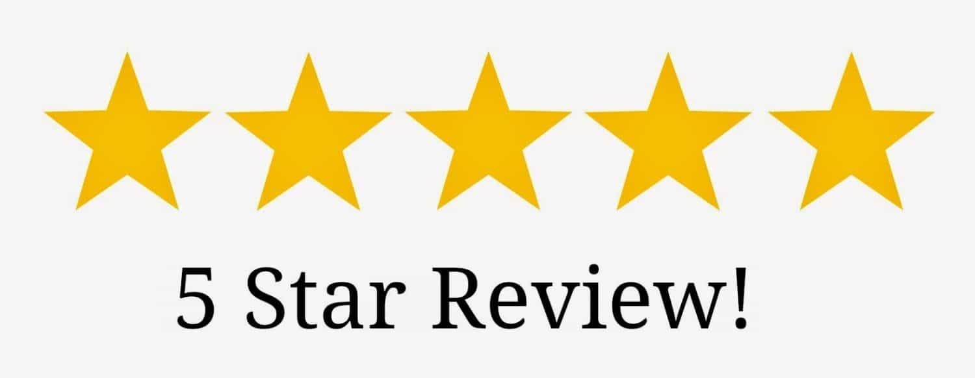
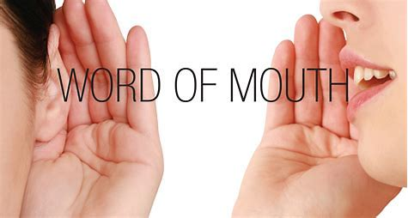
Social Proof
We rely on the opinions or actions of others to inform our own decisions
Notes:
Once more residents are vaccinated than half, social proof can play a part. Trust in other peer decisions. Also speaks to the importance of unit HAI “Champions”
Cialdini, R. B. (1993). In. fluence: the psychology of persuasion. William Morrow, New York, New York, USA.

Slide 7
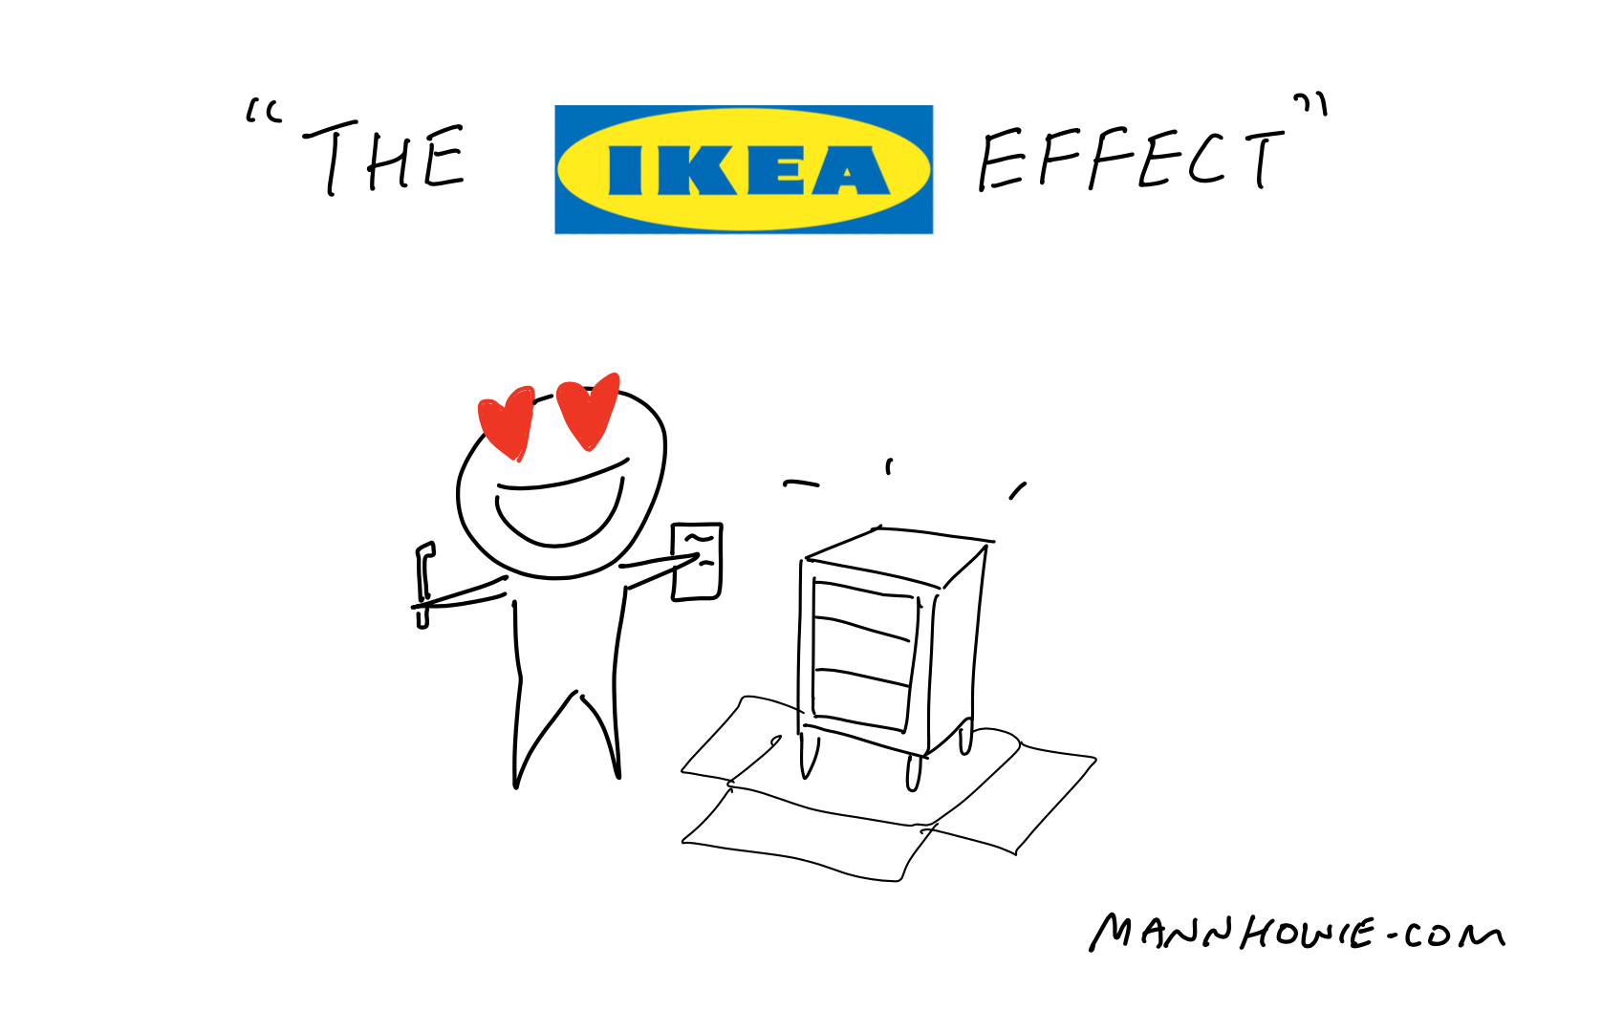
The IKEA Effect
We tend to value an object/initiative more if we assemble it ourselves. The experience/time spent makes it more valuable and emotionally connected.
Effort justification:
Time spent
Mental satisfaction
Notes:
Including resident council and residents into vaccine campaign design. Effort justification = more time spent is directly proportional to mental satisfaction of end result
Norton, M. I., Mochon, D., & Ariely, D. (2012). The IKEA effect: When labor leads to love. Journal of Consumer Psychology, 22(3), 453–460. doi:10.1016/j.jcps.2011.08.002

Slide 8
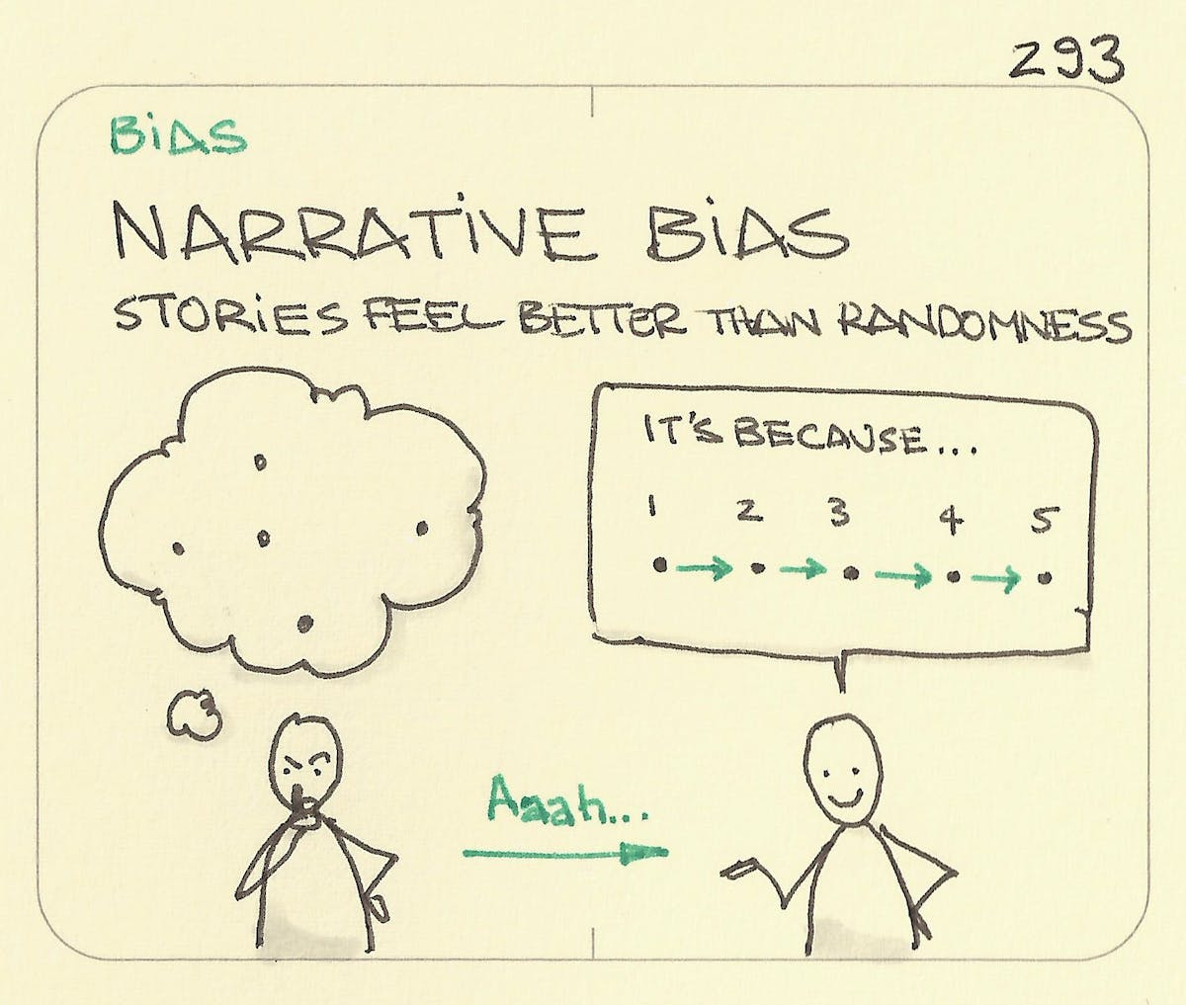
Narrative Bias
Pattern seeking tendency regardless if the facts support the full narrative
Creates a story makes the information easier to recall
Notes:
so-called gambler’s fallacy. For example, if a coin comes up heads five times in a row, people will have a powerful sense that the next flip is more likely to come up tails than heads. However, any single flip has an equal chance of coming up heads or tails. Statistical thinking suggests that coin does not have any memory. That is, the coin does not “know” what the previous results were. Reframing experiences to include logic. Open communication
Tversky, A. & Kahneman, D. (1971). The belief in the “law of small numbers”. Psychological Bulletin, 76, 105-110

Slide 9
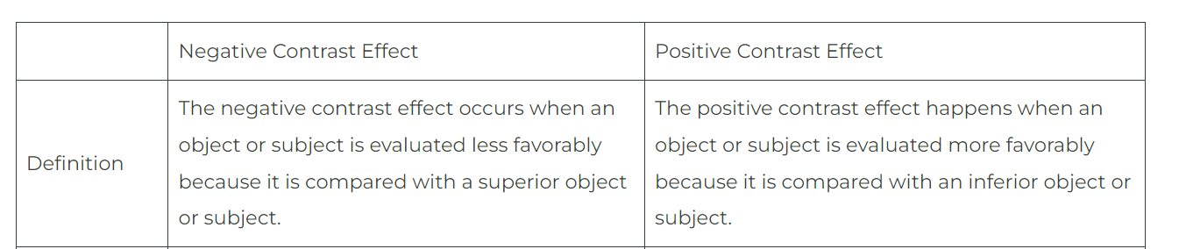
Contrast Effect
Our perceived value or quality of something changes drastically when it’s contrasted with something else, either better or worse
Notes:
why job candidates are judged verses a ranking for each question instead of against each other. expensive item can make a less costly one seem like a great deal, even if it’s not the cheapest option available.
Plous, S. (1993). The psychology of judgment and decision making. Macgraw-Hill Book Company.

Slide 10
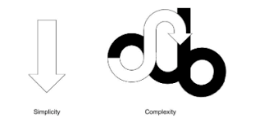
Cognitive Fluency Effect
Keep messages short so they are easy to recall
Familiarity is a strong motivator of human behavior
Is this activity/message similar to a previous encounter?
Notes:
Stop light dashboards
When information is easier to perceive it’s more persuasive and considered more TRUTHFUL to the interpreter. So important when you think of patients receiving information
Filkuková, P., & Klempe, S. H. (2013). Rhyme as reason in commercialand social advertising.Scandinavian Journal of Psychology, 54,423–431.http://dx.doi.org/10.1111/sjop.12069; Hansen, J., Dechêne, A., & Wänke, M. (2008). Discrepant fluency in-creases subjective truth.Journal of Experimental Social Psychology, 44,687–691.http://dx.doi.org/10.1016/j.jesp.2007.04.005

Slide 11
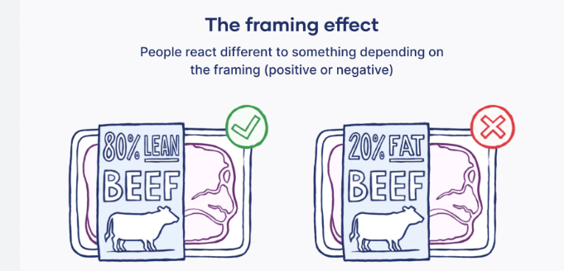
Framing
Same information can be perceived differently when presented in different contexts
Highlight the positive
Notes:
Tversky A., Kahneman D. (1981). The framing of decisions and the psychology of choice. Science 211, 453–458. doi: 10.1126/science

Slide 12
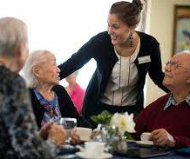

Authority Bias
We tend to place greater value on the option of an authority figure
Notes:
Importance of having medical director and administrator support in initiatives
Milgram S. (1963). Behavioral study of obedience. J. Abnorm. Soc. Psychol. 67, 371–378. doi: 10.1037/h0040525

Slide 13
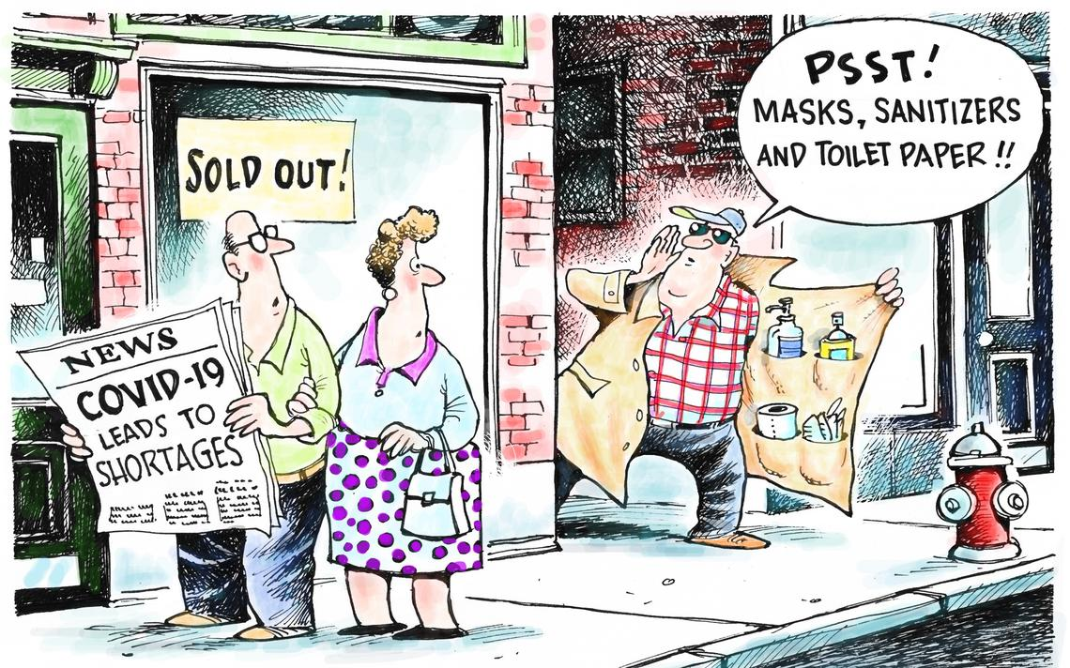
Scarcity Bias
We tend to perceive something that is less readily available as more valuable and desirable
Notes:
Mittone L., Savadori L. (2009). The scarcity bias. Appl. Psychol. 58, 453–468. doi: 10.1111/j.1464-0597.2009.00401.x

Slide 14
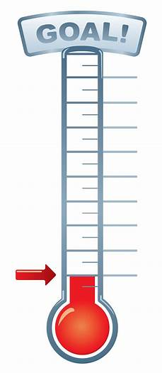
Endowed Progress Effect
When we make progress towards a goal, we feel more committed to achieving that goal
Consider creative ways to track vaccination goals
Comparing individual facilities against one another, all employees/residents/patients, units, etc
Notes:
Nunes, J. C., & Dreze, X. (2006). The endowed progress effect: How artificial advancement increases effort. Journal of Consumer Research, 32(4), 504-512.

Slide 15
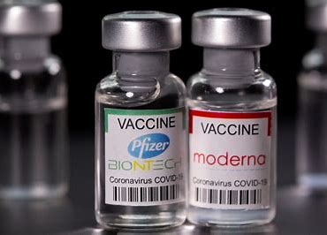
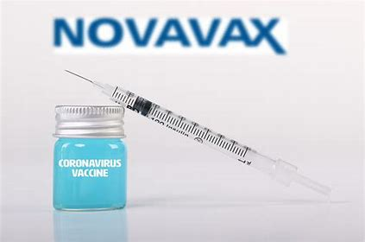
Choice Overload Effect
The more limited the options, the easier it becomes to make a choice
Notes:
We tend to only offer one vaccine to operationalize easier and offering more doesn’t help increase vaccination compliance
Reibstein, David J., Youngblood, Stuart A., & Fromkin, Howard L. (1975). Number of choices and perceived decision freedom as a determinant of satisfaction and consumer behavior. Journal of Applied Psychology, 60(August), 434–437.

Slide 16
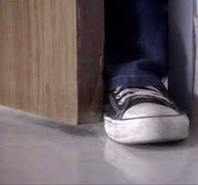
Foot in Door
Committing a small step up front will make us more likely to agree to something larger later on.
Notes:
Freedman , JL and Fraser , SC . 1966 . Compliance without pressure: The foot-in-the-door technique . Journal of Personality and Social Psychology , 4 ( 2 ) : 195 – 202

Slide 17
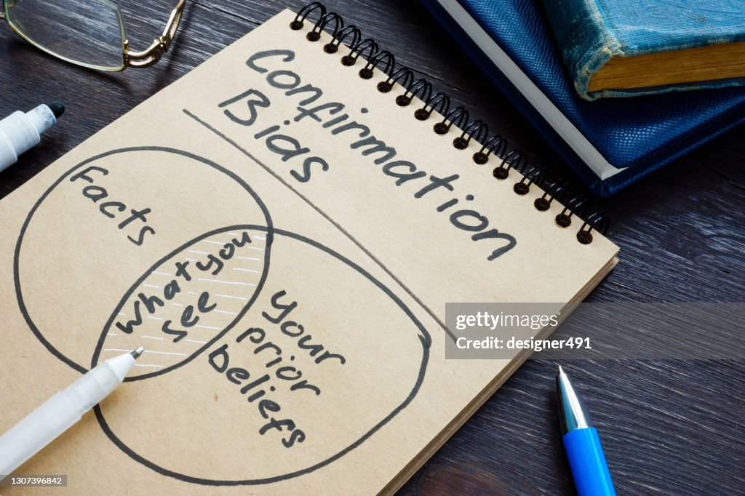
Confirmation Bias
We overvalue information which supports our beliefs, and downplay information that contradicts it
Notes:
Pronin E., Lin D. Y., Ross L. (2002). The bias blind spot: perceptions of bias in self versus others. Personal. Soc. Psychol. Bull. 28, 369–381. doi: 10.1177/0146167202286008

Slide 18
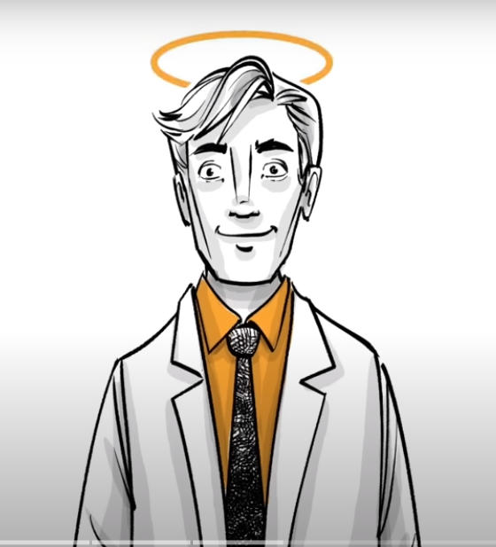
Halo Effect
When an initial impression is positive, it tends to positively influence our perceptions in other areas
Notes:
Resident has a favorite CNA or RN. Built that relationship. IPs in acute care, spend time getting to know RNs or CNAs
Nisbett, R. E., & Wilson, T. D. (1977). The halo effect: Evidence for unconscious alteration of judgments. Journal of Personality and Social Psychology, 35, 250-256

Slide 19

Endowment Effect
When we feel something belongs to us, it becomes valuable to us and we are more reluctant to part with it.
Notes:
Pronin E., Lin D. Y., Ross L. (2002). The bias blind spot: perceptions of bias in self versus others. Personal. Soc. Psychol. Bull. 28, 369–381. doi: 10.1177/0146167202286008

Slide 20

The Humor Effect
People remember information more easily when they find it amusing
Positive connection to the person who used humor
Notes:
Schmidt, S. R. (1994). Effects of humor on sentence memory. Journal of Experimental Psychology: Learning, Memory, and Cognition, 20(4), 953–967. https://doi.org/10.1037/0278-7393.20.4.953
laughter – strong reaction; creates a visceral response

Slide 21
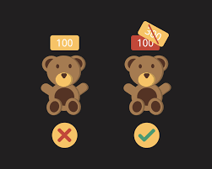
Anchoring
We tend to base decisions on the first piece of information that we are given
Change from boosters to annual vaccination
Notes:
Going from boosters to annual vaccination
Tversky A., Kahneman D. (1974). Judgment under uncertainty: heuristics and biases. Science 185, 1124–1131. doi: 10.1126/science.185.4157.1124

Slide 22
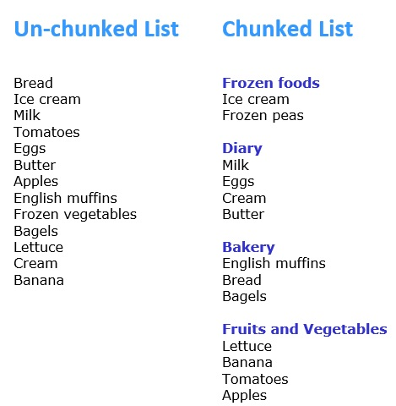
Chunking
Smaller, individual tasks are perceived as less daunting than big ones with multiple stages.
Can be used as a memory aid
Consider audience-specific instead of facility-wide
Notes:
grouping the everyday items someone needs to have in their pockets before leaving the house. Scoffolding
Fonollosa, J., Neftci, E., & Rabinovich, M. (2015). Learning of Chunking Sequences in Cognition and Behavior. PLoS computational biology, 11(11), e1004592. https://doi.org/10.1371/journal.pcbi.1004592

Slide 23

Peak End Rule
We have a tendency to judge experiences based on how they made us feel at the endpoint.
Notes:
Patient experience
Emotional experiences = are remembered more vividly
pediatrics office has a vaccination dog
Fredrickson B. L. (2000). Extracting meaning from past affective experiences: the importance of peaks, ends, and specific emotions. Cogn. Emot. 14 577–606. 10.1080/026999300402808

Slide 24
Behavioral Science Concepts Application
Rewards & recognition
Social proof
The IKEA Effect
Narrative Bias
Default Choice Effect
Contrast Effect
Cognitive Fluency Effect
Framing
Authority Bias
Scarcity Bias
Endowed Progress Effect
Choice Overload Effect
Foot in the Door
Confirmation Bias
Halo Effect
Endowment Effect
The Humor Effect
Anchoring
Chunking
Peak End Rule

Slide 25
Pair & Share Scenarios

Slide 26
Future Infection Prevention Campaigns

Slide 27
References
Wilson, C. G., Nusbaum, A. T., Whitney, P., & Hinson, J. M. (2018). Age-differences in cognitive flexibility when overcoming a preexisting bias through feedback. Journal of clinical and experimental neuropsychology, 40(6), 586-594.
Korteling, J. E. H., Paradies, G. L., & Sassen-van Meer, J. P. (2023). Cognitive bias and how to improve sustainable decision making. Frontiers in psychology, 14, 1129835. https://doi.org/10.3389/fpsyg.2023.1129835
Alexander W. H., Brown J. W. (2010). Hyperbolically discounted temporal difference learning. Neural Comput. 22, 1511–1527. doi: 10.1162/neco.2010.08-09-1080
Norton, M. I., Mochon, D., & Ariely, D. (2012). The IKEA effect: When labor leads to love. Journal of Consumer Psychology, 22(3), 453–460. doi:10.1016/j.jcps.2011.08.002
Tversky, A. & Kahneman, D. (1971). The belief in the “law of small numbers”. Psychological Bulletin, 76, 105-110
Plous, S. (1993). The psychology of judgment and decision making. Macgraw-Hill Book Company.
Filkuková, P., & Klempe, S. H. (2013). Rhyme as reason in commercialand social advertising.Scandinavian Journal of Psychology, 54,423–431.http://dx.doi.org/10.1111/sjop.12069;
Hansen, J., Dechêne, A., & Wänke, M. (2008). Discrepant fluency in-creases subjective truth.Journal of Experimental Social Psychology, 44,687–691.http://dx.doi.org/10.1016/j.jesp.2007.04.005
Tversky A., Kahneman D. (1981). The framing of decisions and the psychology of choice. Science 211, 453–458. doi: 10.1126/science
Milgram S. (1963). Behavioral study of obedience. J. Abnorm. Soc. Psychol. 67, 371–378. doi: 10.1037/h0040525
Mittone L., Savadori L. (2009). The scarcity bias. Appl. Psychol. 58, 453–468. doi: 10.1111/j.1464-0597.2009.00401.x
Reibstein, David J., Youngblood, Stuart A., & Fromkin, Howard L. (1975). Number of choices and perceived decision freedom as a determinant of satisfaction and consumer behavior. Journal of Applied Psychology, 60(August), 434–437.
Pronin E., Lin D. Y., Ross L. (2002). The bias blind spot: perceptions of bias in self versus others. Personal. Soc. Psychol. Bull. 28, 369–381. doi: 10.1177/0146167202286008
Nisbett, R. E., & Wilson, T. D. (1977). The halo effect: Evidence for unconscious alteration of judgments. Journal of Personality and Social Psychology, 35, 250-256
Pronin E., Lin D. Y., Ross L. (2002). The bias blind spot: perceptions of bias in self versus others. Personal. Soc. Psychol. Bull. 28, 369–381. doi: 10.1177/0146167202286008
Schmidt, S. R. (1994). Effects of humor on sentence memory. Journal of Experimental Psychology: Learning, Memory, and Cognition, 20(4), 953–967. https://doi.org/10.1037/0278-7393.20.4.953
Tversky A., Kahneman D. (1974). Judgment under uncertainty: heuristics and biases. Science 185, 1124–1131. doi: 10.1126/science.185.4157.1124
Fonollosa, J., Neftci, E., & Rabinovich, M. (2015). Learning of Chunking Sequences in Cognition and Behavior. PLoS computational biology, 11(11), e1004592. https://doi.org/10.1371/journal.pcbi.1004592
Fredrickson B. L. (2000). Extracting meaning from past affective experiences: the importance of peaks, ends, and specific emotions. Cogn. Emot. 14 577–606. 10.1080/026999300402808

Slide 28
THANK YOU!

