Slide 1
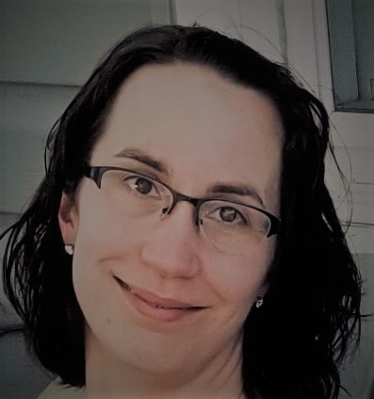
NOMINATING COMMITTEE 1-YEAR:
STEPHANIE HOMUTH
Present Title: Infection Prevention Manager
Name of Employer: M Health Fairview
Type of Facility: Acute
Number of Years in Infection Prevention: 7
CIC Certified: Yes
Educational Background: MPH in Epidemiology
Activities: Running, audio books and chasing my daughter

