Slide 1
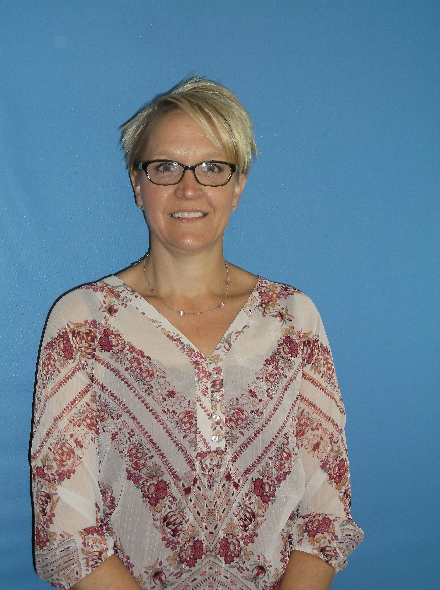
NOMINATING 2-YEAR: LINDA WLODYGA
Present Title: EVS Manager/Infection Preventionist/Employee Health/Clinical Quality Specialist
Name of Employer: Westfields Hospital & Clinic
Type of Facility: Acute Care
Number of Years in Infection Prevention: 4 1/2
CIC Certified: Yes
Educational Background:
PhD
RN
Activities: Quilting, camping, hiking, boating

