Slide 1
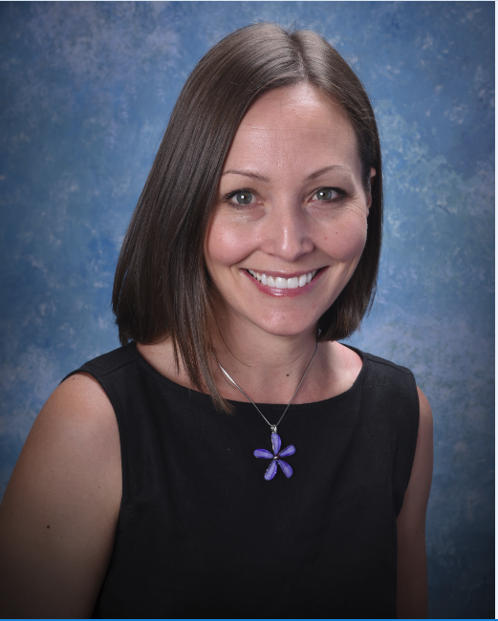
SECRETARY: KATHERINE GRIMM
Present Title: Infection Preventionist
Name of Employer: Maple Grove Hospital
Type of Facility: Acute Care Hospital
Number of Years in Infection Prevention: 6
CIC Certified: Yes
Educational Background:
  Bachelor of Science – Biology
  Master of Public Health – Epidemiology
Activities: Hiking/kayaking/anything outdoors/anytime of the year. Favorite winter activity – crochet. Watching my kids in their activities – ballet, karate, football

