Slide 1
Measles
Andrea Leapley, MPH
Regional Epidemiologist and Laboratory Liaison
Florida Department of Health, Bureau of Epidemiology
August 24, 2018

Slide 2
Overview
Measles infection and transmission
Vaccination
Epidemiology
Reporting requirements
Exposure in a health care facility

Slide 3
Measles Infection and Transmission

Slide 4
History of Measles
References to measles infection date back to the 7th century
In the 10th century, Persian physician Rhazes described measles as “more dreaded than smallpox”
In the pre-vaccine era, nearly everyone was infected during childhood

Slide 5
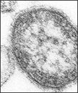
Measles Virus
Paramyxovirus, genus Morbillivirus
Single-stranded RNA virus
One antigenic type
  Eight clades containing 24 genotypes
Notes:
Antigenic variation refers to the mechanism by which an infectious agent alters its surface proteins to avoid a host immune response. While there have been minor changes noted in some of the surface proteins of the measles virus , they have shown no epidemiological significance ( ie no change in vaccine efficacy).
A clade is a grouping of organisms that includes a common ancestor and all its descendants.
The measles genotypes are distinguished by the nucleotide sequences of the hemagglutinin and nucleoprotein genes, which are the most variable in the genome.
Clades are designated as A-H and each genotype is designated by a number. An example of this would be D8, one of the more common strains circulating worldwide recently.

Slide 6
Transmission
Most infectious disease known – highest R₀
Spread through tiny droplets in the air released when someone coughs or sneezes
  Airborne transmission possible but less common
Can remain in the air for up to two hours
Infected persons are infectious from four days before through four days after rash onset
Humans are the only host
Notes:
The R naught or the basic reproductive number is the number of cases one case of a disease will generate over its infection period in an otherwise susceptible population. For example, the reproductive number in previous Ebola outbreaks has been 1.5-2.5. The reproductive number for HIV is 2-5. Influenza is 2-3. Measles, however, is 12-18.

Slide 7
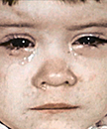
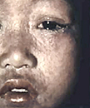
Clinical Presentation
Incubation period: 7–21 days (average 10–12 days)
Prodrome: 2–4 days
  Fever
  Cough
  Conjunctivitis
  Coryza
Rash: 2–4 days after prodrome
  Begins at the hairline and spreads downward
  Maculopapular
  Fades in order it appeared

Slide 8
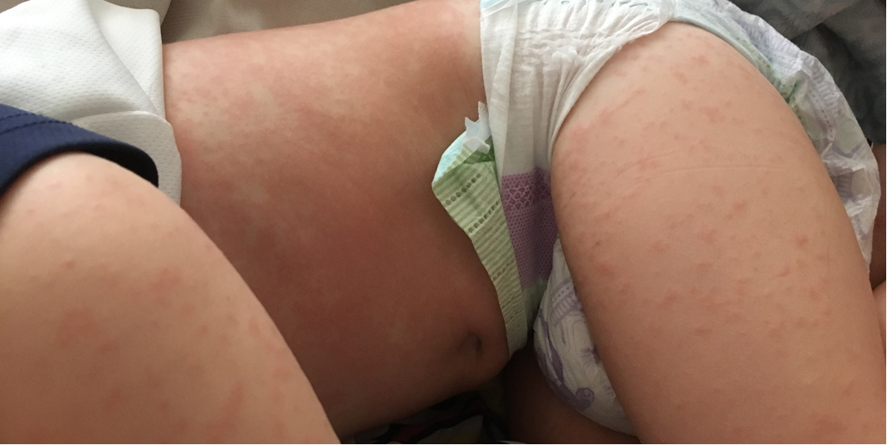
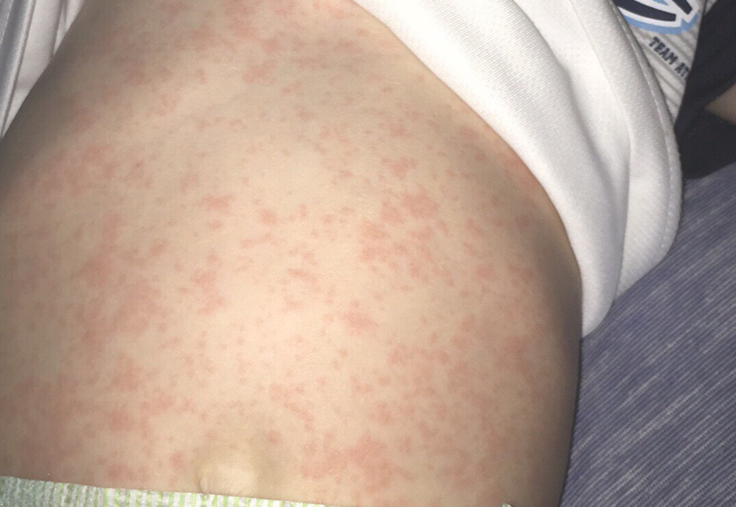
Rash Photos

Slide 9
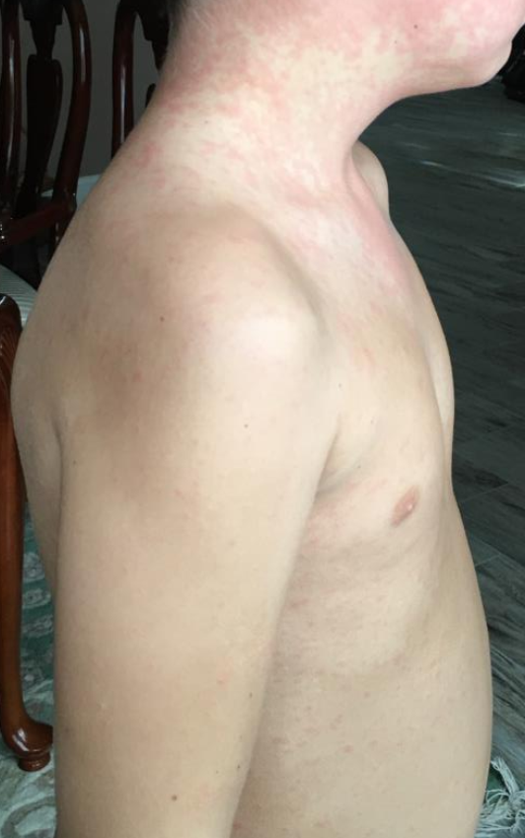
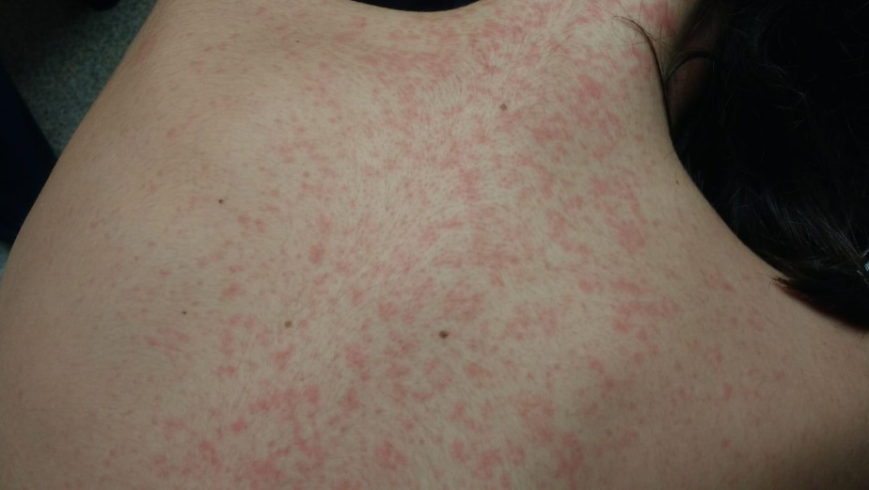
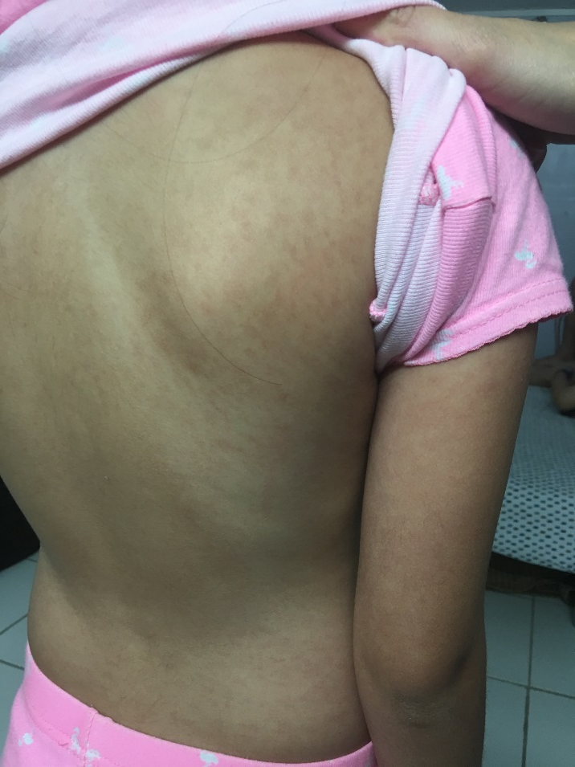
Rash Photos

Slide 10
Complications
Common
  Ear infection: 1/10 children
  Diarrhea: 1/10 people
Severe
  Pneumonia: 1/20 children
  Encephalitis: 1/1,000 children
  Death: 1–2/1,000 children
May cause pregnant women to have a baby with low birth weight or to deliver prematurely

Slide 11
Long-Term Complications
Subacute sclerosing panencephalitis (SSPE)
  Rare but fatal disease of the central nervous system
  Occurs about 7–10 years after measles infection
  For persons diagnosed with measles between 1989–1991, 4–11 out of every 100,000 were thought to be at risk
  Risk is higher for persons who get measles before 2 years of age

Slide 12
Laboratory Diagnosis
Detection of measles RNA by real-time polymerase chain reaction (RT-PCR)
  Nasopharyngeal swab, urine
  Viral shedding declines with time after rash onset, so early collection is encouraged
Detection of measles-specific IgM antibodies
  Serum
  Up to 20% of tests may have a false negative if collected within 72 hours of rash onset
  May be absent or transient in persons with 1 or 2 MMR doses
Molecular analysis can determine the genotype
Notes:
IgM and IgG antibody testing are available commercially.
PCR testing in Florida is only available through the Bureau of Public Health Laboratories and requires approval by your local county health department epidemiology program prior to testing.

Slide 13
Vaccination

Slide 14
Vaccine History
Measles virus first isolated by John Enders in 1954
First measles vaccines licensed in 1963
Combined measles-mumps-rubella vaccine licensed in 1971
Two-dose schedule of MMR recommended starting in 1989
Notes:
In 1963, both an inactivated and a live attenuated vaccine were approved for use. The inactivated vaccine was then withdrawn in 1967 because it was not protecting against measles infection. Also, persons who received the inactivated vaccine were developing a syndrome called atypical measles if they were infected. Then the original live attenuated vaccine was withdrawn in 1975 because many recipients developed a fever and a rash. However, in 1968 another live attenuated vaccine was introduced, and this is the measles vaccine that is still in use today.

Slide 15
Vaccine Efficacy
95% of children vaccinated at 12 months old will develop immunity
98% of children vaccinated at 15 months old will develop immunity
Most persons who fail to respond to the first dose will respond to the second dose
More than 99% of persons who receive two doses of measles vaccine develop serologic evidence of immunity

Slide 16
Vaccine Schedule
First dose of MMR given at 12–15 months
Second dose given at 4–6 years
Adults born in 1957 or later should receive at least one dose of MMR vaccine
  Health care providers should have two doses
Persons born before 1957 can generally be considered immune

Slide 17
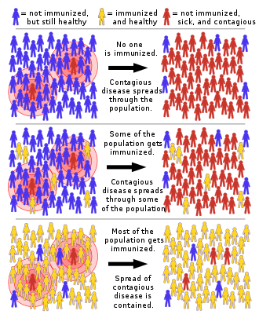
Herd Immunity
Because measles is so infectious, 93-95% of the population needs to have immunity to protect against transmission

Slide 18
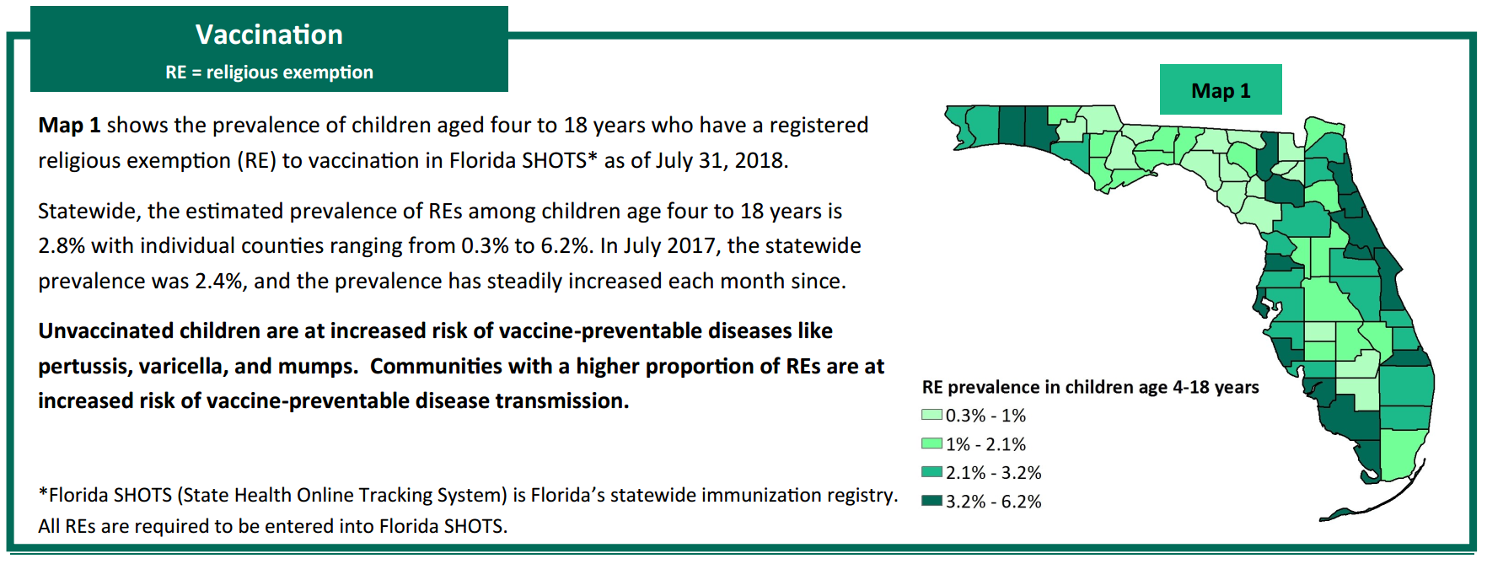
Source: Florida Department of Health Vaccine Preventable Disease Surveillance Report, July 2018 http://www.floridahealth.gov/diseases-and-conditions/vaccine-preventable-disease/_documents/2018-july-vpd-surveillance-report.pdf
Notes:
The 2017 2 year old immunization survey indicated that 94% of 2 year olds in Florida had received their MMR

Slide 19
Epidemiology

Slide 20
Epidemiology in the United States
Before 1963, there were approximately 500,000 cases and 500 deaths reported annually
  Epidemic cycles every 2–3 years
  Actual number of cases estimated to be 3–4 million
More than 90% of persons had measles by age 15
Highest incidence was in 5- to 9-year-old children

Slide 21
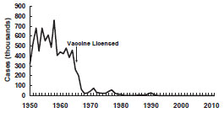
Epidemiology in the United States
Following vaccine licensure in 1963, incidence of measles decreased more than 95%
Epidemic cycles no longer occurred
Measles–United States, 1950–2011
Source: CDC Pink Book https://www.cdc.gov/vaccines/pubs/pinkbook/meas.html#epi

Slide 22
Epidemiology in the United States
Between 1989–1992, the U.S. saw a large resurgence of measles cases
  55,622 cases were reported over the three years
  123 deaths were reported
Most affected group was children under 5 years of age
There were two major factors:
  Low vaccination coverage
  Infants younger than 1 had an increased susceptibility
Notes:
The reason that infants younger than 1 had increased susceptibility is because the mothers of many infants who developed measles were young, and their measles immunity was most often due to vaccination rather than infection with wild virus. As a result, a smaller amount of antibody was transferred across the placenta to the fetus, compared with antibody transfer from mothers who had higher antibody titers resulting from wild-virus infection. The lower quantity of antibody resulted in immunity that waned more rapidly, making infants susceptible at a younger age than in the past.

Slide 23
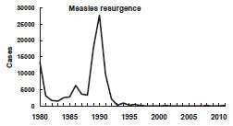
Epidemiology in the United States
Measles–United States, 1980–2011
Source: CDC Pink Book https://www.cdc.gov/vaccines/pubs/pinkbook/meas.html#epi

Slide 24
Epidemiology in the United States
After the resurgence, reported cases declined rapidly
Decline mostly due to intensive efforts to vaccinate preschool-aged children
In 2000, the World Health Organization (WHO) declared endemic measles was eliminated from the U.S.
Notes:
This resurgence was the impetus for the creating of the CDC’s Vaccines for Children Program, which provides free vaccine to providers to immunize uninsured, underinsured, and Medicaid-receiving children.

Slide 25
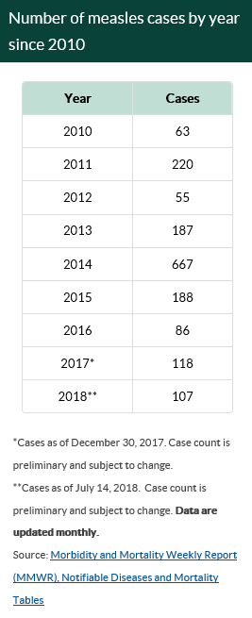
Post-Elimination Era
Between 2001–2008, 557 cases were reported
  66% unvaccinated
  16% unknown vaccination status
  42% imported cases
Between 2009–2014, 1,264 cases were reported
  74% unvaccinated
  16% unknown vaccination status
  22% imported cases
Source: Centers for Disease Control and Prevention https://www.cdc.gov/measles/cases-outbreaks.html

Slide 26
Post-Elimination Era Outbreaks
Between 2001–2008, 38 outbreaks were reported
  Median size: 4 cases (range 3–34)
Between 2009–2014, 66 outbreaks were reported
  Median size: 5 cases (range 3–383)
Outbreaks generally involve persons who are directly exposed to an imported case of measles or infected during a resulting chain of transmission
Most persons are unvaccinated or have an unknown vaccination status

Slide 27
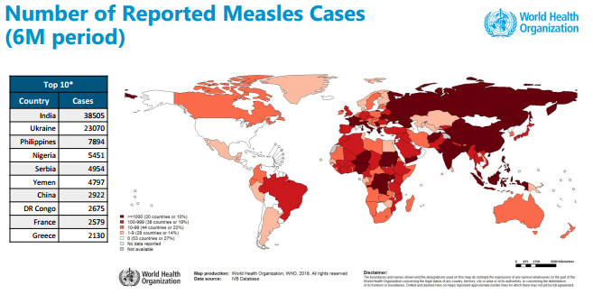
Number of Reported Measles Cases (6-Month Period)
Source: WHO Global Measles and Rubella Update August 2018 http://www.who.int/immunization/monitoring_surveillance/burden/vpd/surveillance_type/active/Global_MR_Update_August_2018.pdf?ua=

Slide 28
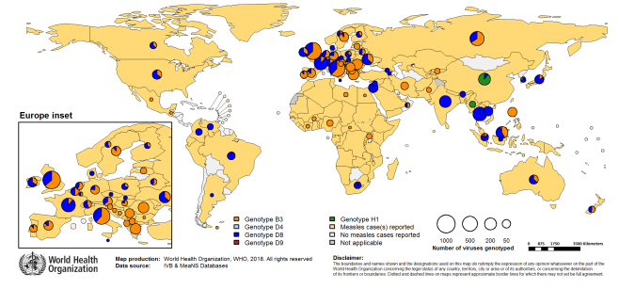
Distribution of Measles Genotypes (Last 12 Months)
Source: WHO Global Measles and Rubella Update August 2018 http://www.who.int/immunization/monitoring_surveillance/burden/vpd/surveillance_type/active/Global_MR_Update_August_2018.pdf?ua=1

Slide 29
Epidemiology in Florida
Source: FLHealthCharts.com and Merlin data

Slide 30
Epidemiology in Florida
January 1–August 23, 2018:
7 cases reported
4 cases acquired outside the U.S. or acquired from an imported case
3 cases acquired in Florida
0 cases were vaccinated prior to exposure or received post-exposure prophylaxis in a timely manner

Slide 31
Reporting Requirements

Slide 32
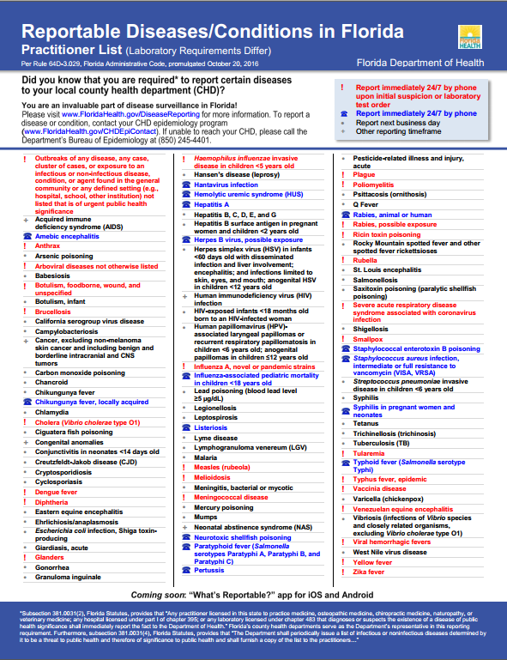

Slide 33
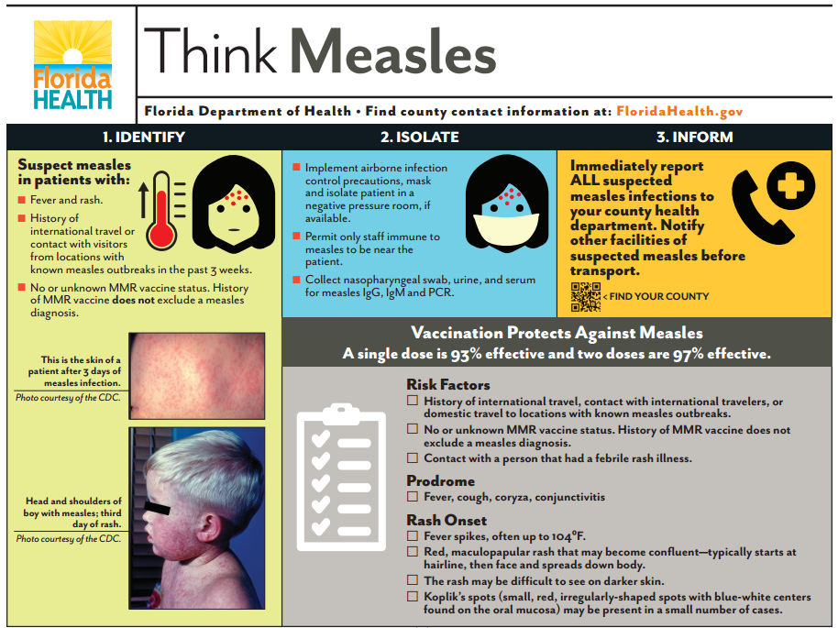

Slide 34
Exposure in a Health Care Facility

Slide 35
Exposure in the Emergency Department
Consider ways your facility can reduce risk.
For exposed contacts who develop symptoms, DOH recommends:
  Call the physician/facility or DOH prior to seeking care so arrangements can be made to avoid exposures
  Meet the patient outside and provide a mask
  Use a back door to avoid going through a crowded ED/waiting room
  Take patient immediately to a negative-pressure room that can be left empty for two hours after the patient leaves

Slide 36
Isolation of a Hospitalized Patient
Standard precautions
Airborne precautions for 4 days after onset of rash in otherwise healthy patients
  For duration of rash in immunocompromised patients
Patients exposed to a case and who are susceptible should be placed on airborne precautions from 5 days after the first exposure until 21 days after the last exposure

Slide 37
Exposure in a Health Care Facility
Create a list of individuals exposed to measles at your facility.
  Time
  Airspace
Prioritize the list based on known information.
  Priority 1: Not immune/high risk
  Priority 2: Not immune/not at high risk
  Priority 3: Immune status unknown
  Priority 4: Immune

Slide 38
Exposure in a Health Care Facility
Send lists of individuals in all priority groups to your county health department (CHD) as soon as possible
Notify all exposed individuals as soon as possible, in order of priority
Send a completed list of individuals you contact to your CHD so that active monitoring can be initiated

Slide 39
Assessing Immunity
Immune
  Born before 1957
  1 or 2 doses of MMR, documented (health care workers must have 2 documented doses)
  Positive IgG titer result for measles
  Laboratory confirmation of disease
Not Immune
  Never received any doses of MMR for any reason
  Infant under the age of 12 months
  Severely immunocompromised

Slide 40
Assessing Immunity
Immune Status Unknown
  If an individual does not fall into the immune or not immune groups, their status is unknown
  Pursue an IgG titer if necessary to readmit to high-risk setting or return to work in a public setting
  If no IgG titer is run, assume the individual is not immune

Slide 41
Post-Exposure Prophylaxis
MMR vaccine
  If given within 72 hours of initial exposure, the MMR might provide some protection
  For persons aged 12 months or older, MMR is preferable to using immune globulin (within the 72-hour timeframe)
  If the exposure does not cause infection, post-exposure vaccination should induce protection against subsequent exposures

Slide 42
Post-Exposure Prophylaxis
Immune globulin (IG)
  If administered within 6 days of exposure, can prevent or modify measles in persons without immunity
  Not indicated for persons who have received 1 dose of MMR at age 12 months or later unless severely immunocompromised
Should be given to groups at risk for severe disease and complications
  Infants aged less than 12 months
  Pregnant women without evidence of measles immunity
  Immunocompromised patients

Slide 43
Post-Exposure Prophylaxis
Intravenous immune globulin (IGIV) is recommended for:
  Pregnant women without evidence of measles immunity
  Severely immunocompromised persons regardless of their immunologic or vaccination status
Intramuscular immune globulin (IGIM) is recommended for:
  Infants younger than 12 months old
  Infants aged 6–11 months can receive the MMR in place of IGIM if administered within 72hours of exposure

Slide 44
Questions?

Slide 45
Contact Information:
Andrea Leapley, MPH
Andrea.Leapley@flhealth.gov

