Slide 1
Clorox Healthcare

Slide 2
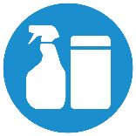

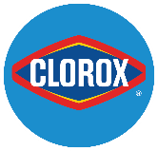
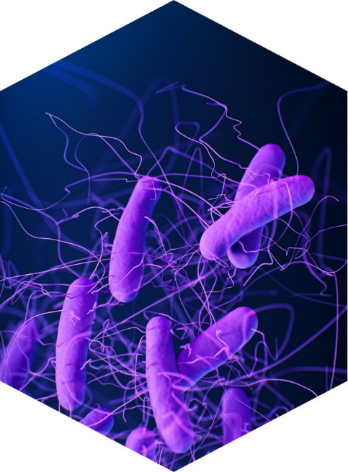


Safeguarding Patient Environments
Better
Results
Efficient
Solutions
Clorox
Confidence
Science-backed products proven to deliver safe & healthy spaces.
Designed to maximize efficiency and minimize risk.
Clorox brand instills high levels of confidence & trust.
Notes:
Revisit Challenges slide and how these challenges come to life in our industry. Example – workforce challenges (staffing shortages, retention issues, inflation-induced budgets) are a direct threat to compliance. Healthcare customers need a disinfectant solution that can kill what needs to be killed quickly AND help them me more efficient.
Healthcare facilities need disinfecting solutions that they can trust to rid the environment from the most dangerous pathogens AND help them be more efficient. How do we deliver against these NEEDS? Clorox Healthcare ready-to-use disinfectants deliver healthcare end-users better results, offer efficient solutions, and inspire confidence.
Frequency of disinfection matters
What disinfectants you choose to use also matter
3 pillars
How is HC different
Decisions are made
Who is our target/customer
Highly regulated
Value analysis
It saves them money/reimbursement

Slide 3
What Matters Most – 4 C’s
Compliance
Fast contact times (required for pathogen kill) means it’s easier for the staff to use.
Ready to use products helps eliminate risk of mixing incorrectly.
Easier to use means more likely to use it.
Compatibility
Disinfectants can damage expensive equipment – having products that are gentler on plastics help reduce the risk of damage.
Coverage
The total coverage 1 wipe provides impacts number of total wipes needed. This means you could actually spend less money with a more expensive wipe.
Clinical Evidence
We want products that have been proven effective. Clinical studies and evidence help eliminate doubt.

Slide 4

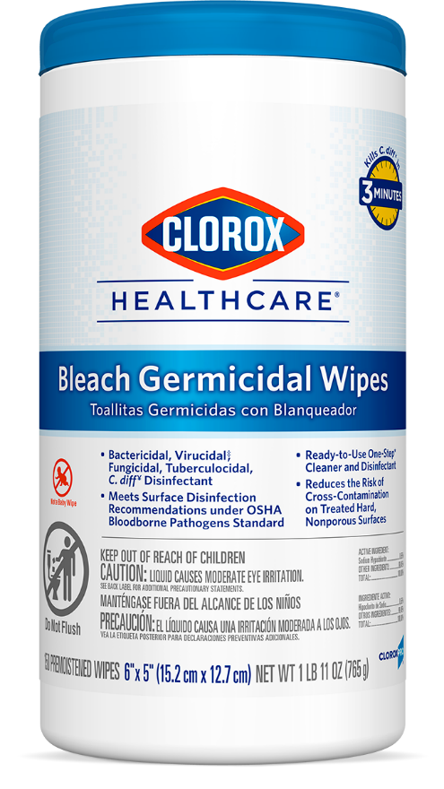

We deliver better results
Kills critical pathogens
Candida auris
Clostridioides difficile
ESKAPE pathogens
Emerging pathogens
*when compared to leading competitor bleach wipes (PDI), based on EPA-registered C. difficile disinfection contact times on hard, non-porous surfaces.
Notes:
Specifically, our bleach wipes vs. PDI – we deliver more kill claims against deadly pathogens like c. auris and offer a 25% faster contact time!
Head-to-head vs. PDI bleach. We have the right to win. No one does bleach better than us. Swagger. Break the PDI bundle. Clinical. Talking to sales.

Slide 5
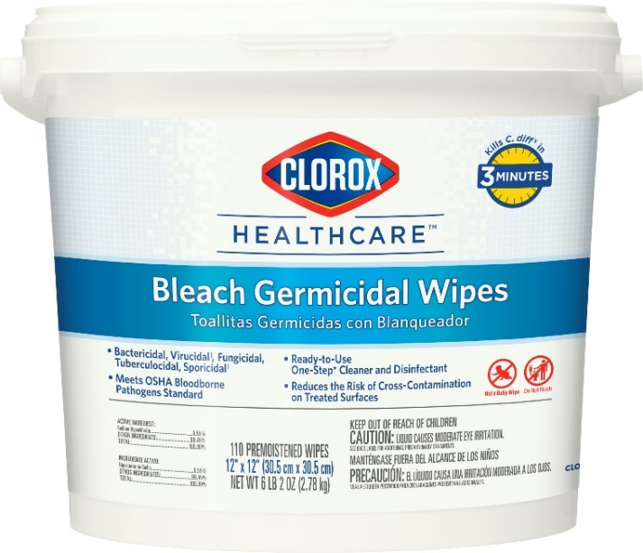

We offer efficient solutions
 | Clorox Healthcare Bleach Germicidal Wipes (12"x12") | Leading competitor bleach wipes (7.5"x15")
EPA-registered C. difficile contact time | 3 minutes | 4 minutes
Surface area covered by 1 wipe (sq. ft.)* | 26.0 sq. ft. | 13.3 sq. ft.
# of wipes to disinfect a patient room (140 sq. ft.) | 6 wipes! | 11 wipes…
*Laboratory testing data. Your results may vary.
Notes:
Surface coverage.
Keeping surfaces wet for the required contact time is critical for desired outcomes and our wipes are proven to keep surfaces wet longer.

Slide 6
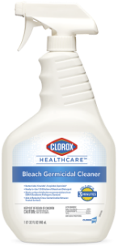
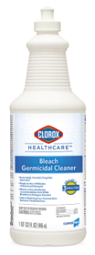
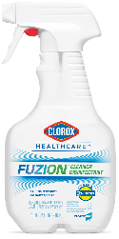
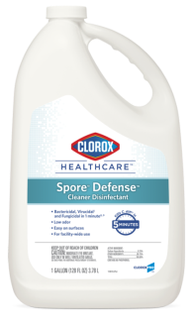
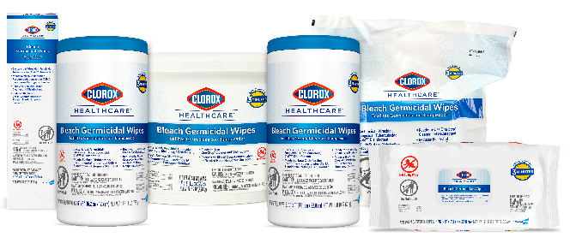
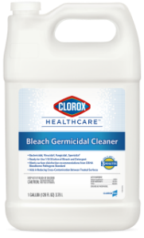
Clorox Healthcare Bleach Portfolio
Clorox Healthcare Bleach Germicidal Wipes | Clorox Healthcare Bleach Germicidal Cleaner Disinfectant | Clorox Healthcare Fuzion Cleaner Disinfectant | Clorox Healthcare Spore Defense Cleaner Disinfectant
Kills C.difficile spores, C. auris, MRSA, and VRE in 3 minutes Recommended in equipment cleaning and care guidelines* | Kills C.difficile spores, C. auris, MRSA, and VRE in 3 minutes Reduces compliance risks and labor costs associated with dilutable disinfectants | Kills C. difficile spores in 2 minutes Low residue formula even on clear plastics, stainless steel, vinyl and more | Kills C. difficile spores in 5 minutes Low odor and great compatibility on common healthcare surfaces
*Use as directed on hard, nonporous surfaces. Consult medical equipment warranty information and equipment care and cleaning guides prior to selecting and using
any surface disinfectant.

Slide 7
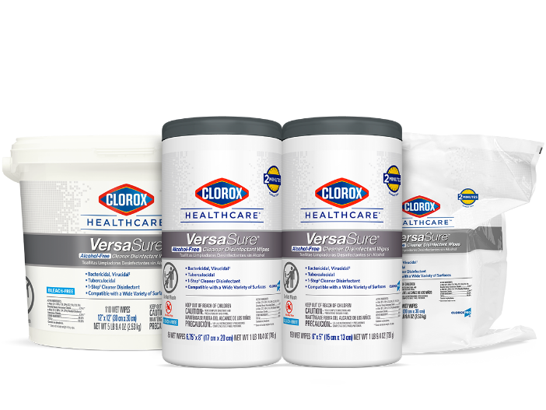
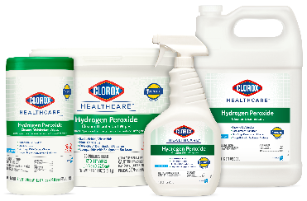
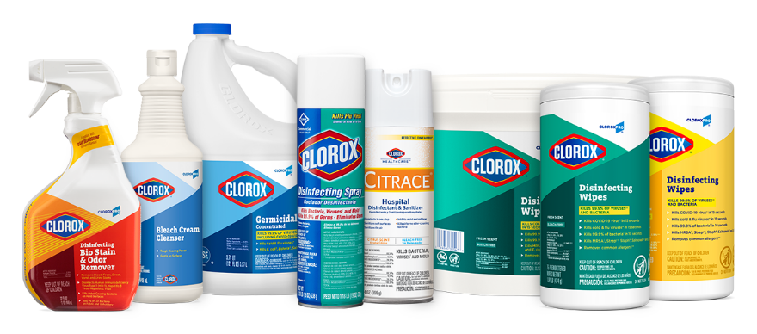
More than just a bleach company
Clorox Healthcare® Hydrogen Peroxide Liquids & Wipes | Clorox Healthcare® Alcohol-Free Quat Wipes | CloroxPro® Specialty Products
Hard and Soft (liquids) surface disinfection Effective against biofilms Great for everyday use | Low odor and residue Great for everyday use | Products to address a variety of needs Soft and Hard surface disinfection
Clorox Healthcare Hydrogen Peroxide Cleaner Disinfectant Liquids Clorox Healthcare Hydrogen Peroxide Cleaner Disinfectant Wipes | Clorox Healthcare VersaSure Cleaner Disinfectant Wipes | CloroxPro Clorox Biostain Cleaner Disinfectant CloroxPro Clorox Cream Cleanser CloroxPro Clorox Germicidal Bleach CloroxPro Clorox Disinfecting Spray Clorox Healthcare Citrace Hospital Disinfectant and Sanitizer CloroxPro Clorox Disinfecting Wipes

Slide 8
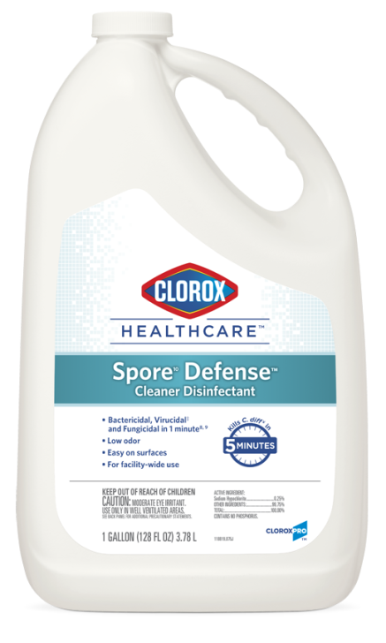
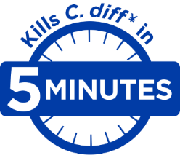
Clorox Healthcare® Spore¹⁰ Defense® Cleaner Disinfectant
Daily Sporicidal for Facility-Wide Use
One-Step cleaner disinfectant designed for use on common healthcare surfaces
One-Step cleaner disinfectant designed for use on common healthcare surfaces
Kills C. diff in 5 minutes*
Low odor, low residue bleach that is safe to use anywhere in the facility, from public spaces to patient care areas
Kills 56 microorganisms, including C. difficile spores, C. auris, MRSA and Norovirus
Ready-to-use cleaner disinfectant for manual disinfection and electrostatic sprayer devices.
Meets the OSHA Bloodborne Pathogens Standard
Great surface compatibility profile for use in patient rooms, restrooms and patient transport
32409
128 fl. oz.
*When used as directed

Slide 9
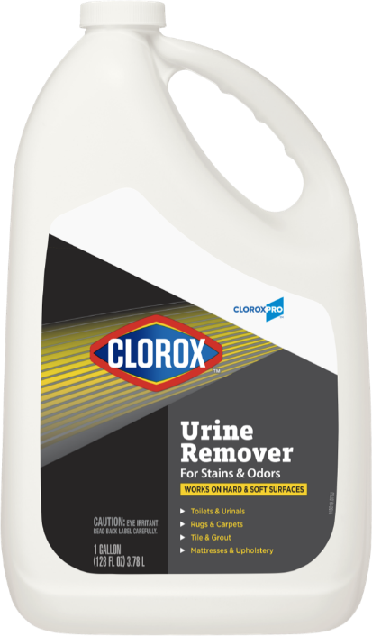
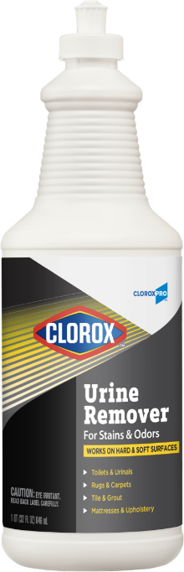
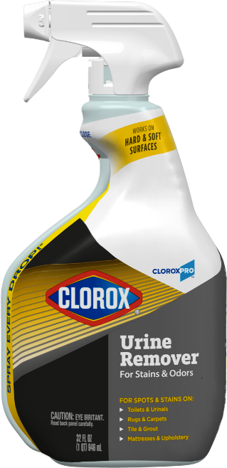
CloroxPro Clorox Urine Remover
Tackles both odors and stains on porous and soft surfaces
Exceptional performance on both urine stains & odors
Removes urine odors and stains from soft surfaces and porous surfaces, including concrete
Ready-to-use, no mixing or diluting required
Specially-formulated for tough-to-clean porous surfaces such as grout, carpet and mattresses
31036
9/32 oz.
31351
4/128 oz.
31415
6/32 oz.

Slide 10
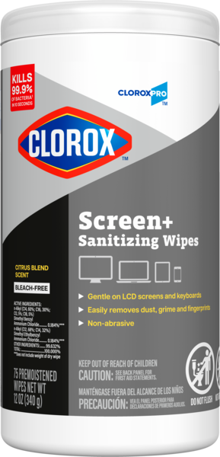
Clorox Screen+ Sanitizing Wipes
Clean and eliminate bacteria from sensitive electronic equipment* such as touchscreens, laptops, monitors and keyboards.
NEW!
Sanitize & Safeguard Electronics
Removes greasy fingerprints, smudges and dust
EPA-registered to kill 99.9% of bacteria in 10 seconds¹
Low-linting, non-abrasive cloth for scratch-free cleaning
60724
6/75 ct.
¹When used as directed on hard, nonporous surfaces.

Slide 11
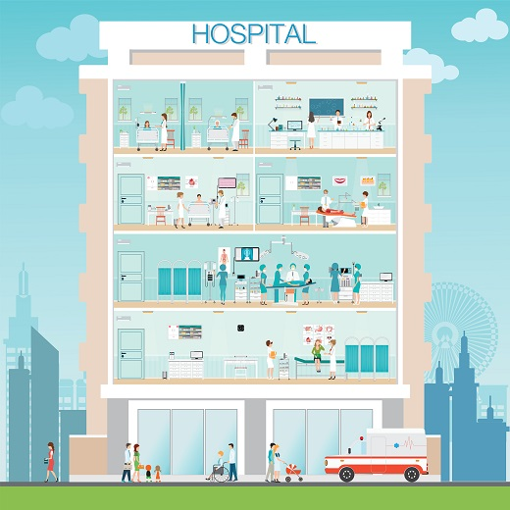


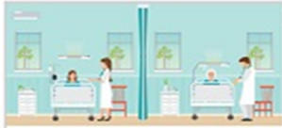









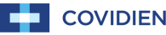
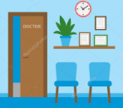





Top Equipment Manufacturers have endorsed Clorox Healthcare Disinfectants
Throughout every department in the hospital, you can find Clorox Healthcare products
endorsed for use on the most frequently used medical devices
Infusion Pumps
Blood Glucose Meters
Patient Rooms
Ultrasound Probes
L&D
Radiology
Detectors
OR
OR Lights
Ventilators
Waiting Areas
Outpatient
Furniture
Vital Sign Monitors
Notes:
Here’s an overview of some of our major medical equipment endorsements

Slide 12
Comprehensive Educational Platform
Clorox Healthcare regularly delivers new educational resources to help your teams stay current on infection control topics and training resources to promote compliant cleaning and disinfection.
Educational Resources
Training Resources
Free CE Courses
Clinical Studies Summaries
Educational
Videos
Technical
Bulletins
Environmental Services Teams
Outpatient
Settings
Clinical
Teams
Perioperative
Settings

Slide 13
Final Wrap : Why Clorox?
#1. Better Outcomes
#2. Efficient Solutions
#3. Clorox Confidence
Disinfectants proven highly efficacious in reducing the risk of HAI’s
Clorox Healthcare Compatible Program and equipment manufacturer endorsements reduce risk of damage to common healthcare surfaces
Clorox Healthcare Bleach wipes disinfect more square footage per wipe with fast contact times and surface coverage
Provide turnkey protocol & training tools to enable best in class implementation and standardization
More than 70% of hospitals in the U.S. rely on Clorox Healthcare disinfectants to safeguard patient environments.
Investment in clinical research & peer reviewed studies for evidence-based products, protocols and IP strategies
Internal Only - Confidential

