Slide 1
Hidden in Plain Sight:
Non-ventilator
Hospital-Acquired Pneumonia (NVHAP) – the #1 Hospital-acquired infection
Dian Baker, PhD, MA, MS, APRN
Professor Emeritus, School of Nursing
California State University, Sacramento
dlbconsulting21@gmail.com
SAGE-GSNPS-PPT-1260794_REV-0_en_us

Slide 2
Disclaimers
This presentation was developed with Stryker's Sage business.
The activities described in this presentation will be provided by an employee/consultant of Stryker.
This presentation may cover clinical topics for which Sage product offerings do not align.
Do not distribute, copy, or otherwise utilize without permission.
The information provided may include evidence-based clinical education and/or Stryker product information.
No off-label information shall be presented.
The presenter may have or have had a financial or advisory relationship with Stryker. The opinions expressed by Dr. Baker are those of Dr. Baker and not necessarily those of Stryker.

Slide 3
Learning Objectives
Describe the clinical consequences that patients' who develop NVHAP suffer
Discuss the human lung microbiome and the adapted island model of the lung
List actions and practices that hospitals can take to help prevent NVHAP

Slide 4

Meet Arthur
Arthur is a healthy 66-year-old, who walked his dog every day
Arthur picked up his grandkids from school everyday and was just started to enjoy his retirement
Until…he was admitted to manage a severe infection from his diverticulitis

Slide 5


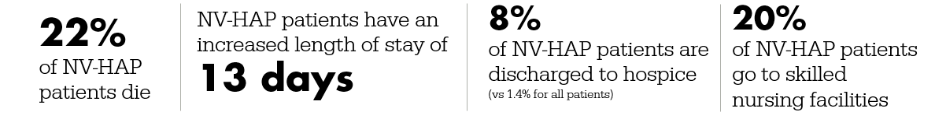
What Happens When a Patient Develops NVHAP?
About
1 in 100
patients develop NVHAP
A recent study in Journal American Medical Association (JAMA) found:
NV-HAP is a common and deadly complication of hospitalization
attributed to 1 in 14 hospital deaths

Slide 6

Why Should We All Be Concerned?
Fiscal Impact
US Medicare
Antibiotic Stewardship
Sepsis
  All hospitals are concerned about the dangers of sepsis
  Pneumonia is the #1 forerunner to sepsis
  30 - 50% of all sepsis cases originate as pneumonia
  Risk of sepsis 29 times greater with NVHAP than when patients are admitted with community- acquired pneumonia
  Hospital-acquired pneumonia is estimated to cost $2.04 billion annually in increased costs
  Medicare beneficiaries 2.8x more likely to die than those who do not get NVHAP
  NVHAP survivors continue to require more medical care and increase costs
  Antibiotic over usage for something we can prevent
  Most common antibiotic starts for suspected respiratory/ pneumonia
Notes:
Overuse of antibiotics for a potentially preventable infection (antibiotic stewardship)
Northern California Kaiser study: Prevention of NVHAP = reduction in antibiotic usage ¹⁴
Overall, HAP mortality decreased from 1.05 to 0.34/1000 admissions
HAP decreased from 5.92 to 1.79/1000 admissions (p=.003)
Broad spectrum antibiotic use reduction
Carbapenem, quinolone, aminoglycoside, and vancomycin use all decreased significantly.
Benzodiazepine use decreased from 10.4% of all inpatient days (2014) to 8.8% of inpatient days (2016).
Kaiser study, Lacerna…Witt et al. A successful program preventing non-ventilator hospital acquired pneumonia in a large hospital system ICHE 2020)

Slide 7
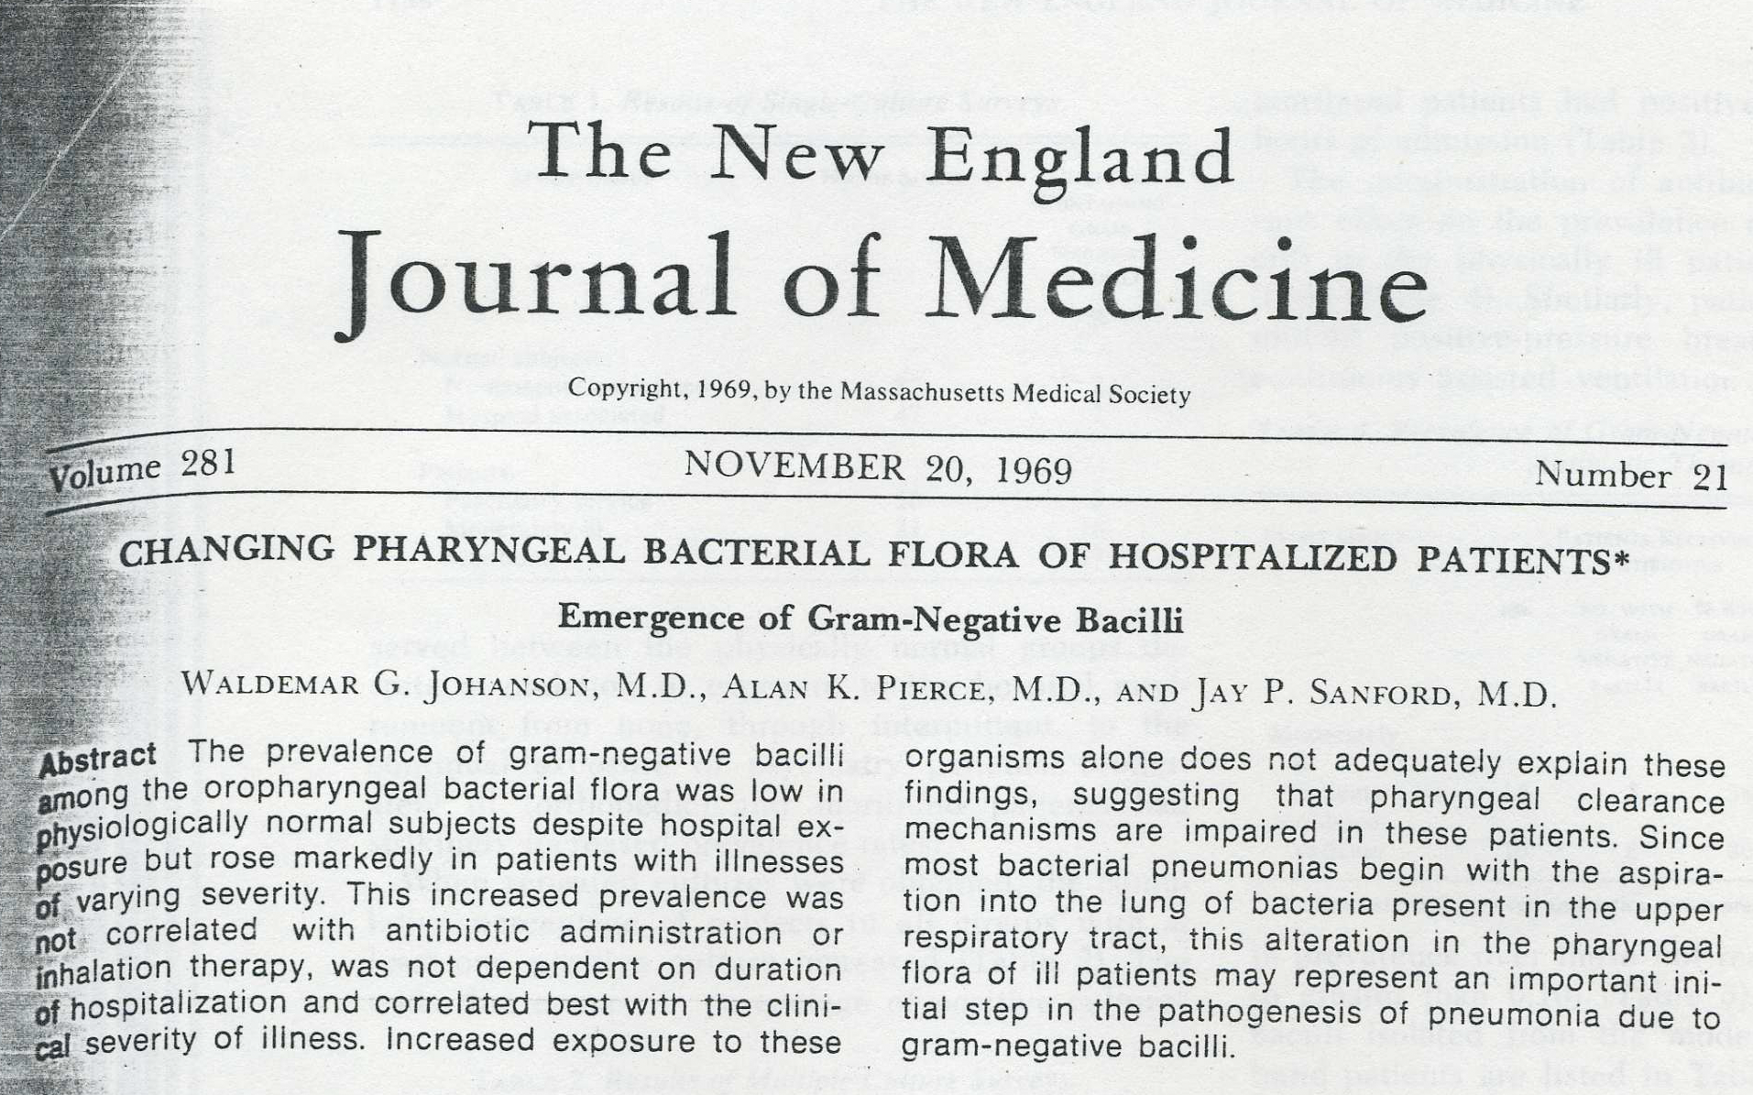
We’ve Known About this for a Long Time !

Slide 8
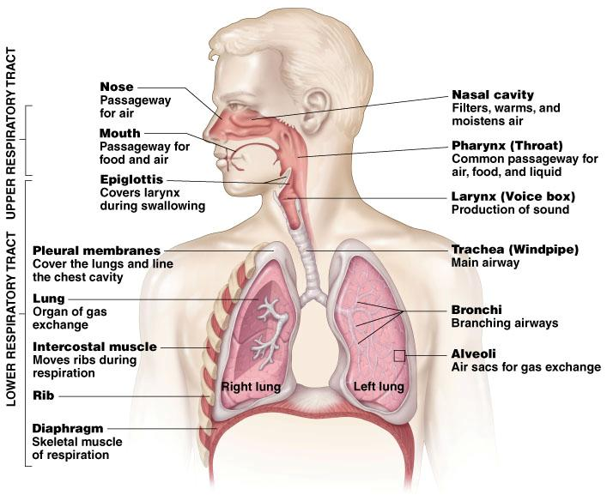
Human Lung Microbiome and the
Adapted Island Model of Lung
All healthy adults micro-aspirate- any type of impairment multiples this risk—
Germs have direct anatomical access to the lung
Lung - body’s largest surface area with environmental exposure (2x gut/ 33x skin) – Not sterile as once thought
Pneumonia comes from germs in the mouth and through the Oropharyngeal pathways
Photo from: A.D.A.M
Notes:
Can we use this Lung image from ADAM?
The Lung is - body’s largest surface area with environmental exposure (2x gut/ 33x skin) – and Not sterile as once thought
Microaspiration as primary source of bacterial immigration to the lung. Subclinical microaspiration is common in healthy adults.
Dickson calls this the “Adaptive island model” – that is, the lung’s microbiome health is determined by balance of microbial immigration (chiefly due to microaspiration) and ability of lung to eliminate contamination. This is because the lung is constantly exposed to environmental contamination. When the lung is infected, respiratory dysbiosis occurs leading to an inflammatory response.
16. Dickson, R.P., Erb-Downward, J.R., & Huffnagle, G.B. (2014). Towards an ecology of the lung: New conceptual models of pulmonary microbiology and pneumonia pathogenesis. Lancet Respiratory Medicine, 2, 238-246. DOI: 10.1016/S2213-2600(14)70028-1
Lungs are no longer considered sterile. Lungs contain over 100 different taxa primarily seeded by oral taxa arriving by Microaspiration and mucosal translation (adults)
Disruption of Microbiome
Lung - body’s largest surface area with environmental exposure (2x gut/ 33x skin) - Not sterile as once thought
Risk with illness & hospitalization
Changes in saliva pH and production
17. Pettigrew, M.M., Tanner, W., & Harris A.D. (2021). The lung microbiome and pneumonia. The Journal of Infectious Diseases, 223(S3),S241–5. DOI: 10.1093/infdis/jiaa702
Pneumonia is actual respiratory dysbiosis – that is a disruption of the lung’s microbiome that leads to an inflammatory process. Pneumonia is a result of lung failure to continue adequate gas exchange in the region of the pneumonia.
Low cost real-time sequencing of RNA and DNA now available to identify pneumonia pathogens and key inflammatory – metabolic indices
Current practices in antimicrobial therapy have moderate success in treating HAP. This indicates that more research and primary prevention of pneumonia in the hospital setting is of the upmost importance.
Due to the high rates of treatment failures for HAP (up to 30%) (re: difficult in identification of bacterial taxa, challenges in obtaining non-vent cultures, contamination, culture threshold, lack investigation for viral cause, etc.) new approaches should be considered.
18. Scannapieco, F. (2013). The oral microbiome: Its role in health and in oral and systemic infections. Clinical Microbiology Newsletter, 35(20), 163-169. DOI: 10.1016/J.Clinmicnews.2013.09.003
19. Scannapieco, F. (2014). Pneumonia and oral pathogens (chapter 9). Oral-systemic health connection: A guide to patient care. Quintessence publishing. ISBN-10: 0867156503 | ISBN-13: 978-0867156508
20. Chanderraj, R., & Dickson, R.P. (2018). Rethinking pneumonia. Proceedings of the National Academy of Sciences of the United States of America ,115(52), 13148-13150 . https://doi.org/10.1073/pnas.1819024116
21. Roquilly, A., Torres, A., Villadangos, J.A., Netea, M.G., Dickson, R. Becher, B., & Asehnoune, K. (2019). Pathophysiological role of respiratory dysbiosis in hospital-acquired pneumonia. Lancet Respiratory Medicine, 7, 710—720. DOI: 10.1016/S2213-2600(19)30140-7
Pneumonia represents respiratory failure. Therapeutically manipulate the microbiome, rather than completed eradicated by antibiotics, and restoration of typical microbiome, more studies immune response to HAP, more precision medicine

Slide 9
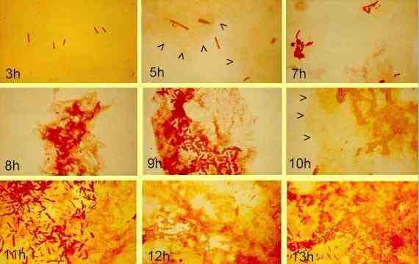
Respiratory Dysbiosis = Risk for Pneumonia
Microbiome of Oral Cavity
  Millions of oral microbes
  700 + species²²⁻²³
  Replicate 5x in 24 hours ²²
  Germs in mouth match germs in lung ²²⁻²⁴
  Change saliva pH & flora within 48 hours of hospitalization
Microaspiration 100,000,000 germs in 1 ML
Disruption of Microbiome
From:/ Biofilm images supplied by: DG Allison & IW Sutherland http://archive.bio.ed.ac.uk/jdeacon/microbes/biofilm.htm
Loesche, W. 2012/ Scannapieco et al. (1992).Crit CareMed, 20:740-745 // Roquilly 2019 doi: 10.1016/S2213-2600(19)30140-7. Epub 2019 Jun 7.PMID: 31182406
DOI: 10.1016/S2213-2600(19)30140-7
Notes:
22. Landers, B. (2009). Oral bacteria: How many? How fast? RDH magazine. https://www.rdhmag.com/infection-control/water-safety/article/16404976/oral-bacteria-how-many-how-fast
23. Lu, M., Zuan, S., & Wang, Z. (2019). Oral microbiota: A new view of body health. Food Science and Human Wellness, 8, 8-15. https://doi.org/10.1016/j.fshw.2018.12.00
24. Chanderraj, R., & Dickson, R.P. (2018). Rethinking pneumonia. Proceedings of the National Academy of Sciences of the United States of America ,115(52), 13148-13150 . https://doi.org/10.1073/pnas.1819024116
25. Munro, C., Grap, M.J., Jones, D., McClish, D.K., & Sessler, C.N. (2009). Chlorhexidine, toothbrushing, and preventing ventilator-associated pneumonia in critically ill adults. American Journal of Critical Care, 18, 428-437. DOI: 10.4037/ajcc2009792
29. Scannapieco, F. A., Stewart, E. M., & Mylotte, J. M. (1992). Colonization of dental plaque by respiratory pathogens in medical intensive care patients. Critical care medicine, 20(6), 740–745. https://doi.org/10.1097/00003246-199206000-00007
Reference for possible questions: [Roquilly, A., Torres, A., Villadangos, J.A., Netea, M.G., Dickson, R., Becher, B., & Asehnouone, K. (2019). Pathophysiological role of respiratory dysbiosis in hospital-acquired pneumonia. Lancet Respiratory Medicine,7, 710-720. {For example, therapeutically manipulate the microbiome, rather than completed eradicated by antibiotics, and restoration of typical microbiome, more studies immune response to HAP, more precision medicine (Roquilly et al 2019].}] Due to the high rates of treatment failures for HAP (up to 30%) (re: difficult in identification of bacterial taxa, challenges in obtaining non-vent cultures, contamination, culture threshold, lack investigation for viral cause, etc.) new approaches should be considered.
Note: 250 species¹ from a pool of around 700 documented oral residents².

Slide 10
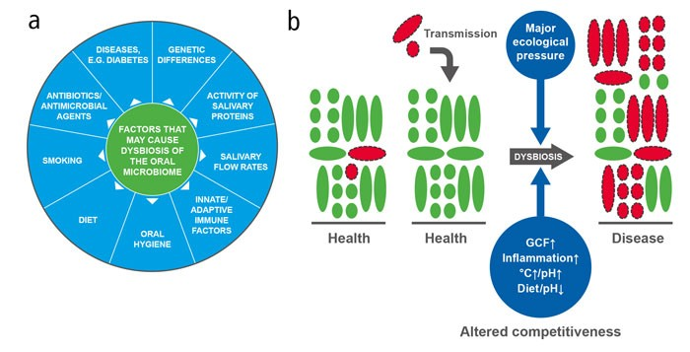


Glucose regulation
Immobility
48 hours for hospital-acquired pathogens in take hold in the oral flora
Kilian et al 2016 The oral microbiome- an update for oral healthcare professionals British Dental Journal 221(10)
Scannapieco et al. (1992).Crit CareMed, 20:740-745
Notes:
What happens in hospitals that creates this risk for NVHAP?
This model by Killian in the UK allows us to take a look at what disrupts the oral microbiome and what specifically happens in the hospital.
We do several things to patients in hospital that place them at risk for microaspiration of harmful germs. In the blue circle at the left, there are several factors noted that disrupt the oral microbiome. The plus signs are the key disruptors that commonly occur during any patient’s hospitalizations.
In the hospital, we often use antimicrobial agents, we give patients medications that dry their mouth and change their salivary flow rates, we diminish their own immune responses, and immobilize them in bed. We make them nothing by mouth, and when they do eat, their normal diet is changed. AND unfortunately, we overlook the opportunity the maintain their oral microbiome with daily oral hygiene.
As the patient moves from a healthy flora to a germ dominate flora there are also changes in the patient’s ability to produce an immune response, as we see the dark blue circles.
In many ways, we create a dysbiosis that results in a risk for pneumonia.
Some of these things we cannot change for our hospital patients but ONE thing we can change: We can improve oral care and maintain the oral microbiome.
26. Killian, M., et al. (2016). The oral microbiome – an update for oral healthcare professionals. British Dental Journal, 221(10), 657-666. DOI: 10.1038/sj.bdj.2016.865
27.Dickson, R.P., Erb-Downward, J., Freeman, C., McCloskey, L., Falkowski, N., Huffnagle, G., & Curtis, J. (2017). Bacterial topography of the healthy human lower respiratory tract. mBio: American Society for Microbiology.
DOI: 10.1128/mBio.02287-16
28. Gomes-Filho, I.S., et al. (Scannapieco, F.) ( 2019). Periodontitis and respiratory diseases: A systematic review with meta-analysis. Oral Diseases, 26, 439-446. DOI: 10.1111/odi.13228
29. Scannapieco, F., Stewart, ,E.M., Mylotte, J.M. (1992). Colonization of dental plaque by respiratory pathogens in medical intensive care patients. Crit Care Med, 20(6),740-5. doi: 10.1097/00003246-199206000-00007

Slide 11
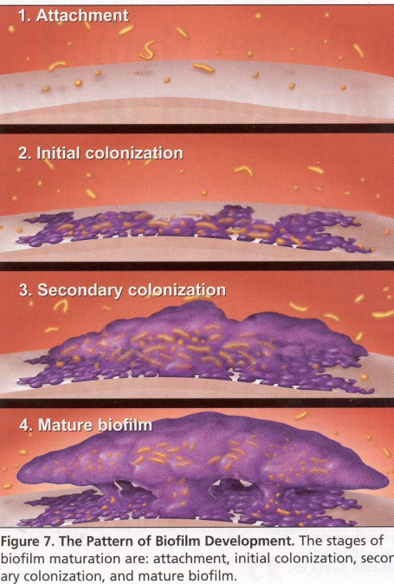
How germs attach and grow in oral biofilm
Kellum etal 2007Understanding inflame cytokine response in PNA and sepsis GenIMS Arch Intern Med. 2007;167(15):1655-1663
Imagine: Nield-Gehrig JS and Willmann DE. Foundations of Periodontics for the Dental Hygienist. Philadelphia: Lippincott Williams & Wilkins Textbook 2003:67-73.
Notes:
Kellum, J. A., Kong, L., Fink, M. P., Weissfeld, L. A., Yealy, D. M., Pinsky, M. R., Fine, J., Krichevsky, A., Delude, R. L., Angus, D. C., & GenIMS Investigators (2007). Understanding the inflammatory cytokine response in pneumonia and sepsis: results of the Genetic and Inflammatory Markers of Sepsis (GenIMS) Study. Archives of internal medicine, 167(15), 1655–1663. https://doi.org/10.1001/archinte.167.15.1655
Image: Nield-Gehrig JS and Willmann DE. Dental plaque biofilms. Foundations of Periodontics for the Dental Hygienist. Philadelphia: Lippincott Williams & Wilkins Textbook 2003:67-73.

Slide 12
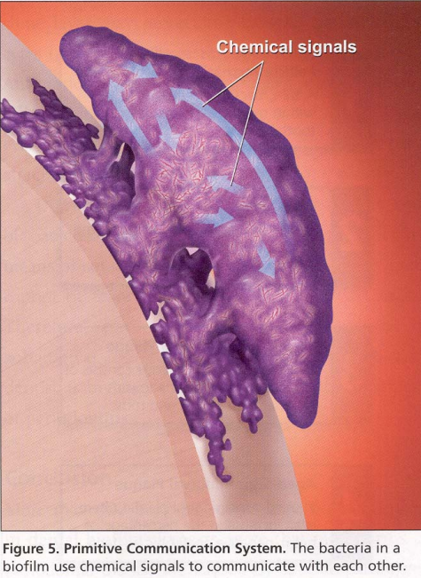
Primary source control!
The biofilm is extremely sticky and hard to remove
This biofilm may directly impact the health of the lung
Mechanical removal of biofilm (plaque) = tooth brushing is required
Kellum etal 2007Understanding inflame cytokine response in PNA and sepsis GenIMS Arch Intern Med. 2007;167(15):1655-1663
Imagine: Nield-Gehrig JS and Willmann DE. Foundations of Periodontics for the Dental Hygienist. Philadelphia: Lippincott Williams & Wilkins Textbook 2003:67-73.
Notes:
Kellum et al. (2007).Understanding inflame cytokine response in PNA and sepsis GenIMS Arch Intern Med. 2007;167(15):1655-1663
Image: Nield-Gehrig JS and Willmann DE. Dental plaque biofilms. Foundations of Periodontics for the Dental Hygienist. Philadelphia: Lippincott Williams & Wilkins Textbook 2003:67-73.

Slide 13
Double Whammy
In addition to germs growing….
Germ colonies develop chemical communication to
Secrete proinflammatory cytokines that reduce immune response
Germ colonies incite an inflammatory response in the lung when they are microaspirated
Kellum etal 2007Understanding inflame cytokine response in PNA and sepsis GenIMS Arch Intern Med. 2007;167(15):1655-1663
Imagine: Nield-Gehrig JS and Willmann DE. Foundations of Periodontics for the Dental Hygienist. Philadelphia: Lippincott Williams & Wilkins Textbook 2003:67-73.
Notes:
Kellum et al. (2007).Understanding inflame cytokine response in PNA and sepsis GenIMS Arch Intern Med. 2007;167(15):1655-1663
Image: Nield-Gehrig JS and Willmann DE. Dental plaque biofilms. Foundations of Periodontics for the Dental Hygienist. Philadelphia: Lippincott Williams & Wilkins Textbook 2003:67-73.
General background information:
There is variation in the cytokines released depending on the type of cellular communication and colonization that develop in an individual’s oral biofilm. For example,
Cellular Receptors: Cell-surface located toll like receptors (TLRs) and cytoplasmatic nucleotide-binding oligomerization domain (NOD)-like receptors (NLRs) belong to the pattern recognition receptors (PRRs). PRRs recognize microbial parts that represent pathogen-associated molecular patterns (PAMPs).
A multimeric complex of proteins known as inflammasome, which is a subset of NLRs, assembles after activation and proceeds to pro-inflammatory cytokine release.
Cytokine Production and Release: Cytokines and bacterial products may lead to host cell mediated tissue destruction. Keratinocytes are able to produce diverse pro-inflammatory cytokines and chemokines, including interleukin (IL)-1, IL-6, IL-8 and tumor necrosis factor (TNF)-α.
Front. Immunol., 14 February 2019 | https://doi.org/10.3389/fimmu.2019.00208

Slide 14

KEY POINT to REMEMBER –
all patients are at risk
Who is at most risk?
Who is NOT at risk?
133 Veterans Affairs hospitals and subsequent mortality, length of stay, inpatient sepsis, and 12-month costs.
Looked at over 72 risk factors to try and predict at hospital admission who would get NVHAP.
Risk stratification was not feasible
Evan Carey ¹, Hung-Yuan P Chen ², Dian Baker ³, Richard Blankenhorn ², Ryan J Vega ⁴, Michael Ho ⁵, Shannon Munro ⁶American Journal of Infection Control
Notes:
All patients are at risk: Even healthy adults and maternity patients with hospitals stays over 48 hours. Unlikely other hospital-acquired infections , where we take an epidemiology risk-based intervention approach, we can not use targeted intervention with NVHAP to prevent lung infection. This is because the risk for NVHAP exists for all our patients. While some patients are clearly at more risk (e.g., stroke, cancer, advanced age), all patients, even young healthy adults and maternity patients carry risk for NVHAP while in the hospital. This means we must provide fundamental basic care consistently for all patients.
5. Baker, D., & Quinn, B. (2018). Hospital acquired pneumonia prevention initiative-2: Incidence of hospital-acquired pneumonia in the United States. American Journal of Infection Control, 46(1), 2-7. DOI: https://doi.org/10.1016/j.ajic.2017.08.036.
All patients are at risk: Even healthy adults and maternity patients with hospitals stays over 48 hours. Unlikely other hospital-acquired infections , where we take an epidemiology risk-based intervention approach, we can not use targeted intervention with NVHAP to prevent lung infection. This is because the risk for NVHAP exists for all our patients. While some patients are clearly at more risk (e.g., stroke, cancer, advanced age), all patients, even young healthy adults and maternity patients carry risk for NVHAP while in the hospital. This means we must provide fundamental basic care consistently for all patients.
133 Veterans Affairs hospitals and subsequent mortality, length of stay, inpatient sepsis, and 12-month costs. NV-HAP occurred in 0.6% of Veteran admissions. Among admissions that developed NV-HAP, the mean length of stay of 26.3 days (6.72 days among non-NV-HAP), 30-day mortality was 18.4% (4.5% among non-NV-HAP), 1-year mortality was 47.8% (21.4% among non-NV-HAP), and total median 12-month direct medical costs were $138,136.32 ($64,357.21 among non-NV-HAP). Inpatient sepsis occurred in approximately 20% of NV-HAP admissions (0.7% among non-NV-HAP). Look at 72 factors with AI to determine risk:
Since population risk stratification is not feasible, prevention efforts should be directed
at the full population of hospitalized Veterans.

Slide 15
How can the healthcare team solve this problem?
Notes:
Now that we understand the harm from NVHAP, how can the healthcare team solve this problem?

Slide 16
GOAL
Primary Drivers
Secondary Drivers
Reduce pathogenic colonization of oropharyngeal cavity–primary source control
Comprehensive oral hygiene for all patients
Prevent
NVHAP
Swallow assessments
Reduce
microaspiration
Elevated Head of Bed
NG/OG tube assessment and care
Strengthen host defenses
Early mobility
Ensure adequate nutrition
Pharmacological/ antibiotic stewardship
Glycemic control
Maintain body temperature
Immunize per CDC
Quinn, Giuliano, Baker (May 2020)AJIC / https://doi.org/10.1016/j.ajic.2020.03.006
Notes:
There are many interventions proposed to prevent hospital acquired pneumonia. Most of them have limited research to support a direct cause and effect relationships to prevent pneumonia. However, there have been multiple, single-site studies and pre/post intervention studies that have found important keys to pneumonia prevention.
The interventions are organized here, as shown in a diagram from the Am J Inf Control May 2020 issue on NVHAP. The interventions are organized by standard prevention paradigms: Primary source control, Reduce risk, and Strengthen host defenses.
We know that to prevent pneumonia we must reduce pathogens in the oropharyngeal cavity, reduce microaspiration, and work to strengthen host defenses.
There are many actions required to prevent NVHAP that also essential -- but today our focus is on oral care. To date, oral care has the best evidence demonstrated to prevent pneumonia and is also based in fundamental science of the oral microbiome.
31. Quinn, B., Giuliano, K. K., & Baker, D. (2020). Non-ventilator health care-associated pneumonia (NV-HAP): Best practices for prevention of NV-HAP. American journal of infection control, 48(5S), A23–A27. https://doi.org/10.1016/j.ajic.2020.03.006
1. Munro SC, Baker D, Giuliano KK, Sullivan SC, Haber J, Jones BE, Crist MB, Nelson RE, Carey E, Lounsbury O, Lucatorto M, Miller R, Pauley B, Klompas M. (2021). Nonventilator hospital-acquired pneumonia: A call to action. Infection Control & Hospital Epidemiology 2021 Jun 9:1-6. doi: 10.1017/ice.2021.239. Epub ahead of print. PMID: 34103108.

Slide 17
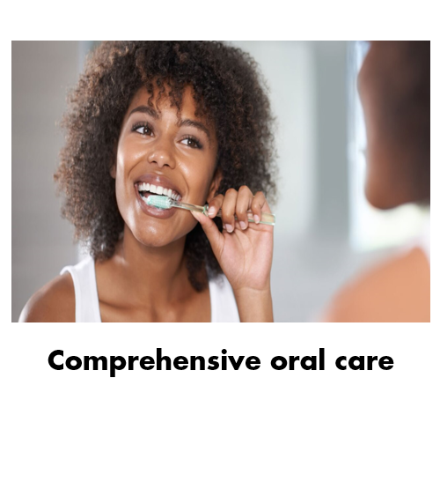
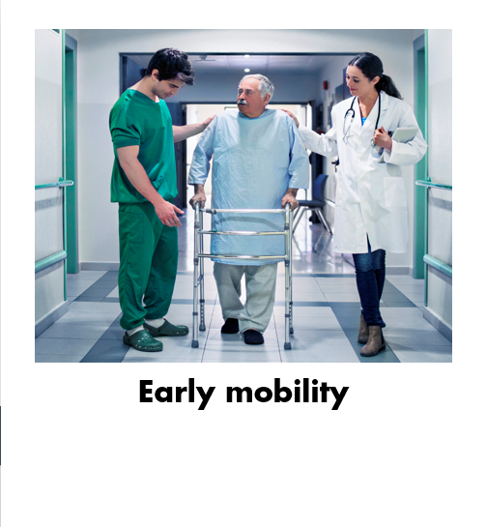
What Do We Know About Solutions?
How can our healthcare team solve this patient safety issue?
Photo: https://www.jnj.com/health-and-wellness/9-tips-to-boost-your-oral-hygiene-routine/, Photo mobility: https://www.johnshopkinssolutions.com/solution/amp/

Slide 18
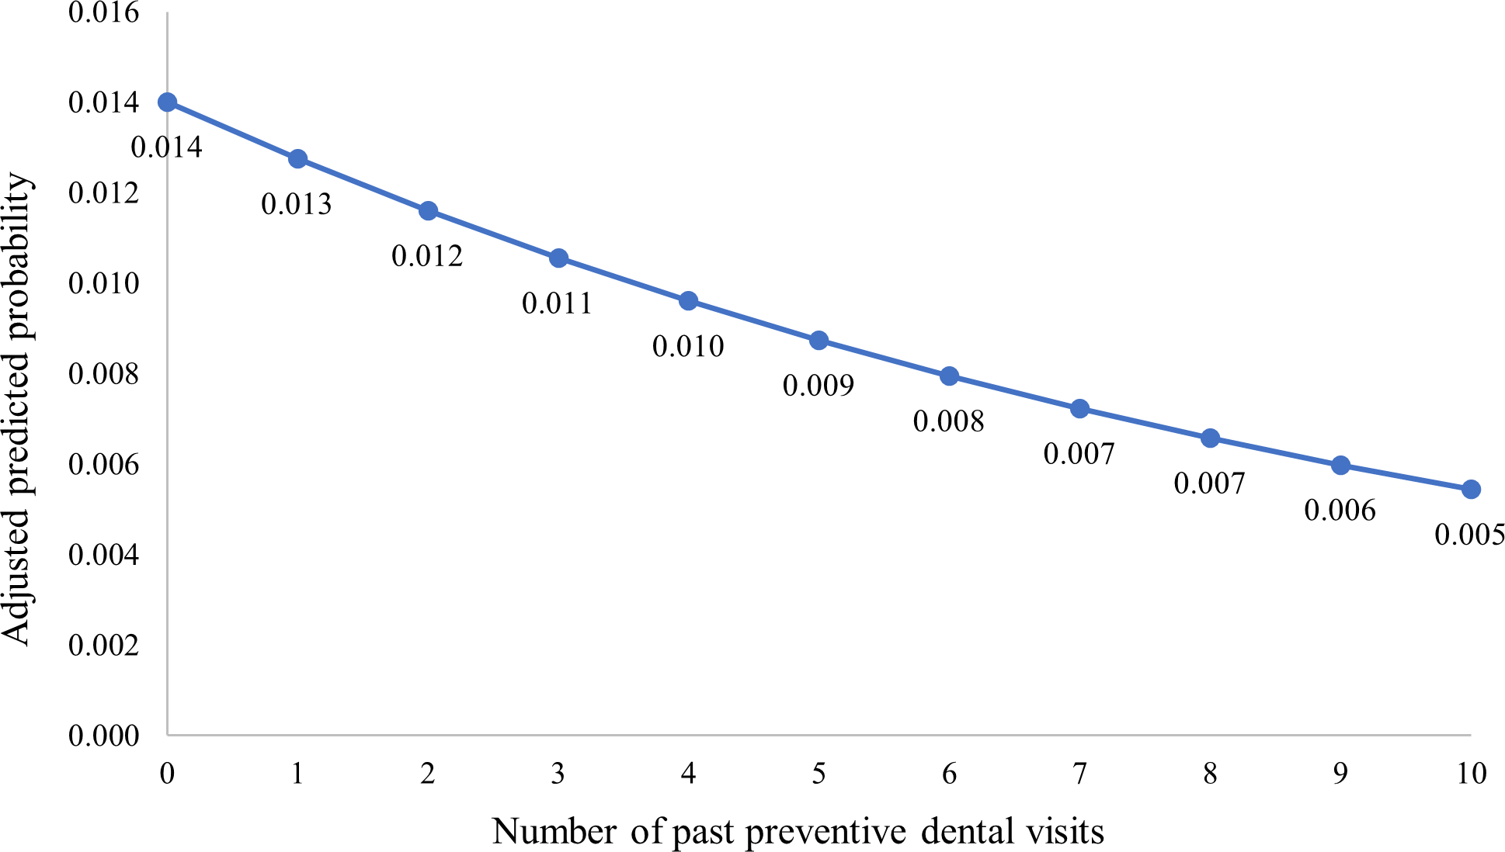
Dental Services and NVHAP
Predicted probability of diagnosis of NVHAP decreased with each additional preventive dental visit 1 year prior to hospitalization
Baker D, Giuliano KK, Thakkar-Samtani M, Scannapieco FA, Glick M, Restrepo MI, Heaton LJ, Frantsve-Hawley J. The association between accessing dental services and nonventilator hospital-acquired pneumonia among 2019 Medicaid beneficiaries. Infect Control Hosp Epidemiol. 2022 Jul 11:1-3. doi: 10.1017/ice.2022.163.

Slide 19
Primary Source Control!
The biofilm is extremely sticky and difficult to remove. Biofilms are resistant to topical antimicrobials
Biofilms incite an inflammatory response in the lung when they are microaspirated
Mechanical removal of oral biofilm by tooth brushing is required
Biofilms release chemicals that stimulate the host to secrete proinflammatory cytokines that induce inflammatory and immune responses
Kellum etal 2007Understanding inflame cytokine response in PNA and sepsis GenIMS Arch Intern Med. 2007;167(15):1655-1663
Notes:
The biofilm is extremely sticky and difficult to remove. Biofilms are resistant to topical antimicrobials
This oral biofilm may directly impact the health of the lung
Mechanical removal of oral biofilm (dental plaque) by tooth brushing is required
Kellum et al. (2007).Understanding inflame cytokine response in PNA and sepsis. Archives of Internal Medicine, 167(15),1655-1663. doi: 10.1001/archinte.167.15.1655
Image: Nield-Gehrig JS and Willmann DE. Dental plaque biofilms. Foundations of Periodontics for the Dental Hygienist. Philadelphia: Lippincott Williams & Wilkins Textbook 2003:67-73.
Kellum, J. A., Kong, L., Fink, M. P., Weissfeld, L. A., Yealy, D. M., Pinsky, M. R., Fine, J., Krichevsky, A., Delude, R. L., Angus, D. C., & GenIMS Investigators (2007). Understanding the inflammatory cytokine response in pneumonia and sepsis: results of the Genetic and Inflammatory Markers of Sepsis (GenIMS) Study. Archives of internal medicine, 167(15), 1655–1663. https://doi.org/10.1001/archinte.167.15.1655

Slide 20


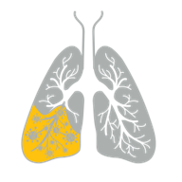



One Hospital’s Story
Sutter Medical Center – 550 bed hospital
Sacramento, California
Launched hospital-wide daily oral care
Increased from 1 time in 4 days to
3 times a day oral care
164
NV-HAP cases avoided
31
estimated lives saved
$4.5 - 6.5M
cost avoidance

Slide 21
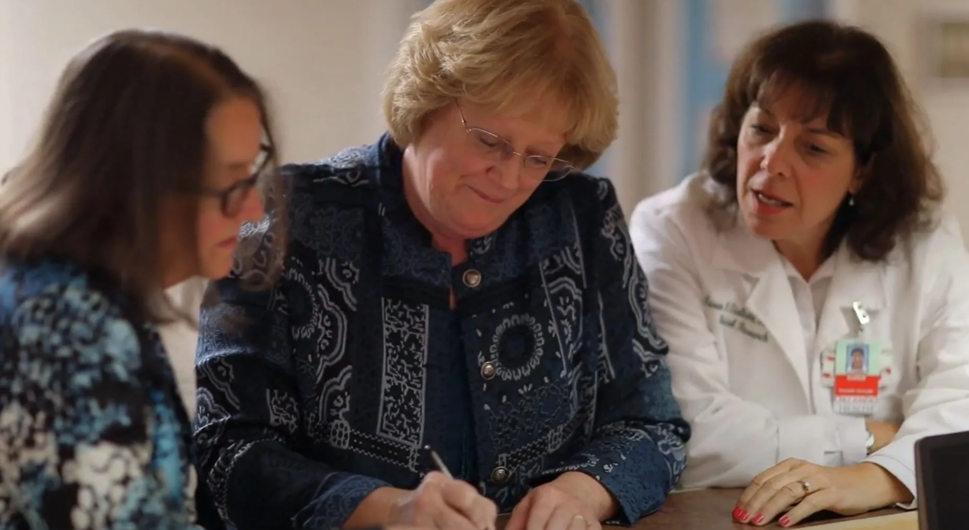


Closing Slide
Oral care as prevention for NVHAP:
A four-unit cluster randomized trial
Primary Study Aim
reduction in NVHAP as measured by incidence per 1000 patient days
Process Outcome
Frequency of oral care
Secondary Outcomes
NVHAP associated morbidity and mortality,
readmission rates, mortality, unplanned ICU transfer, and the development of sepsis not present on admission
Giuliano, Penoyer, Middelton & Baker (2021) Oral care prevent NVHAP. AJN v. 121 No. 6

Slide 22
Primary Study Aim: Implementation of a universal, standardized oral care protocol vs. usual care associated with a reduction in NVHAP as measured by incidence / 1000 patient days?
Treatment Group | NV-HAP |  |  | NV-HAP
Treatment Group | No | Yes | Total | Incidence Rate per 1,000 Patient-Days
Medical Control, No. (%) | 2,059 (99.2) | 16 (0.8) | 2,075 | 1.40
Medical Intervention, No. (%) | 2,706 (99.9) | 3 (0.1)ª | 2,709 | 0.21
Total | 4,765 | 19 | 4,784 | -85 (% Difference)
Surgical Control, No. (%) | 2,075 (99.4) | 13 (0.6) | 2,088 | 1.17
Surgical Intervention, No. (%) | 1,830 (99.6) | 7 (0.4)^{b} | 1,837 | 0.51
Total | 3,905 | 20 | 3,925 | -56 (% Difference)
Notes:
CI = confidence interval; NV-HAP = nonventilator hospital-acquired pneumonia; OR = odds ratio.
a OR for medical control vs. medical intervention units (OR: 7.1; 95% CI, 2.01-24.1, P = 0.002).
b OR for surgical control vs. surgical intervention units (OR: 1.6; 95% CI, 0.65-4.1, P = 0.29).

Slide 23
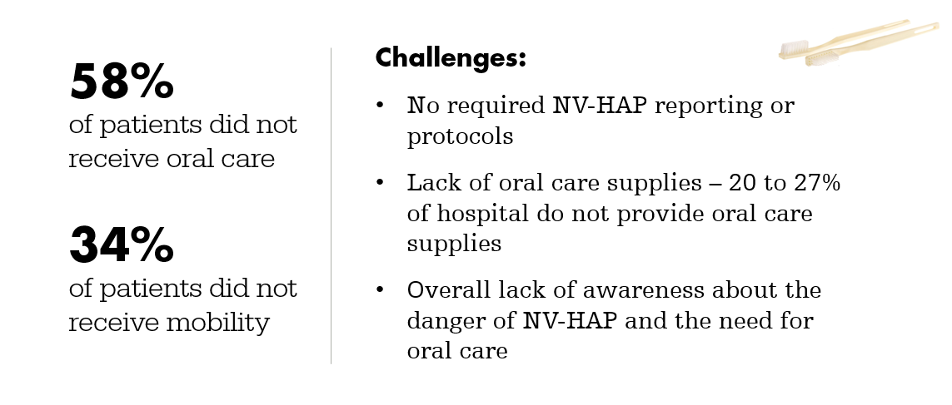
Yet, These Fundamental Patient Interventional Services are Often Omitted

Slide 24

However, Implementation of Daily Oral Care Remains a Challenge
What are some possible barriers to daily oral care in your hospital?

Slide 25

Quality Improvement first step: Gap Analysis
Barriers To Oral Care-
Lack of Toothbrushes and Oral Care Protocols
Most hospitals do not have basic NVHAP prevention programs
  24.2% do not monitor NVHAP cases
  57.6% lack universal oral care policy
  42.4% do not require oral care competency training
  48.5% do not have suction toothbrushes routinely available
27% reported not providing basic oral care supplies
  Toothbrush and Toothpaste * Floss * Mouth rinse
  Denture cleanser * Denture cup * Denture adhesive
  *** Many hospital toothbrushes are harmful – bristle fallout, too hard- gum bleeding
  Families not engaged
  PCTs responsible for oral care – often have 15 -30 patients/ assigned to different RNs
Baker, Dian L., and Karen K. Giuliano. “Prevention Practices for Nonventilator Hospital-Acquired Pneumonia: A Survey of the Society for Healthcare Epidemiology of America (SHEA) Research Network (SRN).”
Infection Control & Hospital Epidemiology, 2021, pp. 1–2., doi:10.1017/ice.2021.427.

Slide 26
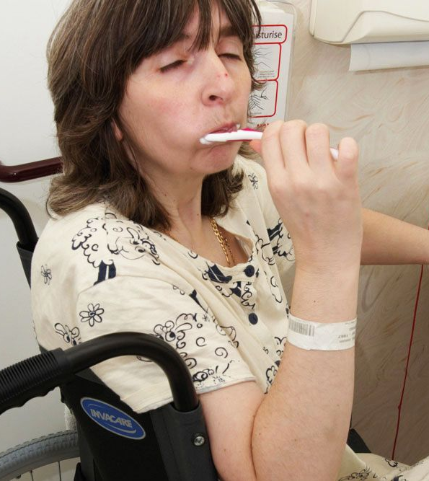
Good News About Oral Care
About 80% of the time, when provided with education and effective oral care products (toothbrush, toothpaste, mouth rinse), patients can provide their own care BUT they need education & motivation
Family members can also be educated and engaged to support oral health
Photo from: https://www.nursingtimes.net/roles/hospital-nurses/improving-mouth-care-provision-in-an-acute-hospital-trust-15-04-2019/

Slide 27
So, what does oral care mean?
Oral health assessment –look in their mouths
Decide: independent care, needs some support, dependent care, or denture care
Education and explanation
Handy, effective oral care supplies – good toothbrush, suction toothbrush (if required), toothpaste with a dentifrice, anti-septic mouth rinse, and denture care when required
Brush each of the 4 quadrants about 30 seconds
Follow-up and RECORD in the EHR

Slide 28

Oral Systemic Health
Visual Oral Health Assessment
provides
important clues about your patients’ overall health

Slide 29
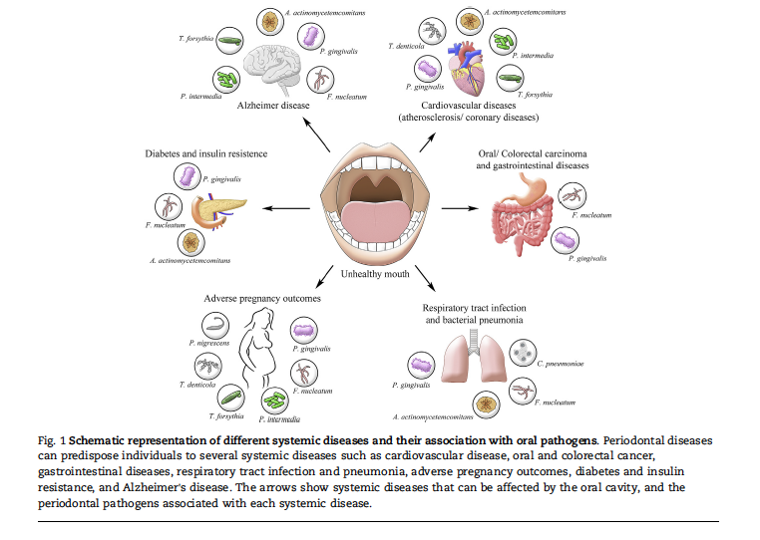
Bui et al. Biomed J. 2019 Feb;42(1):27-35.

Slide 30
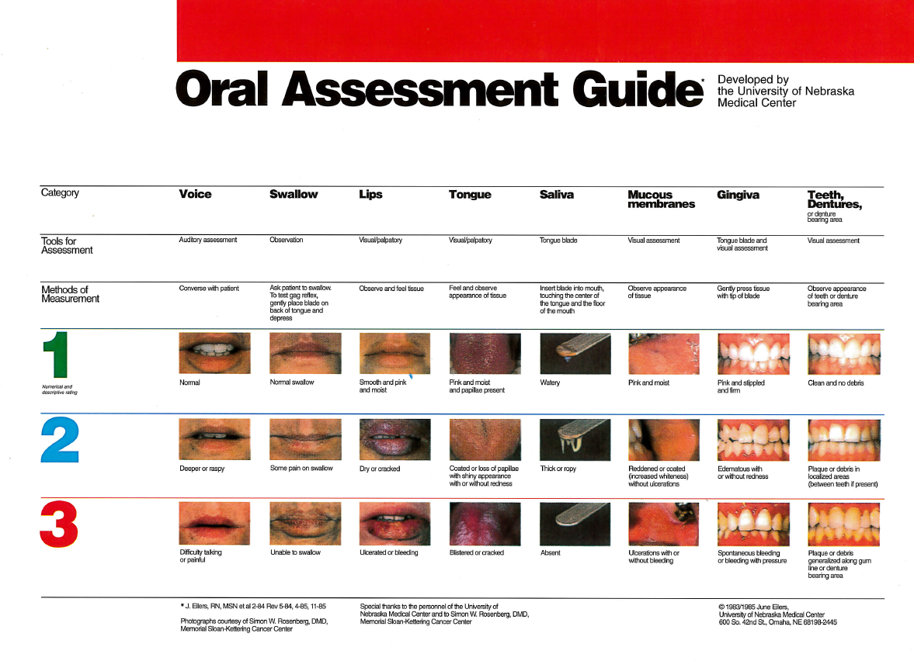
Voice
Swallow
Lips
Tongue
Saliva
Mucous membranes
Gingiva
Teeth/ Dentures
One example, among many, standardized oral health assessment guides
Helpful to have PHOTOS for the staff.
Eilers 1988. University of Nebraska Medical Center

Slide 31
A Few Examples
Would not want to miss this…

Slide 32
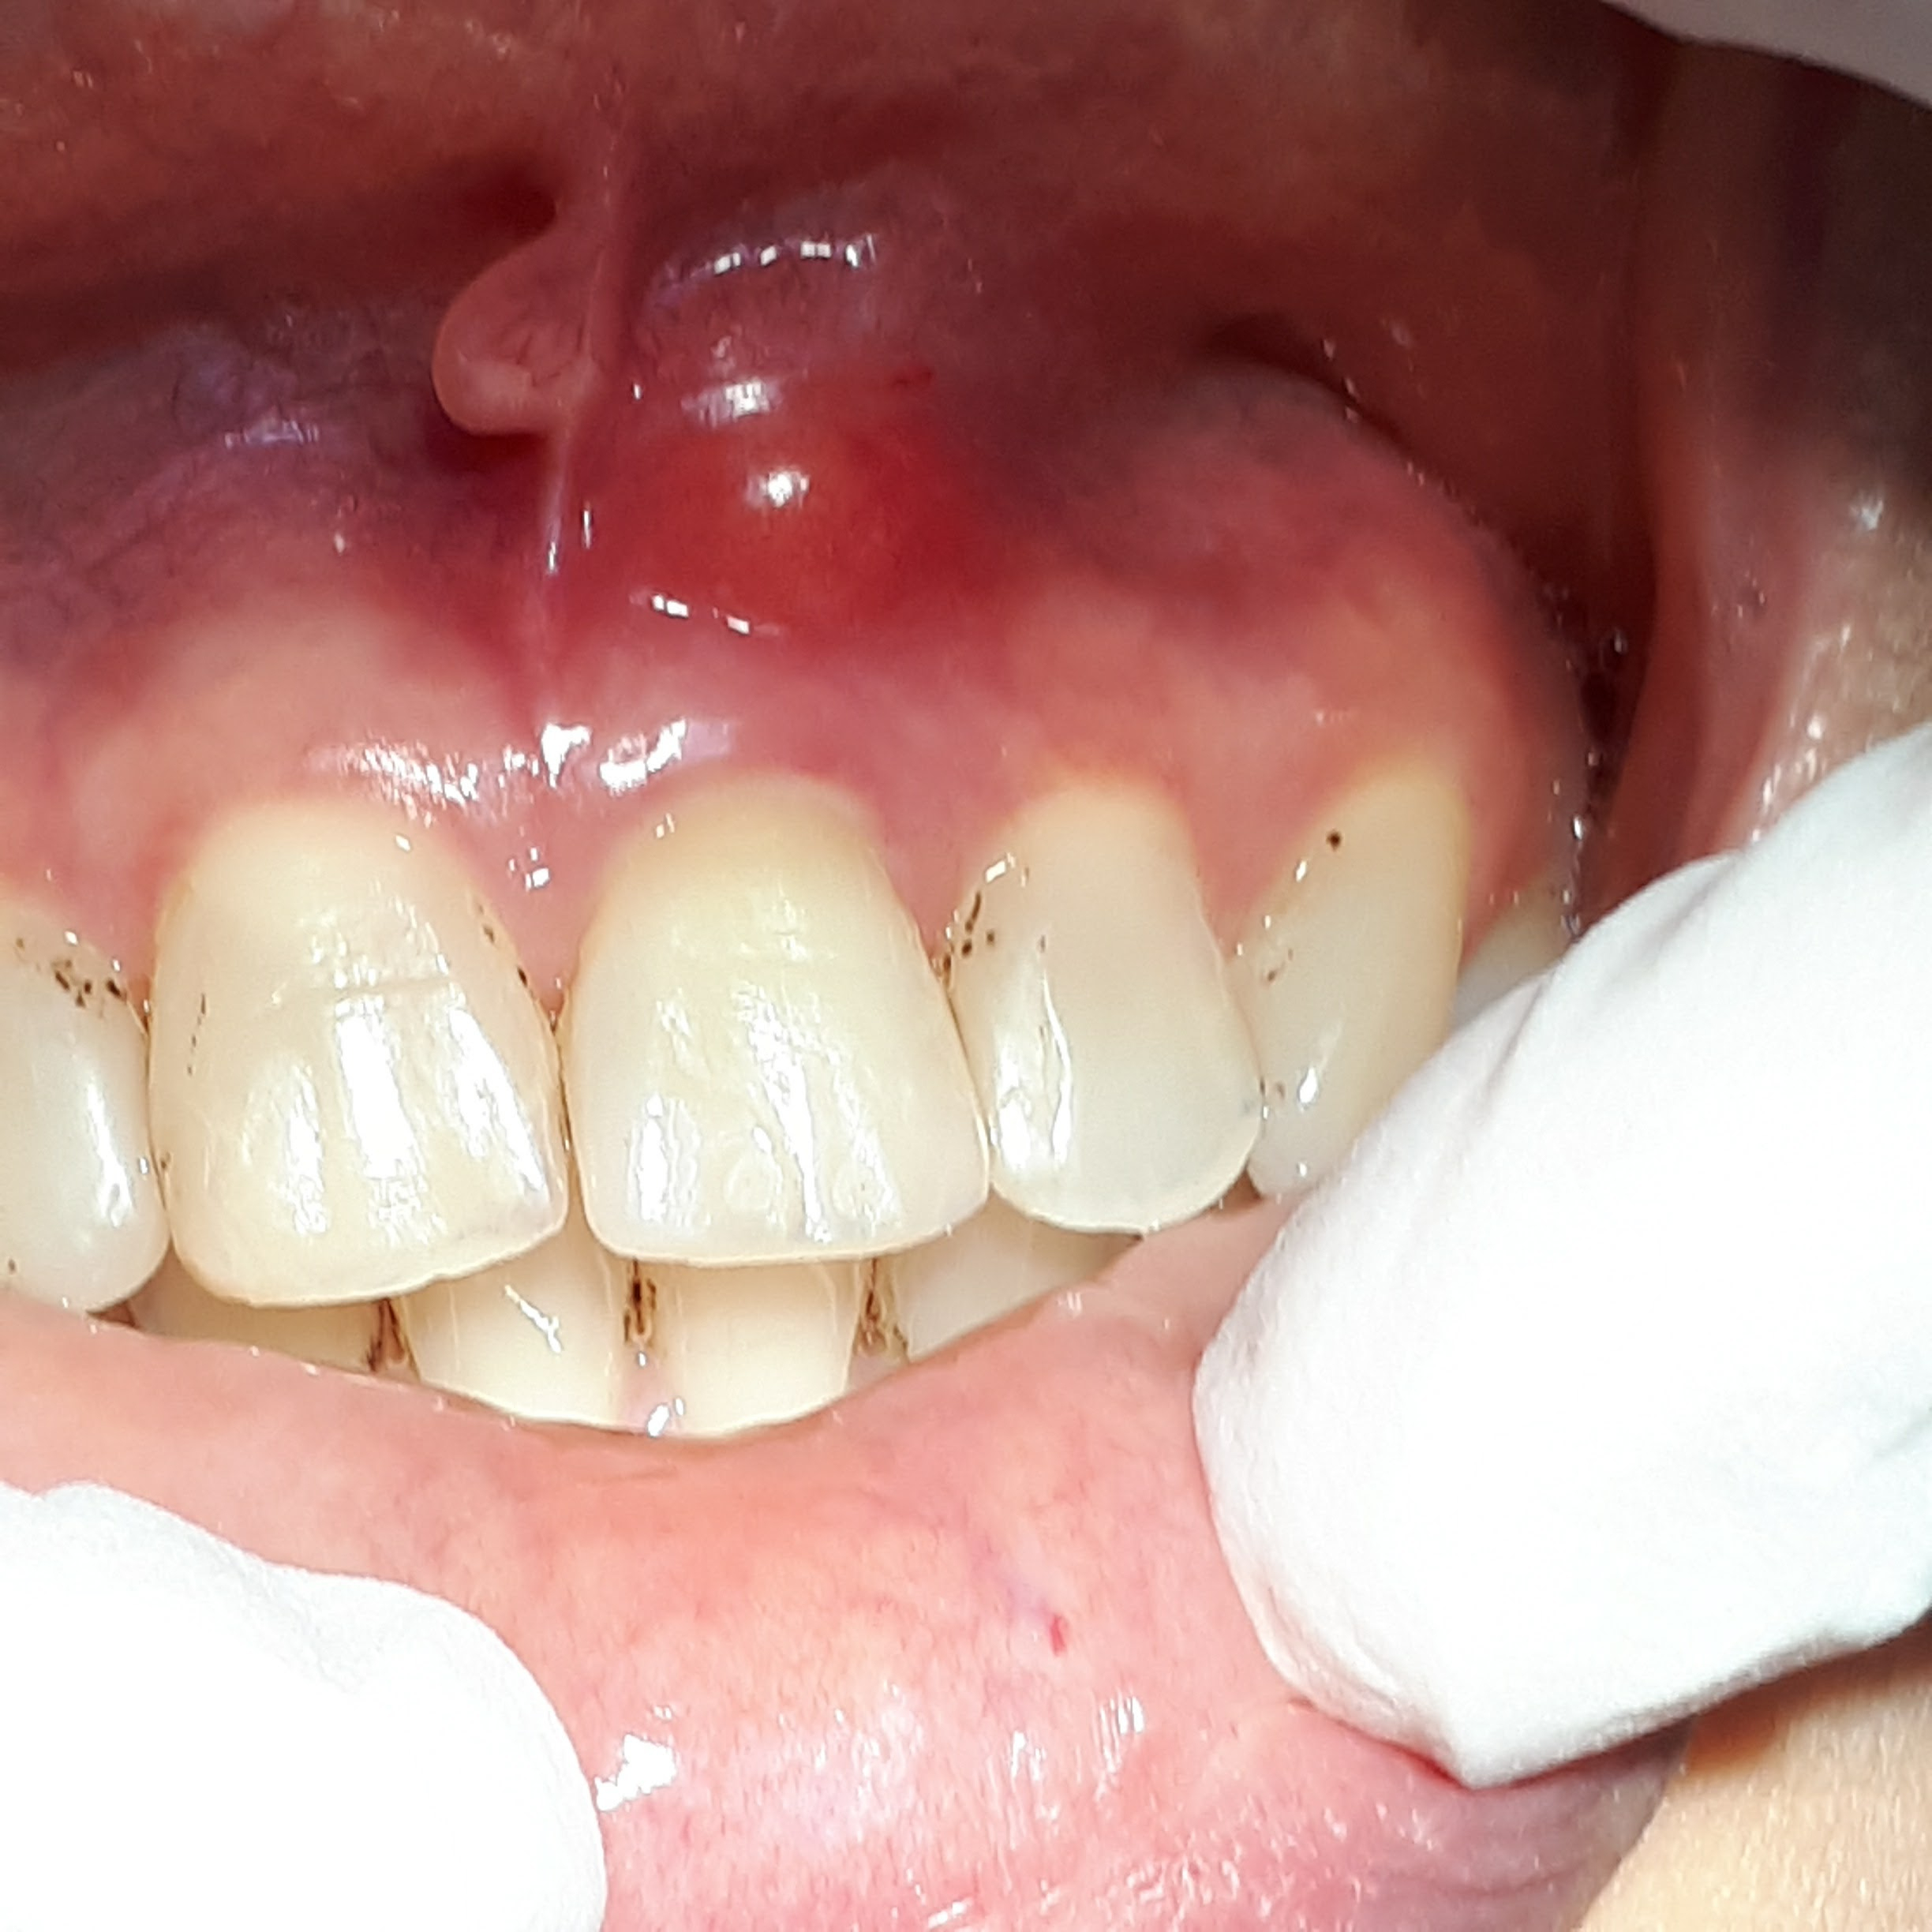
An abscess is a pocket of pus that is caused by a bacterial infection. Active bacterial infections in the mouth can impact your patient’s healing process
They can burst letting germs migrate into the lung and blood stream leading to severe complications.
Spongy, exudate upon palpation
Photo: Shutterstock purchase CS-0773C-0830

Slide 33
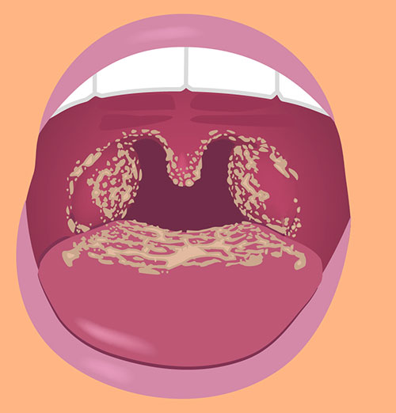
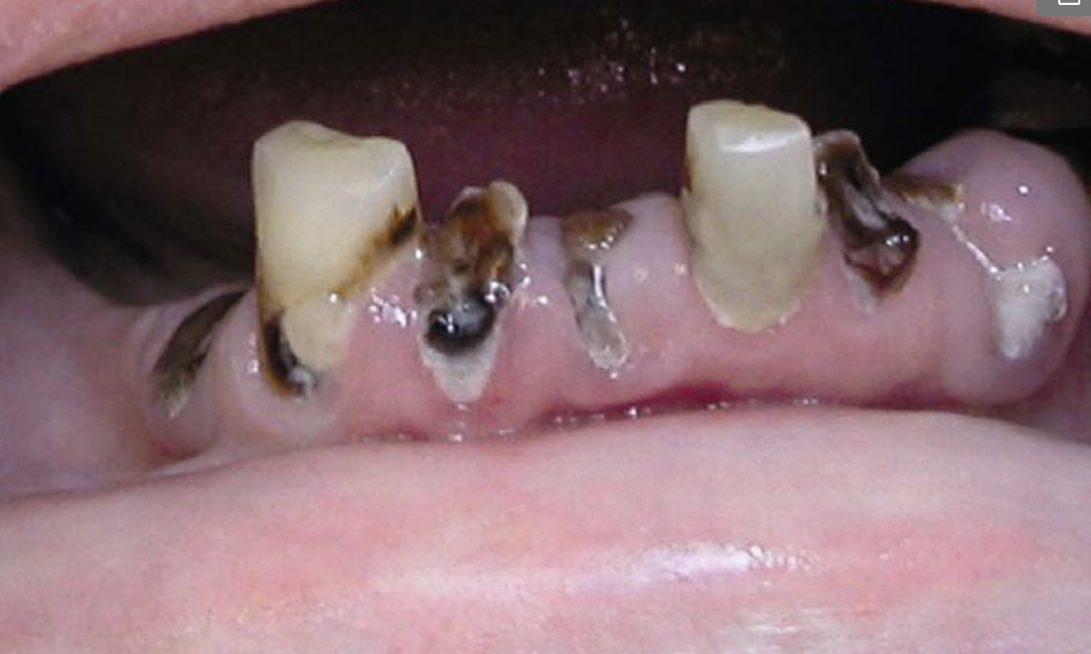
Who is looking at our patient’s mouth?
Candidiasis
Decayed, fractured teeth
https://www.cdc.gov/fungal/diseases/candidiasis/thrush/index.htm
https://www.mccarldental.com/blog/cracked-broken-teeth/l

Slide 34
Oral Findings Requiring Consultation
(Physician and Dental Team)
Signs of oral infection
  Exudate (gingiva, palate) – unusual order, pus
  Swollen cheek
  Excessive, spontaneous bleeding
Multiple fractured and/or decayed teeth (suspicion for dental abscess), particularly with pain
Ulcerations (tongue, cheeks, lips, palate, gingiva)
White patches on cheeks, tongue, palate, gingiva that cannot be wiped off (thrush)
Lost/broken dentures that impede eating
Loose teeth (concern for aspiration)
COVID Tongue – enlarged white chalky or deep pink

Slide 35

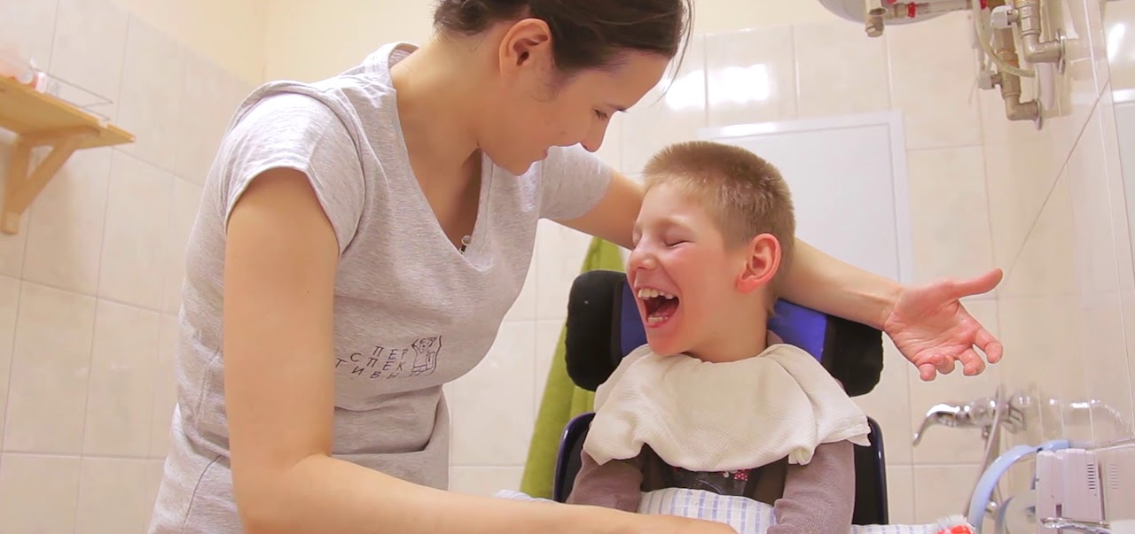
Patient Centered-Care
Equity means
Oral Care and Safety for ALL Patients
Diversity, Equity, and Inclusion (DEI)
https://www.youtube.com/watch?v=KR4xIL0DEnQ

Slide 36
Persons with neurodevelopmental disabilities at very high risk for harm
  Hospital-acquired infection – 7.1%
    HAP rates as high as 9% as compared to 1% general population
  Pressure Ulcer - 4.3%
  Post-surgery complications – 4.3%
  Medication reactions – 5.7%
  Falls - 2.9%
  Iacano & Davis found only 12% received correct medications and only 22% received medications on time
  18% dehydration (not enough fluid)
ALL these rates are significantly higher than for the general hospital population and well above any safety standards – most hospitals don’t collect data for this groups of patients
* 2024: The Joint Commission issued new standards for data collection and care for persons with disabilities during hospital care
Ali et al. (2013); Aikens et al (2016)
Iacono et al. (2014) Patients with Neurodevelopmental Disabilities

Slide 37
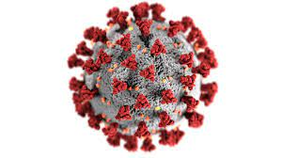
Oral Care During COVID
Oral Care Itself is NOT an Aerosol Producing Procedure
Recent studies indicate increased risk and incidence of bacterial NVHAP and VAP during COVID
CDC: All monitored HAIs increased during COVID – indicates basic nursing care was difficult to achieve
Important: Basic toothbrushing is not considered an aerosol producing procedure
Oral care can be safely undertaken
Consult respiratory therapy and follow your hospital’s requirements for PPE
COVID 19 Oral Grading System (COGS):
  Swelling, mucosa, trauma, infection and jaw mobility scale
  Repeated daily detects presence and severity of oral deficits observed in COVID-19
  UK: ICU Management
  https://healthmanagement.org/c/icu/issuearticle/mouth-care-challenges-and-the-use-of-the-covid-19-oral-grading-system
Carey E, Hung-Yuan PC, Baker D, Blankenhorn R, Munro S. Non-ventilator associated hospital acquired pneumonia (NV-HAP) risk among hospitalized veterans before and during the COVID-19 pandemic. American Journal of Infection Control (published online ahead of print, January 2, 2023), doi: https://doi.org/10.1016/j.ajic.2022.12.012

Slide 38
Key Points To Remember
IT TAKES A TEAM to Reach All Patients !
Include dental professionals
RNs can lead an oral care team with additional training
Include nurse's aides, patient care technicians,
Occupational Therapy, Speech Language Pathologists, and Respiratory Therapists
Engage the Patient-Family Advisory Council (PFAC)
Nurses’ Aides/ Patient Care Technicians — will require training and competency monitoring

Slide 39
Next steps:
1. Monitor NVHAP rates
2. Create and implement oral care protocols for ALL hospital units & track type and frequency of oral care
1. Monitor NVHAP Rates: ICD-10 codes
Improve accuracy
EHR direct extraction: Toolkit: Look in supplemental materials https://jamanetwork.com/journals/jamanetworkopen/fullarticle/2805014
2. Check your EHR – how specifically is oral care tracked?
(or Not?) – can you track independent vs dependent oral care?
3. Work with your team to decide how to monitor, audit, and create accountability for oral care
May work best if each units decides how to tackle oral care and make it work -– local unit workflow
4. DON’T underestimate how challenging it can be to get regular oral care in place for all patients
Notes:
43. Baker, D., Quinn, B., Ewan, V., & Giuliano, K. (2018). Sustaining quality improvement: Long-term reduction of non-ventilator hospital-acquired pneumonia. Journal of Nursing Care Quality, 34(3), 223-229.

Slide 40
In Summary:
Keys to Implementation
Evidence-based Quality Improvement Framework
Set up your Interprofessional team: Nursing assistants, RNs, respiratory, speech and language (SLP), OT, RT infection prevention, MD, Administration, Dietary Services, Supply Chain, Dental Professionals
Make it easy to do the right care:
ADA-aligned dental care supplies including suction toothbrushes on the regular med/ surg units
Clear Protocols, Expectations and Education:
onboarding and ongoing education/ including nurses’ aides

Slide 41


Slide 42
2010
Focused on device-related infection
Non-ventilator hospital-acquired pneumonia not monitored
2025
Hospital-acquired pneumonia now #1 hospital-acquired infection
Non-ventilator hospital-acquired pneumonia still not monitored
*** July 2024: Congressional Appropriations Committee: added note to address NVHAP
This means it is up to all local healthcare professionals to lead the effort to keep our patients safe from NVHAP !!

Slide 43
Resources
(and you can email me: DLBConsulting21@gmail.com)
    Association for Professionals in Infection Control and Epidemiology (APIC) –position statement on NVHAP and dedicated NVHAP journal issue (May 2020)
    2024: CDC: Oral Health in Healthcare Settings to Prevent Pneumonia Toolkit
      https://www.cdc.gov/healthcare-associated-infections/hcp/prevention-healthcare/oral-health-pneumonia-toolkit.html
    Veterans Hospital Administration– HAPPEN project –
    national quality standards that ALL VA patients will receive daily oral care
      https://marketplace.va.gov/innovations/project-happen
  September 15, 2021: The Joint Commission issued a Patient Safety Alert advising hospitals to address NVHAP
  (first prevention measure, among many, was to maintain regular oral care)
  https://www.jointcommission.org/resources/news-and-multimedia/newsletters/newsletters/quick-safety/quick-safety-issue-61/
Notes:
1. Munro, S., Baker, D., Giuliano, K. (2021). Nonventilator hospital-acquired pneumonia: A call to action recommendations from the National Organization to Prevent Hospital-Acquired Pneumonia (NOHAP) among nonventilated patients. Infection Control & Hospital Epidemiology, 1–6
doi:10.1017/ice.2021.239
VA/ VHA Innovation Ecosytem. (2020). National Organization for NV-HAP Prevention (NOHAP)
https://www.va.gov/INNOVATIONECOSYSTEM/views/solutions/national-organization.html
47. Baker, D., Davis, J., & Quinn, B. (2019). Practice position statement: Non-ventilator healthcare-associated pneumonia (NVHAP). Association for Professional in Infection Control and Epidemiology. https://apic.org/wp-content/uploads/2019/10/PositionPaper_NVHAP_2019_v3.pdf
48. The Joint Commission. (September 2021). Quick safety alert: Preventing non-ventilator hospital-acquired pneumonia, 61. https://www.jointcommission.org/-/media/tjc/newsletters/quick-safety-61-nvha-pneumonia-final-9-3-21.pdf

Slide 44
What can we all do right now?
We can partner with hospitals, patients and families
1. Find out your rates of NVHAP
2. What protocols and oral care supplies do you have available for nurses on your general units?
Everyone, including patients, should be asking their local hospitals – “what is your oral care policy, to keep patients free from pneumonia?”
Working together we can prevent NVHAP and improve patient safety

Slide 45

Please share your feedback
on the event with us!

Slide 46
Questions??
“One must always be aware, to notice, even though the cost of noticing is to become responsible.”
Thylias Moss

Slide 47
References
Allen, J, et al. “Covid-19 Patients 20 Lessons from 2020 - Healthmanagement.org.” Mouth Care Challenges and the Use of the COVID-19 Oral Grading System, ICU Management and Practice: What We Learned in 2020 COVID, 2021, healthmanagement.org/uploads/article_attachment/cardiorespiratory-compromise.pdf.
Awano, S., et al. “Oral Health and Mortality Risk from Pneumonia in the Elderly.” Journal of Dental Research, vol. 87, no. 4, Apr. 2008, pp. 334–339., doi:10.1177/154405910808700418.
Baker, Dian, and Barbara Quinn. “Hospital Acquired Pneumonia Prevention Initiative-2: Incidence of Nonventilator Hospital-Acquired Pneumonia in the United States.” American Journal of Infection Control, vol. 46, no. 1, 2018, pp. 2–7., doi:10.1016/j.ajic.2017.08.036.
Baker, Dian, et al. “Practice Position Statement: Non-Ventilator Healthcare-Associated Pneumonia (NVHAP), Non-Ventilator Healthcare- Associated Pneumonia (NV-HAP).” Association for Professional in Infection Control and Epidemiology., 2019, apic.org/wp-content/uploads/2019/10/PositionPaper_NVHAP_2019_v3.pdf.
Baker, Dian L., and Karen K. Giuliano. “Prevention Practices for Nonventilator Hospital-Acquired Pneumonia: A Survey of the Society for Healthcare Epidemiology of America (SHEA) Research Network (SRN).” Infection Control & Hospital Epidemiology, 2021, pp. 1–2., doi:10.1017/ice.2021.427.
Baker, Dian, et al. “Sustaining Quality Improvement.” Journal of Nursing Care Quality, vol. 34, no. 3, 2019, pp. 223–229., doi:10.1097/ncq.0000000000000359.
Barnes, Caren M. “Dental Hygiene Intervention to Prevent Nosocomial Pneumonias.” Journal of Evidence Based Dental Practice, vol. 14, June 2014, pp. 103–114., doi:10.1016/j.jebdp.2014.02.002.
Bassim, Carol W., et al. “Modification of the Risk of Mortality from Pneumonia with Oral Hygiene Care.” Journal of the American Geriatrics Society, vol. 56, no. 9, 2008, pp. 1601–1607., doi:10.1111/j.1532-5415.2008.01825.x.

Slide 48
References
Batalden, P. B, and F. Davidoff. “What Is ‘Quality Improvement’ and How Can It Transform Healthcare?” Quality and Safety in Health Care, vol. 16, no. 1, 2007, pp. 2–3., doi:10.1136/qshc.2006.022046.
Carey, Evan, et al. “Non-Ventilator Associated Hospital Acquired Pneumonia Incidence and Health Outcomes among U.S. Veterans from 2016-2020.” American Journal of Infection Control, vol. 50, no. 1, 2022, pp. 116–119., doi:10.1016/j.ajic.2021.06.001.
Carey, Evan, et al. “The Association between Non-Ventilator Associated Hospital Acquired Pneumonia and Patient Outcomes among U.S. Veterans.” American Journal of Infection Control, Feb. 2022, doi:10.1016/j.ajic.2022.02.023.
Carey E, Hung-Yuan PC, Baker D, Blankenhorn R, Munro S. Non-ventilator associated hospital acquired pneumonia (NV-HAP) risk among hospitalized veterans before and during the COVID-19 pandemic. American Journal of Infection Control (published online ahead of print, January 2, 2023), doi: https://doi.org/10.1016/j.ajic.2022.12.012
Chalmers, JM, et al. “The Oral Health Assessment Tool — Validity and Reliability.” Australian Dental Journal, vol. 50, no. 3, Sept. 2005, pp. 191–199., doi:10.1111/j.1834-7819.2005.tb00360.x.
Dickson, Robert P., et al. “Bacterial Topography of the Healthy Human Lower Respiratory Tract.” MBio, vol. 8, no. 1, 2017, doi:10.1128/mbio.02287-16.
Dickson, Robert P, et al. “Towards an Ecology of the Lung: New Conceptual Models of Pulmonary Microbiology and Pneumonia Pathogenesis.” The Lancet Respiratory Medicine, vol. 2, no. 3, 2014, pp. 238–246., doi:10.1016/s2213-2600(14)70028-1.
Deacon, Jim. “The Microbial World: Biofilms.” Biofilms, Institute of Cell and Molecular Biology, The University of Edinburgh, archive.bio.ed.ac.uk/jdeacon/microbes/biofilm.htm.
ECRI. “Top 10 Patient Safety Concerns 2022.” Emergency Care Research Institute, www.ecri.org/top-10-patient-safety-concerns-2022.
Lutfiyya, M. Nawal, et al. “Diagnosis and Treatment of Community-Acquired Pneumonia.” American Family Physician, 1 Feb. 2006, www.aafp.org/afp/2006/0201/p442.html.

Slide 49
References
Giuliano, Karen K., et al. “Original Research: Oral Care as Prevention for Nonventilator Hospital-Acquired Pneumonia.” AJN, American Journal of Nursing, vol. 121, no. 6, 2021, pp. 24–33., doi:10.1097/01.naj.0000753468.99321.93.
Giuliano, Karen K., and Dian Baker. “Sepsis in the Context of Nonventilator Hospital-Acquired Pneumonia.” American Journal of Critical Care, vol. 29, no. 1, 2020, pp. 9–14., doi:10.4037/ajcc2020402.
Giuliano, Karen K., et al. “The Epidemiology of Nonventilator Hospital-Acquired Pneumonia in the United States.” American Journal of Infection Control, vol. 46, no. 3, 2018, pp. 322–327., doi:10.1016/j.ajic.2017.09.005.
Groeger, Sabine, and Joerg Meyle. “Oral Mucosal Epithelial Cells.” Frontiers in Immunology, vol. 10, 14 Feb. 2019, doi:10.3389/fimmu.2019.00208.
IHI. “Science of Improvement: Testing Changes.” Institute for Healthcare Improvement, www.ihi.org/resources/Pages/HowtoImprove/ScienceofImprovementTestingChanges.aspx#:~:text=The%20Plan%2DDo%2DStudy%2D,used%20for%20action%2Doriented%20learning.
The Joint Commission. “Preventing Non-Ventilator Hospital-Acquired Pneumonia.” The Joint Commission, 15 Sept. 2021, www.jointcommission.org/-/media/tjc/newsletters/quick-safety-61-nvha-pneumonia-final-9-3-21.pdf.
Jones BE, Sarvet AL, Ying J, et al. Incidence and outcomes of non–ventilator-associated hospital-acquired pneumonia in 284 US hospitals using electronic surveillance Criteria. JAMA Netw Open. 2023;6(5):e2314185. doi:10.1001/jamanetworkopen.2023.14185
Kaneoka, Asako, et al. “Prevention of Healthcare-Associated Pneumonia with Oral Care in Individuals without Mechanical Ventilation: A Systematic Review and Meta-Analysis of Randomized Controlled Trials.” Infection Control & Hospital Epidemiology, vol. 36, no. 8, 2015, pp. 899–906., doi:10.1017/ice.2015.77.
Kellum, John A. “Understanding the Inflammatory Cytokine Response in Pneumonia and Sepsis.” Archives of Internal Medicine, vol. 167, no. 15, 2007, p. 1655., doi:10.1001/archinte.167.15.1655.
Kilian, M., et al. “The Oral Microbiome – an Update for Oral Healthcare Professionals.” British Dental Journal, vol. 221, no. 10, 2016, pp. 657–666., doi:10.1038/sj.bdj.2016.865.

Slide 50
References
Kim, David, et al. “Rates of Co-Infection between SARS-COV-2 and Other Respiratory Pathogens.” JAMA, vol. 323, no. 20, 2020, p. 2085., doi:10.1001/jama.2020.6266.
Lacerna, Cristine C., et al. “A Successful Program Preventing Nonventilator Hospital-Acquired Pneumonia in a Large Hospital System.” Infection Control & Hospital Epidemiology, vol. 41, no. 5, 2020, pp. 547–552., doi:10.1017/ice.2019.368.
Landers, Ben. “Oral Bacteria: How Many? How Fast?” RDH Magazine, 2009, www.rdhmag.com/infection-control/water-safety/article/16404976/oral-bacteria-how-many-how-fast.
Lu, Maoyang, et al. “Oral Microbiota: A New View of Body Health.” Food Science and Human Wellness, vol. 8, no. 1, 2019, pp. 8–15., doi:10.1016/j.fshw.2018.12.001.
Lutfiyya, M. Nawal, et al. “Diagnosis and Treatment of Community-Acquired Pneumonia.” American Family Physician, 1 Feb. 2006, www.aafp.org/afp/2006/0201/p442.html.
Lyons, Patrick G., and Marin H. Kollef. “Prevention of Hospital-Acquired Pneumonia.” Current Opinion in Critical Care, vol. 24, no. 5, 2018, pp. 370–378., doi:10.1097/mcc.0000000000000523.
Magill, Shelley S., et al. “Changes in Prevalence of Health Care–Associated Infections in U.S. Hospitals.” New England Journal of Medicine, vol. 379, no. 18, Nov. 2018, pp. 1732–1744., doi:10.1056/nejmoa1801550.
Micek, Scott T., et al. “A Case-Control Study Assessing the Impact of Nonventilated Hospital-Acquired Pneumonia on Patient Outcomes.” Chest, vol. 150, no. 5, 2016, pp. 1008–1014., doi:10.1016/j.chest.2016.04.009. =
Munro, Shannon, and Dian Baker. “Integrating Oral Health Care into Patient Management to Prevent Hospital- Acquired Pneumonia: A Team Approach.” Journal Of The Michigan Dental Association, July 2019, www.michigandental.org/Portals/pro/Journals/July%202019/html5/index.html?page=1&noflash.

Slide 51
References
Munro, Shannon C., et al. “Nonventilator Hospital-Acquired Pneumonia: A Call to Action.” Infection Control & Hospital Epidemiology, vol. 42, no. 8, 2021, pp. 991–996., doi:10.1017/ice.2021.239.
Murray, Christopher JL, et al. “Global Burden of Bacterial Antimicrobial Resistance in 2019: A Systematic Analysis.” The Lancet, vol. 399, no. 10325, 2022, pp. 629–655., doi:10.1016/s0140-6736(21)02724-0.
Nield-Gehrig, Jill S., and Donald E. Willmann. “Foundations of Periodontics for the Dental Hygienist.” Wolters Kluwer, Lippincott Williams & Wilkins Health, 2012. (located in: Dental Plaque Biofilms By Nield-Gehrig, Jill S., RDH)
Novosad, Shannon A., et al. “Vital Signs: Epidemiology of Sepsis: Prevalence of Health Care Factors and Opportunities for Prevention.” MMWR. Morbidity and Mortality Weekly Report, vol. 65, no. 33, 2016, pp. 864–869., doi:10.15585/mmwr.mm6533e1.
Pássaro, Leonor, et al. “Prevention of Hospital-Acquired Pneumonia in Non-Ventilated Adult Patients: A Narrative Review.” Antimicrobial Resistance & Infection Control, vol. 5, no. 1, 2016, doi:10.1186/s13756-016-0150-3.
Patterson, Kerry. Influencer: The Power to Change Anything. McGraw-Hill, 2008.
Quinn, Barbara, et al. “Non-Ventilator Health Care-Associated Pneumonia (NV-Hap): Best Practices for Prevention of NV-Hap.” American Journal of Infection Control, vol. 48, no. 5, 2020, doi:10.1016/j.ajic.2020.03.006.
Quinn, Barbara, and Dian Baker. “Using Oral Care to Prevent Nonventilator Hospital-Acquired Pneumonia.” American Nurse, 12 Mar. 2015, www.myamericannurse.com/using-oral-care-prevent-nonventilator-hospital-acquired-pneumonia/.
Roquilly, A, et al. “Pathophysiological Role of Respiratory Dysbiosis in Hospital-Acquired Pneumonia.” The Lancet Respiratory Medicine, vol. 7, no. 8, 2019, pp. 710–720., doi:10.1016/s2213-2600(19)30140-7.
Scannapieco, Frank. “Pneumonia and oral pathogens.” The Oral-Systemic Health Connection a Guide to Patient Care Chapter 9, Quintessence publishing. 2014. ISBN-10: 0867156503 | ISBN-13: 978-0867156508.

Slide 52
References
Scannapieco FA, Guiliano KK, Baker DL. Oral health status and the etiology and prevention of nonventilator hospital-associated pneumonia. Periodontology 2000. 2022;00(1);1-8.
See, Isaac, et al. “Clinical Correlates of Surveillance Events Detected by National Healthcare Safety Network Pneumonia and Lower Respiratory Infection Definitions—Pennsylvania, 2011–2012.” Infection Control & Hospital Epidemiology, vol. 37, no. 7, 2016, pp. 818–824., doi:10.1017/ice.2016.74.
Sjogren, Petteri, et al. “A Systematic Review of the Preventive Effect of Oral Hygiene on Pneumonia and Respiratory Tract Infection in Elderly People in Hospitals and Nursing Homes: Effect Estimates and Methodological Quality of Randomized Controlled Trials.” Journal of the American Geriatrics Society, vol. 56, no. 11, 2008, pp. 2124–2130., doi:10.1111/j.1532-5415.2008.01926.x.
Stryker, “What the Experts Say The Role of Pneumonia and Sepsis.” Stryker: What the Experts Say The Role of Pneumonia and Sepsis, Sage Products LLC, 2018, www.stryker.com/content/dam/stryker/sage/resources/What-the-Experts-Say-The-Role-of-Pneumonia-and-Sepsis.pdf.
VHA. “National Organization for NV-Hap Prevention (NOHAP).” VHA Innovation Ecosystem Homepage, www.va.gov/INNOVATIONECOSYSTEM/views/solutions/national-organization.html.
Weiner-Lastinger, Lindsey M., et al. “The Impact of Coronavirus Disease 2019 (COVID-19) on Healthcare-Associated Infections in 2020: A Summary of Data Reported to the National Healthcare Safety Network.” Infection Control & Hospital Epidemiology, vol. 43, no. 1, 2021, pp. 12–25., doi:10.1017/ice.2021.362.

