Slide 1
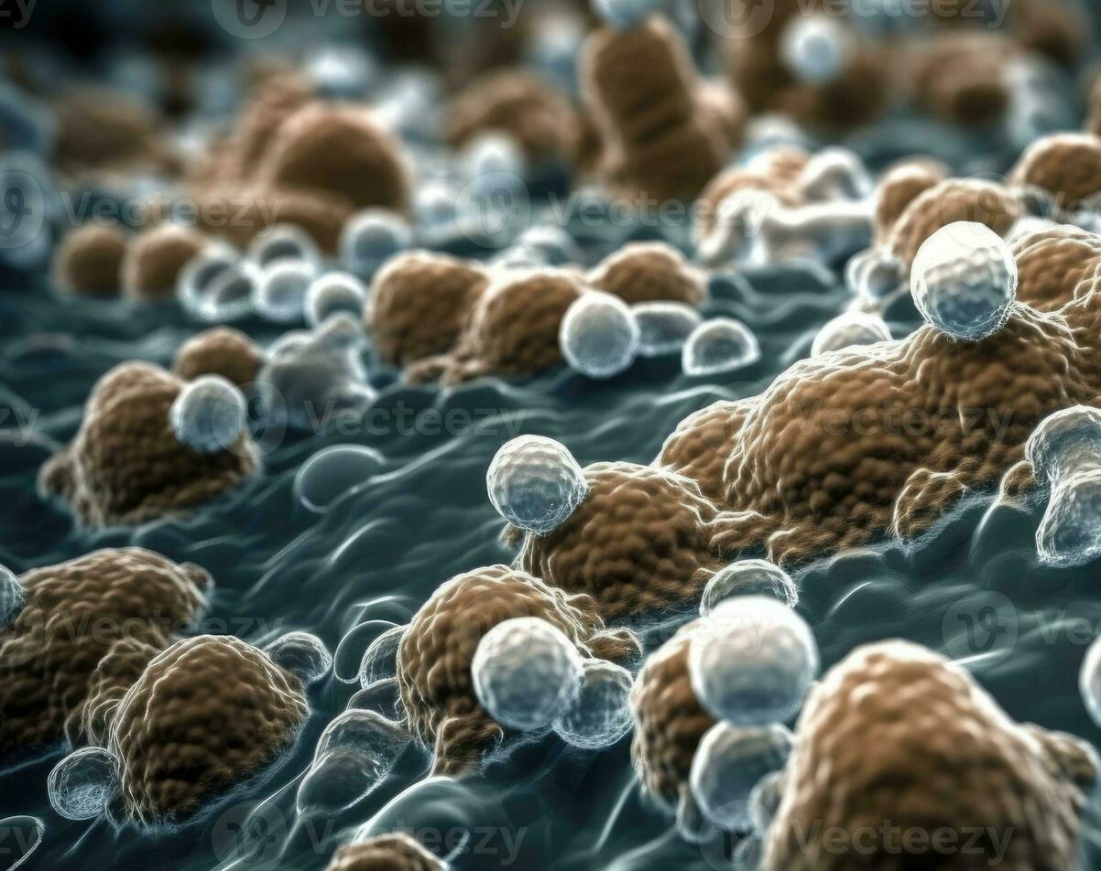
Candida auris Response Harborview Medical Center
Krista Rietberg, MPH, CIC
Infection Prevention and Control
Harborview Medical Center
9/18/2025

Slide 2
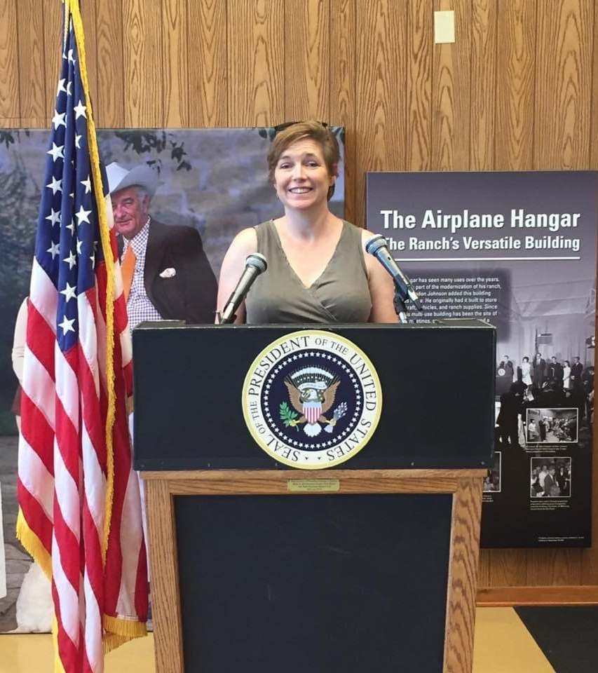
A Little About Me
Likes
All animals
CrossFit
The smell of bleach in the morning
Dislikes
Mean people
Fax machines
Dust

Slide 3
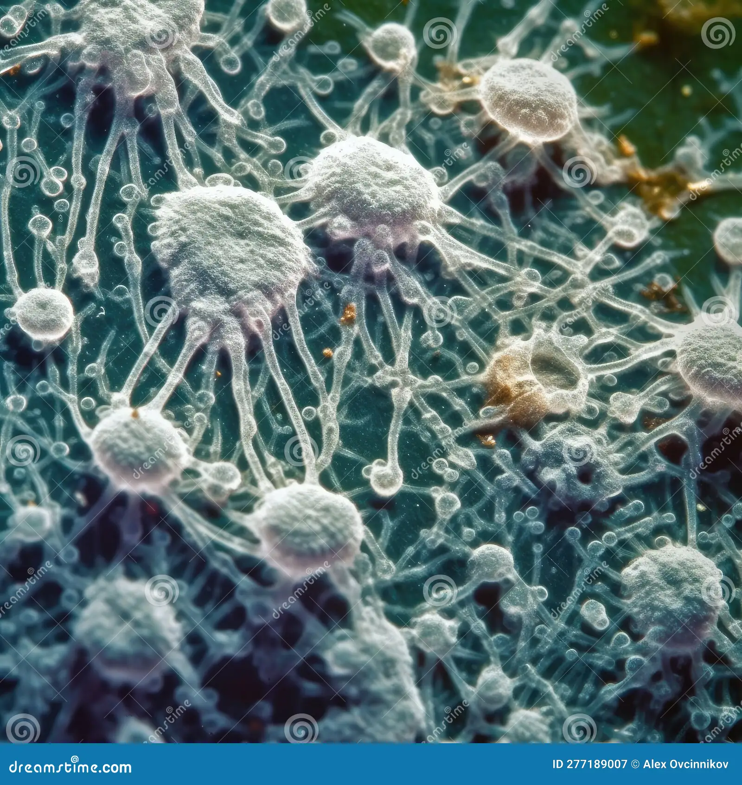
A Little About Candida auris
Likes
Holding dirty hands
Taking road trips on dirty equipment
Couch surfing in dirty rooms
Dislikes
Super Sani Wipes and bleach
Hand sanitizer
Neat freaks

Slide 4
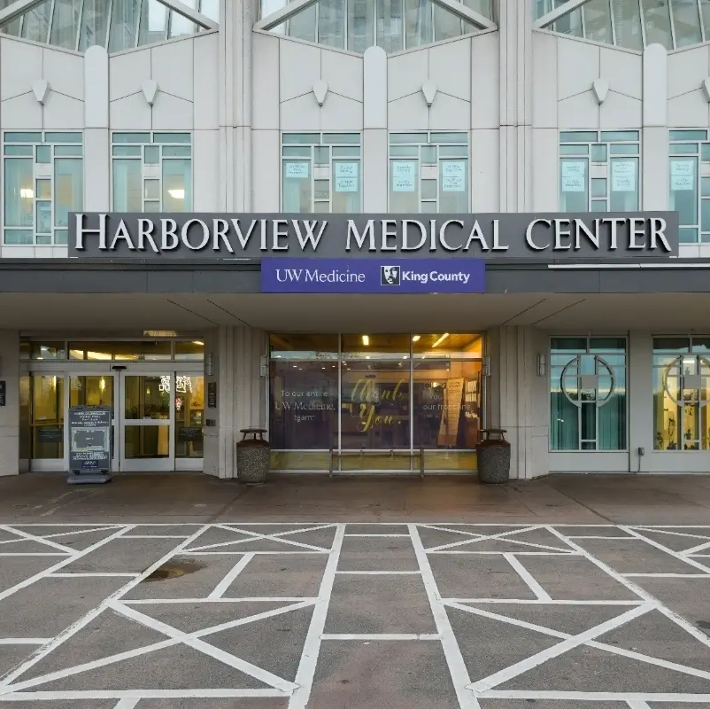
Harborview Medical Center
Regional level 1 trauma center for 5 states
Regional burn center
Teaching facility for the University of Washington
462 beds
Few private rooms
Congregate settings
Capacity typically > 100%
Unique mission population

Slide 5
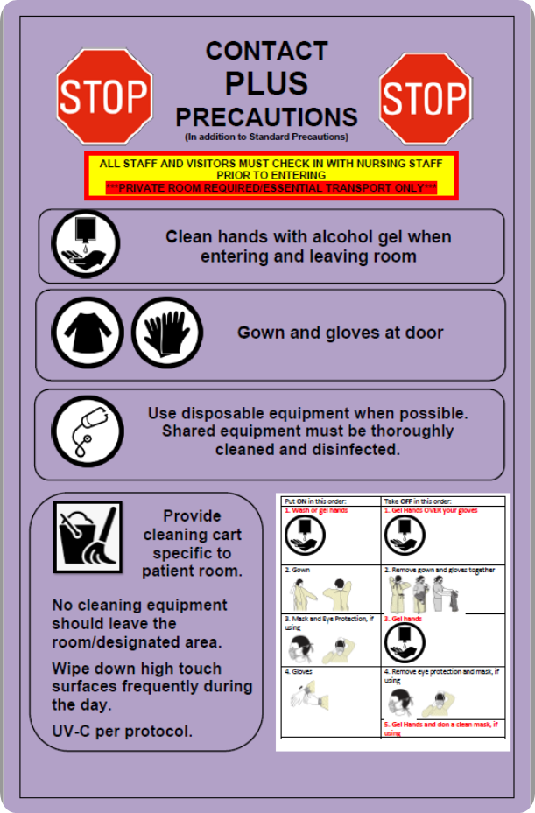
How it Started
2019 surveillance for international admissions
2022 began speciating Candida in urine
2023 cared for first known C.auris patient in WA state

Slide 6
Candida auris in WA State
2016
First identified in the US**
July 2023
First WA case
Suspected local transmission
Jan 2024
First WA HCF outbreak
Local transmission confirmed

Slide 7
Surveillance Testing Evolution
International admissions
Patients coming from facilities with known outbreaks
Patients admitted to inpatient rehab from outside UWMC
PPS on units with positive patients
Admission and PPS on outbreak units
House-wide PPS
Admission and Q7 days
Current-admission swab and Q14 days

Slide 8
How It’s Going
Outbreak Summary
June 2024 positive urine in ICU patient
Patient in same room prior also screened positive
Additional outbreak units identified including congregate setting
88 patients identified as of 09/17/2025

Slide 9

Emergency Response
C.auris Emergency Response Team assembled
  Hospital administration
  Leadership from all departments
Subcommittees to address specific needs
  Shared equipment
  Terminal clean
  Designated stethoscope

Slide 10
Outbreak Risk Factors
Roommates
Placement in room following positive patient
Hand hygiene
Shared equipment

Slide 11
Actions Taken
Hospital-wide Deep Clean
Hand Hygiene
Shared Equipment Cleaning
Designated Stethoscope Program
Terminal Clean Process Update
Decontamination Cleans
ATP Audits

Slide 12
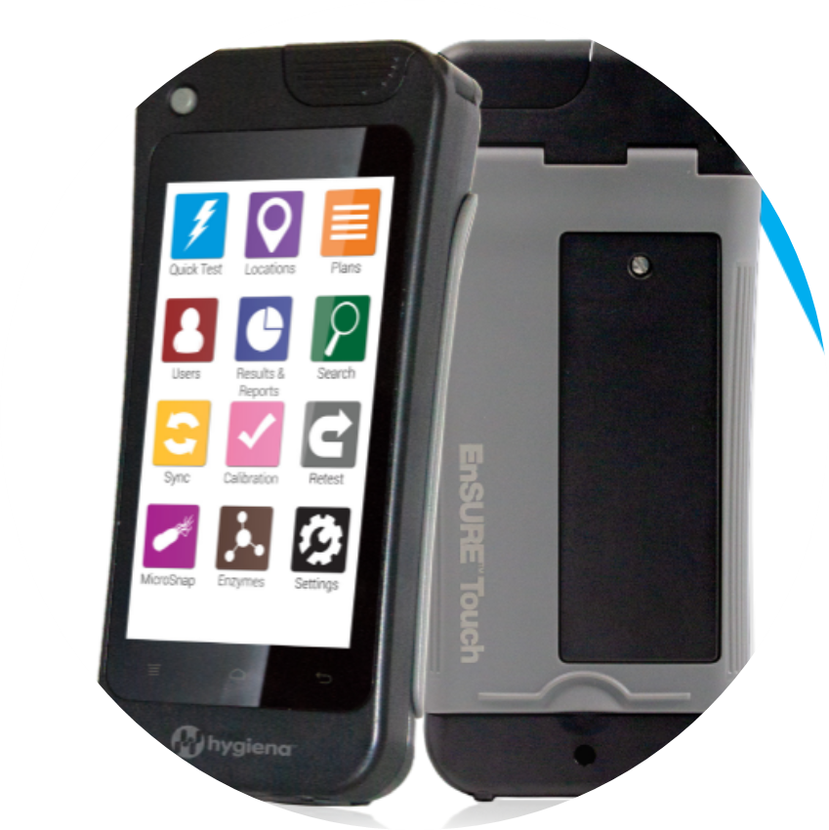
ATP Program
EVS-terminal clean audits
IPC-random audits
Endoscopy-scope cleaning audits
Monthly unit/department audits

Slide 13
Culture Change
Moving From Emergency Response to Sustainability

Slide 14
Culture Change
Culture of safety
New employee onboarding
Traveler onboarding
Student, resident, fellow onboarding
Education campaign and training for current staff
Quarterly training and just in time training for units with transmission or unsatisfactory ATP audits
Accountability
Transparency
Yearly LMS training

Slide 15

Focus
HMC is the only hospital doing routine surveillance testing
We know C.auris is in the community
Can’t eliminate the risk
Keep it under control

Slide 16
Take Aways
C.auris is in your facility
Your shared equipment is dirty
We are lucky we have not seen C.auris infections
Focus on prevention
Monitor for HAIs outside of NHSN
Build relationships

Slide 17

Questions

