Slide 1
Contaminated Instrument & BI Failure Protocols
AORN & ANSI/AAMI ST79:
Combined Guidance & Quick Response Flowchart
WITH
A
Policy Template
(a lovely parting gift)

Slide 2
Objectives
Participants will be able to explain AORN and ANSI/AAMI ST79 standards for contaminated instrument and BI failure response and apply them in practice
Participants will be able to demonstrate step-by-step critical actions in response to contaminated instruments or BI failures, including notification, quarantine, recall, investigation and corrective measures
Participants will be able to utilize facility policies and interdisciplinary communication strategies to reduce patient risk, reassure staff and ensure safe return of sterilization equipment.

Slide 3
Travel From Ideal to Worst Case Scenario
Ideal
Dirty instrument found before use
Dirty instrument found during case (used)
Failure of Biologic Indicator – Failed Sterilizer Load, Discovered prior to Distribution
Failed Sterilizer Load – Undiscovered until…….

Slide 4
When Everything Works
Proper Sterilization Workflow
Step-by-step process:
  Pre-cleaning at point of use – in the OR
  SAFE BioHazard transport
  Manual or ultrasonic cleaning – in CS
  Inspection - CS
  Packaging - CS
  Sterilization (autoclave, EO gas, etc.) - CS
  Storage and safe transport back to the OR
  Inspection of instruments as they’re opened
Quality control and documentation

Slide 5
Opening the Case – Key Steps
Ensure all instruments are sterile, complete, and ready for use before the patient enters the operating room
Verify Sterility Indicators
  Check external and internal chemical indicators (tape, integrators)
  Confirm expiration dates and package integrity
Open in a Sterile Field
  Only trained personnel
  Maintain aseptic technique
Instrument Count & Inspection
  Count instruments per policy
  Inspect for damage, rust, or RESIDUE
  Now…..ready to start! -

Slide 6
Finding the Dirty Instrument BEFORE Use
Best Case! Not used on a patient
  BUT investigation
  Report to OR manager, CS Manager
  Find out what happened
    Process
    People
    Training
    Environment

Slide 7
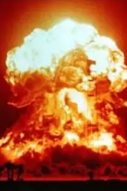
Life is good, you’re rolling along with coffee….
0730 Phone call:
  “Ahhhhhh, hey Jeanette……we have a problem.
  We just found out we used a dirty instrument in a case
  All of a sudden……”

Slide 8
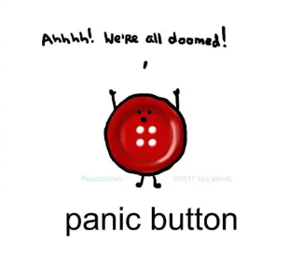
STEP AWAY FROM THE PANIC BUTTON!
COME ON….YOU’VE GOT THIS!
  You JUST went to the PS APIC Chapter Yearly Conference……
  AND
YOU KNOW what to do!

Slide 9
Contaminated Instrument – AORN-AAMI/ANSI Guidance
(Best case) If discovered pre-procedure: halt, notify team and SPD, replace entire sterile field
Any contamination compromises the entire tray or set
During surgery: Stop using the instrument
  Isolate instrument for investigation
  Post-surgery: send to SPD for full reprocessing
  Notify SPD
  Get all your info data ducks in a row
  Fill out an incident report for full investigation

Slide 10
First Things First
YOU have a policy!
Reassure the OR staff
  (because they’re freaking out right now)– You: “we have a policy – lets look at it”
Does the surgeon know?
Does the CS and OR Manager/Director know?
Get all the instrument info
Does Risk Management know?
Get all the patient info – surgeon notifies and treats patient
Investigation (RCA)
IP: Tracking the patient for infection

Slide 11

Next Scenario
From CS Manager: Jeanette, I just discovered we had a load failure
Me: When was the failure? When was the LAST good BI test? Has any instruments with the failure been distributed to the ORs?
(this is when you thank your lucky stars you have Instrument Tracking) – if you don’t yet….DO IT!

Slide 12
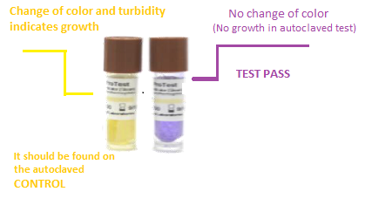
Biological Indicators – ANSI/AAMI
Biological indicators (BIs) provide information on whether necessary conditions were met to kill a specified number of microorganisms (bacterial spores) for a given sterilization process.
Sterilizer companies have complete portfolio of biological indicators offers testing for various applications, including steam sterilization and vaporized hydrogen peroxide (VH2O2) sterilization
Geobacillus stearothermophilus spores are mainly used in these applications due to their high resistance to these sterilization processes.
BIs are typically used within process challenge devices (PCD), designed to represent the most challenging products routinely processed for sterilization testing
A passing result for the BI within the PCD demonstrates that the sterilization cycle effectively inactivates the BI, providing Sterile Processing Department staff with assurance in their steam or VH2O2 sterilization process

Slide 13
BI Failure – Immediate Response
Quarantine all items from failed load to last non-fail load.
If distributed, initiate immediate recall.
Stop use of all items from the load(s).

Slide 14
BI Failure – Notification & Exposure
Notify SPD, Infection Prevention, OR Manager, Risk Management.
1
If items were used, notify surgeon(s) and follow exposure protocol.
2
Evaluate patient risk per facility policy.
3

Slide 15
BI Failure – Investigation
This is when your SPD Manager is your BEST FRIEND
Review sterilizer parameters (time, temp, pressure).
Check BI handling, storage, and placement.
Assess packaging, loading, cleaning steps.
Run 3 consecutive BI challenge tests before returning sterilizer to service.
Share occurrence with all staff in CS

Slide 16
BI Failure – Corrective Actions
Reprocess all recalled items via full sterilization cycle
Retrain staff if error found
Repair/service equipment if mechanical issue found
Re-educate CS staff if indicated

Slide 17
BI Failure – Documentation & Return to Service
Complete sterilization log and incident report.
Document occurrence, corrective action, education and reporting
Require 3 consecutive negative BI results.
Approval from SPD Manager & Infection Preventionist before use.

Slide 18
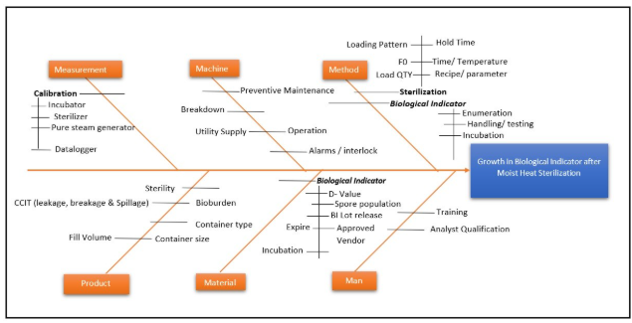

Slide 19
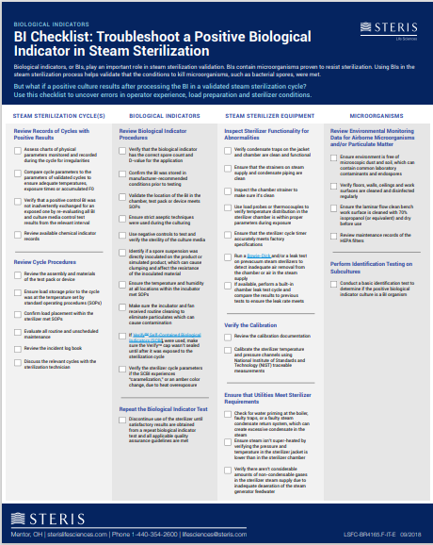
From Steris:
Checklist: Positive Biological Indicator in Steam Sterilization | STERIS

Slide 20
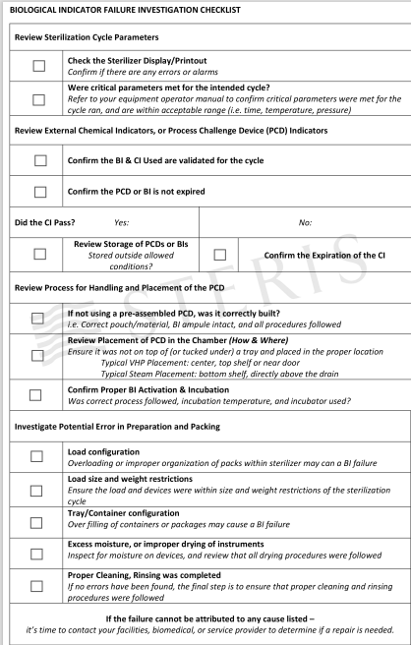
Investigation Checklist:
biological-indicator-failure-investigation-checklist-downloadable-pdf.pdf

Slide 21
Policies

Slide 22
Non-Sterile Instruments:
Part of the Sterile Field Policy
  Monitor for contamination of the sterile field and potential breaks in sterile technique and correct them immediately.
    When a break in sterile technique occurs, take corrective action immediately unless the patient's safety is at risk. When a break in technique cannot be corrected immediately, take corrective action as soon as it is safe for the patient.
    Consider instruments contaminated when they are found
      assembled or clamped closed,
      with organic material on or in the instrument, or
      with other debris on the instrument.
    When contaminated instruments are found in an instrument set, consider the entire set contaminated.
    When an item or items are found to be contaminated, take the following actions, at a minimum:
      remove the contaminated item(s),
      remove any other items that may have come in contact with the contaminated item(s), and
      change the gloves of any team member who may have touched the contaminated item(s).

Slide 23
Policy: BI Failure
Sample policy

Slide 24
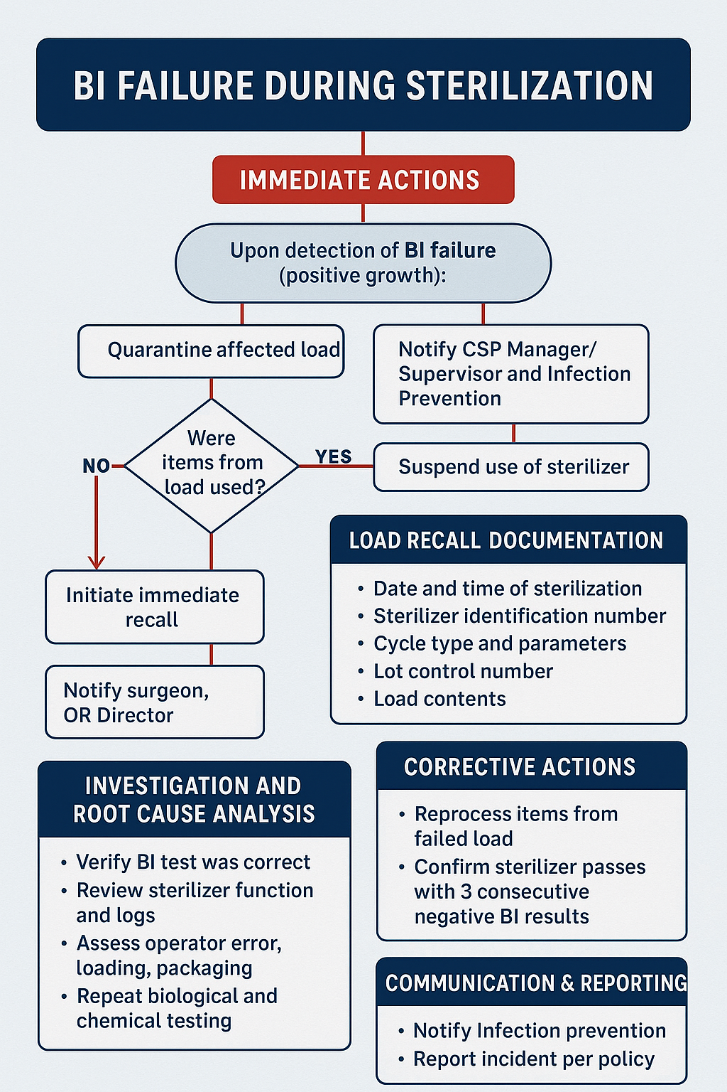
BI Failure Flow Sheet

Slide 25
BI Failure – Final Thoughts
Not the end of the world
MUST have a policy and a Flow Sheet
Get to know your SPD Manager
Connect with your Vendor

Slide 26

Questions

