Slide 2
Legislative & Regulatory Updates
October 19, 2023
SNJ APIC Chapter Meeting
Jessica Arias, MHL, BSN, RN, CIC, FAPIC

Slide 3
APIC National Coalition Letters
STATE
NY legislators supporting S. 6347, regarding Infection Control Risk Assessment (ICRA) standards in healthcare facilities.
FL legislators on the need to support pro-vaccine legislation during the legislative session.
FEDERAL
Letter telling Congress to protect funding for non-defense discretionary appropriations. It was signed by 760 organizations.
APIC sent a letter to Congress urging action around IPC in nursing homes including the need for a full-time IP and surveillance.
Notes:
Nondefense discretionary spending is controlled by lawmakers through appropriation acts, which specify how much money can be obligated for certain government programs in specific years.

Slide 4
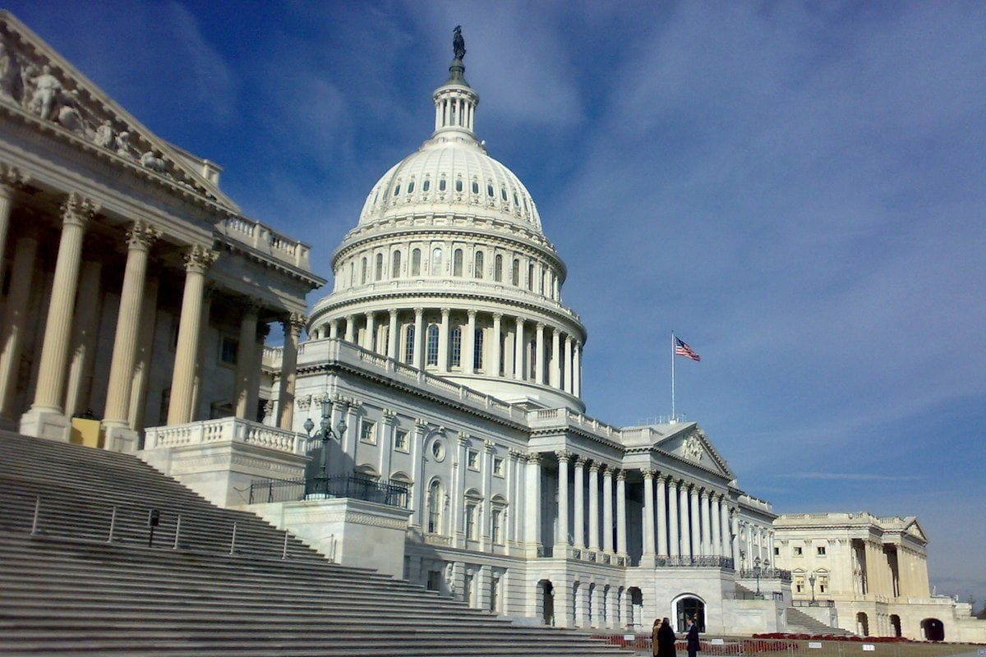
APIC Federal Priorities
Pandemic and All-Hazards Preparedness Act (PAHPA) expiration is this year
Representatives Hudson and Eshoo requested information on this legislation
Senators Sanders and Cassidy have also requested information
APIC reiterated the need for:
Full-time, dedicated IPs in nursing homes
IP Workforce Pipeline
Notes:
Reauthorize core public health preparedness programs including the Public Health Emergency Preparedness cooperative agreements, the Hospital Preparedness Program, the Epidemiology Laboratory Capacity cooperative agreements, the Biomedical Advanced Research and Development Agency and the Strategic National Stockpile.
Surveillance, public health, outbreak response, communication, and diversity

Slide 5
Continued
In February, the Senate Health, Education, Labor, and Pensions (HELP) Committee held a hearing on workforce shortages in healthcare.
In March, the Committee released a “Request for Information” on ways to combat shortages.
APIC submitted information on the following topics:
The need to establish an IP pipeline
A Department of Labor (DOL) O-Net Code

Slide 6
APIC Federal Appropriations Process
National Healthcare Safety Network
Asking for an increase in funding from FY 2023 levels
Expand critical user support for NHSN to additional facilities across the spectrum of care
Enable expansion of NHSN’s Antibiotic Use and Resistance (AUR) module reporting options
Antibiotic Resistance Solutions Initiative
Asking for an increase in funding from FY 2024 levels
Sustains the Antimicrobial Resistance Laboratory Network of seven AR Regional Labs
Implement antibiotic stewardship programs for Antibiotic Stewardship in inpatient, outpatient, and long-term care settings

Slide 7
APIC Federal Legislative Update
BIO Preparedness Workforce Pilot Program
Incentive program for individuals to enter infectious disease fields
Passed late in 2023 as part Omnibus Package
Authorized, but did not fund the pilot program

Slide 8
Get & Stay Involved

Slide 9


Sign up for the Action EList
Become an APIC Virtual Advocate
Join the Action eList to receive the latest legislative and regulatory information.
APIC needs your voice! Join APIC’s virtual advocacy team and meet with legislators right from home.

Slide 10
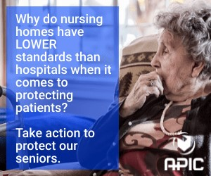





Action Alerts
IPC in LTC Now For years reports have shown infection control lapses in nursing homes. Now is the time for action!
FY 2024 Appropriations Help defend key infection prevention funding in FY 2024.
Certification is a Priority A certified infection prevention workforce is critical to future preparedness.
Vaccines Work Help fight vaccine misinformation in Congress.
STAY TUNED

Slide 11
Latest Public Policy Updates Check your e-mail!
Success of South American Flu Vaccine May Suggest Similar Benefit in U.S.
CDC: IPC Preparations for Respiratory Virus Season

Slide 12
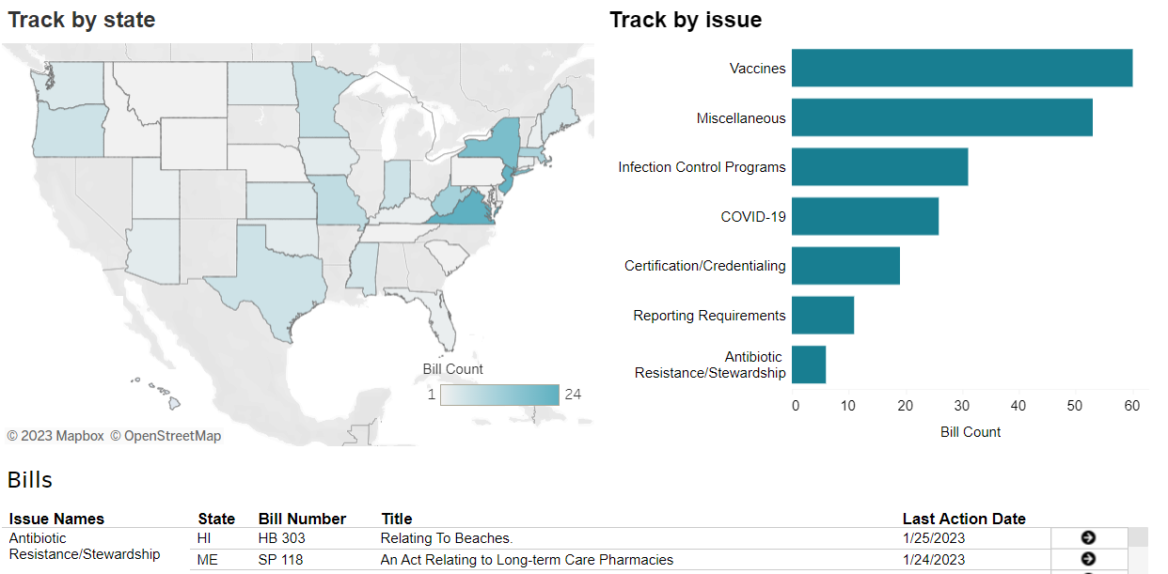
State Legislation
No Updates
https://cqrcengage.com/apic/state

Slide 13
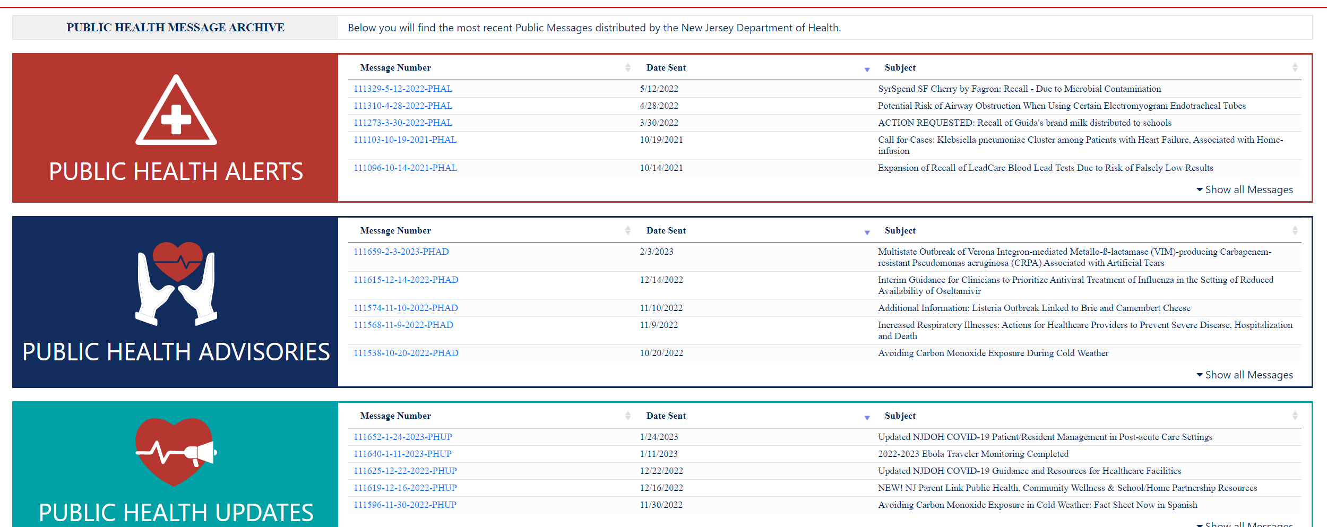
NJ LINCS Health Services Portal
Go to the NJLINCS website
NJ Local Information Network and Communications System
Select “Subscribe to Health Alerts” on the left-hand tab
NJLINCS HAN Messaging
Allows access to archived messages

Slide 14


Infection Control Assessment & Response CDS.ICAR@doh.nj.gov
Containment assessments
ICAR
COVID-19
MDRO
Responding to an outbreak or investigation
prevention assessments
Enhancing overall IPC
Quality improvement
Schedule a FREE ICAR Prevention Consultation

