Slide 1
Legislative & Regulatory Updates
September 2020
Jessica Arias, BSN, RN, CIC

Slide 2

APIC Resources
See presentations via attachment

Slide 3

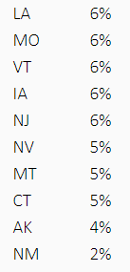
Voice for Infection Prevention (VIP) Advocacy Competition
In full swing for 2020
Action alerts
  www.apic.org/TakeAction
Rank:
  Maine 40%
  Arkansas 26%
  North Carolina 25%
  New York 14%
  Pennsylvania 13%

Slide 4



MDRO
&
C. auris
CDC Optimization Strategies for PPE
  Promptly resume conventional strategies ASAP
Vigilant for monitoring routine IPC measures
  Audits, feedback, re-education

Slide 5
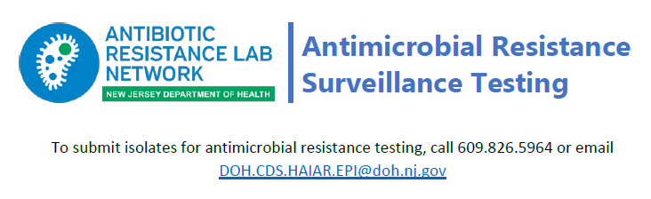
AR Lab Network
Surveillance Testing
Routine surveillance testing
Species identification
Antimicrobial susceptibility testing
Molecular testing
Modified Carbapenemase production testing
https://www.cdc.gov/drugresistance/solutions-initiative/ar-lab-network.html?CDC_AA_refVal=https%3A%2F%2Fwww.cdc.gov%2Fdrugresistance%2Fsolutions-initiative%2Far-lab-networks.html

Slide 6
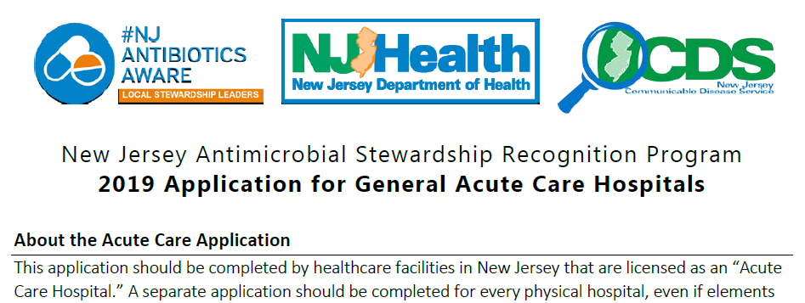

Antimicrobial Stewardship Recognition Program
2020 - 97 applicants
Applications for acute, post-acute & outpatient
Aligns with CDC core elements
Modified due to resource limitations with COVID-19

Slide 7

COVID-19
Tele-ICAR
Jessica Arias & Melody Lee
Self assessment
Virtual consultation upon request
7 domains
https://www.nj.gov/health/cd/documents/topics/NCOV/COVID_Tele_ICAR_Assess_Tool.pdf

Slide 8

Education Opportunities
NJHA webinar series focused on LTC ED 20-026
  Resumption of Services in all Long-Term Care Facilities
  Contact Tedelstein@njha.com
Rutgers Project ECHO https://rwjms.rutgers.edu/community_health/project-echo

Slide 9
Mandatory Influenza Vaccination
Hot Topic

Slide 10
NJ Bill
A1576 “Requires certain health care facilities to provide, and employees to receive, annual influenza vaccination”
  https://www.billtrack50.com/BillDetail/920002
  Maria.Christensen@doh.nj.gov & Michael.Kennedy@doh.nj.gov
Attachments via email
NJHA/NJDOH “Addressing New Requirements Related to Flu Vaccination for 2020”
  Play recording: https://njha.webex.com/recordingservice/sites/njha/recording/8e56b2b447f54bbf94e3c0189b25f714

Slide 11
Quick takeaways…
Must be administered or attestation before 12/31/2020 (Attestation must include lot #)
No vaccination = wear mask when in direct contact, and in common areas, etc...
Educational program
NJDOH will:
Provide medical exemption forms to all facilities
  Will be collected to confirm consistencies with ACIP
Through rulemaking, establish proper procedures for data submission

Slide 12


Slide 13
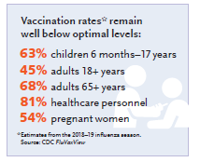
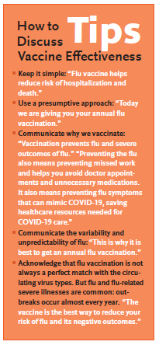
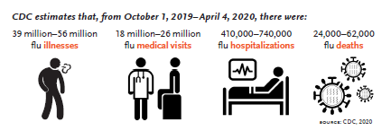
www.immunize.org

Slide 14

What is your facility doing?

