Slide 1
Legislative & Regulatory Updates
February 2020
Jessica Arias, BSN, RN, CIC

Slide 2
APIC’s Public Policy Agenda (2018)
APIC’s federal funding priorities
Elimination of HAIs
AR and ASP
Mandatory influenza vaccination for HCP
Using data and IT to help prevent HAIs
Includes information on the following:
http://cqrcengage.com/apic/PublicPolicyAgenda

Slide 3
Recalls
Cardinal Health Recalls Surgical Gowns and Packs- Level 3 surgical gowns
https://www.fda.gov/safety/medical-product-safety-information/surgical-gowns-and-packs-cardinal-health-fda-statement-potential-quality-issues-affecting-some-its

Slide 4

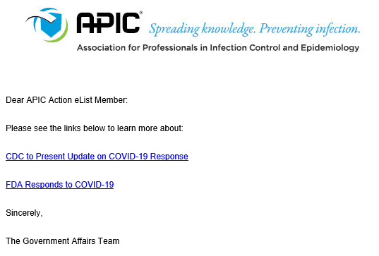
APIC VIP Action eList https://cqrcengage.com/apic/app/register?4&m=5020
https://cqrcengage.com/apic/app/document/34757248;jsessionid=node0l3sbkra1sdsfk42ijz0iel4d1738750.node0
https://cqrcengage.com/apic/app/document/34757247;jsessionid=node0l3sbkra1sdsfk42ijz0iel4d1738750.node0

Slide 5

President’s Budget top line items
Department of Health and Human Services
10% funding reduction to the whole department
Agency for Healthcare Research and Quality
AHRQ would be merged into an NIH program and receive a $81.3M cut (approx. 24%)
AHRQ HAI Research at risk - this is roughly $36M in funding, since it is a line item under AHRQ it would be at risk of being cut or eliminated
Centers for Disease Control and Prevention
Topline $693M cut (approx. 9% cut)
Emerging and Zoonotic Infectious Diseases cut $85M (approx. 15.5%).
Most of APIC’s priorities are under this umbrella. That includes the two items listed below under the Prevention Fund.
Advanced Molecular Detection $30M – Flat Funded
National Healthcare Safety Network $21M – Flat Funded
Prevention and Public Health Fund
HAI line item $12M – eliminated
Epi and Lab Capacity program $40M – eliminated
Antibiotic Resistance Solutions Initiative - $33M cut (approx. 19%)
This program would no longer be a line item under the Zoonotic umbrella and would be moved entirely under the Prevention Fund, which is unfortunately often targeted to be cut entirely due to its affiliation with the ACA.

Slide 6




Slide 7

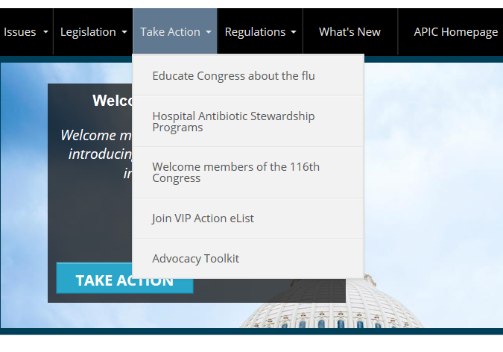
Take Action http://cqrcengage.com/apic/

Slide 8

Speak up
Federal
Support your support for vaccines
Do you know the flu?
Invite your member of Congress to an in-district meeting
State
Vaccines work
Support APIC NY Certification Campaign
Ask for an in-district meeting with your state representatives
https://cqrcengage.com/apic/action_center

Slide 9
NJ Bills
A1576 “Requires certain health care facilities to provide, and employees to receive, annual influenza vaccination”
https://www.billtrack50.com/BillDetail/920002
Maria.Christensen@doh.nj.gov & Michael.Kennedy@doh.nj.gov
A3818/S2173 “Clarifies statutory exemptions from mandatory immunization requirements for child care center and school attendance” commonly referred to the “bill that would eliminate religion as a reason not to vaccinate public schoolchildren”
https://www.billtrack50.com/BillDetail/966141
A5527 “Requires certain long-term care facilities to submit outbreak response plan to DOH”
https://www.billtrack50.com/BillDetail/1131873
https://www.nj.gov/governor/news/news/562019/approved/20190815b.shtml

Slide 10
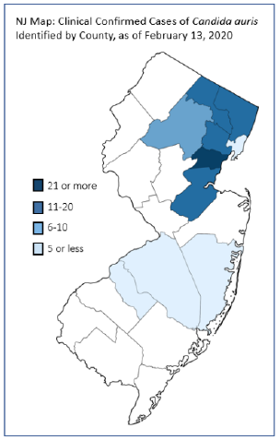
C. auris Updates
CDC Enhanced Barrier Precautions
EPA Registered disinfectants
C. auris claim
C. difficle (List K)
https://www.cdc.gov/fungal/candida-auris/c-auris-infection-control.html#disinfection
https://www.cdc.gov/hai/containment/PPE-Nursing-Homes.html

Slide 11
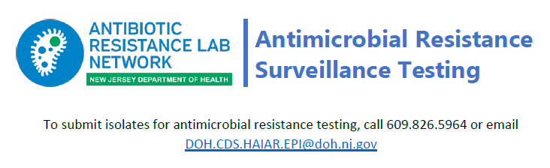
AR Lab Network Surveillance Testing
Routine surveillance testing
Species identification
Antimicrobial susceptibility testing
Molecular testing
Modified Carbapenemase production testing
https://www.cdc.gov/drugresistance/solutions-initiative/ar-lab-network.html?CDC_AA_refVal=https%3A%2F%2Fwww.cdc.gov%2Fdrugresistance%2Fsolutions-initiative%2Far-lab-networks.html

Slide 12
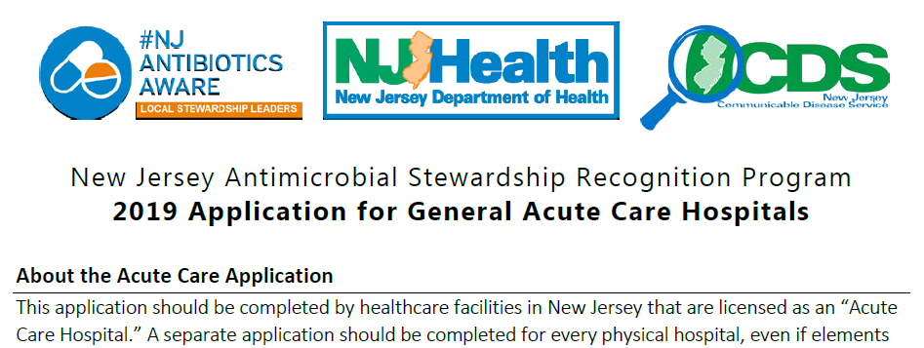

Antimicrobial Stewardship Recognition Program
2019 - 68 awardees
Applications for acute, post-acute & outpatient
Aligns with CDC core elements
Re-opens Summer 2020

Slide 13

ICAR 2.0 Jessica Arias, Bridget Farrell, Carol Genese
Infection prevention
Ventilator Skilled Nursing Facilities
On-site support
Prevent spread of novel MDROs

Slide 14

Education Opportunities
IC/AR Webinars
CRAB or Carbapenem resistant A. baumannii
March 2020 – email to follow
Recording available under “ICAR Resources” Webinars https://www.nj.gov/health/cd/topics/hai.shtml
ICAR Resources or Assessment Opportunity:
CDS.ICAR@doh.nj.gov and/or see ICAR team member
“Training Opportunities”
https://community.apic.org/southernnewjersey/new-item3

Slide 15
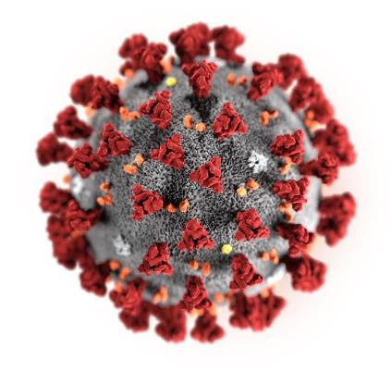
SARS-CoV-2 2019 n-CoV COVID-19
Hot Topic
Facilitated by Jessica Arias
Illustration: CDC / Alissa Eckert & Dan Higgins

Slide 16
What is coronavirus?
Family of viruses that can cause respiratory illness in people
Circulates among animals, including camels, cattle, cats
COVID-19 is the 7th known human coronavirus, is thought to have jumped species from animals to begin infecting humans

Slide 17
Coronavirus
Seasonal
Four common circulating
OC43
229E
HKU1
NL63
Novel (new strain not previously identified in humans)
SARS
MERS CoV
COVID-19

Slide 18
How is COVID-19 different from other known coronaviruses?
Several coronaviruses cause common colds, but are not significant threats for most healthy people
Other coronaviruses have caused past outbreaks, including:
Severe Acute Respiratory Syndrome (SARS)
Middle East Respiratory Syndrome (MERS)
Each caused by a different coronavirus
COVID-19 is a distinct coronavirus
96% identity with bat virus from 2013; close to SARS

Slide 19
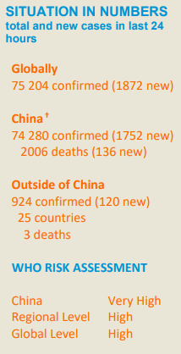
Current outbreak
First case symptomatic on 12/1/2019 in Wuhan City, Hubei Province, China – no connection with fish market
Most in China, but many in a growing list of other countries – including the USA
Common symptoms: Fever, cough, shortness of breath
Case count as of 2/19/2020: 75, 204 confirmed cases globally
US – 15
NJ - 0

Slide 20
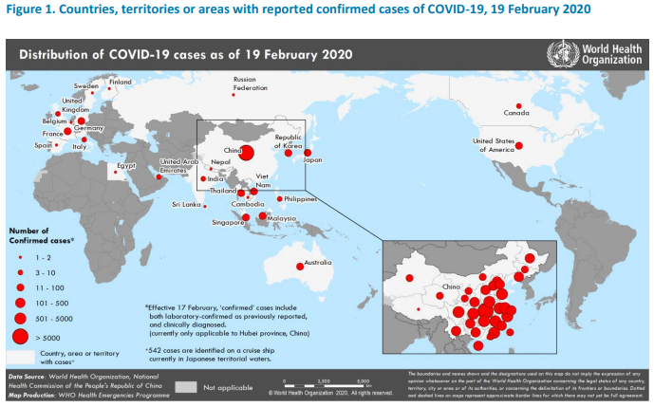
https://www.who.int/emergencies/diseases/novel-coronavirus-2019

Slide 21
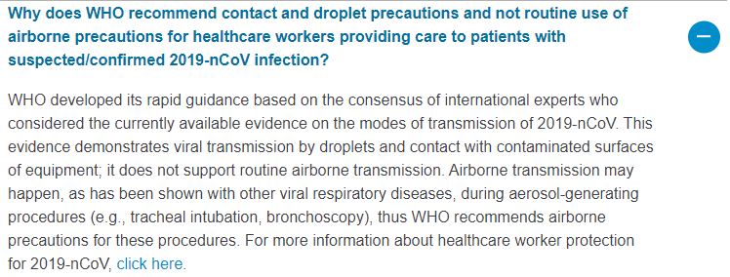
Infection Prevention & Control
CDC: Standard, Contact and Airborne Precautions including use of eye protection
WHO: Standard, Droplet, Contact – Airborne with aerosolizing procedures only
https://www.who.int/news-room/q-a-detail/q-a-on-infection-prevention-and-control-for-health-care-workers-caring-for-patients-with-suspected-or-confirmed-2019-ncov

Slide 22
Infection Prevention & Control
Routine cleaning and disinfection procedures
EPA-registered, hospital-grade disinfectants are appropriate for SARS-CoV-2 (the virus that causes COVID-19) in healthcare settings
Products with EPA-approved emerging viral pathogens claims are recommended for use against SARS-CoV-2
If there are no available EPA-registered products that have an approved emerging viral pathogen claim for 2019-nCoV, products with label claims against human coronaviruses should be used according to label instructions
https://www.epa.gov/pesticide-registration/guidance-registrants-process-making-claims-against-emerging-viral-pathogens
https://www.cdc.gov/coronavirus/2019-nCoV/hcp/infection-control.html

Slide 23

LINCS System
New Jersey Local Information Network Communications System (LINCS)
Public Health Messages at http://www.njlincs.net/PHMessages.aspx
New User Accounts
Select hospital staff http://www.njlincs.net/NewUserRequest.aspx
All other staff & HCF types
Local Public Health Departments https://www.nj.gov/health/lh/documents/LocalHealthDirectory.pdf
See flyer for county specific LINCS coordinator contact information – please include name, job title, email address, and facility name when requesting an account

Slide 24
Resources
CDS Forums – Feb 2020 (upload coming soon)
https://www.nj.gov/health/cd/edu_training/training_res.shtml
New Jersey Department of Health 2019 Novel Coronavirus webpage (CDC syndicated)
https://www.nj.gov/health/cd/topics/ncov.shtml
Local Health Departments (24/7/365)
https://www.nj.gov/health/lh/documents/LocalHealthDirectory.pdf
NETEC COVID-19
https://repository.netecweb.org/exhibits/show/ncov/ncov
https://www.youtube.com/watch?v=bG6zISnenPg (PPE video)
Existing healthcare facility plans
Pandemic Influenza
Avian Influenza
SARs

Slide 25
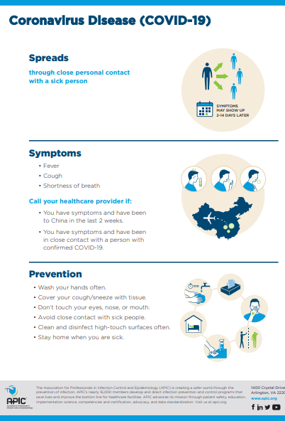

APIC Resources
COVID-19 Poster
https://apic.org/wp-content/uploads/2020/02/02420_Coronavirus_HiresNoBleed.pdf
PPE Do’s & Don’t’s
https://professionals.site.apic.org/infographic/ppe-dos-and-donts/

Slide 26
Coronavirus Preparedness & Response
Facilitated by Gemma Downham

