Slide 2
Legislative & Regulatory Updates
April 2023
Jessica Arias, MHL, BSN, RN, CIC, FAPIC

Slide 3
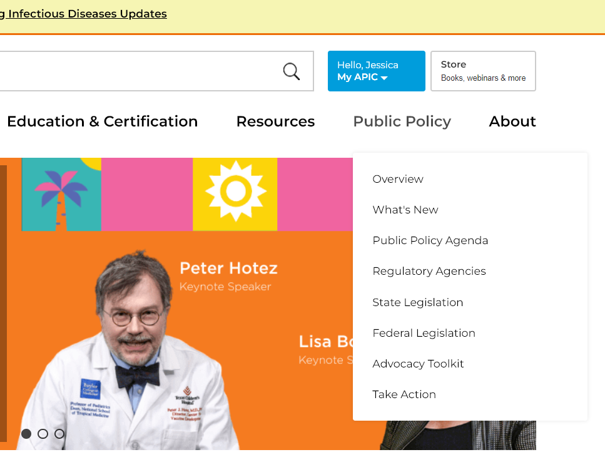
APIC website
https://apic.org/

Slide 4
COVID-19 Public Health Emergency
Department of Health & Human Services (HHS)
To expire end of day on May 11, 2023
Will have continued access to emergency use authorizations (EUAs) via FDA
https://www.hhs.gov/about/news/2023/02/09/fact-sheet-covid-19-public-health-emergency-transition-roadmap.html

Slide 5
Executive Order No. 325 April 3, 2023
No more vaccination and testing requirements for high-risk congregate settings
Healthcare settings SHALL no longer be required to maintain policy that requires covered workers to submit to weekly or twice weekly COVID-19 testing
Healthcare settings SHALL continue to be required to maintain a policy that requires covered workers to provide adequate proof that they are up to date with their COVID-19 vaccinations (uses NJ definition of up-to-date; not CDC).
received a primary series, which consists of either a 2-dose series of an mRNA COVID19 or protein subunit vaccine, or a single dose viral vector COVID19 vaccine, and the first booster dose for which they are eligible as recommended by the CDC
https://www.nj.gov/infobank/eo/056murphy/pdf/EO-325.pdf

Slide 6
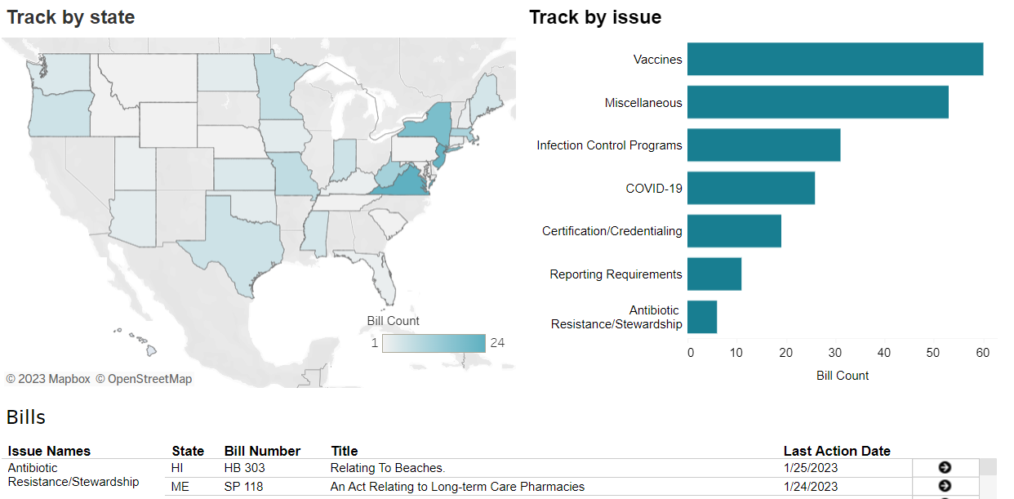
State Legislation
No Updates
https://cqrcengage.com/apic/state

Slide 7
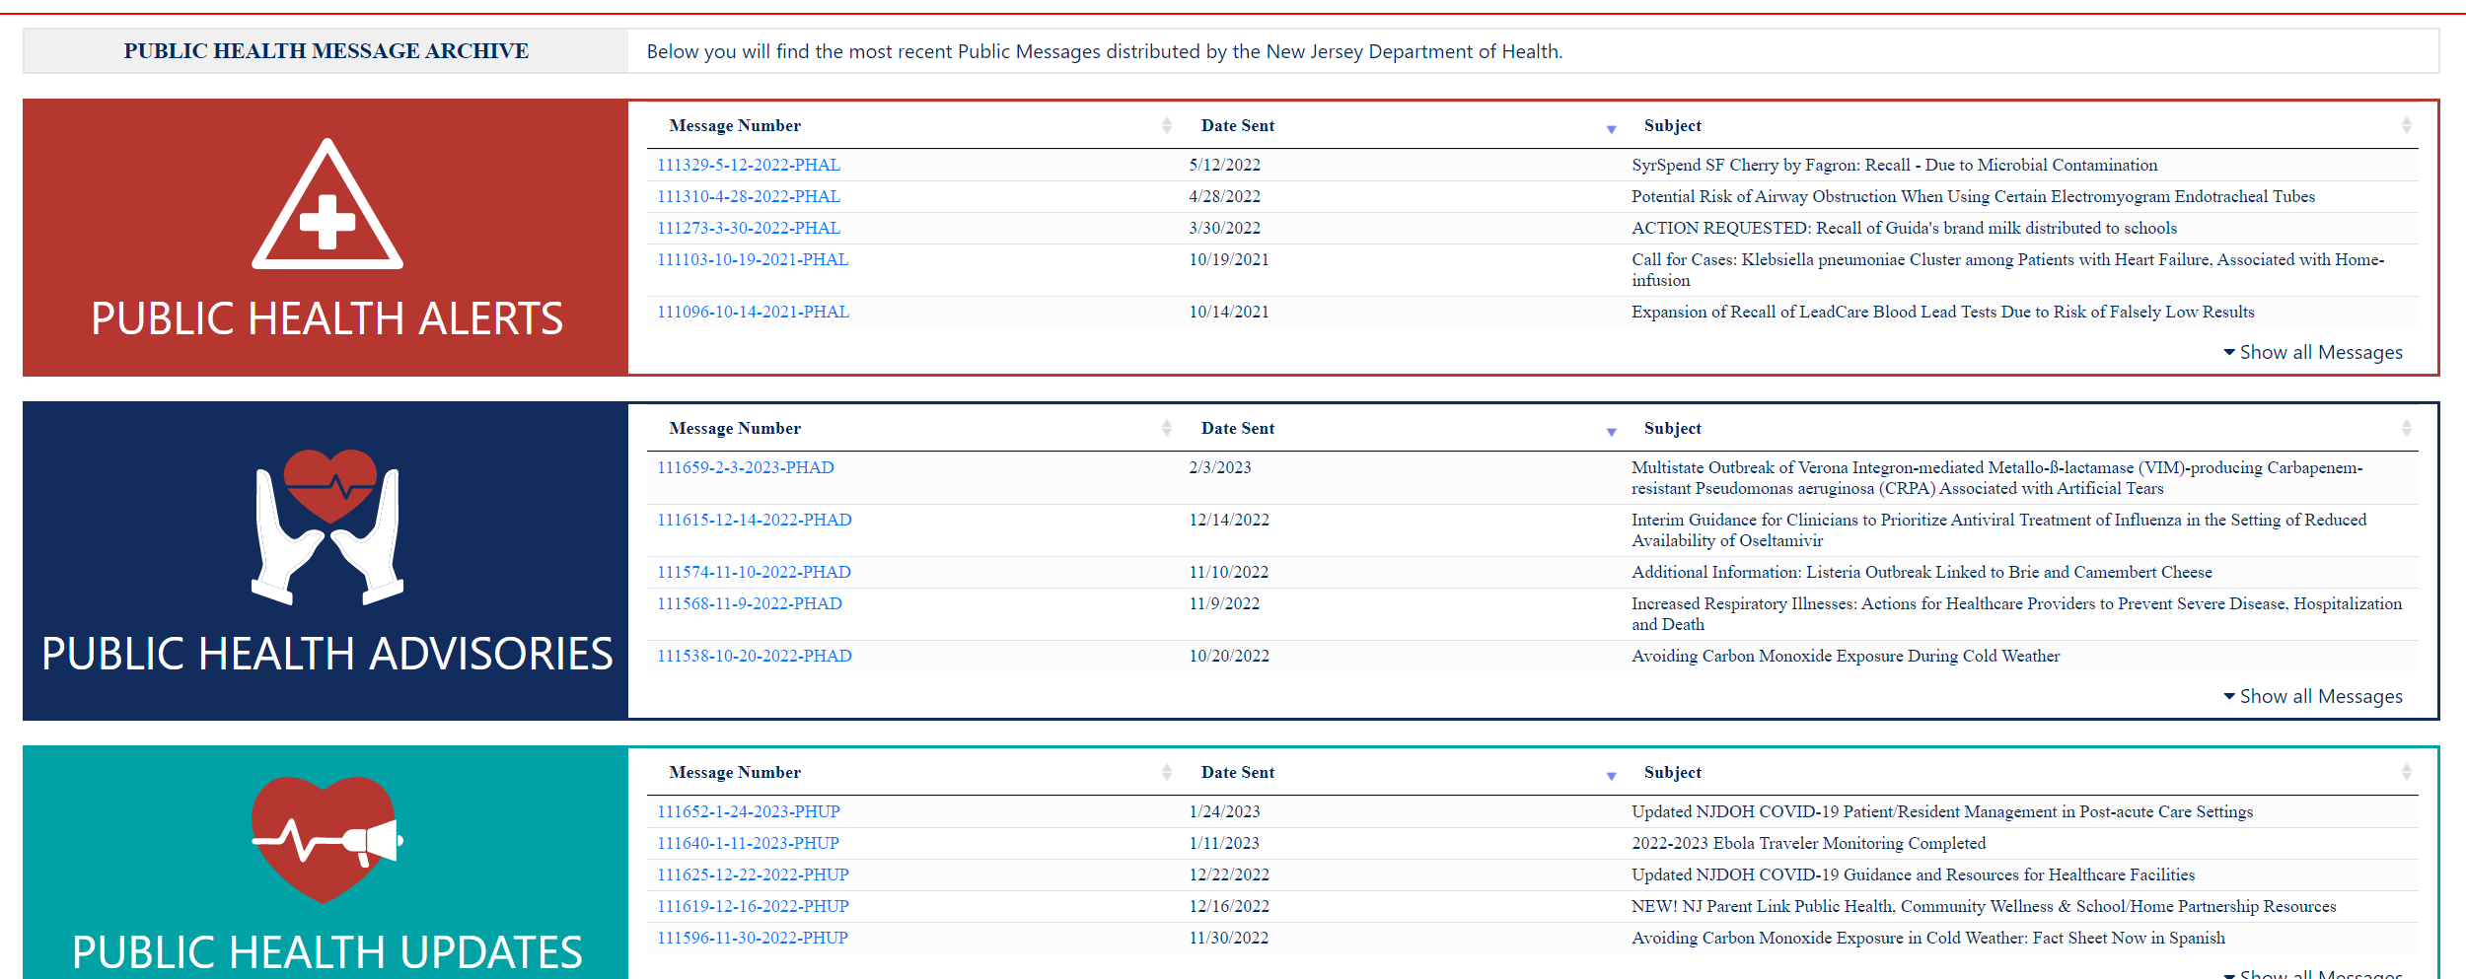
NJ LINCS Health Services Portal
Go to the NJLINCS website
NJ Local Information Network and Communications System
Select “Subscribe to Health Alerts” on the left-hand tab
NJLINCS HAN Messaging
Allows access to archived messages

Slide 8

Infection Control Assessment & Response CDS.ICAR@doh.nj.gov
Sign up for ICAR E-mail Blasts
Containment assessments
ICAR
COVID-19 specific
Responding to an outbreak or investigation
prevention assessments
Overall IPC with a COVID-19 addendum
Enhancing overall IPC
Quality improvement
Schedule a FREE ICAR Prevention Consultation

