Slide 1
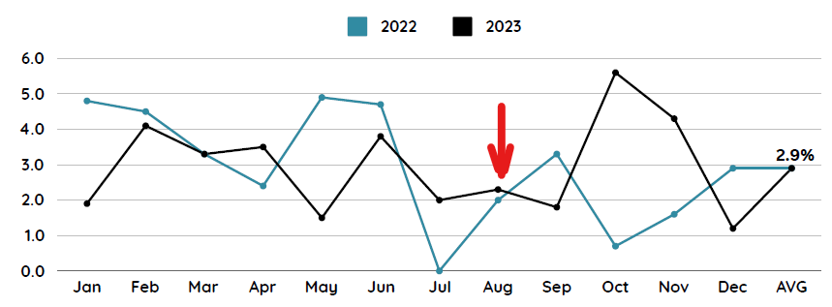


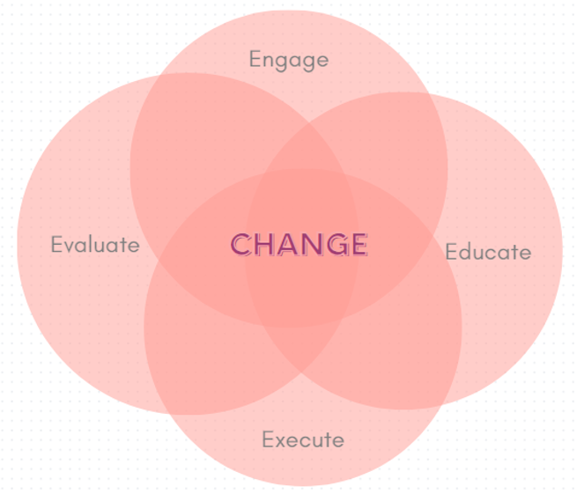
Title of Topic: Reducing Blood Culture Contamination Rates
Audience: Novice x Proficient
Which “E” Are You Discussing: Engage Educate x Execute Evaluate
In one or two sentences, what was the problem or issue that you identified? The Laboratory had been tracking blood culture (BC) contamination rates for several years, with the goal of achieving an overall rate of <3%. Month to month rates, however, ranged from 0.7% to 7.6% and there was significant individual user variability when technique was observed. | Provide some background information, such as how or why the current process evolved to what it is? How does this affect patient safety? Were there any regulatory implications? For many years, the American Society for Microbiology (ASM) and the Clinical Laboratory Standards Institute (CLSI) recommended that overall BC contamination rates should be <3%. It is well known that contaminated BCs leads to inappropriate antibiotic treatment, additional unneeded tests, extended hospital LOS, and excess cost. In December 2022, the CDC endorsed a new quality measure for a common, consistent standard for all U.S. hospitals to follow for calculating, monitoring and reporting BC contamination rates. The National Quality Forum, CLSI, and CMS are working to introduce this new quality measure into IQR reporting in the best interest of patient safety and outcomes. Preventing Adult Blood Culture Contamination: A Quality Tool for Clinical Laboratory Professionals | CDC
What did you do to improve the problem/issue? Who was on your team and what resources did you use? Did you use a specific tool or model (e.g., PDSA, Fishbone Diagram, Pareto Chart, SWOT or Gap Analysis, etc.)? For several years, the approach was that the Lab rounded back one-on-one with individuals identified as having drawn the contaminated BC. Technique was reviewed with re-education as needed (skin antisepsis, blood culture bottle disinfection, blood culture collection site, changing needle to transfer blood to culture bottle, sterile gloves, volume of blood obtained, hand hygiene, the use of initial specimen diversion equipment). BC contaminations persisted so data was stratified to identify where the most contaminations occurred (Phlebotomy=1.5% vs. ED RNs=8%). It was determined that RNs would commonly use the IV start to draw the first set of BCs and multiple gaps in technique contributed to contaminations. A team consisting of Lab, IP, and ED met to discuss historical data and problem solve using PDSA format. Proposed solutions: Train RNs to use Kurin, change IV tubing to allow for diversion of first few ccs, all BCs drawn by phlebotomy). After evaluation of proposals, the decision was made that effective 8/1/2023 all BCs would be drawn by Phlebotomy. Additionally, all BCs would be drawn using a Kurin device. | What was the outcome, and how have you sustained this improvement/success? Training and education with Phlebotomy on proper procedure, with new process start 8/1 and slight improvement in September. However, October and November, it was determined that some phlebotomists were not using the Kurin device (new staff not educated). Phlebotomy staff re-educated with improvements noted in December (1.2%). YTD, January is 2.5% and February is 1.4%. Improvement is being made, but success is not yet sustained, so will continue to monitor and re-evaluate for additional process changes that may need to be made.

