Slide 1

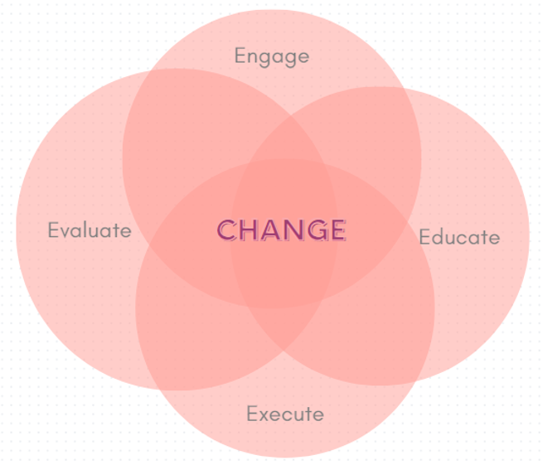

Title of Topic: Engaging surgical teams through SSI ACA reviews Audience: X Novice X Proficient
Which “E” Are You Discussing: X Engage Educate Execute Evaluate
In one or two sentences, what was the problem or issue that you identified? We were struggling to reduce surgical site infections. These infections can be so complex with multiple factors contributing to the outcome. It can be challenging to identify which exact interventions are needed. | Provide some background information, such as how or why the current process evolved to what it is? How does this affect patient safety? Were there any regulatory implications? Starting in 2021, we noticed a substantial increase in SSIs, across all service lines. There was no obvious trend or gap that we could identify. We needed a way to thoroughly review the cases and identify opportunities for improvement. We had success in the past with conducting Apparent Cause Analyses (ACAs) to review CAUTI and CLABSI events in a multi-disciplinary setting. We wanted to apply the same concept to further investigate our SSIs.
What did you do to improve the problem/issue? Who was on your team and what resources did you use? Did you use a specific tool or model (e.g., PDSA, Fishbone Diagram, Pareto Chart, SWOT or Gap Analysis, etc.)? We developed an ACA tool specific for SSIs. We based it on a tool that was presented at APIC National in 2022 and adapted the specific questions to fit the interventions and bundle components in use at our organization. We utilized our SSI Taskforce to review and develop the ACA form, which included Infection Prevention, OR Educator, NSQIP coordinator, ERAS Coordinator, and members of the perioperative nursing teams. We then used the form to review one recent SSI case, as a test run. It went well and the team was very engaged in the process! To continue to build on that engagement, we started inviting the surgeons, set a regular meeting cadence, and continued to improve and add questions to the form as we learned more. | What was the outcome, and how have you sustained this improvement/success? The process has fostered great engagement with our surgical services team members. They come to the meetings having already reviewed the cases and document their findings on the ACA form. Then we put all that information together as we discuss the case. We identify action items from each ACA and track them on our SSI Rolling Action Item list (RAIL) which is very helpful tool for ensuring closure of identified actions. We have received positive feedback from all surgeons who have attended the ACAs, and we hope to continue to grow engagement and improve surgeon attendance specifically.

