Slide 1
Infection Control: Training Tools for your IC Toolkit
Elizabeth Adams, LPN, a-IPC, Infection Prevention Specialist
Dianna Bowling, LPN, Infection Prevention Specialist
APIC Spring Conference (5/5/2023)

Slide 2
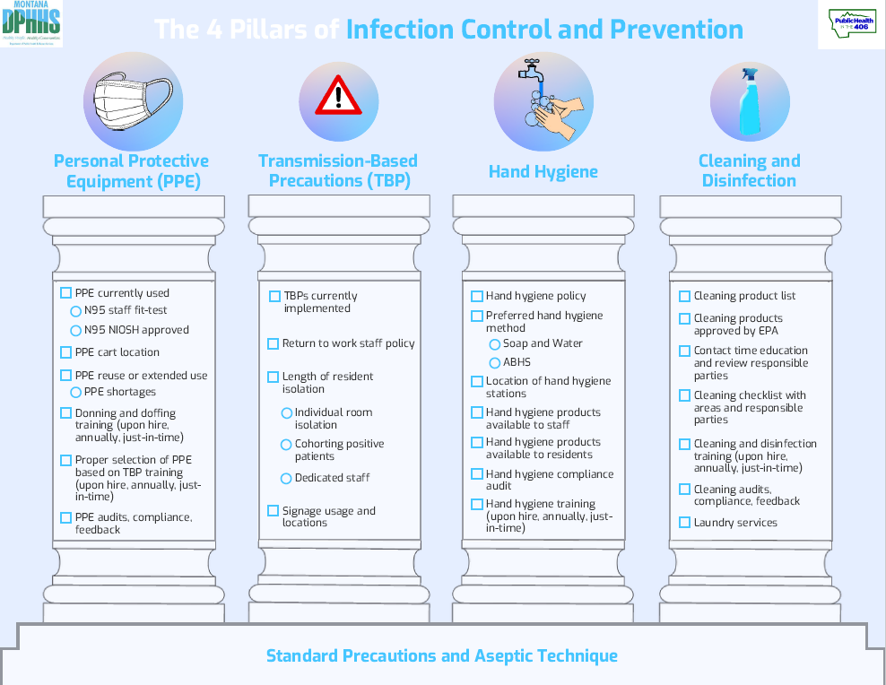

Slide 3
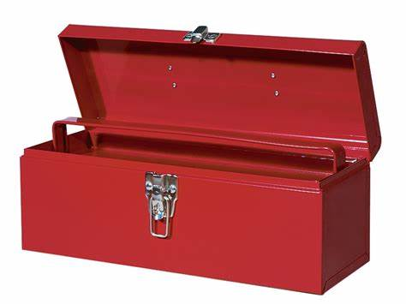
CDC PPE Sequence Infographic
Scenario based examples (select the correct PPE)
Demonstration by facilitator; return demonstration
Personal Protective Equipment

Slide 4
Review of CDC’s TBP signs
Scenario-based (match the disease with the TBP)
Transmission Based Precautions
Scenario-based through examples

Slide 5
HH visualization using gloves and shaving cream
Pictures
This or That: ABHR or Soap and Water
Infographics
Hand Hygiene

Slide 6
EVS Puzzle Pieces (match the term and the definition)
Cleaning and Disinfection
Infographics

Slide 7
Other Training
Skills Fairs
Free to all healthcare facilities that participate in an ICAR with the MT ICP/HAI Section
Number of booths are based on time and space allotted by facility
Based on the needs of the facility and training gaps identified by the ICAR
Escape Room
Webinars

Slide 8
Interested?
Contact the MT ICP/HAI Section today!
406-444-0275 (Erika Baldry)

