Slide 1

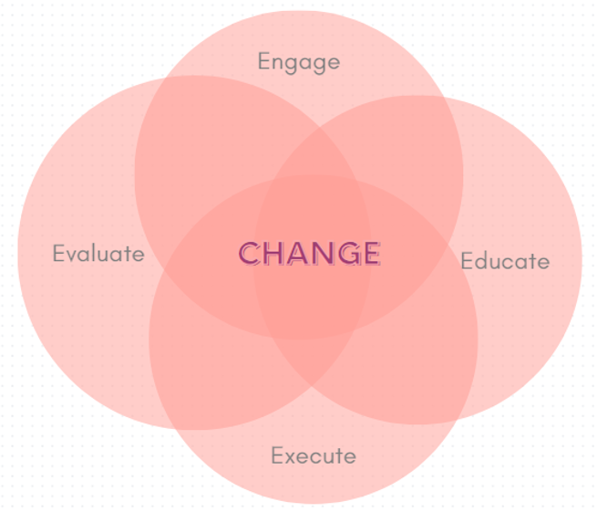

Title of Topic:
Audience: Novice Proficient
Which “E” Are You Discussing: Engage Educate Execute Evaluate
In one or two sentences, what was the problem or issue that you identified? | Provide some background information, such as how or why the current process evolved to what it is? How does this affect patient safety? Were there any regulatory implications?
What did you do to improve the problem/issue? Who was on your team and what resources did you use? Did you use a specific tool or model (e.g., PDSA, Fishbone Diagram, Pareto Chart, SWOT or Gap Analysis, etc.)? | What was the outcome, and how have you sustained this improvement/success?

