Slide 1
Effective Infection Prevention Change Strategies
Kavita K. Trivedi, MD
Director of Clinical Guidance, Communicable Disease Controller
Alameda County Public Health Department

Slide 2
Learning Objectives
After this session, participants will be able to:
Delineate the difference between implementation science and quality improvement
Explain why understanding context is essential when implementing practice
Describe what is meant by process, outcome, and balancing measures
Recognize the value of quality improvement in healthcare epidemiology

Slide 3

Why do we Need Implementation?
Knowing-Doing Gap
Estimated 17yr to implement evidence
Implementation can bridge the two
Regulatory expectation
To implement evidence-based policies
Knowledge
Practice
Balas and Boren (2000)
Grant et al (2003)
The Joint Commission (2021)

Slide 4
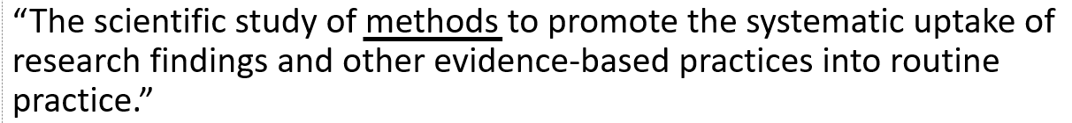
Terminology
Implementation science
“The scientific study of methods to promote the systematic uptake of research findings and other evidence-based practices into routine practice.”
Implementation in practice (Quality Improvement)
“The systematic uptake of research findings and other evidence-based practices into routine practice”
Eccles & Mittman (2006)
Saint et al (2010)
Tomoaia-Cotisel et al (2013)
Geerligs et al (2018)
Kaplan et al (2010)

Slide 5
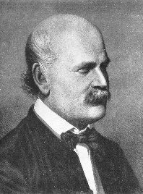
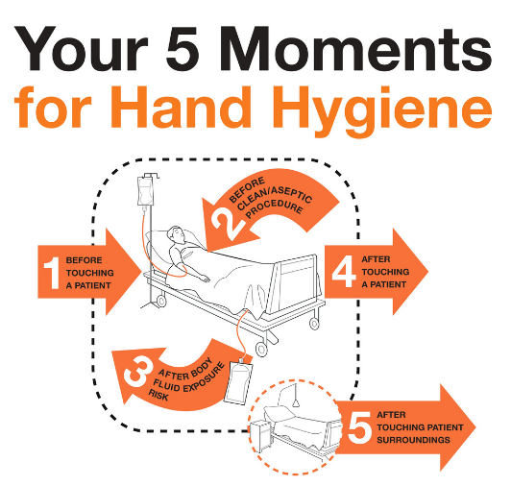




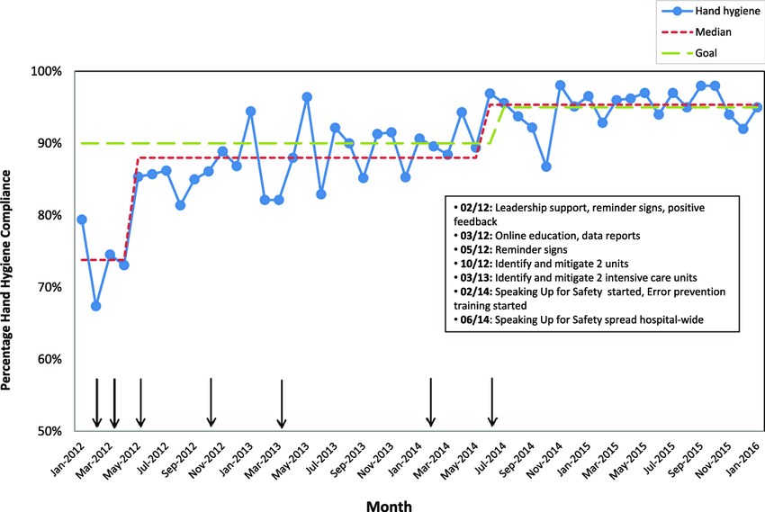

Terminology
Example: Hand Hygiene
Evidence shows that hand hygiene prevents disease transmission
You need your providers to perform hand hygiene
Implementation Science
How should HH be performed?
How should adherence be measured?
What materials are necessary for HH?
What motivates people to perform HH?
What are facilitating factors? Barriers?
Quality Improvement
Which methods will work best for my providers?
Semmelweis (1847)
Eccles & Mittman (2006)
Saint et al (2010)
Tomoaia-Cotisel et al (2013)
Geerligs et al (2018)
Kaplan et al (2010)

Slide 6

System vs Individual
Organizational structure dictates performance
Systems work toward a steady state
“Systems operate the way they are designed to operate”
Working harder vs working better
No amount of effort can change system design
“A bad system will beat a good person every time”
Red bead experiment
IHI Demonstration Video – Red Bead Experiment:
https://youtu.be/oMb_UKYHvto?si=xB6mVslnjmzcZShS
W. Edwards Deming
Deming WE, The New Economics (1994)

Slide 7

Working Harder vs Working Better
Optimizing tomato production
You want market-ready product from seed to fruit in 2 weeks
Existing System Constraint
It is biologically impossible to produce a tomato in <30 days
Strategies to improve production
Positive – Incentives, swag, competition
Negative – Pay cuts, lay-offs
The goal cannot be achieved unless you modify the system
Genetic intervention (cross-breeding)
Invent equipment (soil, environment)

Slide 8
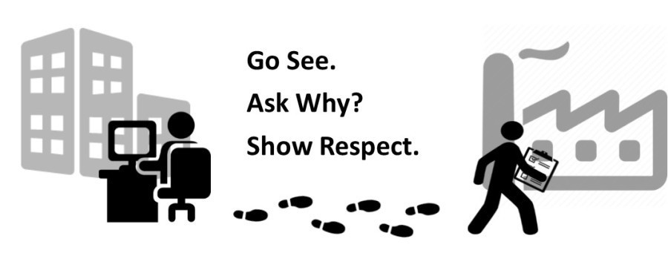
Observation and Qualitative Evaluation
‘Going to the Gemba’
Real-world, real-time observation
Direct engagement with people and process
Collect data, not solutions
Bicheno & Holweg, The Lean Toolbox (2016)

Slide 9
Reliability
How often a process happens as it is supposed to
Percent success or failure
Systems can be highly reliable but humans cannot
Person-Dependent systems are unreliable
Creating reliability requires purposeful design and maintenance
Forced-function
Automation
Standardization
Constant evaluation/observation

Slide 10
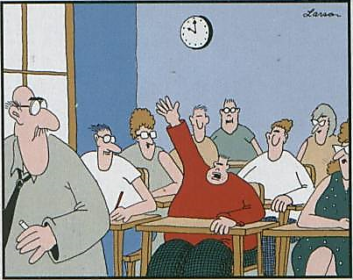
Education is a Low-Reliability Intervention
Necessary but insufficient
Relies on memory and vigilance
Requires repetition and practice
May not account for different learning styles
Prone to failure
Cannot fix lapses in concentration
Does not change habits
May not affect external pressures
Mr. Osborne, may I be excused? My brain is full.
Soong & Shojania (2020)
https://www.ismp.org/resources/education-predictably-disappointing-and-should-never-be-relied-upon-alone-improve-safety

Slide 11

Education has Low-Reliability - Examples
Driving, Skidding, and Breaking
Taught – pump breaks, turn into skid
Reliable fix – Anti-Lock Breaks
Mandatory on all cars

Slide 12
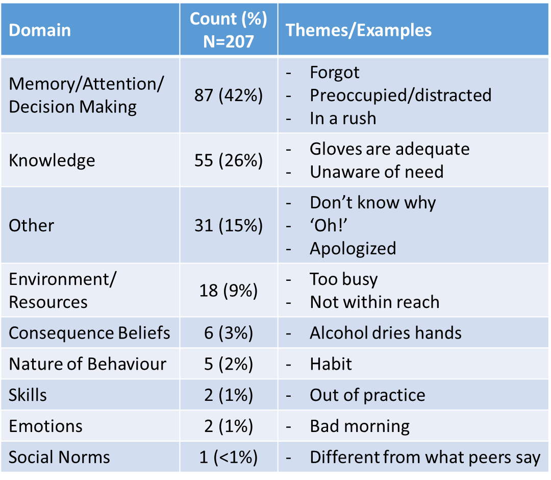
Education has Low-Reliability - Examples
Driving, Skidding, and Breaking
Hand hygiene
No lack of data
No lack of education
Why do we see lack of adherence?
69% of failures not related to education
Fuller et al (2014)

Slide 13
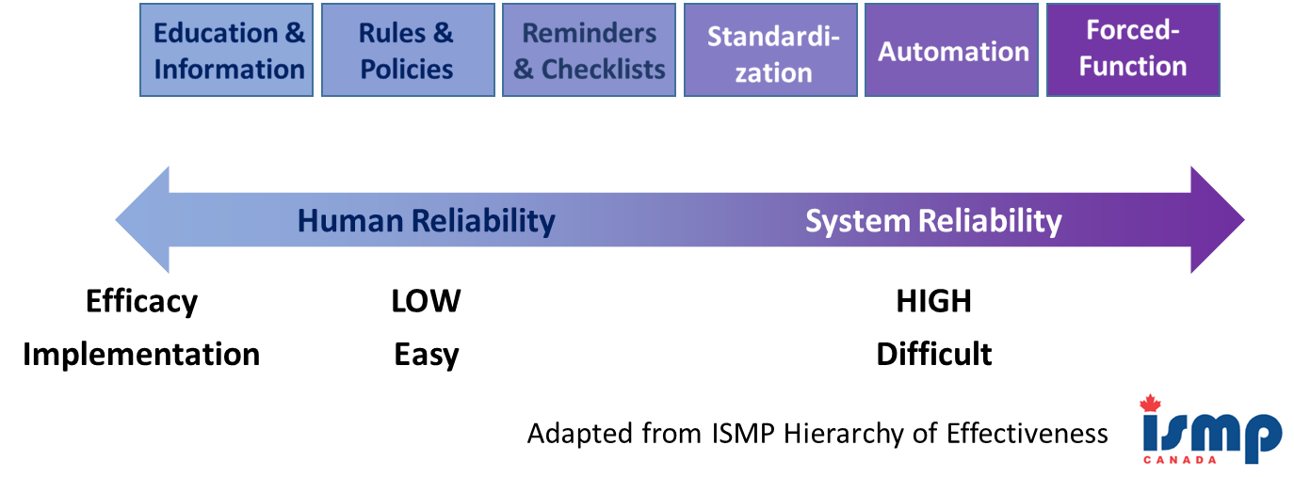
Interventions and Reliability
https://www.ismp.org

Slide 14
Human Factors and Ergonomics
What is IS
The interaction of people with their physical surroundings
Includes technology, each other, and physical structure
Supports work with systems that fit capabilities, needs, and limitations of working partners
Standardizing practice to establish processes as “normal behaviors”
What it IS NOT
How humans tend to behave
Humans making choices based on training
Holden RJ et al. (2013)
Pennathur & Herwaldt (2017)

Slide 15








Human Factors and Ergonomics
Color matters
Color as a signal of content/product

Slide 16
Discussion

Slide 17
Describe your QI projects
Describe something that worked
Describe something that didn’t work
Describe the team that was assisting to implement the change strategy
What could you have done differently

Slide 18
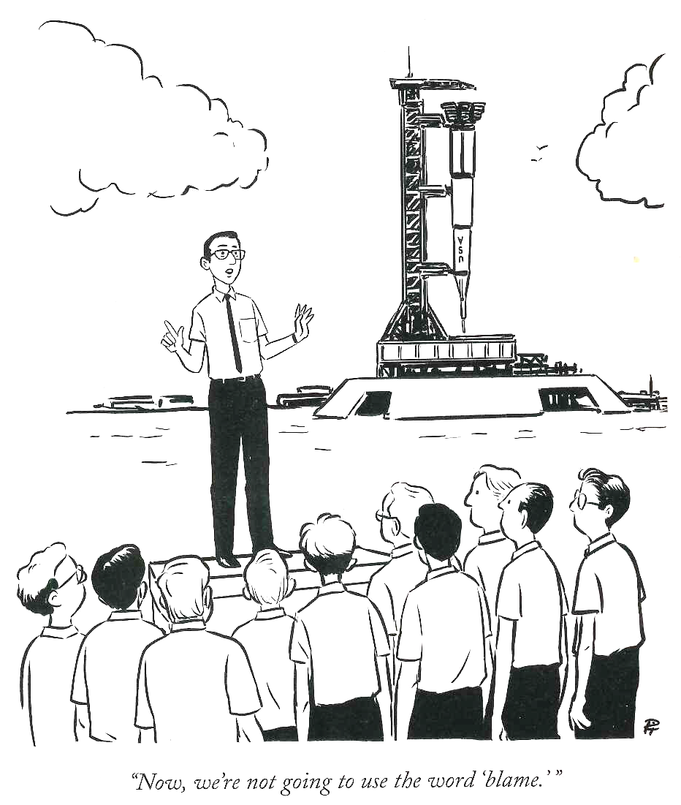

Slide 19
Elements for a Successful QI Project

Slide 20
QI in Practice
Key pieces needed to succeed
Team
Context and Determinants
Measures
Framework

Slide 21
QI in Practice
Key pieces needed to succeed
Team
Can form at any time
Frontline stakeholders, influencers and leaders, technical support
Team membership is fluid
Context and Determinants
Measures
Framework

Slide 22
The Importance of Context
Operational support
Informatics resources
Familiarity and experience
Willingness to change
Safety culture
Healthcare workforce
Patient population
Existing efforts
And more…
Context is:
Directly influences implementation plan
Choice of what and how to implement
Interventions need to match context
Understanding context can be tricky
Experience vs Clean slate
External appearance vs Internal reality
Kaplan et al (2010); Saint et al (2010)
Tomoaia-Cotisel et al (2013) Geerligs et al (2018)

Slide 23
Determinants
Factors influencing a practice or change
Facilitators – promote a practice or change
Barriers – hinder practice or change
Levels to assess
Individual – Preferences, needs, attitudes, knowledge
Facility – Team composition, communication, culture, resources
Partners – Degree of support and buy-in
How to identify
Literature
Direct observation
Conversations
Trivedi et al (2023)

Slide 24
Determinants - Prioritization
May be helpful which to address by stratifying:
Feasibility
Team vs Unit vs System level
Precedent vs none
Funding
Timeline
Quick vs prolonged to affect
Urgency
Align with strategic plan
Safety or regulatory issue
‘Time Sinks’
Probably not worth addressing
Effort
‘Quick Wins’
May be worth doing up-front
Impact

Slide 25
Determinants Example – SSI Prevention
Project: Implement SSI prevention bundle for all surgeries
Facilitators
Surgical and perioperative champion(s)
External collaboration – SPS, NSQIP
Barriers
Large set of complex micro-systems
Who makes final decisions?
Resistance to change
Long time to show impact
Other competing projects

Slide 26
Measures
Data to show progress (or lack thereof)
Measures should be appropriate
To address the question being asked
For implementation method used
Rapid turnaround
Automation of any or all steps
Impactful
Data that matters to your context

Slide 27
Aims and Measures
S
pecific
easurable
ctionable
ealistic
ime-based
Two types of aims
Global Aim – Very big picture
SMART Aim - Project-directed
Three types of measures
Outcome – ultimate goal
What you are trying to prevent or improve
Process – action reliability
How consistently are you doing what you need to affect the outcome
Balancing – undesired outcome of change
Unintended harm, the cost of your project (safety, stress, etc)
M
A
R
T

Slide 28
Aims & Measures Example – VAP Prevention
Global aim: Eliminate all VAPs
SMART Aim: To reduce the VAP rate from 3.0% to 2.4% by December 31
Project: Implement VAP prevention bundle for all intubated patients
Measures
Outcome – VAPs
Process – Bundle reliability
Balancing – Reintubation
Early extubation is a bundle component
Do not want to do too soon (leads to reintubation)
Specific
Actionable
Measurable
Realistic
Time-based
20% reduction

Slide 29
Framework
Methodology to help organize efforts and interpret results
Choosing a framework
Practical:
What is local expertise/experience? Available resources? Timeline?
Methodologic:
What is the outcome you are trying to achieve?
Many published frameworks
Some have books and materials (‘How To’)
All require some expertise (qualitative research/coding, survey development and analysis)
Trivedi et al (2023)

Slide 30
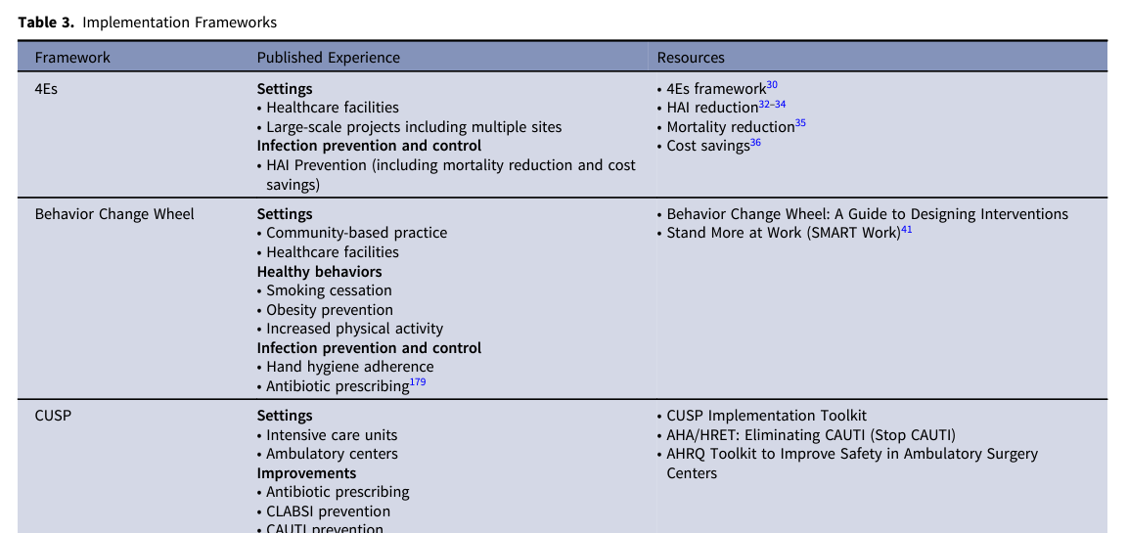
Framework Examples
SHEA Compendium Chapter
Trivedi et al (2023)

Slide 31
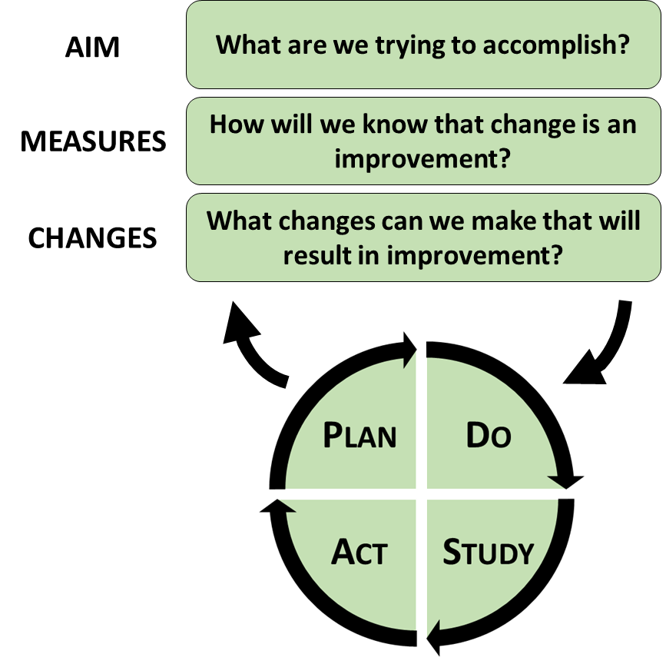
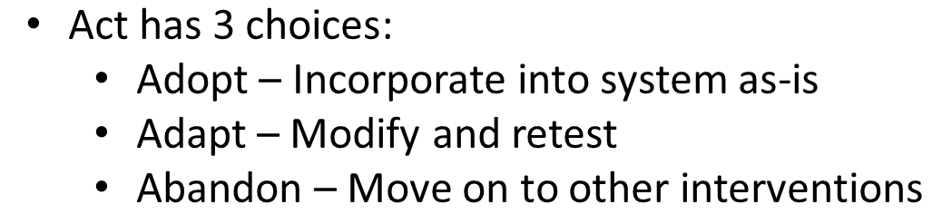
Framework Example – Model for Improvement
Used widely in healthcare, IP&C, Public Health
Change vs change resulting in improvement
3 questions to develop hypothesis
PDSA cycles to experiment and modify
Designed for team-driven projects
Relies heavily on data analysis and interpretation
Statistical process control
Langley et al, The Improvement Guide (2019)

Slide 32
Summary
Implementation Science vs Quality Improvement
Implementation Science – How and why interventions may work
Quality Improvement – Making interventions work in a specific context
Be systematic and scientific
No assumptions (Don’t start with interventions)
Direct observations (‘Go to the gemba’) - Understand your context
Education is a low reliability intervention
Necessary but not sufficient
Essentials for Success
Team
Knowing context and determinants (Barriers/Facilitators)
Proper measures (Process, Outcome, Balancing) and framework

Slide 33
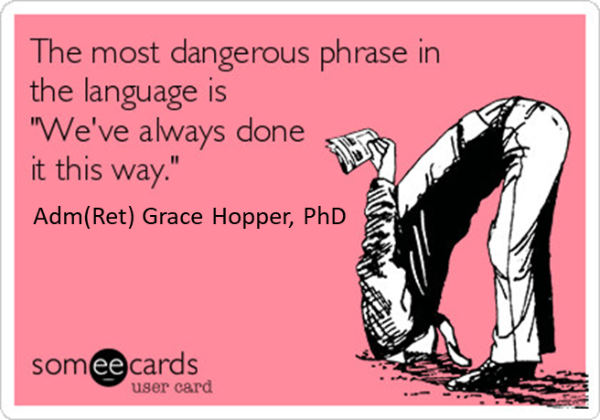

Slide 34
FRAMEWORKS

Slide 35
Standard Approach - Framework
Principles and evidence summarized for 9 published frameworks
More exist
Hybrid approach
Resources to help choose
Context – local expertise, consultant help
Included with each described framework
Online databases
ERIC
CFIR
RE-AIM and PRISM
Expert Recommendations for Implementing Change
Consolidated Framework for Implementation Research
Reach
Effectiveness
Adoption
Implementation
Practical Implementation Sustainability Model
Maintenance

Slide 36
Framework Example – 4Es
Summarize the Evidence
Interventions into behaviors
Engage
The Why behind the What
Envision
the problem within the larger system
Identify Local Barriers
to implementation
Engage
local and central multidisciplinary teams
Evaluate
Assess data to guide
next steps
Educate
Share the Evidence
Measure Performance
Process and/or Outcome
Ensure All Patients Receive Intervention
Execute
Design process to address challenges
Think big AND small
Identify barriers and facilitators (roadmap) Measure and report
Pronovost et al (2008)
Cabana et al (1999)

Slide 37
4Es
Guides improvement teams in planning to address key partners for the implementation process: senior hospital leaders, improvement team leaders, and frontline staff
Planning for and utilization of multifaceted interventions that address the 4Es, coupled with explicit efforts to improve teamwork and safety culture have been associated with
reductions in HAIs
Mortality
Increased cost savings

Slide 38
Discussion re 4Es Implementation

Slide 39
Can you think of a problem you could address utilizing the 4Es?
Engage, Educate, Execute and Evaluate
What is your Why?
Who are you trying to Engage?
How will you Execute?
How will you Evaluate?
Can you incorporate SMART goals?

Slide 40
References
Balas EA, Boren SA. Yearb Med Inform 2000:65-70.
Grant J, Green L, Mason B. Res Eval (2003) 12:217-224.
The Joint Commission. (2021) All Accreditation Programs Survey Activity Guide. https://www.jointcommission.org/-/media/tjc/documents/accred-and-cert/survey-process-and-survey-activity-guide/2021/2021-all-programs-organization-sag.pdf.
Eccles MP, Mittman BS. Implement Sci (2006) 1:1. doi: 10.1186/1748-5908-1-1.
Kaplan HC, Brady PW, et al. Milbank Q (2010) 88:500-559. doi: 10.1111/j.1468-0009.2010.00611.x
Saint S, Howell JD, Krein SL. Infect Control Hosp Epidemiol (2010) 31 Suppl 1:S14-7. doi: 10.1086/655991
Tomoaia-Cotisel A, Scammon DL, et al. Ann Fam Med (2013) 11 Suppl 1:S115-123. doi: 10.1370/afm.1549
Geerligs L, Rankin NM, et al. Implement Sci (2018) 13:36. doi: 10.1186/s13012-018-0726-9
Deming WE. The New Economics for Industry, Government, Education. © 1994 W Edwards Deming Institute. Published by MIT Center for Advanced Educational Services, Cambridge, MA
Bicheno J, Holweg M. The lean toolbox : A handbook for lean transformation. 5th ed. Buckingham: PICSIE Books; 2016.
Soong C, Shojania KG. BMJ Qual Saf (2020) 29:353–7. DOI: 10.1136/bmjqs-2019-009897
https://www.ismp.org/resources/education-predictably-disappointing-and-should-never-be-relied-upon-alone-improve-safety
Fuller C et al. Am J Inf Ctrl (2014) 42:106-10. DOI:10.1016/j.ajic.2013.07.019
Pennathur PR, Herwaldt LA. Curr Treat Options Infect Dis (2017) 9:230–249. doi:10.1007/s40506-017-0123-y
Holden RJ, Carayon P, Gurses AP, et al. Ergonomics (2013) 56:1669–1686. doi: 10.1080/00140139.2013.838643.
Trivedi KK, Schaffzin JK, et al. Infect Control Hosp Epidemiol (2023) 44:1232. doi:10.1017/ice.2023.103
Science of Improvement: establishing measures, 2023. Institute for Healthcare Improvement website. https://www.ihi.org/resources/Pages/HowtoImprove/ScienceofImprovementEstablishingMeasures.aspx.
Langley G, Moen R, Nolan K, et al. The Improvement Guide: A Practical Approach to Enhancing Organizational Performance. 2nd Edition ed. San Francisco: Jossey-Bass Publishers; 2009

