Slide 1

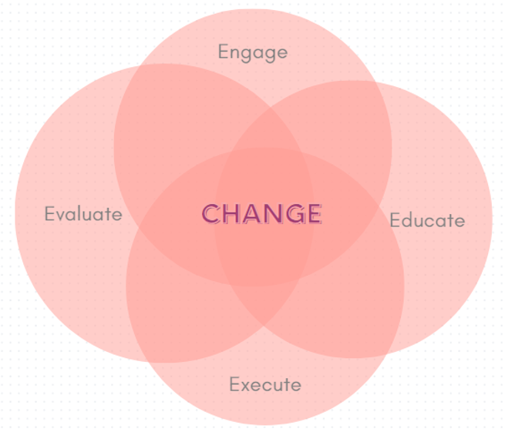

Title of Topic: NHSN Reporting: A Guide to Reporting When Staffing Changes Happen Audience: Novice Proficient
Which “E” Are You Discussing: Engage Educate Execute Evaluate
In one or two sentences, what was the problem or issue that you identified? When staff turnover or changes occurred within facilities, many of the same NHSN questions were coming to the NHSN Epidemiologist indicating that there was a potential problem with how NHSN information was being transferred to the new individual in the position responsible for reporting to NHSN. | Provide some background information, such as how or why the current process evolved to what it is? How does this affect patient safety? Were there any regulatory implications? NHSN reporting requirements increased drastically for all facility types during the COVID-19 pandemic and there was also large turnover in staff leaving potential breaks in staffing of positions that were responsible for reporting to NHSN. Those in these positions are normally responsible for a large variety of tasks and sometimes NHSN reporting gets forgotten or lost during these abrupt or planned changes. When new individuals in these positions did not know they were supposed to be reporting to NHSN, the facility had the potential to face CMS regulatory penalties for failing to report. The MT HAI team was notified by CDC when COVID-19 reporting lapses were identified. It was the expectation of the MT HAI team to contact these facilities.
What did you do to improve the problem/issue? Who was on your team and what resources did you use? Did you use a specific tool or model (e.g., PDSA, Fishbone Diagram, Pareto Chart, SWOT or Gap Analysis, etc.)? This identified the need for a more standardized NHSN how-to guide for reporting that could be kept on file at the facility for when these staff turnover or changes occurred. The how-to guide template will be shared by the NHSN Epidemiologist with all IPs in Montana in addition to all individuals listed as the NHSN facility administrator. This how-to guide was developed with resources from NHSN and customized by the facility. It contains a new staff checklist, basic administrative instructions, reporting requirements, educational roadmap, NHSN projects completed/or are ongoing, a leaving checklist, and more. | What was the outcome, and how have you sustained this improvement/success? A complete NHSN care package for the incoming staff member which is tailored specifically to that facility, using a template developed by the NHSN Epidemiologist at MT DPHHS. The how-to guide can be maintained and updated with each incoming staff member to make sure that it contains the most up-to-date information.

