Slide 1

APIC MT Chapter Spring Conference: Education
MT DPHHS ICP/HAI Section
Erika Baldry, MPH, CIC
ICP/HAI Section Supervisor
Epidemiologist

Slide 2

Overview
15-minute presentation
30-minute discussion at your table based on a prompt
15-minute report out and share

Slide 3
Erika Baldry, Section Supervisor
Infection Prevention and Control
National Healthcare Safety Network (NHSN)
Healthcare-Associated Infections
Antimicrobial Stewardship
Elizabeth “Liz” Adams, Infection Prevention Specialist and Dialysis Lead
Dianna Bowling, Infection Prevention Specialist
Samantha Carle, Infection Prevention Specialist
Andrea Woody, Infection Prevention Specialist
Pam Webb, Contracted Infection Preventionist
Tori Doll, NHSN Lead
Jenner Minto, AR Expert and Pharmacist
Vince Colucci, AR Expert and Pharmacist
Multidrug-Resistant Organisms (Erika Baldry)
HAI Outbreaks (All)
Infection Control and Prevention/Healthcare Associated Infections Section
Non-regulatory agency responsible for responding to outbreaks of communicable disease. Provide education, tools, and resources related to infection control and prevention, multidrug-resistant organisms and other healthcare-associated infections to local/tribal public health and healthcare facilities throughout Montana.

Slide 4
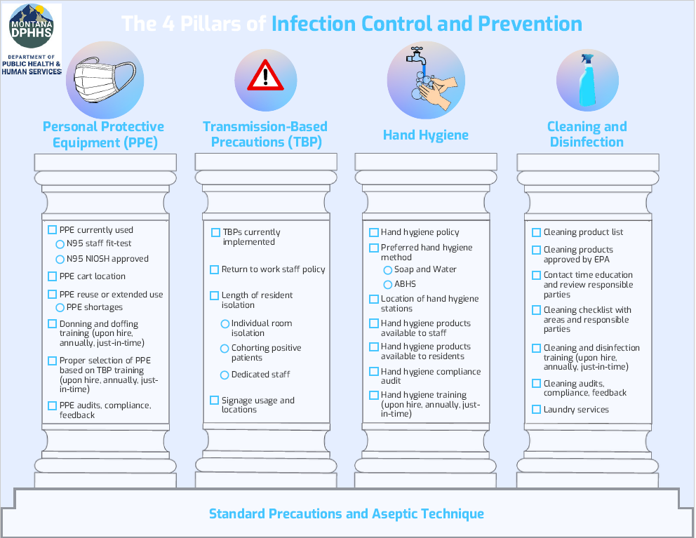

Slide 5

Education: Creating Interactive Trainings to Foster Learning and Engagement

Slide 6
Educational Materials Available to Healthcare Facilities
Examples of Educational Training Created:
Onsite infection control assessments and response (ICARs)
Infection Prevention 101 course for frontline healthcare staff (online, interactive)
Skills Fair Booths (Hand Hygiene, Environmental Services, Aseptic Technique, Transmission-Based Precautions, Personal Protective Equipment)
Escape Room for Infection Preventionists
Looking for a training? Feel free to contact me at Erika.Baldry@mt.gov

Slide 7
Escape Room Development: Identify Your “Why”

Slide 8
Escape Room for Infection Preventionists
Overview
  Developed an Escape Room specific for Infection Preventionists during the APIC Fall Retreat
Our “WHY”
  Increase knowledge related to infection control and prevention
    Personal Protective Equipment
    Transmission-Based Precautions
    Environmental Cleaning and Disinfection
    Healthcare-Associated Infections/Multidrug-Resistant Organisms
    Hand Hygiene
    Audits and Infection Control Terminology
  Provide a training that increased engagement from infection preventionists
  IPs apply foundational IP knowledge

Slide 9
Escape Room Development: Do your research!

Slide 10

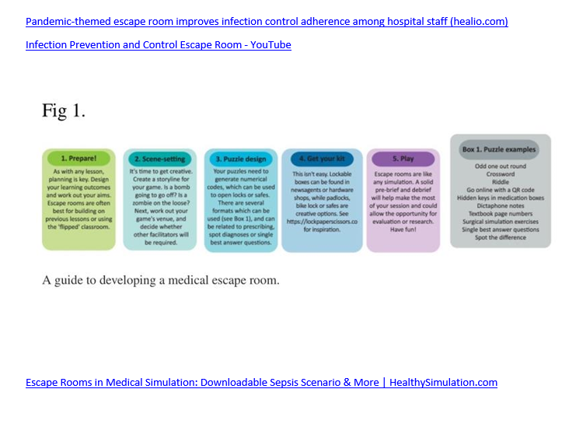

Slide 11
Escape Room Development: Develop a Script (What Story Do you Want to Tell?)

Slide 12
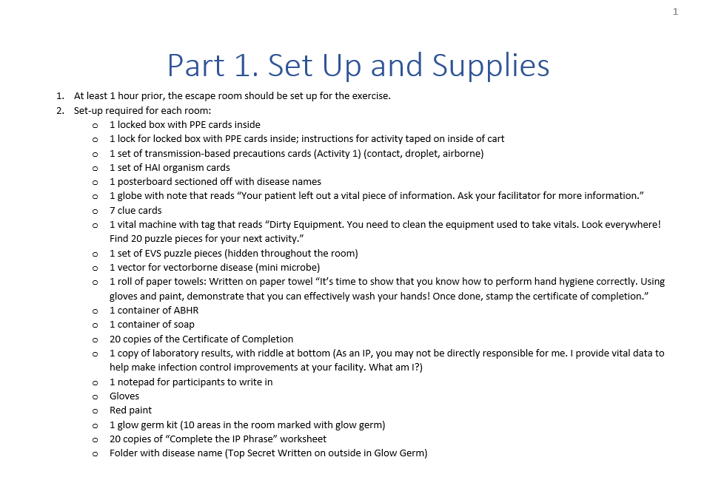
Escape Room for Infection Preventionists: Development

Slide 13
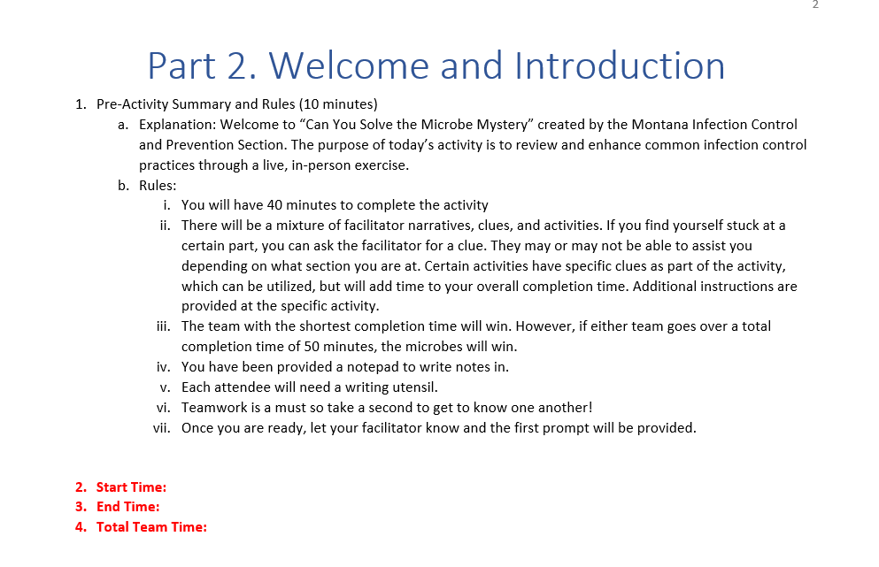
Escape Room for Infection Preventionists: Development

Slide 14
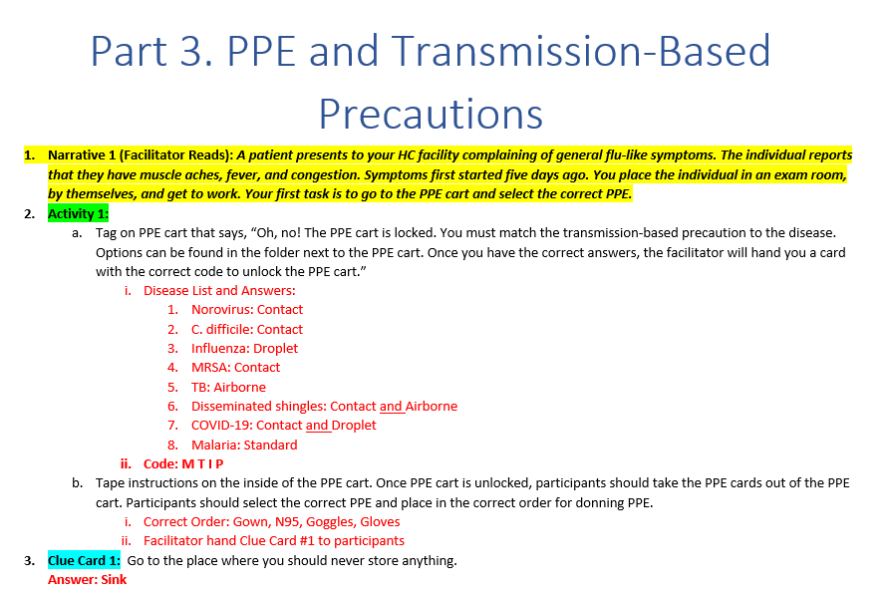
Escape Room for Infection Preventionists: Development

Slide 15
Create Tools and Visuals

Slide 16
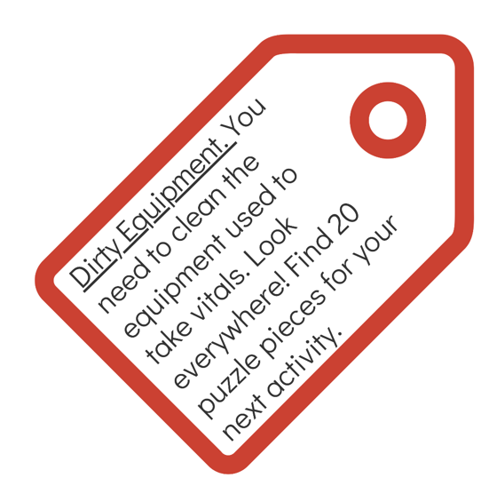
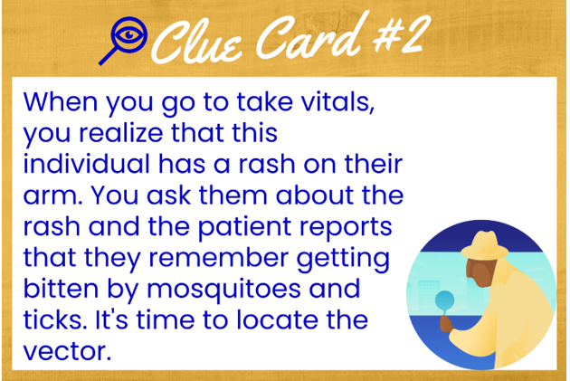
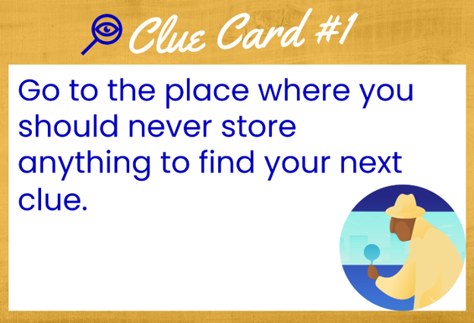
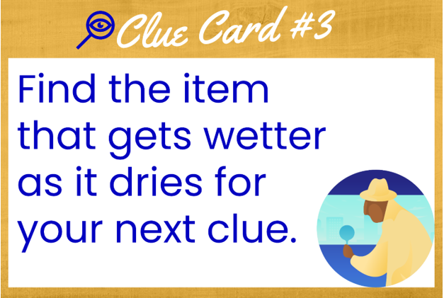


Slide 17
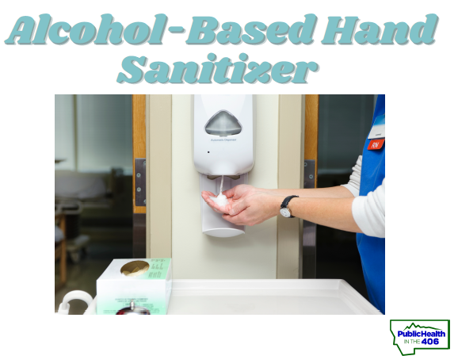
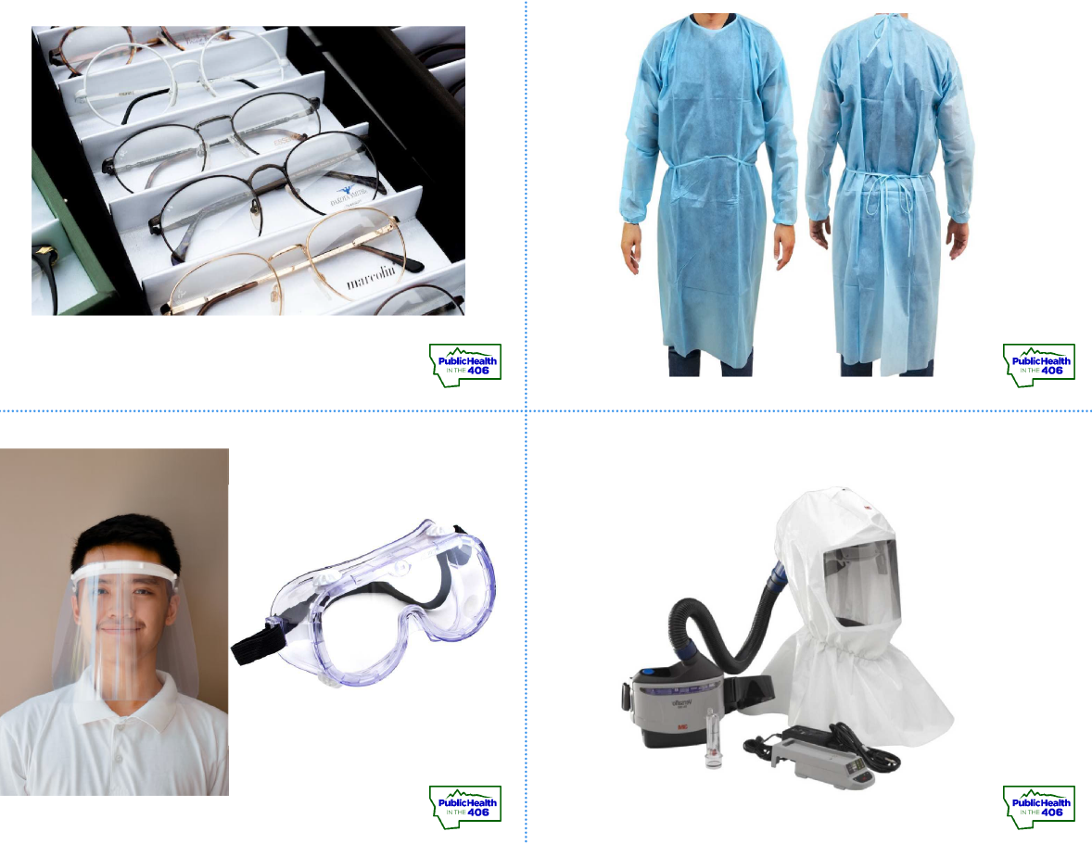

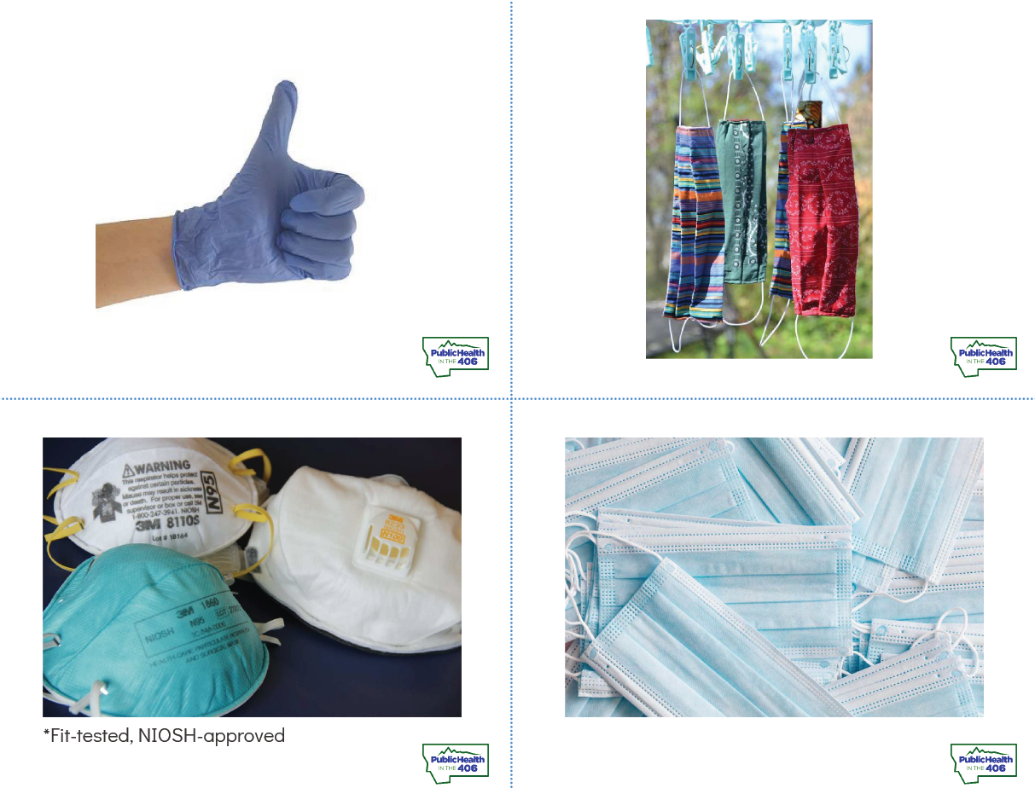
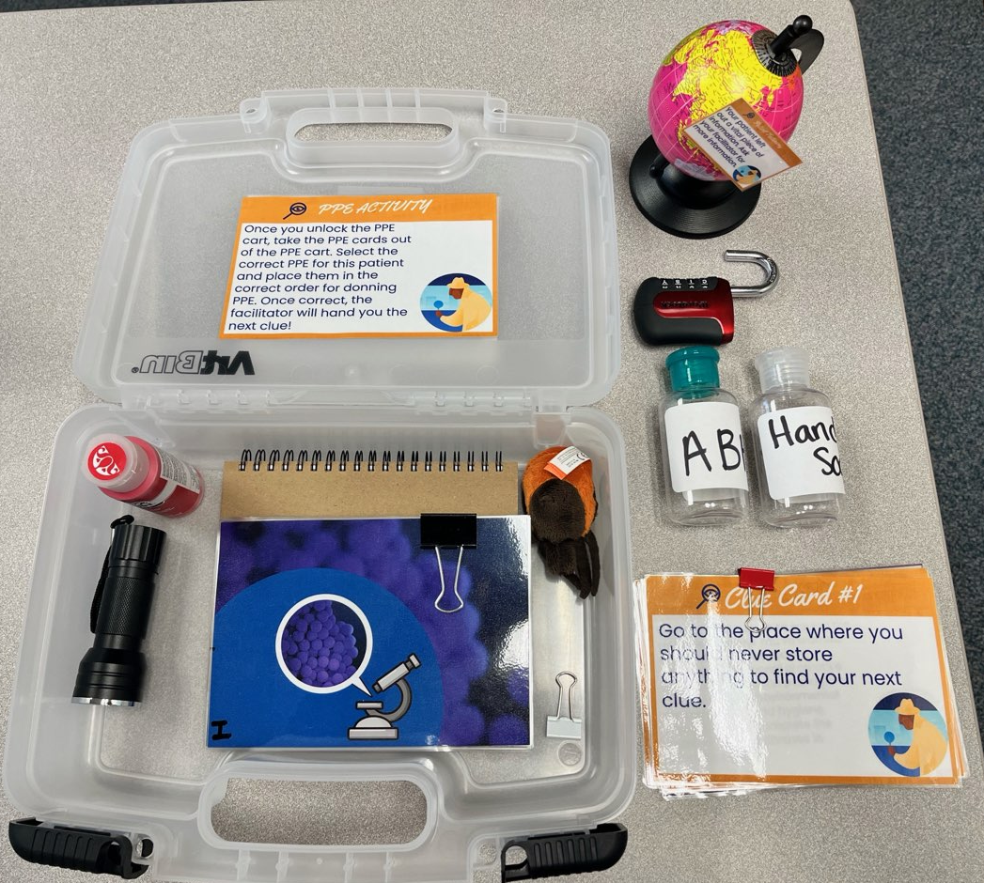
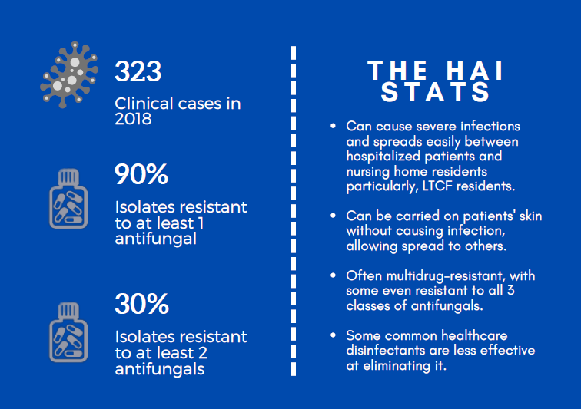

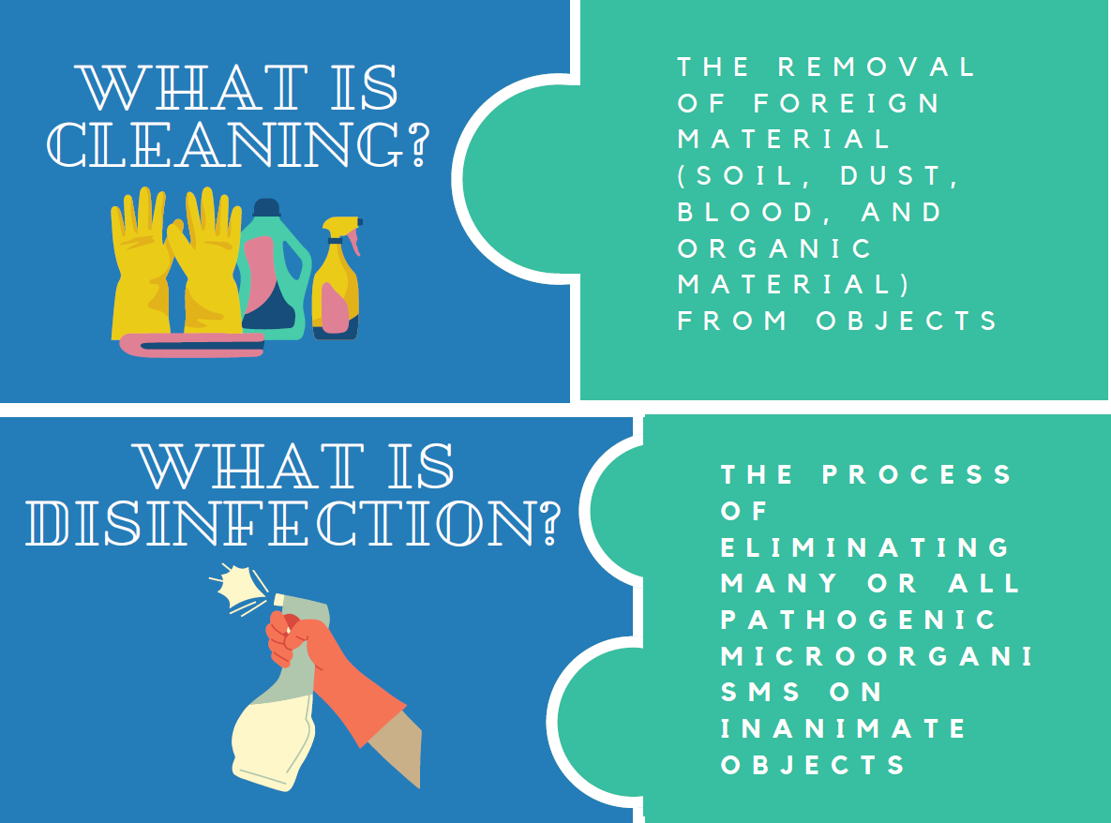
Many of the tools we used for this Escape Room are used for other trainings so they’re multi-use.

Slide 18
Practice and Feedback

Slide 19

Escape Room for Infection Preventionists: Feedback and Lessons Learned
Performed a test run with other staff in our bureau and received feedback on what worked and what didn’t work
Open to feedback when we perform this training so we can continue to make it more useful and practical for infection preventionists
Create tools that can be used alone or for other trainings to help reduce duplication of work

Slide 20

Discussion

Slide 21
Prompts: As a team, determine which prompt you’d like to review.
2
1
While performing EVS rounds, you ask frontline staff if they know what products should be used on specific equipment and what the contact time is. Staff respond they are unsure what cleaning and disinfectant products are used in their facility.
While performing hand hygiene audits, you identify that staff are only performing hand hygiene about 30% of the time they should be.
3
4
While performing isolation rounds, you notice that the isolation cart has items placed on top, there is no TBP signage on the door, and staff are wearing different PPE each time they enter the room.
You receive a call from your local public health department that a patient in your facility tested positive for a Carbapenemase-Producing Organism. When you report to staff, no one seems to know what to do.

Slide 22

Discussion Worksheet: Let’s Get Creative!
What’s the problem or concern related to your prompt? (5 minutes)
What are some potential barriers? (5 minutes)
Develop a fun and engaging training for staff (20 minutes)
  What is the title of your training?
  What is your training objective or purpose?
  What goal would you like to achieve?
  How will you measure success?
  What training topics should be included in the training?
  What resources might be available to you?
  What resources will you need to develop?
  How can the training be interactive?
  How will you test it out?
  How will you collect feedback?

Slide 23
Report Out: Sharing Ideas

Slide 24

Share what you learned through this process.
Share what project you created.
Did you find this challenging?

Slide 25
Thank you for your participation!
Contact Information:
Erika Baldry, MPH, CIC
406-444-0275
Erika.Baldry@mt.gov

