Slide 1

(Outbreak After Action Review)
In one or two sentences, what was the problem or issue that you identified? Covid Outbreak that hit 11 residents and 7 staff in November and December. Then on the day outbreak should’ve ended, we got hit with influenza that hit 4 staff and 3 residents. | Provide some background information, such as how or why the current process evolved to what it is? How does this affect patient safety? Were there any regulatory implications? During outbreak status a lot of change was going on and we had a lot of new staff that were unfamiliar with processes/policy. We had a new IP- me, an interim DON and did not have an active Infection Control Committee or QI team.
What did you do to improve the problem/issue? Who was on your team and what resources did you use? Did you use a specific tool or model (e.g., PDSA, Fishbone Diagram, Pareto Chart, SWOT or Gap Analysis, etc.)? An After Action Review was held to see where area of improvement were needed moving forward. The team was multidisciplinary team, we encouraged nurses, CNAs and any staff member who could to attend. | What was the outcome, and how have you sustained this improvement/success? We are taking some things to our QI department to improve. However, we are now more prepared for future outbreaks with clear roles and concept that we will meet ASAP when outbreak is established. It gave all aspects and members a voice on where improvements could be made.

Slide 2
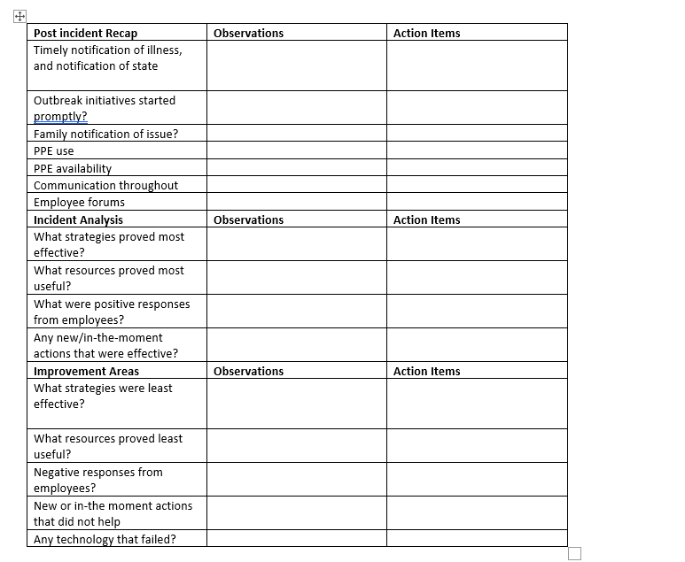
After Action Review (AAR)

Slide 3
