Slide 1

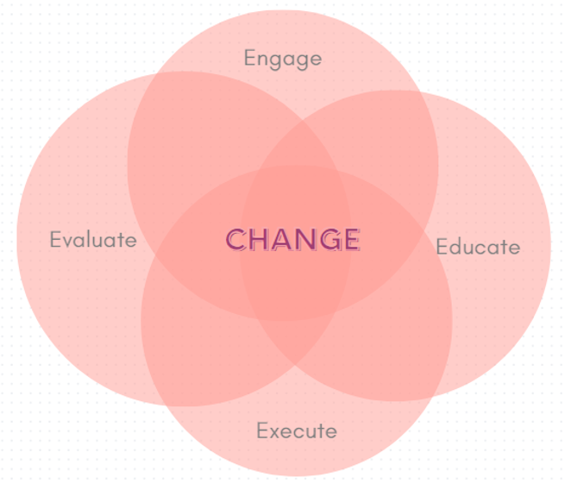

Title of Topic: Growth of Hand Hygiene Observation Program
Audience: Novice Proficient
Which “E” Are You Discussing: Engage Educate X Execute Evaluate
In one or two sentences, what was the problem or issue that you identified? The purpose of this project is to develop our hand hygiene surveillance program by implementing the use of technology for data collection and analysis along with expanding the scope to include all inpatient units, emergency department and surgery, and increase the number of hand hygiene observation audits to >200/month for each unit. | Provide some background information, such as how or why the current process evolved to what it is? How does this affect patient safety? Were there any regulatory implications? Consistent hand hygiene practices by caregivers is the top way to prevent healthcare associated infections and hand hygiene compliance > 90% is the standard. Regulatory agencies such as the Joint Commission and CMS require implementation of a hand hygiene program that: 1) follows CDC/WHO guidelines and 2) sets goals for improving compliance. Previously at our facility, HH surveillance was limited to ICU with CNAs performing audits and RN managers driving the program to ensure the goal of 200 observations each month was reached (even during the stress of the pandemic). Data was manually collected and analyzed. Growing our program will allow for more robust data collection methods and help ensure an adequate sample size which will allow us to accurately monitor hand hygiene compliance among the range of healthcare providers across all departments.
What did you do to improve the problem/issue? Who was on your team and what resources did you use? Did you use a specific tool or model (e.g., PDSA, Fishbone Diagram, Pareto Chart, SWOT or Gap Analysis, etc.)? I partnered with process improvement and RN managers to expand our hand hygiene program. Using lean concepts such as process mapping, value stream mapping, A3 problem solving, conducting timed observations and interviews with frontline caregivers performing observations has helped to define the current state of the program. I’ve presented this work to RN unit managers to identify barriers and have facilitated creativity exercises to help the group to generate ideas and develop actions to address gaps and issues. | What was the outcome, and how have you sustained this improvement/success? While still a work in progress, the hand hygiene program has been started in nearly all departments with each unit collecting data each month. In depth analysis of the program has shown it would take ~15 mins each day for units to reach monthly targets and participants feel hygiene auditing is easy and entering observations into the database takes little time. Despite this simplicity, workflows for performing hand hygiene observations varies across departments and it has not yet become ingrained in of our culture of safety. Work continues to identify countermeasures to address identified barriers and implement strategies to test using PDSA cycles.

