Slide 1
The 4 Es: Execution
Implementation Strategies to Move the Needle
Rosemary Martin ASCP(M)^{CM}, CLSSBB, CIC, Principal System IP Program Manager

Slide 2

Class Objectives
  Develop a comprehensive action plans to embed best practices.
  Identify and mitigate potential barriers to successful project implementation.
  Learn strategies to sustain efforts.

Slide 3
Agenda:
Topics
Overview: Use Case for 4es Knowing-Doing Gap
Implementation Assessment: Assessment Pillars/Considerations Workout!!! Your turn to do an assessment.
Implementation Plan: Choose Strategy Action Plan Workout!!! Your turn to create countermeasures, action plans, and prioritize.
Execute: Owner’s Tasks Timelines Transition Plan

Slide 4
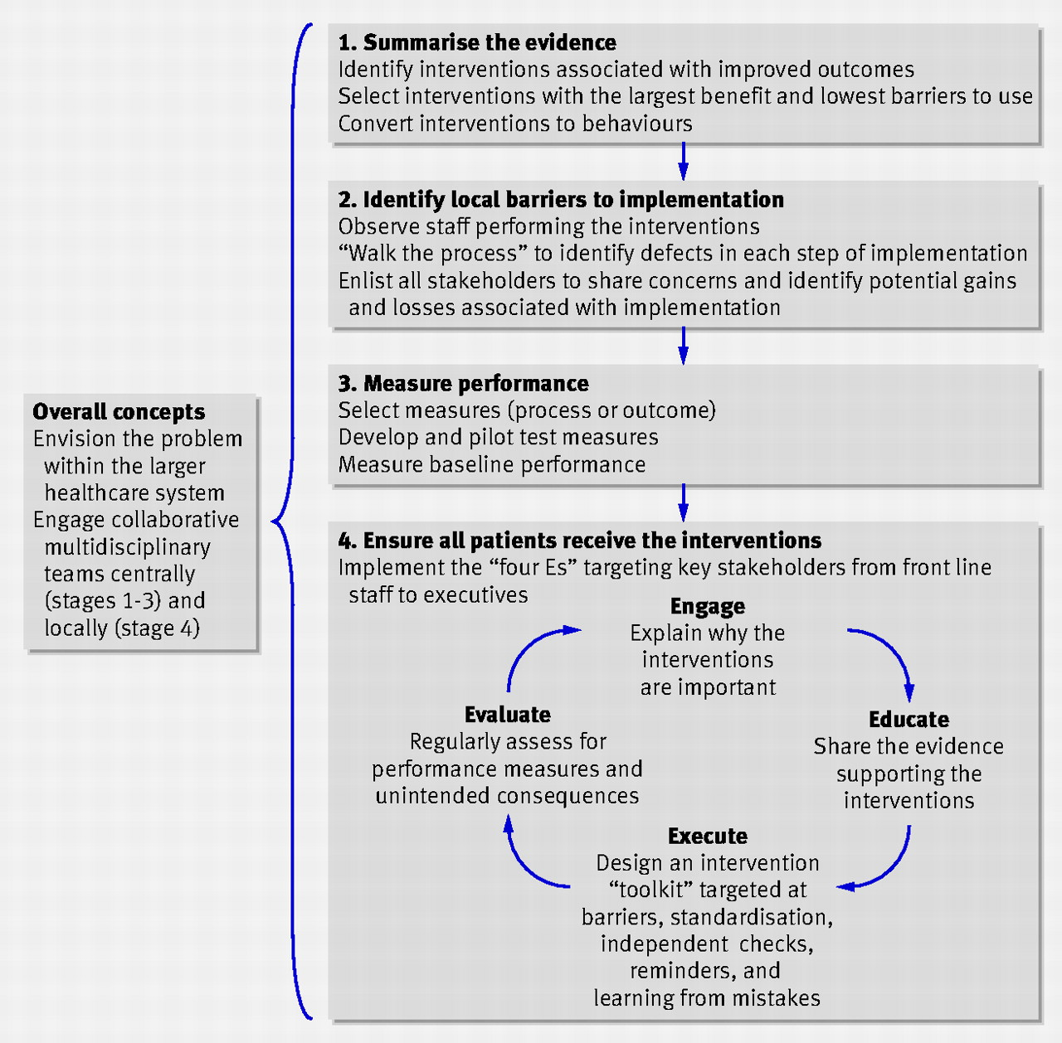
Use Case for 4Es…
Projects
Improvement Projects
Best Practice Implementation
Notes:
There are many projects in life. At home you may want to renovate a room, make a garden, organize a closet. At work you may want to create a schedule with coworkers, make a visibility board for work.
Nestled in the projects are improvement projects. These will move the needle on goals that are either stuck or processes that are broken.
But a very interesting subset of these projects are those where we know the solution, but we just don’t know how to implement it and make it stick. That’s where the 4Es models come in.

Slide 5
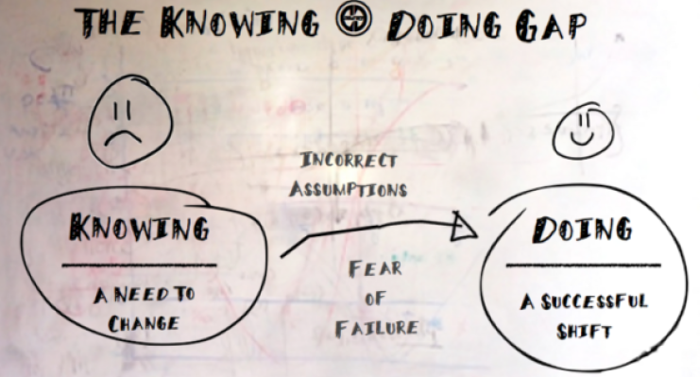
The “Knowing---Doing” Gap
Why?
Notes:
Healthcare best practices have been known for a long time and codified in many reference texts. We have our 5 moments of Hand Hygiene, line insertion bundle, etc. Can we name other best practices that are well known?
**Take Response from Audience**
Question is if everyone can identify best practice what aren’t we doing it?
**Take Response from Audience**
Correct. The practices are not hardwired. There are many drivers including incorrect assumptions, fear of failure, lack of time, lack of tools that lead to lack of adoption.
BUT- We must adopt and hardwire best practice to provide the best care for our patients.
In this class we will discuss concepts and strategies for embedding best practice.

Slide 6
Implementation Assessment

Slide 7




Assessment
Notes:
This may have already occurred in Stage 2: “Identify Barriers to Implementation”. If so, review what they found try to see if anything was missed for consideration.
Other times, our best practice programs are given to us mid-stream. You will not be sure how to move forward if you don’t know what has been done.
When handed to us mid-stream or when you haven’t been part of the process from the beginning it is natural to say, “Wait, what has been done so far?”
And that is the exact right question.

Slide 8
Assessment Pillars
Implementation Factors
Organizational Structure
Workflow Processes
Culture
Policy & Procedures
Technology, Tools & Physical Environment
Notes:
When you are ready to execute you will need to have a keen understanding of these drivers within your local environment to understand what you need “nail down” to succeed.
The hope is you will be thinking of questions such as readiness of your group, buy-in from leadership for support, is there a physical environmental need, related dependent processes, the teachers’/implementors’ knowledge, education, type of education, and the list goes on.
Let’s pause and test drive this assessment.

Slide 9
Assessment Questions
Organizational Structure
No inventory of required tools
Chosen implementation method doesn’t work with organization structure
Culture
No collaboration
Workflow Process
Not a step in the process
Policy/Procedure
Not codified
Physical Environment/Tools
Miss match of leadership level, position, experience
No resources
No readiness
No awareness
No operational consideration
No compliance
Too many steps to achieve the goal
Wrong timing
No education
Can’t do the process in the space provided
Not understandable
Notes:
These are the standard assessment questions you will need to answer to know how to embed your program.
At a high level you need to know, what existing processes are available for you to use:
Standard Communication Pathways
Standard Education Pathways
Standard Implementation Pathways
Standard Monitoring/Control Pathways
If none exist, you need to know “what sticks” in the environment.
Ex. Is everyone using TEAMS IM so that is the best way to communicate v email?
Ex. Are folks used to using a communication dashboard where huddles also occur.
Ex. Are folks used to one-on-one training, virtual training, etc.
Ex. Is your program already being measured by unit leaders and monitored by exec? Do people like e-forms, paper audits, etc.

Slide 10
Assessment Game
Hand Hygiene Implementation Factors
Organizational Structure
Workflow Processes
Culture
Policy & Procedures
Technology, Tools & Physical Environment
Notes:
Hand Hygiene. **Let audience chime in**
Structure: HH stations, Purell dispensers, sinks with soap.
Leadership: Support, role model, and socializing. Do they support auditing.
Work processes: are there HH steps built into their workflow processes, “Gel in, gel out”, is there a formal HH program, etc.
Culture: We are an institution that washes their hands (would it be uncomfortable if your peers noticed you didn’t wash your hands)
HH: Do we have policies.
Tech/Environment: Is the sinks located in such a way that makes it easy to accomplish. Physical barriers?

Slide 11
Implementation Plan

Slide 12
Step 1: Choosing the Right Strategy
“Let it happen”
“Help it happen”
“Make it happen”
Greenhalgh, T. Robert, G, Macfarlane, F. (2004) Diffusion of Innovations in Service Organizations: Systematic Review and Recommendations .
Notes:
Ask yourself what is feasible? And does it achieve your goal?
This is a model from Diffusion of Innovations in Service Organizations: Systematic Review and Recommendations, Greenhalgh. T, et al.
Interdisciplinary Research Leaders (University of Minnesota) Rachel C. Shelton, ScD, MPH, Mailman School of Public Health Columbia University. Online series IRL Research and Science Course https://www.youtube.com/@irl-researchandsciencecour9705/playlists

Slide 13
Step 2: Action Plan
Assessment Categories | Assessment Findings | Assessment Action Plan to Embed:
Organizational Structure Chosen implementation method doesn’t work with organization structure Miss match of leadership level, position, experience No resources
Culture No collaboration No readiness No awareness No operational consideration No compliance
Workflow Process Not a step in the process Too many steps to achieve the goal Wrong timing
Policy/Procedure Not codified No education Not understandable
Physical Environment/Tools No inventory of required tools Can’t do the process in the space provided
Notes:
The list of findings from stage 2 AND your additional findings shine a spotlight on barriers that prevent your ability to embed a best practice.
Create an action plan to resolve the findings to prepare for go-live.

Slide 14
Action Plan Game:
Assessment Categories | Assessment Findings | Assessment Action Plan to Embed:
Organizational Structure Chosen implementation method doesn’t work with organization structure Miss match of leadership level, position, experience No resources | You find only infection prevention supports this program. You find everyone is too busy to audit. | Identify who else owns the process AND does the process. Ensure they are also leading the initiative. Is there another way to collect data OR another group of people who can collect data.
Culture No collaboration No readiness No awareness No operational consideration No compliance | Frontline staff doesn’t understand the importance of hand hygiene. | What is the most effective type of communication (what worked previously) for education.
Workflow Process Not a step in the process Too many steps to achieve the goal Wrong timing | You find hand hygiene is not a step embedded in their processes. | Use reference/societal standards to have HH included in the process.
Policy/Procedure Not codified No education Not understandable | We have a 54-page hand hygiene policy that is 10 years old. | Surely it doesn’t have to be that long AND it renders the policy useless as it is hard to find info.
Physical Environment/Tools No inventory of required tools Can’t do the process in the space provided | You are missing Purell stations, and many are empty. | Ensuring you have the tools you need goes a long way for adoption.
Notes:
Only infection prevention supports this program→ identify who else owns the process AND does the process. Ensure they are also leading the initiative.
You find everyone is too busy to audit→ Is there another way to collect data OR another group of people who can collect data.
Frontline staff doesn’t understand the importance of hand hygiene.→ What is the most effective type of communication (what worked previously)
54-page old hand hygiene policy→ Surely it doesn’t have to be that long AND it renders the policy useless as it is hard to find info.
Missing and empty Purell Station→ Ensuring you have the tools you need goes a long way for adoption.

Slide 15
Implementation Plan
Focus Area | Considerations:
Goals | Socialize with stakeholders, endusers and process contributors what changes are happening, vision of the roll out and timeline. Set a go-live date.
Timeline | Create a timeline for major and minor steps that need to be done during implementation.
Resources | Provide a clear overview and detailed map of resources (human, equipment, space) you need to be successful at each step.
Roles/ Responsibilities | Set clear expectations for those who will lead and participate during the implementation process. Be sure there is an escalation/communication pathway between all people involved.
Initial Success Metrics | Determine one metric you will measure frequently to know the process changes are working as intended.
Balancing Measures | Monitor balancing measures to ensure no unintended consequences. Prepare contingency plans for anticipated risks.
Notes:
Create a document that captures the following information.
The following steps are critical to do:
Ensure you have all the resources you need prior to go-live.
Ensure you have developed a timeline and received approval from stakeholders and those who are going to do the work. The timeline must sequence the events and have a date associated with the task so you can understand if you are on time or not.
Ensure agreement on go-live date.

Slide 16
Implementation Phase: Implementation Owner’s Tasks
Caregivers “Doing the Work”
Updated guidance documents to set expectations.
Tools for Smooth Implementation
Pre-Implementation Checklist
Timeline for go-live
Leadership Invested in the Project
Project Charter
Measurement Worksheet
Standard tools they are expected to use for the change.
Job aides or other documents that help with the “how to” at the bedside.
Sponsor check-in/approval
Elevator Speech for socialization
Plan for next 1 month post implementation.
Monitor/control plan.
Issues escalation pathways.
Fishbone or other RCA documents.
Selected solutions.
Monitor/control plan.
Other documents created during the project to support the work.
Training.

Slide 17
Execute

Slide 18
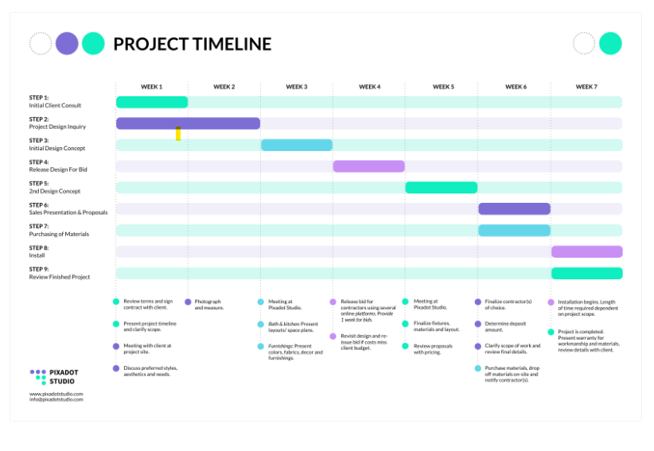
Timeline
Socialize go-live date (5 times 5 ways). You want everyone (directly or indirectly) involved to know that you are going live.
Set up a kickoff meeting on go-live day and future check-in meetings.
You must be present for the implementation.
Share your timeline, display your timeline and most importantly use your timeline to drive the work.
Meet with unit leadership at the end of the day to provide them with status. Ask for feedback.
Do not transition project unless you have successful adoption.

Slide 19

Transition of Ownership
Use the time during implementation to coach local leaders and end-users on program goals and expectations.
Discuss the “how-to” and remove barriers the team may have identified in ownership.
Write up the agreed upon transition plan.
Transfer all project documents to the team and socialize next steps with sponsors.
Hold a formal meeting to transition ownership.
Prepare a closeout plan to transition the work to the owners.

