Slide 1
Did We Make a Difference? Evaluating Your Progress Toward Effective Change
Montana APIC Spring Education Conference
May 9, 2024
Developed with assistance from Barb DeBaun, MSN, RN, CIC, Improvement Advisor

Slide 2
4 E’s to Implementing Change
Engage How can we engage hearts and minds?
Educate How can we turn the evidence into behaviors?
Execute How can we do this?
Evaluate How do we know if we made a difference?

Slide 3
How will I know I Made a Difference?
Executive Leaders
Have resources been allocated to collect and use data?
Is the work climate better?
Are patients safer?
Team Leaders
Have I created a system for data collection, unit level reporting and using data to improve?
Is the work climate better?
Are patients safer?
Staff
What is our unit level report card?
Is the unit a better place to work?
Is teamwork better?
Are patients safer?
How do I know?
© Quality and Safety Research Group, John Hopkins University

Slide 4
Types of Evaluation
Formative evaluation - ensures that a program or activity is feasible, appropriate and acceptable before it is fully implemented.
Process/Implementation evaluation – determines whether program activities have been implemented as intended
Outcome/Effectiveness evaluation – measures program effects by assessing the progress in the outcomes or objectives of the program
Impact evaluation – assess program effectiveness in achieving its ultimate goals
Practical Use of Program Evaluation, CDC
Notes:
Formative evaluation is usually conducted when a new program or activity is being developed or when an existing one is being adapted or modified. It will show whether the proposed program elements are likely to be needed, understood and accepted by the population you want to reach and the extent to which evaluation is possible.
Process evaluation determines whether program activities have been implemented as intended and resulted in certain outputs. The process evaluation is done throughout the life of the project and will allow you to track how well the program is working and the extent to which the program is being implemented as designed.
Outcome evaluation shows the degree to which the program or project is having an effect on behaviors or outcomes
Impact evaluation this is completed at the end of the program and shows whether program or project met its ultimate goal. It provides evidence for use in policy and funding decisions.

Slide 5
Data Collection!

Slide 6
On Death, Dying & Data
Denial
Anger
Bargaining
Depression
Acceptance
Notes:
In her book “On Death and Dying” Elizabeth Kubler Ross wrote that grief could be divided into five stages, two more were later added. We are all familiar with denial, anger, bargaining, depression and acceptance. The same stages of grief can be applied to collecting and reporting on data.

Slide 7
Why do we collect data?
Improvement
Used for learning
Reporting
Used to judge

Slide 8
Data Collection
Who collects the data?
How do they do it?
Does everyone do it the same way?
Be aware of Interrater Reliability

Slide 9
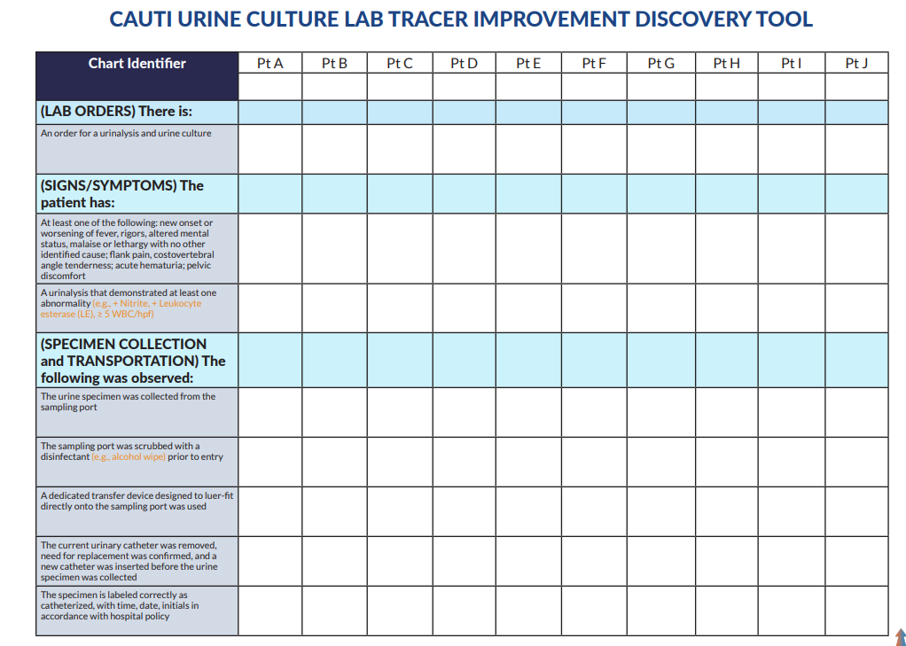
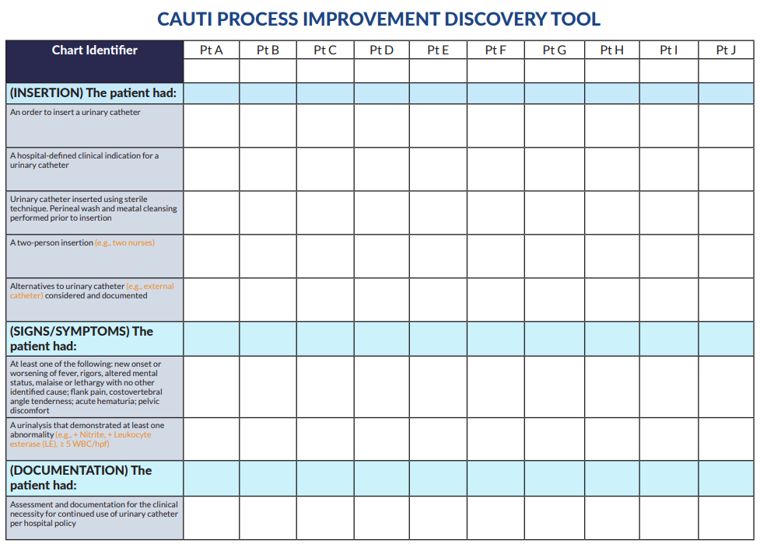
Use Tools to Determine Root Cause

Slide 10



Data Display and Analysis
How do you want to tell your story?
Who are you going to tell your story to?

Slide 11


3 Tips for Success
One size does not fit all
Know your audience
Check for accuracy

Slide 12
Display Matters

Slide 13
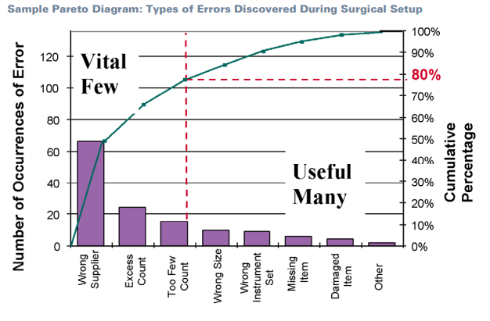
Pareto: where do I start?
Notes:
A Pareto chart helps a team focus on problems that offer the greatest potential for improvement, by showing different problems’ relative frequency or size in a descending bar graph which highlights the problems’ cumulative impact. Individual values are represented in descending order by bars and the cumulative total of the sample is represented by the curved line.
The Pareto principle states that for many outcomes, roughly 80% of consequences come from 20% of the causes. This is important to understand because it can help you identify which initiatives to prioritize so you can make the most impact.

Slide 14
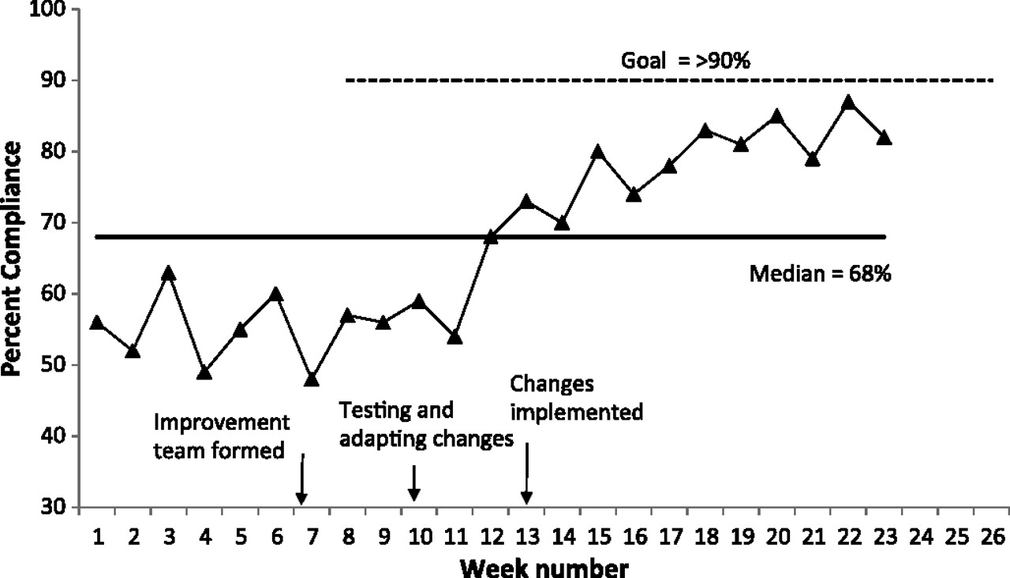
Annotate to narrate the story
Notes:
Use your data points to tell the story. Show where your interventions occurred and what the goal of the project is.

Slide 15
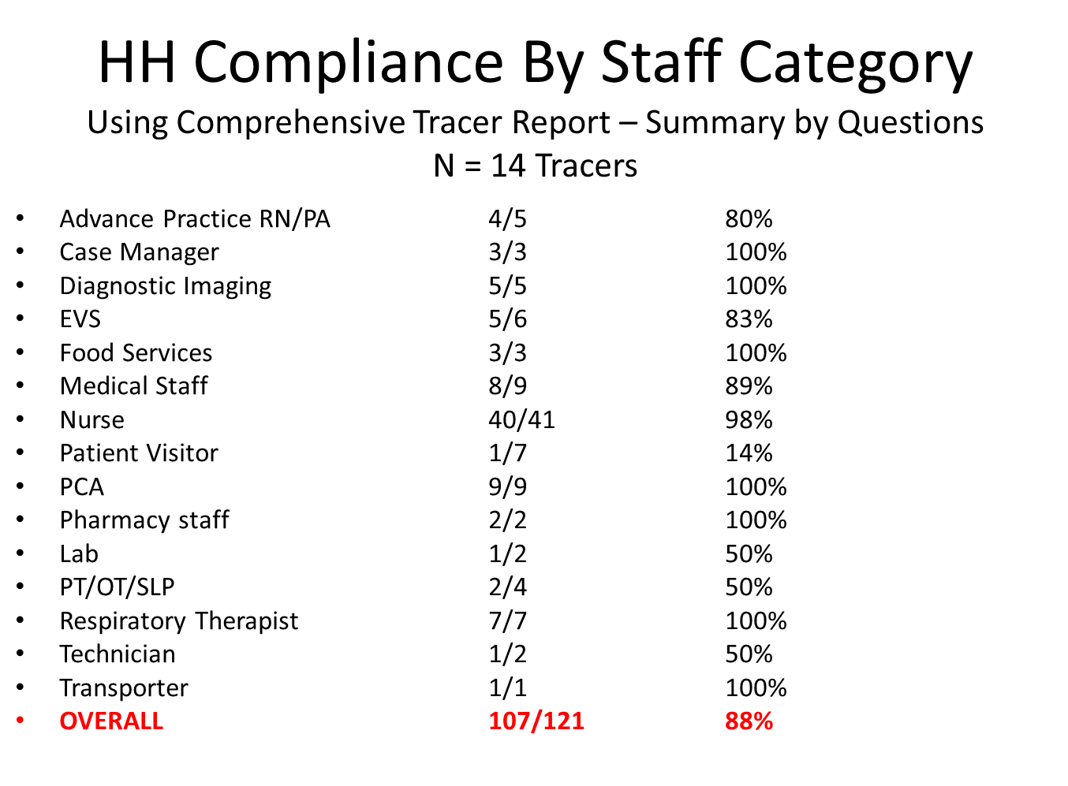

Slide 16
Performance Compared to the National Average
HAI Category | FY2019 Baseline* | FY2020 YTD*
CLABSIs | 22 | 21
CAUTIs | 28 | 28
Colon SSIs | 3 | 6
HYST SSIs | 5 | 1
MRSA bacteremia | 12 | 17
C. diff | 73 | 45
*Total Number of Reportable Infections
Red = Worse than National
Yellow = Similar to National
Green = Better than National
Notes:
Comparing your

Slide 17
Connecting to the core of data
 | 2012
 | January
 | February
 | March
April | May | June
July | August | September
 | October
 | November
 | December
 | 2013
 | January
 | February
 | March
April | May | June
July | August | September
 | October
 | November
 | December
We missed something We got it 100% right
Notes:
This is a Safety Cross that makes it easy to see the number of months where no harms occurred. A good engagement of staff who are not motivated by run charts, rates or ratios.

Slide 18

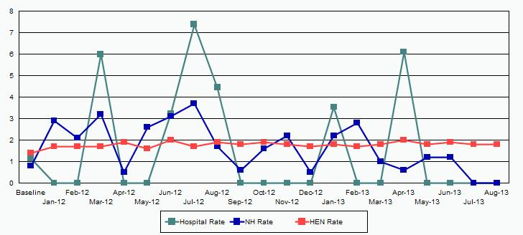
It’s not a rate, it’s a human being
Courtesy of Martha Leighton; Eliot Hospital, Manchester, NH
Notes:
Our rates aren’t that bad, less than 10%. It matters if it is your Grandparent
Have to make this real
Each patient counts
Use each person’s event instead of rates

Slide 19
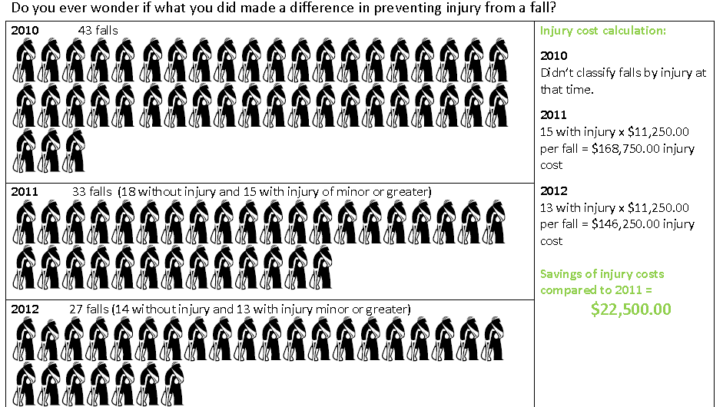
The Number of People Harmed
Notes:
St Luke Community MT

Slide 20
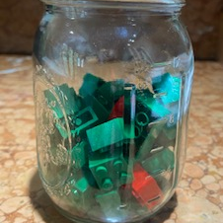
Make success and failure visible

Slide 21

Data display
Tells the statistical story that you want to relay about a data set so receiver can see at a glance and come to some conclusion
Very powerful
Can be informative and effective
Can be misleading and destructive

Slide 22

Data Traps
Run charts showing outlying data
Look at both process and outcome measures together
Use balancing measures
Notes:
Does an outlier show a misstep in a process or is it one event in a small patient population
Keep an eye on both your process and outcome measures together to see if your interventions are making improvements or if outcome changes are happening for some other reason
Look at all the information available - Barb’s example of reduction in catheter days but increase in falls

Slide 23

Time to practice!

Slide 24



Report out

Slide 25

Thank you!
Contact Information:
Casey Driscoll, CPHQ 406-457-8000 Casey.Driscoll@mtha.org

