Slide 1

Occupational Exposure to Brucella
Cherry Virrey, RN, BSN, MPH, CIC

Slide 2
From Specimen to Danger: Navigating the Path of Brucella Exposure in Laboratory Environments
Authors/Speakers:
Objectives
Jessica Alban MLS(ASCP), CIC
Christine Ramsey MPH, MLS(ASCP)
Review levels of occupational exposure
Evaluate IP response
Explore risk mitigations
Learn strategies to foster collaboration
Notes:
From Cleveland Clinic Ohio

Slide 3
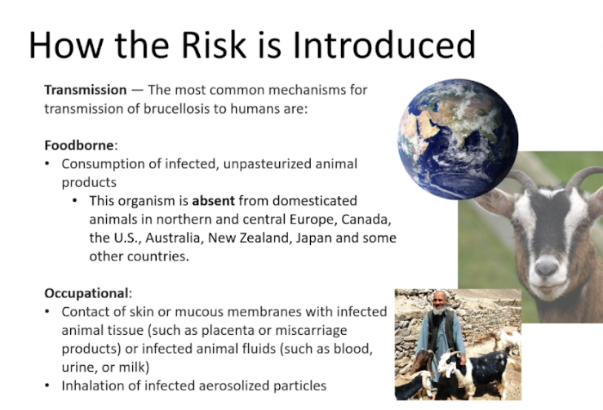
Transmission
Notes:
When assessing risk, ask: what is organism, how is transmitted?
Worldwide about 500,000 cases report.
Only 100-200 of those are reported in US each year.
Brucella just removed from the “select agent program”

Slide 4
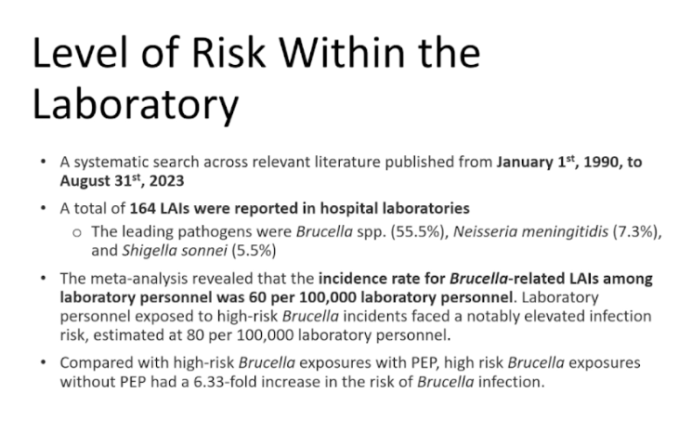
Notes:
Brucella can lie dormant in a “latent form”
The longest recorded cases of brucellosis involve recurrences or long-term chronic illness spanning 50 years in one case of a United States man; which presented as septic shock .

Slide 5
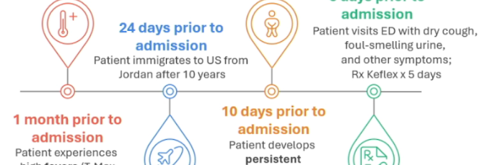
Patient Medical Timeline
Notes:
Shared tools
Used as well
Our pt vs their pt

Slide 6
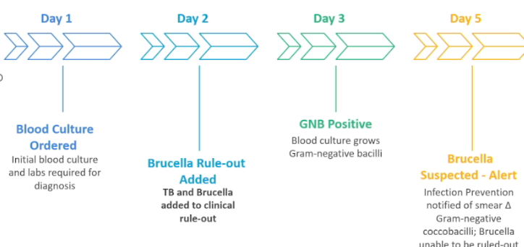
Diagnostic Process of Patient Specimen
Notes:
Shared tools
Coccobacilli- alert

Slide 7
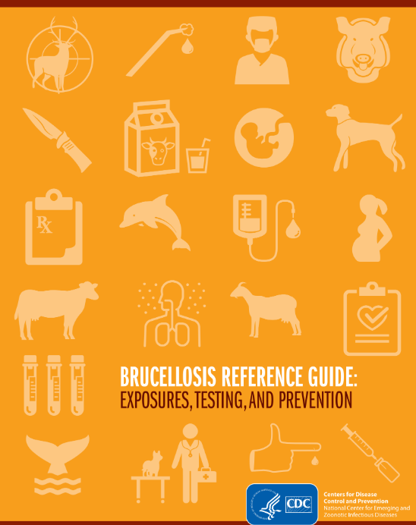
https://www.cdc.gov/brucellosis/media/pdfs/2025/02/brucellosi-reference-guide.pdf
Notes:
EH sent out to us

Slide 8
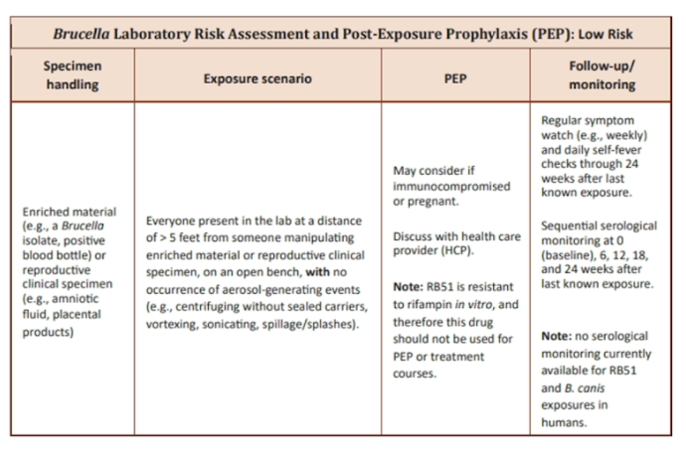
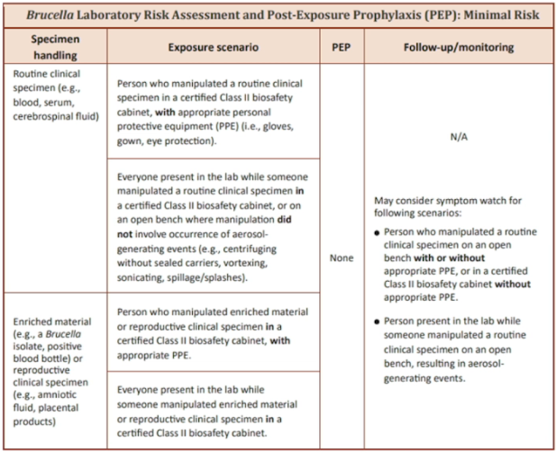
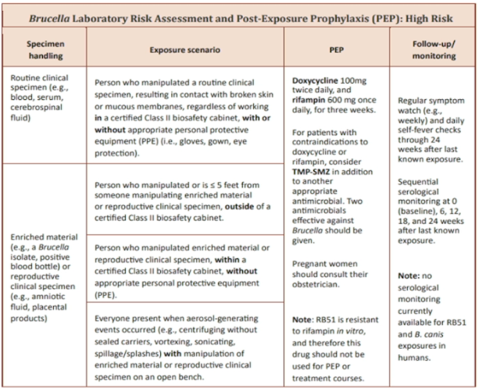
Risk Assessment
Notes:
Risk Assessment- what IPs do best

Slide 9
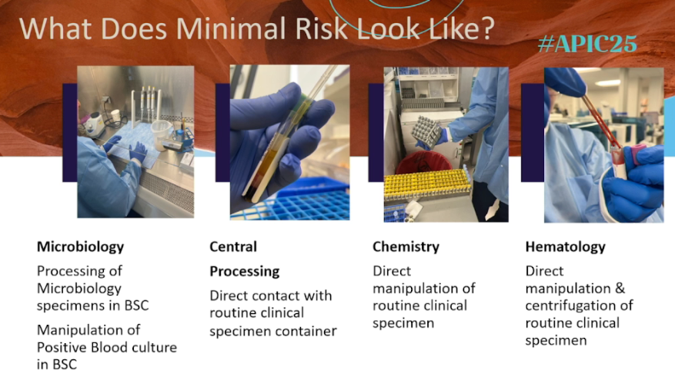
Risk Assessment-Minimal
Notes:
Presenters did great job at pulling tighter exposure scenario with pics of what that risk looks like

Slide 10
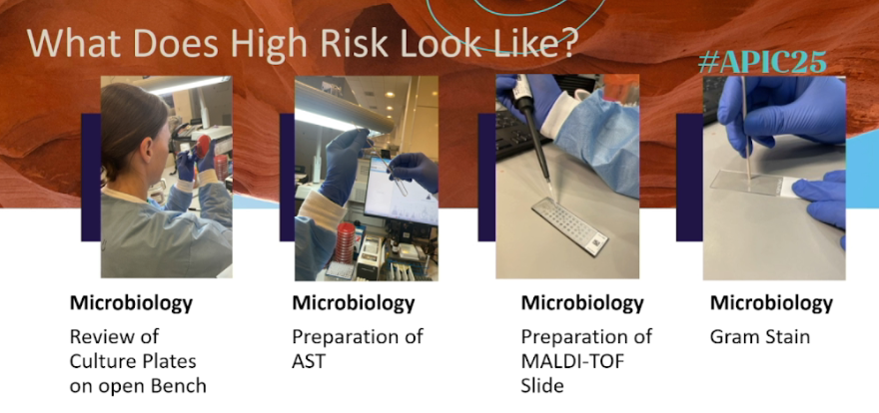
Risk Assessment- High
Notes:
How many staff- PEP used, allergy/pregnancy

Slide 11
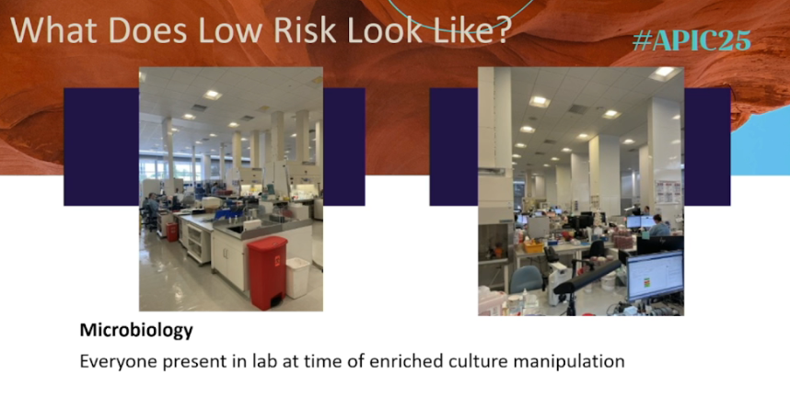
Risk Assessment- Low
Notes:
“pregnancy” category

Slide 12
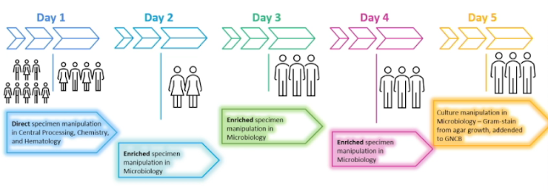
Diagnostic Process of Patient Specimen

Slide 13
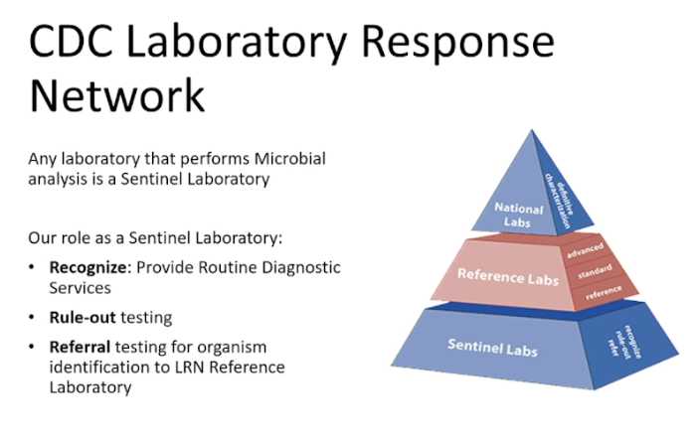
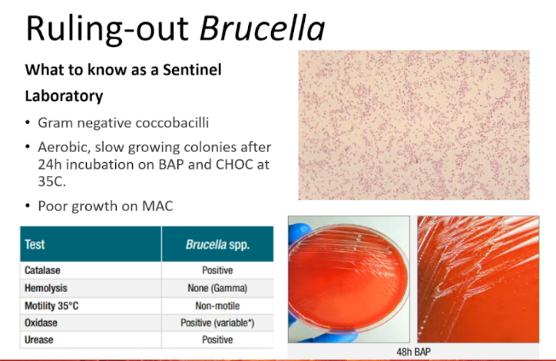
Sentinel Laboratory

Slide 14
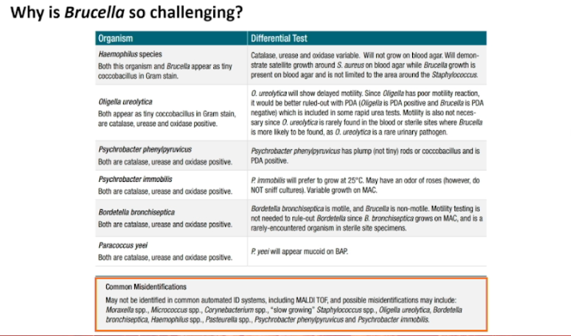
Mis-identification?
Notes:
2nd guessing whole life

Slide 15
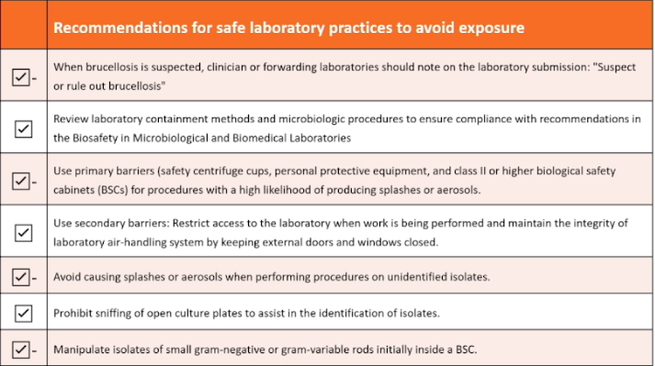
Assessing Lab Practices

Slide 16
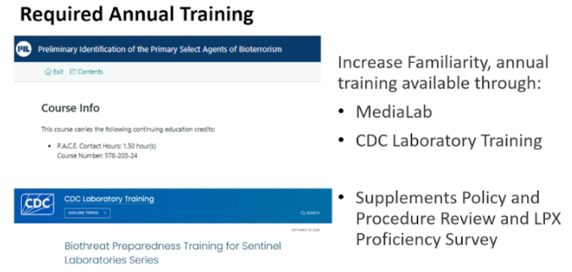
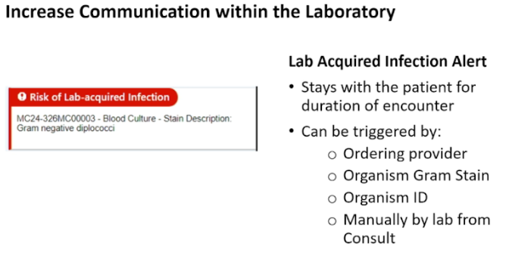
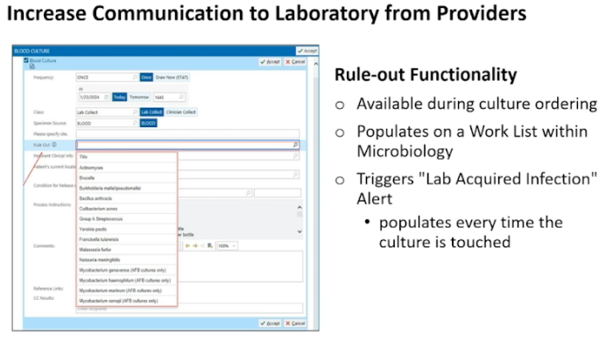
Risk Mitigation Strategies

Slide 17
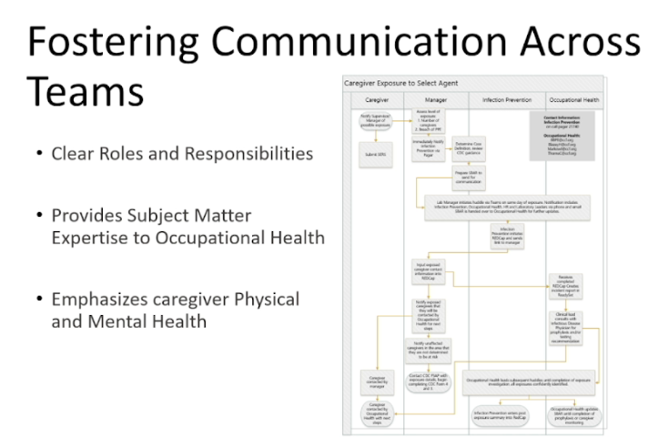
Communication
Notes:
Like all disaster papers, the first line always start with lessons learned: “communication” failure

Slide 18
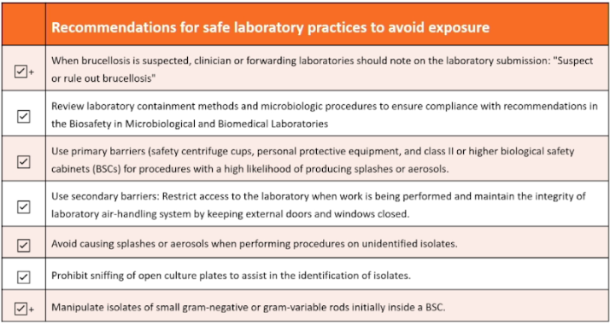
Reassessing Lab Practices

Slide 19
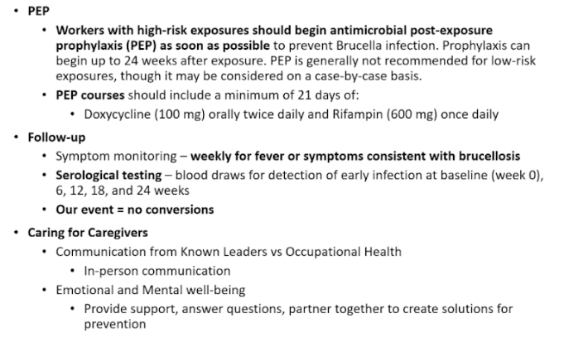
Review of Caregivers

Slide 20
Questions?
Thank you

