Slide 1
Measles: clinical aspects
Neil M. Ampel, M.D.
Consultant, Arizona Department of Health Services

Slide 2
Historical Context
First described around 900 CE by the Persian physician Abū Bakr Muhammad Zakariyyā Rāzī (Rhazes)
likely 2,000 - 3,000 years old
Given the Latin name morbilli (“little disease”) to distinguish it from smallpox
Rubeola (“little red”) and measles (Dutch for “spot” or “pimple”) came later
Once also called “First Disease” to distinguish it from other common childhood exanthems
scarlet fever, rubella, erythema infectiosum, roseola infantum
Peltola H. Acta Paediatrica 2025; doi: https://doi.org/10.1111/apa.70370

Slide 3
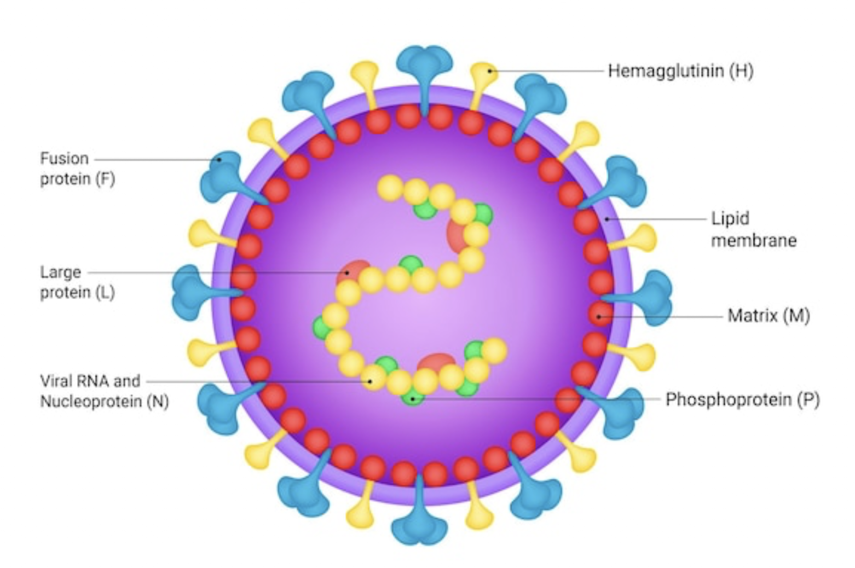
The measles virus
Paramyxoviridae family, Morbillivirus genus
helical, enveloped, single-stranded, negative-sense RNA virus with projecting hemagglutinin (H) and fusion (F) proteins
related to mumps, parainfluenza virus, RSV, metapneumovirus, Nipah virus
Humans are the only natural host
A disease of civilization!
Likely derived from cattle rinderpest virus around 500 BCE
Spread in humans once urban areas >250,000 population occurred in Mesopotamia and Eurasia

Slide 4
The discovery of the measles virus
Measles described as a distinct entity in Western medical literature in 1670 by Thomas Sydenham
Found to be infectious in 1757
Francis Home noted disease in 10 of 12 health children inoculated with blood from a patient to 12 healthy individuals
mimicking variolation
Parnum described a measles outbreak on the Faroe Islands in 1846
defined the incubation period, contagiousness, and life-long immunity after infection
O’Neill, Rake, Shaffer and Stokes in 1940 were able to cultivate the measles virus in chick embryos
Katz SL. Chapter 22, in “History of Vaccine Development,” Plotkin, SA [ed]), 2011

Slide 5
The development of the measles vaccine
During a measles outbreak outside of Boston in 1954, Thomas Peebles and John Enders obtained blood and pharyngeal swab material from 13 year-old David Edmonston
“Young man, you are standing on the threshold of science”
The virus was attenuated by >80 passages through several types of cell cultures
“Edmonston B strain”
In 1963, the first live-attenuated measles vaccine was licensed in the United States
A killed version was licensed in the U.S. between 1963-1967
resulted in incomplete immunity, atypical measles
removed from the market in 1968
The live virus was further attenuated in 1968 by Hilleman
Edmonston-Enders (Moraten) vaccine (More attenuated Enders)
Included in MMR in 1971
Katz SL. Chapter 22, in “History of Vaccine Development,” Plotkin, SA (ed), 2011

Slide 6
Results of measles vaccination
Prior to 1963
3-4 million annual cases measles in the U.S.
48,000 were hospitalized
1,000 developed encephalitis
400-500 died
From 1968-1983 (15 years), measles vaccination
prevented 52 million cases, including
17,000 hospitalizations
5,200 deaths
By 2000, endemic transmission of measles was eliminated in the U.S.
<100 cases per year (a >99.9967% reduction from pre-1963!)

Slide 7
Safety and adverse events with MMR vaccination
5-15% post-vaccination syndrome (5-12 days after)
Fever (>103°F or >39.4°C)
Mild morbilliform rash
Soreness, redness at vaccination site
Stiffness or pain in the joints
Less frequent
Cervical lymphadenopthy
Febrile seizures ~8-14 days (1 in 3,000-4,000 children <7 years)
Rare
Thrombocytopenia (~6 weeks)
Anaphylaxis (3.5 per 10 million doses)
Measles inclusion body encephalitis (3 reported cases, 1 confirmed)
No association
Autism, brain damage, or death
CDC

Slide 8
Measles immunity and MMR vaccination recommendations in the United States
Children are protected by maternal antibody for 1-2 months
Rapidly wanes by 6 months
Two doses of MMR provide 97% protection against measles
protection begins within 2 weeks of first dose
appropriate to vaccinate under outbreak conditions
First dose between 12-15 months; second dose 4-6 years
may give first dose earlier (6-11 months) in outbreak settings (doesn’t count for full vaccination)
For adults born in or after 1957
if received only 1 dose of MMR or
laboratory evidence of non-immunity
For higher-risk adults
born ≥1957, no laboratory immunity
2 doses MMR, 28 days apart
healthcare workers
international travelers
students in post-secondary institutions
household contacts of immunocompromised persons
outbreak settings

Slide 9
Measles immunity and MMR vaccination recommendations in the United States
Measles immunity can be determined by antibody titer
IgG levels ≥240 IU/mL
One or two vaccinations can be considered in adults if evidence of waning immunity
especially if born after 1957 and at risk
MMR is a live-attenuated vaccine. Do not give:
Pregnancy
measles associated with miscarriage, stillborn and preterm birth
give postpartum and avoid pregnancy for 28 days
Cellular Immunodeficiency
Persons with HIV infection and CD4 <15%; active leukemia/lymphoma; persons receiving cancer chemotherapy; SCID
Anaphylaxis to vaccine component (gelatin, neomycin)

Slide 10
Measles transmission
Infection is acquired by an airborne route
Likely through both aerosol (<5 µm) and droplet (>5-10 µm) exposure
direct contact with respiratory secretions
surface contamination plays a very minor role
R₀ is 12-18
1 infected person will infect 12-18 non-immune individuals
Control requires ≥95% community immunity to prevent spread
Compared to
Chickenpox: 7-10; pertussis: 5-17; SARS-CoV-2: 3-8; influenza: 1-2
Measles virus is persistent in the indoor environment
Virus survives >2 hr in airborne droplet nuclei
Ventilation important
airborne transmission predicted by room CO₂ concentration
(Iwamura & Tsutsumi, Cureus 2024; doi:10.7759/cureus.64882)
N95 masks for health care personnel
Surgical masks for patients with suspected measles

Slide 11
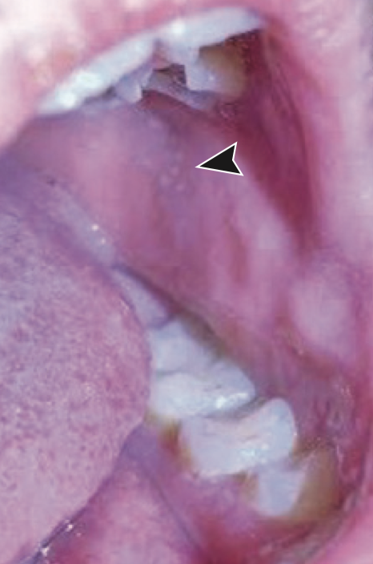
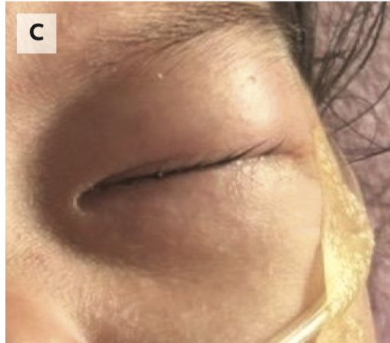
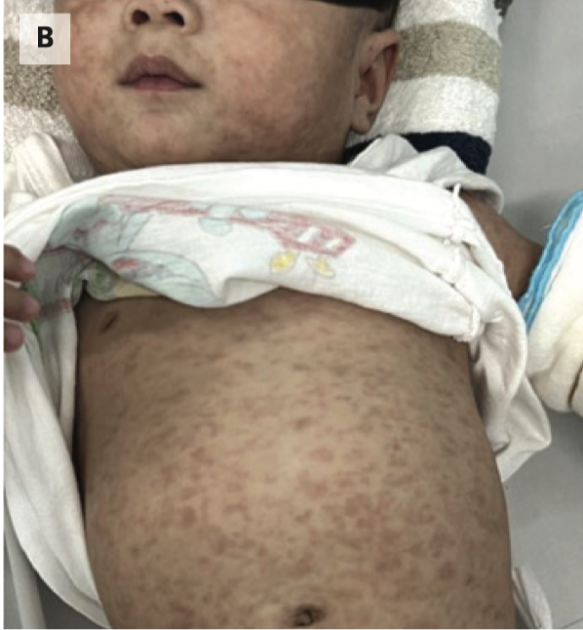
Measles: presentation
Fever: 10-14 days after exposure
Three “C’s”
Cough
Coryza
Conjunctivitis
Koplic spots:
1-3 mm white spots on erythematous base on buccal mucosa opposite the molars
1-2 days prior to rash, 1-2 days after
seen in 60-70% of cases and are pathognomonic
Rash: 3-5 days after fever
Erythematous, maculopapular (morbilliform), not petechial
Face → Head → Trunk → Legs
Resolves in reverse order after 3-5 days
Infectious: 4 days before to 4 days after rash onset
Diarrhea: common
at time of prodrome and may last up to 30 days
Ho & Mulholland, NEJM 2025; 393:2447

Slide 12
Measles: recognizing in the health care setting
Prodromal Syndrome
Fever of acute onset that increases day-by-day up to 105°F (40.6°C)
At least one of the “Three “C’s” is usually present
cough: harsh, dry, non-productive “bark”
coryza: nasal discharge, sneezing, nasal congestion
conjunctivitis: bilateral redness, mild discharge, no corneal involvement
Koplic spots: predate rash and resolve by 2 days after rash
Rash begins 3-5 days after prodromal symptoms at height of fever
starts on face and behind the ears
spreads outward and downward
becomes hyperpigmented
starts to fade after 5-6 days
becomes confluent and desquamating
Most reliable symptoms:
Rash → Fever → Coryza → Cough → Conjunctivitis
Immunocompromised hosts may have atypical presentation missing some of these
Daniels DK et al. Ped Emerg Care 2025; 42:79

Slide 13
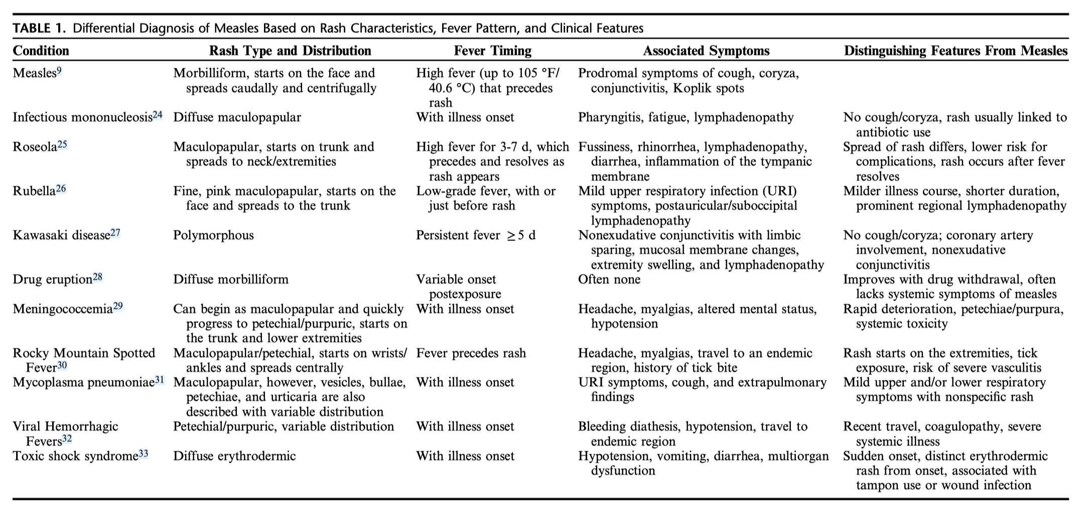
Measles: differential diagnosis
Daniels DK et al. Ped Emerg Care 2025; 42:79

Slide 14
Measles: atypical and modified
Atypical measles (rare)
Occurs in those who received with the killed vaccine (1963-1967)
high fever, headache 7-14 days after exposure
coryza, conjunctivitis
rash 3-4 days later: palms and soles → limbs, trunk
atypical: vesicular, petechial
severe pneumonitis: persistent cough, chest pain, chest x-ray infiltrates
↑ liver aminotransaminases, thrombocytopenia
transmission to others
rapid and high IgG titer
Modified measles
Occurs in those with prior measles immunity (natural or acquired)
longer incubation period (7-21 days)
milder disease but with similar symptoms and signs as natural measles
minimal IgM response
not highly contagious
Martin DB et al. Ann Intern Med 1979; 90:877
Hickman CJ et al. J Infect Dis 2011; 204:S549

Slide 15
Measles and pregnancy
Measles is more severe during pregnancy
increased risk of pneumonia
Measles is associated with increased adverse birth outcomes
↑ rates of miscarriage, pre-term birth, still-born
not teratogenic (unlike rubella)
Congenital measles (rare)
measles occurring within the first 10 days of life when mother had measles infection during pregnancy
↑ risk death, hearing loss, subacute sclerosing panencephalitis (SSPE)
Joseph NT. Obstet Gynecol 2026; 147:44

Slide 16
What to do if measles is suspected
Place the patient in respiratory isolation
Have patient wear a surgical mask
Place patient in a private room with door closed
if possible, place in airborne infection isolation room (AIIR)
negative-pressure (-2.5 to 15 Pa)
≥12 air-exchanges/hour with HEPA filtration on exhaust and no recirculation
sealed enclosure with anteroom, if possible
If AIIR not available
close door and place towels along bottom
continue isolation until 4 days after rash on-set
Health Care Personnel should wear N95 respirators
preferably with documented measles immunity
Notify your local public health department!

Slide 17
Measles: diagnosis
Molecular testing
Nasopharyngeal swab (preferred) or throat swab
Urine
(Heparinized blood)
Increased yield with number of different samples
Send samples for measles RT-PCR testing
Serology
Obtain serum sample
Send for measles IgM and IgG
obtain second IgG specimen 10 days after first
Viral Culture
not routinely performed and not recommended

Slide 18
Measles: diagnosis
Test | Optimal Timing* | Detectable Window* | Specimen | Advantages | Limitations
RT-PCR | within 3 days | up to 10 days | Nasopharyngeal, throat, urine, blood, BAL | High sensitivity (94%) and specificity (99%) | Strict collection and transport requirements
IgM serology | from onset | up to 6-8 weeks | Serum, oral fluid | Longer testing window | False negatives if <3 days of rash onset and in immunocompromised patients
IgG serology | within 10 days | paired samples, 1st within 10 days and then 10 days later | Serum | Confirms recent vs past infection | Slow, not helpful in acute decision making
*based on onset of rash
Daniels DK et al. Ped Emerg Care 2025; 42:79

Slide 19
Testing for measles in Arizona
Immediately notify your local county health department
Measles antibody testing (IgM and IgG) can be obtained through several commercial laboratories
For PCR testing
Collect a nasopharyngeal or throat swab
polyester fiber–tipped synthetic swab (e.g., Dacron, rayon, or nylon), with a plastic shaft
Do not use calcium alginate or cotton swabs or wooden shafts
place into 1-3 mL of standard viral transport medium (VTM)
refrigerate (2-8°C)
Health department will decide if appropriate to test and instruct on how to transport to Arizona State Public Health Laboratory (ASPHL)

Slide 20
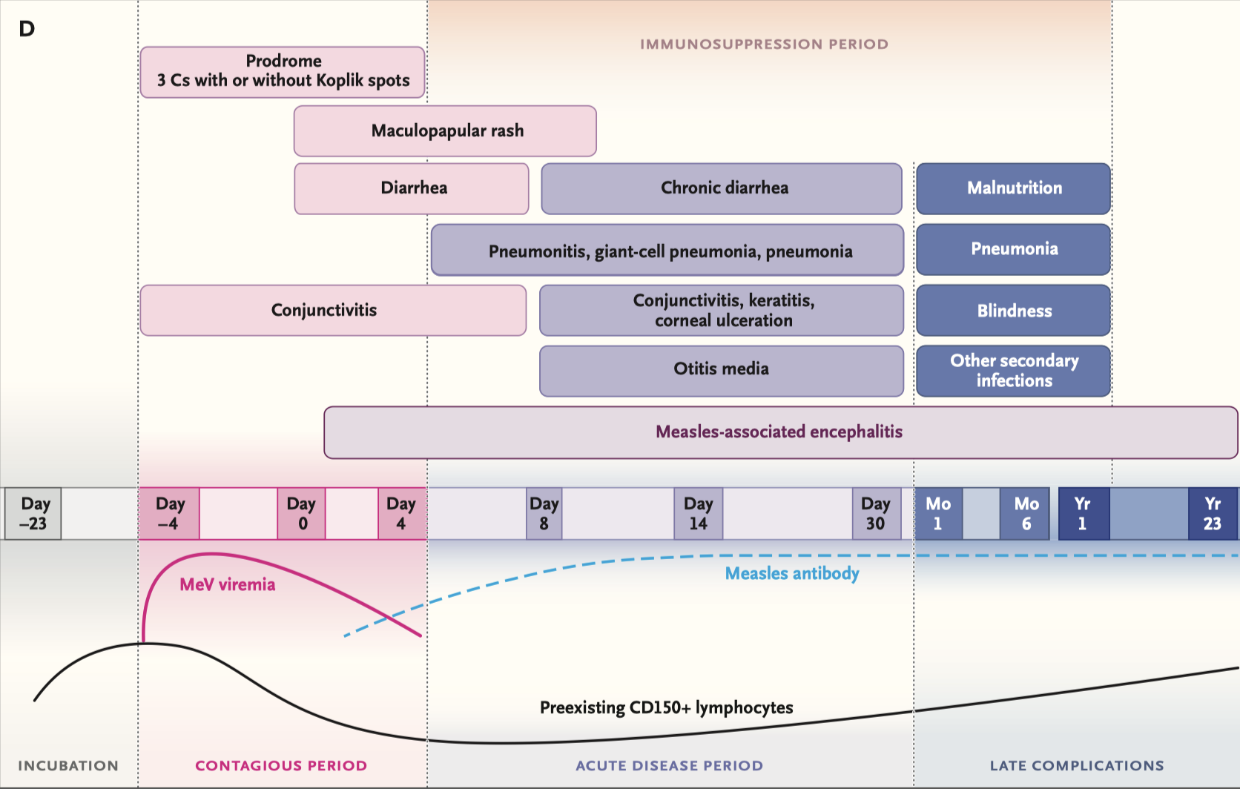
Pathogenesis and complications
Ho & Mulholland, NEJM 2025; 393:2447

Slide 21
Measles: cell receptors and immune suppression
Measles virus (MeV) recognizes 3 cellular receptors:
CD150: wild type MeV
targets and depletes B-cells and memory T-cells
results in temporary immune amnesia
lasts 5-12 months
reduced innate and adaptive immunity
increased risk of infection
reduced response to immunization
CD46: vaccine-related MeV
not associated with immune amnesia
vaccination associated with non-specific effects (NSE)
reducing morbidity and mortality of non-measles infections
Nectin-1
MeV exists infected airway epithelial cells through this receptor
Ho & Mulholland, NEJM 2025; 393:2447

Slide 22
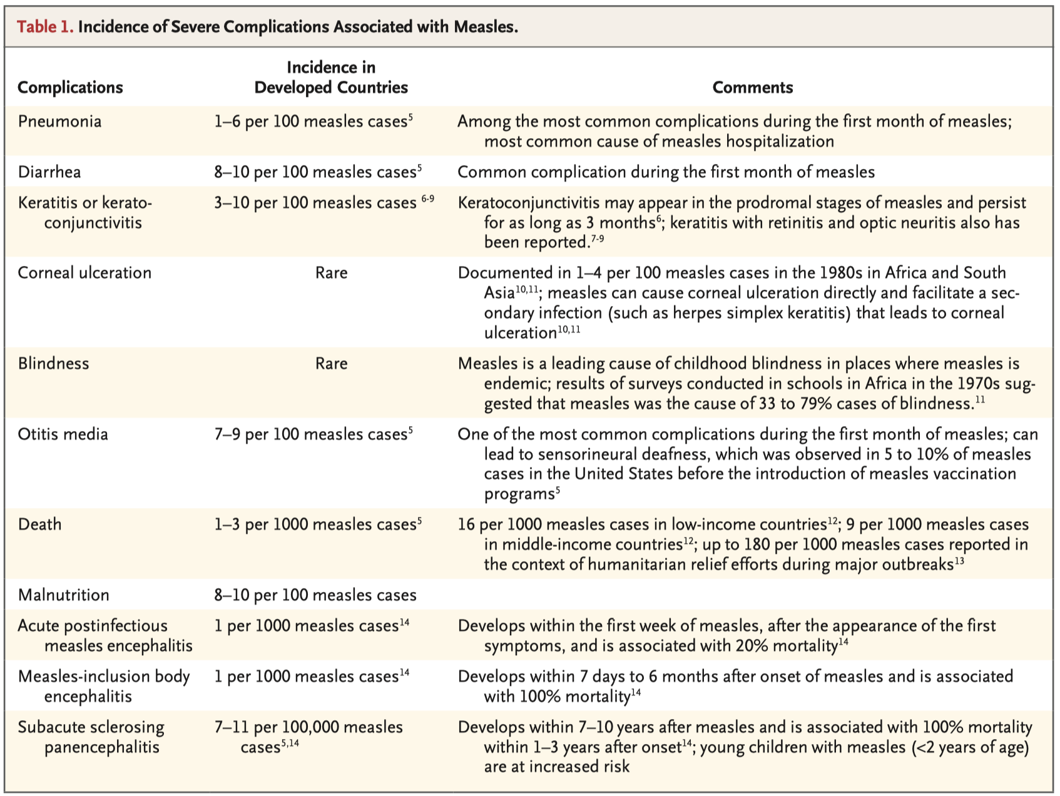
Measles: complications
Ho & Mulholland, NEJM 2025; 393:2447

Slide 23
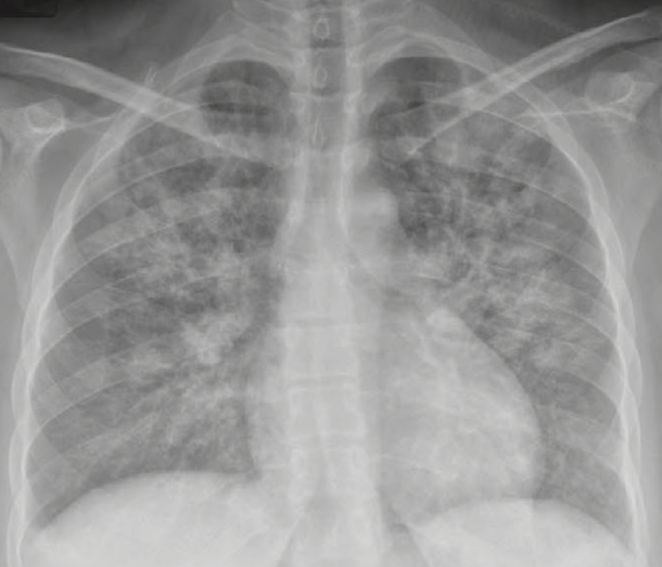
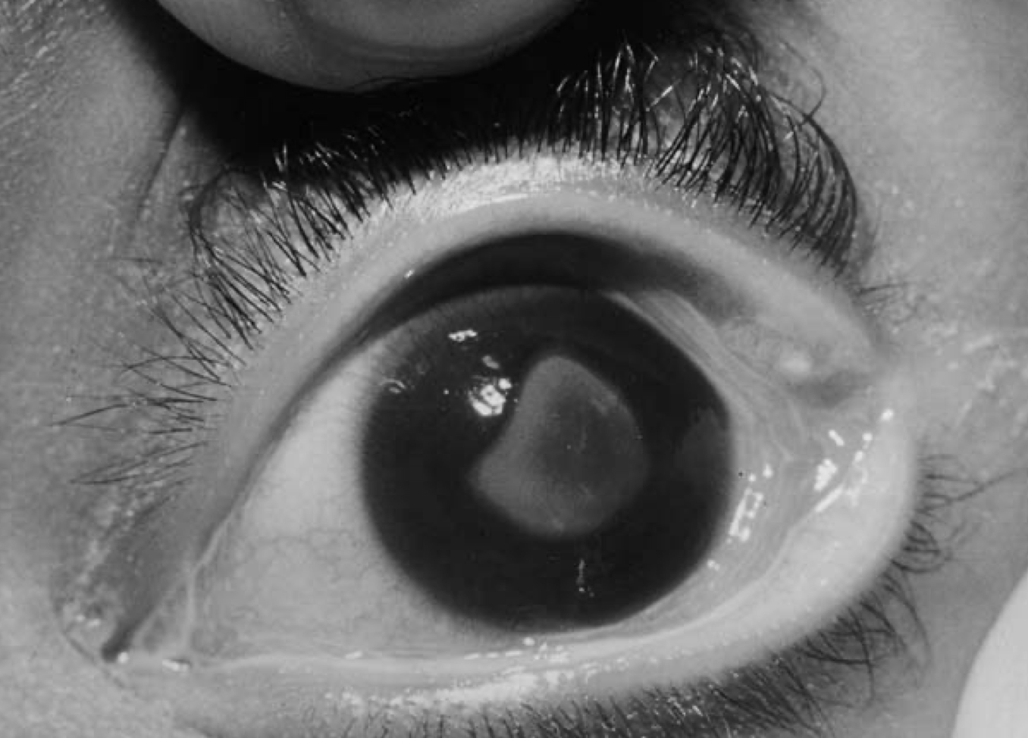
Measles: general complications
Hepatitis, leukopenia and thrombocytopenia are frequent findings during acute illness
Complications occur in 30% of unvaccinated measles patients
Pneumonia (1-6%)
leading cause of hospitalization and mortality
may be directly due to measles virus
or to bacterial etiology
Streptococcus pneumoniae, Staphylococcus aureus, Hemophilus influenzae
Otitis media (7-9%)
may result in deafness
Keratoconjunctivitis (3-10%)
different from conjunctivitis of prodrome, which rapidly resolves
corneal inflammation → scarring → blindness
malnutrition, Vitamin A deficiency
Diarrhea (8%)
Malnutrition (10%)
Kakoulis L et al. Internat J Clin Prac 2019; DOI: 10.1111/ijcp.13430
Semba & Bloem Surv Ophthal 2004; 49:243

Slide 24
Measles: CNS complications
Acute measles encephalitis
1-14 days after rash onset
1:1000 cases
headache, vomiting, stiff neck, meningeal irritation, drowsiness
acute, rapid progression, seizures
CSF: pleocytosis, PCR-positive for MeV
MRI: patchy, gray-matter edema
Acute disseminated encephalomyelitis (ADEM)
1-14 days after rash onset
1:1000 cases
headache, altered mental status, ataxia
subacute progression, steroid responsive
demyelinating, likely autoimmune
CSF: minimal pleocytosis, PCR-negative for MeV
MRI: large white matter lesions (T2 enhancement)
Subacute sclerosing panencephalitis (SSPE)
due to viral persistence in the brain
7-10 years after initial infection
usually in those <20 years of age
mood disturbances, hyperactivity, cognitive decline, monoclonal seizures
1:25,000 cases
but 1:1300 in children <5 years; 1:600 in children <1 year
Lertamornkitti & Britton; Measles is Misery. Paediatric Respir Rev 2025; 56:24

Slide 25
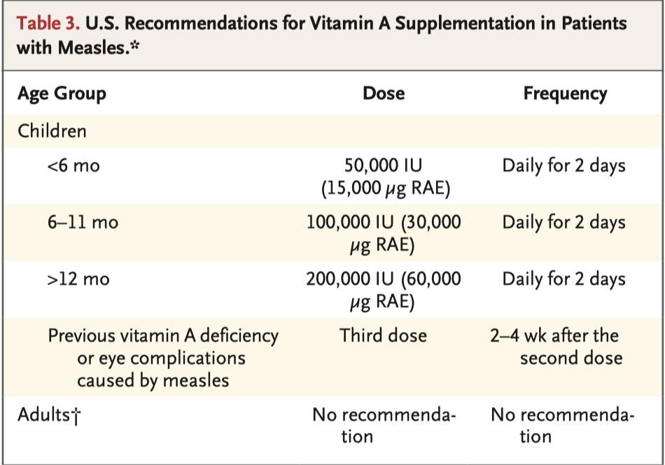
Measles: management
Treatment is supportive
there are no approved antivirals for measles virus
some experts use ribavirin or interferon-α
Role of Vitamin A
measles infection results in low vitamin A levels
pre-existing vitamin A levels may predispose to more severe disease
vitamin A supplementation in resource limited settings has been associated with lower mortality but data are limited in U.S.
currently, supplementation is recommended in U.S. for children with measles
no role for vitamin A to prevent measles
Ho & Mulholland, NEJM 2025; 393:2447

Slide 26
Measles: what is exposure
Sharing same room or airspace with a case
within 30 meters
No minimum time of exposure
≥30 minutes considered very high risk
Lack of measles immunity
<2 doses of MMR, no laboratory confirmation of immunity, no prior measles history
Public health may consider 21 days of quarantine

Slide 27
Measles: post-exposure prophylaxis
Passive immunization with immune globulin (GAMMAGARD)
give within 6 days of exposure
infants (<6 months to up to 12 months)
IM 0.5 ml/kg (maximum 15 mL)
give MMR 6 months later
pregnancy without evidence of measles immunity and severely immunocompromised hosts
IV 400 mg/kg
MMR vaccination: give within 72 hours
Children ≥12 months and adults
no documented prior two-doses of MMR
no prior measles diagnosis
without evidence of immunity (IgG≥240 IU/mL)
adults born prior to 1957 may be exempted
Infants 6-12 months
immune globulin should not be given with MMR
2 subsequent doses of MMR are still required
Arciulolo RJ et al. Clin Infect Dis 2017; 65:1843
CCDR 2018; 44-9:226

Slide 28
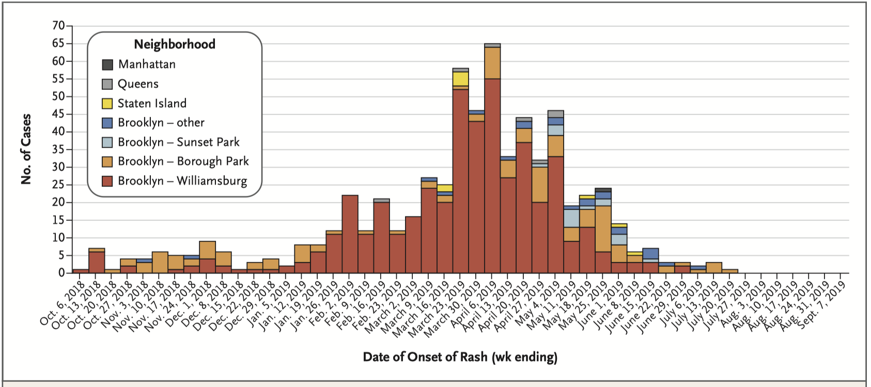
Measles: prior outbreaks
Measles was declared eliminated in the U.S. in 2000
associated with use of MMR vaccine beginning in 1971
Several recent outbreaks associated with low vaccination rates reported in the mid-2000’s
2018: among New York Orthodox Jewish population
Source: an unvaccinated child who developed a rash 9 days after returning from Israel in September 2018
649 confirmed cases
85.8% unvaccinated; median age: 3 years
49 hospitalized, 20 admitted to ICU, no deaths; 94.6% unvaccinated
transmission occurred in home, schools, childcare, and community-wide
Control achieved
initiated on March 27, 2019
20,000 contacts
post-exposure MMR vaccination
immune globulin
home quarantine
a total of 188,635 doses of MMR vaccine were administered to children 12-59 months
MMR vaccine rate increased from 79.5% to 91.1% between October 1, 2018, and September 1, 2019
cost $8.4 million
control measures started
Zucker JR et al. NEJM 2020; 382:1009

Slide 29
Current on-going large U.S. measles outbreaks
Location | Number of cases | Outbreak details
West Texas (Gaines County) | >762 | Schools and churches in rural areas; 41 hospitalizations, 2 deaths (children)
New Mexico (Lee County) | >100 | Indoor community gatherings; 1 death (adult)
Utah/Arizona border | >254 | Schools and homes
South Carolina (Spartanburg County) | >920 | Schools, churches, and hospitals

Slide 30
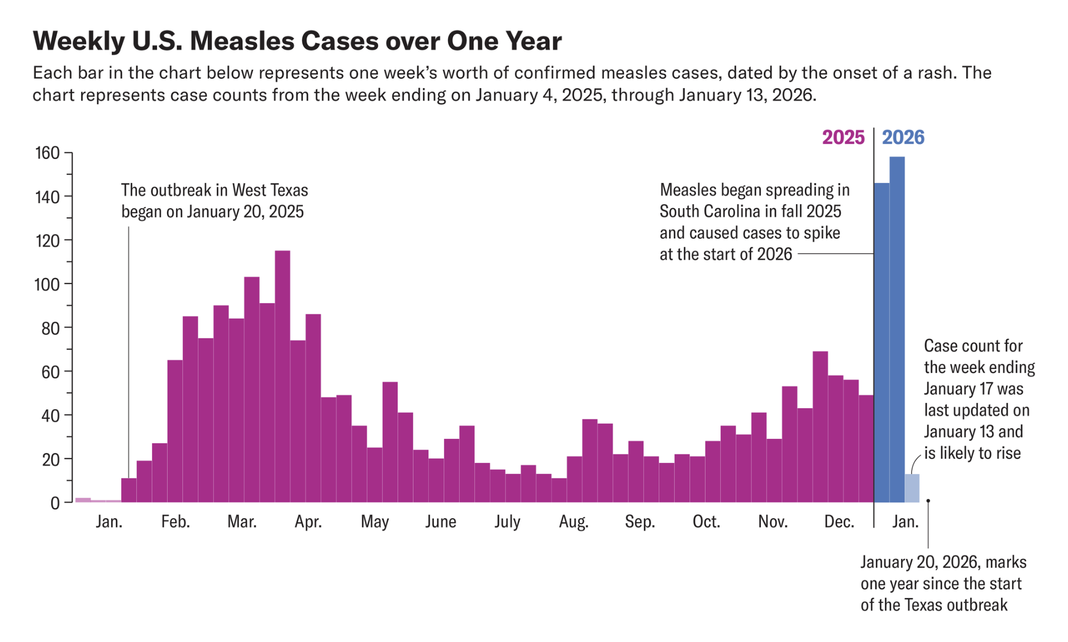
Current on-going measles outbreaks in the U.S.
Utah/Arizona outbreak
During the first 16 weeks of 2025
800 measles cases in 10 outbreaks (↑180% from 2024)
West Texas, New Mexico, Oklahoma
median age: 9 years
96% unvaccinated or unknown status
85 hospitalized (only 1 documented to be vaccinated)

Slide 31
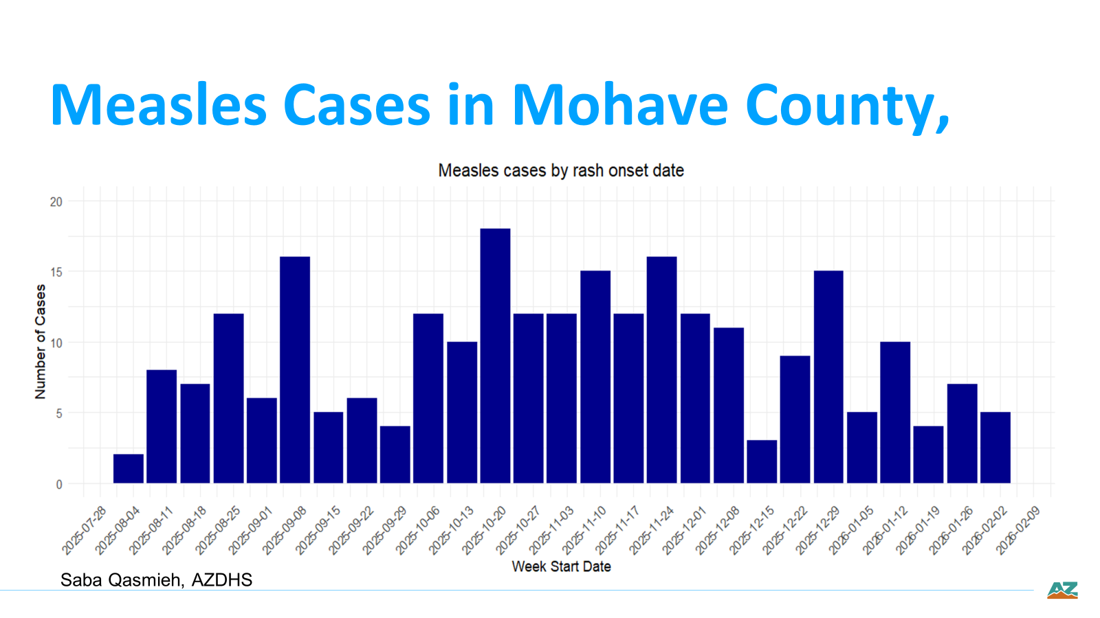
Notes:
Here is an epidemic-curve of the outbreak – characteristics based on this epicurve shows ongoing transmission or prolonged or smouldering outbreak that has been going on for a period of time.
Characteristics of this epicurve highlight that cases are ongoing, peaks at certain weeks highlight an exposure event, and holidays when there are likely mass gatherings that increase transmission.

Slide 32
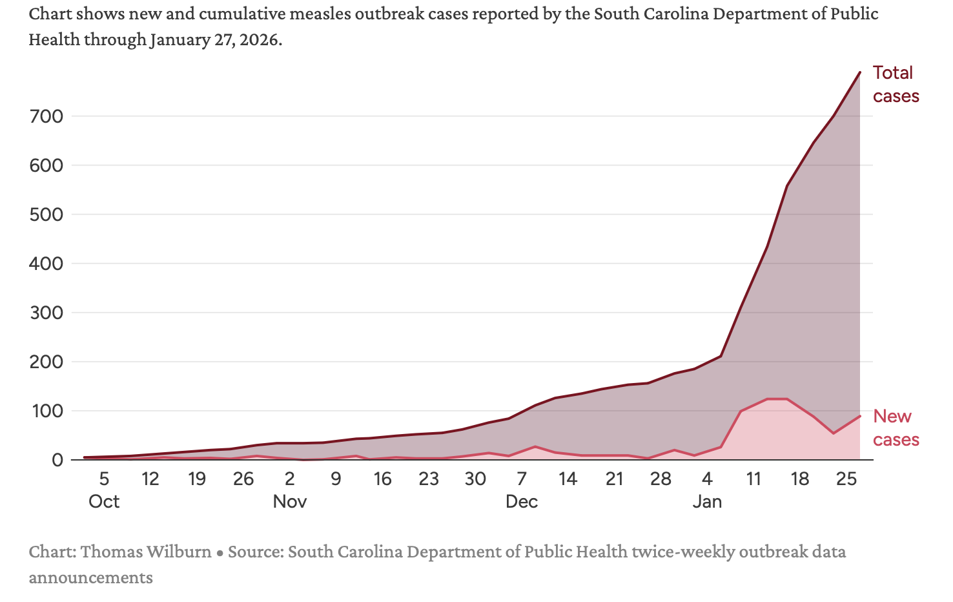
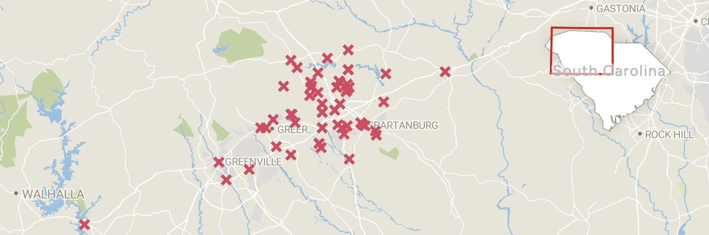
Current on-going measles outbreak in South Carolina
Began October 2, 2025 with identification of 5 cases without source in Spartanburg County, followed by 2 additional cases from two schools with MMR vaccination rates of 21% and 82%.

Slide 33
Conclusions
Measles is highly contagious
It requires ≥95% community immunity to prevent spread
Two doses of MMR is 97% effective in inducing individual immunity
MMR vaccination is highly effective in preventing measles outbreaks
Measles can be suspected clinically
Fever, 3 C’s, Koplic spots followed by rash
Testing entails RT-PCR of throat, nasopharyngeal, urine, and/or blood and serology
Patients suspected of measles should be placed in respiratory isolation
HCP should wear N95 masks and be measles immune
30% of healthy individuals have complications from measles infection
pneumonia, hearing loss, blindness, malnutrition, encephalitis
There is no specific treatment for measles
Vitamin A supplementation may reduce complications but doesn’t prevent measles infection
Multiple measles outbreaks are currently occurring in the U.S.
The primary cause is failure to vaccinate, not failure of the vaccine

Slide 34
Measles: Infection Control in Healthcare Settings
Gwen Borlaug, MPH, eCIC, eFAPIC
Public Health Advisor, ADHS

Slide 35
ADHS Measles Resources
ADHS Measles Surveillance Toolkit for Healthcare Settings
*NEW* ADHS FAQs: Managing Measles Exposures in Healthcare Personnel
*NEW* ADHS FAQs: Preventing and Controlling Measles in Healthcare Facilities
CDC Measles Information for Healthcare Providers
CDC Measles Website
ADHS Measles Clinician Fact Sheet
ADHS Measles Clinician FAQs
ADHS Clinician Guide: Comparison between Measles, Influenza and Rubella
Arizona Measles Outbreak Data
County Health Departments
CDC Interim Infection Prevention and Control Recommendations for Measles in Healthcare Settings
CDC Infection Control in Healthcare Personnel: Epidemiology and Control of Selected Infections Transmitted Among Healthcare Personnel and Patients (2024)
CDC Measles Preparedness and Response in Healthcare Settings

Slide 36
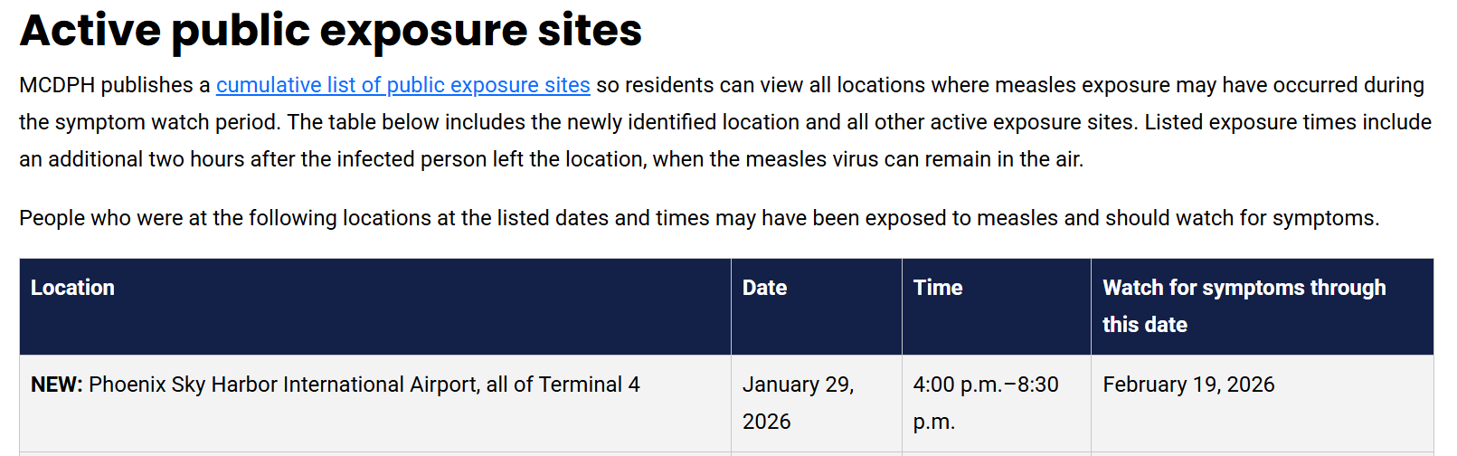
Measles in Arizona
Example of LHD notifications of exposures

Slide 37
Measles Prevention in Clinical Settings
Proactive Vaccination Program
HCP with no evidence of immunity.
Consider for residents of LTCF born after 1957 with no evidence of immunity, especially in areas where measles is being transmitted.
Infection Control
Identify
Isolate
Inform

Slide 38
ADHS Measles Surveillance Toolkit for Healthcare Settings
The most effective way to prevent measles transmission is through routine vaccination with a measles-containing virus, typically administered as MMR (measles, mumps, and rubella). The Centers for Disease Control and Prevention’s (CDC) recommended adult immunization schedule is both safe and effective at preventing disease and reducing outbreaks.

Slide 39
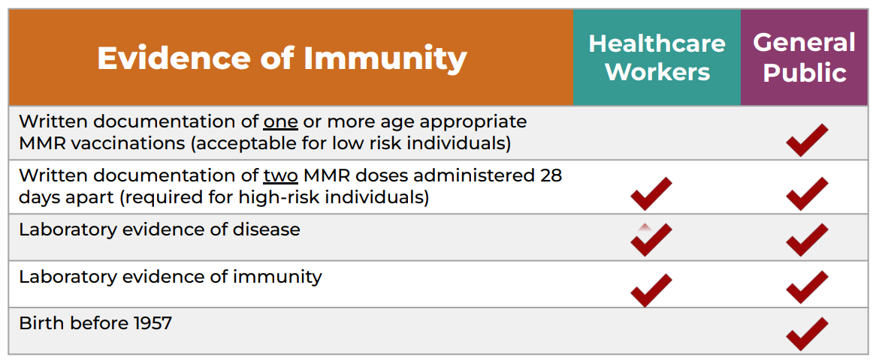
HCP Presumptive Evidence of Immunity

Slide 40
Definition of HCP
CDC definition:
All paid and unpaid persons working in healthcare settings who have the potential for exposure to patients and/or to infectious materials, including body substances, contaminated medical supplies and equipment, contaminated environmental surfaces, or contaminated air.
HCP include but are not limited to, emergency medical service personnel, nurses, nursing assistants, physicians, technicians, therapists, phlebotomists, pharmacists, students and trainees, contractual staff not employed by the healthcare facility, and persons not directly involved in patient care, but who could be exposed to infectious agents that can be transmitted in the healthcare setting (e.g., clerical, dietary, environmental services, laundry, security, engineering and facilities management, administrative, billing, and volunteer personnel).

Slide 41
Special Considerations for HCP
HCP vaccinated between 1963 and 1967 with inactivated measles vaccine: Revaccinate with two doses of MMR, spaced at least 28 days apart.
HCP who have two valid MMR doses: Do not perform serologic testing for immunity. If serologic testing is performed and results are negative or equivocal, do not give additional doses of MMR.
During a measles outbreak, serologic testing should not delay vaccination, as rapid protection is critical for outbreak control.

Slide 42
HCP with No Evidence of Immunity
Offer MMR vaccine at no cost to personnel without evidence of immunity.
Staff with only one documented MMR dose should receive a second dose as soon as possible.
Recently vaccinated personnel do not require work restrictions.

Slide 43
Measles Infection Control: Identify
Assume a patient has measles if they have measles symptoms and:
Spent time in an area in the U.S. with a known measles outbreak.
Recently were around someone else with measles.
Traveled internationally in the last 21 days.
Have not been vaccinated for measles or don’t know their vaccination status.
If your facility is located in an area where measles is known to be spreading, anyone with measles symptoms should be considered to have measles until you can rule it out.
CDC Project Firstline Measles Micro-Learn

Slide 44
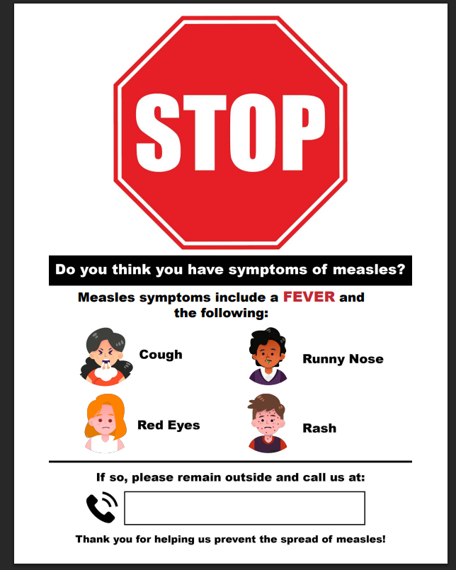

Slide 45
Measles Infection Control: Isolate
When a patient with suspected measles visits a healthcare setting, the following actions are recommended:
Advise the patient to call upon arrival and remain outside until escorted in.
Provide a mask immediately.
Escort the patient directly to an airborne infection isolation room (AIIR). If unavailable, place them in a private room with the door closed.
Only HCP with documented measles immunity should enter the room.
Instruct the patient on self-isolation, respiratory etiquette, and hand hygiene before discharge.
* For information on airborne precautions, airborne infection isolation rooms (AIIR), and environmental infection see airborne precautions. Airborne precautions should be maintained for 4 days after rash onset. Immunocompromised patients may remain infectious for longer and should remain in isolation for the duration of illness.
ADHS Measles Surveillance Toolkit for Healthcare Settings

Slide 46
Measles Infection Control: Isolate
Remember to follow standard precautions in addition to airborne precautions:
Clean your hands before and after caring for the patient and after handling items or touching surfaces in the patient’s room.
Adhere to your facility’s routine practices to clean and disinfect surfaces and handle linens.
Use additional personal protective equipment (PPE) when exposure to blood/body fluids/non-intact skin is anticipated.
CDC Project Firstline Measles Micro-Learn

Slide 47
Measles Infection Control: Inform
Notify your local public health department of suspected measles cases.
Be prepared and able to collect appropriate specimens as directed by your local or state health department.
CDC Project Firstline Measles Micro-Learn

Slide 48
HCP Measles Exposures
HCP exposure in a healthcare setting is defined as spending any amount of time while unprotected (i.e., not wearing recommended respiratory protection) in a shared air space with an infectious measles patient at the same time (even if the patient is masked), OR in a shared air space vacated by an infectious measles patient for up to 2 hours.
*Consult with your local public health department for exclusion guidance*

Slide 49
Measles Post-Exposure Prophylaxis
Given to exposed individuals with no presumptive evidence of immunity.
Two types (do not give simultaneously):
The MMR vaccine should be administered within 72 hours of initial exposure to healthy individuals (pregnant women should receive immune globulin).
Immunoglobulin (IG) should be administered within 6 days of initial exposure for individuals at higher risk of severe illness or complications.
Continue to monitor for symptoms through at least 1 incubation period.
Exclude HCP without presumptive evidence of immunity, regardless if given PEP, starting on day 5 through day 21 following their last known exposure.

Slide 50
Measles Preparedness
CDC Measles Assessment Tool to evaluate:
Ability to recognize measles cases
Process for contact tracing and exposure management
Methods for notifying key staff regarding measles cases in the facility.
Training and education of staff
Documentation of HCP measles vaccination/immunity
Respiratory Protection Program
Triage practices
CDC Measles Preparedness in Healthcare Settings

Slide 51
Measles Preparedness
CDC Responding to Measles Exposures
CDC Sample Script to Assess Patients and Visitors
CDC Measles Preparedness in Healthcare Settings

Slide 52
Measles Questions
Contact ADHS at
VPD@azdhs.gov

