Slide 1

April 2026 Tucson Conference

Slide 2








Tucson Conference April 2026
A special thank you to our sponsors!

Slide 3
President’s Update
Membership Outreach
Scholarship Winners
Chapter-Specific Swag
Upcoming Education
Communications Plan/ Website Updates

Slide 4


Global Health Survey Update
Extended for Increased Engagement!
Hospital IP Survey https://redcap.link/5uxirots
LTCF Survey - https://redcap.link/ltc_az

Slide 5
Agenda
11:00 | Welcome and Intro | Kristin Grimes, RN MSN CIC
11:05 | Clostridioides difficile | Dr. D. Alexander Perry, MD, MPH
11:50 | Lunch | Kristin Grimes, RN MSN CIC
12:25 | Hepacart | Dan Gurevitz
12:35 | HRO Leadership | Lisa Stoneking, MD FACEP & Melissa Zukowski, MD MPH
1:35 | Breezy Med | Mike Johnson
1:50 | MDROs Impact on Interfacility Transfers & Impact of Documentation Gaps on CAUTI in Kenyan Hospital | Paulina Coloumbo & Flavia Nakayinma
2:35 | Nestle/Vowst | Syreeta Barrett
2:45 | Cintas | Amy Martinez
3:00 | Breaking the Chain: How hospitals and health departments can stop Candida auris together | Amy Lind, MPH & Morgan Baker, RN MSN CIC
3:30 | Closeout | Kristin Grimes, RN MSN CIC

Slide 6
Clostridioides Difficile
Dr. Alex Perry
APIC Grand Canyon Mini Conference
April 24, 2026

Slide 7
A Case
This is a work of fiction. Names, characters, places and incidents either are products of the author’s imagination or are used fictitiously. Any resemblance to actual events or locales or persons, living or dead, is entirely coincidental.

Slide 8
A Case
65-year-old individual with heart failure and chronic kidney disease is admitted to the hospital following a fall. They have a hematoma to their scalp and are obtunded in the emergency department. Given inability to protect airway they are intubated and admitted to the ICU.
A urine is obtained through means that are undocumented. It has trace leukocyte esterase, trace blood, and bacteria, so is started on vancomycin and cefepime due to concerns for urinary tract infection, though no symptoms are assessed.

Slide 9
A Case Continued
During the patient’s time in the ICU, the patient is kept on broad-spectrum antibiotics but also started on tube feeds and continued the scheduled bowel regimen that was started on admission.
On day 6 of hospitalization, the patient is noted to have loose stools. A C. difficile test is ordered and returns antigen positive but toxin negative, prompting an infectious disease consultation.

Slide 10
C Difficile: The Epi and Micro

Slide 11
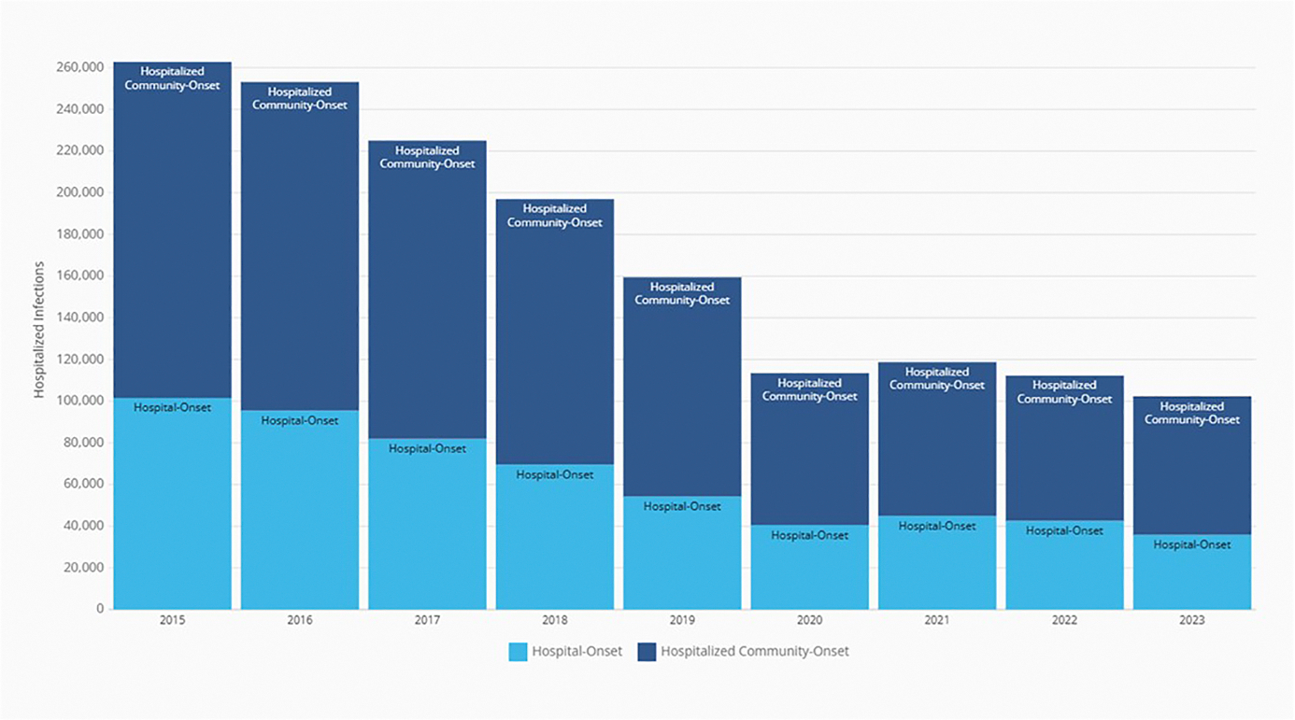
Epidemiology of C. difficile
Found colonized in intestines of up to 3% to 5% of healthy individuals
  8% to 10% of adults residing in hospitals or long-term care facilities
450,000-500,000 cases annually in the US with 5-6.5% mortality
Incidence rates shifting:
  2023 community-associated CDI cases was 62.3 per 100,000 persons
  2023 healthcare-associated cases was 54.9 per 100,000 persons
https://arpsp.cdc.gov/profile/nhsn/cdi
10.1038/ajg.2015.22
10.1056/NEJMoa1910215
cdc.gov/healthcare-associated-infections/media/pdfs/2023-CDI-Report-508.pdf
Notes:
Colonization can be has high as 20-30%
2017 numbers

Slide 12
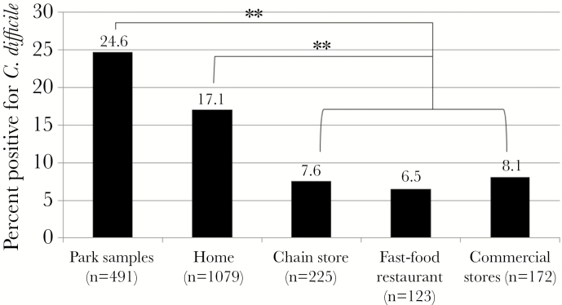
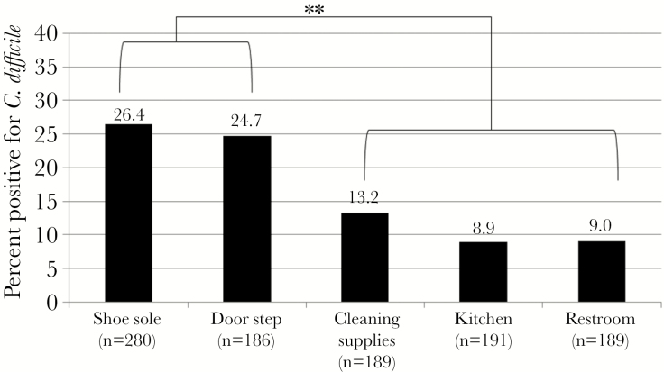
C. Difficile is Everywhere
  Environmental locations including restrooms, park equipment
  Found in retail meats: ground beef, pork, turkey, sausages from 20-63%
  In hospitals, "high-touch" surfaces: bed rails, call buttons, phones, tables
  Most contaminated area is within 3 feet of patient’s bed*
    There is evidence of aerial dissemination of spores even in bedbound patients
10.1055/s-0040-1701234
10.1186/1471-2334-8-7
10.1093/ofid/ofx018
Notes:
Percentage of samples positive for C. difficile in the environment

Slide 13
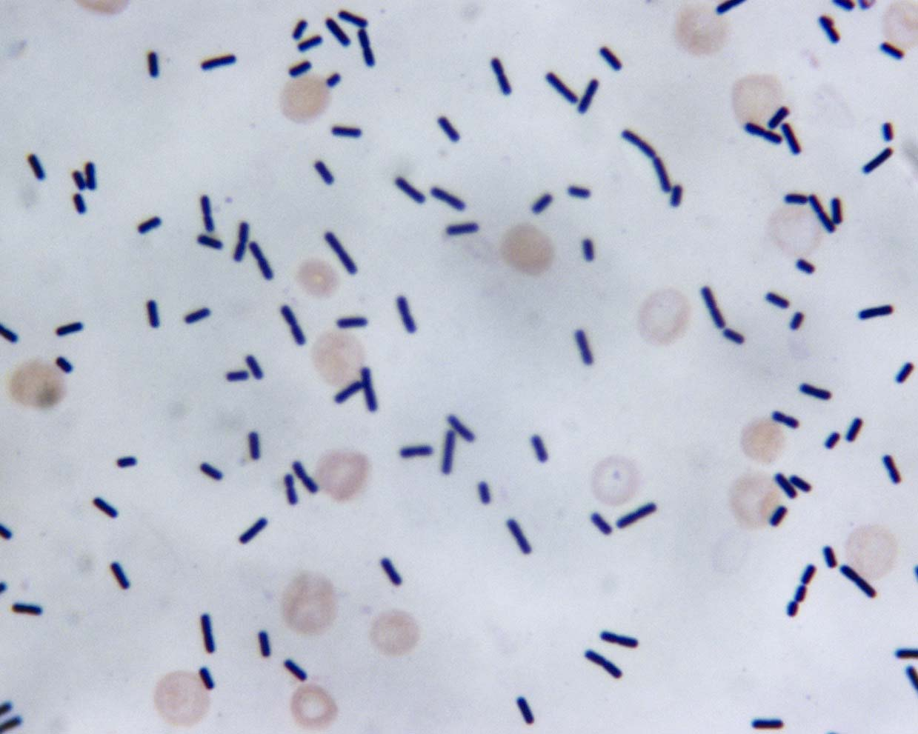
Microbiology
Gram-positive, anaerobic, spore-forming rod
C. difficile spores are metabolically inactive and can survive for months on dry surfaces
  Resistant to heat, acid, and disinfectants
Creates 2 toxins, A and B ,which contribute to its pathogenicity
https://www.pathologyoutlines.com/imgau/microbiologycdifficiteLieberman09brq.jpg
10.1128/microbiolspec.ei10-0007-2015
Notes:
C. diff was renamed from Clostridium to Clostridioides in 2016 to better reflect its taxonomic differences

Slide 14
Pathogenesis
Antibiotics
Additional risk factors:
Abnormal colonic microbiota
Toxigenic C. diff exposure or prior colonization
Diarrhea and colitis
Age
Abdominal surgery
Inflammatory bowel disease
Immunosuppression
Effective immune response and microbiota restoration
Asymptomatic carriage
Asymptomatic carriage
Effective antitoxin response
Inadequate antitoxin response
Recurrence
Inadequate immune response and reinfection

Slide 15
C Difficile: Diagnosis and Presentation

Slide 16
C. Difficile Symptoms
Watery diarrhea ≥ 3 more times daily
Abdominal pain/cramping
Fever
Tenesmus
Hematochezia/melena*
Notes:
Rarely ileus

Slide 17
When to Test
Guidelines state to test for C. difficile when a patient has 3 or more unformed stools in a 24-hour period
When to not test:
  As a test of cure for a patient that has been treated
  If diarrhea can be a medication side effect/alternate causes
  In a patient with chronic stable diarrhea
  If laxatives were given in the last 48 hours
  If tube feeds were initiated
10.1016/j.ajic.2023.08.008

Slide 18
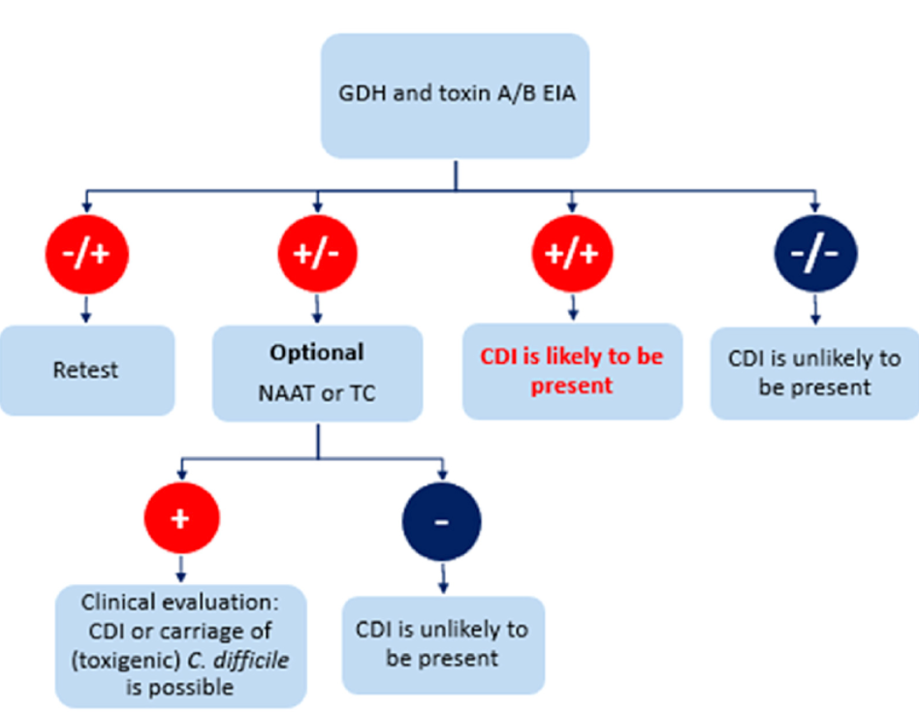
Diagnostic Tests
Glutamate dehydrogenase (GDH)
  C difficile antigen
  Only detects presence of C. difficile bacteria
EIA/ELISA
  Enzyme immunoassay for the toxin
  Retest if this is only positive test
PCR
  Detects toxin producing genes
  Overly sensitive as can detect colonization
  Use in conjunction with antigen/antibody test for discordant results
Smell - Not a thing
https://doi.org/10.1016/j.cmi.2017.12.005

Slide 19
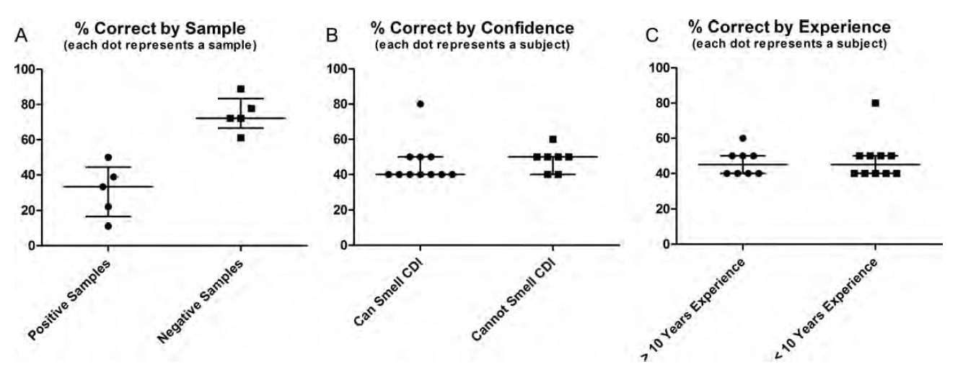
Diagnosis - Smell
Nurses were better at detecting no C. difficile
doi: 10.1093/cid/cis974
Notes:
Eighteen nurses participated.
5 positive and 5 negative stools
Experience ranged from 1 to 30 years (8 with >10 years of experience). E
11 felt confident in their sniffing ability (61%).
The median percentage correct was 45% (range, 40%–80%)

Slide 20
C. Difficile Disease Severity
Clinical Definition | Supportive Clinical Data
Non-severe (mild to moderate) | Leukocytosis with a white blood cell count of ≤15000 cells/mL and a serum creatinine level <1.5 mg/dL
Severe | Leukocytosis with a white blood cell count of >15000 cells/mL or a serum creatinine level >1.5 mg/dL
Severe complicated/Fulminant | Presence of hypotension or shock, ileus, or toxic megacolon
Notes:
Issues with classification of disease – unvalidated and subjective

Slide 21
C. Difficile: Treatment

Slide 22
C. difficile Disease Treatment
Non-severe CDI (C. difficile infection)
  Fidaxomicin 200mg PO BID x 10-14 days
  Vancomycin 125mg PO Q6H x 10-14 days
  Metronidazole 500mg PO TID x 10-14 days in low-risk patients*
Severe CDI /Fulminant (if co-existing hypotension/shock, ileus, or megacolon)
  Vancomycin 500mg PO Q6H
  Metronidazole IV /Tigecycline IV
If ileus:
    Vancomycin rectal administration
  Surgery
    Colectomy
    Loop-ileostomy or End-ileostomy

Slide 23
Time to Diarrhea Improvement
Every patient responds to vancomycin differently
1989 study of 46 patients showed ~50% respond about day 3-4
Can take up to day 6-7
10.1016/0002-9343(89)90223-4.
Notes:
Fekety R, Silva J, Kauffman C, Buggy B, Deery HG. Treatment of antibiotic-associated Clostridium difficile colitis with oral vancomycin: comparison of two dosage regimens. Am J Med. 1989 Jan;86(1):15-9. doi: 10.1016/0002-9343(89)90223-4.

Slide 24
Treatment for Recurrences
First recurrence (10-25% of patients)
  Fidaxomicin standard or alternating course
  Vancomycin 10-14-day course
  Vancomycin pulse-dose taper
Second/Subsequent Recurrence (65% of patients)
  Fidaxomicin standard or alternating course
  Vancomycin pulse dose taper
  Fecal transplant*

Slide 25
Preventing Recurrence - Novel Fecal Microbiota Transplant
Two novel agents have been FDA approved for prevention of recurrent C. difficile in adults ≥ 18 years to restore microbiome
  Rebyota - Live-jslm
  Vowst – Live-brpk

Slide 26
Novel Fecal Microbiota Transplant
Live-JSLM (Rebyota)
Live-BRPK (Vowst)
FDA approved in November 2022
Prepared from donated stool from qualified individuals and delivered as a single dose via rectal enema.
  Done 1-3 days after last dose of CDI therapy
  Can be done in the outpatient clinic setting
FDA approved in April 2023
Oral capsule that contains purified Firmicutes bacterial spores derived from human fecal samples
  Done 2-4 days after last dose of CDI therapy
  4 capsules orally once daily for 3 days

Slide 27
Probiotics
PLACIDE trial
  3000 elderly patients receiving antibiotics randomized to receive probiotics or placebo
  No difference in CDI rates, though low rate of CDI (~1% in each group)
2017 meta-analysis that included this trial also found no difference in CDI rate
2017 Cochrane review – only benefit in those with baseline risk of CDI >5%, otherwise, no benefit
2024 review – no benefit in prevention save for Lactobacillaecae
Probiotics should not be used in the immunocompromised or critically ill
  Case reports of BSIs
  Can impede reconstitution of normal bowel microbiome

Slide 28
C. Difficile and Infection Prevention

Slide 29
Antimicrobial Stewardship
C. difficile manifests due to the dysbiosis caused by antibiotic use
  Risk persists up to 3 months after antibiotic cessation
Highest association antibiotics: clindamycin, fluoroquinolones, and cephalosporins (3+4>1+2)/carbapenems
  Does not matter on duration
Implementation of an antimicrobial stewardship program can reduce CDI incidence by as much as 30 to 50%
  Specifically restricting antibiotic use is more effective than audit and feedback
10.1055/s-0040-1701234
10.1016/S1473-3099(16)30514-X
10.1093/cid/ciz169
10.1093/jac/dku046

Slide 30
Diagnostic Stewardship
Work with clinical microbiology lab to develop testing criteria
  i.e. testing of only Bristol stools 6-7, testing algorithm
Avoid testing:
  Patients without clinically significant diarrhea
  Patients who have been tested in the prior 7 days
  Patients on laxatives or enteral feeds
Educate providers and bedside nurses about appropriate use and interpretation of C. difficile testing
If using nursing-driven testing protocols, education of testing practices should be performed before implementing and education should be continuously reinforced
10.1017/ice.2023.18

Slide 31
Contact Precautions
Single patient rooms
  Cohorting CDI patients if single rooms not available
Contact precautions with gloves and gowns to reduce patient-to-patient spread
  Dedicated patient equipment and avoiding bringing shared equipment into patient rooms
  Continuing precautions for at least 48 hours after diarrhea resolves
  Can continue until discharge as patient’s continue to shed spores
  Consider making family members/visitors wear the gowns
10.1017/ice.2023.18

Slide 32
Hand Hygiene
Most transmission of C. difficile is patient-to-patient transfer from healthcare personnel
Soap and water are superior to alcohol-based hand rub for physical removal of spores
  In controlled settings with proper technique
  Without proper technique, essentially ineffective/inferior to hand rubs
Gloves are likely superior to hand hygiene in prevention of spread
Should still be instructed to family members/visitors of patients
10.1017/ice.2023.18

Slide 33
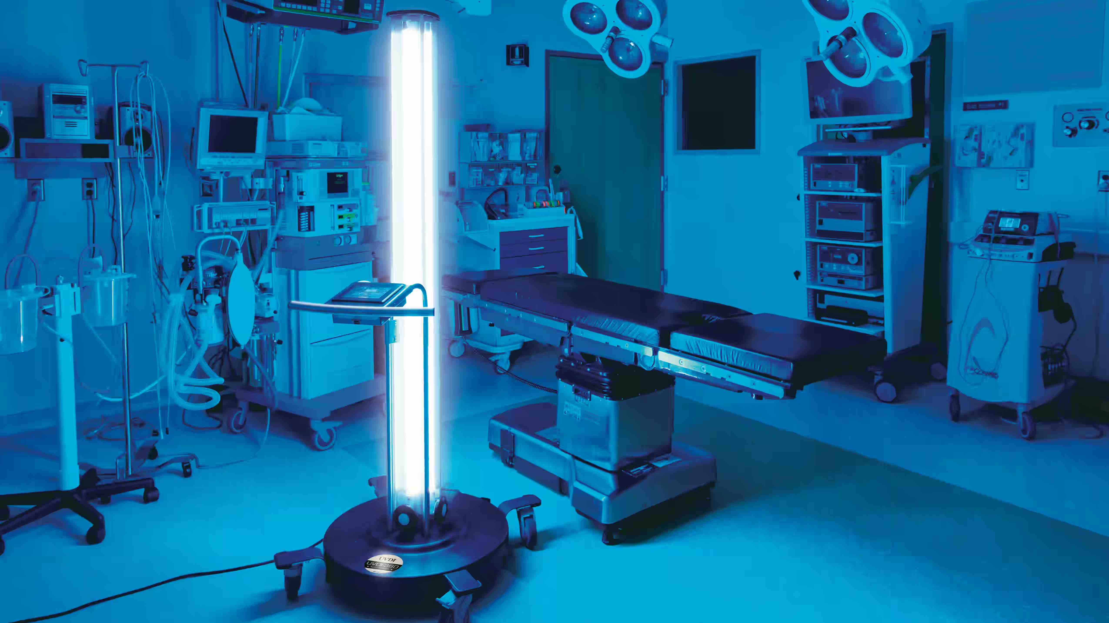
Environmental Cleaning
Sodium hypochlorite kills the spores
Daily disinfection of touchable surfaces in the rooms of patients with CDI reduces acquisition of pathogens
Vaporized hydrogen peroxide (VHP) and ultraviolet light (UV-C) as terminal cleaning in addition to bleach cleaning can reduce bioburden
  VHP in addition to bleach did not reduce infections
  UV-C in addition to bleach did reduce infections
https://www.cephalon.eu/wp-content/uploads/2019/01/UVDI-360-OP.jpg
10.1017/ice.2023.18
10.1016/j.ajic.2023.09.019

Slide 34
Wrapping up

Slide 35
Back to our case…
65-year-old individual with heart failure and chronic kidney disease is admitted to the hospital following a fall. They have a hematoma to their scalp and are obtunded in the emergency department. Given inability to protect airway they are intubated and admitted to the ICU.
A urine is obtained through means that are undocumented. It has trace leukocyte esterase, trace blood, and bacteria, so is started on vancomycin and cefepime due to concerns for urinary tract infection, though no symptoms are assessed.

Slide 36
Back to our case…
During the patient’s time in the ICU, the patient is kept on broad-spectrum antibiotics but also started on tube feeds and continued the scheduled bowel regimen that was started on admission.
On day 6 of hospitalization, the patient is noted to have loose stools. A C. difficile test is ordered and returns antigen positive but toxin negative, prompting an infectious disease consultation

Slide 37
Summary
C. difficile is a pathogen that can cause infectious diarrhea both in and out of the healthcare setting
While healthcare-associated rates have been improving, community-associated has been increasing
Testing should be done on those with consistent symptoms and appropriate stool types to C. difficile
While treatable, some patients can have recurrent infections that may require longer courses of antibiotics or fecal transplants
Prevention of healthcare-associated infections is multifactorial requiring antimicrobial stewardship, diagnostic stewardship, contact precautions, hand hygiene, and environmental cleaning

Slide 38
Questions

Slide 39
Leading for Safety:
How you Respond Matters
Melissa Zukowski, MD, MPH – ACMO BUMCT
Lisa Stoneking, MD, MBA – ACMO BUMCS
April 24, 2026

Slide 40
Case
55-year-old surgical ICU patient with a central line that looks like it might be infected to the nurse
How do you respond?
Notes:
Let me give you an example—something that probably feels familiar, and I want you to think about this case as we go through this talk. You have a patient in the ICU with a central line. It’s day five. The nurse notices the dressing is coming loose…the site looks a little red. She calls the surgical attending to take a quick look, but they are in the OR. They rush up between cases and in their hurried state, they enter the room without appropriate hand hygiene or gloving practices. The attending snaps at the nurse for wasting their time and says it looks fine and leaves. 24 hours later the patient spikes a fever and blood cultures come back positive for Staph aureus. Now we have a CLABSI. So, the question is—how do you respond? As we dive deeper into some safety science and high reliability organizations today, I want everyone to keep this scenario in the back of your mind. Whether hospital based, ambulatory based or a partner in the community, I am sure everyone in the room today can relate to coming across one or more of these situations in their circle of impact.

Slide 41
.
Your System’s Operating Point
Notes:
We are going to shift now to some basics on safety science. I want you to picture the system you work in and imagine this small square is you and your system’s operating point - This is you as an individual, you as your team, or you as your entire hospital system.

Slide 42
.
Your System’s Operating Point
Notes:
We know our system’s operating point does not live in a silo. We do not operate in a vacuum without outside competing challenges. We all are operating within the bigger system …and every system operates within boundaries—between efficiency… and safety.

Slide 43
Economic Failure
.
Your System’s Operating Point
.
Your System’s Operating Point
Accident
Acceptable Workload
Notes:
There are 3 competing aspects that impact us all – Economic pressures, Workload pressures and the most important that we want to avoid – accidents, mishaps and bad outcomes. If you go too far in one direction and have economic failure you go bankrupt. Too far in another direction you work people too hard and have staff injuries or people quit or you break your equipment. Or if you go too far in another direction you have accidents and mishaps. So, at any given moment your system is operating withing these 3 boundaries. Your small square or operating point is pushed and pulled every day 24/7/365.

Slide 44

Economic Failure
Accident
.
.
Acceptable Workload
Notes:
Commonly what happens is that the economic failure boundary and workload constraints boundary are easiest to see on the day to day and get the most attention – how many people in the room today have had a meeting or a call or conversation this week about something related to the economics or finance of your system? How many people have had a meeting, call or conversation about staffing, equipment or the like? Because of these two very important but competing priorities or forces – we see that over time those begin to take priority and push towards the accident boundary.
And the reality is—most of us are operating closer to that edge than we think.

Slide 45
Where do you think your team is operating?
.
Your System’s Operating Point
What are you doing to
Reinforce your accident
Boundary?
What new pressures are you seeing?
Notes:
We’re balancing workload, staffing, competing priorities…budgetary constraints, workforce productivity. What are some of the things that you feel fall into these competing priority buckets that make your work system strained and how are we reinforcing that accident boundary?
Partner up with 1-2 neighbors and consider these 3 Qs over the next 3 minutes and then we’ll come back together to share thoughts:
-What are you doing to reinforce your accident boundary?
-Where do you think your team is operating?
-What new pressures are you seeing?

Slide 46
Economic Failure
Accident
.
.
Education
Rules
Policies
Process Changes
Safeguards
Technology
Acceptable Workload
Notes:
Some of these reinforcements are similar to those mentioned by the group – To try to protect that system operating point, we try to reinforce the accident boundary with education, policies, processes, safeguards, technology (those are the usual tools to reinforce that accident boundary and make it more resilient to the real-world pressure …But even with all of that—we still have harm.

Slide 47
Economic Failure
Accident
.
.
Acceptable Workload
Notes:
We know what usually happens in the real world is that we cross that accident boundary, but we get lucky. Because Murphys law is actually wrong - everything that can go wrong actually usually goes right. So, what happens in complex systems, is because most of the time everything that could go wrong didn’t go wrong, we get lucky and before we know it … what happens….

Slide 48

Economic Failure
“New”
Accident
Boundary
Danger Zone
.
.
Acceptable Workload
Notes:
We’re living in this danger zone where we are actually beyond our initial accident boundary but because we didn’t kill anybody, we tell ourselves that we aren’t at the boundary yet – that is drift… that is the definition of drift. I saw the sign that says no swimming and now I’m standing waist deep in the ocean in the shark infested waters, just enjoying my day, and every minute that goes by that i don’t get eaten by a shark, i tell myself it isn’t a big deal. But the risk hasn’t changed, only my perception of the risk.

Slide 49
Economic Failure
HRO:
Managing
in the
Danger Zone
.
.
Acceptable Workload
Notes:
That’s where HRO comes in and is SO important – we need HRO to help with the managing of the danger zone.

Slide 50
High Reliability Organizations (HRO)
Reluctance to Simplify
Sensitivity to Operations
Preoccupation with Failure
Commitment to Resilience
Deference to Expertise
Notes:
How many in the room have heard of HRO? Hopefully many have at least heard of this important term, but if its new to you and your team, that is ok – we are going to deep our toes into it today… together.
The term “high reliability organizations” describes an organizational culture that strives to achieves safety, quality, and efficiency goals all while operating in complex, high-risk environments, like those we work in everyday. Our own individual – danger zones.
The aviation industry, nuclear industry, and some leading health systems have embraced this researched-based approach to safety excellence.
At the core of HRO is a culture of “collective mindfulness” in which all team members look for, and report, small problems or unsafe conditions BEFORE they pose a substantial risk to the organization. All this while focusing on a repeatable set of team-based behaviors. Use of HRO is designed to change how we think about patient safety through these 5 key principles:

Slide 51

Reluctance to Simplify
Work is complex, dynamic and not easily simplified (i.e. problems happen due to “bad apples”)
Look to deeply understand root causes (both process and culture)
Appreciate standardization’s role in reducing variation yet understand the complexity in people, relationships and processes.
Notes:
Starting at the top! Reluctance to simplify - People resist simplifying their understanding of work processes and how and why things succeed or fail in their environment. People in HROs* understand that the work is complex and dynamic. They seek underlying rather than surface explanations. While HROs recognize the value of standardization of workflows to reduce variation, they also appreciate the complexity inherent in the number of teams, processes, and relationships involved in conducting daily operations.
Another way to think about this one:
Reluctance to simplify (ie, the acceptance that work is complex, with the potential to fail in new and unexpected ways)
Example: CAUTI, CLABSI bundles - Projects that show success by going deeper than “bad apple” thinking – there are more factors that just the physician who placed the line for example….

Slide 52

Sensitivity to Operations
Systems are complex
HRO’s strive for constant “Big picture” or “Situational Awareness”
Mindfulness – how things are supposed to work vs. how they are actually working
Notes:
Based on their understanding of operational complexity, people in HROs strive to maintain a high awareness of operational conditions. This sensitivity is often referred to as "big picture understanding" or "situational awareness." It means that people cultivate an understanding of the context of the current state of their work in relation to the unit or organizational state—i.e., what is going on around them—and how the current state might support or threaten safety. This hypersensitivity works to reduce the level of automaticity that naturally occurs in our work environments. Whether an assembly line or a floor, the work here is to avoid the trap of rote mindless operations, like how we can’t even remember parts of our drive (residency example of driving from South home – how did I get there, what happened?)
Sensitivity to operations. Preserving constant awareness by leaders and staff of the state of the systems and processes that affect patient care. This awareness is key to noting risks and preventing them.
Examples: Safety huddles, team huddles, MDRs, Timeouts

Slide 53

Preoccupation with Failure
Think about “what could go wrong” to combat the norm, “nothing is going to happen”
Dedication and vigilance to learning
Not waiting for errors, accidents or events to begin inquiry into risk
Notes:
Everyone is aware of and thinking about the potential for failure. People understand that new threats emerge regularly from situations that no one imagined could occur, so all personnel actively think about what could go wrong and are alert to small signs of potential problems. The absence of errors or accidents leads not to complacency but to a heightened sense of vigilance for the next possible failure. Near misses are viewed as opportunities to learn about systems issues and potential improvements, rather than as evidence of safety.
Preoccupation with failure. When near-misses occur, these are viewed as evidence of systems that should be improved to reduce potential harm to patients. Rather than viewing near-misses as proof that the system has effective safeguards, they are viewed as symptomatic of areas in need of more attention.
They regularly ask, how could things go wrong today?
Examples: Near Miss Reporting, daily vigilance for risk identification (just because nothing has happened, doesn’t mean we are any safer today) - IP rounding

Slide 54

Commitment to Resilience
Commitment to the unpredictable nature of system failures
Mechanisms for routinely monitoring the environment for risks to mitigate chances for failure
Well defined processes for inquiry when failure does occur
Notes:
Commitment to resilience is rooted in the fundamental understanding of the frequently unpredictable nature of system failures. People in HROs assume the system is at risk for failure, and they practice performing rapid assessments of and responses to challenging situations. Teams cultivate situation assessment and cross monitoring so they may identify potential safety threats quickly and either respond before safety problems cause harm or mitigate the seriousness of the safety event.
Resilience. Leaders and staff need to be trained and prepared to know how to respond when system failures do occur. Because they will.
Example: SWAT team and toolkits like those used during the pandemic and our current and past measles scares

Slide 55

Deference to Expertise
People closest to the work are the most knowledgeable about the work
Deference to those in the environment with greatest knowledge may not be most senior
High levels of psychological safety are needed so all stakeholders are comfortable to surface concerns
Notes:
People in HROs appreciate that the people closest to the work are the most knowledgeable about the work. Thus, people in HROs know that in a crisis or emergency the person with greatest knowledge of the situation might not be the person with the highest status and seniority. Deference to local and situation expertise results in a spirit of inquiry and de-emphasis on hierarchy in favor of learning as much as possible about potential safety threats. In an HRO, everyone is expected to share concerns with others and the organizational climate is such that all staff members are comfortable speaking up about potential safety problems. Especially those at the sharp end of the spear. A deemphasis on hierarchy is essential for organizations to prevent and respond to problems effectively.
Deference to expertise. If leaders and supervisors are not willing to listen and respond to the insights of staff who know how processes really work and the risks patients really face, you will not have a culture in which high reliability is possible.
Example: Multidisciplinary teams, care coordination rounds

Slide 56
Sounds great, but what does that mean for me?
Notes:
So, we’ve talked about why HRO matters. Now the question becomes—what can we actually do with that? Because most of us aren’t safety experts, or c-suite, or directors…But we are leaders. And every one of us impacts safety—every day.

Slide 57
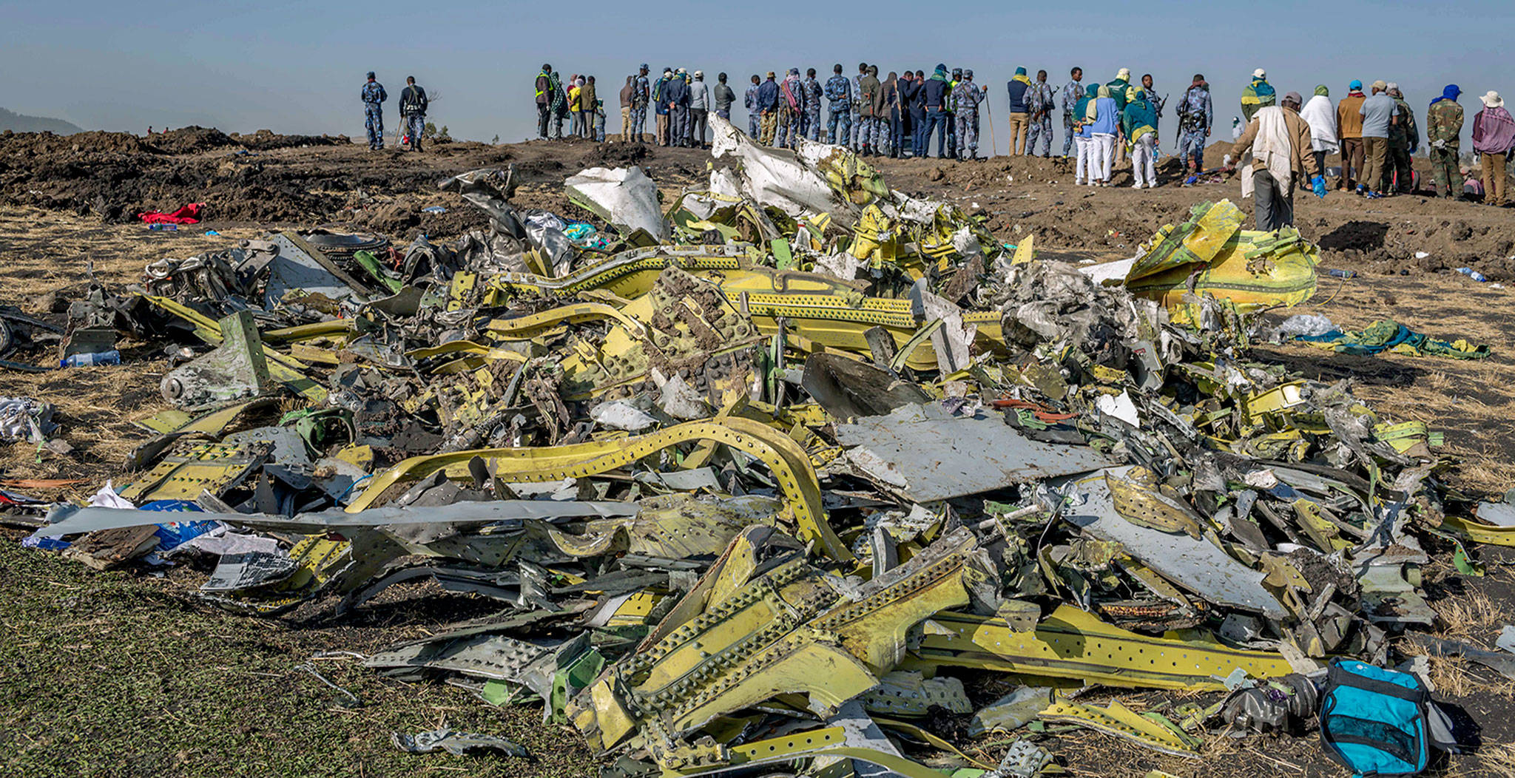
Notes:
Take a moment and visualize this image. Picture this as you imagine yourself taking a phone call from a team member about an event. Take a moment and realize that we have 2 possible responses to the story being told - the accident/mishap/unanticipated event…this is the emotional equivalent of going and standing out in the wreckage. When you’re standing in the wreckage, you’re going to hear 2 voices – 1 of judgement and blame and 1 voice of learning and improving. We as leaders need to be self aware that when we are out standing in the wreckage that there is going to be a very powerful voice of judging and blaming. Who did this? I can’t believe they did that? How could this have happened? But that’s not a place we can learn and improve from. As the HRO literature highlights – you can either judge and blame OR learn and improve – you CAN NOT do both.

Slide 58
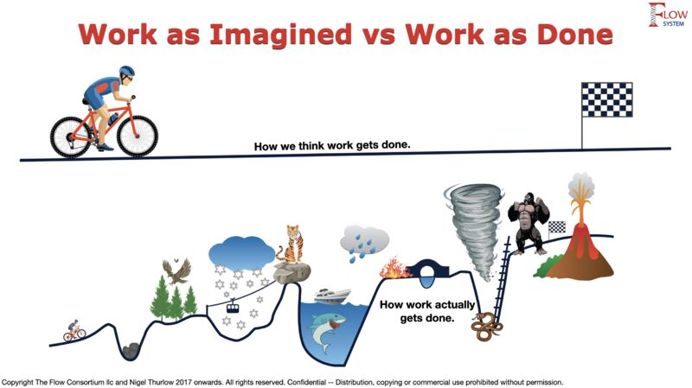

“Work as Imagined”
Leaders:
Think “normal work” is safe
See error as a choice
Hold people accountable
Tell people what to do
Enforce the policies
Find the “broken part”
See safety as the absence of bad things
The Flow Consortium.
Notes:
Another way of thinking about this is that it is easy for us to think of the world of work as imagined - how we think work gets done. When you have the mindset of a leader that is anchored in work as imagined, we think work is safe, error is a choice, and you see your job as leaders is to hold people accountable and tell people what to do and enforce policies and find the one broken part. And in this mindset you see safety as the absence of bad things.

Slide 59
“Work as Done”
Leaders:
Create a safe place for conversation
Understand that normal work is dangerous
Understand that being wrong feels like being right
Realize that the people doing the work know the most about the risks
Harness the insights of their team to learn things that were previously hidden
See safety as the presence of good things
The Flow Consortium.
Notes:
But that’s not how work actually happens. Work as done is messy. It’s interrupted. It’s happening under pressure. People are navigating trade-offs and ambiguity all day long. And if we don’t understand that reality—we’re leading a version of healthcare that doesn’t actually exist. And if we want to make that world better, It’s not our job to tell people what to do, it’s our job to make it safe to learn. So as leaders we want to pivot to these key understandings (see above list)

Slide 60
Accessing “Work as Done” through “Reluctance to Simplify”
People make mistakes
Blame fixes nothing
Context drives behavior
Learning and improving are vital – and learning is deliberate
How you respond matters
Todd Conklin. The 5 Principles of Human Performance - A Contemporary Update of the Building Blocks of Human Performance for the New View of Safety.
Sidney Dekker. The Field Guide to Understanding Human Error.
Notes:
The rest of the talk is about How you respond matters and a really simple set of tools that any of you can use to improve how you respond.

Slide 61
Let’s think back to our case…
Notes:
Remember, how you respond matters…lets think of a couple different ways you could respond to both the nurse and the physician in this case.

Slide 62
Why?
Why did they do that?
Why didn’t they follow the policy?
Why weren’t they more careful?
Notes:
Way #1 – Let’s ask a bunch of questions that start with why…why did they do that? Why didn’t they follow the policy? Why weren’t they more careful? That’s one way I could respond.
Why didn’t the nurse push harder? Why didn’t the physician follow protocol? Why didn’t the nurse speak up? We’ve all heard those. What’s another way I could respond?

Slide 63
What?
What is the usual process?
What was going on that night?
What led up to this happening?
What are the competing priorities here?
What made being wrong feel like being right?
Notes:
I could say…what is the usual process? What was going on that day? What led up to this happening? What are the competing priorities here? What made being wrong feel like being right?
How does that feel to you audience?.... I could start with the why questions, or I could start with the what questions…

Slide 64
How?
How does the team usually do this?
How do we make sure the right thing happens?
How do we know if we have the right safeguards?
How do we know if our process is working?
Notes:
Or what if I showed up and said tell me about how the team usually does this. How do we make sure the right thing happens? How do we know if we have the right safeguards? How do we know if our process is working? If you were involved in this—which conversation would you want to be part of?– audience interaction. What other things would you want to ask/know about this case/these interactions?

Slide 65
How?
So What?
Now What?
What?
Who?
Where?
Why?
Which?
Yes or No?
The Hudson Institute
Notes:
How you respond matters - One of the most powerful things we can do is choose how we show up, what choice do we have? We have a choice in the questions we ask and that’s how we make it safe for people to tell us what is actually going on.
The red questions are really triggering for people. When we ask why, we think it is a curious question. We think we’re just looking for information, I'm just getting curious about the mechanism and what actually happened, but the listener hears why and immediately goes into defense mode because the listener hears why and their brain immediately thinks they need to defend what they did. They don’t hear it as a “tell me more”. They hear it as a judgement word.

Slide 66

Leading a Culture of High Reliability –
What Can We Do Tomorrow?
What can you do daily to ensure all voices are heard?
(What do you do already or have learned?)
Looking beyond processes, what do you have to pay attention to as a leader?
What are some questions we can ask in the face of failure?
How do you learn from the collective expertise in our environments?
What steps do you take or would like to take to heighten the awareness to our safety conversations?
Notes:
Small group 5-minute discussion – What are you going to do with this information Monday morning?
Report back, share…

Slide 67
How you respond matters….
Your job is to make it safe to learn about how the work actually happens.
You do this by being in control of your response to bad news as a leader.
You control your response by being intentional with your questions.
Challenge yourself to focus more on “what” and “how” and less “who” and “why.”
Notes:
In summary….your job is to make it safe to learn about how the work actually happens. You’re not there to judge. Were there to learn. The way to make it safe to learn about what actually happens is you have to control your response to bad news and you control your response by being intentional about your questions. And the way you do that is focusing more on What and How and less on who and what if you want to learn about the world of work as its done.
So when we say ‘how you respond matters’—what we’re really saying is…One of the most powerful things we can do as leaders…is choose how we show up.
Because how we show up… is the work. In those moments—people are watching. And we are either building a culture of safety… or eroding it. and that determines—whether they speak up next time…or stay silent. And in infection prevention—that difference matters every single day.

Slide 68

Thank You
Notes:
We want to close today with a powerful quote about leadership and showing up taken from some of key recognized leaders:
“HRO Leadership is not about being in charge. It is about taking care of those in your charge. And the best way to take care of people is to show up—consistently, authentically, and with courage—even when the path forward is unclear."
This captures the essence of true leadership and the HRO journey: it's not about authority or titles, but about presence, commitment, and the willingness to lead forward even in uncertainty when the unexpected happens. Great leaders don't wait for perfect conditions—they show up, take responsibility, and inspire others through their actions and dedication.
Thank you for being here today. Thank you for showing up every day as a leader and for your teams. Thank you for being a leader – it is NOT easy – thank you for asking the How questions. Remember – how you respond matters.

Slide 69

MINI APIC CONFERENCE | April 24, 2026
From Transfer to Transmission
The Role of Interfacility Transfer in Multidrug-resistant Organism Burden
Paulina M. Colombo, Epidemiology PhD Candidate, University of Arizona

Slide 70
Introduction
Background
Future Directions
Current literature
Dissertation Aim Overview
Aim 3
Aim 1
Aim 2 & Preliminary Results

Slide 71

Antimicrobial Resistance (AMR) is growing global health crisis, driven by multidrug-resistant organisms (MDROs).
Rapidly aging population
Seasonal population surges
Rural & urban geographies
Healthcare workforce shortages across underserved regions

Slide 72
Figure 1. Laboratory-confirmed, reportable multidrug-resistant organism case counts in Arizona¹
Arizona Department of Health Services, Office of Infectious Disease Services. Number of Reported Cases of Selected Notifiable Diseases, by Category, for each County, Arizona, 2015–2025. Arizona Department of Health Services; 2015–2025.

Slide 73
Figure 1. Laboratory-confirmed, reportable multidrug-resistant organism case counts in Arizona¹
+ 41%
+ 68%
Arizona Department of Health Services, Office of Infectious Disease Services. Number of Reported Cases of Selected Notifiable Diseases, by Category, for each County, Arizona, 2015–2025. Arizona Department of Health Services; 2015–2025.

Slide 74
Interfacility Transfer (IFT)
Direct patient relocation from one healthcare facility to another.

Slide 75
Patient relocation to new healthcare environments is a routine part of care in the United States.
3.5% of all U.S. hospital admissions each year involve patient transfers between acute care hospitals.²
2. Hernandez-Boussard T, Davies S, McDonald K, Wang NE. Interhospital Facility Transfers in the United States: A Nationwide Outcomes Study. J Patient Saf. 2017;13(4):187-191. doi:10.1097/PTS.0000000000000148

Slide 76
Patient relocation to new healthcare environments is a routine part of care in the United States.
25% of nursing home residents are transferred to hospitals, each year.³
3. Vogelsmeier A, Popejoy L, Fritz E, et al. Repeat hospital transfers among long stay nursing home residents: a mixed methods analysis of age, race, code status and clinical complexity. BMC Health Serv Res. 2022;22(1):626. Published 2022 May 10. doi:10.1186/s12913-022-08036-9

Slide 77
Patients undergoing transfers face worse outcomes than non-transferred patients.
Double the risk-adjusted mortality rate of non-transferred patients
(4.5% vs. 2.1%) ²
Longer hospital stays
(13.3 vs. 4.5 days) ²
More frequent discharges to Skilled Nursing Facilities or other nonroutine destinations
(46.4% vs. 31.3%) ²
2. Hernandez-Boussard T, Davies S, McDonald K, Wang NE. Interhospital Facility Transfers in the United States: A Nationwide Outcomes Study. J Patient Saf. 2017;13(4):187-191. doi:10.1097/PTS.0000000000000148

Slide 78
Notes:
When we think of infection prevention, we usually think of within-facility interventions. But consider the following scenario that is maybe a familiar one to many of you:

Slide 79
aim 1
How does interfacility transfer network connectivity influence
hospital-level
MDRO burden?

Slide 80
aim 1
How does interfacility transfer network connectivity influence hospital-level MDRO burden?
data
methods: visualization
  Arizona
  In-patient Hospital Discharge Records (2015 – 2025)
Visualize hospital transfers using
network analysis sociograms
Generate network analysis
connectivity metrics
(e.g., in-degree and weighted in-degree)

Slide 81
aim 1
How does interfacility transfer network connectivity influence hospital-level MDRO burden?
data
methods: modeling
  Arizona
  In-patient Hospital Discharge Records (2015 – 2025)
Goal: Test whether a hospital’s transfer connectivity predicts its quarterly MDRO burden.
Model Components
  Outcome: quarterly MDRO incidence within each
  Arizona hospital
  Predictors: hospital connectivity measures, patient
  age, median length of stay, average
  Charlson Comorbidity Index score

Slide 82
aim 2
What are patient-level predictors of MDRO presence at hospital admission following transfers from long-term care?

Slide 83
aim 2
What are patient-level predictors of MDRO presence at hospital admission following long-term care transfers?
data
objectives
  Arizona
  In-patient Hospital Discharge Records (2015 – 2023)
Assess changes in frequency of long-term care transfers involving MDROs
Use statistical modeling to identify predictors of MDROs present upon hospital admission
MDRO admission prevalence
ICD-10 codes for colonization, history, or infection with a multidrug-resistant pathogen accompanied by a present upon admission (POA) identifier.

Slide 84
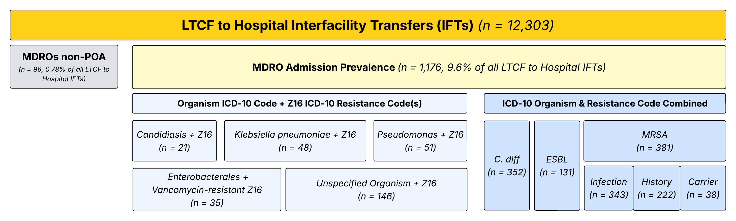
aim 2
What are patient-level predictors of MDRO presence at hospital admission following long-term care transfers?

Slide 85
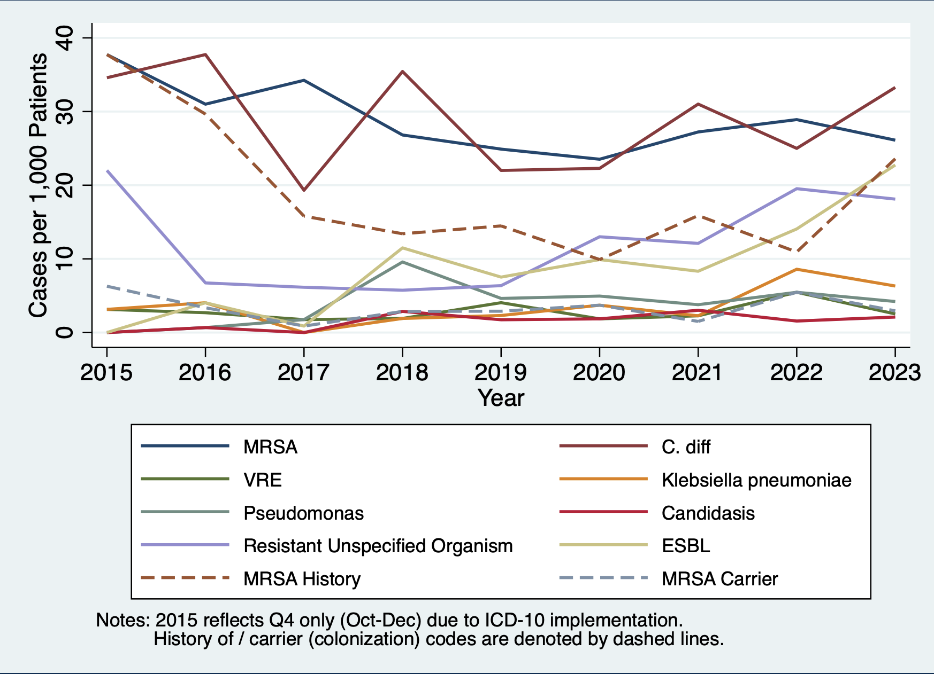
aim 2
Figure 2. Individual MDRO Admission Prevalence Rate per 1,000 Hospital Discharges (2015–2023)

Slide 86
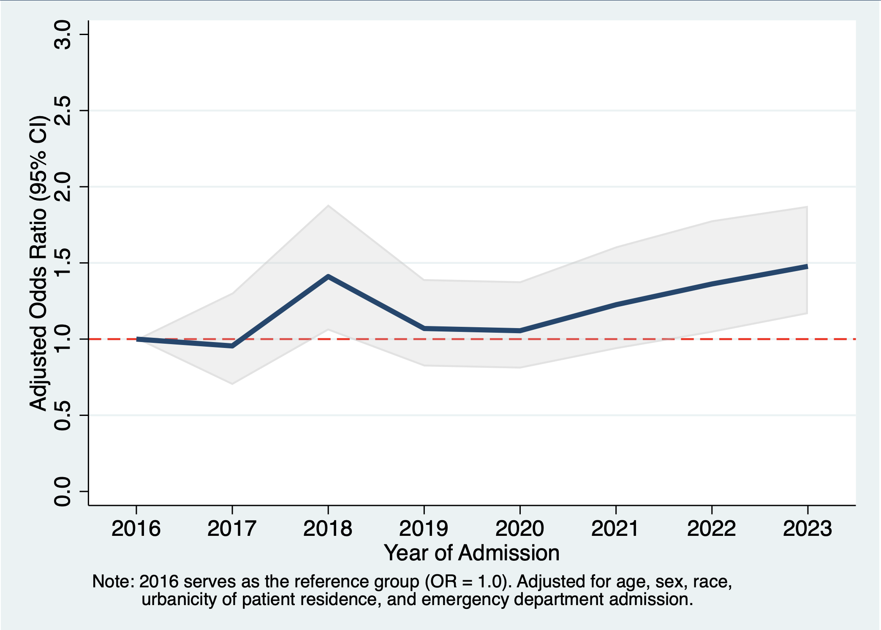
aim 2
Compared to 2016, LTCF-to-hospital transfer admissions in 2023 had 48% higher odds of presenting with at least one MDRO upon admission.
Figure 3. Logistic Regression Odds of Combined MDRO Admission Prevalence, by admission year (2016 – 2023)

Slide 87
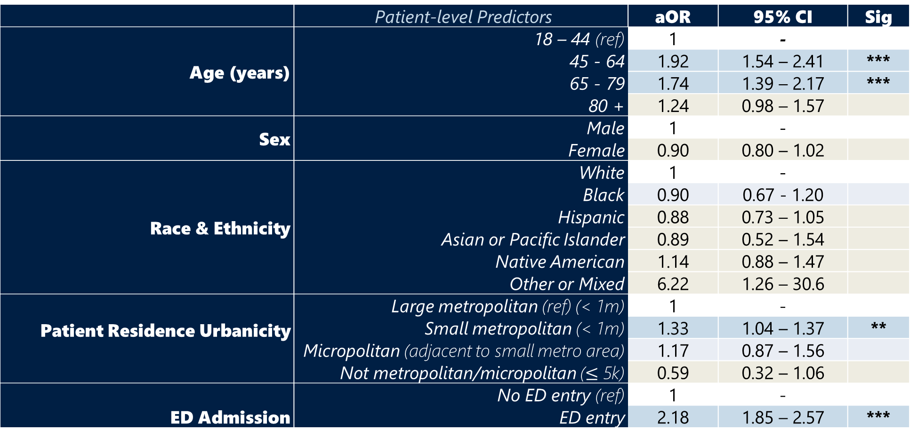
aim 2
Table 1. Results from multivariable logistic regression modeling combined MDRO admission prevalence by patient demographic and entry modality factors (n=12,425)
 | Patient-level Predictors | aOR | 95% CI | Sig
Age (years) | 18 – 44 (ref) | 1 | -
 | 45 - 64 | 1.92 | 1.54 – 2.41 | ***
 | 65 - 79 | 1.74 | 1.39 – 2.17 | ***
 | 80 + | 1.24 | 0.98 – 1.57
Sex | Male | 1 | -
 | Female | 0.90 | 0.80 – 1.02
Race & Ethnicity | White | 1 | -
 | Black | 0.90 | 0.67 - 1.20
 | Hispanic | 0.88 | 0.73 – 1.05
 | Asian or Pacific Islander | 0.89 | 0.52 – 1.54
 | Native American | 1.14 | 0.88 – 1.47
 | Other or Mixed | 6.22 | 1.26 – 30.6
Patient Residence Urbanicity | Large metropolitan (ref) (< 1m) | 1 | -
 | Small metropolitan (< 1m) | 1.33 | 1.04 – 1.37 | **
 | Micropolitan (adjacent to small metro area) | 1.17 | 0.87 – 1.56
 | Not metropolitan/micropolitan ($≤$ 5k) | 0.59 | 0.32 – 1.06
ED Admission | No ED entry (ref) | 1 | -
 | ED entry | 2.18 | 1.85 – 2.57 | ***
** p < 0.001 *** p < 0.0001

Slide 88
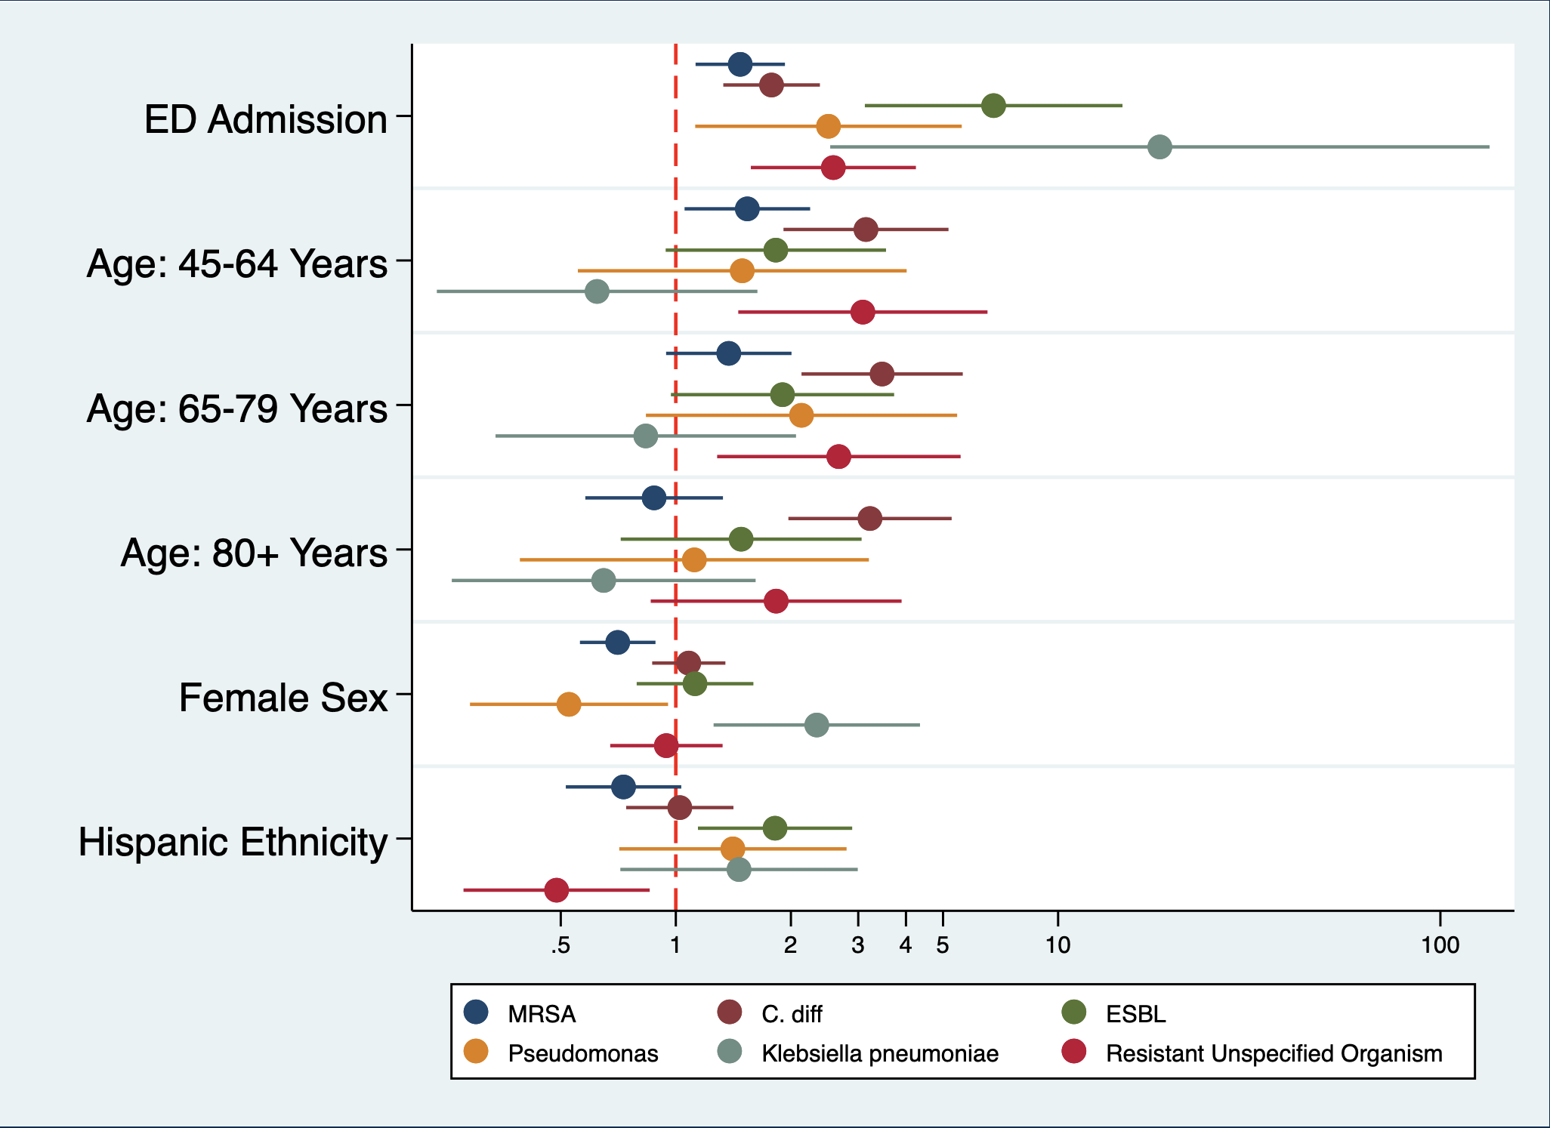
aim 2
Figure 4. Logistic Regression Model Predictors of Most Frequent Individual MDRO Admission Prevalence

Slide 89
aim 3
What are systems-level barriers and facilitators to effective interfacility communication regarding MDRO status?

Slide 90
aim 3
What are the systems-level barriers and facilitators to effective interfacility communication regarding MDRO status?
goal
Arizona has established an interfacility transfer law, requiring providers to explicitly communicate a patient’s MDRO status to the receiving facility.⁴
Identify actionable ways to improve MDRO patient handoff protocols.
*recommend use of an interfacility transfer form!
4. Arizona Department of Health Services. Required Notification of Interfacility Transfers: Article 3 (305). Arizona Department of Health Services; 2017. Accessed April 17, 2026. https://www.azdhs.gov/documents/preparedness/epidemiology-disease-control/communicable-disease-reporting/providers/multidrug-resistant-organisms-list.pdf

Slide 91
aim 3
What are the systems-level barriers and facilitators to effective interfacility communication regarding MDRO status?
Qualitative Key Informant Interviews
Acute Care
Long-term Care
Medical Transportation
Clinical staff, administrators, infection preventionists

Slide 92
aim 3
What are the systems-level barriers and facilitators to effective interfacility communication regarding MDRO status?
What are the IFT communication processes? (incoming vs. outgoing transfers)
What works? What doesn’t?
What is the role of relationships in IFT communication?
What are the impacts of IFT communication on MDRO transmission?

Slide 93
potential impacts
aim 1
aim 2
aim 3
Determine the impact of interfacility transfer networks on hospital-level MDRO burden.
Identify patient-level predictors of MDRO presence upon hospital admission from long-term care.
Highlight systems-level barriers and facilitators to interfacility MDRO communication.
Raise healthcare personnel awareness of IFT in the burden of MDROs
Awareness of MDRO trends in ICD-10 data
May help inform refinement of targeted admission screening
Identify gaps and opportunities in interfacility-transfer communication processes

Slide 94
near future directions
aim 1
aim 2
aim 3
Determine the impact of interfacility transfer networks on hospital-level MDRO burden.
Identify patient-level predictors of MDRO presence upon hospital admission from long-term care.
Highlight systems-level barriers and facilitators to interfacility MDRO communication.
Study to assess whether network connectivity could improve predictive capacity of NHSN’s SIR calculations.
Compare targeted vs. broad admission screening effectiveness
Collaborate with large EHRs to standardize IFT communication processes
Complete analysis!
Merge in social vulnerability index data
Recruitment for qualitative interviews!

Slide 95




thank you!
Paulina Colombo, MPH
Epidemiology PhD Candidate,
paulinacolombo@arizona.edu
Dr. Justin Hayes, MD
Infectious Disease Physician
Dr. Katherine Ellingson, PhD, CIC
Associate professor, Epidemiology

Slide 96
Catheter-associated urinary tract infections (CAUTI) Surveillance at an East African Regional Referral Hospital
APIC Tucson Conference
Flavia Nakayima Miiro, MS, a-IPC,
Epidemiology PhD Candidate

Slide 97
Presentation outline
Background
Research aim
Methods
Results
Conclusion

Slide 98
Background
Burden - 70% of urinary tract infections are catheter-associated¹
Risk - 1 in 4 hospitalized patients is catheterized²
Monitoring - Surveillance of HAI is a core element of infection prevention and control³
Limited ongoing surveillance – International Nosocomial Infection Control Consortium (INICC) conducts HAI surveillance in ICUs in 45 LMICs⁴

Slide 99
Background…
Higher CAUTI incidence in LMICs – 3.2 per 1,000 catheter-days in INICC vs. 1.1 per 1,000 in the USA^{5,6}
High incidence reported in single-site studies – 28 per 1000 catheter-days in Uganda, 32 per 1000 catheter-days in Kenya^{7,8}
Gap – Studies have not highlighted how incidence is affected by documentation completeness

Slide 100
Research Aim
To determine the completeness in documentation necessary for CAUTI surveillance on adult inpatient wards, the impact of completeness on incidence estimates

Slide 101
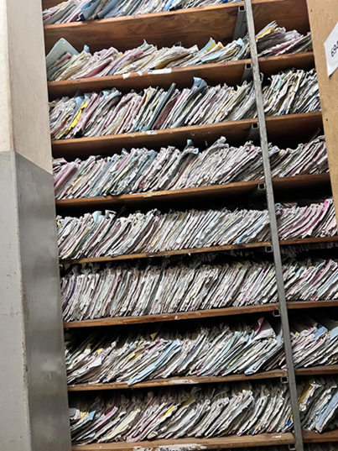
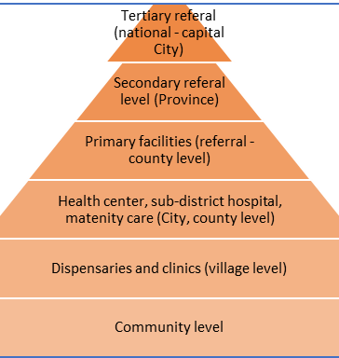
Methods
Retrospective medical chart review covering medical records from Jan 1 to Dec 31, 2023
Study setting: 739-bed level 5 hospital in Kenya
Inclusion: adult inpatients who had a urine culture request (suspect UTI) and an indwelling urinary catheter
Ethical approval: in-country and UA IRB

Slide 102

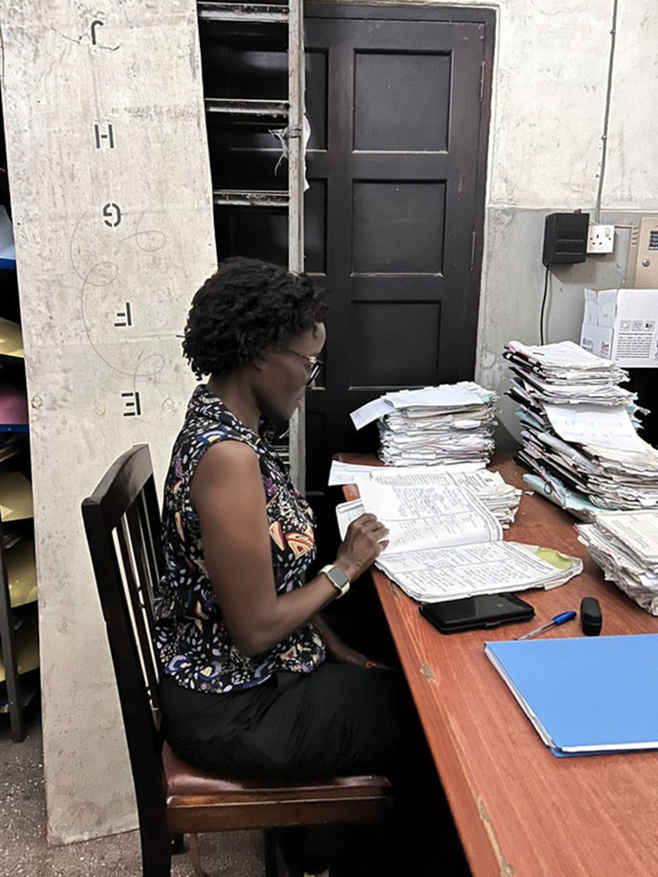
Methods…
Chart abstraction using redcap
Describe population as mean ± SD, and nominal variables as n (%)
Documentation completeness (%)
Catheter use point prevalence to estimate denominator – 52
Monte Carlo simulation used to estimate CAUTI incidence: documentation gap and antibiotic prescriptions

Slide 103
Methods…
 |  | Clinical symptoms
Microbiology |  | Inclusive A culture request used as a proxy for symptoms (symptom documentation not required) | Restrictive Documented signs and symptoms required in medical records
 | Inclusive Positive or Negative culture results with antibiotics 7d before the culture | Scenario I: Broadest assumes all requests had symptoms | Scenario II: Accounts for antibiotic masking but requires symptom documentation
 | Restrictive Positive culture results documented | Scenario III: Assumes symptoms were present for all culture requests | Scenario IV: The strictest model that requires both lab proof and clinical symptoms. NHSN aligned

Slide 104
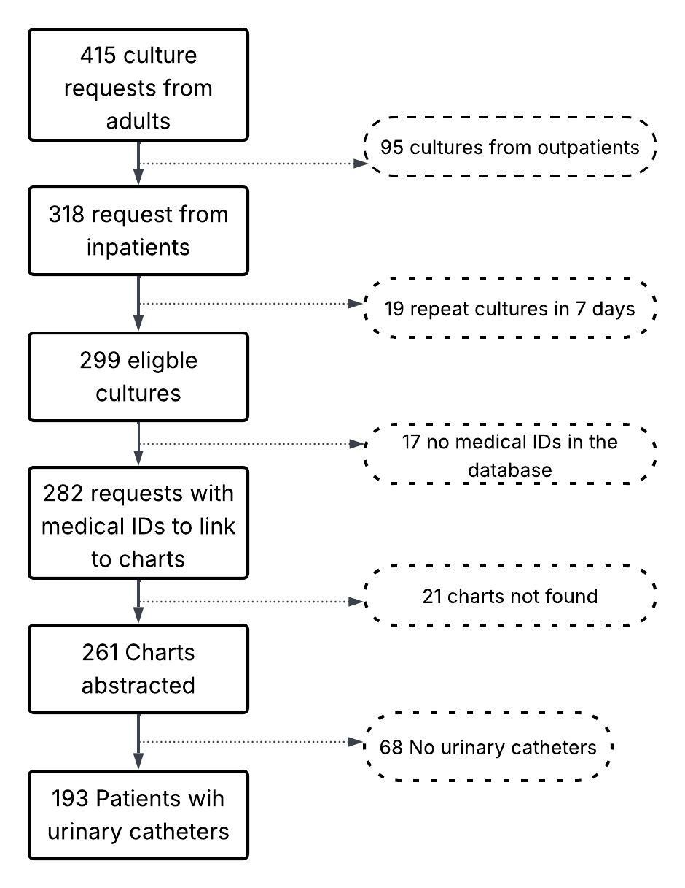
Sample size
Jan 1 through Dec 31, 2023.
193

Slide 105
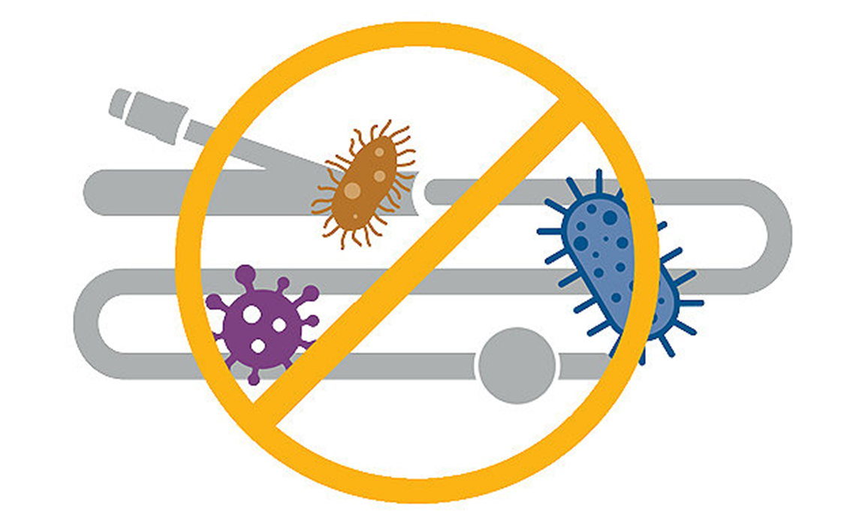
RESULTS

Slide 106
Descriptive statistics (N=193)
Variable | Overall n (%)
Age, median (IQR) | 51 (24)
Sex Female Male | 96 (49.7) 97 (50.3)
Ward of admission ICU Medical Surgical Obstetrics and Gynecology | 36 (18.7) 126 (65.3) 25 (12.9) 6 (3.1)
Comorbidity present | 184 (95.3)
Length of stay, median (IQR) | 17 (20)
Indications for catheterization Comfort of care Monitor input/output Surgery/post-surgery management Urine retention Urinary tract obstruction Not indicated | 5 (2.6) 130 (67.4) 11 (5.70 12 (6.2) 4 (2.1) 31 (16.1)
Type of catheter inserted Foley’s Silicon Not indicated | 24 (12.6) 10 (5.2) 159 (82.2)
Antibiotic prescribed within 7 days of culture request | 98 (58.3)
65.3% admitted on the medical ward
95.3% had comorbidities
Median length of hospital stay 17 days
67.4% catheterized to monitor output
16.1% did not have indication of catheterization documented
82.2% did not have the type of catheter indicated
58.3% had antibiotic prescription within 7 days of the culture request

Slide 107
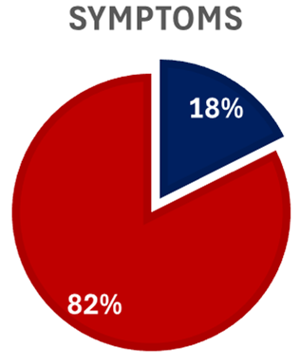
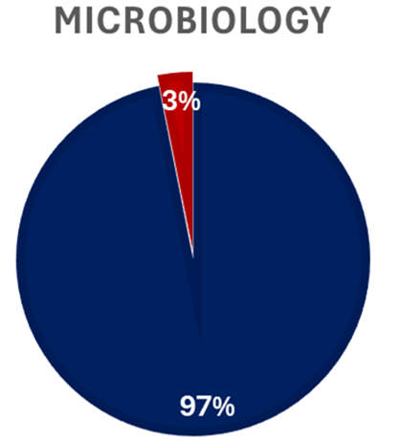
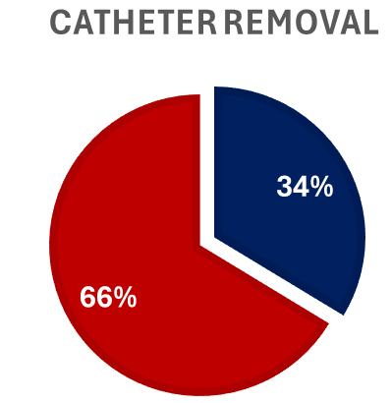

Documentation status on patient chart

Slide 108
Methods…
 |  | Clinical symptoms
Microbiology |  | Inclusive A culture request used as a proxy for symptoms (symptom documentation not required) | Restrictive Documented signs and symptoms required in medical records
 | Inclusive Positive or Negative culture results with antibiotics 7d before the culture | Scenario I: Broadest assumes all requests had symptoms | Scenario II: Accounts for antibiotic masking but requires symptom documentation
 | Restrictive Positive culture results documented | Scenario III: Assumes symptoms were present for all culture requests | Scenario IV: The strictest model that requires both lab proof and clinical symptoms. NHSN aligned

Slide 109
Comparison of CAUTI case volume and incidence rates across four surveillance scenarios with 95% Confidence intervals

Slide 110
CAUTI Incidence Rates Using Bayesian posterior distributions across varying surveillance scenarios using Monte Carlo simulation

Slide 111
Conclusions
CAUTI incidence rates are affected by documentation completeness and antibiotic prescription timing
Documentation gaps start right at the point of insertion, with indications of catheterization and the type of catheter
Whereas laboratory capacity has been cited in literature as a key hindrance to surveillance, lab capacity is not a key issue here⁸

Slide 112
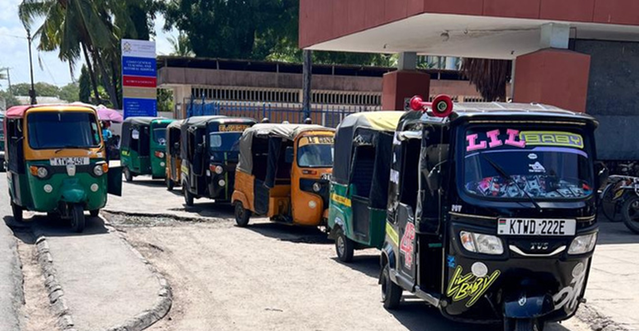
Asante

Slide 113
References
WHO, Global report on infection prevention and control. 2024, World Health Organization. p. xvii-xviii, 10-23.
Lewis, S.S., et al., Comparison of non-intensive care unit (ICU) versus ICU rates of catheter-associated urinary tract infection in community hospitals. Infect Control Hosp Epidemiol, 2013. 34(7): p. 744-7.
(WHO), W.H.O., Guidelines on Core Components of Infection Prevention and Control Programmes at the National and Acute Health Care Facility Level. 2016. 91.
Meddings, J., et al., Multistate programme to reduce catheter-associated infections in intensive care units with elevated infection rates. BMJ Qual Saf, 2020. 29(5): p. 418-429.
Oumer, Y., et al., Catheter-Associated Urinary Tract Infection: Incidence, Associated Factors and Drug Resistance Patterns of Bacterial Isolates in Southern Ethiopia. Infect Drug Resist, 2021. 14: p. 2883-2894.
Ndomba, A.L.M., et al., Urinary Tract Infections and Associated Factors among Patients with Indwelling Urinary Catheters Attending Bugando Medical Centre a Tertiary Hospital in Northwestern Tanzania. Microorganisms, 2022. 10(2): p. 473.
1Etyang, C., G. Nambozi, and L. Brennaman, A Nurse-Led Low-Cost Intervention Effectively Traces Prevalence of Catheter Associated Urinary Tract Infections at a Low-Resourced Regional Referral Hospital in Western Uganda: A Case for Policy Change. Policy, Politics, & Nursing Practice, 2020. 21(1): p. 4-11.
Mwanja, H., et al., Utility of syndromic surveillance for the surveillance of healthcare-associated infections in resource-limited settings: a narrative review. Front Microbiol, 2024. 15: p. 1493511

Slide 114
Implementation and Impact of an MDRO Admission Screening Program
Joan Ivaska, DrPH, MPH, CIC
Executive Director, IP, CSPD, SPCS
Morgan Baker, RN, MSN, CIC
Regional Director, Infection Prevention
April 2026
Notes:
"Good morning everyone. My name is Dr. Joan Ivaska, and I am the Executive Director of Infection Prevention, Sterile Processing, and Surgical and Procedural safety at Banner Health. Today, I will be presenting on the implementation and impact of an MDRO admission screening program that we began in 2024.

Slide 115
Objectives
Discuss why perform MDRO admission screening
Understand patient populations for screening
Review the screening, specimen collection and lab processes
Understand patient management post screening
Review program results to date
Discuss ongoing monitoring and other considerations
Q & A
Notes:
"Let's start by outlining the objectives of today's discussion. We will cover the reasons for performing MDRO admission screening, understand the patient populations for screening, review the screening, specimen collection and lab processes, understand patient management post-screening, review our program results to date, discuss ongoing monitoring that we are performing, and address any questions you may have at the end."

Slide 116
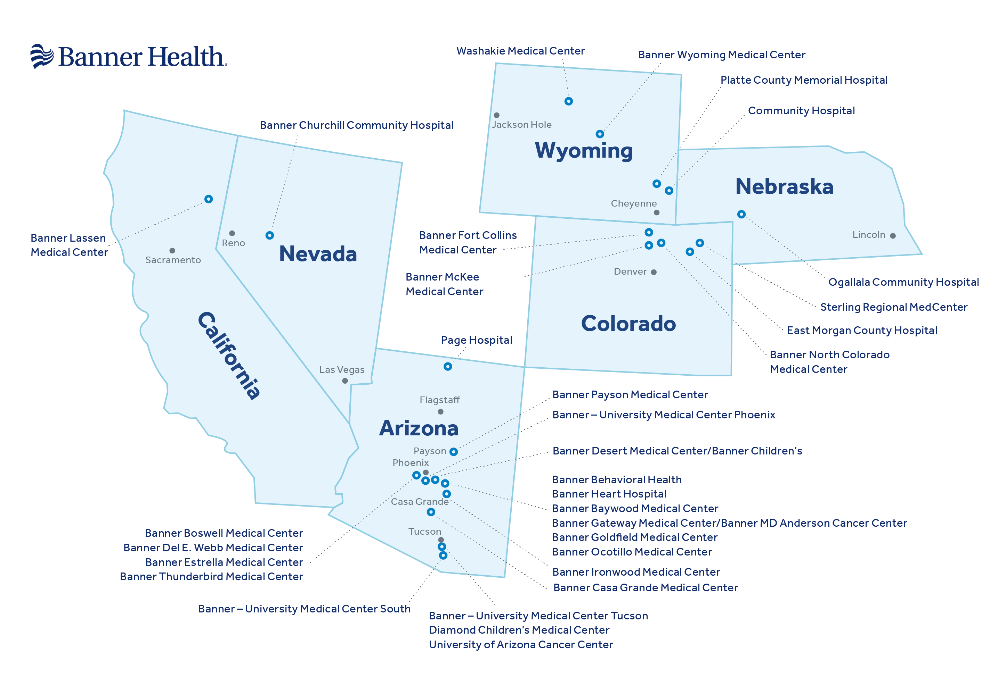
Banner at a Glance
30 acute care and critical access hospitals
  3 academic medical centers
  3 inpatient pediatric medical centers
  1 heart specialty hospital
  1 behavioral health hospital
46 Urgent care facilities
212 physician offices and clinics
40+ physical therapy centers and rehabilitation hospitals
23 Imaging centers
16 local and 6 state health jurisdictions
Notes:
First, a little background on Banner Health. Banner Health operates across several states, including California, Nevada, Utah, Colorado, Wyoming, Nebraska, and of course Arizona. We have 30 acute care and critical access hospitals, more than 46 urgent care facilities, 212 physician offices and clinics, over 40 physical therapy centers and rehabilitation hospitals, and 23 imaging centers. This map shows the locations of our facilities across theses six states. Being spread across multiple health jurisdictions complicates how we implemented our screening program as we truly do operate as a system and not as stand alone facilities.

Slide 117
Background
MDRO screening of certain high-risk populations and pathogens has been recommended by CDC since 2019
Screening and response is graded into tiers of organisms
      Tier 1: organism or resistance mechanism that is new to the US
      Tier 2: organisms primarily associated with healthcare facilities and that few if any treatment options exist, so control is critical (e.g. carbapenemase resistant organisms (CPO))
      Tier 3: organisms targeted regionally due to epidemiologic importance due to increasing spread, but that have not reached endemic state (e.g. CPO or Candida auris)
      Tier 4: organism has become endemic and has narrower scope of control and investigation (e.g. CRE with NDM/KPC, MRSA, VRE)
Most states have screening language aligned with CDC recommendations, but have not been enforcing to date
  CO began requiring screening in mid-2023
  Some AZ counties began requiring extensive post-exposure investigation and broad patient screening in 2022-23 secondary to large community outbreak of Candida auris and increasing rates of CPO
Notes:
MDRO screening of certain high-risk populations and pathogens has actually been recommended by the CDC since 2019. Screening and response are graded into tiers based on the organism's resistance mechanism, prevalence within the community, and the potential broader impact should ongoing transmission occur . While most states have screening guidelines aligned with CDC recommendations, largely enforcement has been lacking. Colorado began mandatory screening for certain healthcare facilities in mid-2023, and some Arizona counties implemented extensive post-exposure investigations and broad patient screening in response to Candida auris outbreaks and increasing CPO rates over the past few years. Both of these situations influenced our decision to move forward with an MDRO admission screening program at Banner Health.

Slide 118
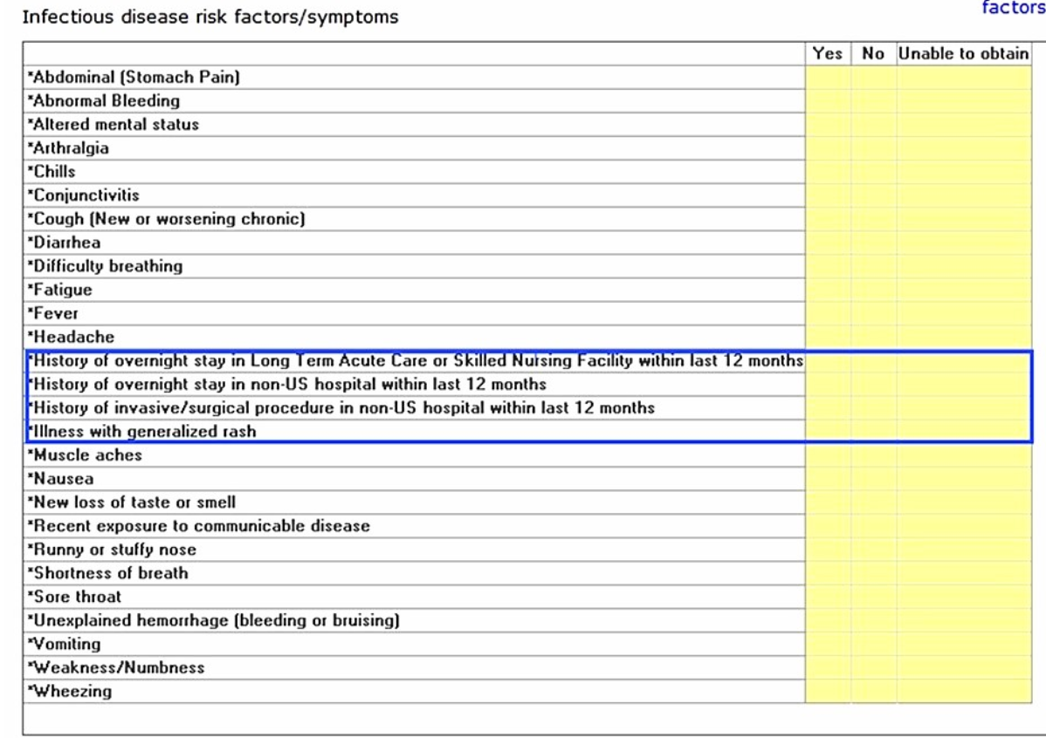
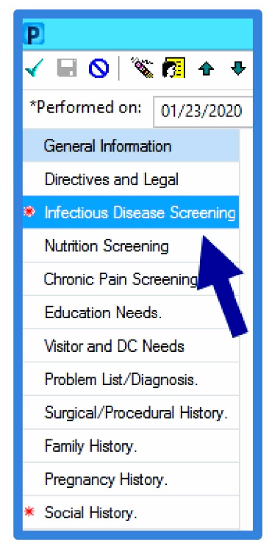
Patient populations and screening
Included populations are acute locations and patient is anticipated to have an overnight stay
At risk populations:
  Patients who have had an overnight stay or invasive medical or surgical procedure in a healthcare facility outside the U.S. in the previous year
  Patients who have had an overnight stay in a LTACH or vSNF anywhere in the U.S. in the previous year
Notes:
So let’s now get into the details of our program as it stands today. Included populations are our acute care facilities where the patient is anticipated to have an overnight stay. At-risk populations included in the CDC recommendations include patients who have had an overnight stay or invasive medical or surgical procedure in a healthcare facility outside the U.S. in the past year, or whom have had an overnight stay in a long-term acute care hospital or ventilator capable skilled nursing facility anywhere in the U.S. in the previous year. Due to the operational challenges in identifying the type of facility a patient has been in, we opted to include patients reporting a stay or transferred from any long-term acute care hospital or skilled nursing facility, not just those with ventilator capabilities.

Slide 119
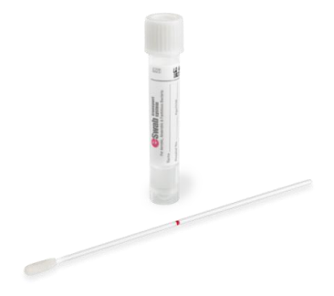
Screening
Patients with a yes to any of the three questions have system-generated orders:
  Contact precautions
  CPO screening test
  Candida auris screening test
Exceptions
  Patients discharged from the ED can have system screening orders cancelled
  Patients who are known positive or have been screened within the last 30 days will not have new screening orders triggered (orders suppressed by rules)
  Preadmission testing (surgical patients)- screening is completed on infectious disease screening form on admission
Nurse obtains verbal consent from patient, collects swabs and sends to lab
  Patients may refuse, but will be maintained in contact precautions for the remainder of their stay
  CPO screening is a rectal swab
  Candida auris screening is an axilla/groin swab
Notes:
"Patients with a stay of one year or more in any of three categories (contact precautions, CPO screening test, Candida auris screening test) will have system-generated orders. Exceptions include discharged patients and those recently screened or positive. Nurses obtain verbal consent to collect swabs for CPO and Candida auris screening, and patients refusing may still be placed in contact precautions."

Slide 120
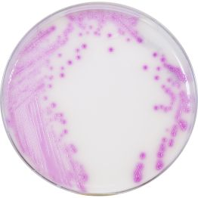
Laboratory Process
Screening is done via culture-based methods
  Candida auris- groin/axilla swabs plated to Hardy CHROM Candida + auris media. Confirmation of Candida auris using UV fluorescence and/or MALDI-TOF MS
  Carbapenemase-producing organism screening
    Rectal swabs plated to HardyCHROM CRE agar. Organisms that grow are identified with either VITEK2 or MALDI-TOF MS
    Isolates of Enterobacterales, Pseudomonas aeruginosa, and Acinetobacter baumannii are tested for presence of NDM, VIM, IMP, OXA-48-like, and KPC using NG-Test CARBA5
  AZ: all Candida auris and CPO isolates sent to ASPHL
Turn-around times (TAT are from when the culture starts at the testing laboratory)
  C. auris screens – 72 hours for a final negative result
    At the 24 and 48 hour reads of this culture, a report of “In progress” will be issued if
    there is no growth on the media, or growth of organisms with morphologies not typical
    of Candida auris
    Cultures positive for C. auris will be reported immediately
  CPO screens – 24-48 hours for a negative result
Patient kept in contact precautions until result received
Notes:
"Screening is done via culture-based methods. Candida auris screening involves groin/axilla swabs plated to Hardy CHROM Candida + auris media. Confirmation is done using UV fluorescence and/or MALDI-TOF MS. CPO screening involves rectal swabs plated to HardyCHROM CRE agar. Organisms that grow are identified with either VITEK2 or MALDI-TOF MS. Turn-around times for results vary, with C. auris screens taking up to 72 hours for a final negative result."

Slide 121
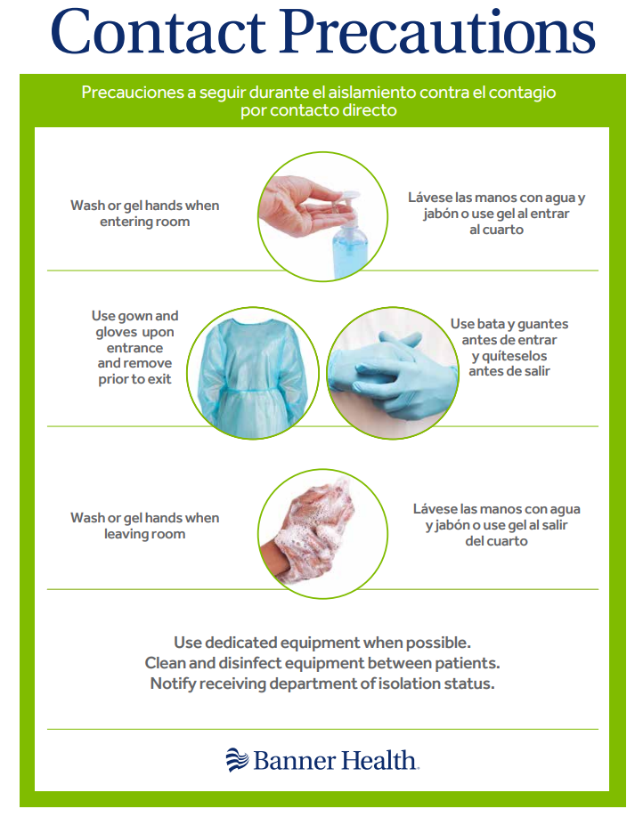
Patient Management
Positive patients:
  Must be reported to public health
    Lab reporting through ELR process
    IP/provider reporting through state reporting system per communicable disease reporting regulations
  Kept in contact precautions for duration of stay
  Only treated if they have clinical infection. No treatment for colonization, on screen alert language to providers
  Status reported back to sending agency and/or receiving agency on hospital visit summary
Positive patients are placed in contact precautions during any subsequent stay for 1 year
Notes:
Positive patients must be reported to public health through the ELR process and state reporting systems. They must remain in contact precautions for one year and are only treated for clinical infections, not colonization. Detailed instructions on personal protective equipment and hygiene practices must be followed."

Slide 122

MDRO Admission Screening
Screening began in AZ and CO In March 2024, and all other states in April 2024
Test Indications:
  Admission risk factor- IT rules fire orders
  Point Prevalence Surveillance (PPS)
    Directed by public health when a patient is found positive to determine if there has been facility transmission within given units
    Ordered by IP
  Exposure/Close Contact
    Roommate or having been on the same unit as the positive patient for 3 or more days while the patient was not in transmission-based precautions
    Ordered by IP
  Clinical isolates
43
5
8
5
Privileged and confidential pursuant to state laws including AZ: A.R.S. § 36-441 et seq., A.R.S. § 36-2401 et seq., A.R.S. § 36-445 et seq. CA: Evidence Code §§ 1157 and 1157.5. CO: C.R.S. § 12-36.5-104, C.R.S.A. § 25-3-109 NE: Health Care Quality Improvement Act § 71-7909 et seq., § 71-7901 et seq., § 71-7912 et seq., § 71-7913 et seq. NV: N.R.S. § 49.119, N.R.S. § 49.265 WY: W.S. § 35-2-609, W.S. § 35-2-910, W.S § 35-17-305
Notes:
"MDRO admission screening began in Arizona and Colorado in March 2024 and expanded to all other states in April 2024. Test indications include admission risk factors, Point Prevalence Surveillance conducted by public health, and exposure/close contact scenarios, both ordered by infection prevention."

Slide 123
Program Results
4249 patients in 28 acute care facilities identified for admission screening in 2024
  2552 patients consented and screened for Candida auris
  3346 patients consented and screened for CPO
  181 patients in whom one or more risk factors could not be determined
 | Candida auris | CPO
LTAC-SNF Stay | 2.38% | 7.74%
Non-US Hospital Stay | 2.28% | 3.94%
Non-US Procedure | 2.89% | 5.19%
Admission screening positivity rates by pathogen and risk factor
43
5
8
5
Privileged and confidential pursuant to state laws including AZ: A.R.S. § 36-441 et seq., A.R.S. § 36-2401 et seq., A.R.S. § 36-445 et seq. CA: Evidence Code §§ 1157 and 1157.5. CO: C.R.S. § 12-36.5-104, C.R.S.A. § 25-3-109 NE: Health Care Quality Improvement Act § 71-7909 et seq., § 71-7901 et seq., § 71-7912 et seq., § 71-7913 et seq. NV: N.R.S. § 49.119, N.R.S. § 49.265 WY: W.S. § 35-2-609, W.S. § 35-2-910, W.S § 35-17-305
Notes:
In 2024, 4249 patients in 28 acute care facilities were identified for admission screening. 2552 patients consented and were screened for Candida auris, and 3346 patients were screened for CPO. Screening positivity rates for Candida auris and CPO were 2.38% and 7.74%, respectively."

Slide 124
Program Results
Candida auris results distribution
CPO results distribution
43
5
5
Privileged and confidential pursuant to state laws including AZ: A.R.S. § 36-441 et seq., A.R.S. § 36-2401 et seq., A.R.S. § 36-445 et seq. CA: Evidence Code §§ 1157 and 1157.5. CO: C.R.S. § 12-36.5-104, C.R.S.A. § 25-3-109 NE: Health Care Quality Improvement Act § 71-7909 et seq., § 71-7901 et seq., § 71-7912 et seq., § 71-7913 et seq. NV: N.R.S. § 49.119, N.R.S. § 49.265 WY: W.S. § 35-2-609, W.S. § 35-2-910, W.S § 35-17-305
Notes:
The results distribution for Candida auris shows that 98% of the results are negative, while 2% are positive. For CPO, 93% of the results are negative, and 7% are positive."

Slide 125
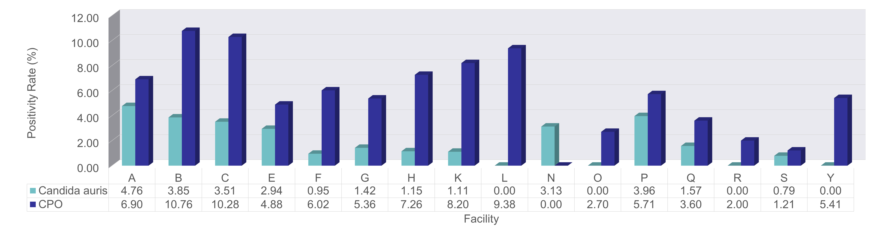
Program Results
Positivity rate by facility and pathogen
12 of the 28 facilities had zero screening positives for both Candida auris and CPO, with 99.3% of positives occurring in facilities within a single state
Facilities B and C are in geographic locations with significant referrals from surrounding LTAC/SNF facilities
43
5
8
5
Privileged and confidential pursuant to state laws including AZ: A.R.S. § 36-441 et seq., A.R.S. § 36-2401 et seq., A.R.S. § 36-445 et seq. CA: Evidence Code §§ 1157 and 1157.5. CO: C.R.S. § 12-36.5-104, C.R.S.A. § 25-3-109 NE: Health Care Quality Improvement Act § 71-7909 et seq., § 71-7901 et seq., § 71-7912 et seq., § 71-7913 et seq. NV: N.R.S. § 49.119, N.R.S. § 49.265 WY: W.S. § 35-2-609, W.S. § 35-2-910, W.S § 35-17-305
Notes:
"Positivity rates for Candida auris and CPO vary across 28 facilities. Facility A has the highest rates for both pathogens. 12 facilities had zero screening positives for both pathogens, and 99.3% of positives occurred in facilities within a single state."

Slide 126
Program Results
There was no difference in Candida auris colonization rates based on exposure to one of the three risk factors
There was a significant relationship between exposure to an LTAC/SNF and CPO positivity, X² (1, N = 3315) = 7.8219, p = 0.005
There was a significant relationship between exposure to an overnight stay in a non-US hospital and CPO positivity, X² (1, N = 3218) = 4.7624, p = 0.029
There was not a relationship between having had a procedure in a non-US hospital and CPO positivity
43
5
8
5
Privileged and confidential pursuant to state laws including AZ: A.R.S. § 36-441 et seq., A.R.S. § 36-2401 et seq., A.R.S. § 36-445 et seq. CA: Evidence Code §§ 1157 and 1157.5. CO: C.R.S. § 12-36.5-104, C.R.S.A. § 25-3-109 NE: Health Care Quality Improvement Act § 71-7909 et seq., § 71-7901 et seq., § 71-7912 et seq., § 71-7913 et seq. NV: N.R.S. § 49.119, N.R.S. § 49.265 WY: W.S. § 35-2-609, W.S. § 35-2-910, W.S § 35-17-305
Notes:
There was no difference in Candida auris colonization rates based on exposure to any of the three risk factors. However, there was a significant relationship between exposure to an LTAC/SNF and CPO positivity, as well as exposure to an overnight stay in a non-US hospital and CPO positivity."

Slide 127
MDRO Screening Considerations
While the vast majority of positives have occurred in AZ to date, all states have reference language to following CDC screening criteria, with CO having a state board of health requirement
Vast majority of MDRO transmission and prevalence is in Maricopa County
We will continue to see spread of these pathogens in more states, so being proactive is in our best interest
PPS in acute care is operationally challenging, costly, and is not decreasing transmission or improving patient safety
  Early identification through screening and placement in contact precautions has resulted in fewer exposure events and the associated point prevalence or close contact exposure testing
Identification of colonization on admission helps with discharge back to sending post-acute location, decreasing LOS and reducing placement challenges
43
5
8
5
Privileged and confidential pursuant to state laws including AZ: A.R.S. § 36-441 et seq., A.R.S. § 36-2401 et seq., A.R.S. § 36-445 et seq. CA: Evidence Code §§ 1157 and 1157.5. CO: C.R.S. § 12-36.5-104, C.R.S.A. § 25-3-109 NE: Health Care Quality Improvement Act § 71-7909 et seq., § 71-7901 et seq., § 71-7912 et seq., § 71-7913 et seq. NV: N.R.S. § 49.119, N.R.S. § 49.265 WY: W.S. § 35-2-609, W.S. § 35-2-910, W.S § 35-17-305
Notes:
While the vast majority of positives have occurred in Arizona, all states follow CDC screening criteria. Early identification through screening and placement in contact precautions has resulted in fewer exposure events. Identification of colonization on admission helps with discharge planning, reducing LOS, and placement challenges."

Slide 128
Other Considerations
Majority of transmission is occurring in post-acute locations, including home care, outpatient dialysis, etc.
  More robust surveillance, prevention, and mitigation strategies are needed in LTAC/SNF care settings to prevent CPO endemicity
    Public health interventions
    Staffing expectations
    Infection prevention education
    Ongoing monitoring of compliance with infection prevention practices
  Placement of all patients coming from AZ LTAC/SNF in a private room until after screening results are received to prevent exposure/PPS given high positivity rates in AZ
Response and containment protocols need further revision for acute care versus post-acute locations
  Consider only requiring PPS in acute care hospitals when exposure/close contact positives (evidence of horizontal transmission) have been identified, and within a defined time period
National, state or local health jurisdiction admission screening rules and regulations should be specific to the geographic location and prevalence of the pathogen of interest in the county rather than applied broadly across the state or nation
  Minimize administrative burden and increase the efficacy of the screening
43
5
8
5
Privileged and confidential pursuant to state laws including AZ: A.R.S. § 36-441 et seq., A.R.S. § 36-2401 et seq., A.R.S. § 36-445 et seq. CA: Evidence Code §§ 1157 and 1157.5. CO: C.R.S. § 12-36.5-104, C.R.S.A. § 25-3-109 NE: Health Care Quality Improvement Act § 71-7909 et seq., § 71-7901 et seq., § 71-7912 et seq., § 71-7913 et seq. NV: N.R.S. § 49.119, N.R.S. § 49.265 WY: W.S. § 35-2-609, W.S. § 35-2-910, W.S § 35-17-305
Notes:
Robust surveillance and prevention strategies are needed in LTAC/SNF care settings to prevent CPO endemicity. Placement of patients from high-risk areas in private rooms until screening results are available is crucial. Admission screening rules should be specific to the geographic location and prevalence of the pathogen."

Slide 129

Process Monitoring
Process monitoring
  Reports built for ongoing monitoring of process and results
  Results are shared with key stakeholders
  Process may be adjusted/modified based on results and in alignment with changing public health requirements
Resources:
  CDC Interim Guidance for a Public Health Response to Contain Novel or Targeted Multidrug-resistant Organisms (MDROs)
  CDC Public Health Strategies to Prevent the Spread of Novel and Targeted Multidrug-resistant Organisms (MDROs)
Notes:
Process monitoring involves ongoing monitoring of processes and results, sharing these results with key stakeholders, and adjusting processes based on results and changing public health requirements. Key resources from the CDC provide guidance for a public health response to contain Novel or Targeted MDROs and strategies to prevent their spread.

Slide 130
State Specific Resources
Arizona
  https://www.azdhs.gov/documents/preparedness/epidemiology-disease-control/healthcare-associated-infection/hai-candida/candida-auris-flyer.pdf
California
  https://www.cdph.ca.gov/Programs/CHCQ/HAI/Pages/Candida-auris.aspx
Colorado
  https://drive.google.com/file/d/1HV5f4iw9E0nBupynlX7JiqmorBZzu3Rd/view
Nebraska
  https://dhhs.ne.gov/HAI%20Documents/Screening%20for%20Candida%20auris%20Colonization.pdf
Nevada
  https://dpbh.nv.gov/uploadedFiles/dpbh.nv.gov/content/Programs/HAI/dta/Training/Nevada%20State%20Candida%20Auris%20Toolkit(1).pdf
Notes:
Here are some state-specific resources related to Candida auris infection preparedness and healthcare-associated infection prevention for Arizona, California, Colorado, Nebraska, and Nevada."

Slide 131

Notes:
Thank you for your attention. If you have any questions, please feel free to ask.

Slide 132
Breaking the Chain: How Hospitals and Health Departments Can Stop Candidozyma (Candida) auris Together

Slide 134
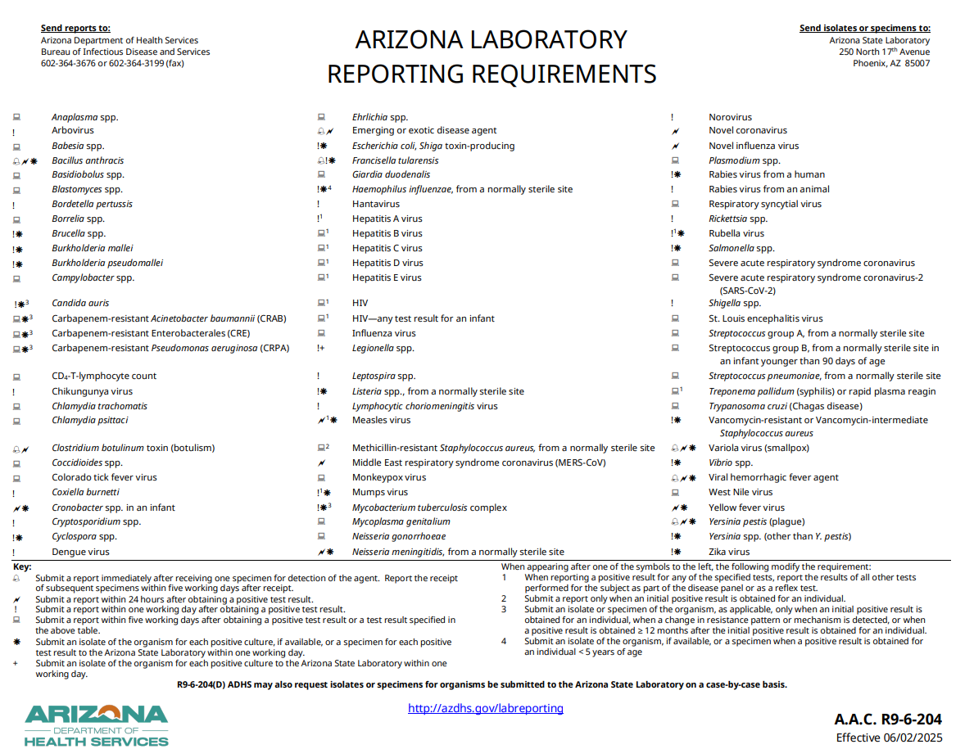
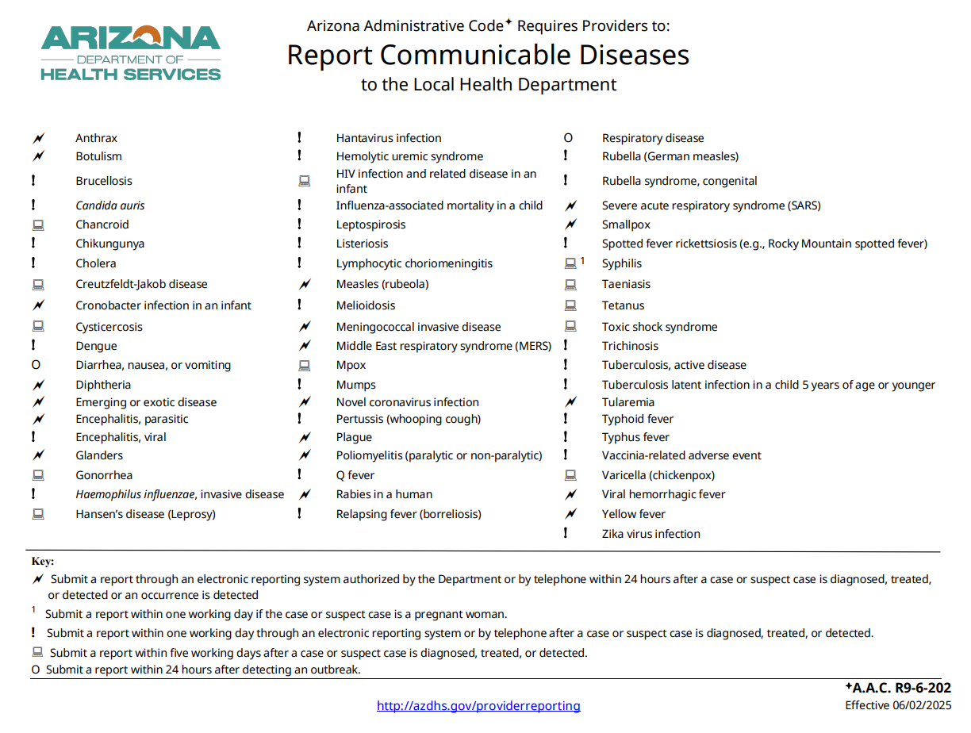
C. auris Reporting Requirements
Laboratories must report positive tests and send specimens to ASPHL within one working day
Healthcare Providers must report detected cases electronically or via phone within one working day
Report to PCHD:
520-724-7797 ext. 4
epi@pima.gov
Notes:
All C. auris isolates are to be forwarded to the Arizona State Public Health Laboratory (ASPHL) for confirmatory testing: Laboratory Submission List 2025.docx

Slide 135
IPC for C. auris
C. auris decolonization has not yet been achieved; assume lifelong infection
  Transmission-Based Precautions (TBP) must be maintained indefinitely
  Acceptable TBP: Contact Precautions or Enhanced Barrier Precautions (subacute care settings only)
Contact Precautions
  Acute care settings (ACH, LTACH, vSNF)
  Subacute care settings if other conditions warrant (C. difficile)
Enhanced Barrier Precautions (EBP)
  Subacute care settings if full contact precautions not needed
Environmental Services (EVS)
  EPA List P products should be used in daily and terminal cleaning of rooms/items used for C. auris patients
  Dedicate items for care if possible or use single-use items
Contact PCHD to receive our latest C. auris information bundle!
General Guidelines
Notes:
PCHD Epidemiology Main Line: 520-724-7797
PCHD Epidemiology Main Email: Epi@pima.gov

Slide 136
Before the Report:
Communication Between Facilities
Per Arizona Administrative Code and CMS:
  There is a requirement of interfacility transfer (IFT) notification for patients infected or colonized with a multidrug-resistant organism (MDRO) and/or infectious disease that requires Transmission-Based Precautions
Why does IFT matter?
  Keeps IPs and care teams informed
  Ensures appropriate continuity of Transmission-Based Precautions (TBP)
  Consistent use of IFT tools between facilities is the most efficient tool for avoiding MDRO containment breach
If your EMR system allows, flag exposed patient charts with note of their exposure to facilitate screening upon readmission
Inter-Facility Transfer Forms (IFT)

Slide 137
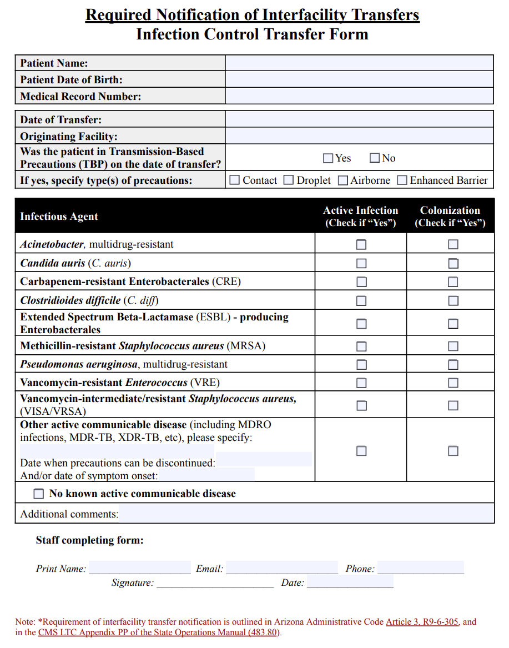
ADHS’ Interfacility Transfer Form
Patient identifiers
Transferring Facility, TBP
Infectious Agent, Current Infection and/or Colonization
Notes:
Link to updated Interfacility Transfer Form: Updated Interfacility Transfer Tool _ Feedback

Slide 138
After The Report:
What Happens Next?
The Pima County Health Department performs Healthcare Facility Tracking (HFT)
  Time period of interest: Day of sample collection -30 days up to present day (see example next slide)
    Caveat: Tier I Organisms (emerging pathogens) may have a longer period of retrospective review
PCHD performs outreach to all facilities that provided care to the case during the time period of interest
Findings from HFT may result in screening recommendations
  Contact Screening: Performed for close contacts of a case, such as roommates
  Point Prevalence Screening (PPS): Wider screening on unit where a case received care
Common question:
What if a case’s close contacts are no longer at my facility (and are therefore unavailable for contact screening)?
  Recommendation per CDC: Unit-wide PPS
Healthcare Facility Tracking (HFT)
Notes:
ADHS C. auris investigation protocol: Candida auris Investigation Manual 2025.docx

Slide 139
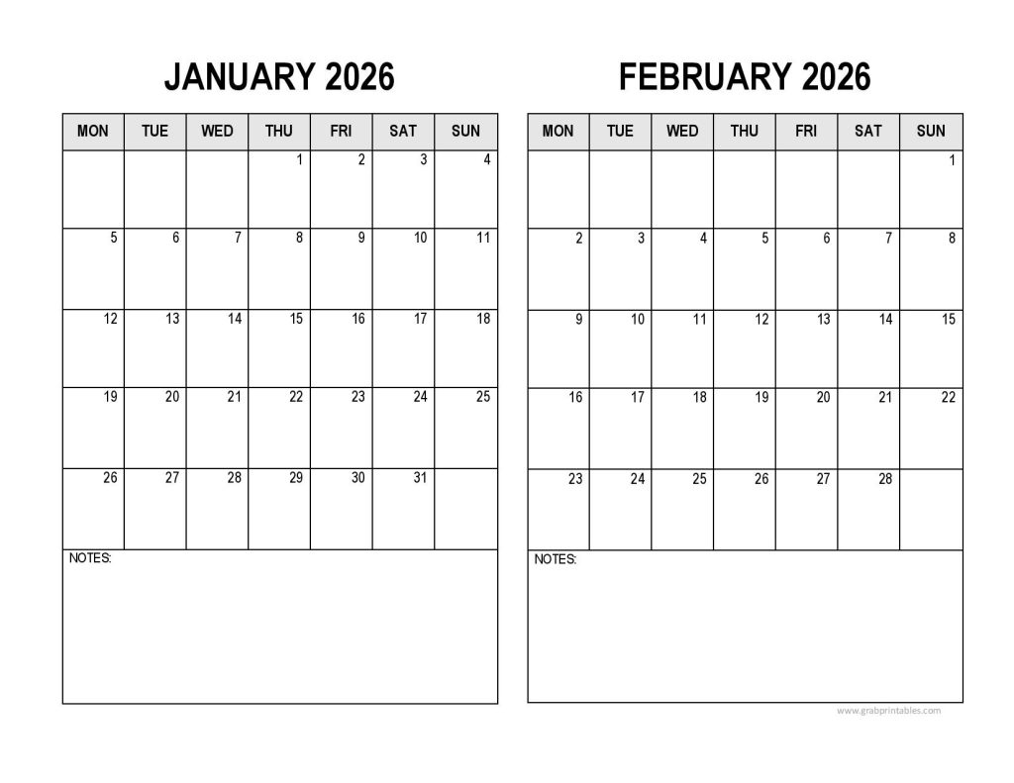
Healthcare Facility Tracking
How does PCHD know which HCFs to perform outreach to? Electronic Health Record (EHR) review
  Time period of interest: Day of sample collection -30 days up to present day
30-day lookback

Slide 140
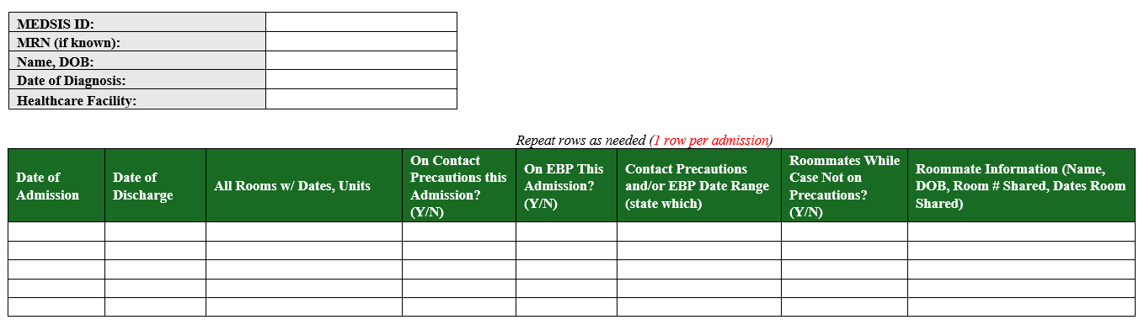
What We Request From You

Slide 141
C. auris in Pima County: A History
September 2025:
Tucson Medical Center implements C. auris admission screening
Data Source: MEDSIS
Note: Data are provisional and subject to change
March 2024:
Banner sites implement C. auris admission screening

Slide 142
Takeaways
Patients infected/colonized with C. auris must be indefinitely kept on Contact Precautions or Enhanced Barrier Precautions (non-acute settings only).
EPA List P products have efficacy against C. auris
Healthcare facility tracking and investigation is performed for the date of positive sample collection minus 30 days, up through present day.
Use the ADHS Interfacility Transfer Form for all patient transfers to ensure appropriate TBP continuation at the receiving facility.
More Pima County healthcare facilities screening = we improve our snapshot of C. auris in our healthcare system and communities.
This effort requires all of us to work together.

Slide 143
Questions?

Slide 144

Conference Evaluation & IPU Registration

Slide 145


Closing
This Photo by Unknown Author is licensed under CC BY-SA

